Slide 1
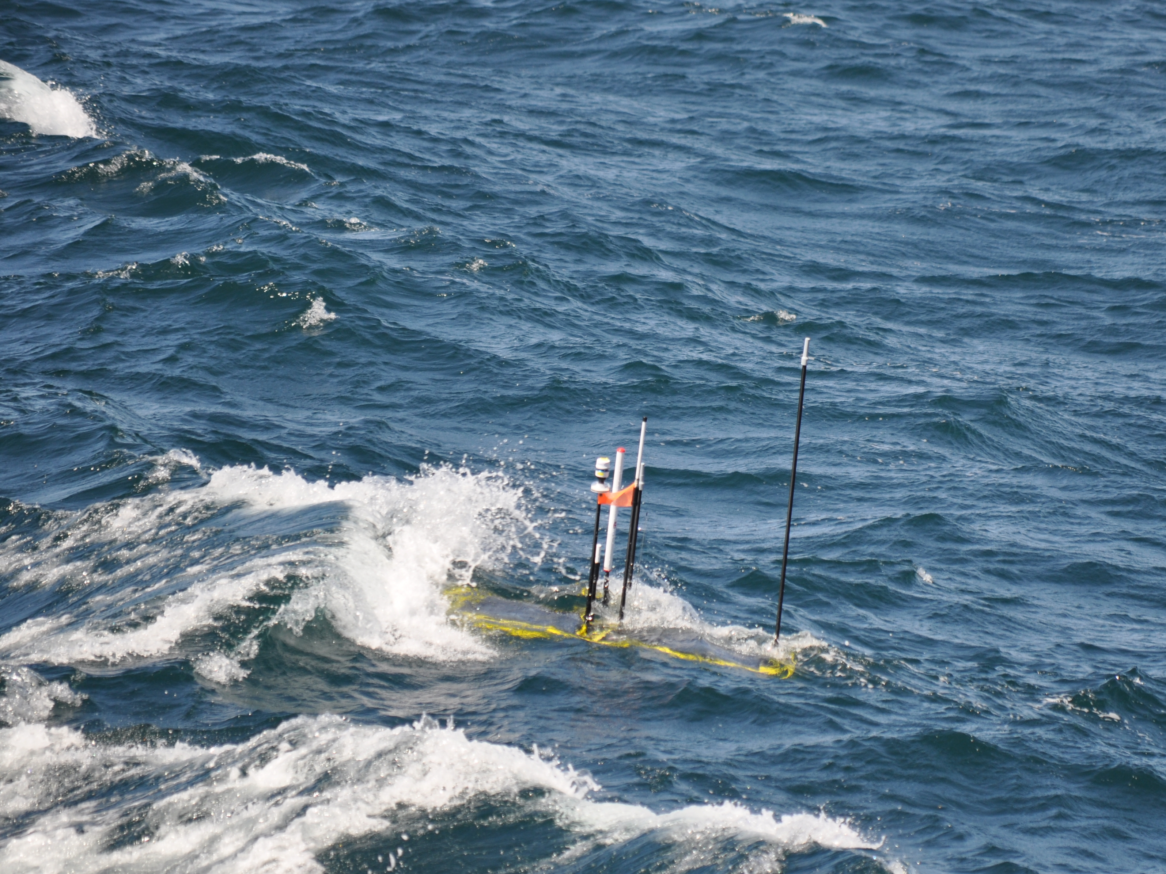
Wave Glider Hot Spot
    Provide a communications gateway between shore and underwater assets
    Reduced cost
    Higher data volume
901411
Kanna Rajan, Mark Chaffey, Tom O’Reilly, Brian Kieft

Slide 2
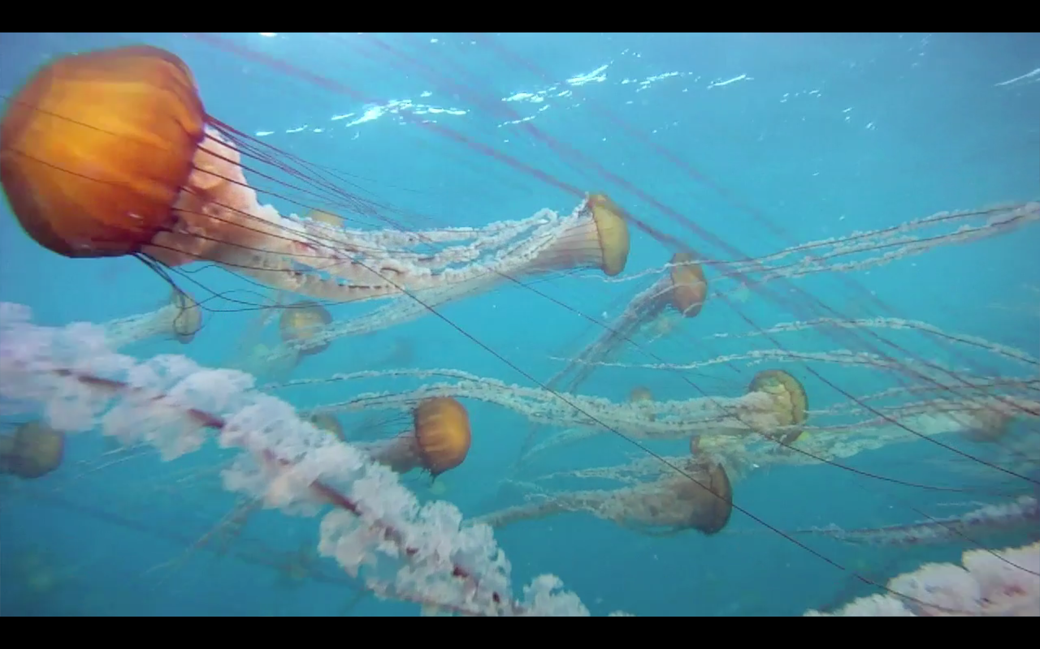
Growing Data
Persistent presence + multiple assets = large datasets
Large data sources (Mb to Gb)
  Imaging
  Genomic
  ADCP
Background image: video taken by Tethys LRAUV, 12/2011

Slide 3
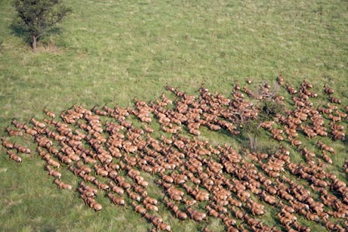
Science Applications
Patch and organism tracking, minimize surface time
Acoustic navigation / localization
Informed decision making (e.g. through ODSS)

Slide 4
Relevance to MBARI Strategic plan
“…adapt innovative technologies…”
  Exploration and discovery
  Ocean visualization
  Ecosystem dynamics
  Ocean biogeochemistry

Slide 5
Specific Applications
Improve effectiveness and coordination of assets
    Distributed Autonomy
      University of Porto SeaCon AUV collaboration fall CANON 2013
    CANON / LRAUV
      LST tracking
      LRAUVs
    Aerostat
    Benthic Event Detectors

Slide 6
The Costs of Data
Financial (ship time, data transfer)
  WG: $800/day, Ship: $12K/day
Opportunity cost

Slide 7
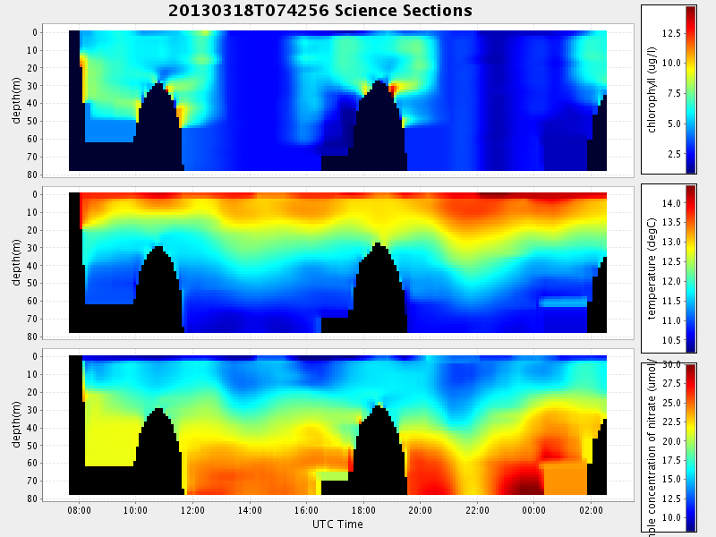
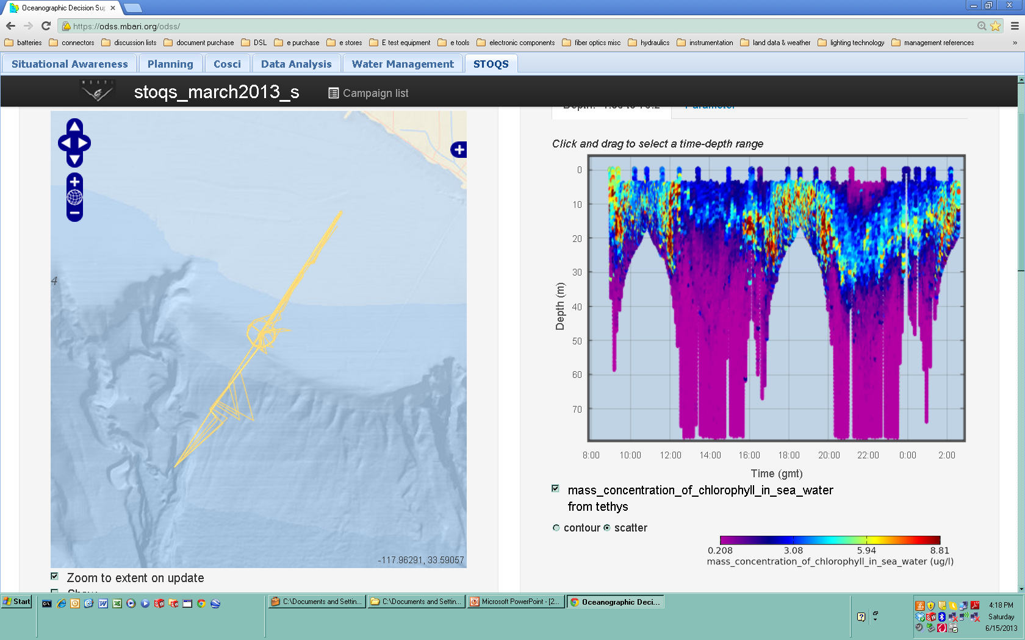
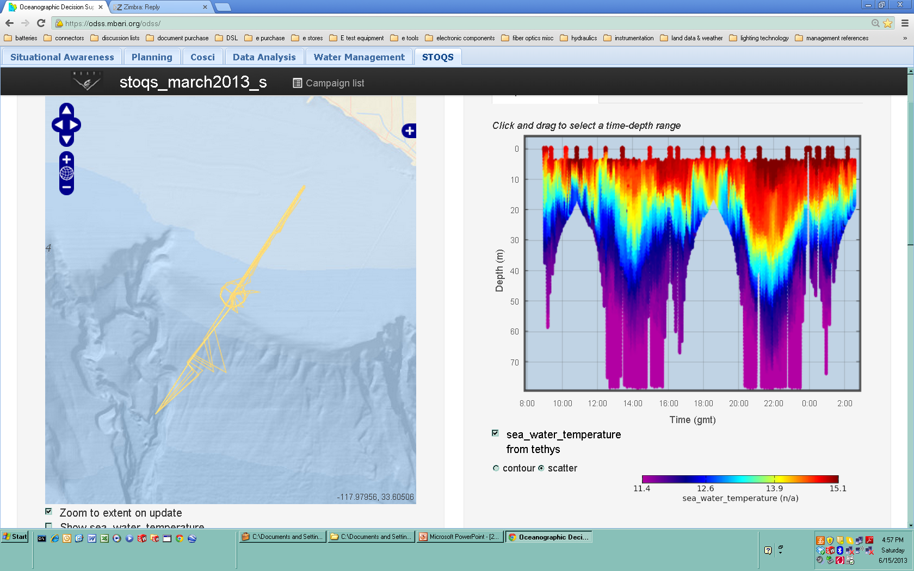
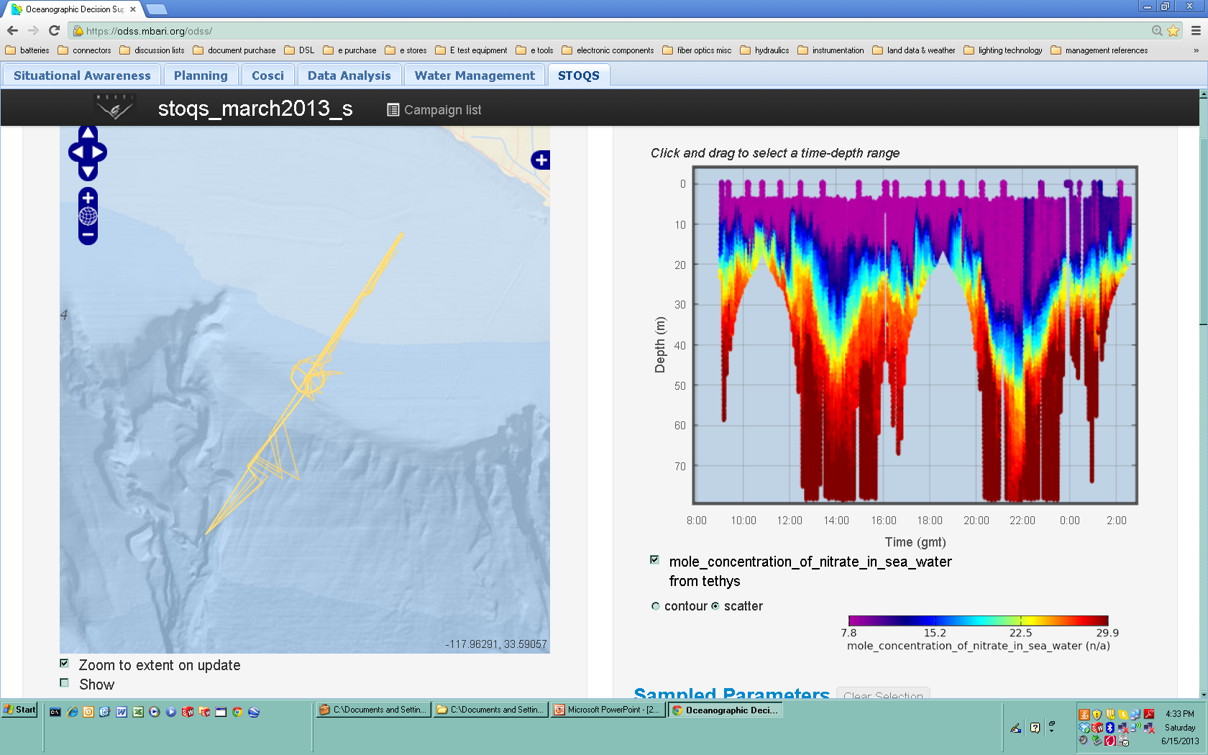
The Costs of Data
Informed Decision Making
  EcoHAB spring 2013: decimated versus complete data

Slide 8
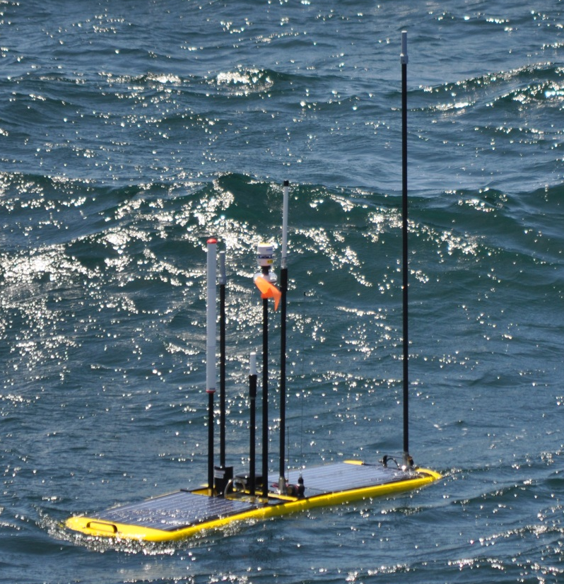
Current Work
Radio and antenna integration
  Freewave (2)
  GSM Modem (Multitech 3G)
  Cell coverage map of CANON ops area
Dorado-WG link characterization sea trials
  Transfer 1.34 Mbyte in less than 5 minutes
  Max distance 450m away
  ~ 200 times data rate of existing Iridium

Slide 9
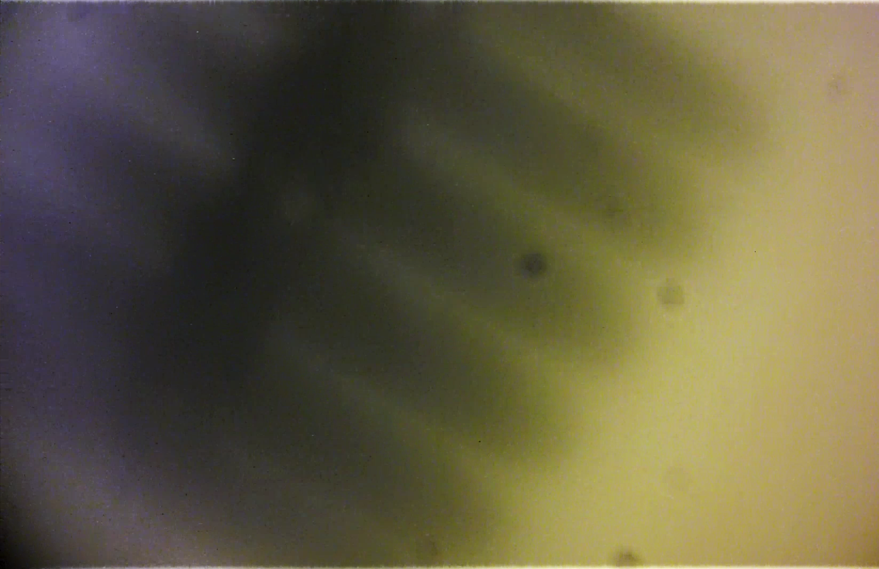
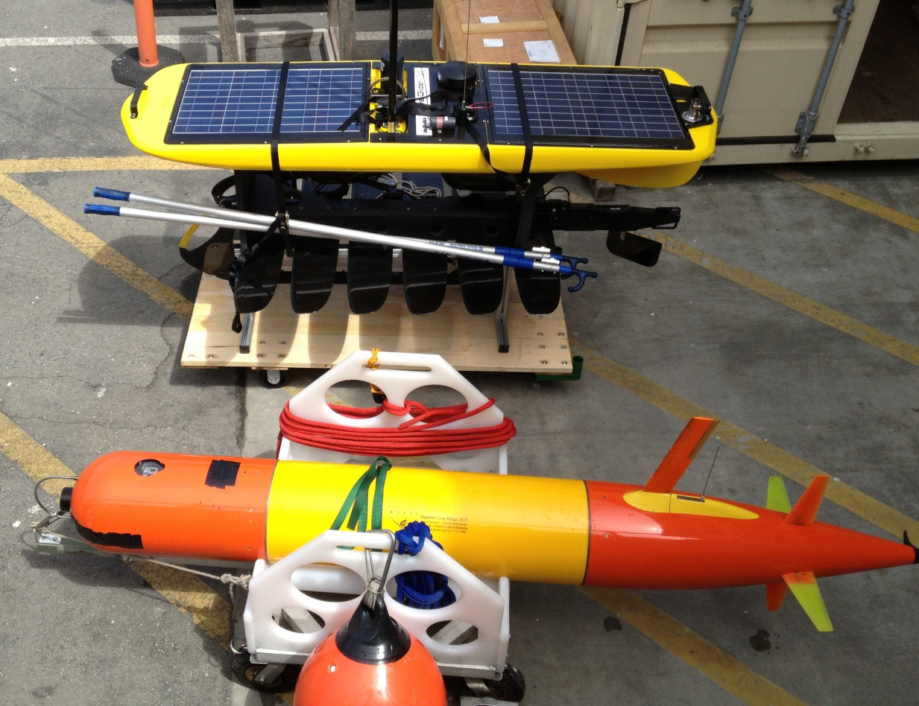
Current Work
Initial acoustic work focused on homing to the Wave Glider.
Modem mounted here
Daphne iUSBL used to home
to Wave Glider

Slide 10
Proposed Work
Addition of Acoustic modem and interface
  iUSBL add on possibility
Add endpoints
  Refine protocols to demonstrate use with LRAUV, LST, BEDs
Globalstar/Iridium Integration*
802.11 Wifi*
GSM Modem Integration*
Power Management
Aerostat data transfer demonstration
Investigate Georgia Tech Agile Aperture Antenna (http://www.unmannedsystemstechnology.com/2013/06/gtri-agile-aperture-antenna-tested-on-autonomous-ocean-vehicle/)
* Work begins 2013, in Distributed Autonomy

Slide 11
Equipment
Waveglider
Wave Glider Towbody*
Acoustic modem (LF)*
Acoustic modem (MF)*?
802.11 radio*
Satellite modems*
iUSBL (DAT MF)*?
* Proposing to share inventory from other programs

Slide 13
SV3 Benefits
Extensible power bus
More energy available below the float (including the towbody)
Higher performance computing
Parallel integration/development with LRI (i.e. better support)
More payloads
Back seat driver
Propulsion
L&R from Paragon as usual

