Slide 1
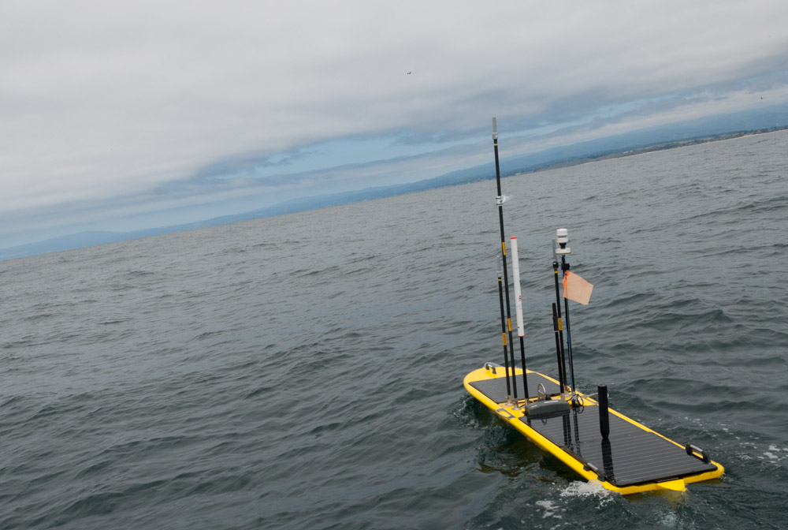
Wave Glider Hot Spot 2016
901411
Brian Kieft, Tom O’Reilly

Slide 2
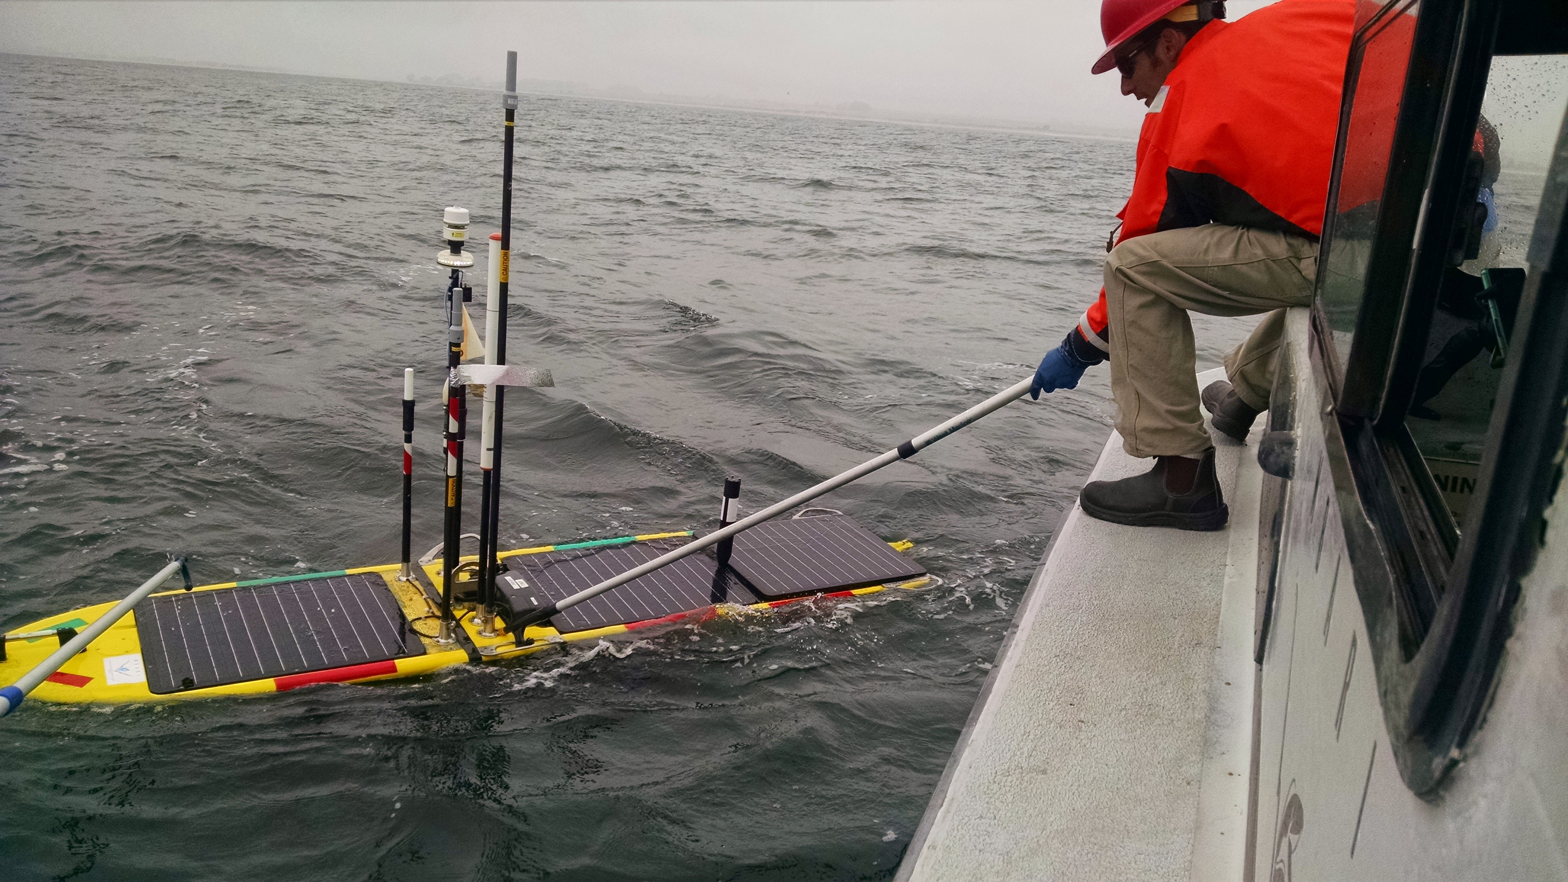
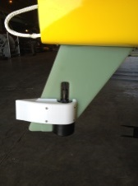
Hot Spot on SV3
802.11
Cell
Iridium/GlobalStar
Acoustic
modem /usbl

Slide 3
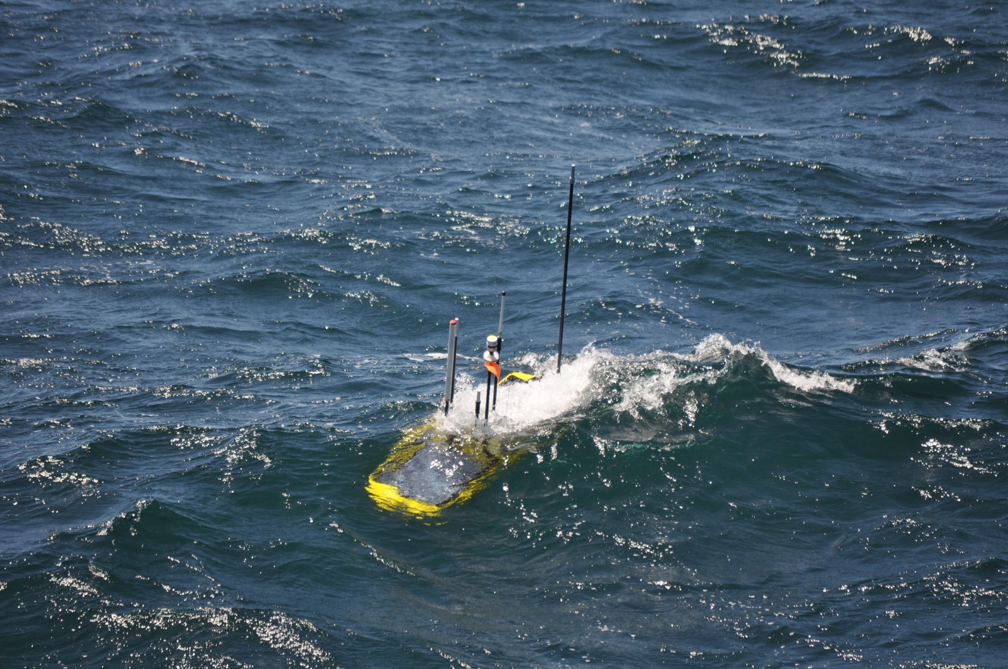
Antenna Height Matters
Antennas high above water line

Slide 4
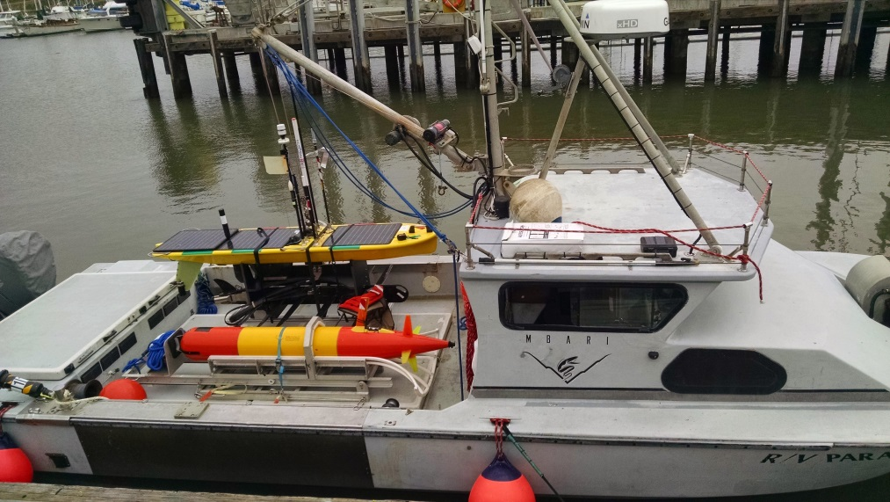
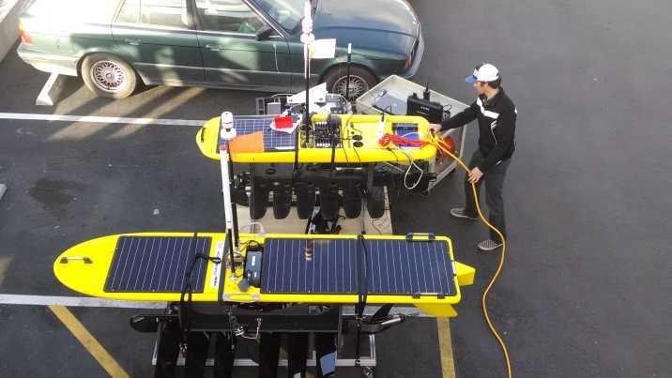
Where We’ve Been
12 Hotspot deployments over past two years
  Sea Tests (Dorado)
  Porto AUV/Dorado joint ops
  Station M (Benthic Rover x3)
  EcoHAB (LRAUV x2)
  Benthic Event Detectors
  Smooth Ridge (Rover)
  CANON (x3)
Transitioned SV2 payload box to SV3 Vehicle
Existing Capabilities / Payloads
  Autonomous following of AUV (DAT)
  Slant range geolocation (acoustic modem)
  Underwater Data Transfer (acoustic modem)
  Surface Data Transfer (wifi, 900 MHz)

Slide 5
Lagrangian drift survey:
October 2014
Wave Glider autonomously followed submerged LRAUV for 48 hours
drifting AUV at thermocline
WG, following drifting AUV
profiling AUV
1000 m
Notes:
RV Rachel Carson able to easily locate Wave Glider. Acoustic track shows small wiggles which are artifacts – note that we don’t yet account for offsets between DAT, compass, GPS
Autonomous navigation saved operational cost – no need for operator to continually issue commands through WGMS interface
Last Fall navigation commands were issued automatically from on shore following receipt of target location from WG cell; now they issued directly from the Hot Spot payload to the main vehicle computer.

Slide 6
Cost to transfer 13.4 MB
AUV data per day
 | AUV-Iridium | AUV-HotSpot-cell | AUV-Hotspot-Globalstar
Total AUV surface time | 5.0 hours | 46 minutes | 46 minutes
Hot Spot operational cost | N.A. | $100 | $100
Airtime cost | $380 | $1 | $13
Total cost | $380 | $101 | $113
Notes:
AUV - Hot Spot link: 900MHz radio AUV – Hot Spot range: < 400 meters
Iridium bandwidth: 2400 bits/sec
Compression: 2.7 AUV antenna wash-over: 10%
Iridium cost: $1.25/minute GlobalStar cost: $2.58/MB

Slide 7
Cell signal strength at Hot Spot

Slide 8
Where We’re Going
    Leverage Initial Investment
    Standard Payload
    Onboard Sensor Data Transfer
    Further Automation
    LRAUV acoustic command/control/nav working with Jordan’s project

Slide 9
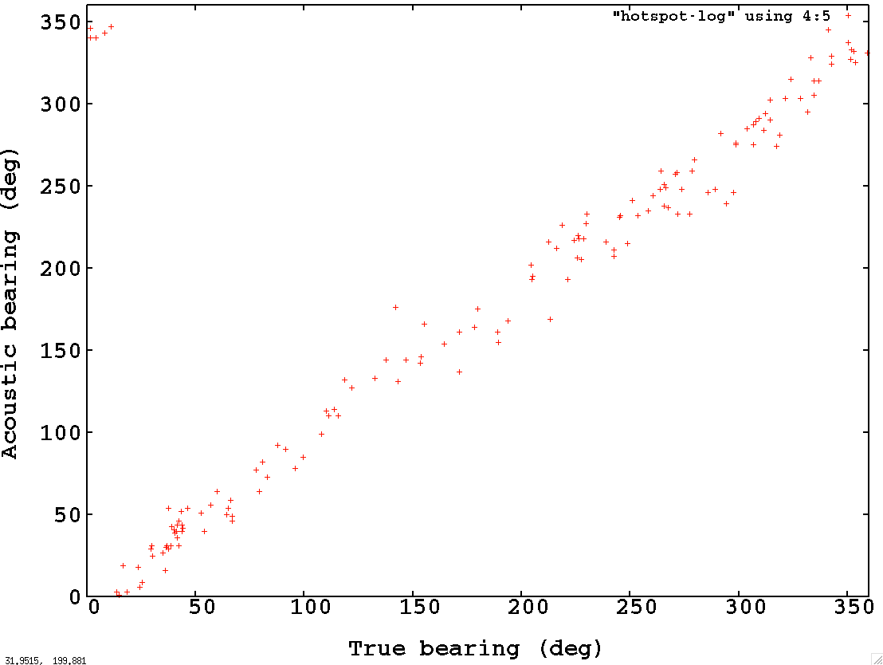
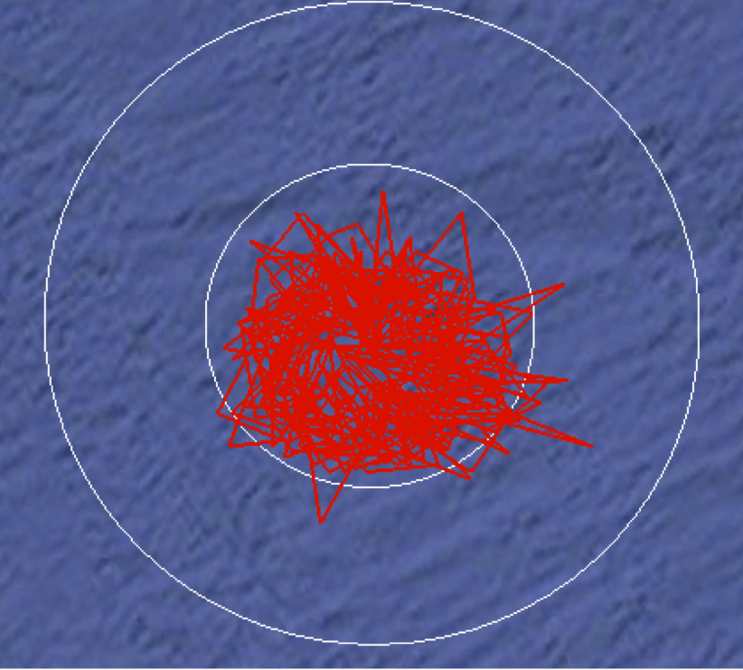
Existing USBL Error
Tan 26.2= .492
R= 100m
~50m error
50 m
100 m
Mean bearing error:
26.2 deg

Slide 10
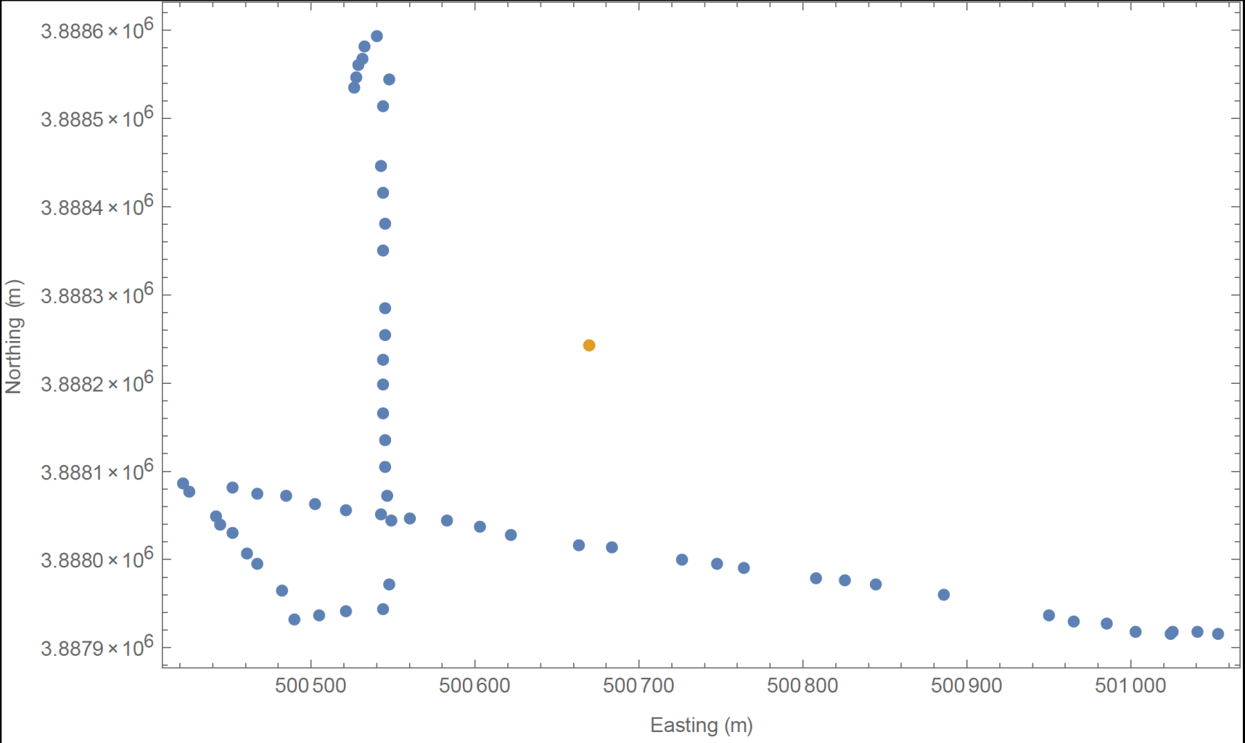
Range Only Geolocation

Slide 11
Collaboration
    Improve USBL Accuracy
    Automate Range Only Geolocation
    Collaboration Ivan Masmitja (SARTI UPC, Spain)
    Collaboration agreement in effect

Slide 12
Onboard Sensor Data Gateway
Existing SV3 Sensor Architecture is:
  Power Hungry – 3W overhead for .25W sensor
  Poorly Documented:
      “Hi Tom,
      Unfortunately, our software architecture isn’t well documented or explained, even internally.”
    Ryan Carlon – Business Development, LRI
    04/27/2015

Slide 13
Previously Shared Inventory
Additional Hotspot for SV2
Acoustic modem (LF)
iUSBL (DAT MF)

