Slide 1
Environmental conditions
 | Sig wave height (m) | Dom wave period (s) | Dom wave direction | Avg wind (Kts)
June 12 | 2.2 | 10 | WNW | 19, NW
June 14 | 1.8 | 9 | WNW | 11, NW

Slide 2
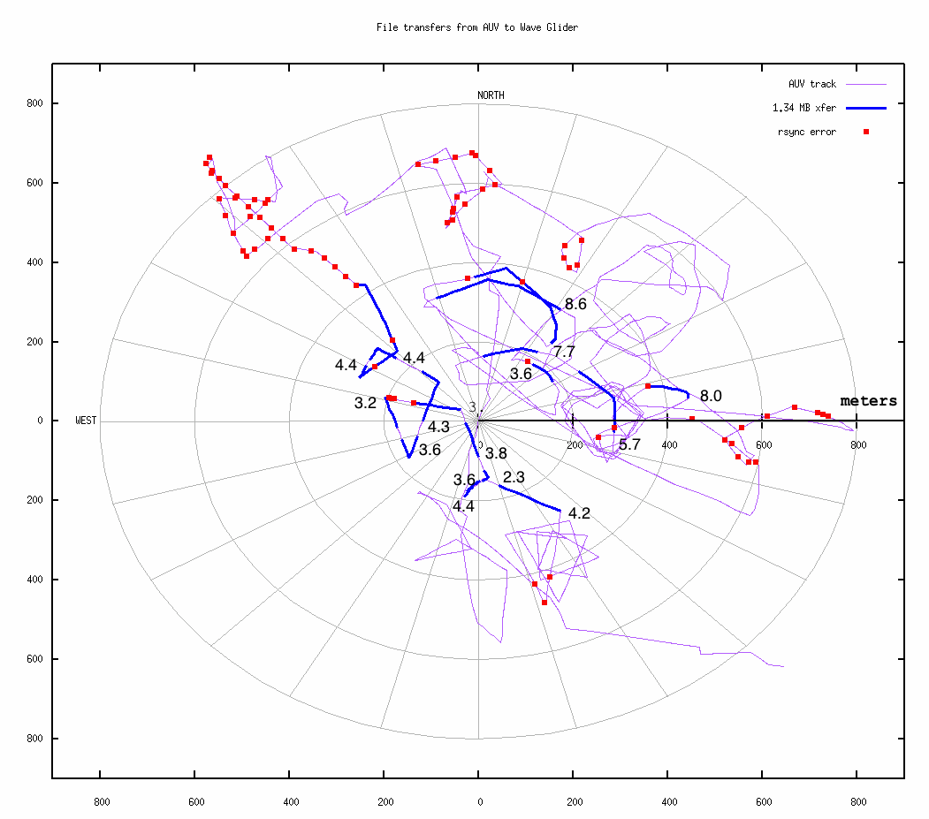
1.34 Mbyte file-set:
Mean transfer time: 4.8 minutes
Mean transfer time within 200 meters: 3.6 minutes
Farthest successful transfer range: 450 meters, transferred in 8.0 minutes

