Slide 1


Communications relay and autonomous tracking applications for Wave Glider
Tom O’Reilly, Brian Kieft, Mark Chaffey

Slide 2
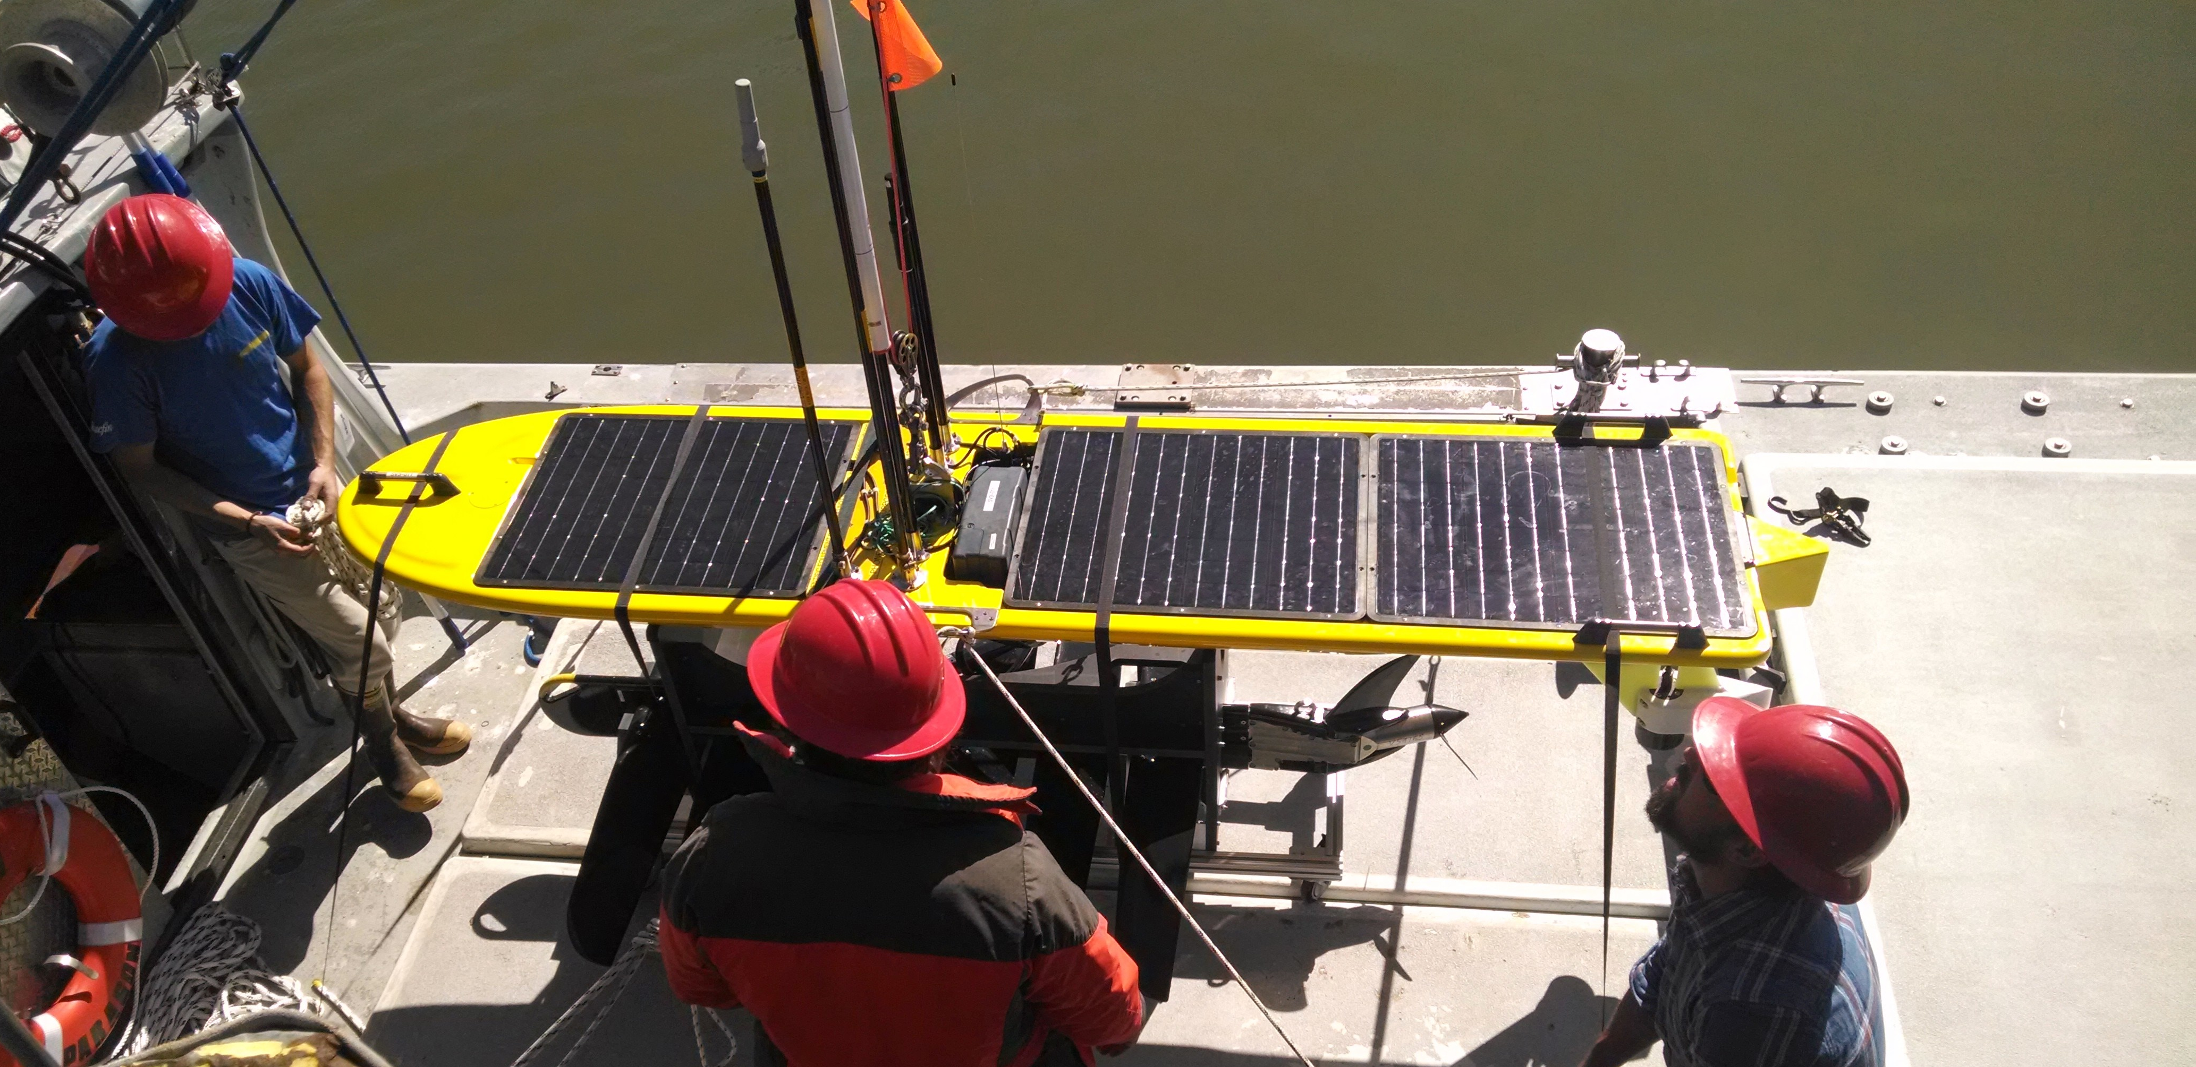
Hot Spot Wave Glider
Communications relay: Relay data between autonomous sensor platforms, ships, shore
Acoustics: Localize and track underwater targets

Slide 3
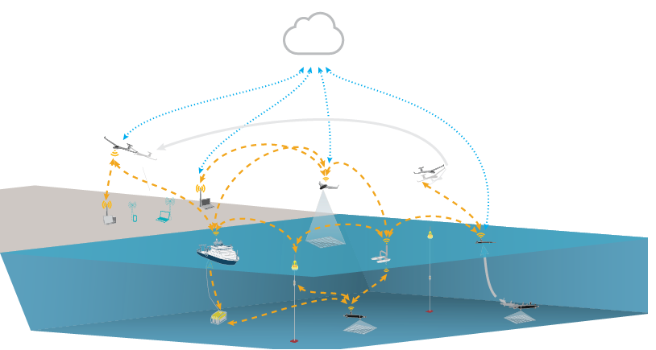
Hot Spot Wave Glider
lsts.fe.up.pt
Inspired by work of Rajan, Borges de Sousa, Pinto, Martins et al (University of Porto LSTS)
Notes:
Hot Spot supports needs biological oceanography, geology investigators

Slide 4
Hot Spot Wave Glider
Goals
Support MBARI’s science division (biology, geology...)
  Operational asset, not experimental platform
Near real-time high-resolution data retrieval
Lower ship time, dollar and opportunity costs
Rapid, low-cost development
Notes:
Hot Spot supports biological oceanography, geology investigators. Utilize existing Wave Glider infrastructure (including navigation), Linux utilities – “off the shelf” approach

Slide 5
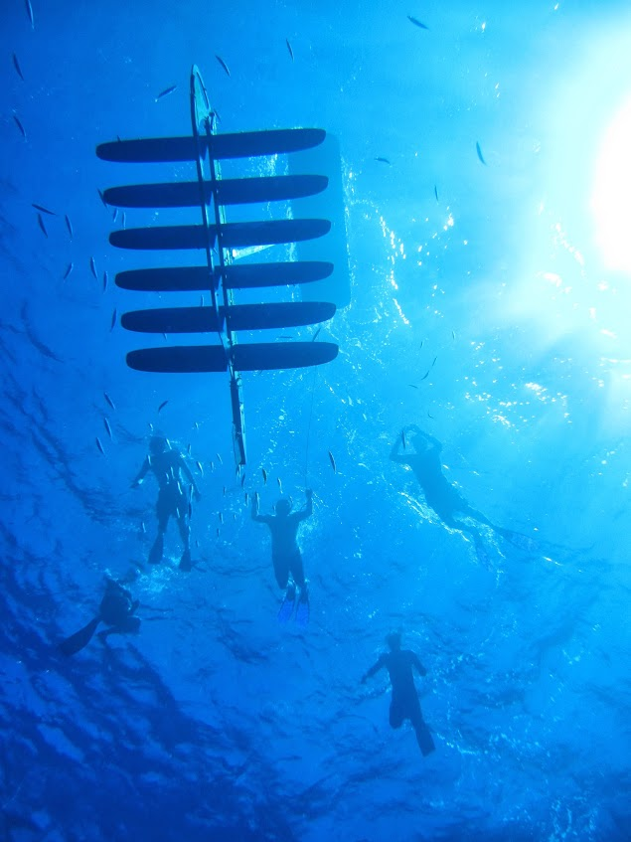
Wave Glider
Very reliable, long-duration (months), autonomous
Cheap to operate
Frees ships for other tasks
Users develop custom applications and payloads

Slide 6
Hot Spot runs on Wave Glider
Sensor Management Computer
ARM processor
Multiple serial ports for radios, modems
Linux OS: standard tools include Java, Python, bash, etc.
Interface to main vehicle computer
Main vehicle computer

Slide 7
I. Communications relay

Slide 8
Hot Spot network
RF links subject to disruption
  Sea state and weather
  AUV dives, moves out of range
  Satellite/cell availability
Notes:
AUV surfaces to quickly transfer data over LOS

Slide 9
Disruption tolerance
rsync file-transfer protocol
  It’s everywhere; very robust implementations
  Very efficient “delta-transfer” algorithm
  Disruption-tolerant; transfer resumes where it left off
  Requires TCP/IP link
Notes:
Rsync is included with most Linux distributions – no need to install

Slide 10
Hot Spot store-and-forward exchange using rsync
SHORE
Cellular
HOT SPOT
incoming
802.11
outgoing
incoming
cache
outgoing
Pull outgoing files from AUV into cache

Slide 11
Hot Spot store-and-forward exchange using rsync
SHORE
Cellular
HOT SPOT
incoming
802.11
outgoing
incoming
cache
outgoing
Pull outgoing files from shore into cache
Push cached files destined for AUV

Slide 12
Hot Spot store-and-forward exchange using rsync
SHORE
Cellular
HOT SPOT
incoming
outgoing
cache
Push cached files destined for shore
Notes:
If RF link breaks mid-transfer, rsync will pick up where it left off on next attempt. If destination link not available, rsync will try later; Hot Spot is store-and-forward/data-mule.
Only differences between source and destination are transferred; so if ‘n’ bytes are added to an N-byte file between retrievals, only ‘n’ bytes are transferred

Slide 13
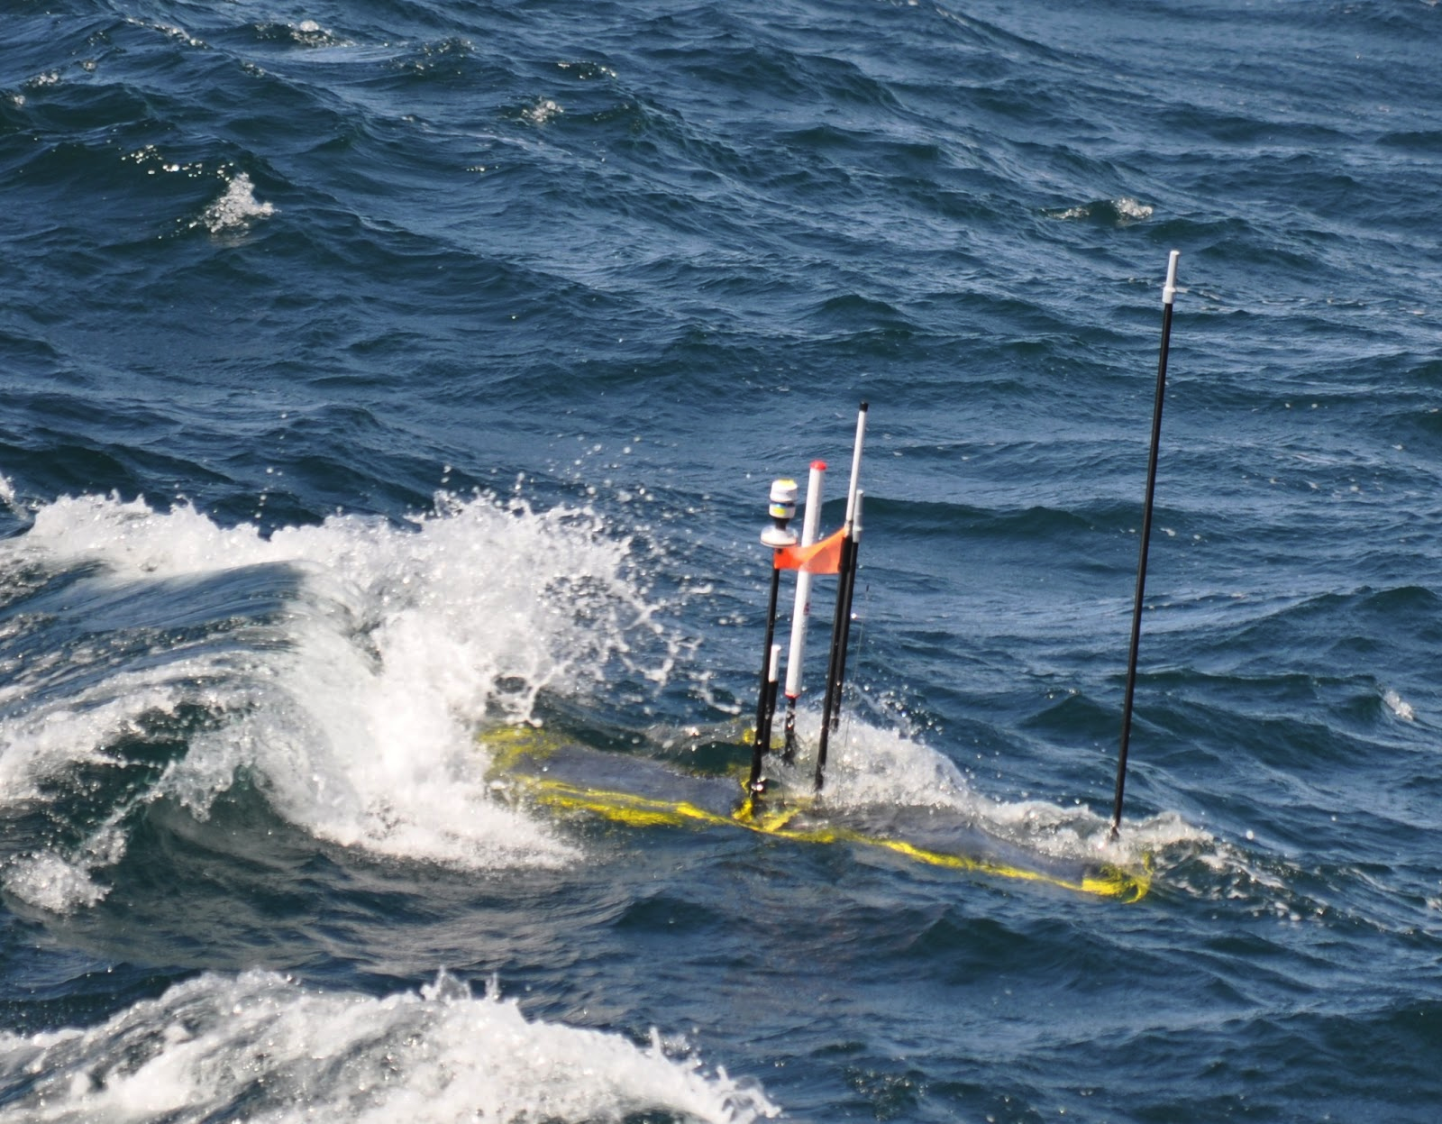
Hot Spot radios
Line-of-sight to AUV
  802.11 Wifi (Ubiquiti)
  900 MHz (Freewave)
Link to shore
  Cell modem (coastal regions)
  Globalstar satellite (coastal, some open ocean)
  Iridium satellite (world-wide)
Radio links support TCP/IP
“Console” to Hot Spot from shore
Notes:
Console capaibilty; through ssh (cell, Globalstar) or Iridium console

Slide 14
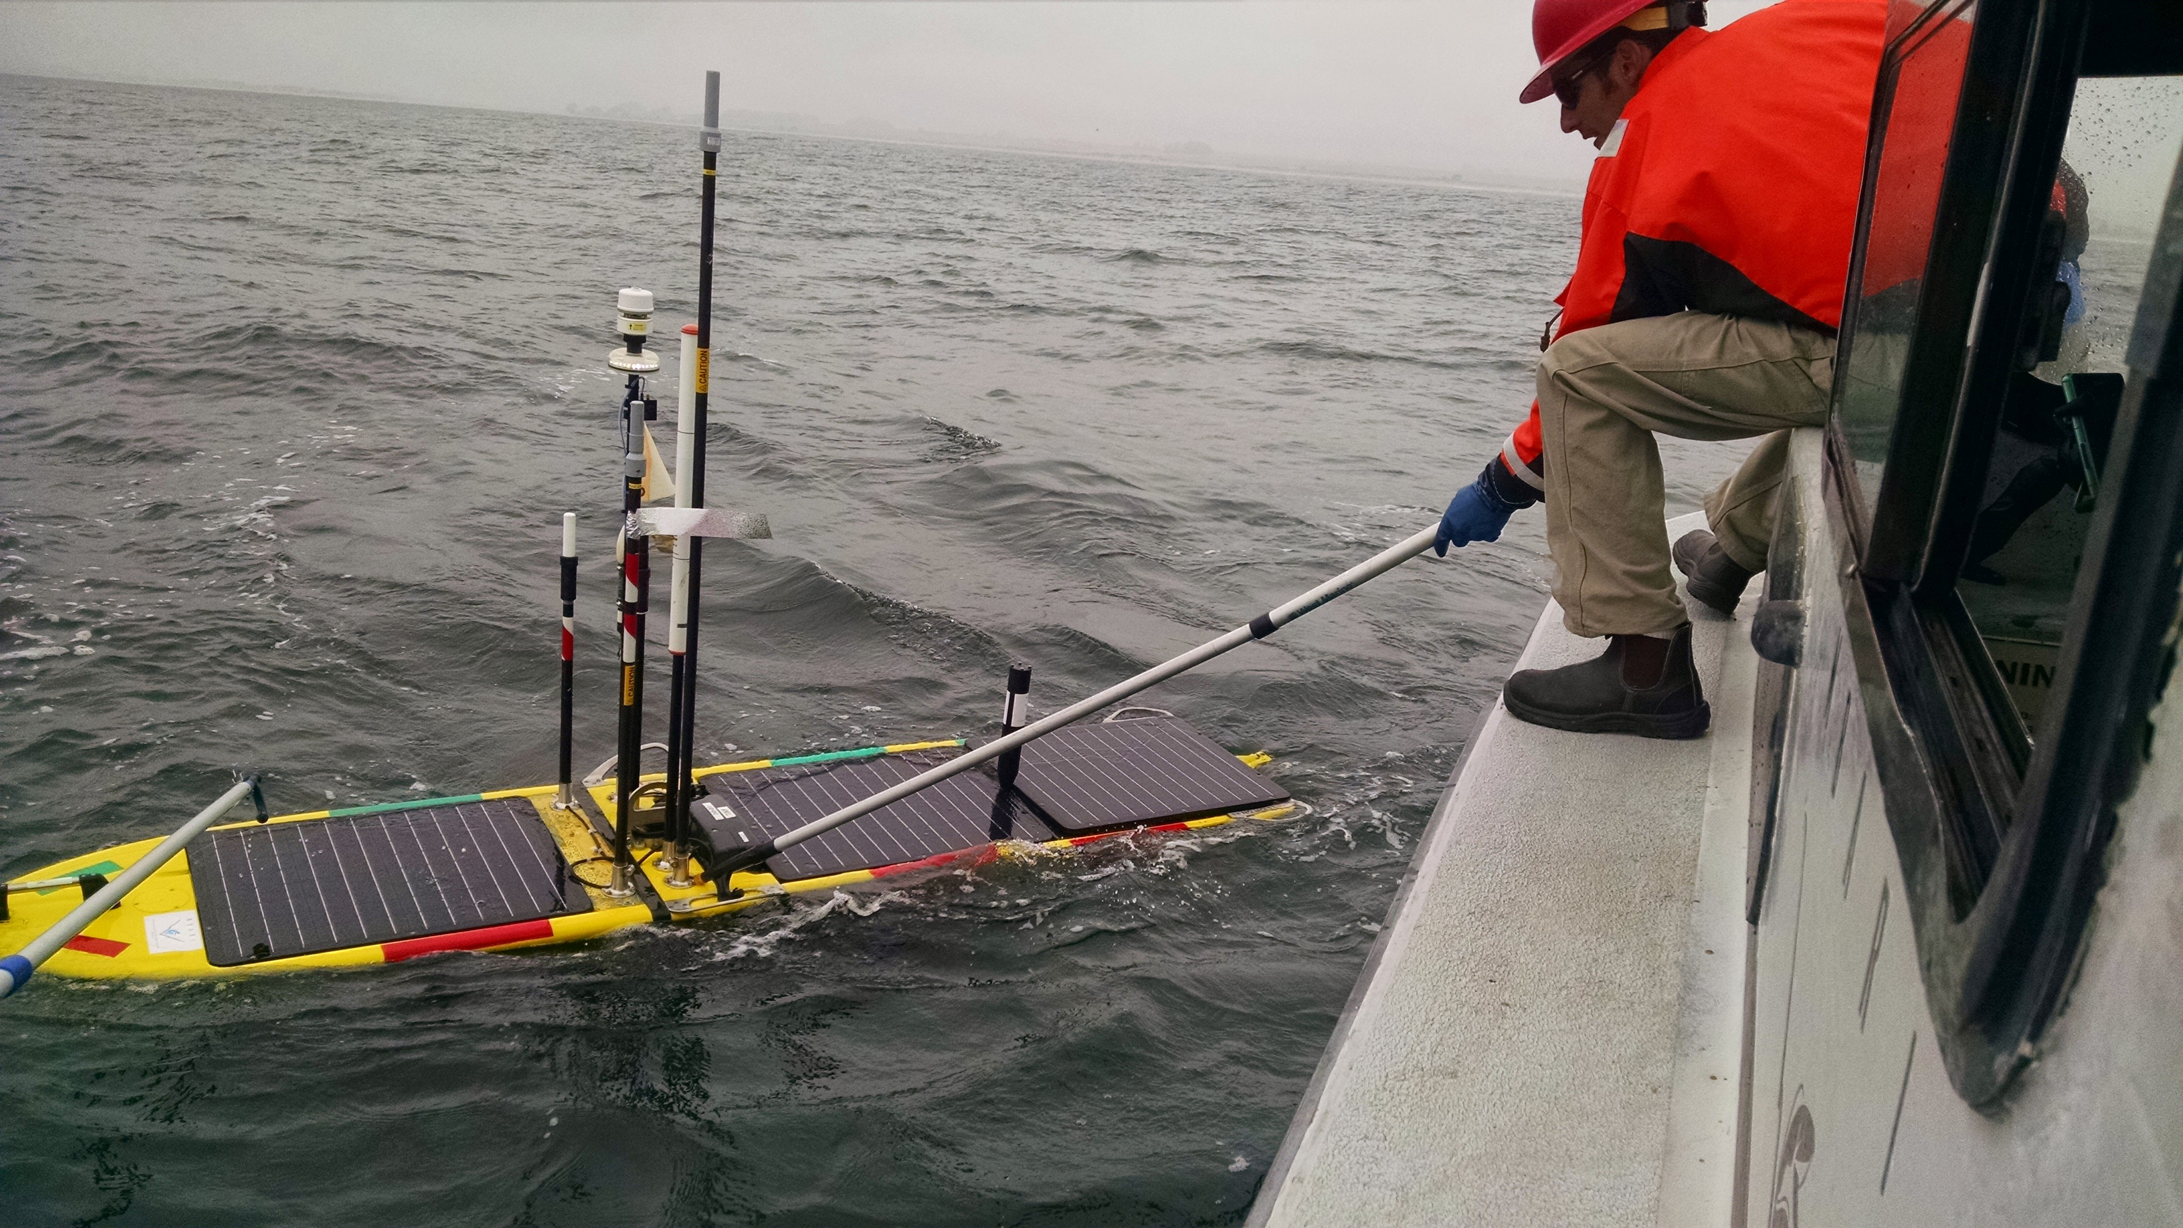
Hot Spot antennas
802.11
Antennas high above water line
Cell
Iridium/GlobalStar

Slide 15
Cell signal strength at Hot Spot

Slide 16
Hot Spot network
AUV and Wave Glider must rendezvous for RF transfer
Notes:
AUV surfaces to quickly transfer data over LOS

Slide 17
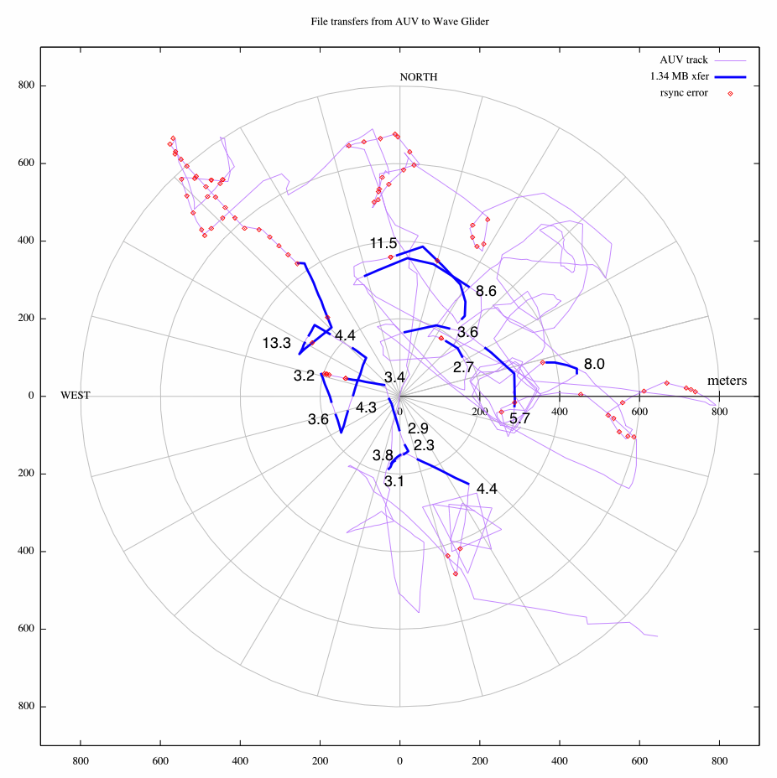
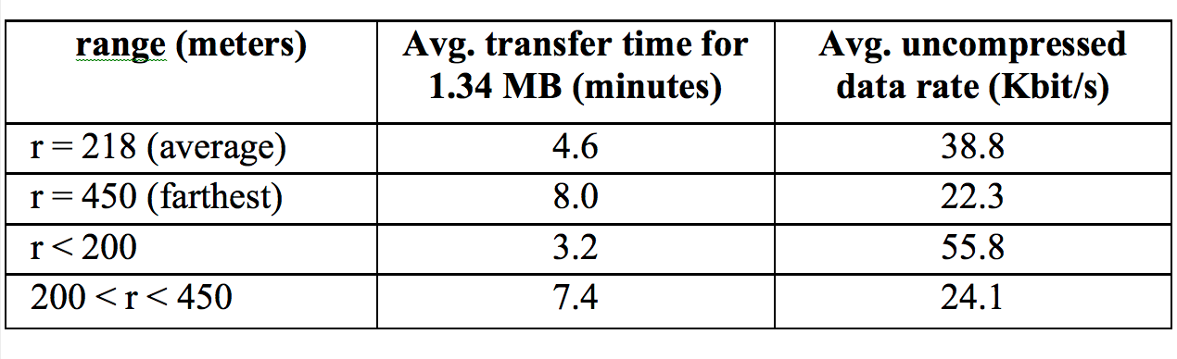
File transfers via rsync from AUV to Wave Glider over 900 MHz radio
Notes:
Significant wave height ranged from 1.7 – 2.7 meters during these tests

Slide 18
Cost to transfer 13.4 MB
AUV data per day
 | AUV-Iridium | AUV-HotSpot-cell | AUV-Hotspot-Globalstar
Total AUV surface time | 5.0 hours | 46 minutes | 46 minutes
Hot Spot operational cost | N.A. | $100 | $100
Airtime cost | $380 | $1 | $13
Total cost | $380 | $101 | $113
Notes:
AUV - Hot Spot link: 900MHz radio AUV – Hot Spot range: < 400 meters
Iridium bandwidth: 2400 bits/sec
Compression: 2.7 AUV antenna wash-over: 10%
Iridium cost: $1.25/minute GlobalStar cost: $2.58/MB

Slide 19
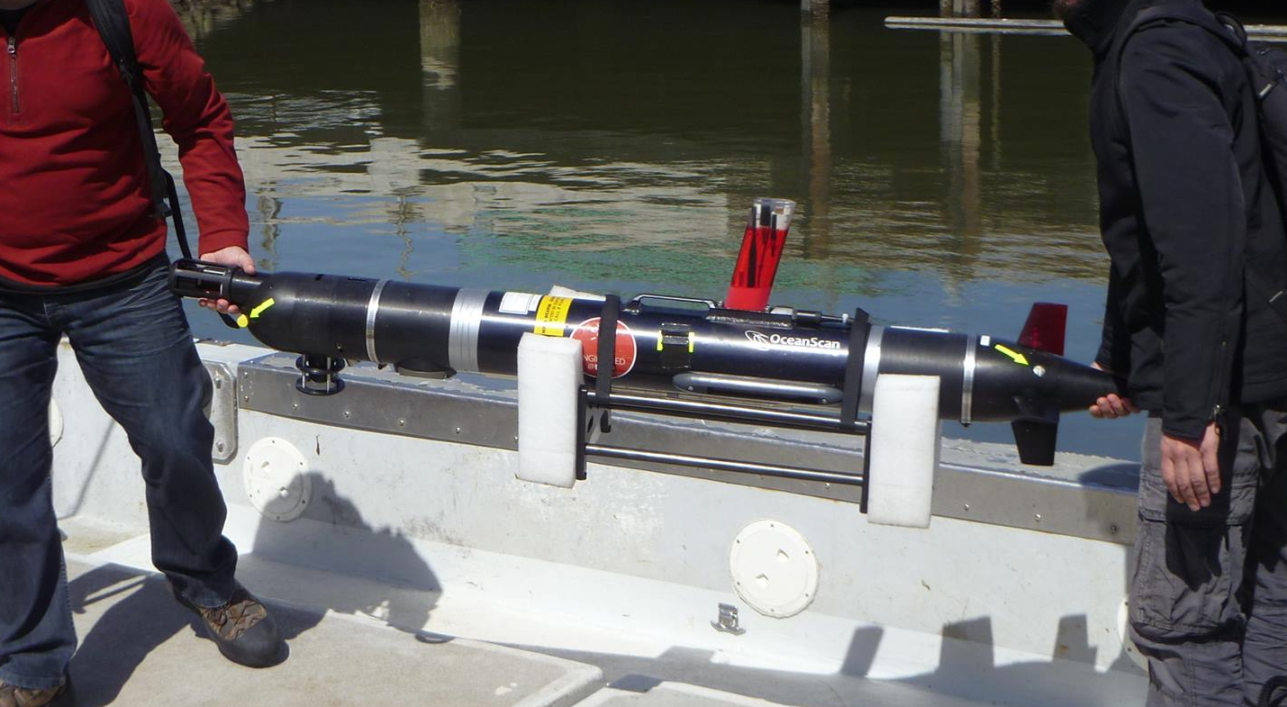
Hot Spot relay applications
Coordinated ops between MBARI Dorado +
LSTS Xtreme-2 AUVs + ecogenomic sensor in
Monterey Bay
  Max 739 meters wifi range
  Avg 15 Kbit/sec on wifi-cell
  Avg 102 Kbyte file size
  Avg 119 sec xfer
LSTS Porto Xtreme-2 AUV
Long Range AUV in S. California, harmful algal bloom development
  Relayed 53 MB of AUV data to shore over eight days
  Troubleshot AUV at sea through Hot Spot console
Notes:
Straightforward to enable Xtreme-2 as Hot Spot node. Xtreme2 used 802.11, Dorado used 900 MHz Freewave.

Slide 20
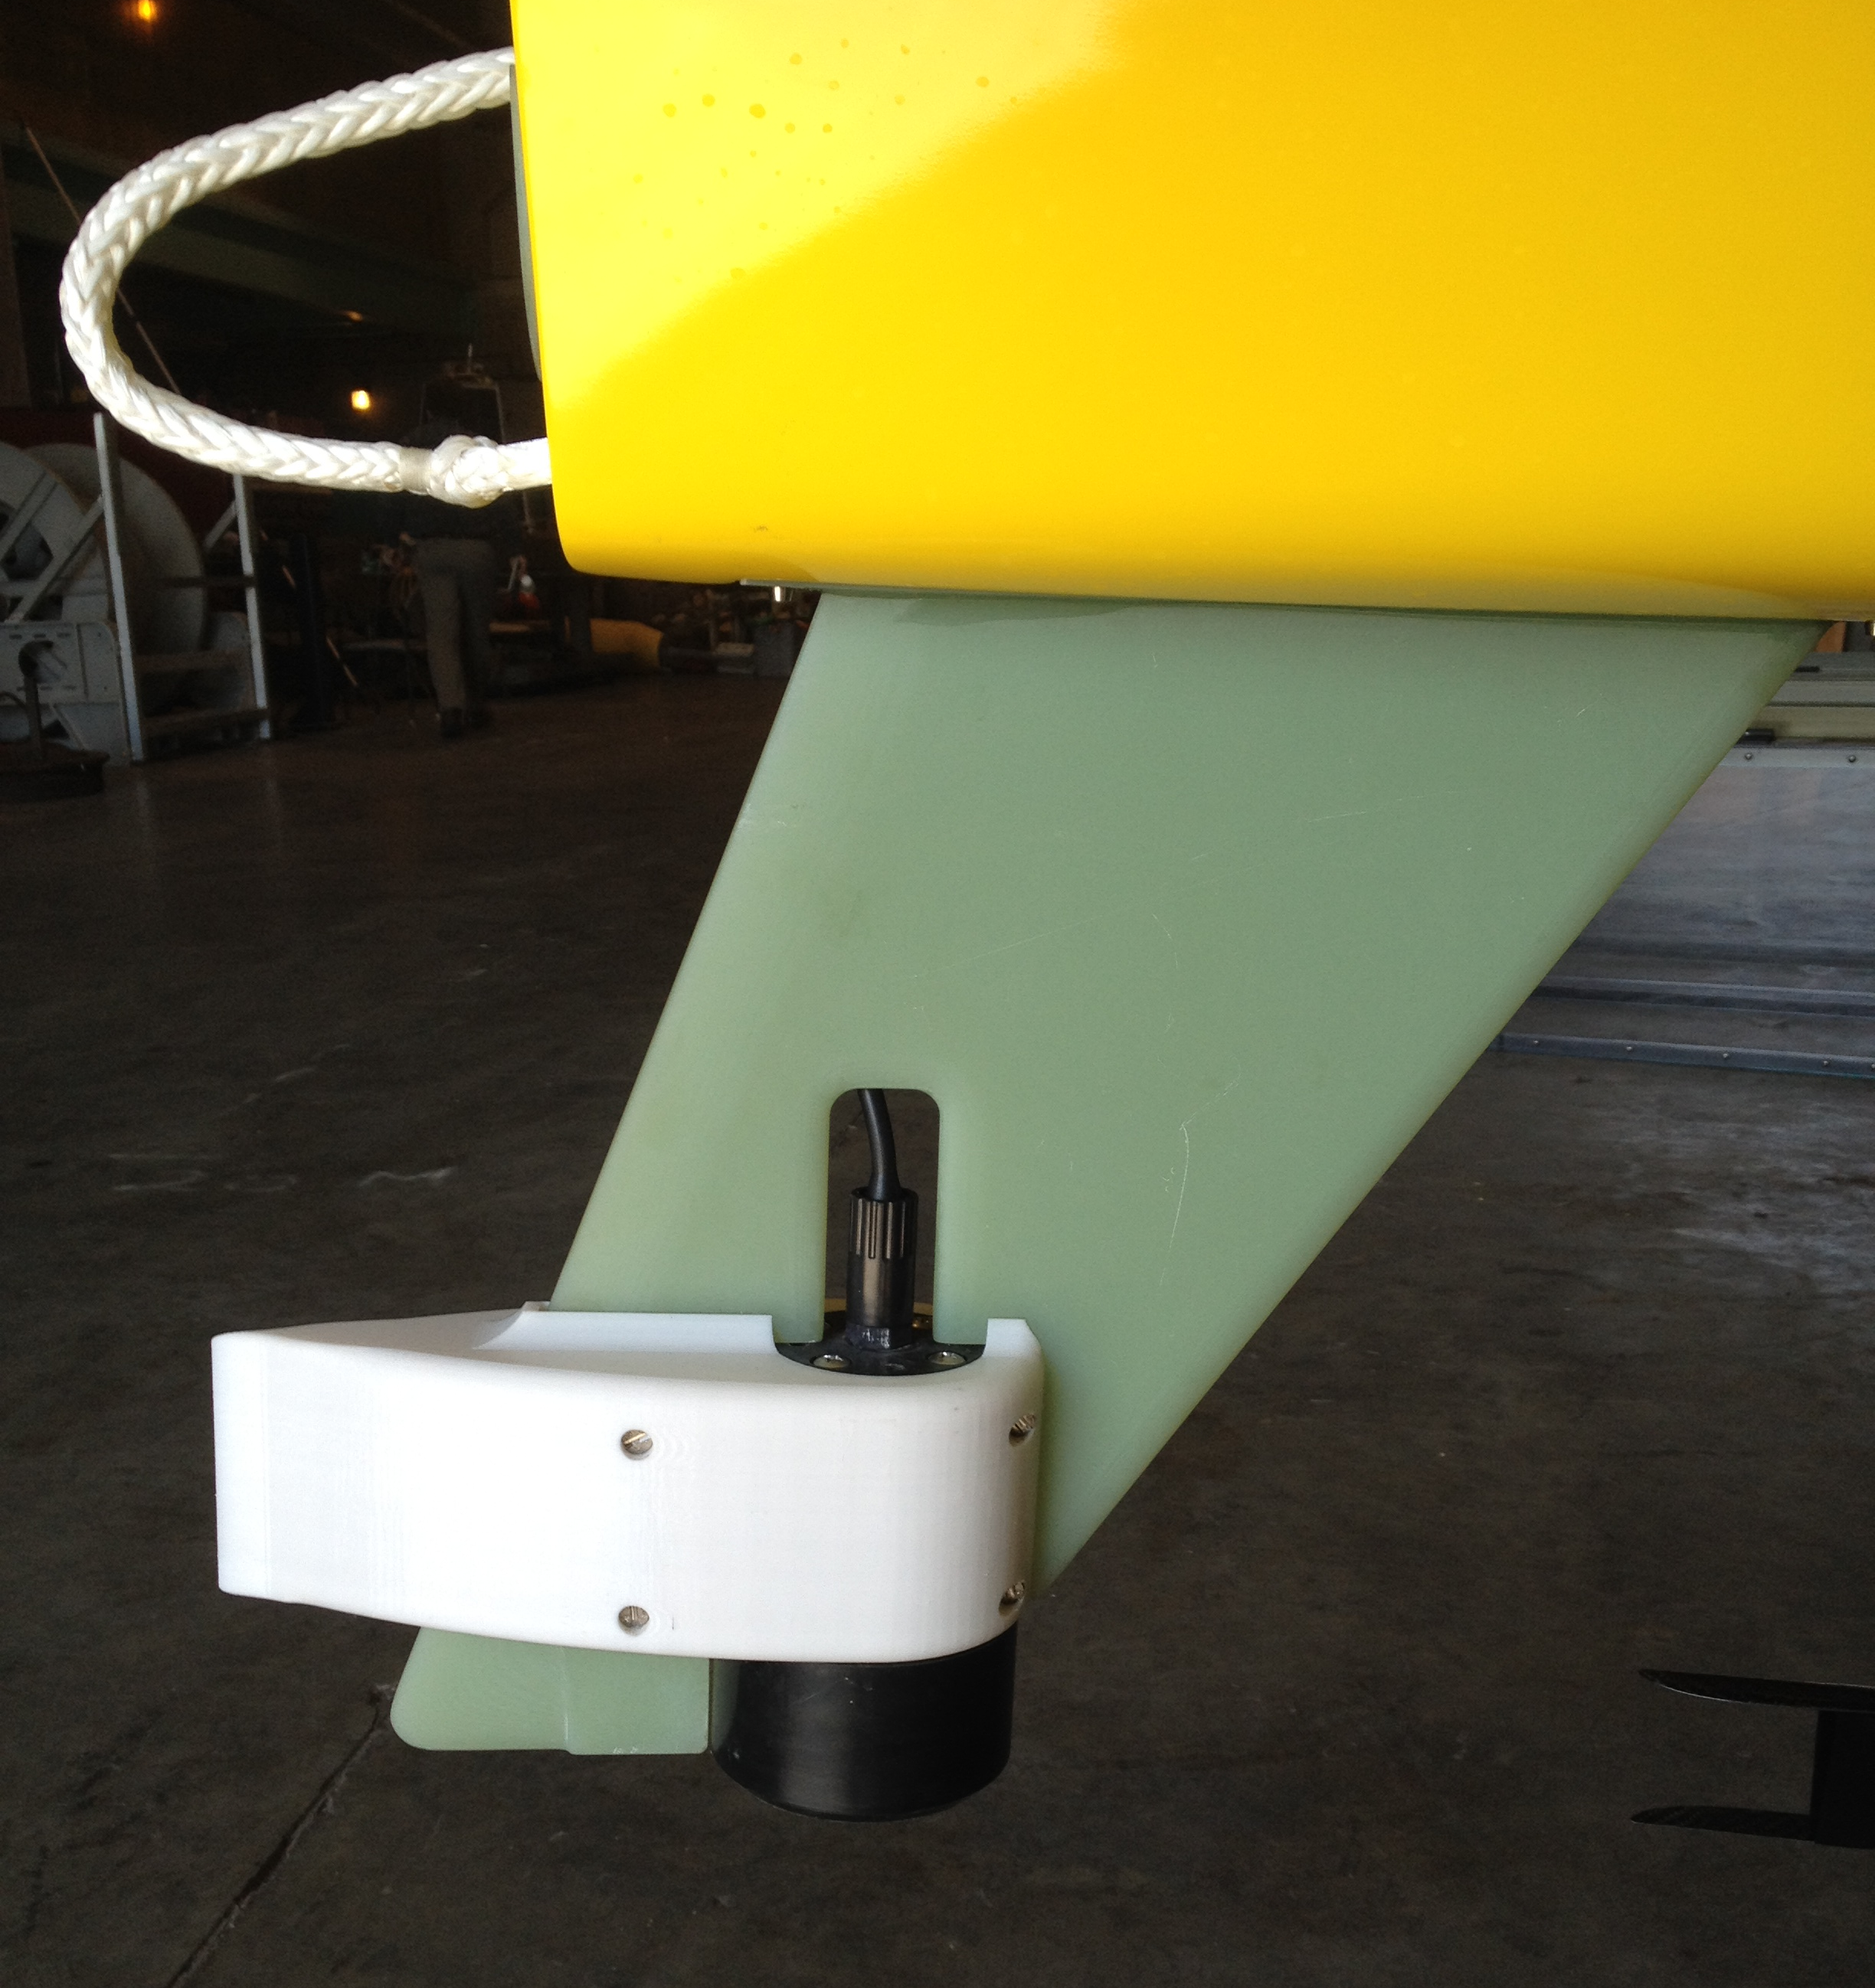
II. Acoustic Hot Spot applications
Directional Acoustic Transponder (DAT) mounted on WG skeg
  Gives target range, bearing, elevation
Target (e.g. AUV) carries acoustic modem or DAT
Notes:
Teledyne-Benthos makes the DAT, which is like a combined USBL-modem. We use the Medium Frequency devices (16-29 KHz), compromising range for smaller size (relative to the LF device). We see low acoustic noise levels on the Wave Glider – not an issue so far.
Have not encountered multipath problems yet.

Slide 21
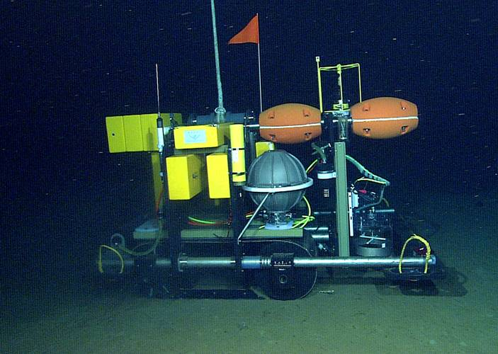
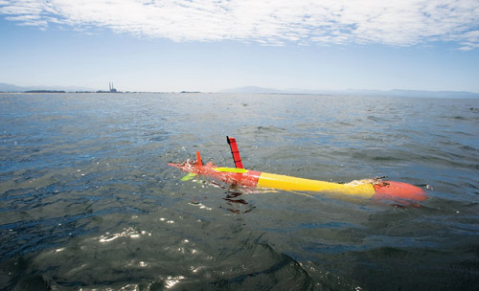
Acoustic Hot Spot applications
WG chases submerged AUV
WG homes on, hovers over stationary target (e.g. benthic rover)
AUV homes on WG (e.g. for data transfer)
Long Range AUV (LRAUV)
Benthic Rover

Slide 22
Hot Spot “chase” algorithm
GPS
GPS loc
Hot Spot computer
Main vehicle
computer
Nav cmd
“Black box”
DAT
rudder
Get target bearing/range/elev from DAT
Compute target lat/lon
If target location is “safe”, command vehicle to circle target
Repeat every n seconds
Notes:
Compute target lat/lon from bearing/range (DAT) and Wave Glider lat/lon (GPS)

Slide 23
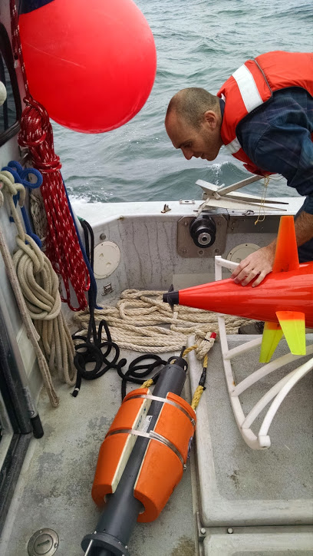
Target practice
Moored acoustic modem 10m above sea floor, water depth 50m, known lat/lon
Wave Glider Hot Spot “chases” modem, circle r=100 m
Compare computed target location to actual

Slide 24
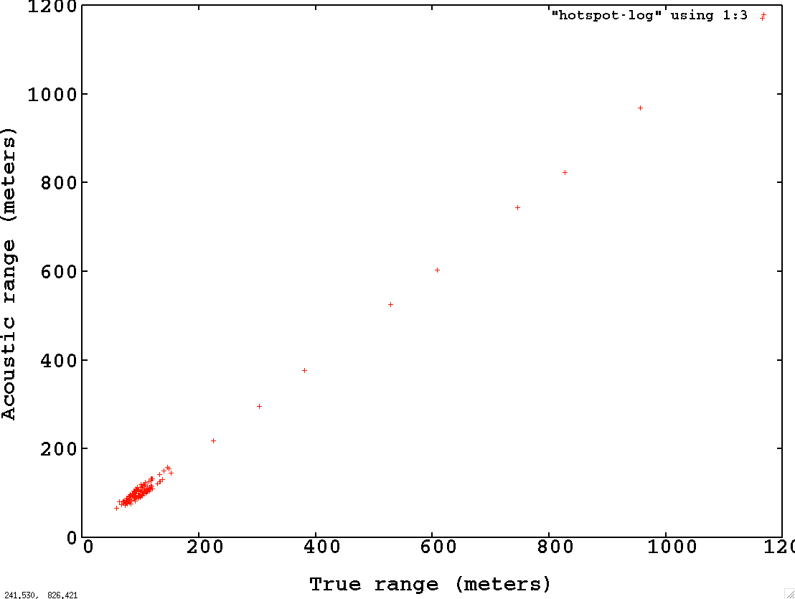
Acoustic vs true range to stationary target
Notes:
WG computes target location for each acoustic response, issues nav command to center a 100 meter watch circle on that location. Gets new target location about once every 75 seconds. Most ranges in 60-153 meter range

Slide 25
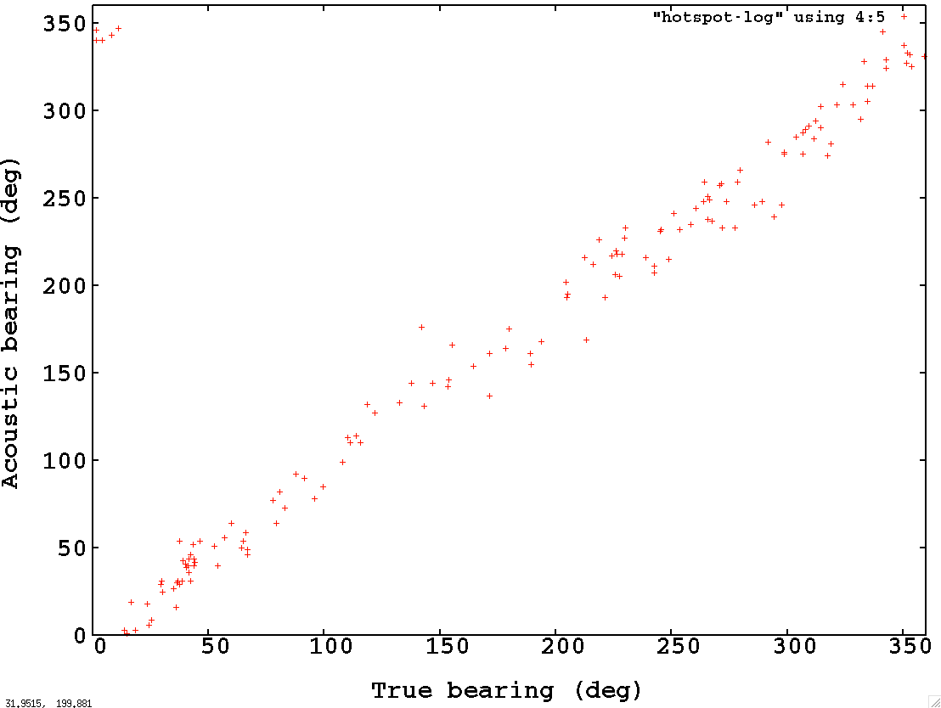
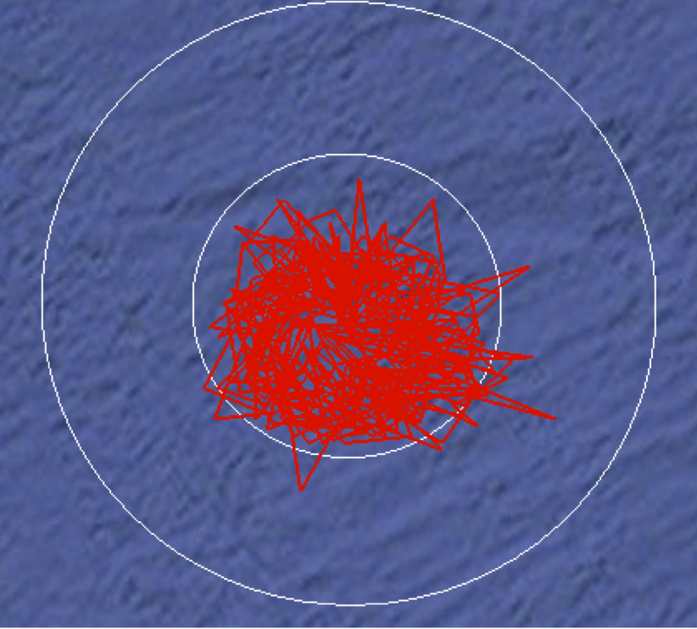
Acoustic vs true bearing to stationary target
50 m
100 m
Mean bearing error:
26.2 deg
Notes:
Several bearing errors > 40 degrees. When measured from 100 meters; 30 deg bearing error -> 50 meters position error, 40 deg bearing error -> 64 meters position error

Slide 26
Remineralization during phytoplankton bloom
Characterize chemistry/biology within drifting water mass, esp. near thermocline
Continuously analyze water mass in situ with sensors on Wave Glider and AUVs
Visit water mass with crewed ship each day, collect water samples for lab analysis
Sample in
Lagrangian frame
Long Range AUV (LRAUV)

Slide 27

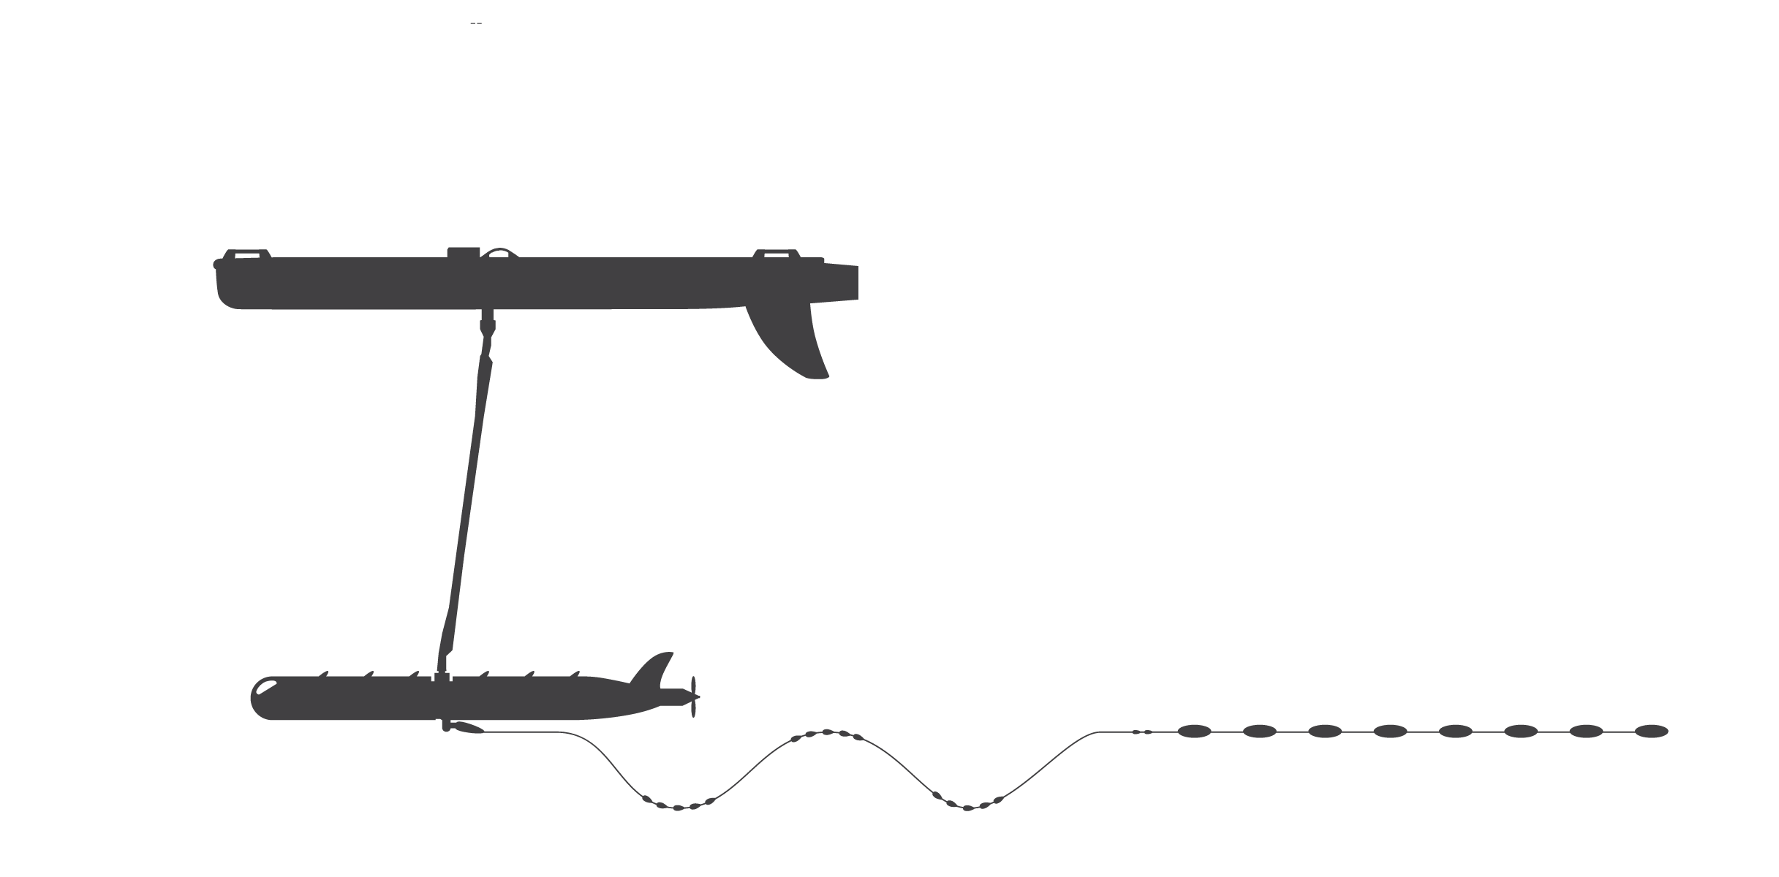
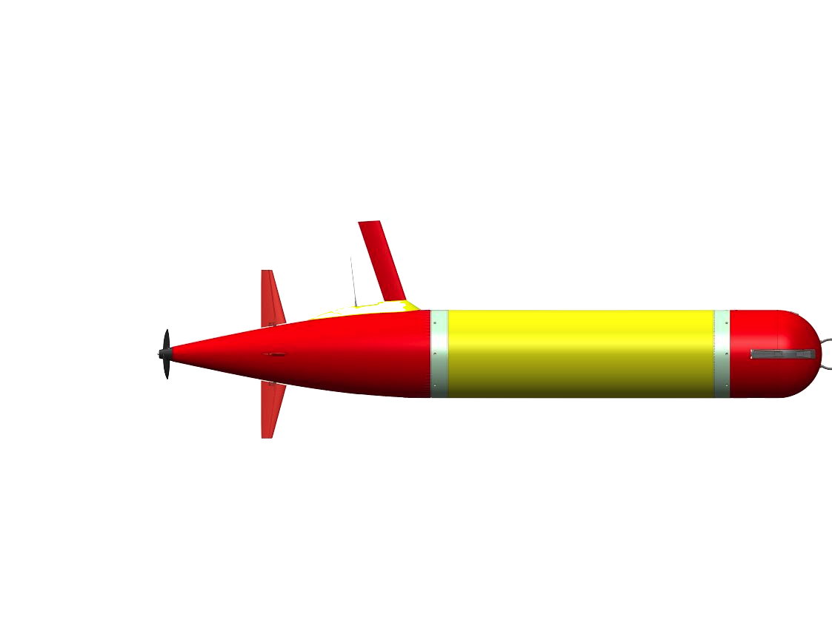
Chase application:
Lagrangian drift sampling
R/V Rachel Carson
Wave Glider
Profiler
Drifter
Notes:
Drifter LRAUV moves with current, servos to thermocline or other depth surface using variable buoyancy system. Wave Glider and profiler LRAUV acoustically determine drifter LRAUV location and circle it. All three vehicles carry science sensors (CTD, fluorescence, backscatter, dissolved oxygen). Crewed ship periodically visits to take water samples for genomic/microscopic/isotopic analysis, uses Wave Glider surface location to easily locate the volume to be sampled.

Slide 28
Lagrangian drift sampling:
October 2014
Wave Glider autonomously chased drifter for 48 hours
drifting AUV at thermocline
WG, following drifting AUV
profiling AUV
1000 m
Notes:
RV Rachel Carson able to easily locate Wave Glider. Acoustic track shows small wiggles which are artifacts – note that we don’t yet account for offsets between DAT, compass, GPS
Autonomous navigation saved operational cost – no need for operator to continually issue commands through WGMS interface
Last Fall navigation commands were issued automatically from on shore following receipt of target location from WG cell; now they issued directly from the Hot Spot payload to the main vehicle computer.

Slide 29
Conclusions
AUV-Hot Spot file transfer at 10s Kbps at 100s of meters range
Significant dollar savings (~1/3) and surface time savings (~1/5) over AUV-Iridium
Autonomously track moving underwater targets within 10s of meters for days
Wave Glider infrastructure leveraged for these applications

Slide 30



Acknowledgements
University of Porto: Kanna Rajan, Joao Borges de Sousa, Ricardo Martins, Jose Pinto, Renato Caldas, Pedro Calado, Hugo Dias
MBARI: Thom Maughan, Fred Py, Brett Hobson,
M Jordan Stanway, Francisco Chavez, John Ryan, Kevin Gomes, Hans Thomas
Liquid Robotics: Mike Cookson, Ryan Carlon
The David and Lucile Packard Foundation

Slide 31
End

Slide 32
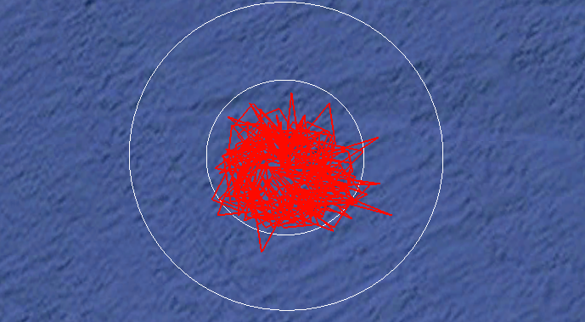
Computed coordinates of “chased” stationary target
r=100 m
(WG circle radius)
r=50 m
89 m
107 m
Water depth: 50 m
10 m cable from modem to seafloor
Acquired over 11 hr 40 min
Notes:
Data acquired over 11 hrs, 40 min; about 42,000 points

Slide 33
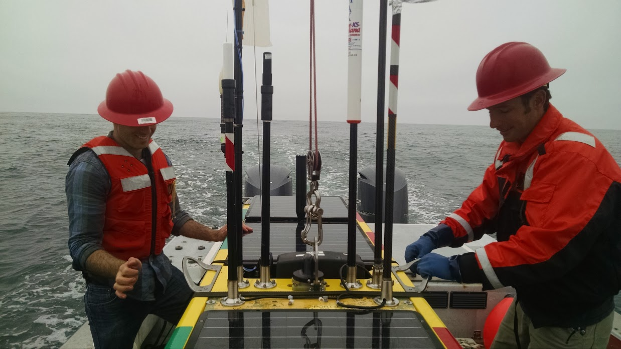

Slide 34
Next steps
Account for GPS, DAT, compass offsets
Automate acoustic data relay through radios (e.g. acoustically-retrieved CTD)
Refine AUV home to Hot Spot for data relay

Slide 35
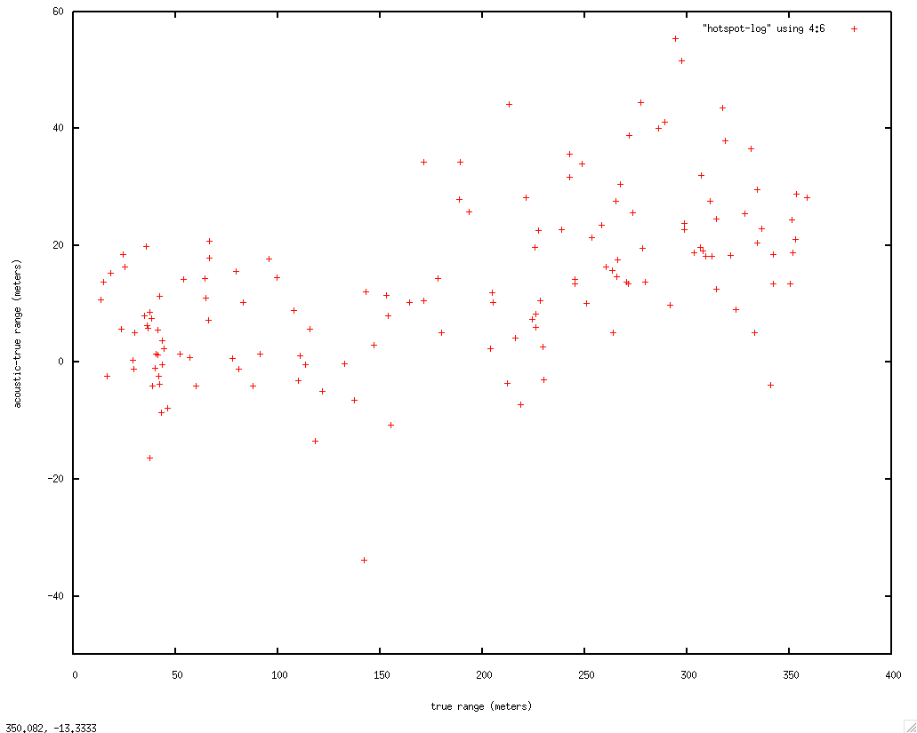
Bearing error vs true bearing

Slide 36
The Communications Revolution - Comparison of Data Rate and Costs for Surface HotSpot Radio Relay
10x
1000x
Notes:
These two graphs compare the data rate and cost of the three radio communications options available for delivering real-time data.
Satellite services are in blue and cellular ground service in orange.
The Iridium satellite constellation short burst data service – the current Tethys system. This service offers high reliability, low power and worldwide coverage. Most importantly it has an availability of around 90-95% so AUV’s are almost always able to make a connection when they surface – very important – but the tradeoff is that it is correspondingly slow in sending data.
The Globalstar satellite constellation is shown here. It has an availability of around 40-50% but a higher data transfer rate. The poor availability makes it unsuitable for human-to-machine communications, but fine for machine-to-machine or M2M communications. A computer does not mind having to continually redial to get the entire data set through.
In orange here is the commercial 3G cellular phone network. Note the large change in scale. The data throughput is about 300-400 times the Iridium satellite system.
On the right we look at costs per byte. Here again there is a major scale change and the Globalstar satellite system is more than several orders of magnitude less expensive then the Iridium SBD messaging system.
With a data cost of $25 per GByte, the commercial 3G cellular phone network is essentially free in this application.
The bottom line is that AUV’s must use Iridium for robustness, but the Wave Glider HotSpot is not similarly constrained and can select the most appropriate radio link.

Slide 37
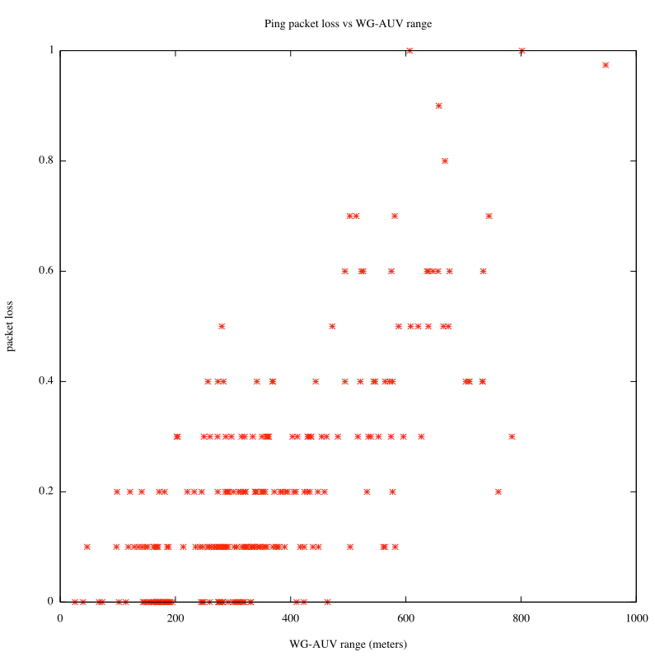
Ping packet loss as a function of WG-AUV range
Ping packet loss
WG-AUV range (meters)

Slide 38
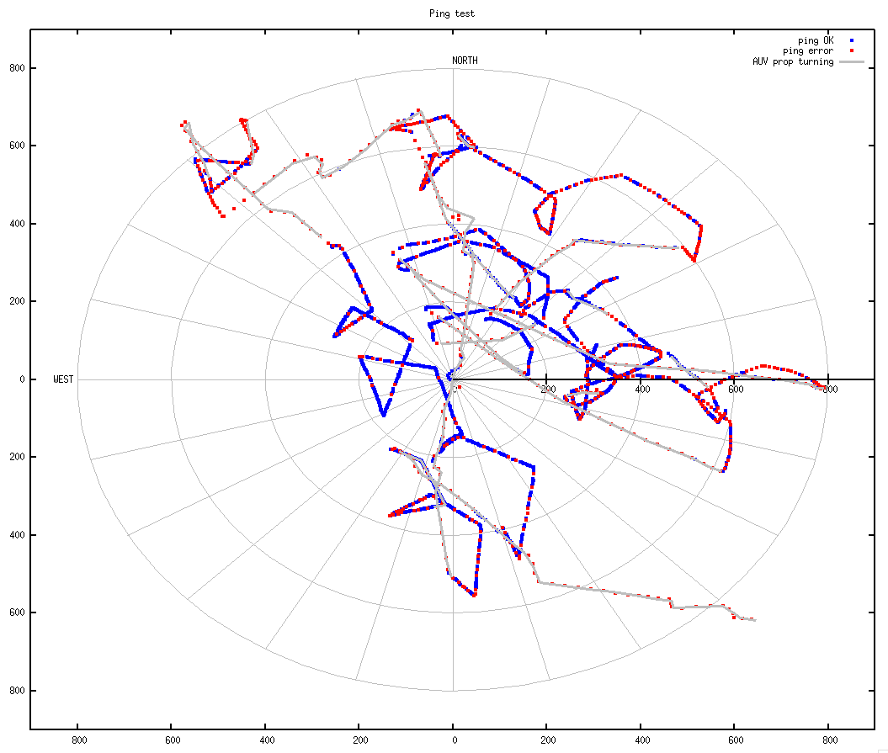
Pings from Wave Glider to AUV

Slide 39
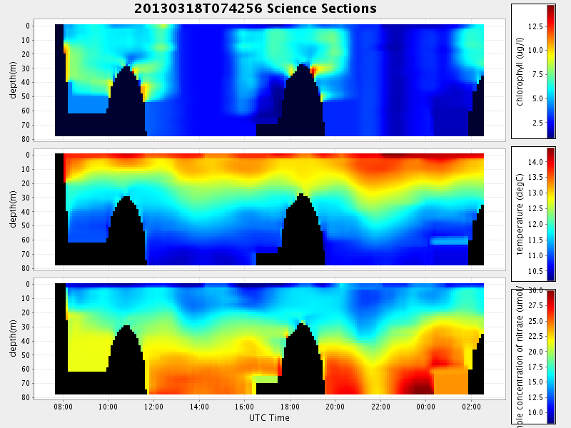
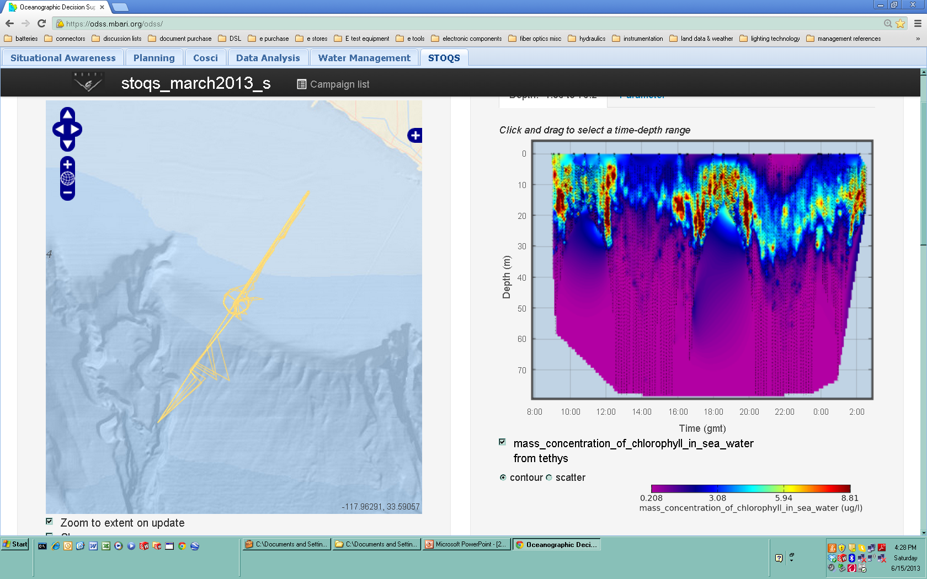
What Can We Expect From More Real-Time Data Return?
an example from Tethys ECOHAB data from March 18, 2013
Real-time returned data – contour plot
10% of all returned data – scatter plot
chlorophyll
AUV surface interval restricted to 5 minutes maximum Each plot represents between 750 and 900 data values
15,159 data values

Slide 40
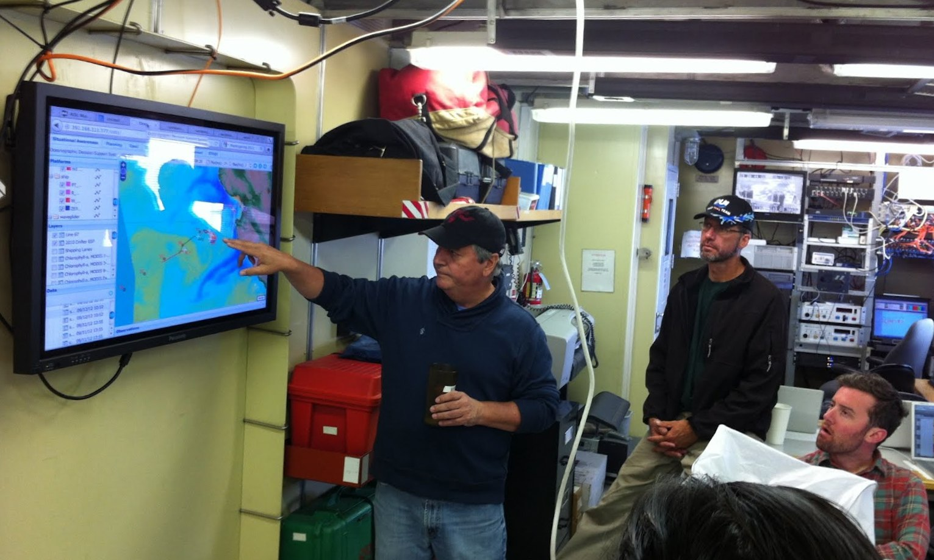
The Importance of Real Time Data Return
Provides raw data for the MBARI Ocean Decision Support System (ODSS) software application for coordinated mission planning.
Allows re-directing assets during dynamic field experiments with collaborative adaptive sampling, one of the major themes of our current field initiatives.
  Coordination of sampling decisions with the ESP where every sample counts.
  Determining where to take AUV Gulper water samples.
  Where to take water samples from a ship.
For returning high quality intermediate data from Tethys during long missions (up to 20 days!).
All possible due to the communications revolution.
Notes:
The value of the Wave Glider HotSpot is it’s ability to return realtime data.
Real time data is major theme of MBARI’s research and what we’ve been hearing about today, the increasing dependence on real-time data for decision making during the course of field experiments.
Here we see Francisco Chavez using the MBARI OCEANOGRAPHIC DECISION SUPPORT SYSTEM software application for a field experiment last Fall. Adequate real-time data is the raw material for visualization and decision making tools.
It’s a big ocean out there and real time data is necessary for making informed sampling decisions, a major theme of our field programs. This is especially important when you have limited capacity, for example the AUV Gulper water sampler or the Environmental Sample Processor.
The AUV Tethys is an exciting new tool with missions up to 20 days. The ability to return high quality intermediate data is of great importance.
Thanks to the revolution in communications that has been occurring over the last several decades more data is available in real-time from remote field experiments then has ever been possible before.

Slide 41
Advantages of a Wave Glider Surface Data Relay – a Radio “Hot Spot”
Flexibility and access of a surface platform allows the use of faster, less expensive data links.
  Continuous access to GSM Cellular phone or Satellite communications.
  Large energy budget for communications.
  Radio antennas can extend clear of the wave splash zone.
  Payload space for multiple high powered radios.
Minimize AUV surface time, air-time costs
“Console” from shore to AUV
  Hot Spot radios augment Liquid Robotics radios, which are difficult to access
Notes:
Unlike an AUV, a Wave Glider can maintain continual connection with satellites and if within about 10 nautical miles of shore, the commercial cellular phone network.
Whereas an AUV must do all of it’s communications during a brief surface interval, a Wave Glider HotSpot can use less robust but higher data rate radio links. If data does not initially get through it can be continually re-sent until it does.
The HotSpot can use some intelligence on which radio system to use. It can first attempt a connection using the lowest cost option, then, if that is not reliable enough, it can switch to a higher cost but greater range data relay such as satellite.
The energy budget of the Wave Glider is greater than possible on an AUV and energy can be replenished using solar panels or other means.
Of course the mounting of antennas is much easier and they can be much higher above the water.
There is also plenty of space for radio hardware.
41

Slide 42
Dorado and Xtreme-2 AUV coordinated operations
 | Dorado (9 MHz) | Xtreme-2 (802.11)
Range to Hot Spot (meters) | min 78, max 2489, avg 687 | min 56, max 739, avg 314
File size (uncompressed bytes) | min 36, max 40587, avg 14149 | min 2190, max 913932, avg 101831
Total AUV-to-shore transfer time (seconds) | min 14, max 648, avg 182 | min 13, max 393, avg 119
Effective AUV-to-shore transfer rate (bits/sec) | min 2, max 7138, avg 1770 | min 51, max 224506, avg 15049

Slide 43
Hot Spot relay applications
Fall 2013; coordinated operations between MBARI Dorado and LSTS Xtreme-2 AUVs in N. Monterey Bay
  Surveyed water masses near MBARI genomic sensor
  Hot Spot relayed AUV science data to shore, commands from shore to AUVs, messages between AUVs
Spring 2014: Long Range AUV in S. California, characterized harmful algal bloom development
  Relayed 53 MB of AUV data to shore over eight days
  Troubleshot AUV at sea through Hot Spot Iridium console
Notes:
Straightforward to enable Xtreme-2 as Hot Spot node.

Slide 44
Disruption tolerance
DTN (Delay Tolerant Networking)
  Powerful, flexible
  Still in flux, incomplete documentation, serious bugs in at least one implementation
rsync file-transfer protocol
  It’s everywhere; very robust implementations
  Very efficient “delta-transfer” algorithm
  Disruption-tolerant; transfer resumes where it left off

Slide 45
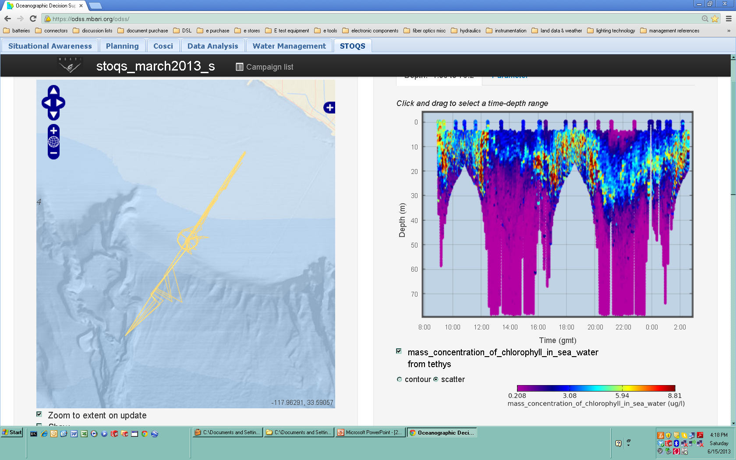
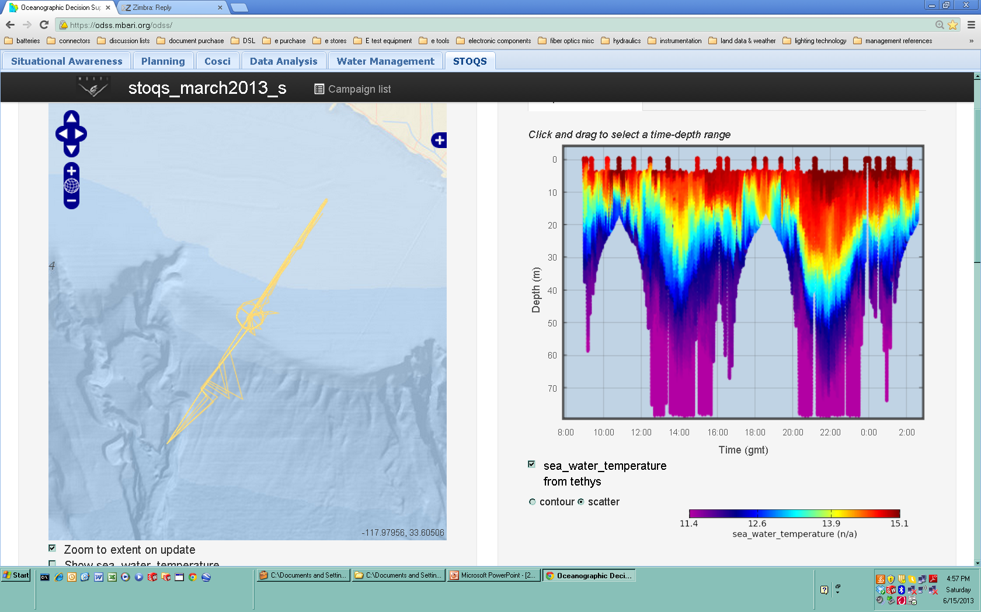
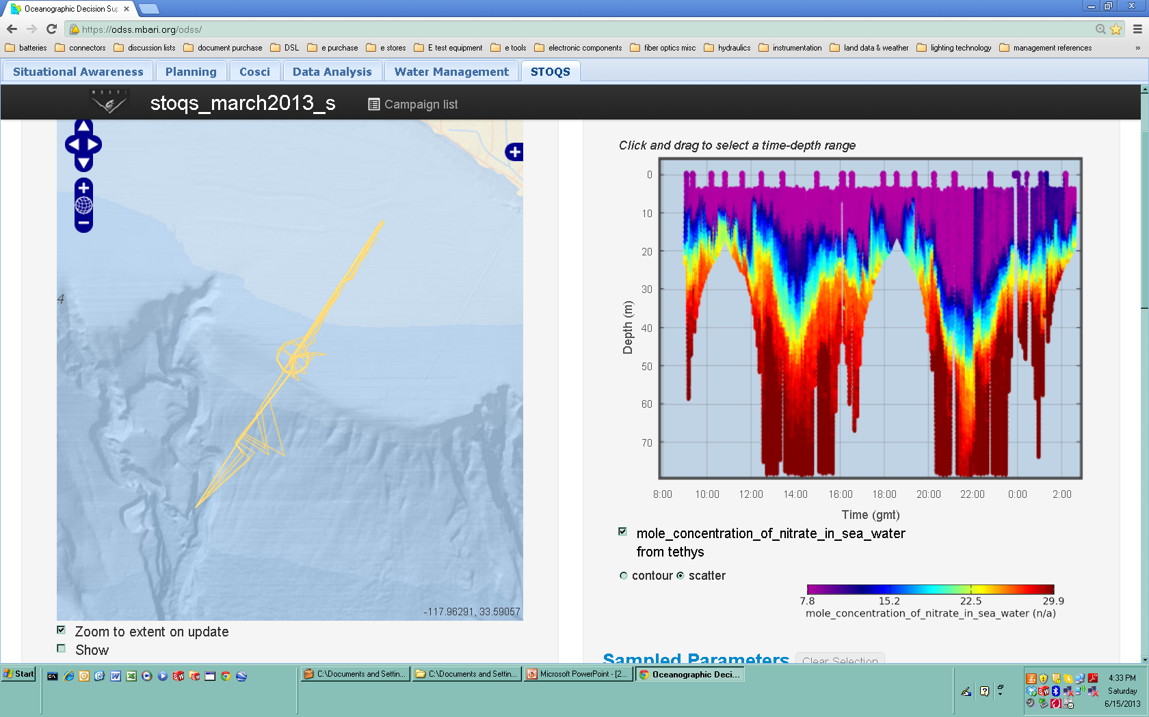
Iridium versus predicted Hot Spot real-time data
chlorophyll
temperature
nitrate
Iridium: 750 - 900 data values per contour plot
Hot Spot: 15,159 data values per scatter plot
Notes:
This slide of Tethys data from the ECOHAB experiment in March illustrates the effect of restricting the AUV’s surface time to 5 minutes for data downloading of real-time data in the current system. The vehicle sends back a very reduced data set as shown on the left side plots. I want it clear that the sparse data represented on the left is the result of restricting the AUV surface interval, and if the AUV was allowed to remain on the surface longer the plots would have more resolution.
The data in plots on the right side is a decimated version of the complete data set for each of the three parameters, chlorophyll, temperature and nitrate.
We predict however that based on the number of data values represented here and our experiments with the Wave Glider HotSpot, for future experiments similar to this one, if the AUV is within about 400 meters of the Wave Glider HotSpot, we should be able to bring back data sets in a 5 minute surface time comparable to the higher resolution plots on the right..
We should also be able to bring back complimentary data sets from the AUV’s in experiments such as this one that were not being returned at all in real time due to data rate and surface time limitations.

Slide 46
Cost to transfer 13.4 MB
AUV data per day
 | AUV-Iridium | AUV-HotSpot-cell | AUV-Hotspot-Globalstar
Total AUV surface time | 5.0 hours | 46 minutes | 46 minutes
Hot Spot operational cost | N.A. | $100 | $100
Airtime cost | $380 | $1 | $13
Total cost | $380 | $101 | $113
AUV - Hot Spot link: 900MHz radio AUV – Hot Spot range: < 400 meters
Iridium bandwidth: 2400 bits/sec
Compression: 2.7 AUV antenna wash-over: 10%
Iridium cost: $1.25/minute GlobalStar cost: $2.58/MB

Slide 47
Hot Spot acoustic “chase” algorithm
(python/java software)
Get target bearing/range
Compute target lat/lon
If target location is “safe”, command vehicle to circle target
Repeat every n seconds
Target practice: Moored acoustic modem 10m above sea floor, water depth 50m
Notes:
Compute target location from WG GPS location, target bearing and range (using Vincenty’s algorithm).
Verifies that target is in safe polygon
Implemented in python and java

Slide 48
Hot Spot RF relay advantages
Fast, cheap continuous link to shore
Fast radio link to AUV
Tall antennas
Large energy budget
Minimize AUV surface time
Wave Glider and AUV must rendezvous on surface!
Notes:
Frees ships to perform other tasks that require humans on-site
AUV and WG must be within a few hundred meters to exchange data via RF.

