Slide 1
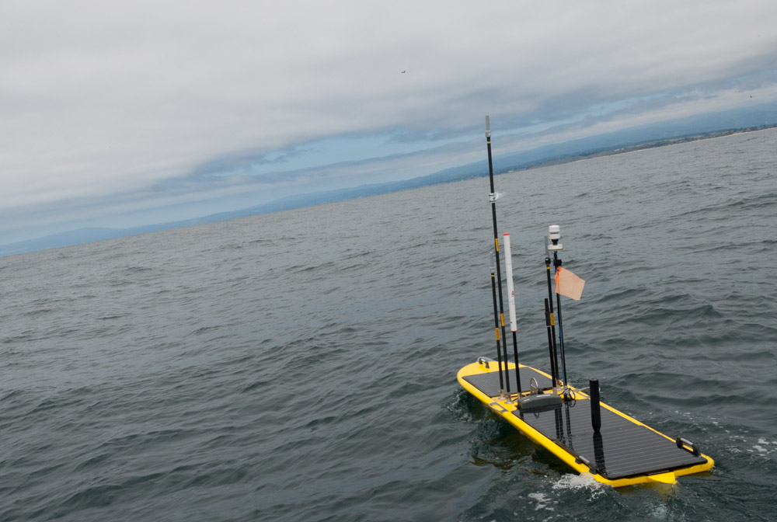
Wave Glider Hot Spot 2017
901411
Brian Kieft and Tom O’Reilly

Slide 2
2016 deliverables
Field program support
Standardized payload
Automated range-only stationary target localization
Refined acoustic targeting accuracy
Automated BED operations
Onboard sensor data transfer
SMC upgrade

Slide 3
Operations
7 deployments YTD
~10,000 nm travelled overall
Often > 4 PIs / deployment
Collaborative development
Notes:
Chavez, Paull, Smith

Slide 4
Proposed 2017 work
Field program support
Acoustic message transfer capability
Support Targeted AUV Sampling project with oceanic front detection/tracking
Collaborate with JRF; VHF over-the-horizon comms
Tech transfer to U of H (already in progress)
Iridum Next investigation

Slide 5
Lagrangian drift survey:
October 2014
CANON 2015 – Autonomous following implemented onboard
drifting AUV at thermocline
WG, following drifting AUV
profiling AUV
1000 m
Notes:
RV Rachel Carson able to easily locate Wave Glider. Acoustic track shows small wiggles which are artifacts – note that we don’t yet account for offsets between DAT, compass, GPS
Autonomous navigation saved operational cost – no need for operator to continually issue commands through WGMS interface
Last Fall navigation commands were issued automatically from on shore following receipt of target location from WG cell; now they issued directly from the Hot Spot payload to the main vehicle computer.

