Slide 1
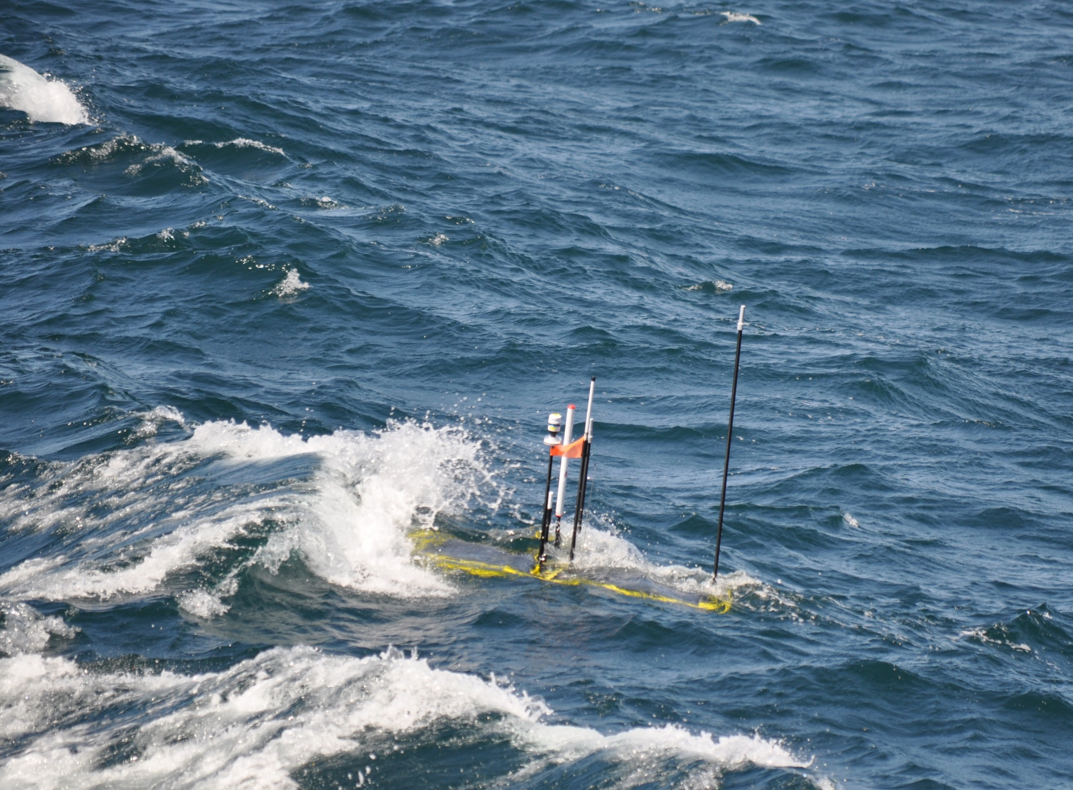
Waveglider Hotspot
Mark Chaffey, Brian Kieft, Tom O’Reilly

Slide 2
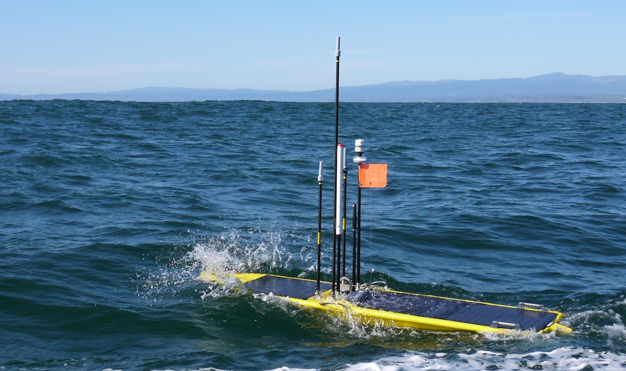
Data Hotspot
Deployed on SV3 Waveglider
Over The Horizon
  Human/Data
Nearshore (3G)
  Human/Data
Local (RF)
  Surface comms
Unsersea
  LF/MF acoustic
  USBL?
Notes:
Iridium OTH for human interaction
Globalstar OTH for data transfer

Slide 3
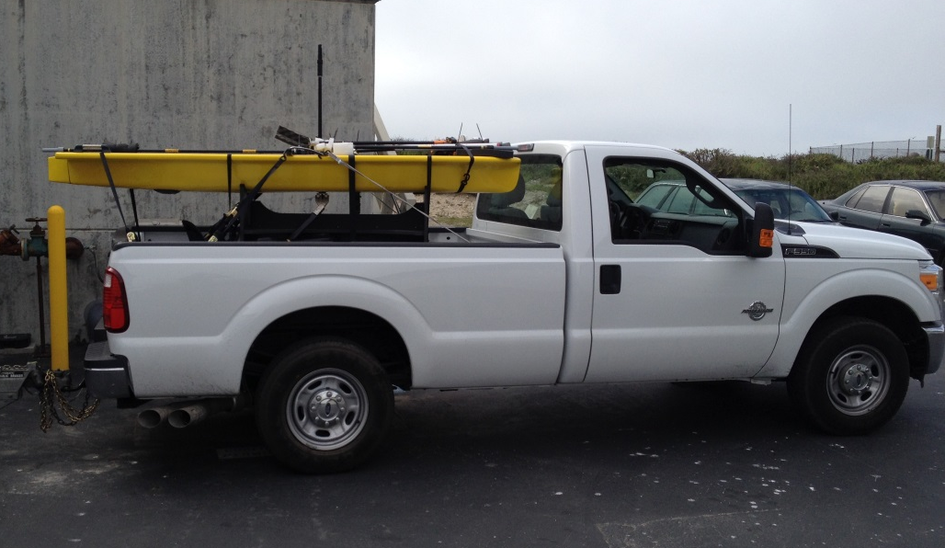
Field Deployments
YTD 5 deployments
  Dorado AUV
  LRAUV
  Benthic Rover
  Benthic Event Detectors
Easily Transported to deployment locations outside of Monterey Bay

Slide 4
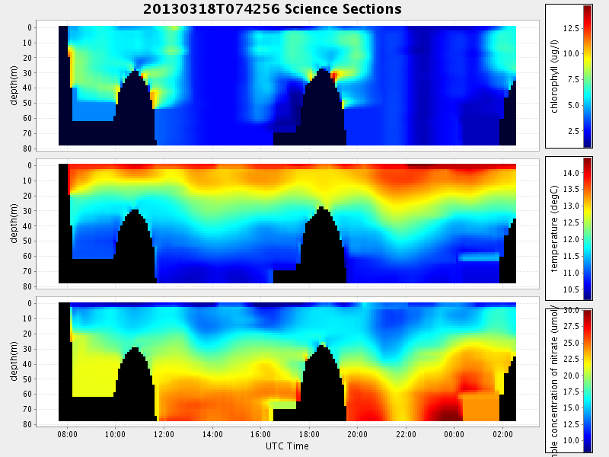
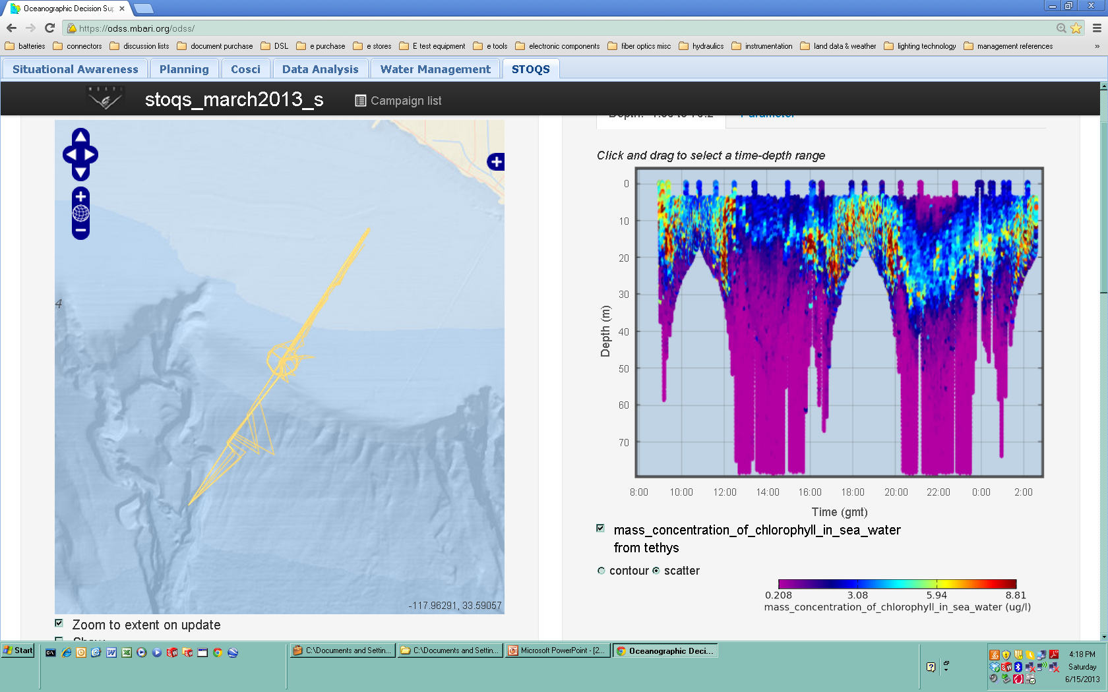
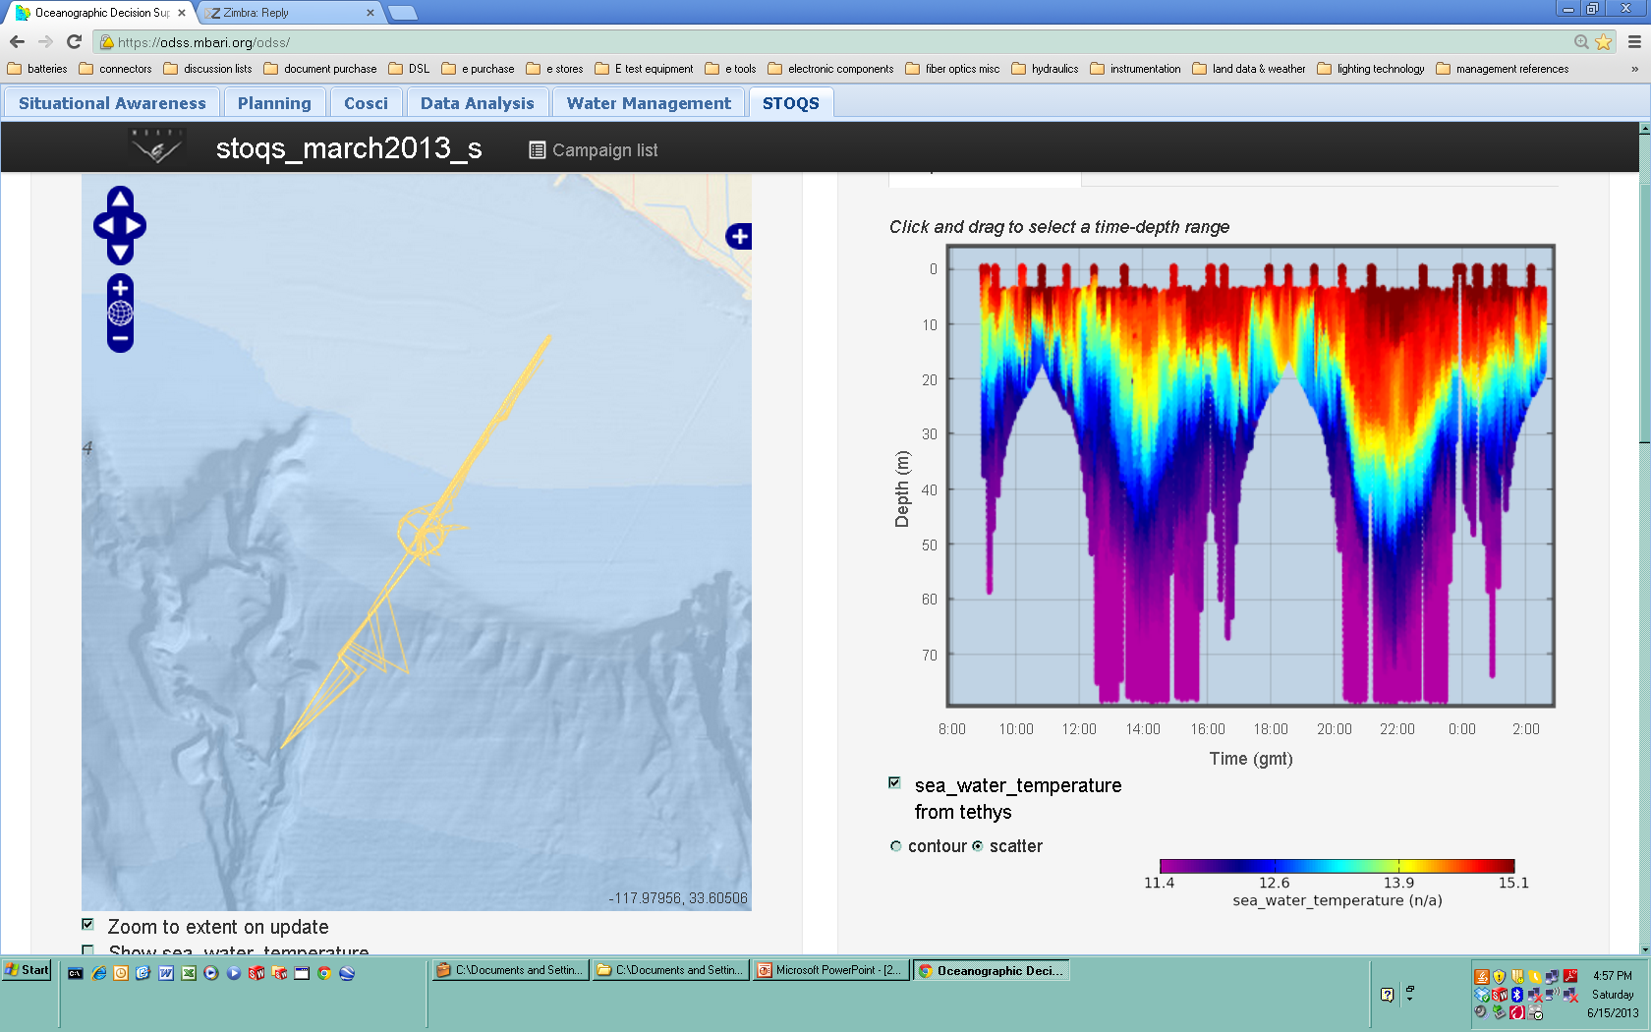
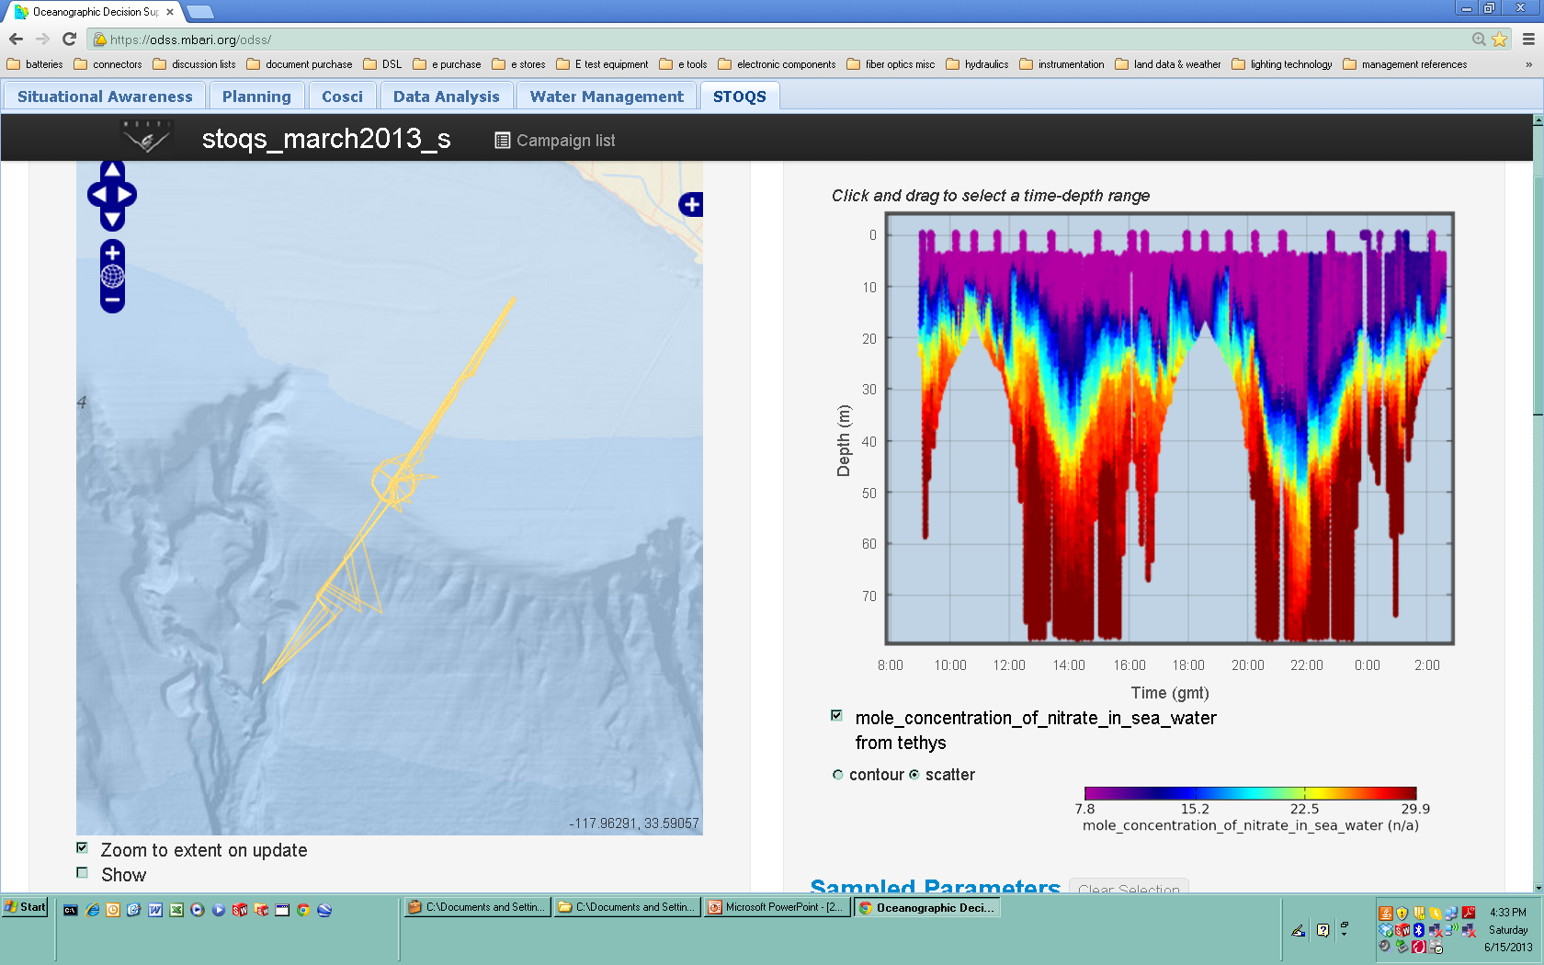
Benefits
Minimize surface time for AUVs
Providing Informed Decision Making
  EcoHAB spring 2013: decimated versus complete LRAUV data

Slide 5
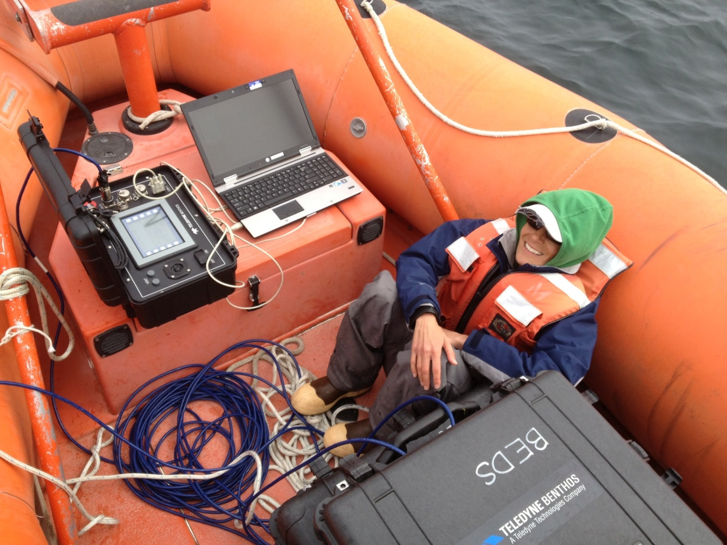
Reducing Human Interaction
Alana Sherman downloading data acoustically from a benthic instrument.

Slide 6
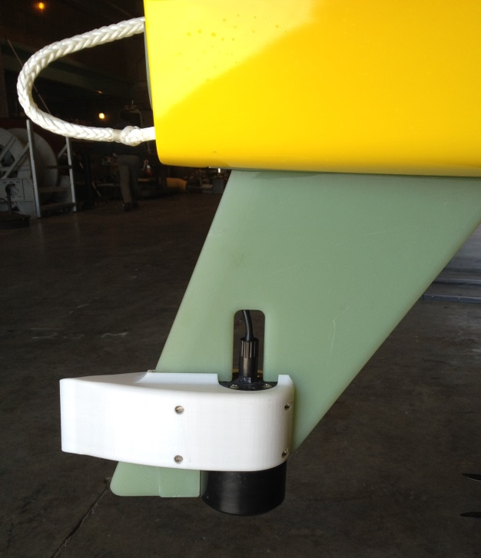
Acoustic Data Transfer

Slide 7
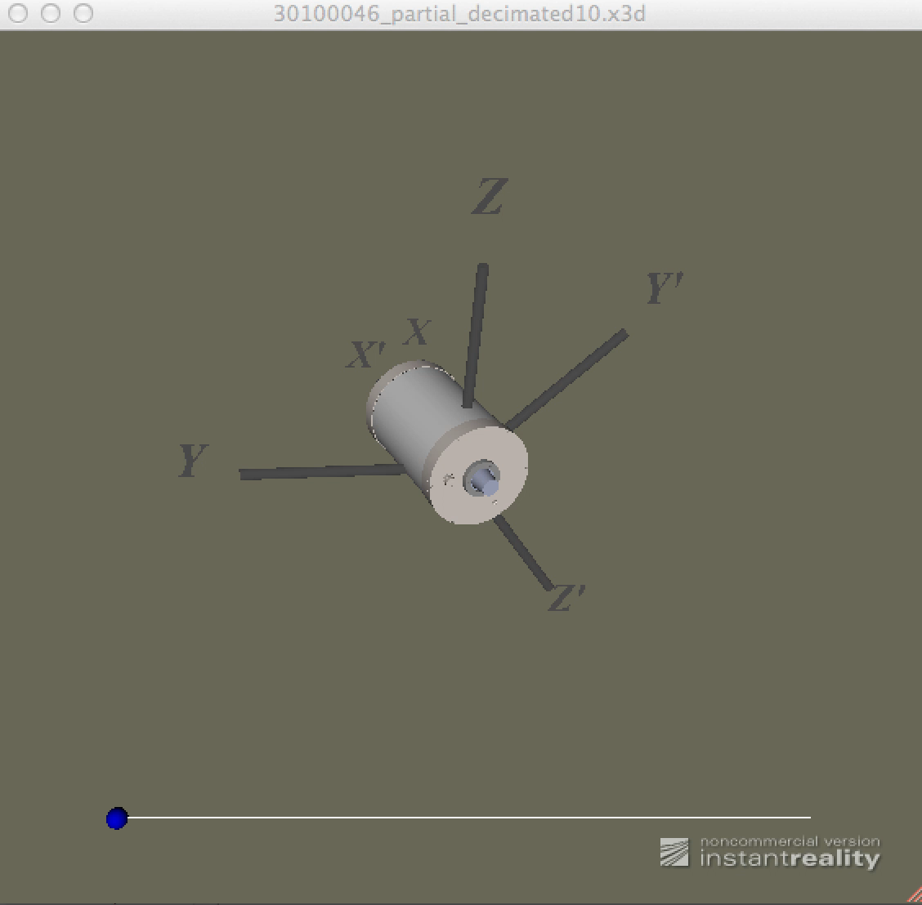
Acoustic Data Transfer

Slide 8
Ongoing/Future Efforts
Refining acoustic data transfer options
Optimizing OTH versus 3G data path depending on local conditions
Asset tracking
Underwater navigation fixes

