Slide 1
AUV Science Operations Using Terrain Relative Navigation #901500
Stanford TRN research
MBARI development project
MBARI Operations
MBARI development project bridging Stanford TRN research with MBARI Operations
Carried the 2016 Rockfish effort
NASA Iceberg AUV project
  Iceberg AUV
  Wall-following
  TRN

Slide 2
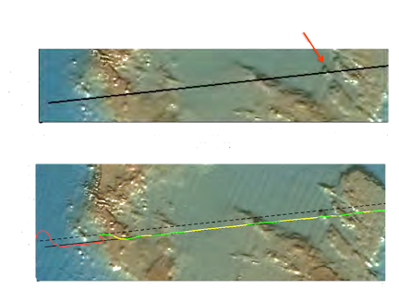
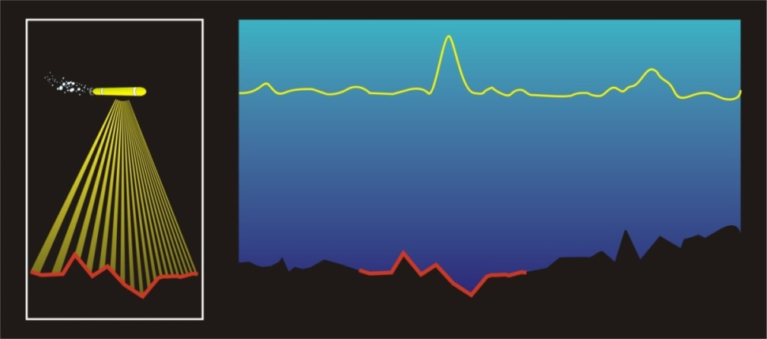

Terrain-Relative Navigation (TRN)
Trajectory specified in map coordinates (before dive)
Target boulder
Measurement
Likelihood Score
Filter converges
Trajectory without TRN correction
Terrain Map
Low-cost, precision navigation tool
Uses existing acoustic instruments (altimeter, DVL, multi-beam sonar)
Compare the time history of the depth profile with an on-board map
The accuracy of other navigation techniques degrades over time. This makes it difficult to return to a site, e.g. a rock pile
TRN figures out where you are with respect to the terrain
Slide courtesy of Dr. Steve Rock

Slide 3
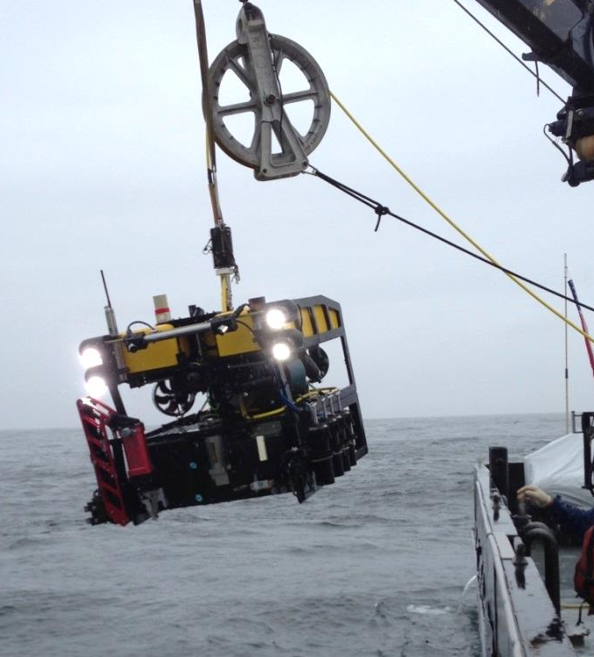
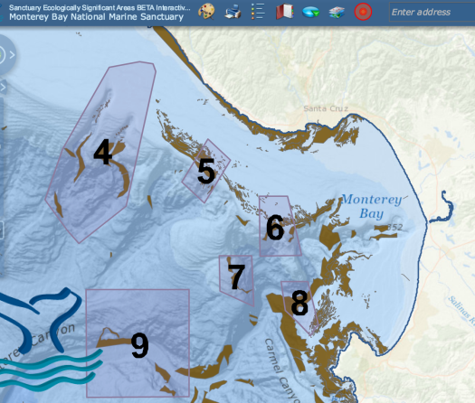
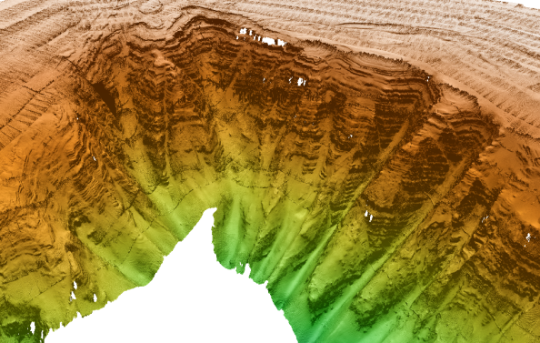
2016 Field Trials
Used Mapping AUV to generate a High resolution map of a suspected deep rockfish habitat
  in a Sanctuary Ecologically Significant Area (SESA)
Deployed MBARI’s “low-cost” MiniROV
  Improved maneuverability, imaging, navigation
  Employed TRN to determine map offset for precise navigation
  Imaged/counted fish in the water column followed by visual ID
    Low-cost swath sonar for fish detection

Slide 4
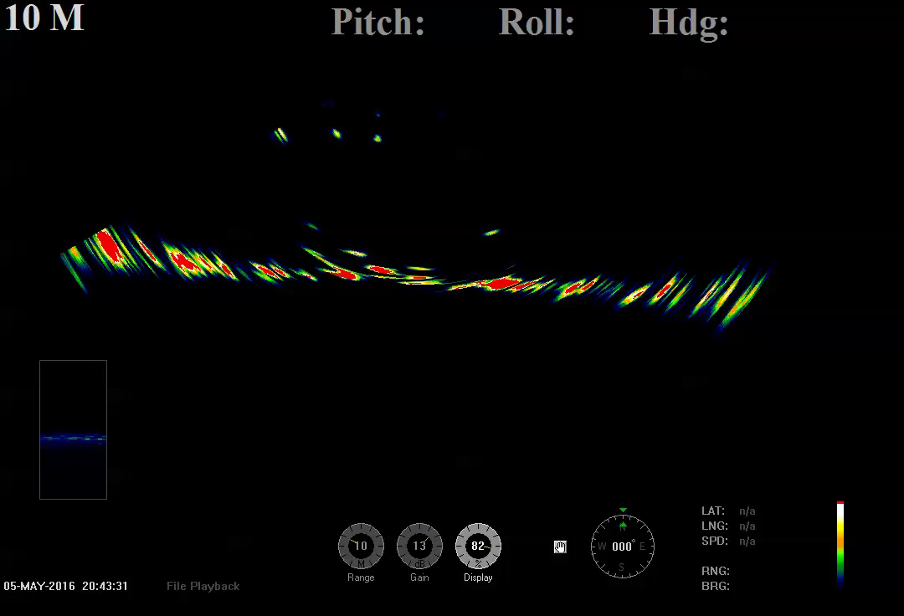
Rockfish in the Water Column
Low-cost Multi-beam Sonar

Slide 5
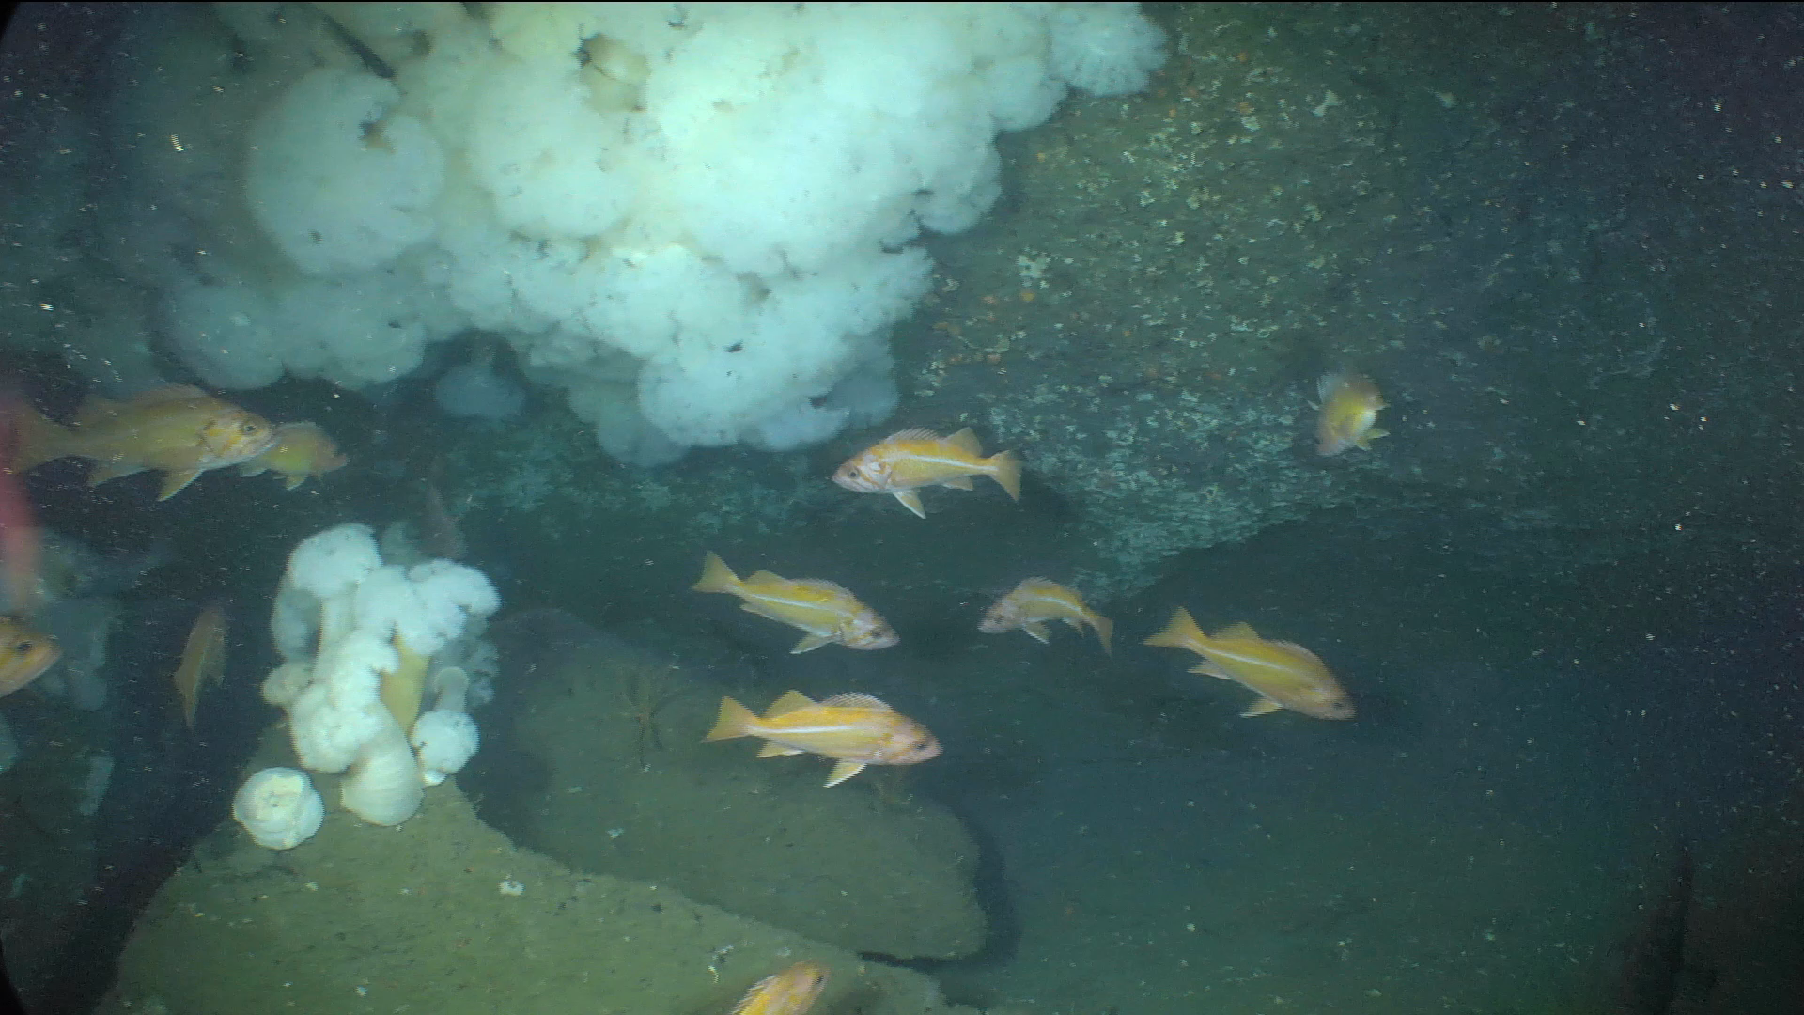
MiniROV footage
“Rare” and Rebuilding Species

Slide 6
