Slide 1
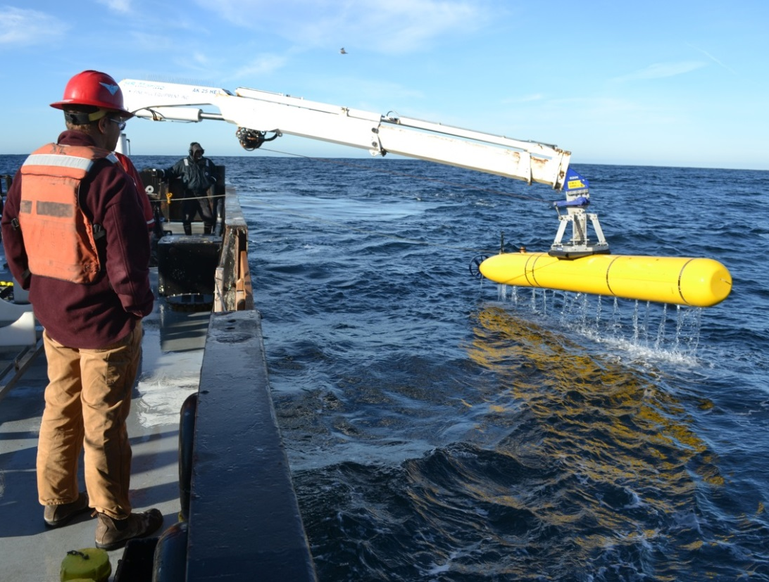
AUV Science Operations Using Terrain Relative Navigation (TRN) #901500
2017 Project Team:
Brett Hobson
Steve Rock
Rob McEwen
Rich Henthorn
Dave Caress
Hans Thomas + AUV Team

Slide 2

TRN Development Path
Stanford TRN Research
MBARI Development Project
MBARI Operations

Slide 3
NASA Iceberg AUV Project
  Novel navigation technique applicable to navigating around asteroids, but immediately useful for free-drifting icebergs
  Smith’s halo-effect around icebergs
  Benefited MBARI’s AUV program
    Reactive obstacle avoidance and wall following
  Developed and built a Dorado-variant AUV
    side & down-looking mapping and imaging

Slide 4
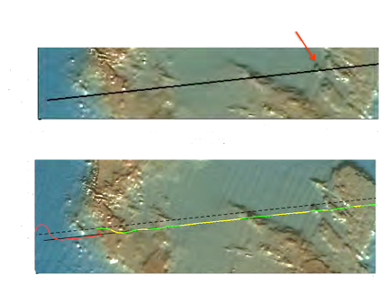
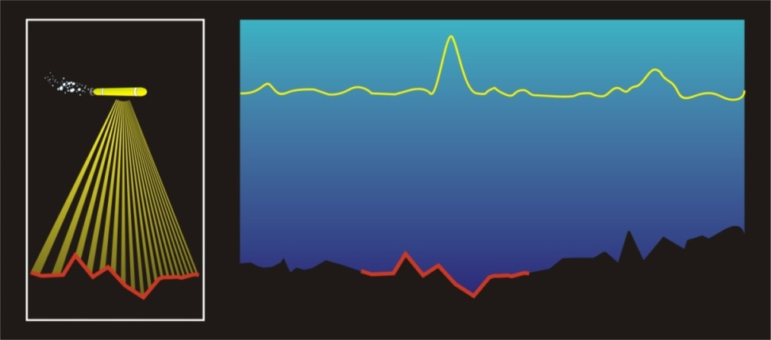
Terrain-Relative Navigation (TRN)
Trajectory specified in map coordinates (before dive)
Target boulder
Measurement
Likelihood Score
Filter converges
Trajectory without TRN correction
Terrain Map
Uses existing acoustic instruments (altimeter, DVL, multi-beam sonar)
Compare the time history of the depth profile with an on-board map
The accuracy of other navigation techniques degrades over time. This makes it difficult to return to a site, e.g. a rock pile
TRN figures out where you are with respect to the terrain
Slide courtesy of Dr. Steve Rock

Slide 5
Current Dorado navigation system:
  Kearfott INS (ITAR), best in class with a drift rate of +10m of drift every 10km
  Add typical map errors of 10s of meters
This is OK for planning and flying safe multibeam mapping missions with 50m standoff
Reactive obstacle avoidance or terrain-following uses forward and down-looking sonars to tell the AUV where it is relative to the terrain
Dorado AUVs have a ~ 15m turning radius
  Better start turning 15m before an obstacle
Stanford is working to provide a predictive, feed-forward control that should allow the AUV to start maneuvering even before it see’s the terrain change
Stanford is working to provide path planning for the best TRN performance

Slide 6
Dorado Fast-Sim can now work with real terrain
  Vehicle must be following the simulated path for it to be valid
Spoiler alert (preview of Rock’s presentation tomorrow)
Stanford is working to provide a predictive, feed-forward control that should allow the AUV to start maneuvering even before it see’s the terrain change
Stanford is working to provide path planning for the best TRN performance

Slide 7
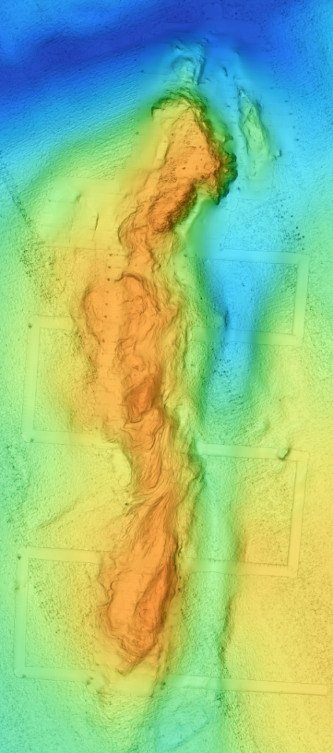
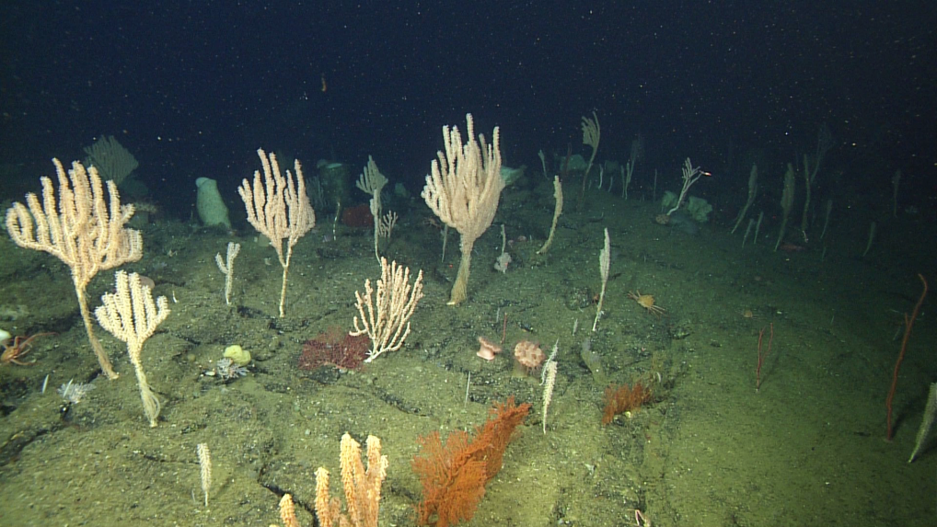
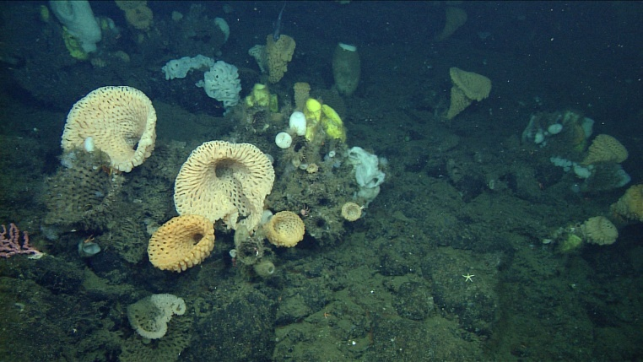
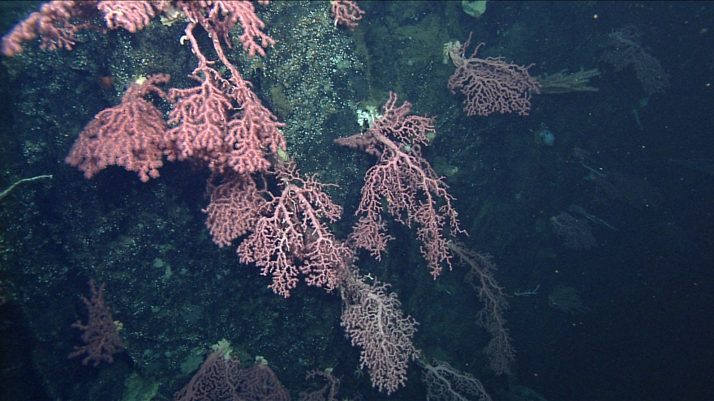
Sur Ridge Coral Community Ecology
Bamboo Corals
Strong Spatial Patterns
Mixed Sponges
Bubblegum Corals
Jim Barry’s Slide

Slide 8
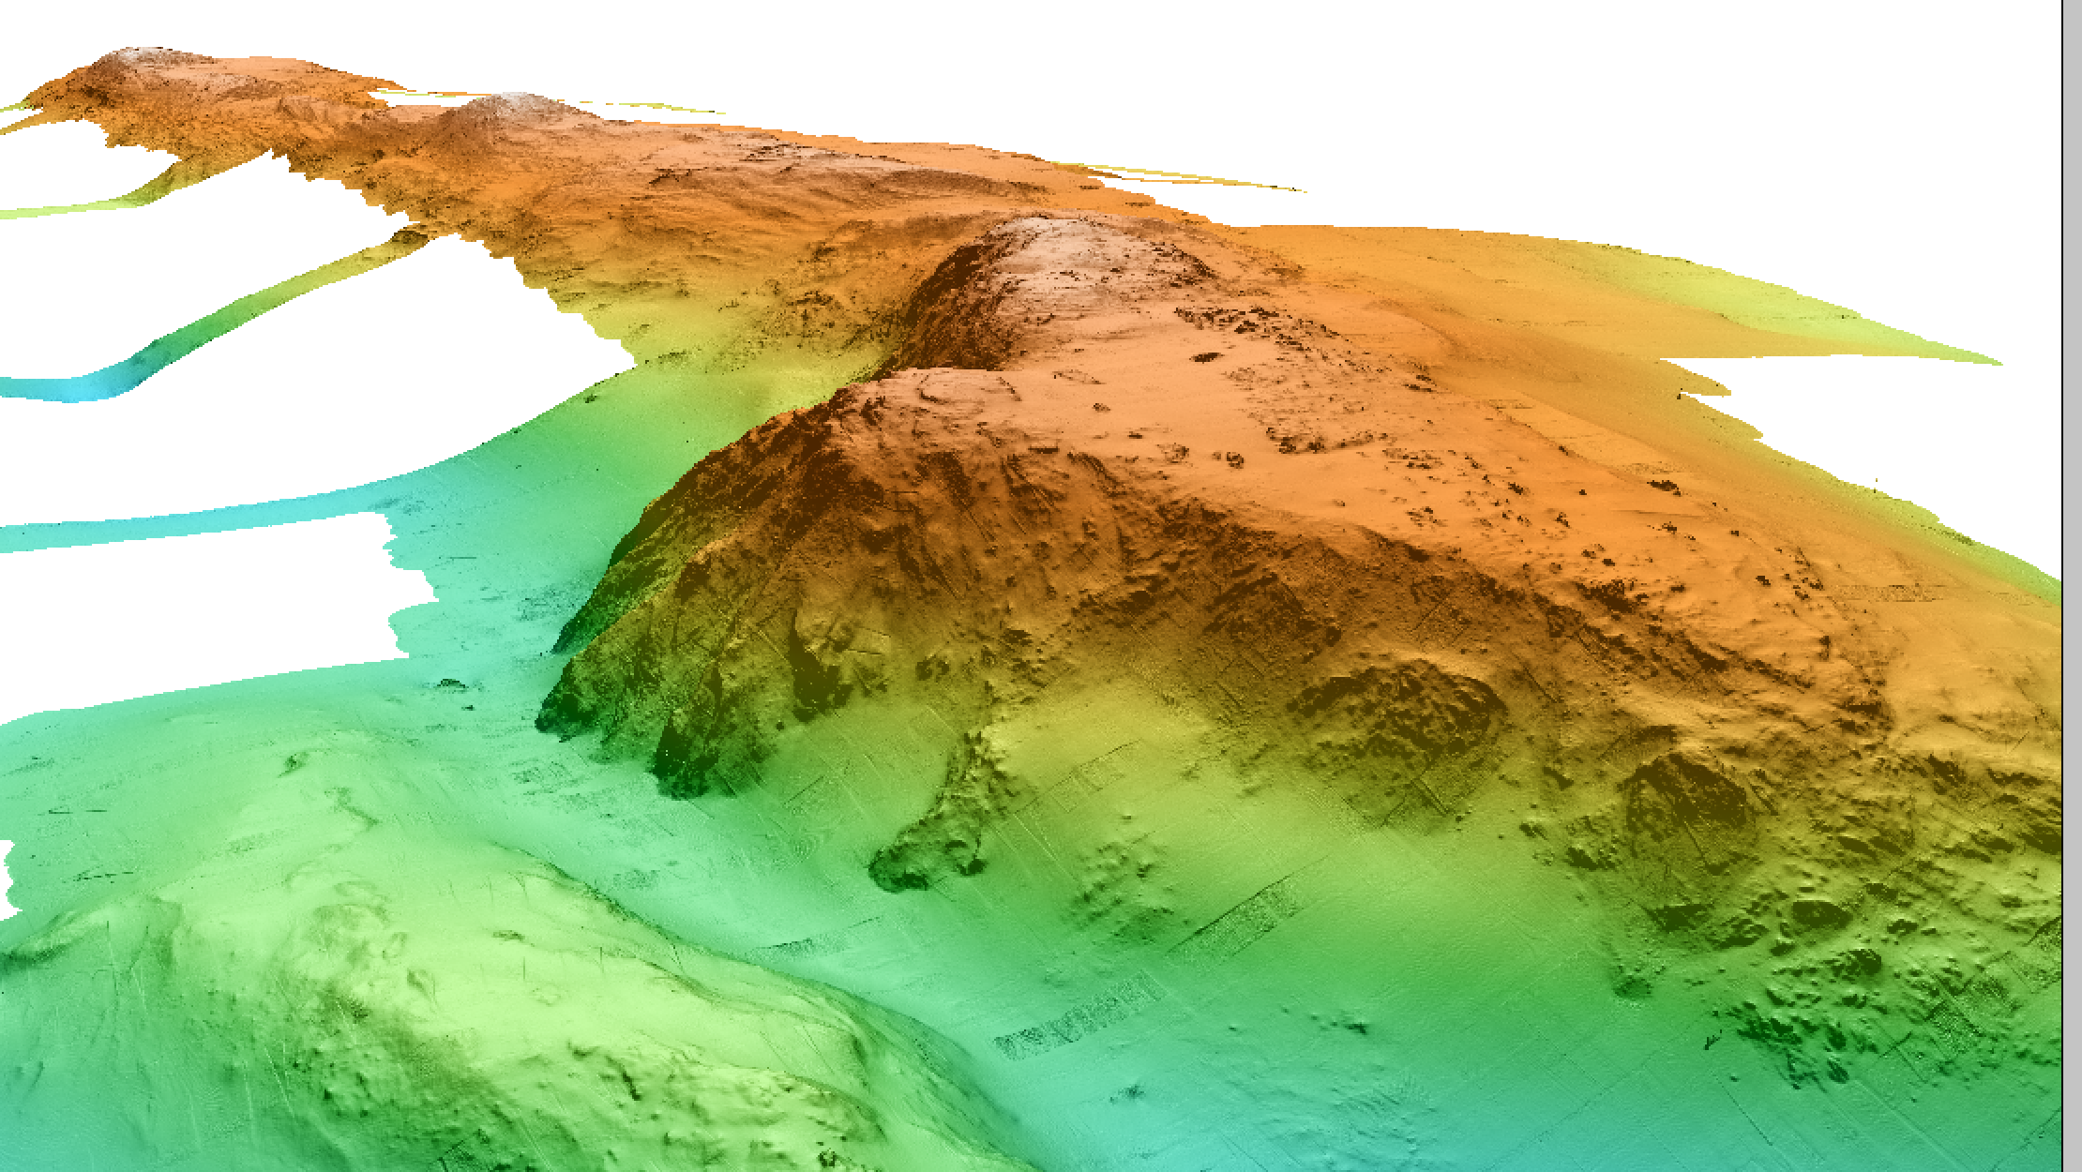
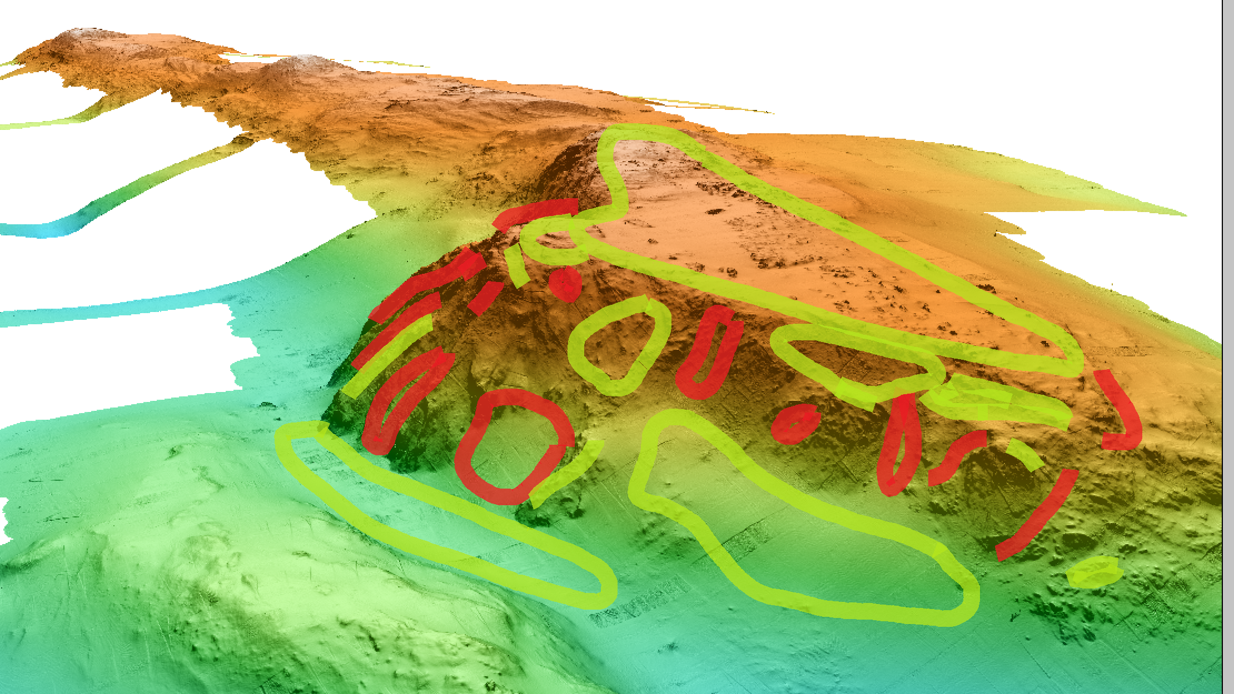
Exploring Sur Ridge with a Dorado AUV

Slide 9
Portuguese Ledge Test Site
Portuguese Ledge test site

Slide 10
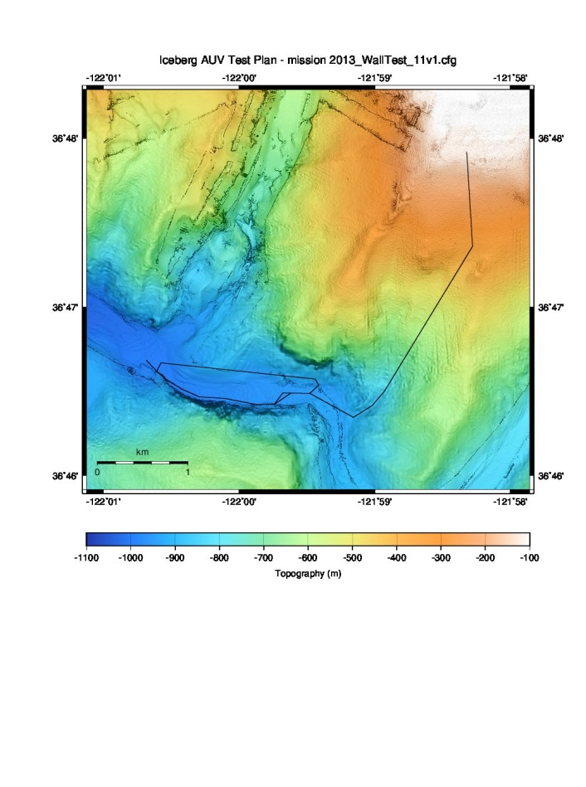

Slide 11
1m limit cycle: 4m altitude = 3 to 5m
5m max color imaging altitude
  3m is much better
Don’t crash – AUV and ancient corals aren’t happy
36,000 images from 10 hr mission along 36 km
Add monochrome camera for higher altitudes
Add structured light lasers for bathymetery and scaling

Slide 12
End

Slide 13
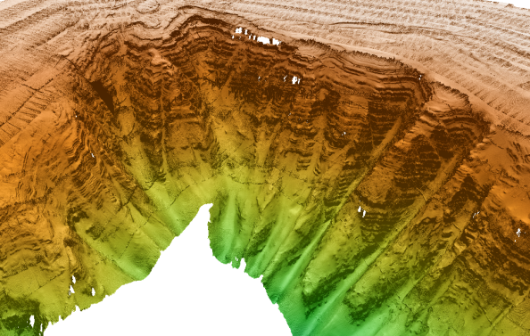
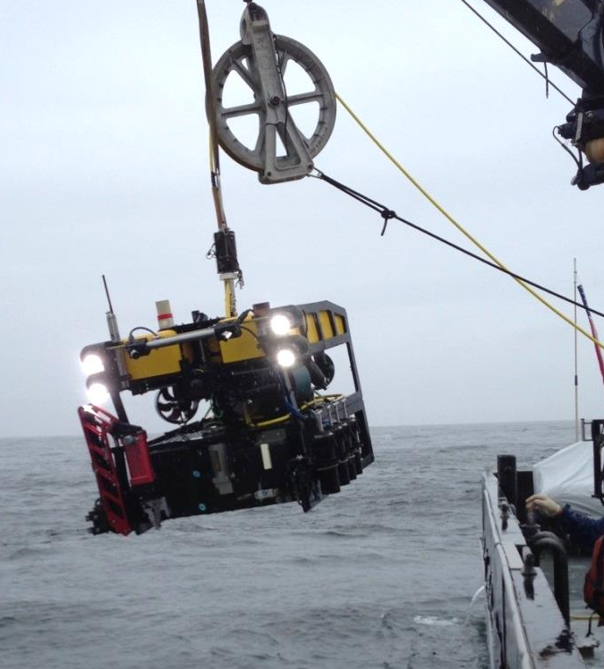
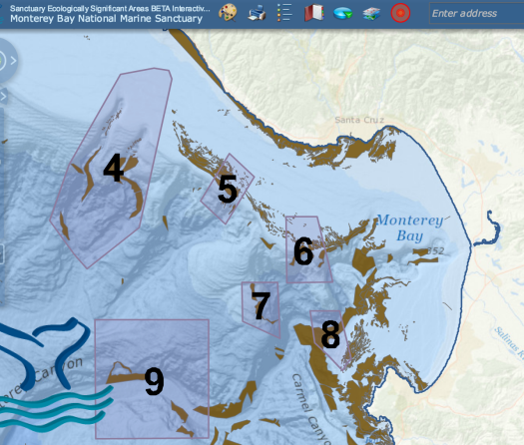
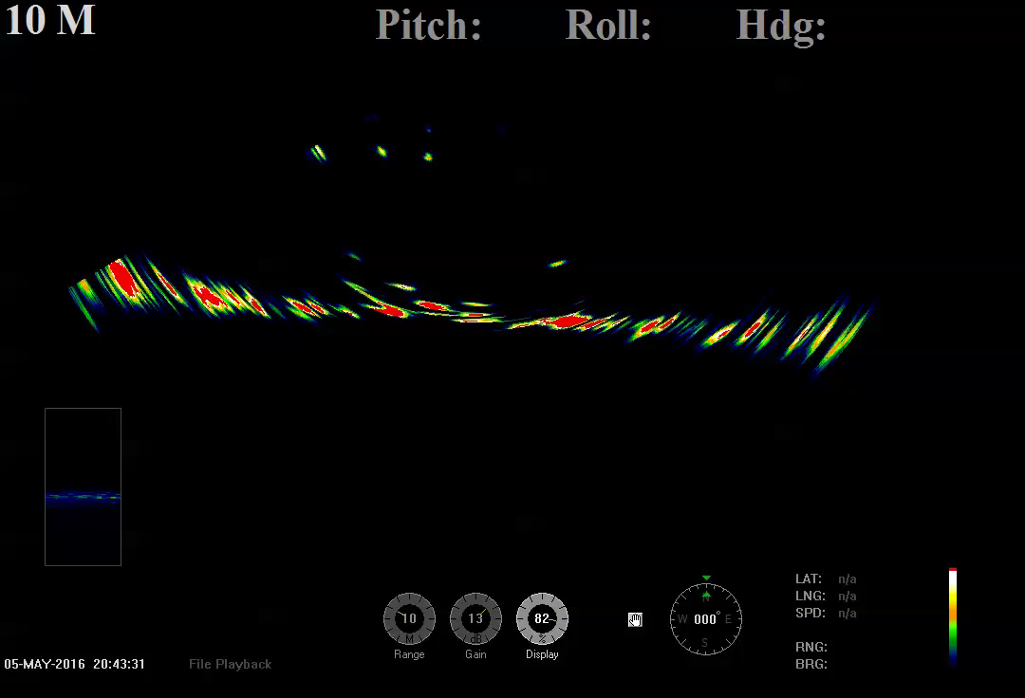
2016 Field Trials
Used Mapping AUV to generate a High resolution map of a suspected deep rockfish habitat
  in a Sanctuary Ecologically Significant Area (SESA)
Deployed MBARI’s “low-cost” MiniROV
  Improved maneuverability, imaging, navigation
  Employed TRN to determine map offset for precise navigation
  Imaged/counted fish in the water column followed by visual ID
    Low-cost swath sonar for fish detection

