Slide 1
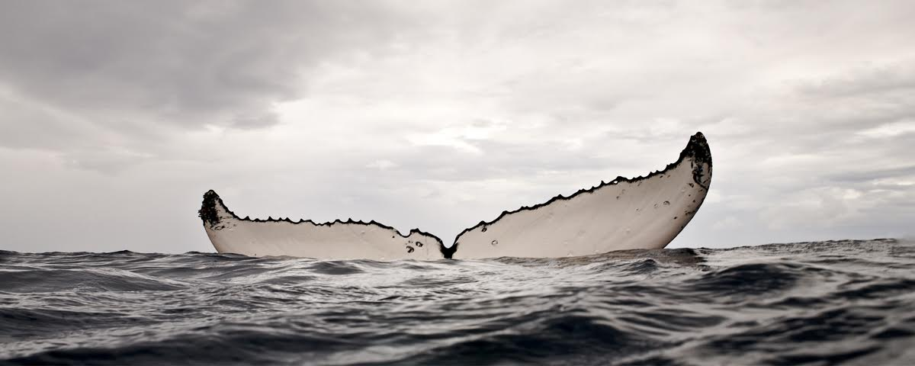
Entering a world of sound
Photo: Bryant Austin, studio: cosmos

Slide 2
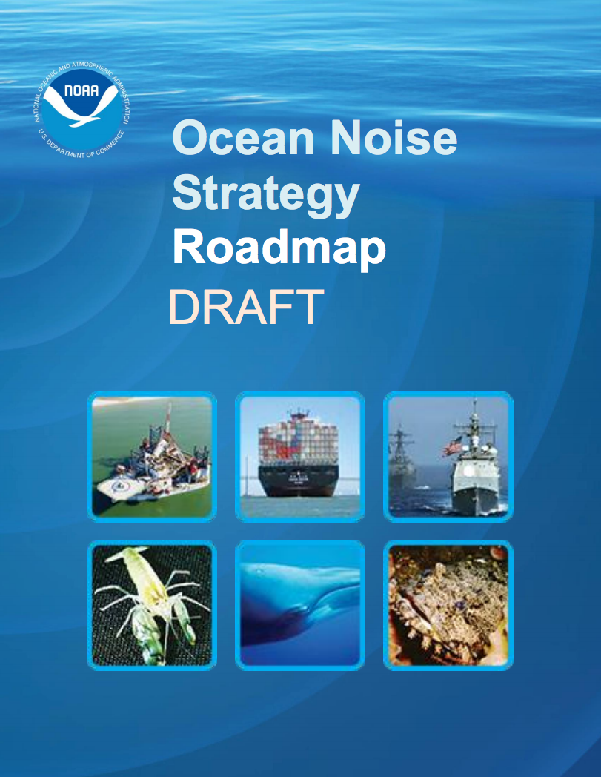
A formative time for ocean noise policy
… enhance NOAA’s ability to manage species and the places they inhabit in the context of a changing acoustic environment
… National Marine Sanctuaries represent key NOAA assets to achieve the ecological goals of acoustic habitat protection

Slide 3
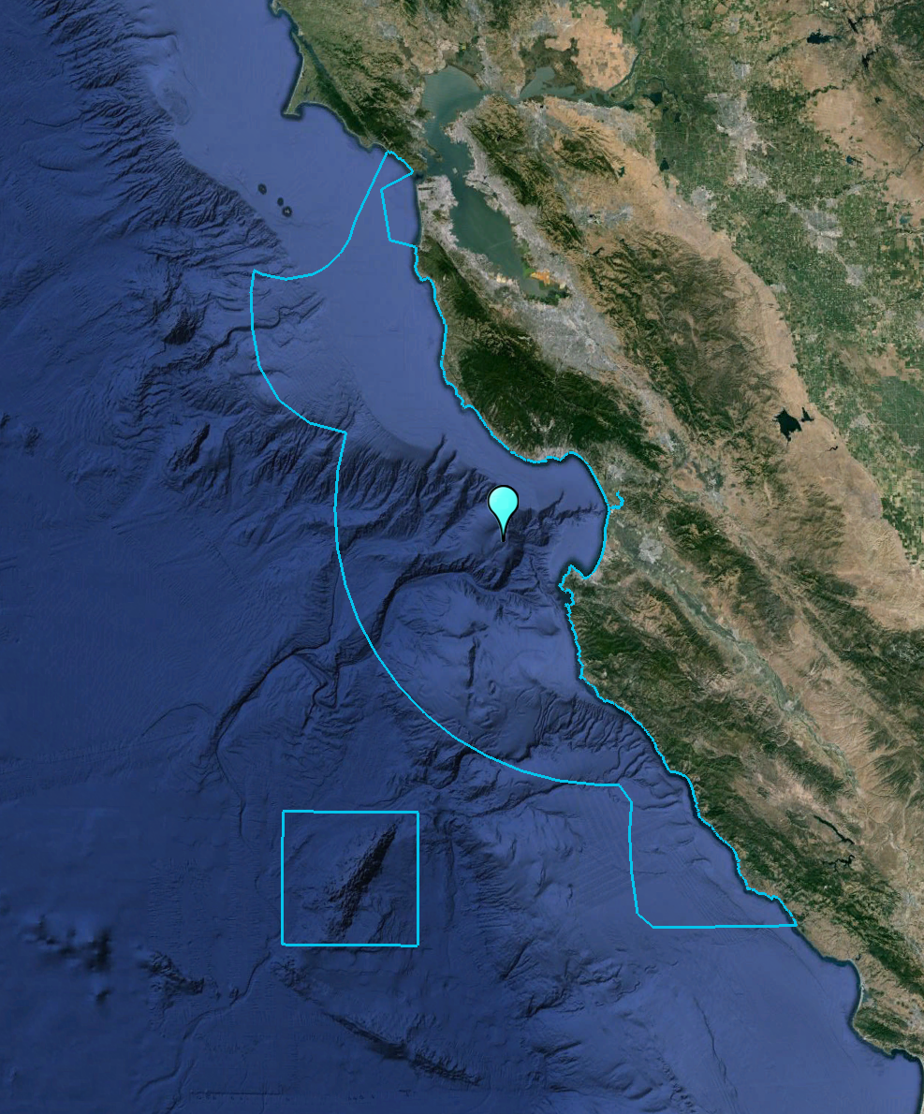
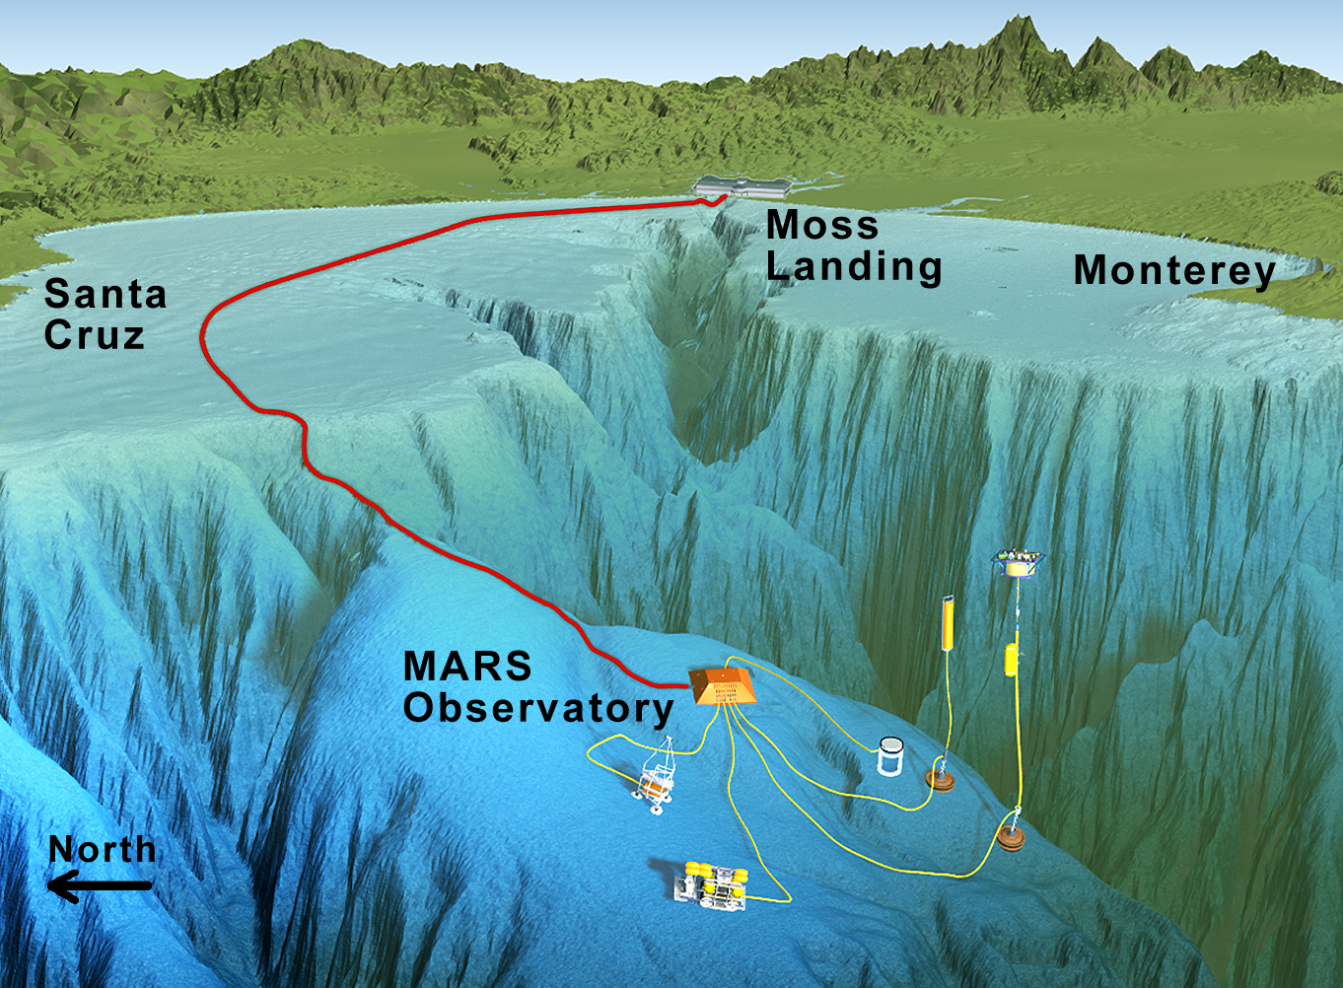
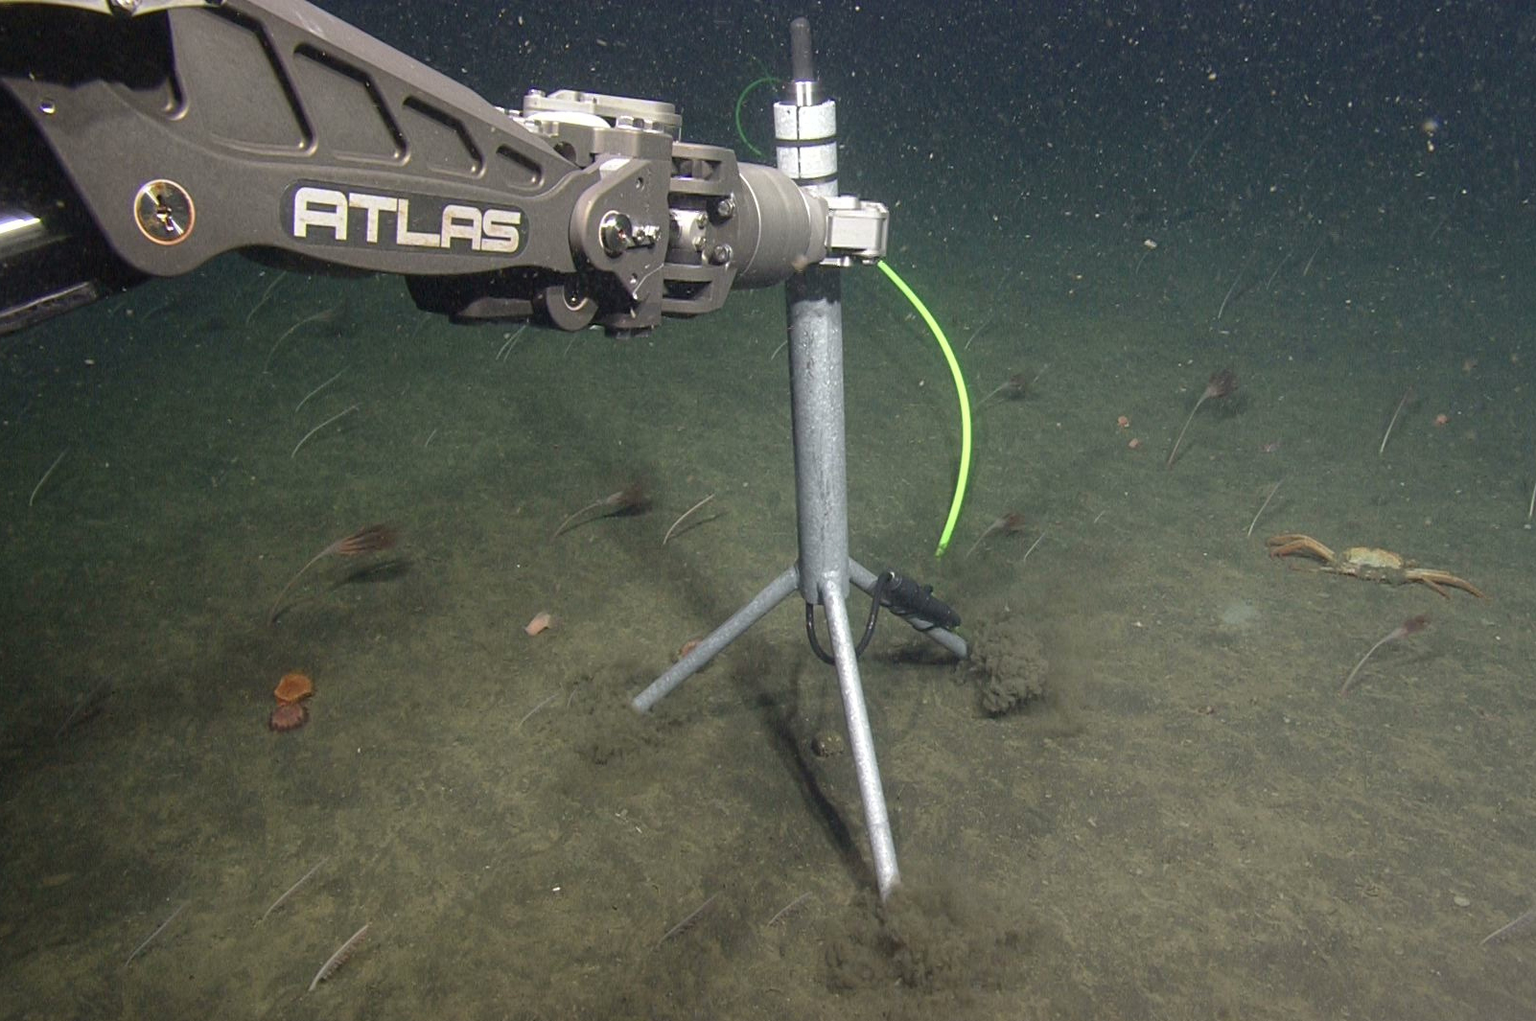
Listening to the Sanctuary Soundscape
July 28, 2015
Hearing range: nearby to hundreds of kilometers

Slide 4
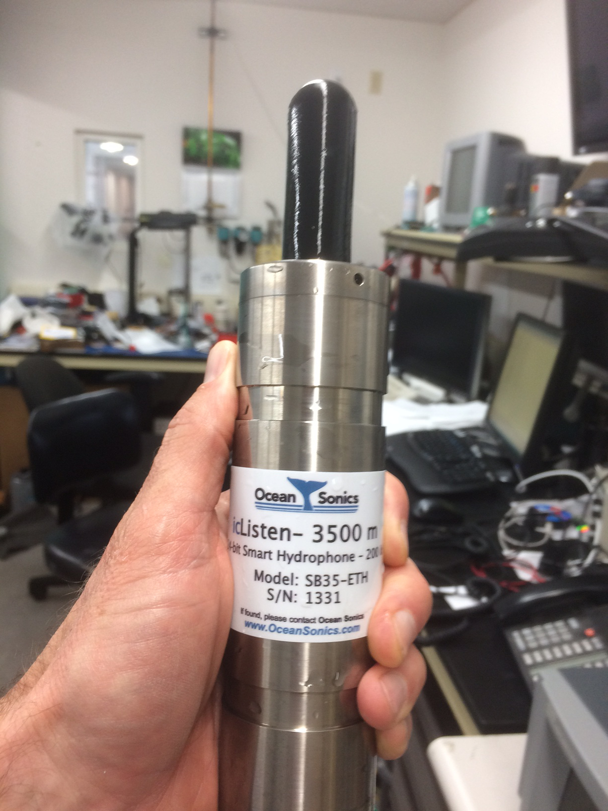
Little hydrophone, big data (2 TB / month)
Challenges
robust recording
routine processing
automated detection and classification
live listening

Slide 5
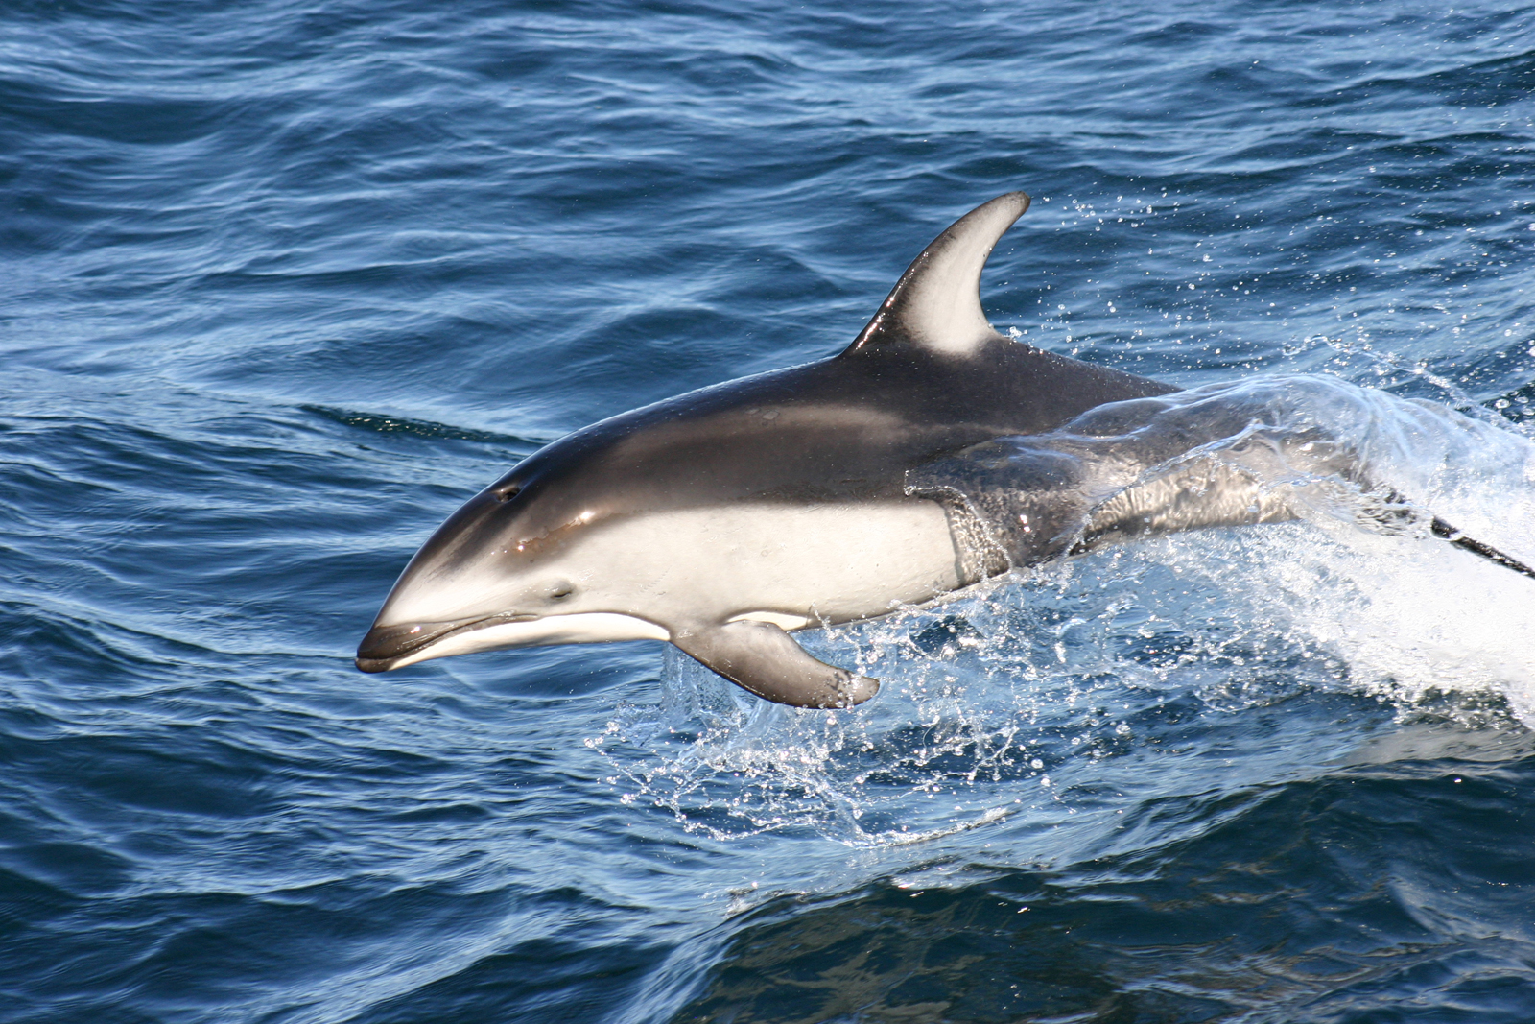
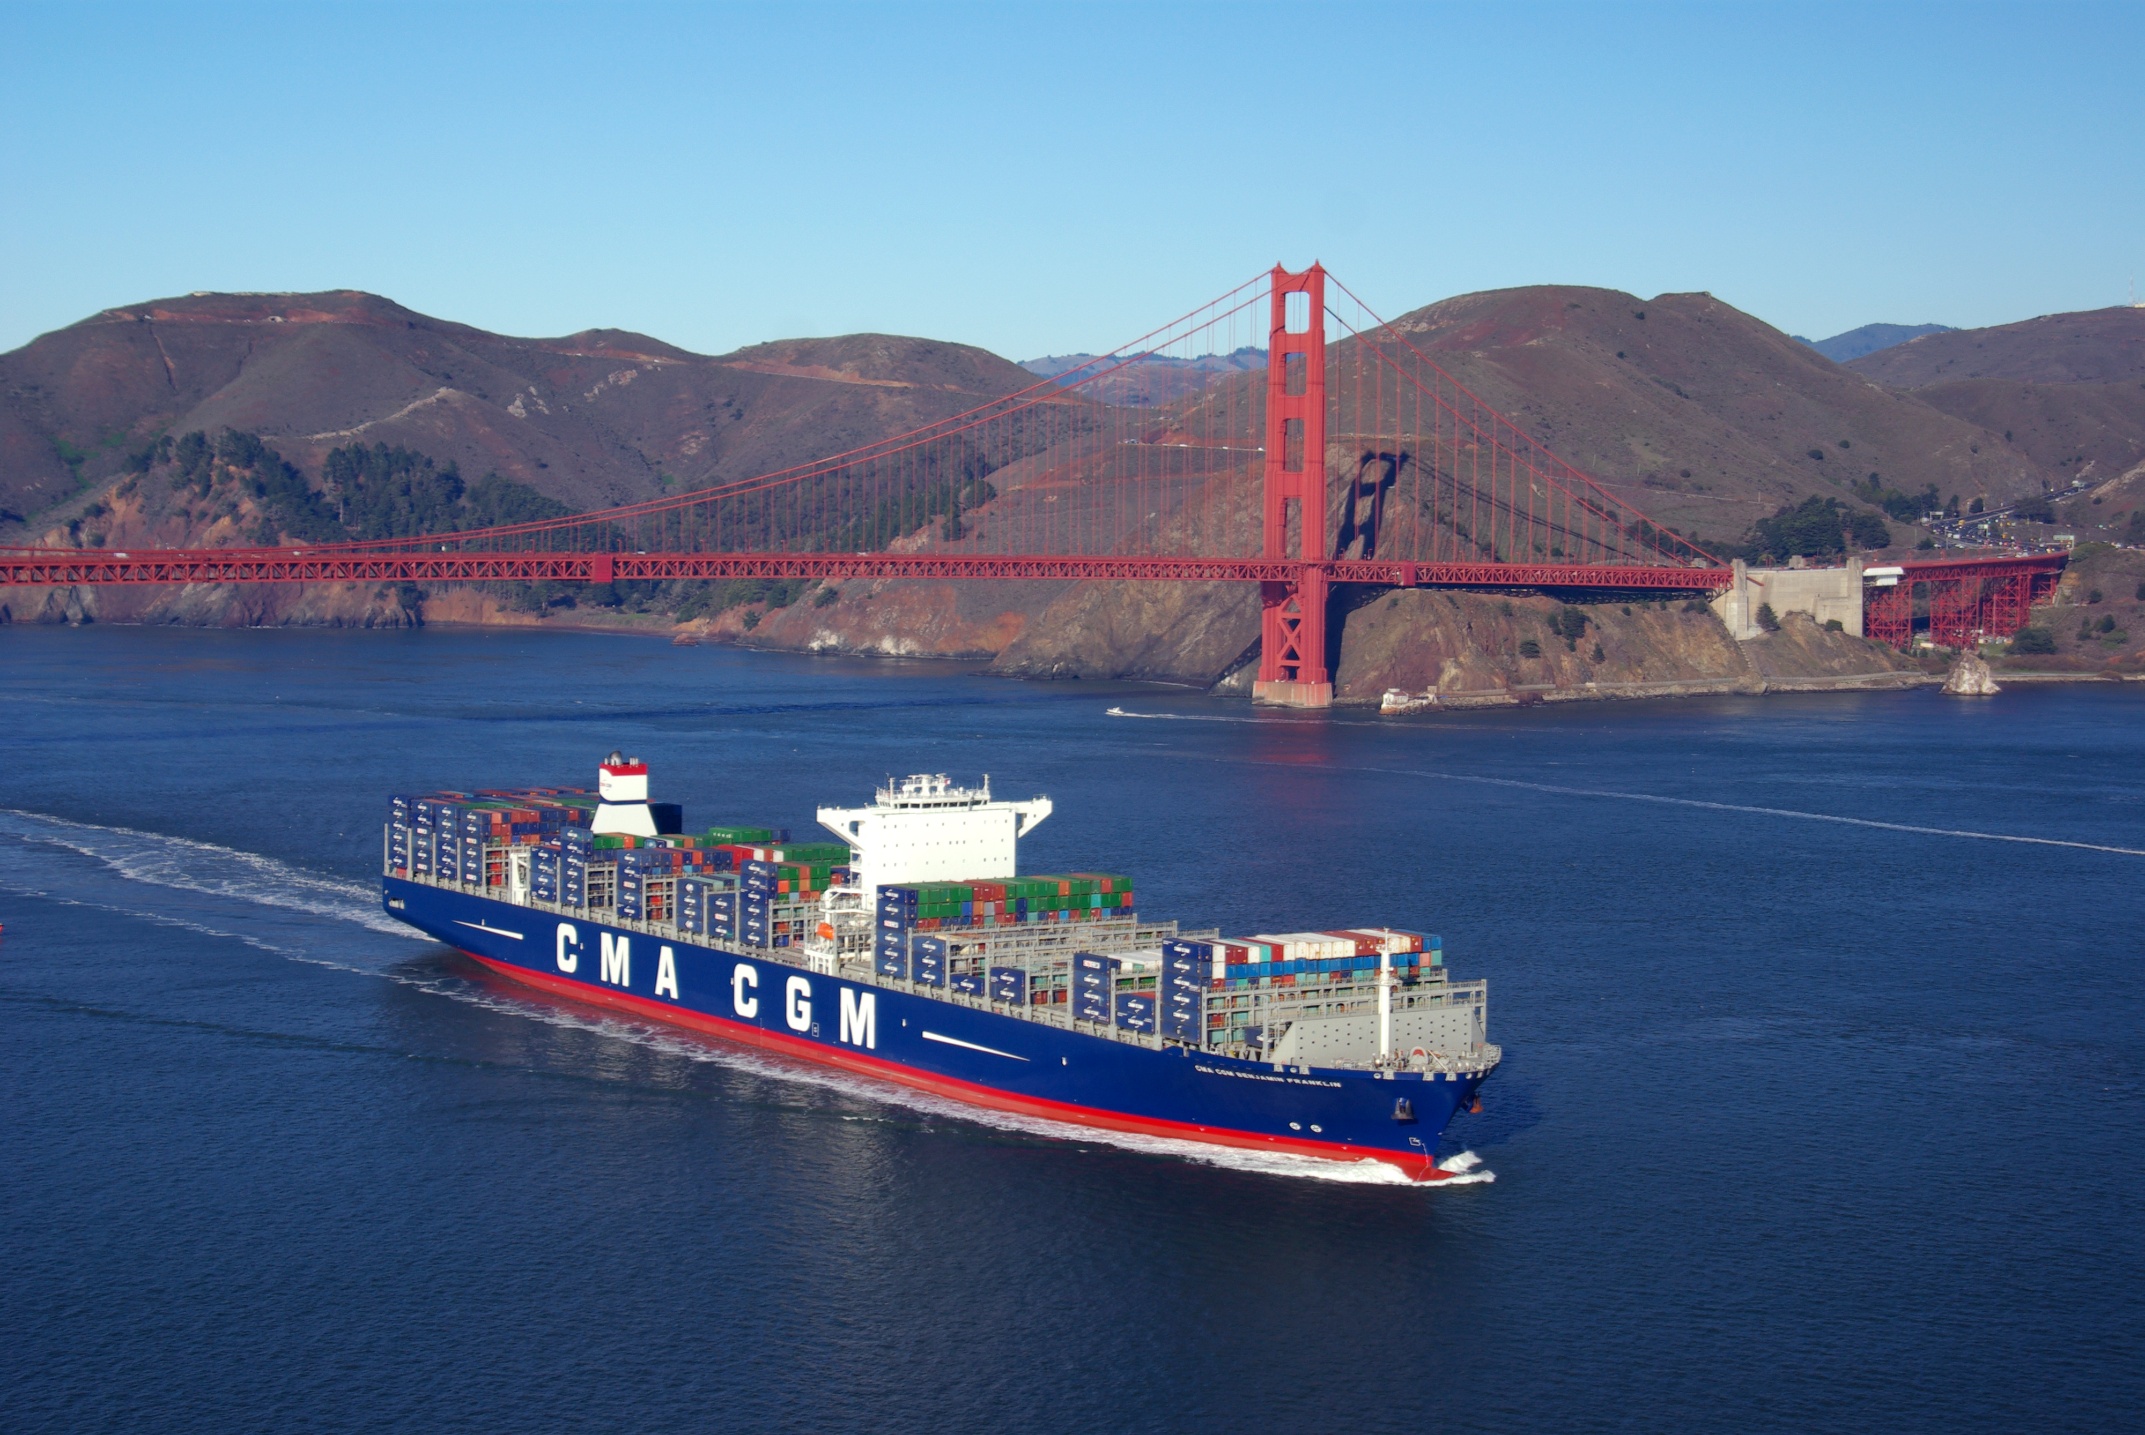
Project goals
NOAA
Port of Oakland
Research: Understand (a) the presence and activity of marine mammal species, some of which cannot be studied with visual methods, (b) relationships to ecosystem variation, and (c) the nature and consequences of anthropogenic noise.
Education: Enrich educational programs with Sanctuary Soundscape recordings.

Slide 6
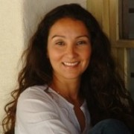
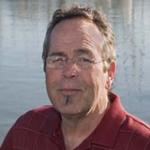
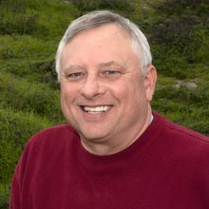
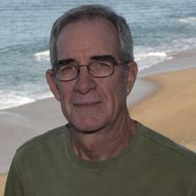
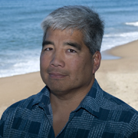
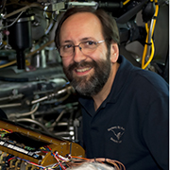
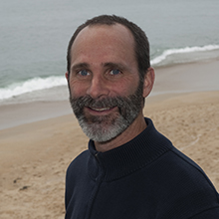
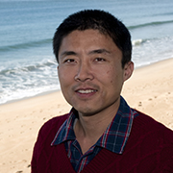

Project team
MBARI
Danelle Cline
Craig Dawe
David French
Ken Heller
George
Matsumoto
Paul McGill
John Ryan
Yanwu Zhang
Collaborators
Hopkins Marine Station: Jeremy Goldbogen, Dave Cade
Independent researchers: Marjolaine Caillat, Mark Fischer
Moss Landing Marine Laboratories: Alison Stimpert
Naval Postgraduate School: John Joseph, Tetyana Margolina
NOAA/MBNMS: Andrew DeVogelaere, Lisa Uttal
Scripps: Simone Baumann-Pickering, Anna Meyer Loebbecke, Jennifer Tricky
UCSC: Brandon Southall

Slide 7
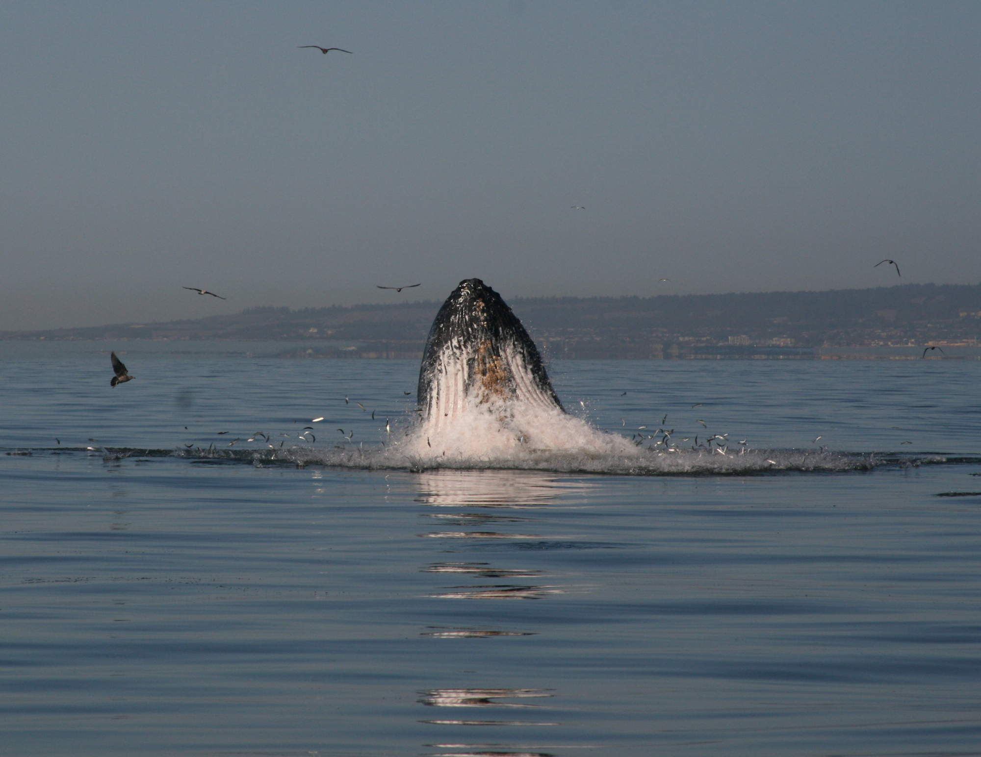
Forage species, foragers, foraging ecology
Packard Foundation West Coast Strategic Plan (2013) and MBARI Technology Roadmap (2014)
Forage species (krill, small pelagic fishes, squid) serve a crucial role, linking primary producers to the food web, and therefore to climate-driven variability.
Protecting forage species stocks from overharvesting supports broader ecosystem needs. This requires advancing understanding and prediction.
Photo: Erich Rienecker, MBARI

Slide 8
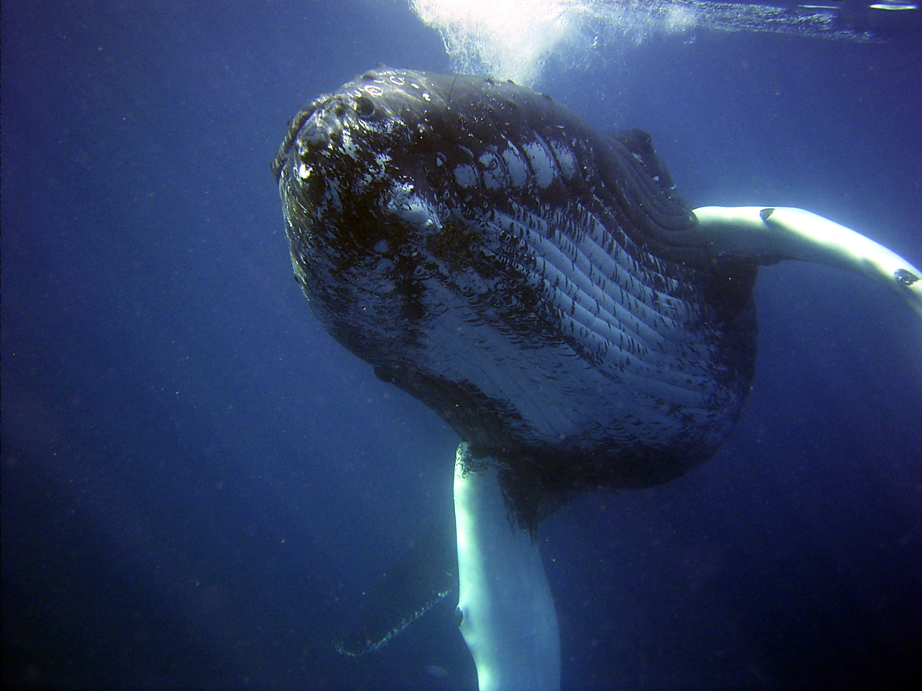
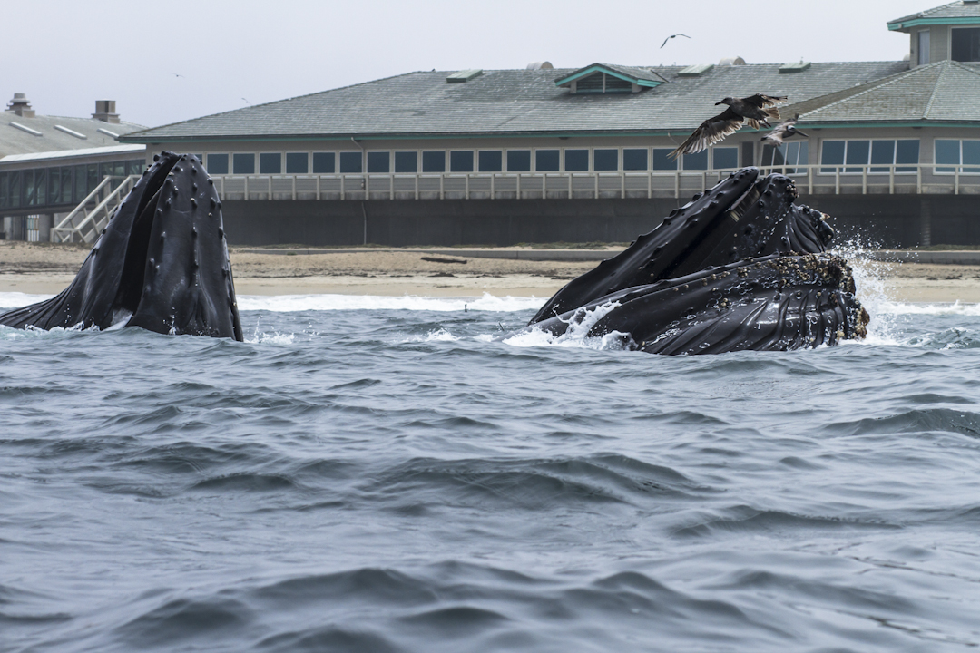

Voices @ MARS: humpback whale
Photo: NOAA
Photo: Alan Gonzales
Humpback whale
4 populations endangered or threatened; 10 populations, including Eastern North Pacific, not listed under ESA (NOAA)
life span up to 80 years
adults ~ 50 ft / 60,000 pounds, phenomenally agile and acrobatic
gestation: 11 – 12 months
forage: krill and schooling fish
foraging hotspot very close to MBARI recently (Pennington et al., 2015)
use of bubble nets to forage
fin structure inspired engineering of wind turbine blades

Slide 9
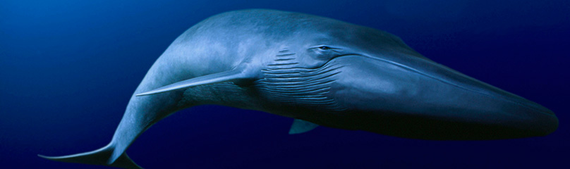
Voices @ MARS: blue whale
Calls:
D•A•B
Photo : World Wildlife Fund
Blue whale
endangered, ~ 15,000 individuals
globally, the eastern North Pacific hosts greatest concentration
life span 80 – 90 years
adults up to ~ 100 ft / 380,000 pounds
gestation: 11 – 12 months (birth announcement: 25 ft, 3,000 pounds)
nursing calf gains 200 pounds / day
forage: krill, can eat up to 8000 pounds in a day
foraging hotspot along shelf break in Monterey Bay region (Croll et al., 2005)

Slide 10
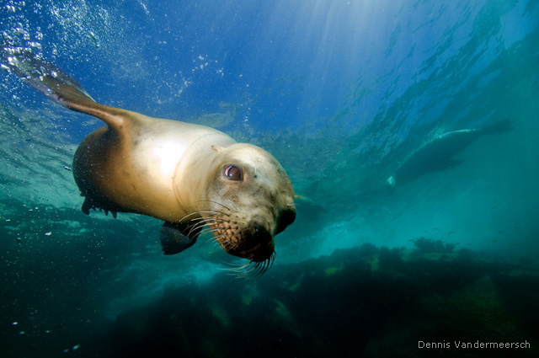
Voices @ MARS: marine mammal communities
NOAA
NOAA

Slide 11
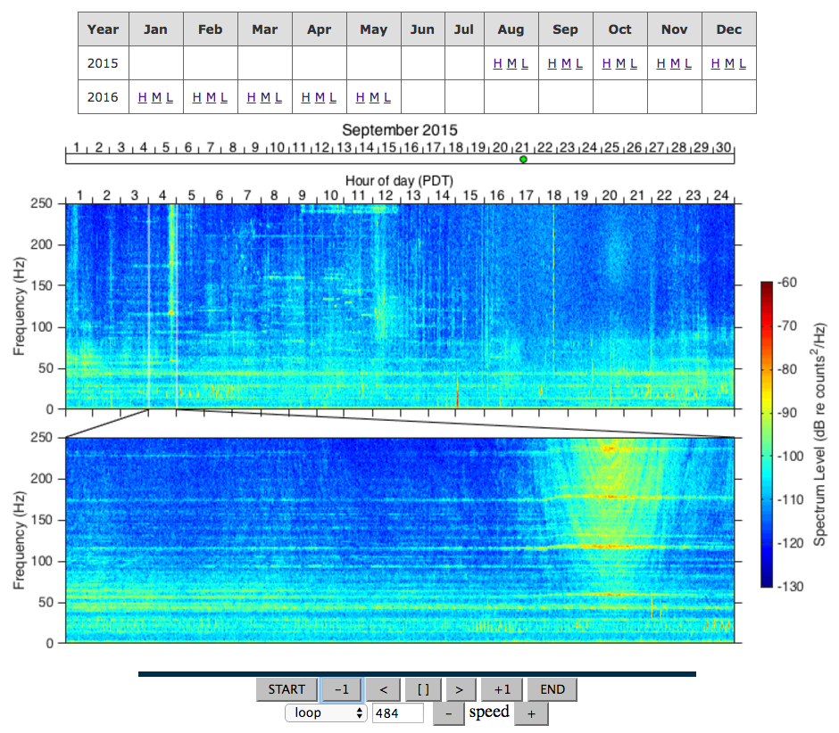
Soundscape visual browsing

Slide 12
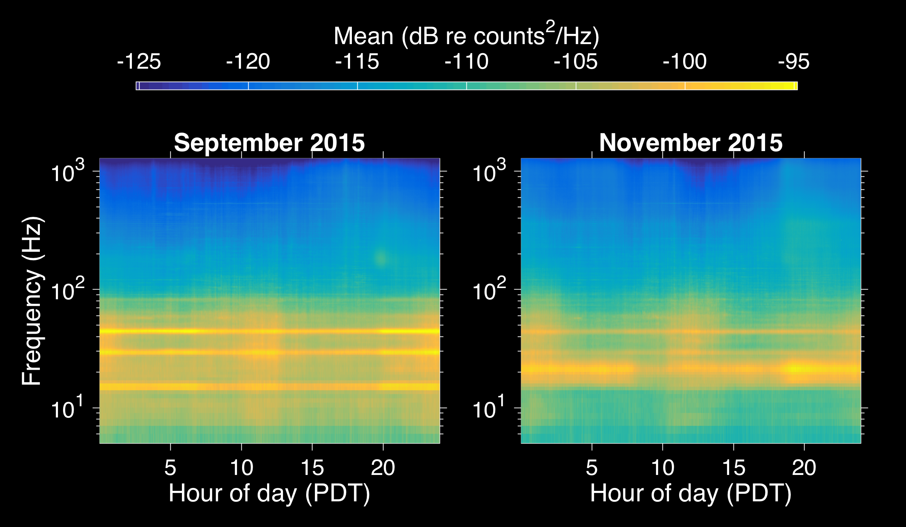
Soundscape statistical analysis
Fin whale
Blue whale
Notes:
Each of these plots can be described as an average day of sound energy during that month. Averaging for the whole month, while retaining reference to time of day, reveals the dominant frequencies at which vocalizations were occurring (which species were present and vocal). This example indicates a shift of the dominant signal from Blue whales to Fin whales between September and November. This analysis also reveals variations related to time of day (diurnal and semidiurnal patterns evident here).

Slide 13
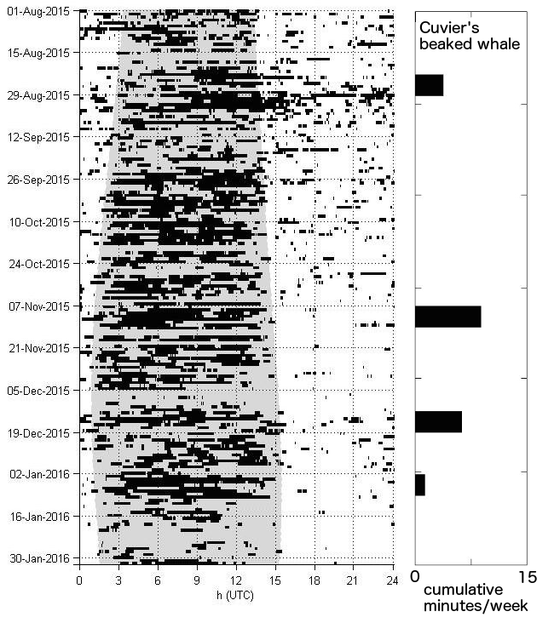

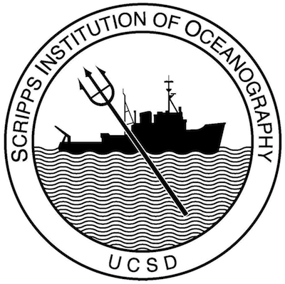
Soundscape analysis by human experts
Unidentified odontocetes (left)
Cuvier’s beaked whale (right)

Slide 14
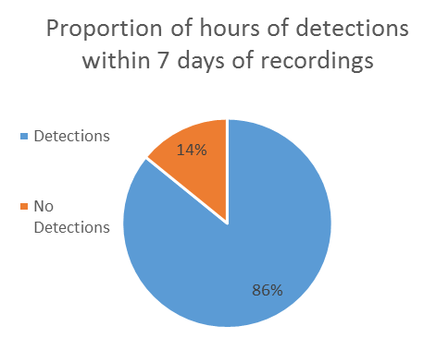


Soundscape analysis by human experts
50 hours labor for initial analysis of 168 hours of recordings.
4 hours labor for detailed analysis of 10 minutes of recordings, focused on clicks of beaked whales and delphinids.

Slide 15
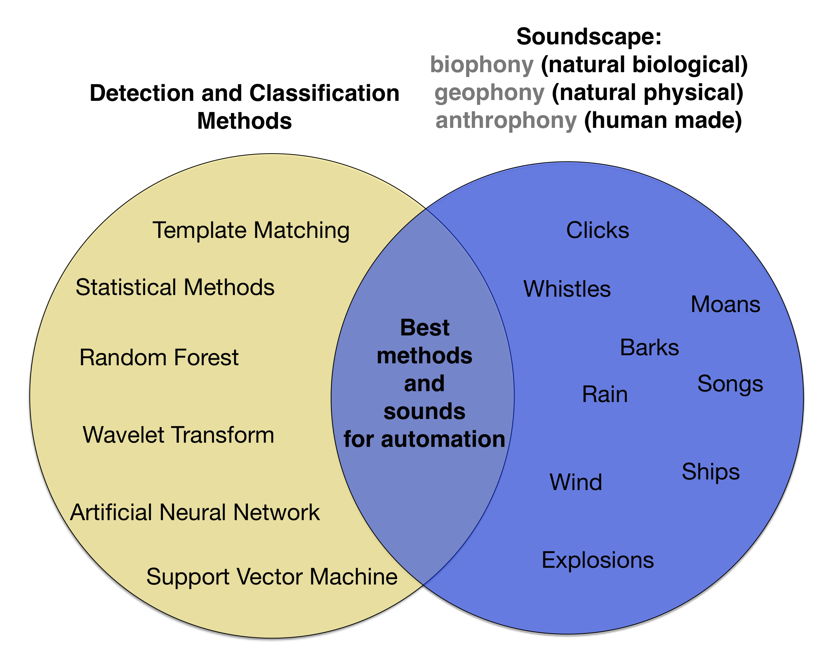
Automated detection and classification

Slide 16
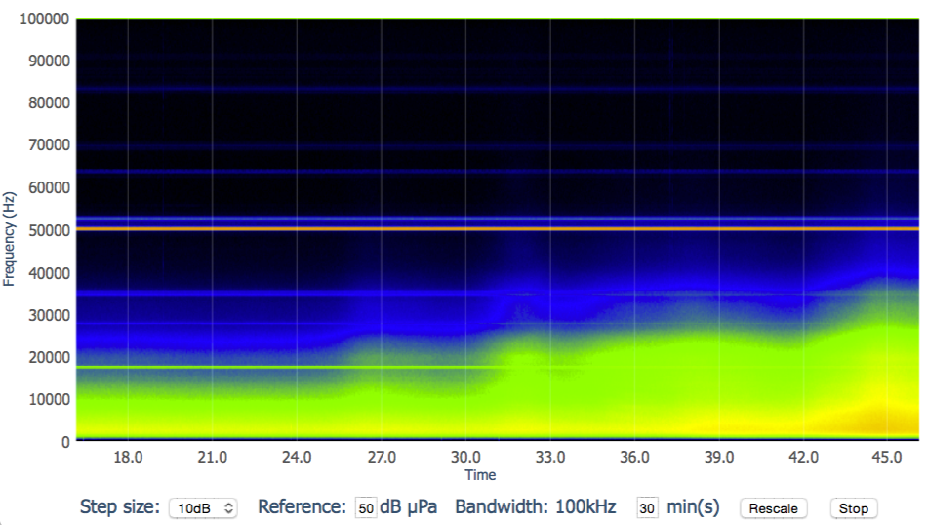
Raindrops keep falling on my sea surface
March 21, 2016 3:48 PM, email from Paul McGill:
The current spectrogram shows rain squalls headed our way (I think).

Slide 17
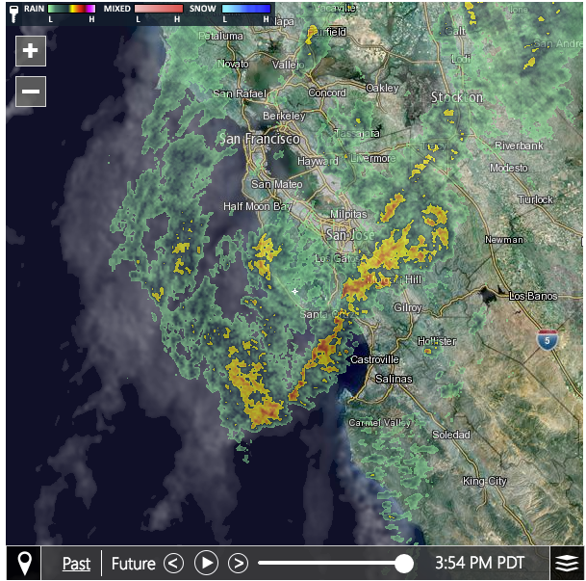
A squall, indeed
… and 25 minutes later, it was raining on MBARI.

Slide 18
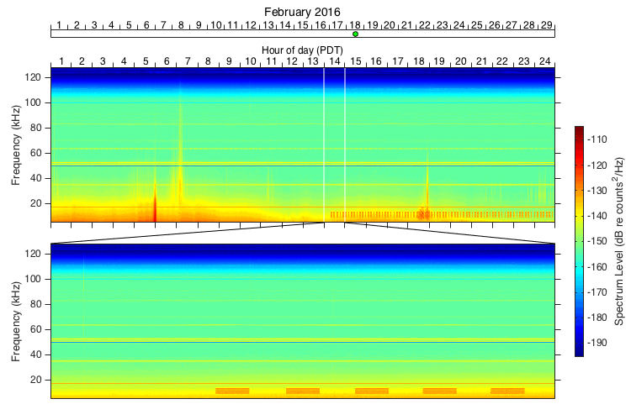
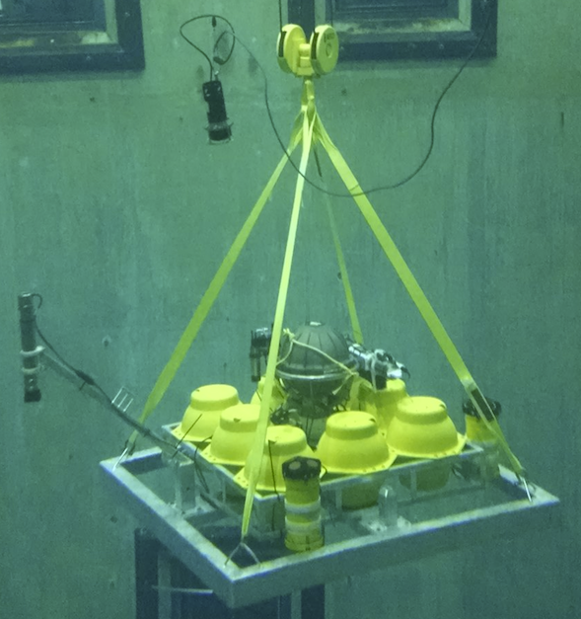
Aiding marine operations
Benthic Instrument Node
Photo: Tom O’Reilly
February 18, 2016, email from Danelle Cline:
Something strange in the spectrogram right now…
Problem solved using Wave Glider
Notes:
* The MARS hydrophone began recording regular, periodic acoustic transmissions beginning February 18, 2016. This was reported to the the Coordinated Canyon Experiment team for investigation.
* Examination of the hydrophone recordings showed that the transmissions were from a Benthos modem whose address matched the modem on BIN 1, deployed at 1800 m depth. Intervention was required to avoid excessive battery drain on the BIN.
Acoustic communication with BIN 1 using Wave Glider revealed that the BIN was repeatedly rebooting following failure to start one of the instruments (ADCP). This also allowed modification of the configuration to stop the reboot problem.
The WaveGlider-based intervention allow the BIN to function correctly, continuing to collect data and avoid battery drain.

Slide 19
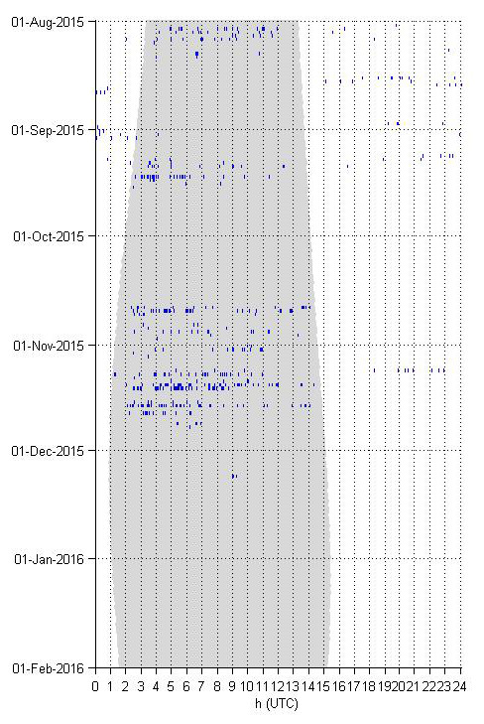
Anthropogenic noise: explosions
August 2015: 448
September 2015: 486
October 2015: 386
November 2015: 976
December 2015: 11
January 2016: 1
Total: 2308

Slide 20
Anthropogenic noise: shipping
Port of Oakland

Slide 21
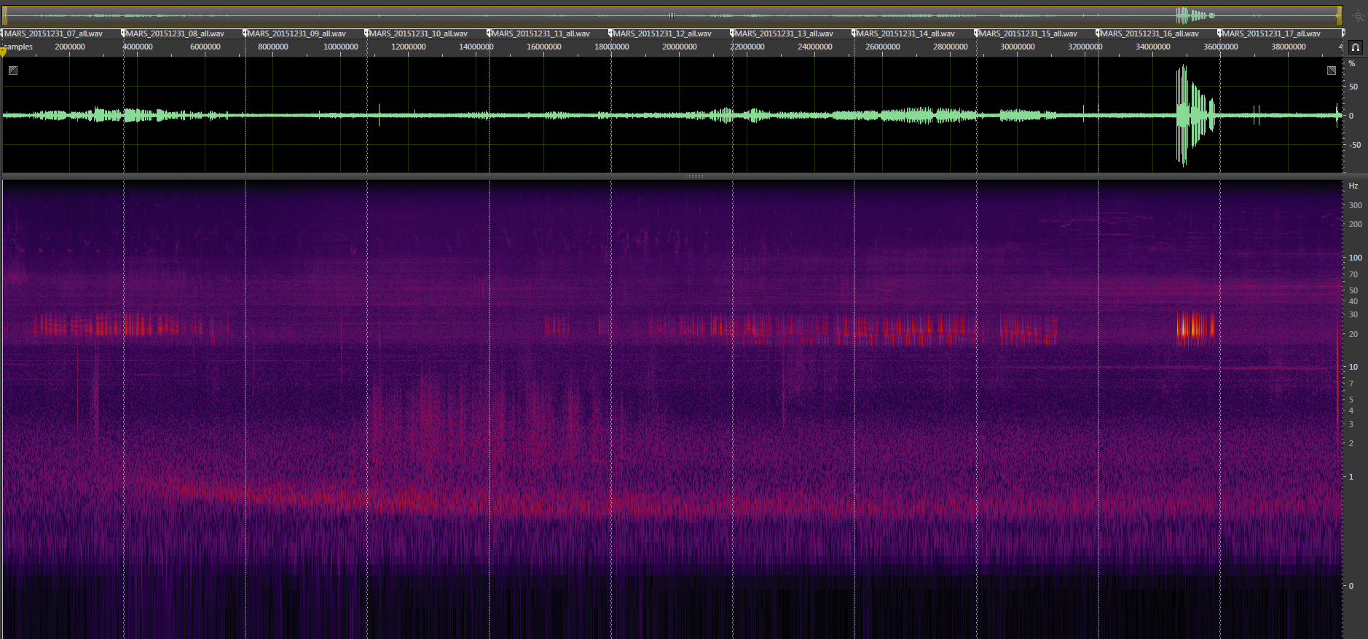
Anthropogenic noise: shipping
100
Fin whales
Frequency (Hz)
10
1
Container vessel
Mark Fischer, Aguasonic Acoustics
1 2 3 4 5 6 7 8 9 10
Hour of day, 31 December 2015
Working with National Marine Sanctuary Program and MBNMS (L. Hatch, A. DeVogelaere, M. Caillat) toward comparative analysis of noise in different regions

Slide 22
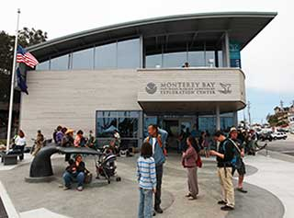
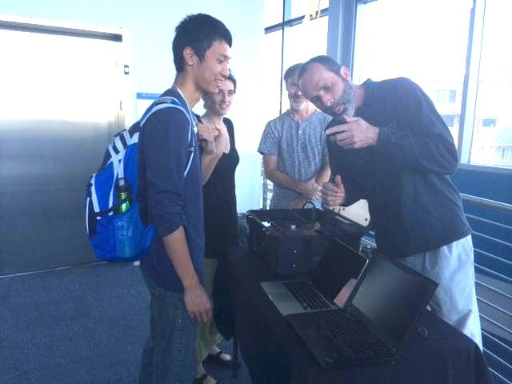
Education & Outreach
First public outreach at NOAA Exploration Center in Santa Cruz on 27 February 2016. To be repeated this month.
MBARI summer intern projects on detection / classification of blue & fin whales (summer 2015), beaked whales (summer 2016)
Supporting student projects at Stanford, NPS, and Scripps
Providing recordings to California State Parks PORTS program, which reaches > 50k students / year through telepresence programs.
Discussing exhibit contributions to Monterey Bay Aquarium (Eric Nardone and Mike Chamberlain), NOAA Exploration Center, PG Museum

Slide 23
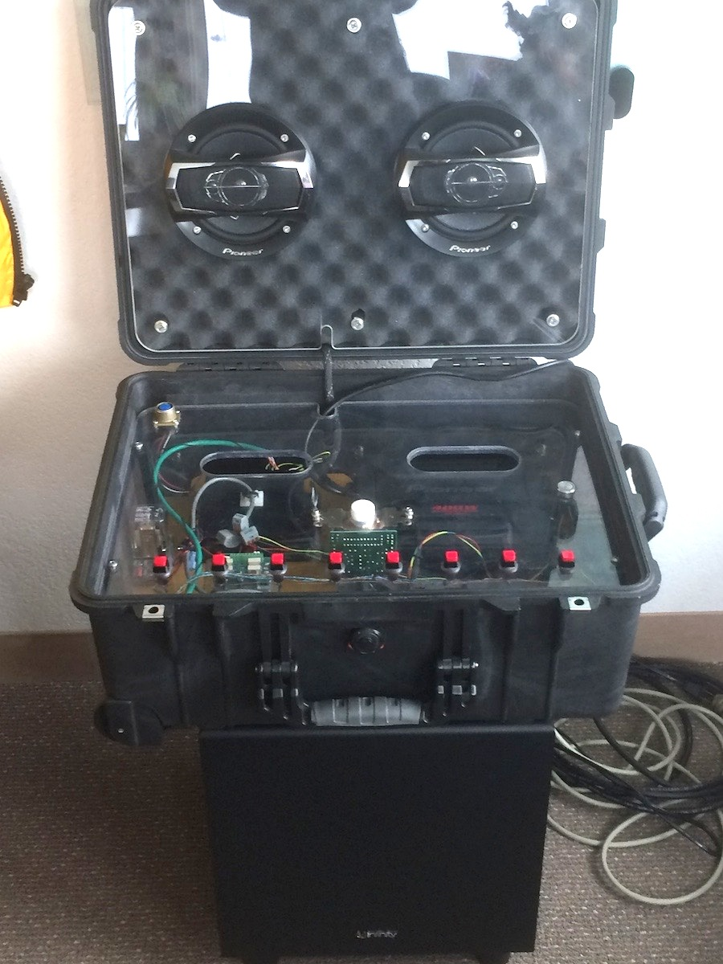
Soundscape mobile exhibit
Example sounds of the Sanctuary
Blue whale
Fin whale
Humpback whale
Pacific white sided dolphin
Mixed community: delphinids, pinnipeds, whale
Dolphin clicks
Beaked whale clicks (slowed to be audible)
Anthropogenic: fishery “seal bombs”
Mid & high range speakers
1 2 3 4 5 6 7 8
subwoofer
Built by David French and Mike Conway

Slide 24
Summary from a scoping study
Listening in the heart of Monterey Bay National Marine Sanctuary offers tremendous opportunities:
research
education and outreach
supporting the Marine Sanctuary mission at regional and national levels

