Slide 1
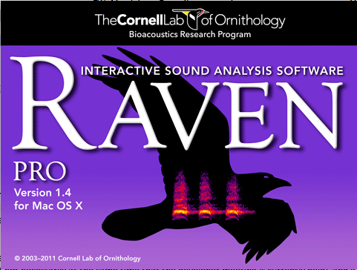
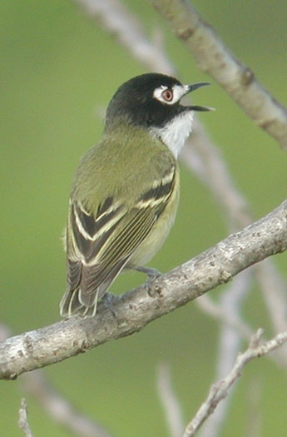
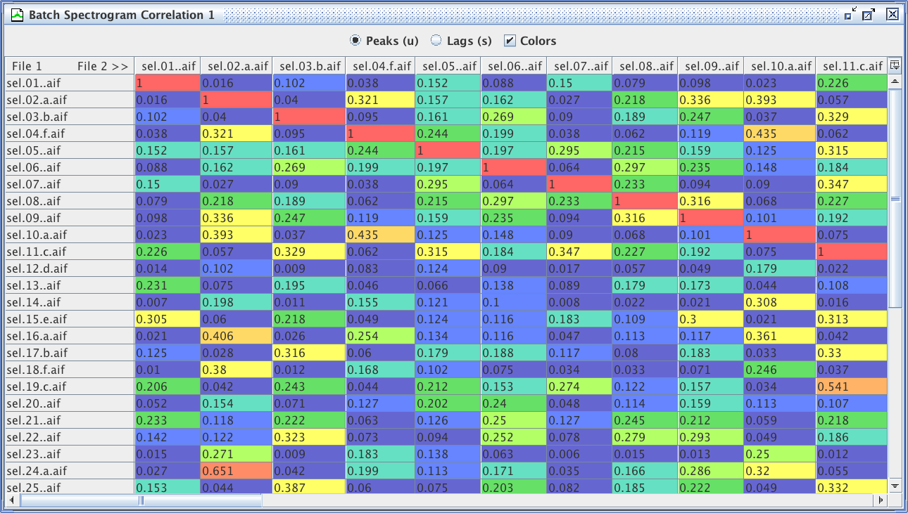
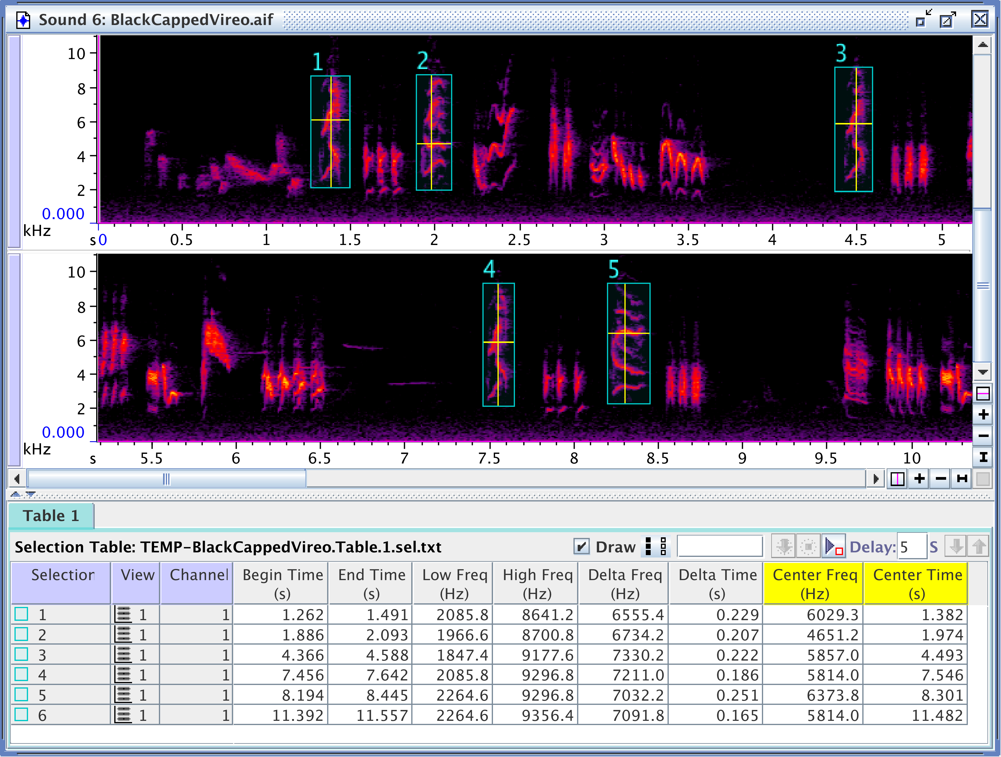

Sound Analysis Workshop
Ithaca, NY
3 – 7 April 2017
© 2007-17, Cornell Bioacoustics Research Program
Bioacoustics Research Program

Slide 2
Questions about animal sounds
How can I describe or characterize a newly discovered sound?
How do the sounds of species X vary geographically?
How does a sound used in a particular behavioral context encode biologically important information (e.g., age, social status, “quality”)?
Are sounds of different populations or individuals more or less similar to each other based on proximity, genetic relatedness, etc.?
Can I detect the presence of species X at a site by its sounds?
Can I count the sounds of a target species to infer relative density, abundance, or passage rate?
...

Slide 3
Workshop roadmap
What we want to do:
What we use:
Describe
Spectrograms
Measure
Measurements
Compare
Spectrogram correlation
Find
Automated detectors
Count

Slide 4
Schedule overview
Monday
Introductions; Why are you here?
Raven orientation
Intro to digital sound and spectrograms
Intro to Raven measurements
Intro to SWIFT autonomous recorder
Tuesday
More on spectrograms
More on measurements (including decibels)
Automated detection in Raven
Customizing Raven
Wednesday
Annotating and reviewing selections
Intro to spectrogram cross-correlation
Statistical approaches for comparing sounds (overview)
Raven view linkage
Thursday
Small-group and 1:1 sessions; SWIFT data review
Questions, review, topics of interest
Friday
Small-group and 1:1 sessions
Questions, review, topics of interest
Wrap-up: revisit opening questions
Notes:
- keep informal

Slide 5
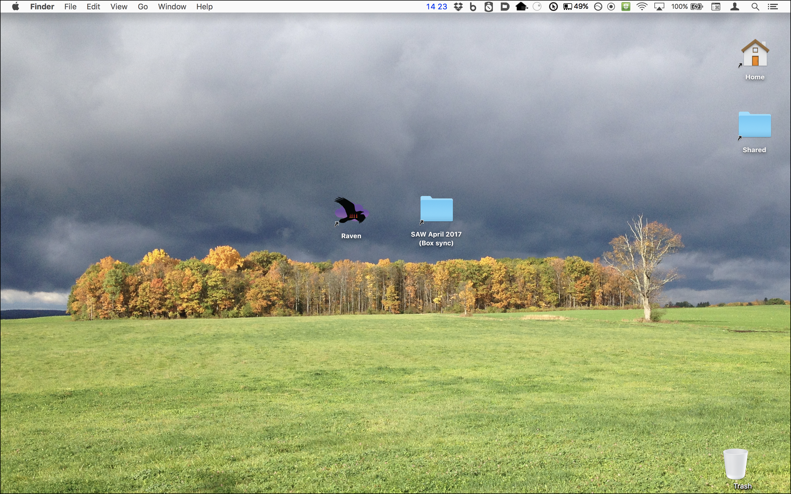
Logistics
“SAW April 2017 (Box sync)” folder
THIS IS A SHARED FOLDER –
DO NOT MOVE ANYTHING OUT OF IT!

Slide 6
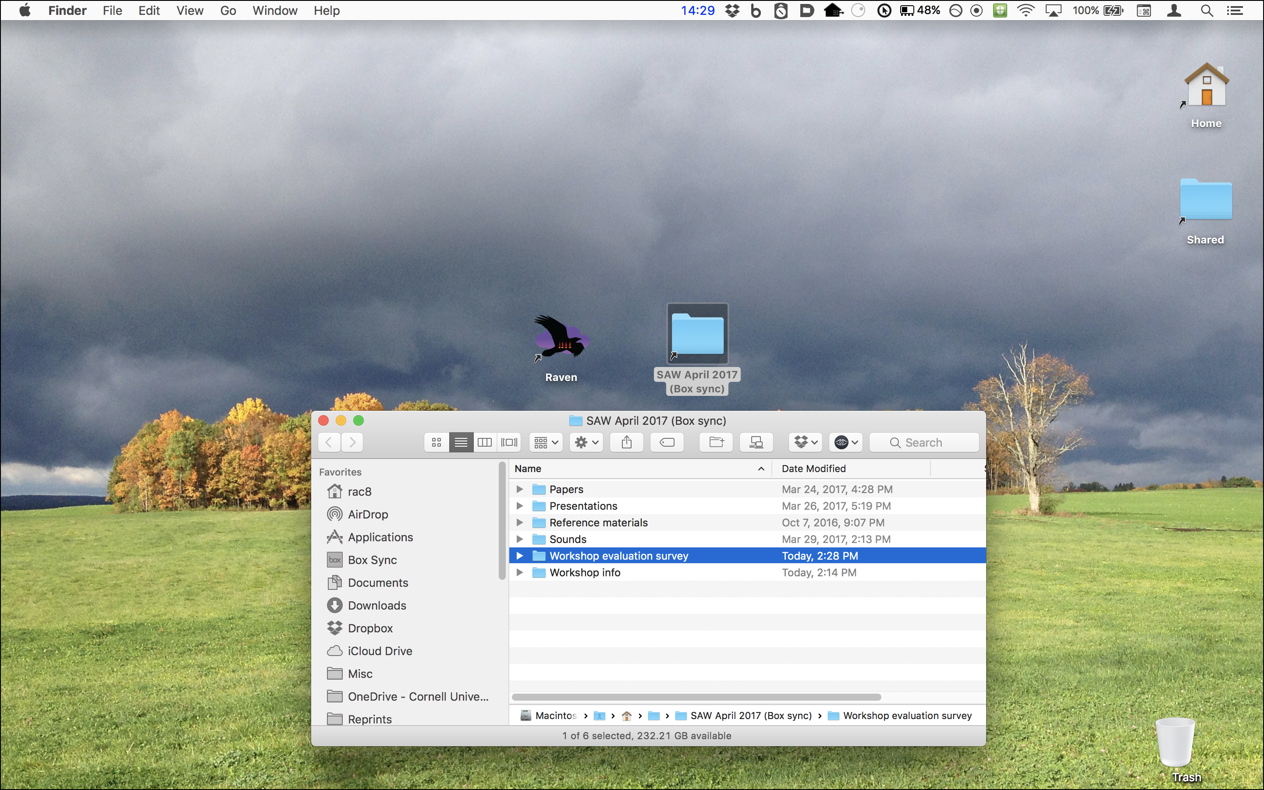
Logistics
“SAW April 2017 (Box sync)” folder
THIS IS A SHARED FOLDER –
DO NOT MOVE ANYTHING OUT OF IT!

Slide 7
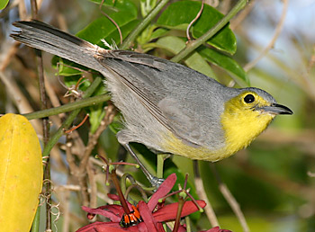
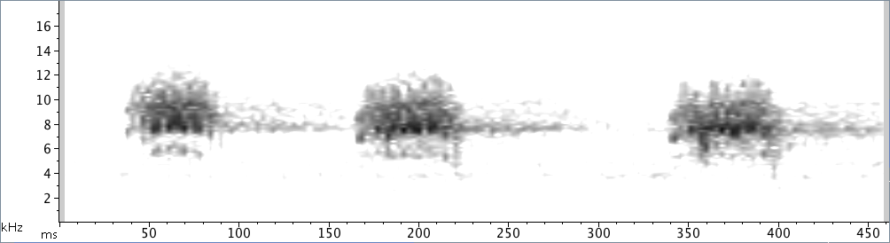
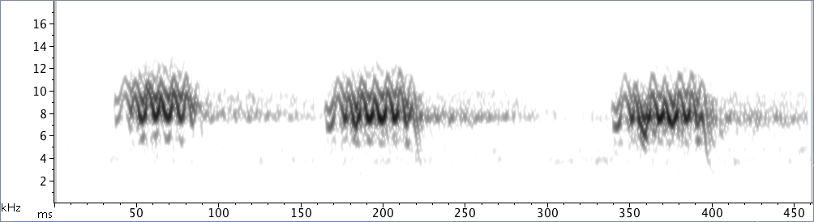
Spectrograms
Oriente warbler
surfbirds.com
1/10 speed:

Slide 8
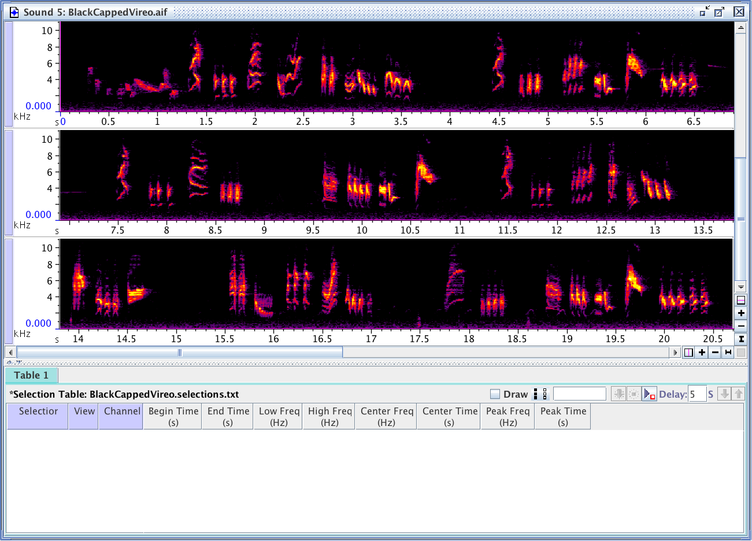
Measurements

Slide 9
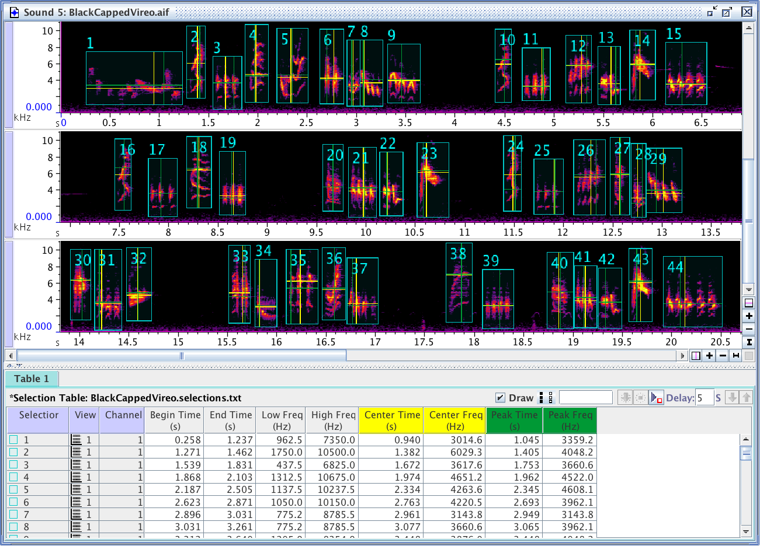
Measurements

Slide 10
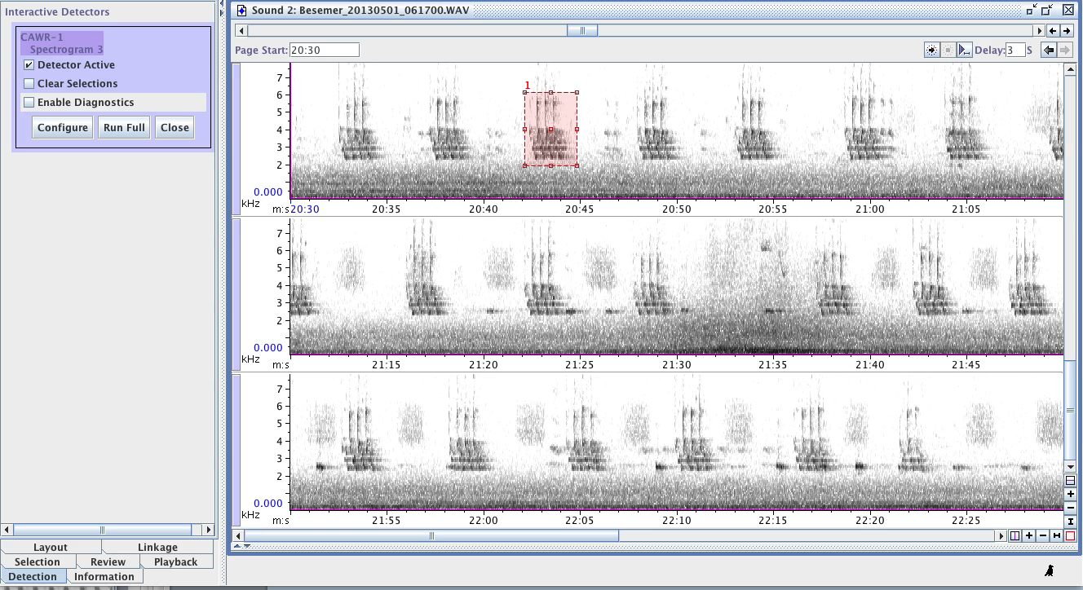
Automated detection

Slide 11
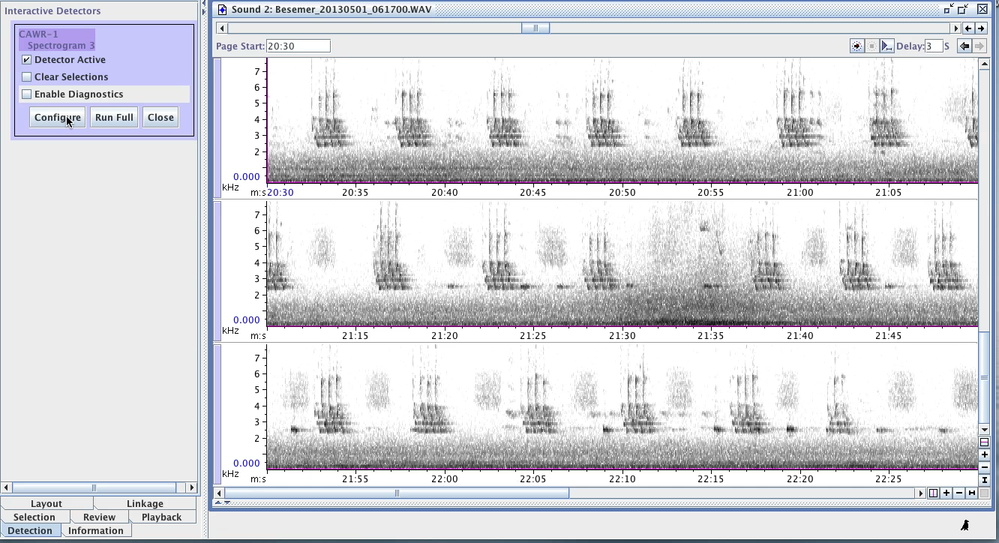
Automated detection

Slide 12
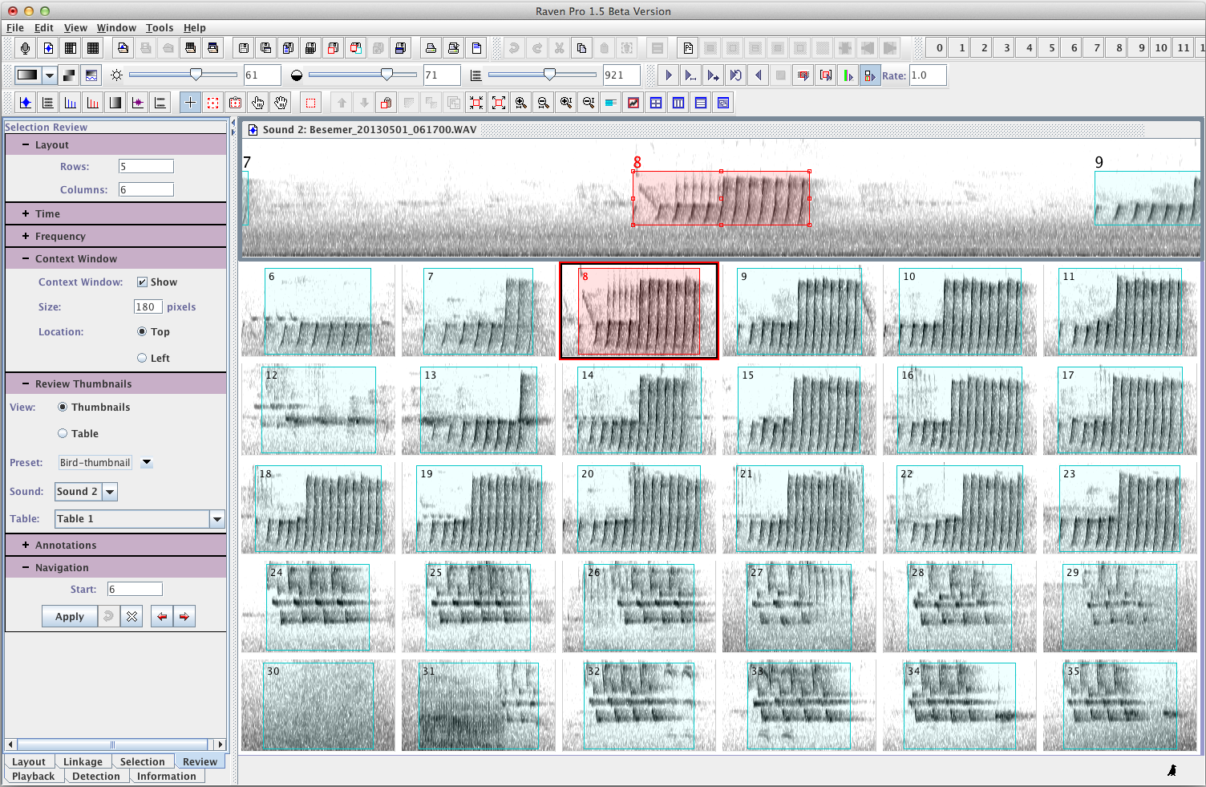
Selection review and annotation

Slide 13
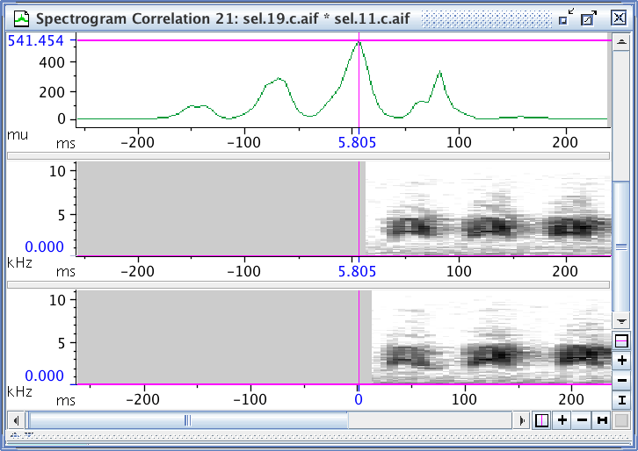
Spectrogram correlation
An objective, quantitative measure of sound similarity
Pixel-by-pixel comparison of spectrograms

Slide 14
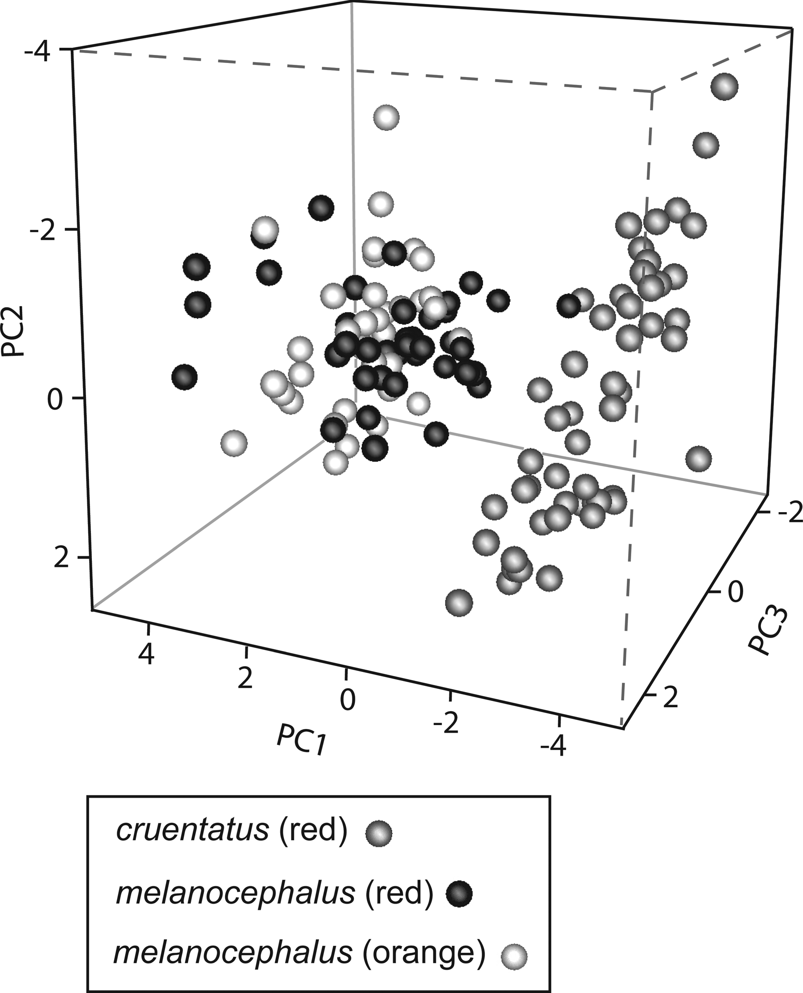
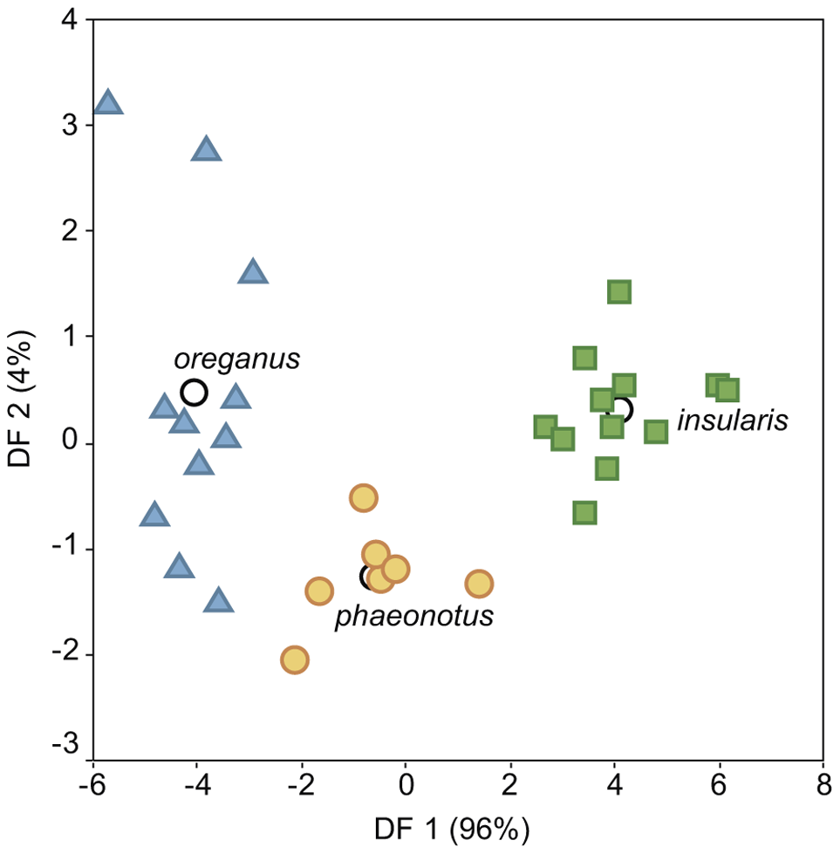
Statistical approaches to sound comparison
Feature extraction
Measure multiple features of a sound
Use some statistical approach to combine measured features into a single measure of similarity

Slide 15
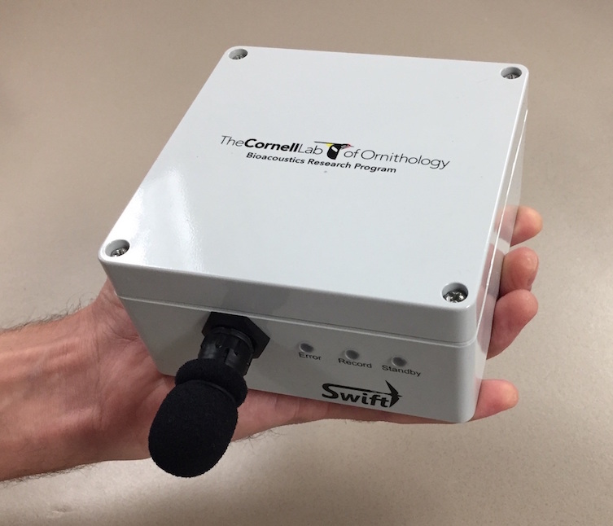
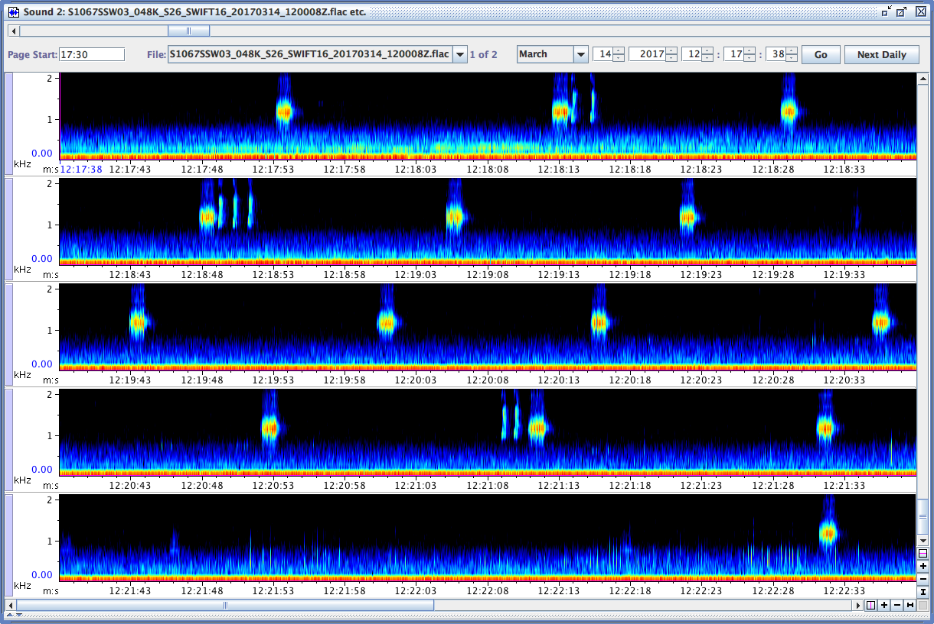
Soundscape recording with SWIFT

Slide 16
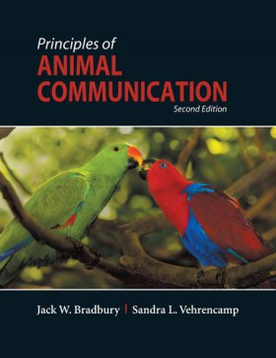
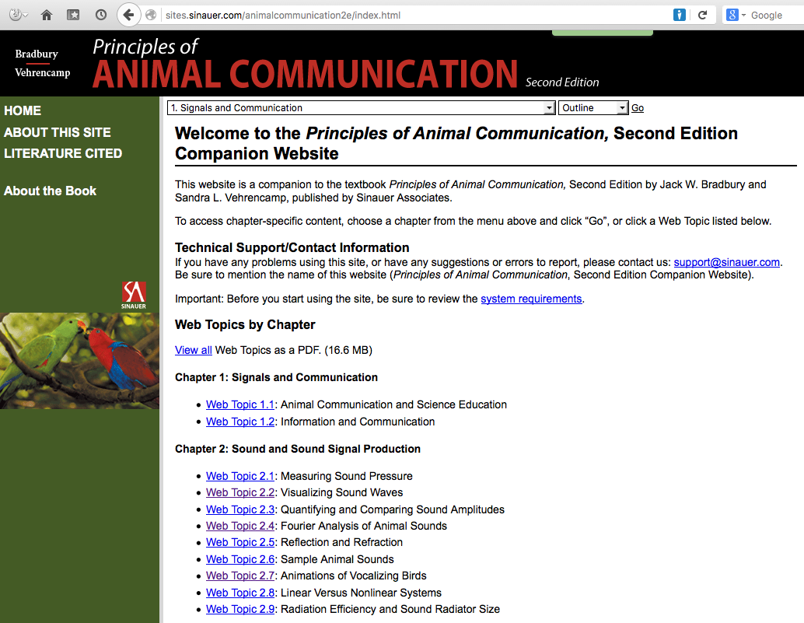
Textbook and online resources
Bradbury, J. W. and S. L. Vehrencamp. 2011. Principles of Animal Communication, 2d edition. Sinauer Associates.
Notes:
- distillation of most essential parts of 5-day workshop

Slide 17
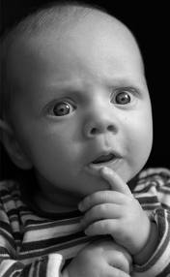
Questions?
Notes:
List everyone’s questions/goals...

