Slide 1
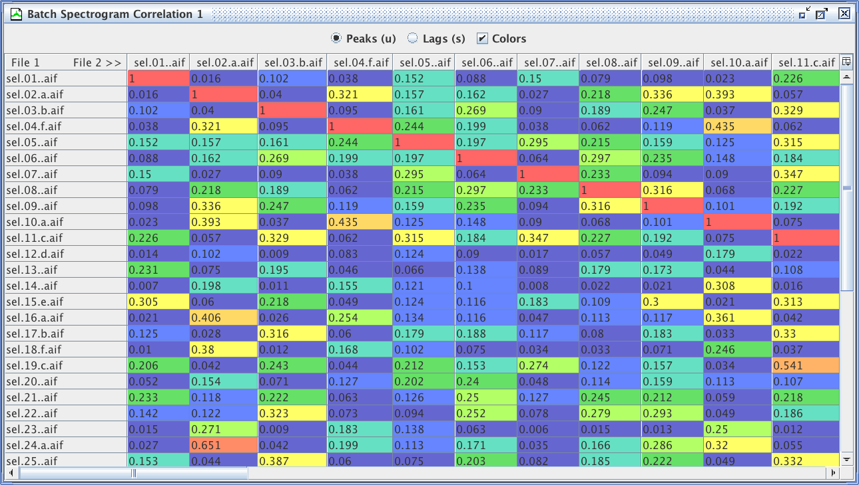
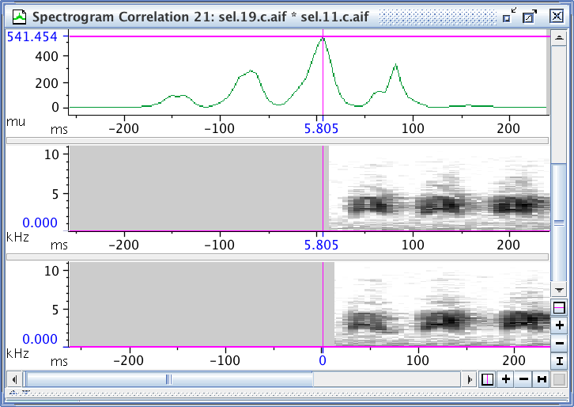
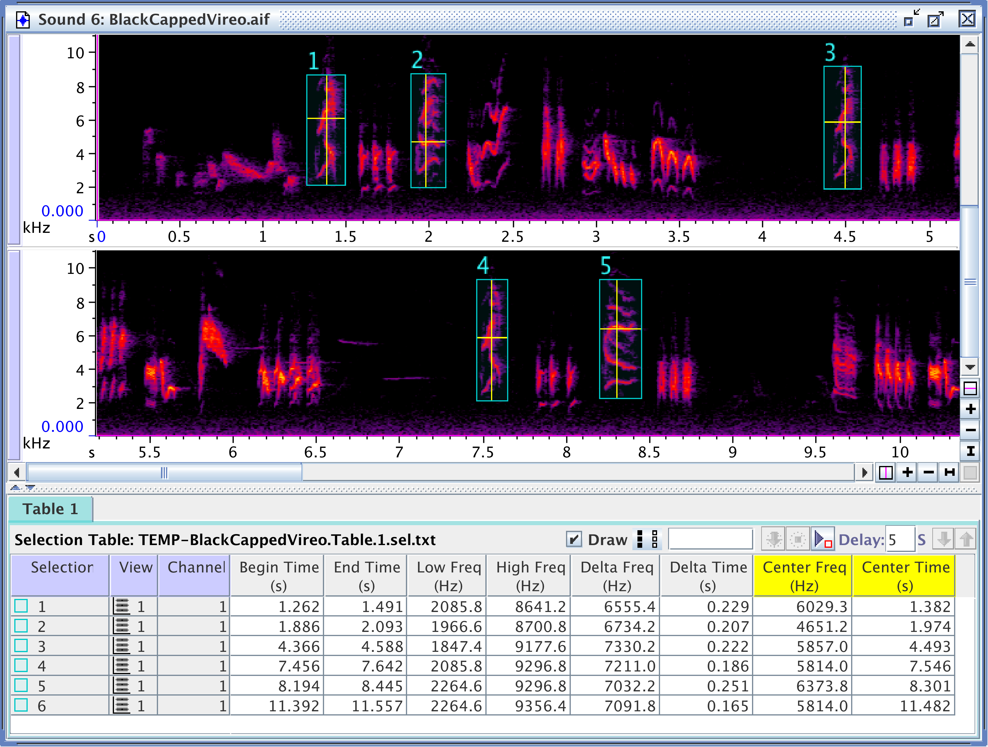

Approaches to quantifying
sound similarity
Sound Analysis Workshop
Ithaca, NY
3 – 7 October 2017
© 2007-17, Cornell Bioacoustics Research Program
Bioacoustics Research Program

Slide 2
Questions about sound similarity
Categorical variation
Questions about acoustic structure in relation to categories of vocalizations or individual animals (e.g., population, sex, family or social group, behavioral context, or human-identified vocalization category):
Can membership in a category be predicted by acoustic measurements?
Can we distinguish members of categories or sounds made in specific behavioral contexts based on acoustical features?
Are sounds from within the same category more similar to each other than sounds from different categories?
. . .
Notes:
these are just examples; lots of other questions of this general form are possible

Slide 3
Questions about sound similarity
Continuous variation
Questions about similarities or differences among sounds along a continuum:
How similar are sounds in relation to some continuous variable of interest, like geographic distance, measures of genetic similarity, or continuous measures of social relationship?
How consistent in structure are sounds made by a given individual individual or within a song?
. . .
Notes:
these are just examples; lots of other questions of this general form are possible

Slide 4
Approaches to quantifying sound similarity
Feature extraction
Measure multiple features of a sound
Use some statistical approach to combine measured features into a single measure of similarity
Spectrogram cross-correlation
Pixel-by-pixel comparison of spectrograms
(Not an exhaustive list!)
Notes:
• There many approaches; these are two of the most widely used approaches; others include DTW and Random Forest distance
• we can’t really get into these all in detail

Slide 5
Feature extraction
Feature extraction
Measure multiple features of a sound
Use some statistical approach to combine measured features into a single measure of similarity, or to distinguish among categories of sounds
Advantages
Can be based on well-defined, intuitive measurements
Can be used with any type of sound
Provides insight into specific ways sounds are (dis)similar
Limitations
Need to decide what features to measure
Results may depend on choice of features (and possible weighting)

Slide 6
Spectrogram cross-correlation (SPCC)
Spectrogram correlation
Pixel-by-pixel comparison of spectrograms
Advantages
No decisions about what features to measure, how to weight them
Simple
Simple
Limitations
Not suitable for all types of sounds
Does not provide insight into specific ways sounds are (dis)similar
Results depend on spectrogram parameters
➸ Results sometimes conflict with human
judgment of similarity

Slide 7
Summary: SPCC vs. Feature Extraction
 |  | SPCC | Feature extraction
 | Need to decide what to measure; different decisions may alter results | + NO | – YES
 | Output requires further statistical manipulation to get overall similarity measure | + NO | – YES
 | Can be based on intuitively recognizable features | – NO | + YES
 | Provides insight into specific ways sounds are (dis)similar | – NO | + YES
 | Suitable for any type of sound | – NO | + YES
+ = advantage
– = disadvantage

Slide 8
