Slide 1
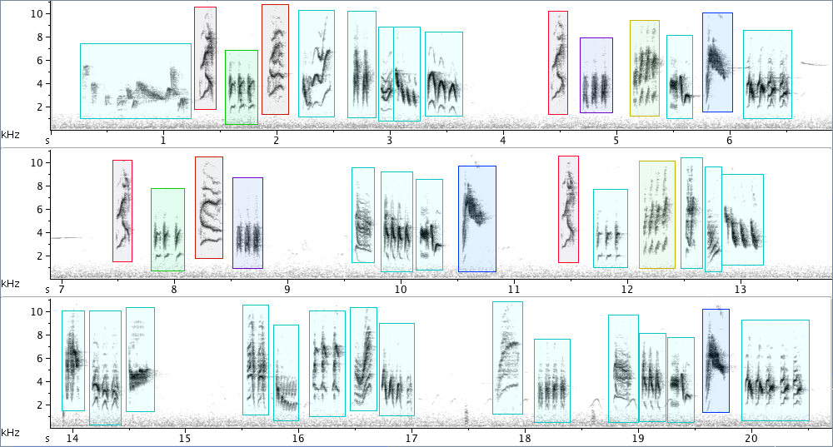
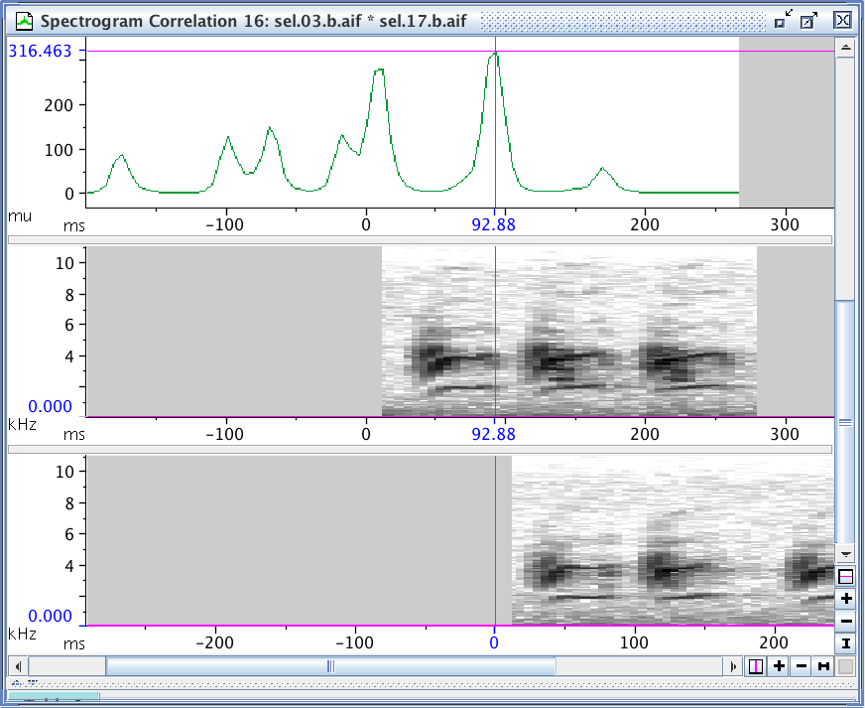
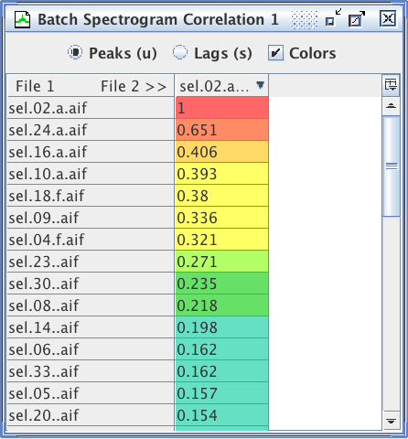

Comparing sounds by
spectrogram correlation
Sound Analysis Workshop
Ithaca, NY
3 – 7 April 2017
© 2007-17, Cornell Bioacoustics Research Program
Bioacoustics Research Program

Slide 2
Spectrogram cross-correlation (SPCC)
What is spectrogram correlation?
An objective, quantitative measure of sound similarity
Pixel-by-pixel comparison of spectrograms
Advantages
Objective
No decisions about what features to measure, how to weight them
Simple
Limitations
Not suitable for all types of sounds
Does not provide insight into specific ways sounds are (dis)similar
Results depend on spectrogram parameters
Simple
➸ Results sometimes conflict with human
judgment of similarity

Slide 3

Spectrogram correlation
Pixel-by-pixel comparison

Slide 4

Spectrogram correlation
Pixel-by-pixel comparison

Slide 5

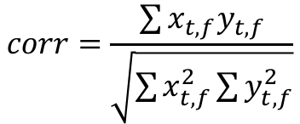
Spectrogram correlation
Pixel-by-pixel comparison
Quantifying similarity
multiply power values from
corresponding pixels in each
spectrogram matrix
sum the pairwise products
of the pixel values
normalize the sum
$$corr=\frac{\sum{x_{t,f}y_{t,f}}}{\sqrt{\sum{x_{t,f}^{2}}\sum{y_{t,f}^{2}}}}$$

Slide 6

Spectrogram correlation
Spectrogram matrices improperly aligned in time
find best alignment by sliding images (matrices) across each other in time, calculating correlation at each time step
use max(corr_{t}) as measure of similarity

Slide 7
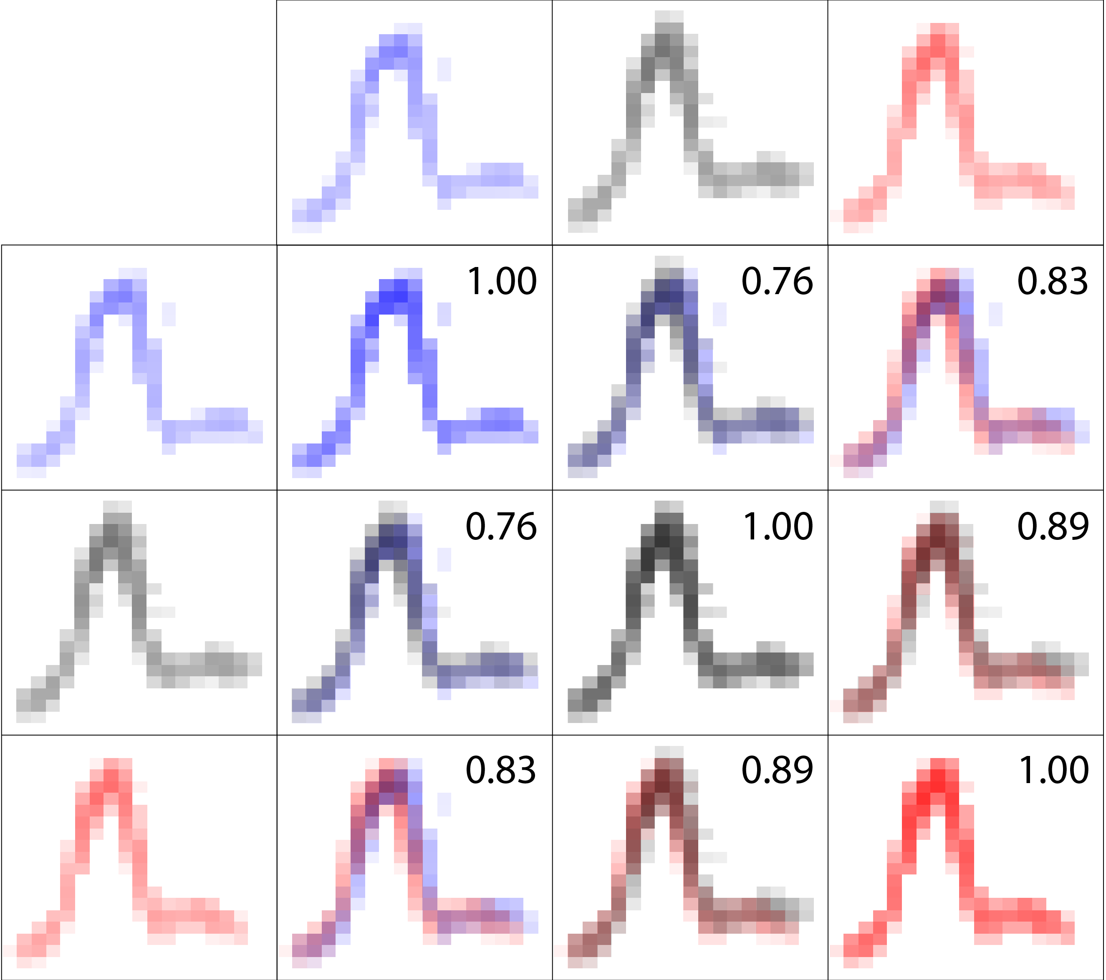
Spectrogram correlation
Multiple pairwise comparisons

Slide 8
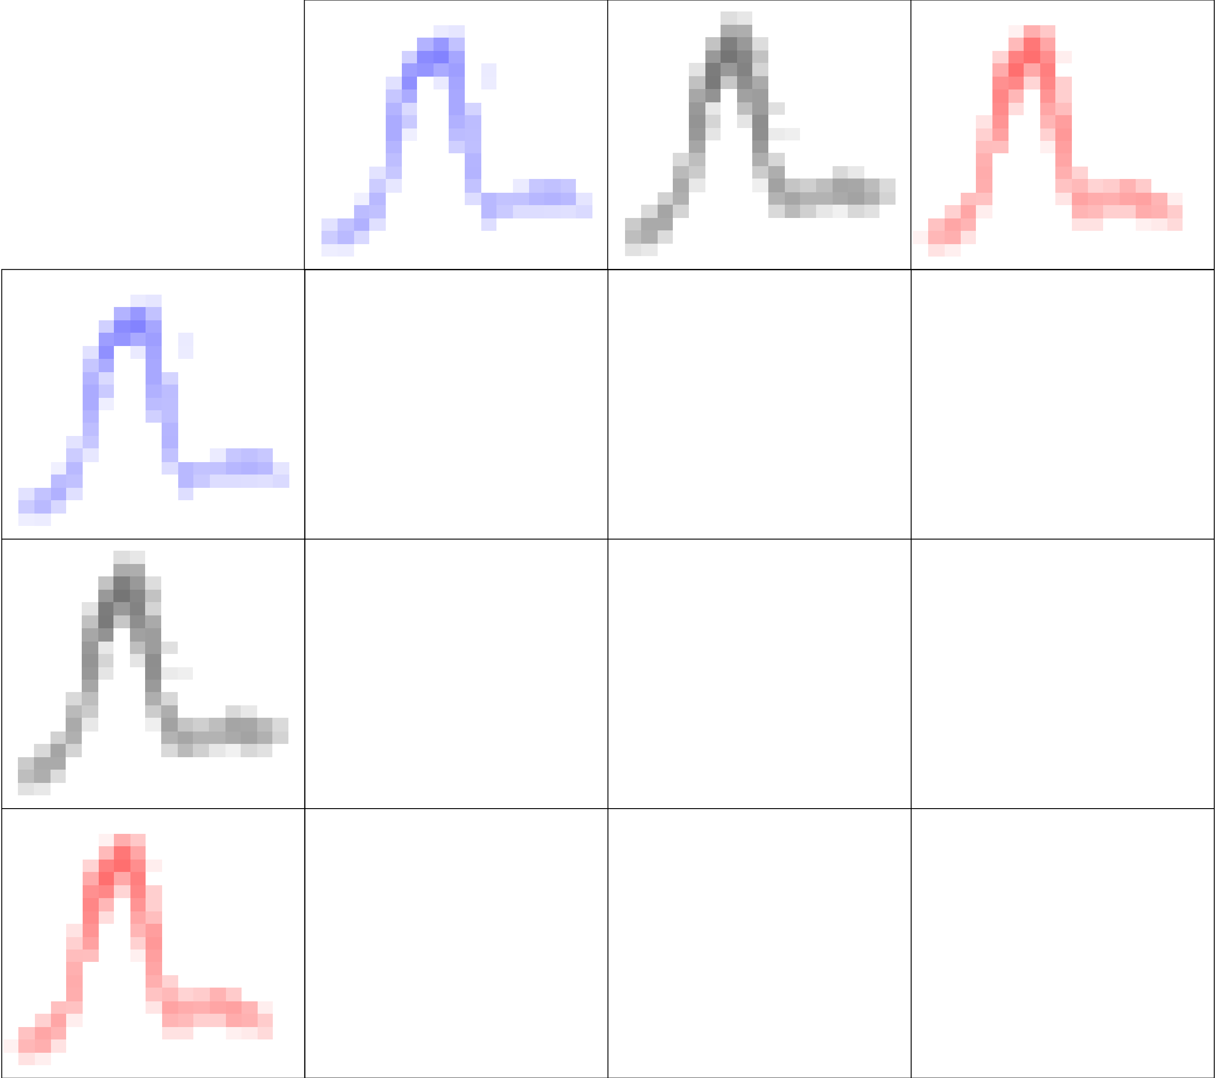
Spectrogram correlation
Multiple pairwise comparisons

Slide 9
Spectrogram correlation
Multiple pairwise comparisons

Slide 10
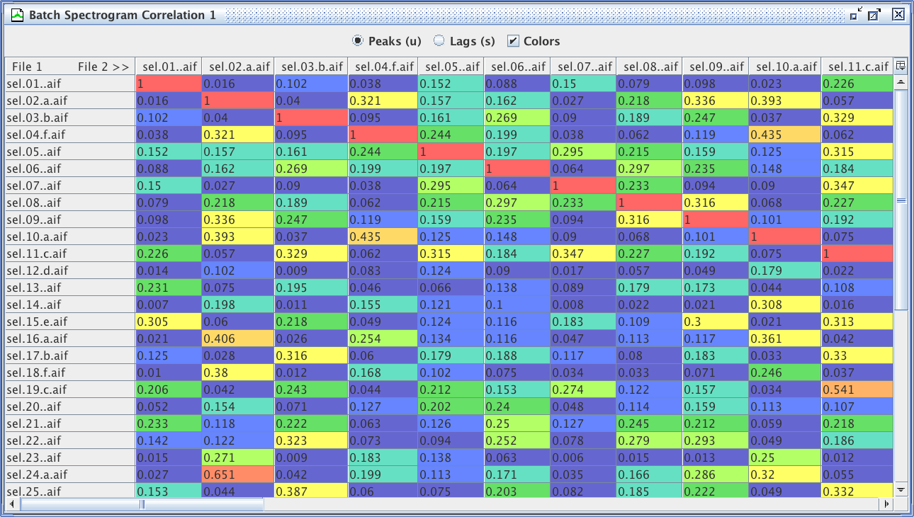
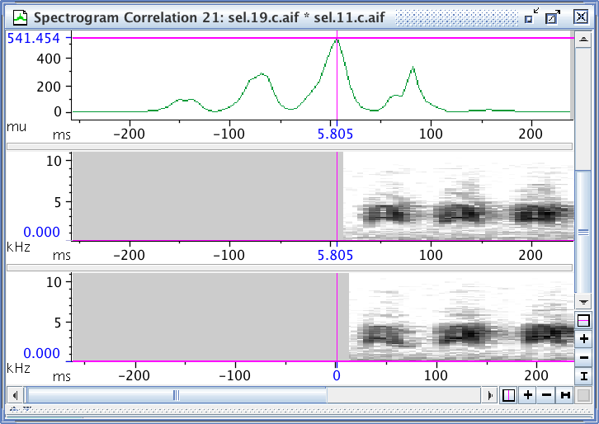
Spectrogram correlation
Comparing many sounds with each other: batch correlation

Slide 11
Spectrogram correlation
How are SPCC data used?
Accuracy of vocal mimicry:
Dalziell, A. H., & Magrath, R. D. (2012). Fooling the experts: accurate vocal mimicry in the song of the superb lyrebird, Menura novaehollandiae. Animal Behaviour, 83, 1401–1410.
Parent-nestling communication in relation to brood parasitism:
Colombelli-Négrel, D., Hauber, M. E., Robertson, J., Sulloway, F. J., Hoi, H., et al. (2012). Embryonic learning of vocal passwords in superb fairy-wrens reveals intruder cuckoo nestlings. Current Biology : CB, 22, 2155–60.
Kin recognition in cooperative breeders:
McDonald, P. G., & Wright, J. (2011). Bell miner provisioning calls are more similar among relatives and are used by helpers at the nest to bias their effort towards kin. Proceedings of the Royal Society B-Biological Sciences, 278, 3403–3411.
Evolution of vocal production mechanisms in fish:
Rice, A. N., & Bass, A. H. (2009). Novel vocal repertoire and paired swimbladders of the three-spined toadfish, Batrachomoeus trispinosus: insights into the diversity of the Batrachoididae. Journal of Experimental Biology, 212, 1377–1391.
Population- and species-level divergence of vocal culture (song dialects):
Dalisio, A. C., Jensen, W. E., & Parker, T. H. (2014). Divergence of vocal culture among isolated alpine habitats is inconsistent among three Oscine species. Journal of Ornithology 156, 165–178.

Slide 12
Spectrogram correlation
Statistical approaches used with correlation matrices
Comparisons of mean correlation scores
Dalisio, A. C., Jensen, W. E., & Parker, T. H. (2014). Divergence of vocal culture among isolated alpine habitats is inconsistent among three Oscine species. Journal of Ornithology.
McDonald, P. G., & Wright, J. (2011). Bell miner provisioning calls are more similar among relatives and are used by helpers at the nest to bias their effort towards kin. Proceedings of the Royal Society B-Biological Sciences, 278, 3403–3411.
De Kort, S. R., Eldermire, E. R. B., Valderrama, S., Botero, C. A., & Vehrencamp, S. L. (2009). Trill consistency is an age-related assessment signal in banded wrens. Proceedings of the Royal Society B-Biological Sciences, 276, 2315–2321.
Cluster analysis to identify hierarchical groupings
Dalisio, A. C., Jensen, W. E., & Parker, T. H. (2014). Divergence of vocal culture among isolated alpine habitats is inconsistent among three Oscine species. Journal of Ornithology.

Slide 13
Spectrogram correlation
Statistical approaches used with SPCC data
Principal coordinates analysis (“PCO” or “PCoA”)
Cortopassi, K. A., & Bradbury, J. W. (2000). The comparison of harmonically rich sounds using spectrographic cross-correlation and principal coordinates analysis. Bioacoustics, 11, 89–127.
“PCO decomposes an object-by-object similarity matrix (such as that generated by SPCC) into a set of latent orthogonal object measures. SPCC combined with PCO analysis provides not only visual groupings of sounds (like cluster analysis), but also a set of independent measures against which the association of extrinsic contextual variables can be measured (unlike cluster analysis).”
Rice, A. N., & Bass, A. H. (2009). Novel vocal repertoire and paired swimbladders of the three-spined toadfish, Batrachomoeus trispinosus: insights into the diversity of the Batrachoididae. Journal of Experimental Biology, 212, 1377–1391.
Colombelli-Négrel, D., Hauber, M. E., Robertson, J., Sulloway, F. J., Hoi, H., et al. (2012). Embryonic learning of vocal passwords in superb fairy-wrens reveals intruder cuckoo nestlings. Current Biology, 22, 2155–60.

Slide 14
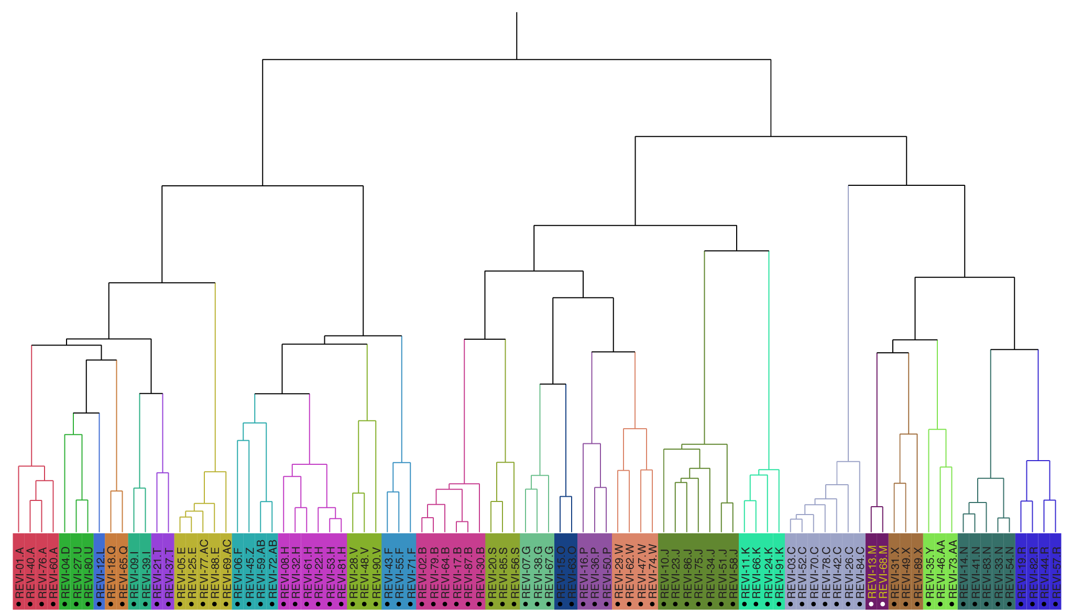
Spectrogram correlation
BLED + correlation + hierarchical cluster analysis
Red-eyed vireo song types
91 songs, 25 types

Slide 15
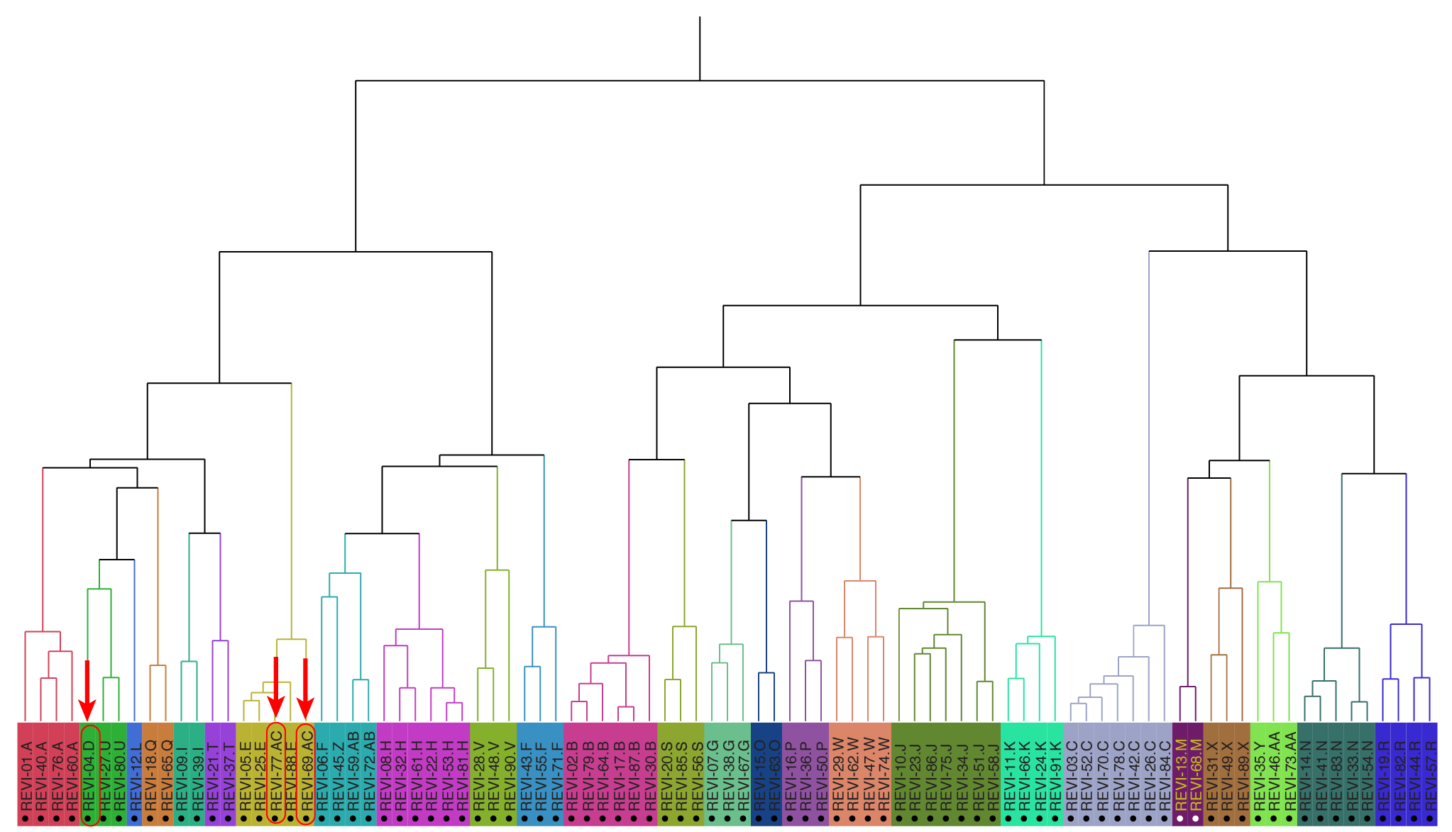
Spectrogram correlation
BLED + correlation + hierarchical cluster analysis
Red-eyed vireo song types
91 songs, 25 types
human errors!

Slide 16


