Slide 1
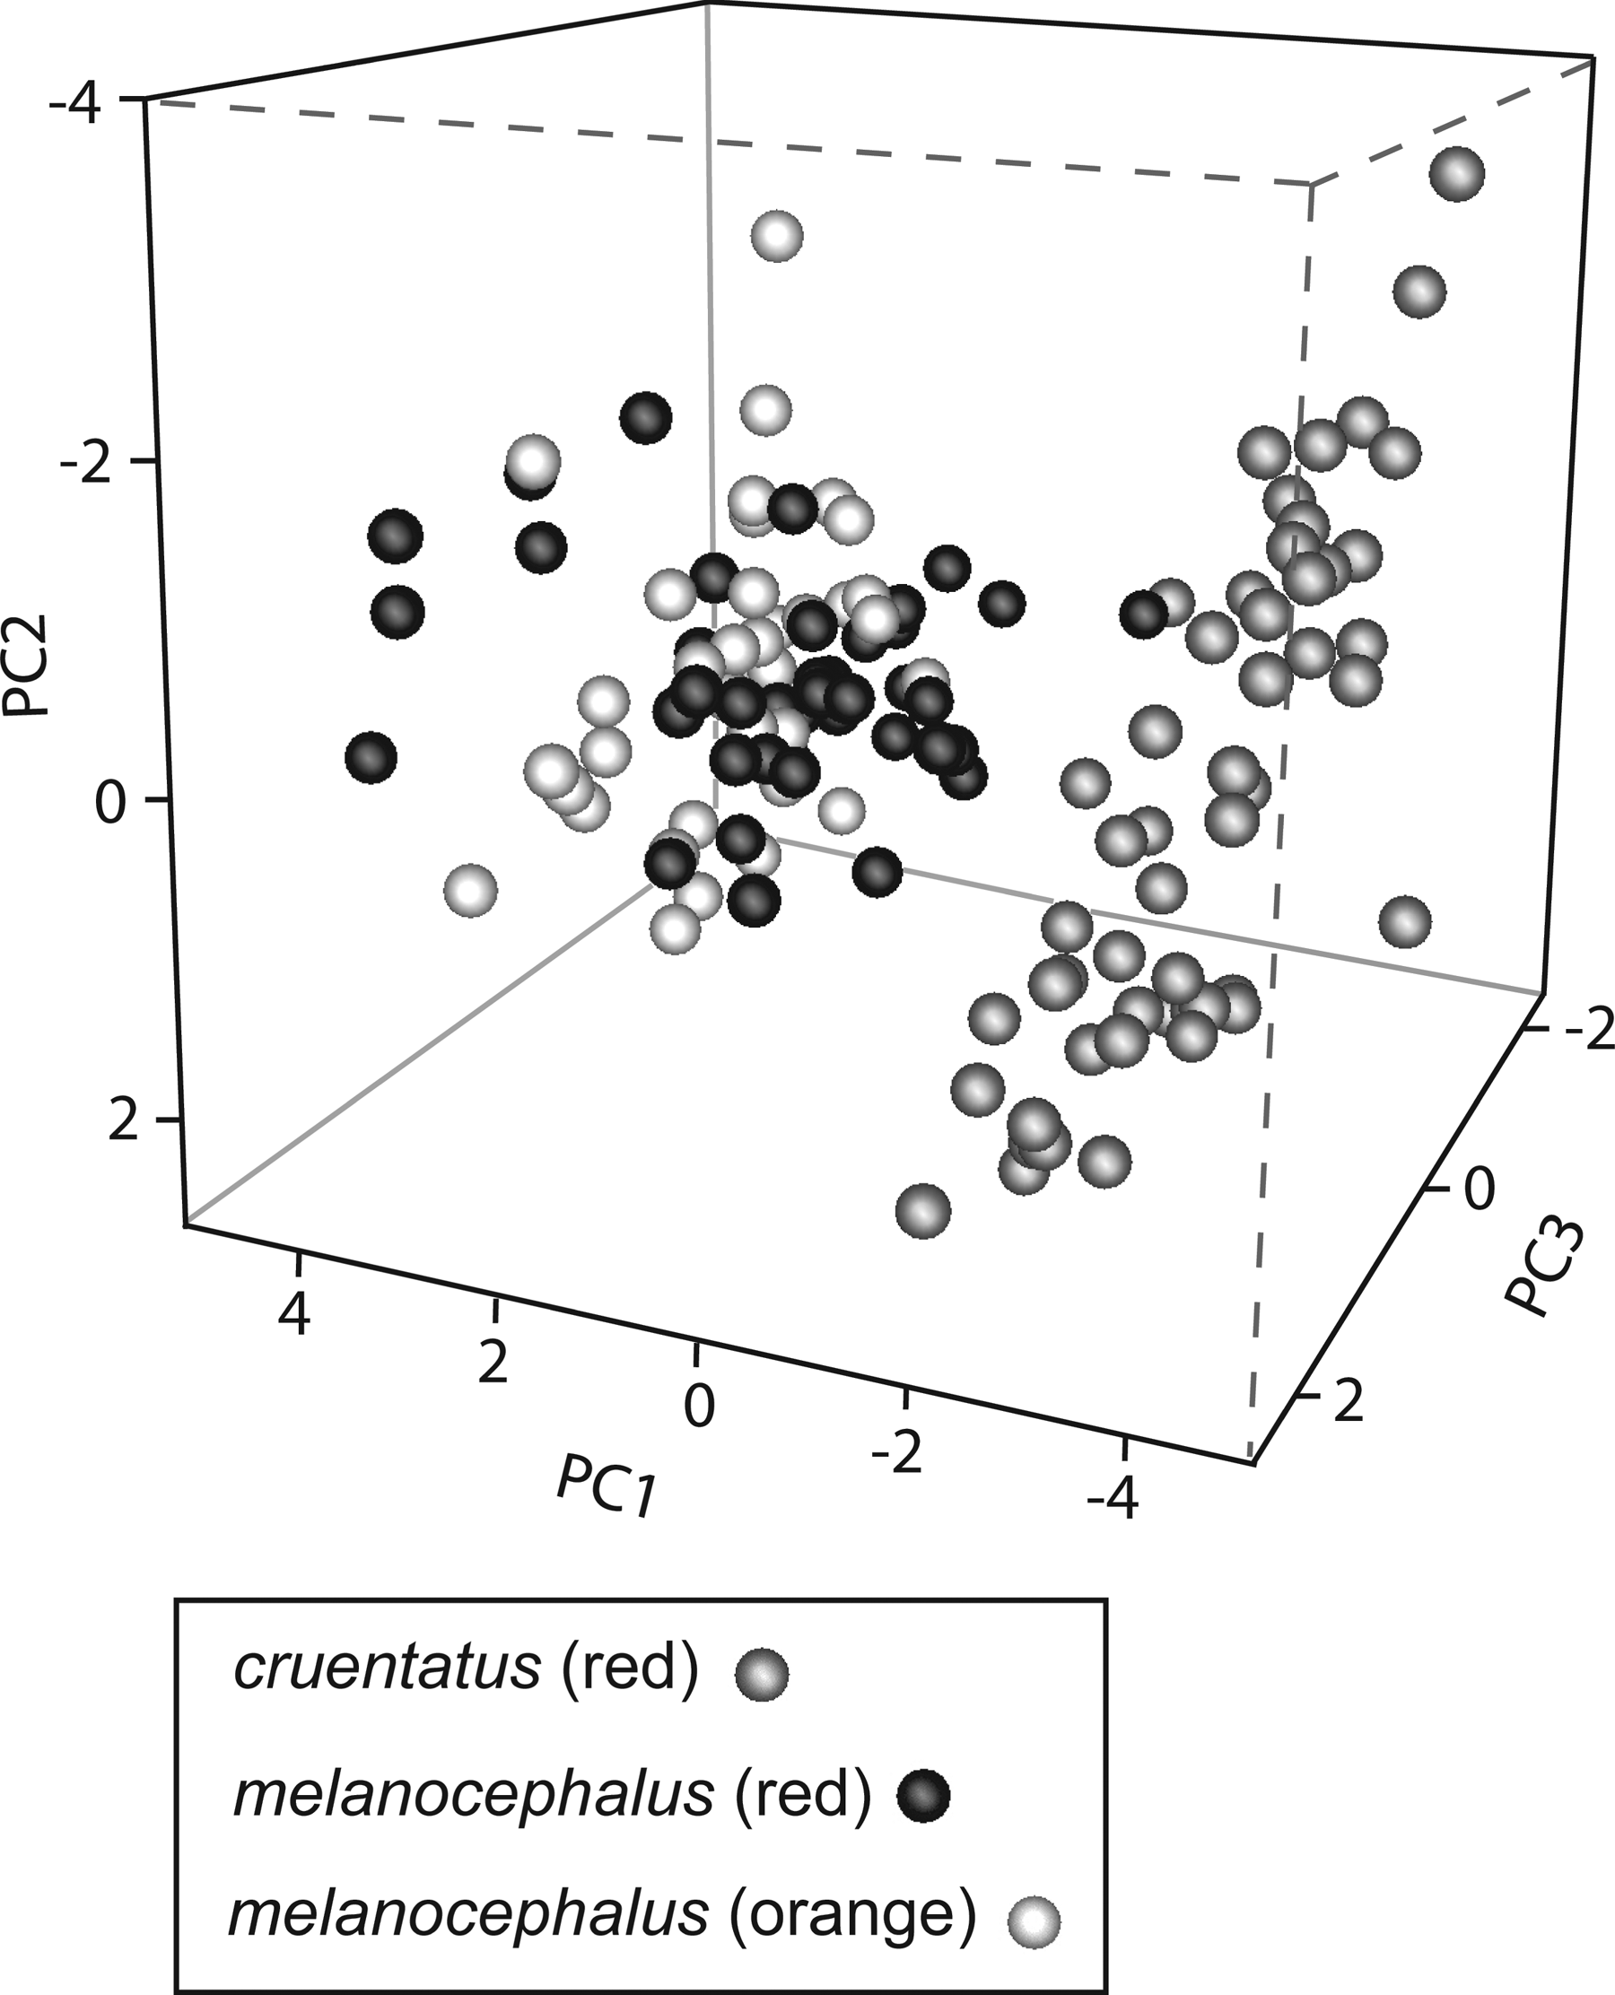
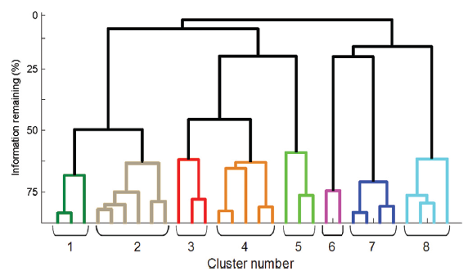
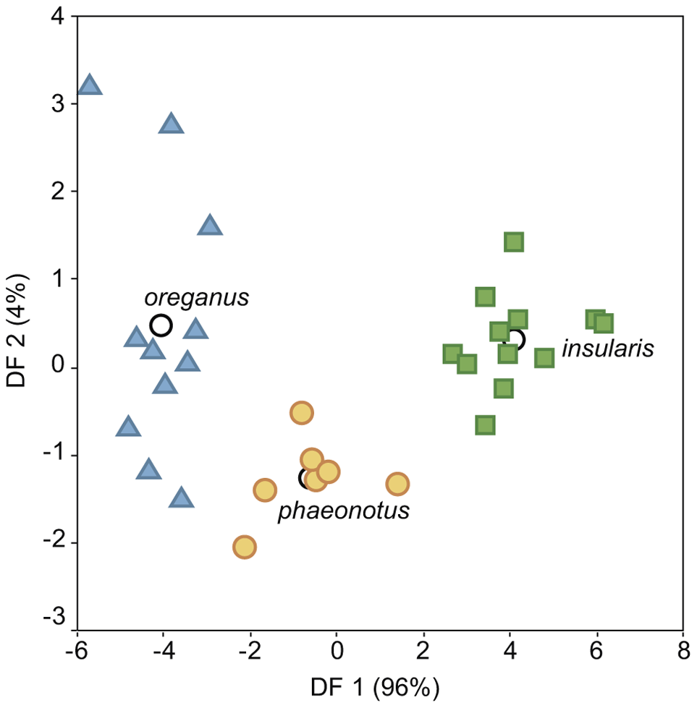

Some feature-based statistical methods
for classifying sounds
Sound Analysis Workshop
Ithaca, NY
3 – 7 April 2017
© 2007-17, Cornell Bioacoustics Research Program
Bioacoustics Research Program

Slide 2
Feature extraction: Principal Components Analysis
A method for reducing the number of variables / dimensions needed to describe a set of objects (e.g., acoustic events)
Extracts a set of orthogonal derived features (measurements) from larger set of (potentially correlated) original features
Principal Components are ordered: the first PC accounts for as much variation in the original data as possible, the second as much residual variation after the first, etc.
Principal Components Analysis For Dummies:
https://georgemdallas.wordpress.com/2013/10/30/principal-component-analysis-4-dummies-eigenvectors-eigenvalues-and-dimension-reduction/

Slide 3
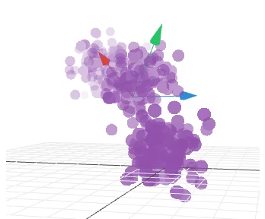
Feature extraction: Principal Components Analysis
Finding the first few principal components is like finding the angle
from which you can best see the structure of multidimensional cloud of points:
Interactive 3D visualization of PCA:
http://setosa.io/ev/principal-component-analysis/

Slide 4
Feature extraction: Discriminant Function Analysis
A statistical method for determining whether a set of features can be used to effectively distinguish among different categories (e.g., individual identity, sex, age class, social group, subspecies, population, human-assigned vocalization category);
Creates linear combinations of predictor variables (discriminant functions) that maximize differences among labeled groups;
Inputs:
vector of features or principal components derived from acoustic features
class labels (e.g., individual identity, sex, subspecies, category, etc.)
Outputs:
discriminant functions
class labels

Slide 5
PCA & DFA
What’s the difference?
Both PCA and DFA involve creating linear combinations of the original acoustic measurements.
Principal Components Analysis
tries to account for as much variation as possible and account for correlations among measurements across all of the sounds measured, irrespective of class; PCA doesn’t consider class labels
PCA in effect discovers structure in the data without any prior knowledge of what the categories are
sometimes just looking at a 2- or 3-dimensional PC plot will show clear discrimination among groups
Discriminant Function Analysis
DFs are constructed specifically to maximize the differences among classes
DFA uses knowledge of the category labels

Slide 6
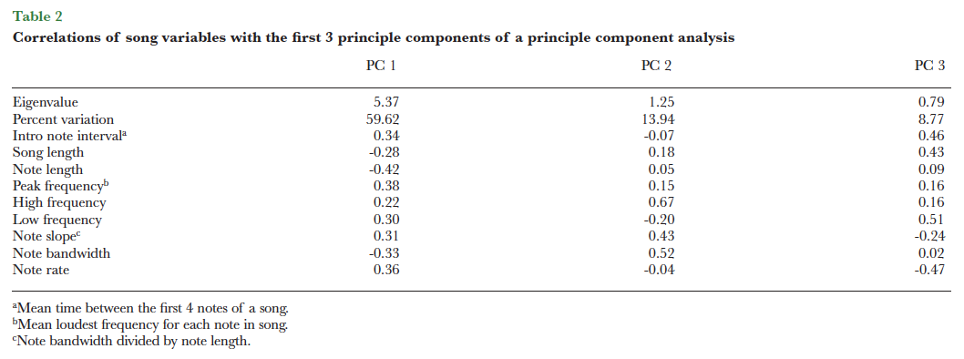
Principal Components Analysis
Examples
Greig, E. I., & Webster, M. S. (2013). Spatial decoupling of song and plumage generates novel phenotypes between 2 avian subspecies. Behavioral Ecology, 24, 1004–1013.
9 dimensions reduced to 3:
Figure 3. The first 3 principal components for the sampled song from each male (n = 133 males). Gray points indicate songs from red cruentatus populations, black points indicate songs from red melanocephalus populations, and white points indicate songs from orange melanocephalus populations.

Slide 7
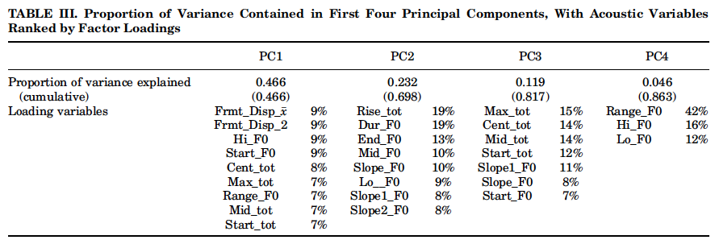
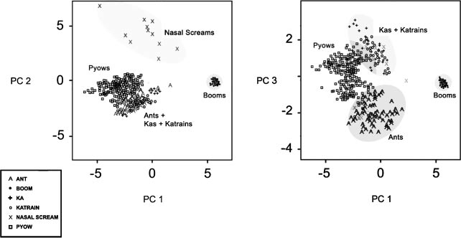
Principal Components Analysis
Examples
Fuller, J. L. (2013). The vocal repertoire of adult male blue monkeys (Cercopithecus mitis stulmanni): A quantitative analysis of acoustic structure. American Journal of Primatology, 1–14.
9 dimensions reduced to 4:
Fig. 1. Recording samples (N = 772) plotted in principal component space. Symbols and cluster labels refer to putative call types assigned a priori to samples. PC1 and PC2 (left) account for 70% of variance and easily segregate booms and nasal screams from a cluster containing the other call types. Plotting on PC1 and PC3 (right) (59% of variance) shows the distinctiveness of pyows, ants, and the combined cluster of kas and katrain units

Slide 8
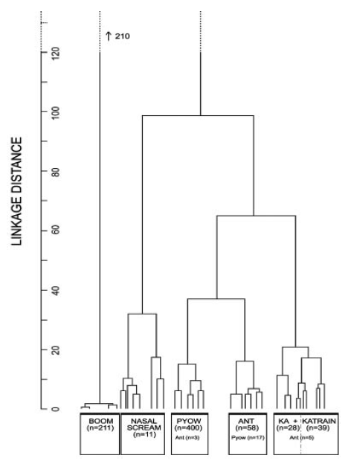
Hierarchical Cluster Analysis
Examples
Fuller, J. L. (2013). The vocal repertoire of adult male blue monkeys (Cercopithecus mitis stulmanni): A quantitative analysis of acoustic structure. American Journal of Primatology, 1–14.
Confirming subjective categories via cluster analysis based on PC scores:
Fig. 2. Dendrogram from hierarchical cluster analysis using samples’ (N = 772) PC scores. Between‐cluster distance (vertical lines) for booms was twice other distances, so its linkage is not shown. Nodes below 5.0 (except booms) are contracted into a single node. Clusters are labeled by a priori call types (n = number of samples contained below the join).

Slide 9
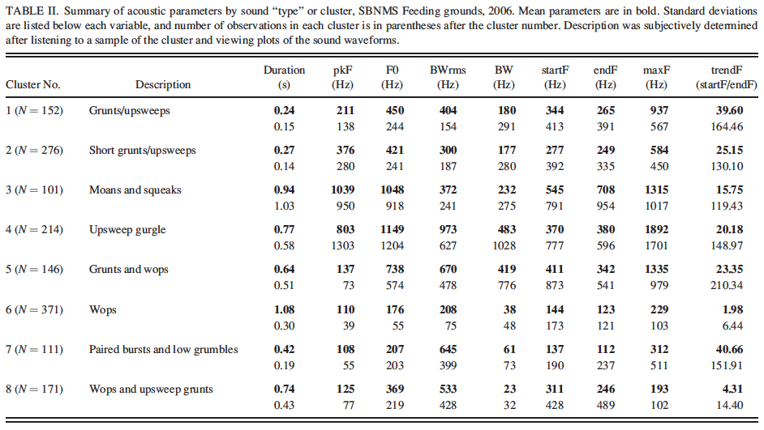
Hierarchical Cluster Analysis
Examples
Stimpert, A. K., Au, W. W. L., Parks, S. E., Hurst, T., & Wiley, D. N. (2011). Common humpback whale (Megaptera novaeangliae) sound types for passive acoustic monitoring. Journal of the Acoustical Society of America, 129, 476–482.
Identifying sound types via cluster analysis based on extracted measurements:
Fig. 2. Results of cluster analysis, SBNMS feeding ground, 2006. Each cluster is represented by a different color. Descriptions and acoustic summaries of each cluster are in Table II.

Slide 10
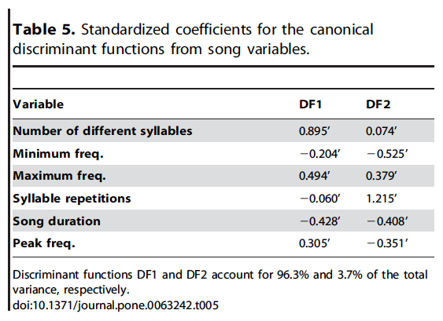
Discriminant Function Analysis
Examples
Aleixandre, P., Montoya, J. H., & Mila, B. (2013). Speciation on Oceanic Islands: Rapid Adaptive Divergence vs. Cryptic Speciation in a Guadalupe Island Songbird (Aves: Junco). PLoS One, 8.
6 dimensions reduced to 2:
Figure 7. Discriminant function analysis of song variables for the three junco lineages. J. h. insularis (green squares), J. h. oreganus (blue triangles) and J. phaeonotus (orange circles). Empty circles represent group centroids.

Slide 11
Discriminant Function Analysis
How is DFA used? (just a few of many examples...)
Identification of vocal mimicry:
Igic, B., & Magrath, R. D. (2013). Fidelity of vocal mimicry: identification and accuracy of mimicry of heterospecific alarm calls by the brown thornbill. Animal Behaviour, 85, 593–603.
Validating human-defined vocalization categories:
Fuller, J. L. (2013). The vocal repertoire of adult male blue monkeys (Cercopithecus mitis stulmanni): A quantitative analysis of acoustic structure. American Journal of Primatology, 1–14.
Distinguishing subspecies by song structure:
Pieplow, N. D., & Francis, C. D. (2011). Song differences among subspecies of yellow-eyed juncos (Junco phaeonotus). Wilson Journal of Ornithology, 123, 464–471.
Individual recognition based on acoustic measurements:
Tripp, T. M., & Otter, K. A. (2006). Vocal individuality as a potential long-term monitoring tool for Western Screech-owls, Megascops kennicottii. Canadian Journal of Zoology-Revue Canadienne De Zoologie, 84, 744–753.
Sex discrimination based on acoustic measurements:
Smith, A. S., Birnie, A. K., Lane, K. R., & French, J. A. (2009). Production and perception of sex differences in vocalizations of Wied’s black-tufted-ear marmosets (Callithrix kuhlii). American Journal of Primatology, 71, 324–332.

Slide 12


