Slide 1
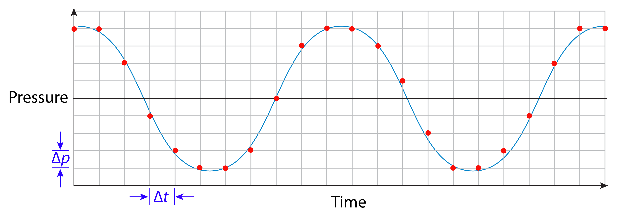

Digital Representation of Sound
Sound Analysis Workshop
Ithaca, NY
3 – 7 Apr 2017
© 2007-17, Cornell Bioacoustics Research Program
Bioacoustics Research Program

Slide 2
Why?
Spectrograms are a fundamental tool in studying animal sounds.
In order to use spectrograms most effectively, you need to understand what they are and how they’re made.
A basic understanding of digital audio is needed to
(1) fully understand spectrograms, and
(2) recognize potential problems with digital recordings.
Notes:
Understanding of spectrograms needed is at conceptual, not mathematical level;
also-- what is the relationship between image in spectrogram and what we hear?

Slide 3
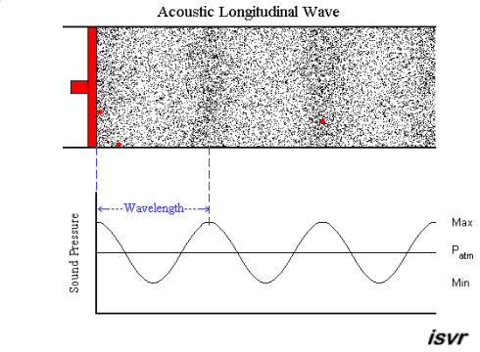
What is sound?
http://www.isvr.soton.ac.uk/SPCG/Tutorial/Tutorial/Tutorial_files/Web-basics-nature.htm

Slide 4
Topics
Digital representation of sound
Introduction to spectrograms

Slide 5
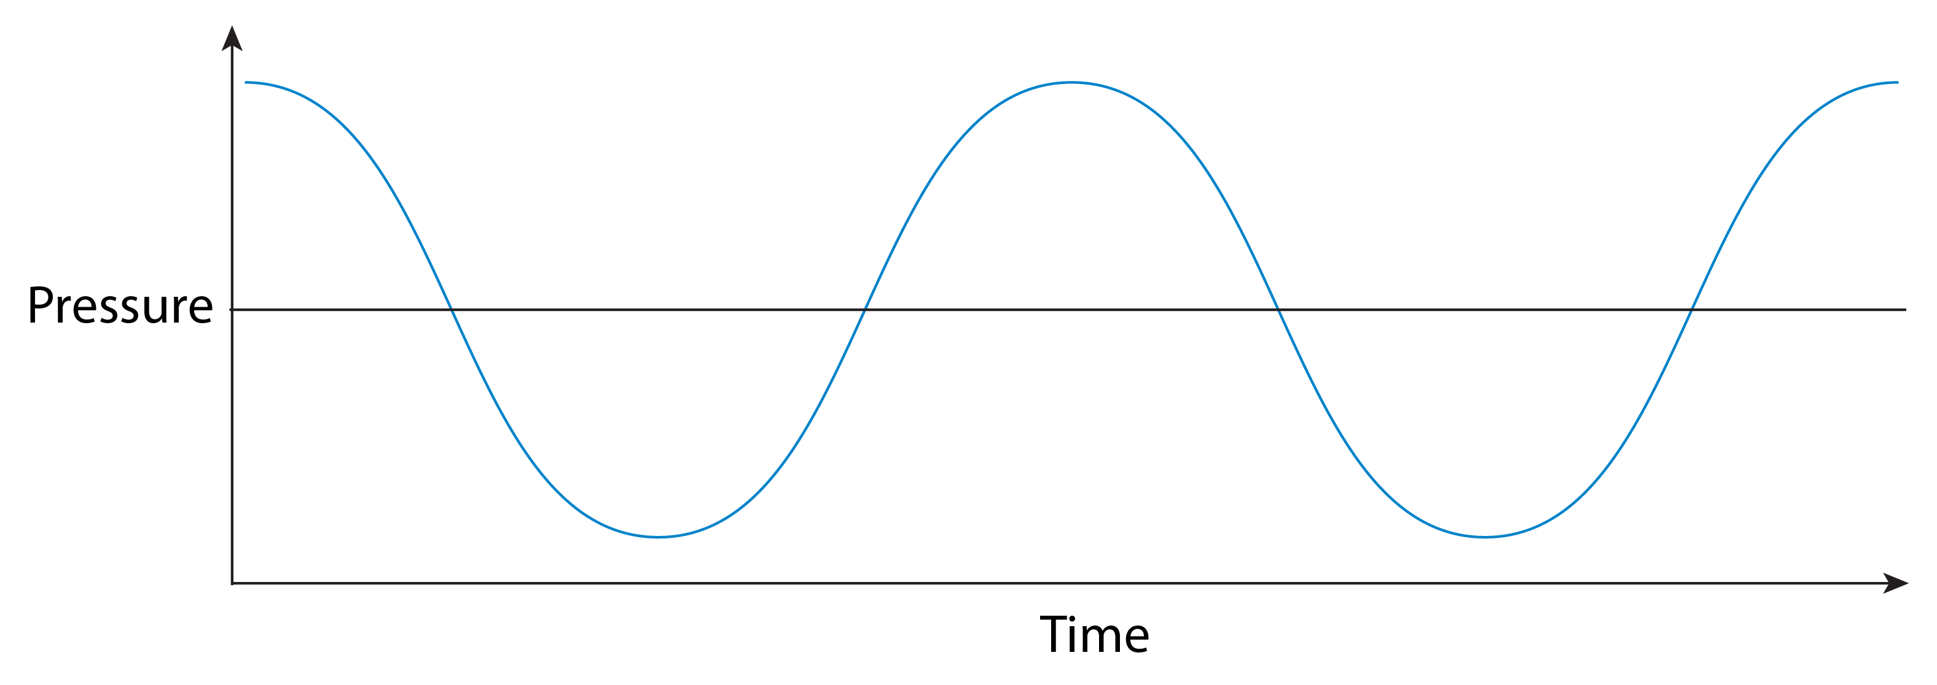
Digital representation of sound

Slide 6
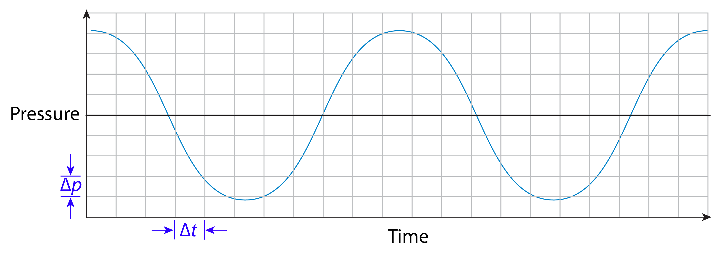
Digital representation of sound

Slide 7
Digital representation of sound
A digital audio recording is characterized by:
• sampling rate F_{s}= 1/Δt
How many times per s do we measure the sound pressure?
• bit depth (aka sample size)
How precisely (Δp) does each sample measure the sound pressure?

Slide 8
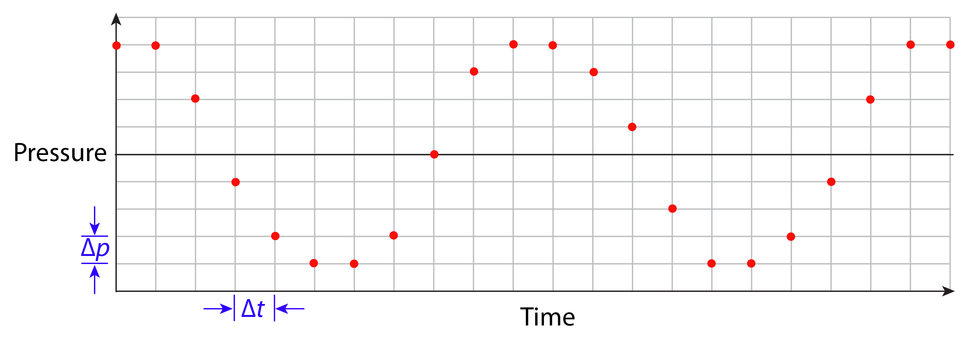
Digital representation of sound
A digital audio recording is a series of sample values, e,g,:
{ 4, 4, 2, -1, -3, -4, -4, -3, 0, 3, ... },
combined with information needed to interpret the sample values (e.g., the sample rate, F_{s})

Slide 9
Digital representation of sound
This information can be used to reconstruct the analog waveform:
provided ∆t and ∆p are small enough

Slide 10
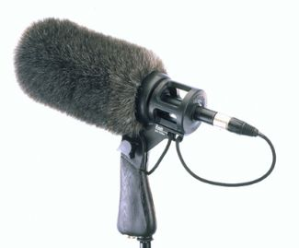
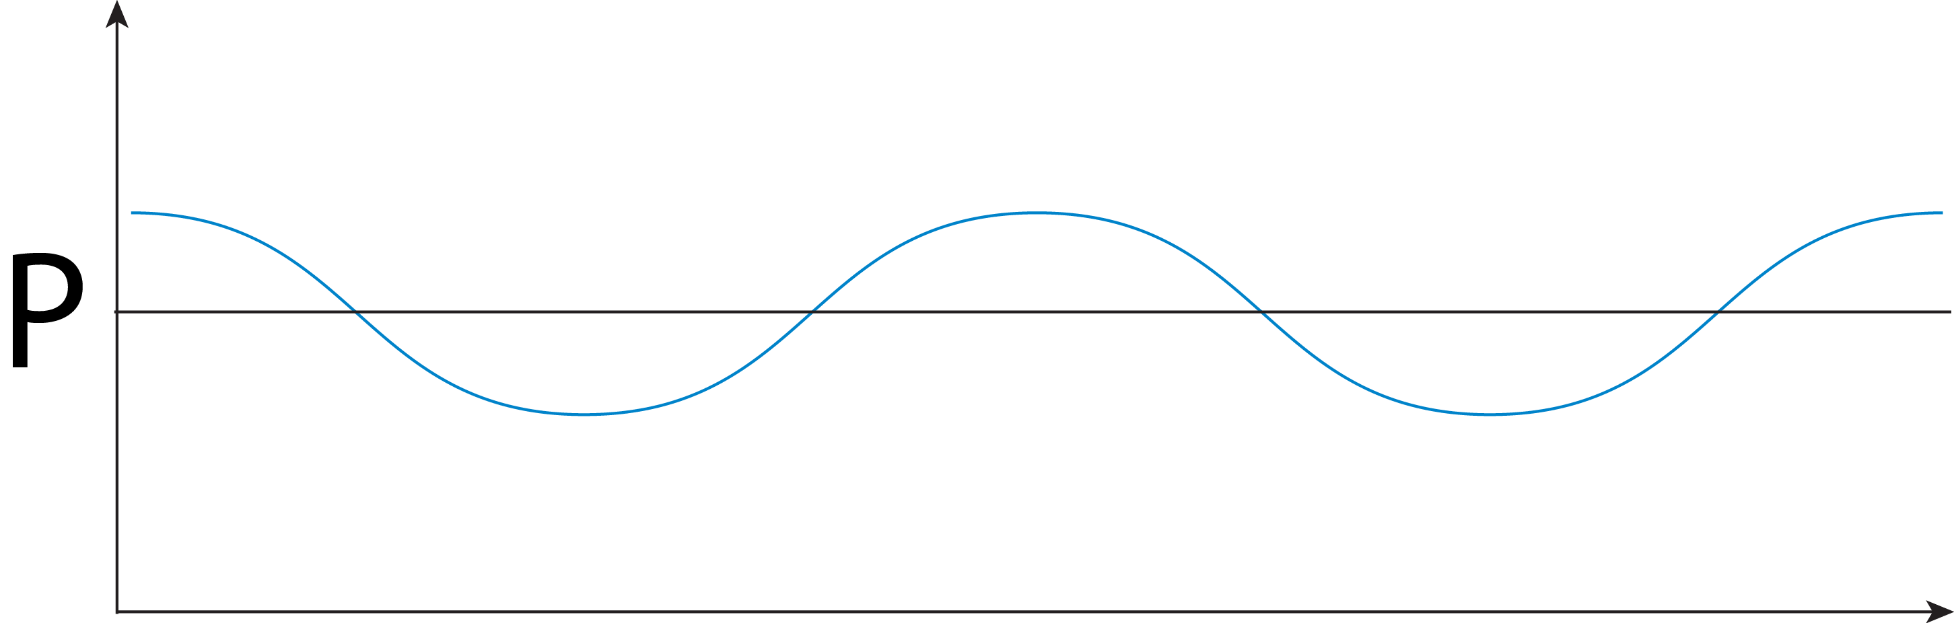
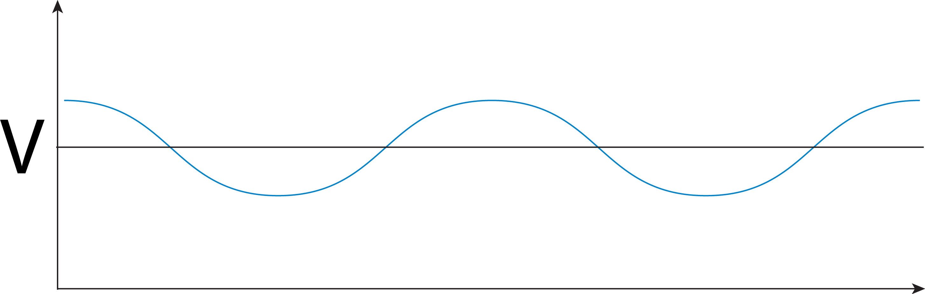
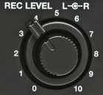
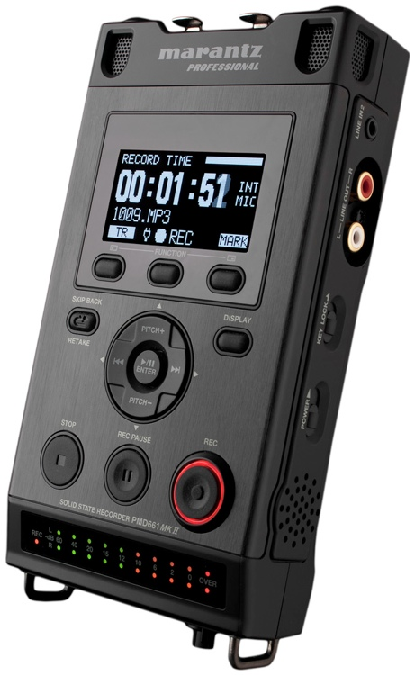
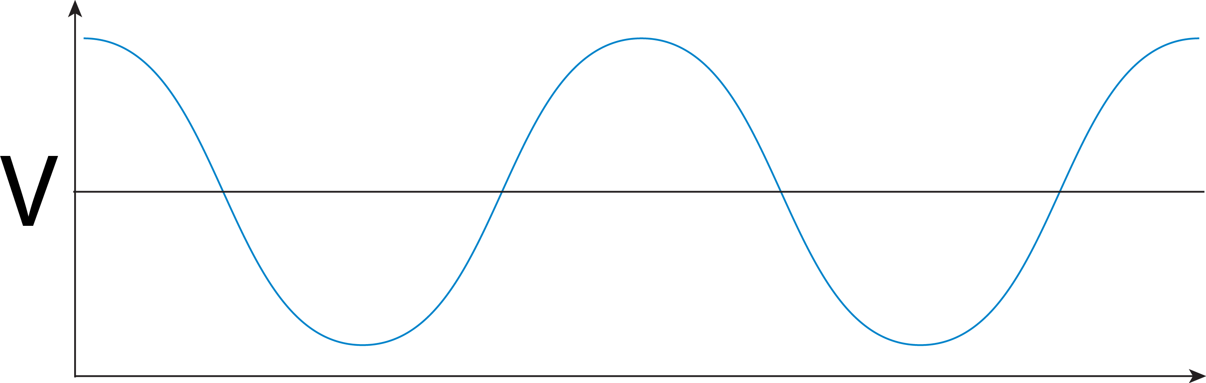
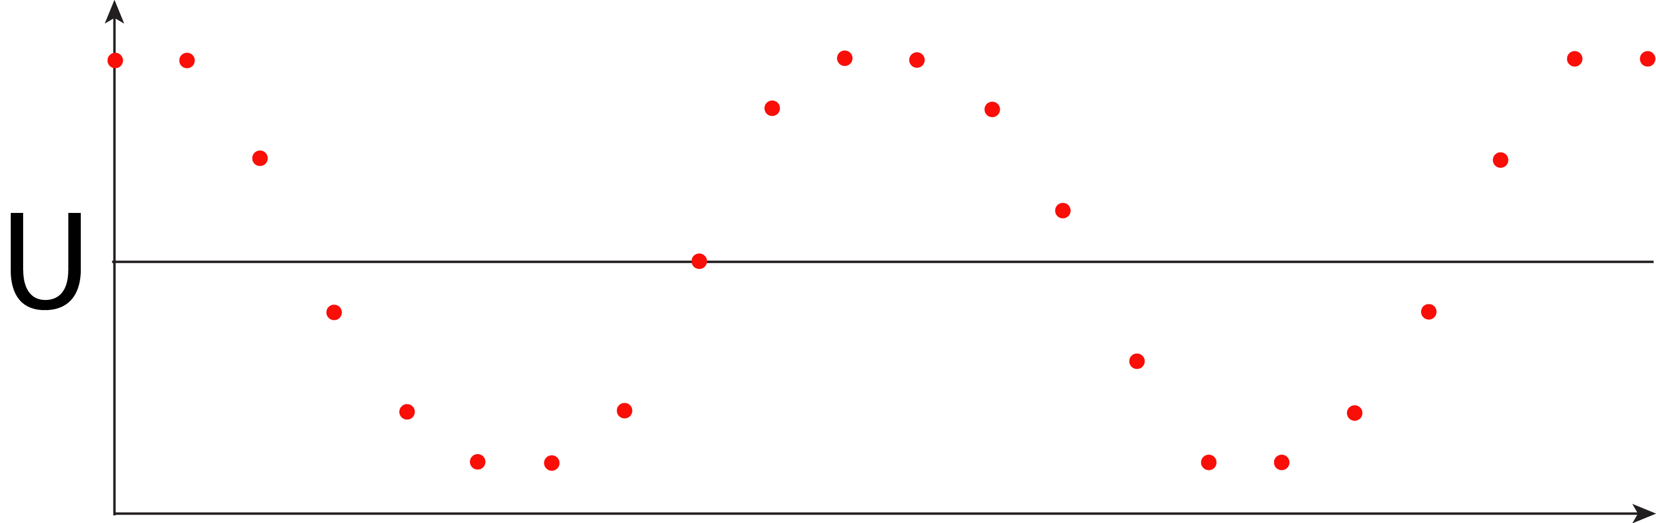
The digital recording chain
sound pressure (µPa) vs. time
1. microphone
voltage (mV) vs. time
2. preamplifier
(bigger) voltage (mV) vs. time
sample values vs. time
e.g., 16 bit: [-32768, 32767]
3. analog / digital
converter

Slide 11
The digital recording chain
sound pressure (µPa) vs. time
sample values proportional to sound pressure
sample values vs. time
e.g., 16 bit: [-32768, 32767]

Slide 12
Digital representation of sound
Sampling rate and frequency range
A digitized signal can only represent frequencies < one-half the sampling frequency (F_{s}/2).
F_{s}/2 is called the Nyquist frequency: the highest frequency that can be represented with a given sampling rate.
Be aware of the relationship between the frequency range of your signals of interest and your sampling rate.
(More on this later.)
Notes:
RAVEN: zoom to see indiv samples;
use Info panel to check sample rate; note no spectrogram > Nyquist

Slide 13
Digital representation of sound
Sample size (= bit depth)
Each sample is a binary number with a particular number of binary digits or bits– the sample size or bit depth.
With n bits, we can represent 2^{n} different sample values.
Example: 4-bit samples can represent 2⁴ = 16 different values:
0000 0 1000 8
0001 1 1001 9
0010 2 1010 10
0011 3 1011 11
0100 4 1100 12
0101 5 1101 13
0110 6 1110 14
0111 7 1111 15
16-bit samples: 2¹⁶ = 65,536 values.
24-bit samples: 2²⁴ = 16,777,216 values.
Notes:
FUTURE: why more bits are better

Slide 14
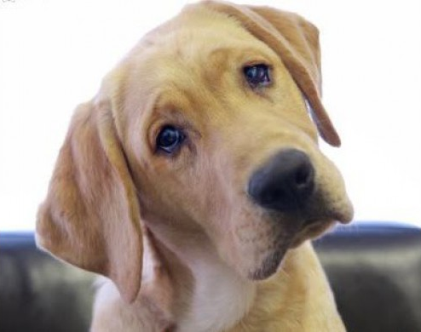
Digital representation of sound
Questions?

Slide 15
