Slide 1
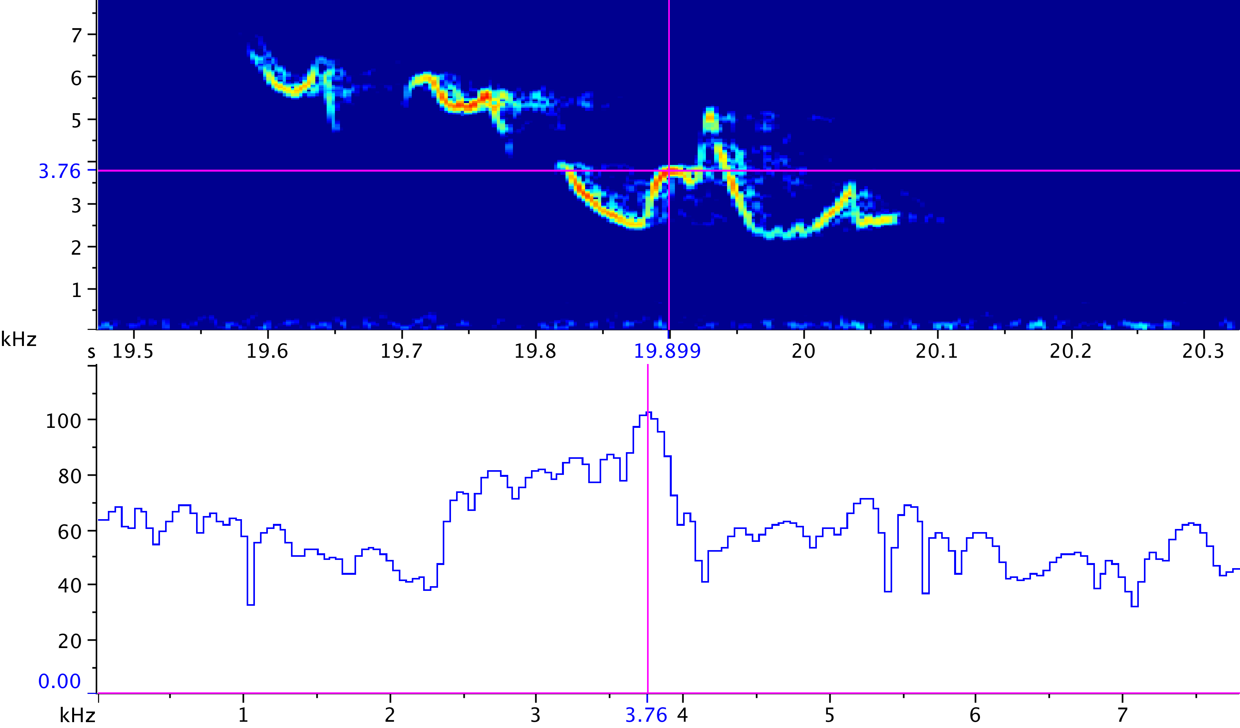

Introduction to Spectrogram Analysis
Sound Analysis Workshop
Ithaca, NY
3 – 7 Apr 2017
© 2007-17, Cornell Bioacoustics Research Program
Bioacoustics Research Program

Slide 2
Introduction to spectrograms
Time-domain and frequency domain representations of sound
Converting time-domain to frequency-domain: the DFT as a black box
Representing time-varying spectra: the spectrogram
Analysis resolution: the time-frequency tradeoff

Slide 3
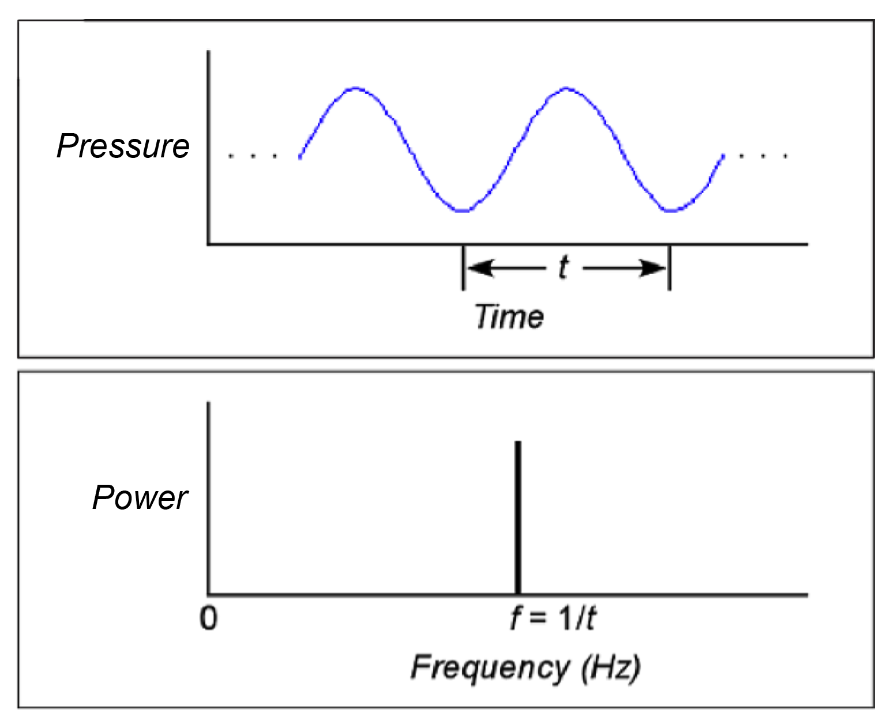
Time-domain and frequency-domain representations of sound
Pure tone (sinusoid)
infinitely long sound, not changing over time
Notes:
pure sinusoid, infinitely long (IMPORTANT LATER)
- note what the axes are!

Slide 4
Time-domain and frequency-domain representations of sound
Pure tone (sinusoid)
infinitely long sound, not changing over time
Notes:
pure sinusoid, infinitely long (IMPORTANT LATER)
- note what the axes are!

Slide 5
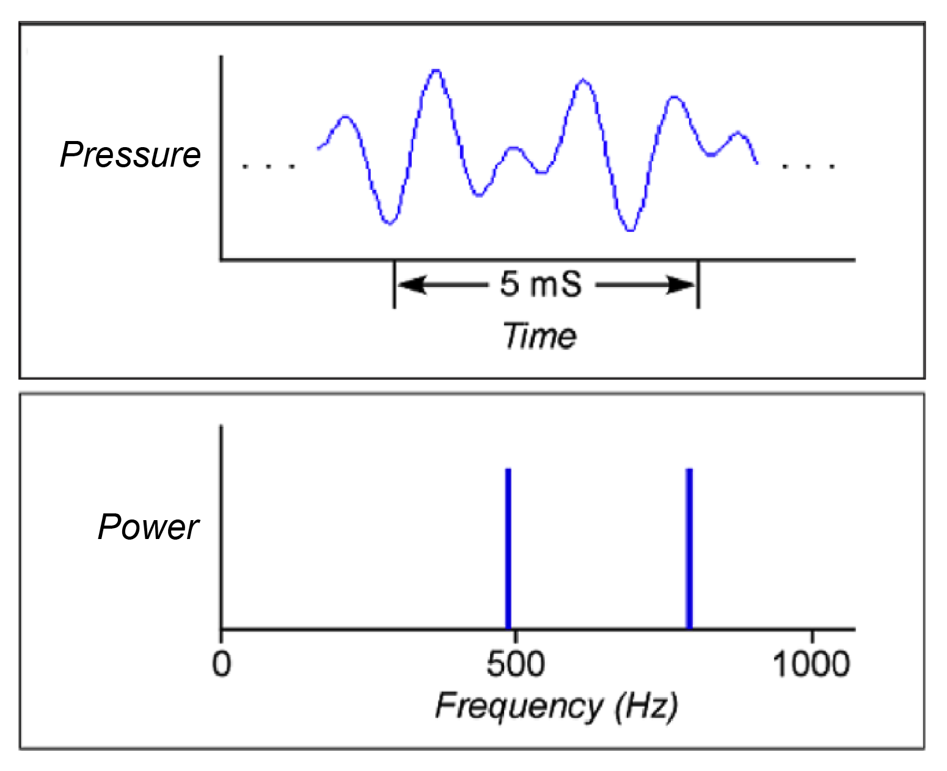
Time-domain and frequency-domain representations of sound
Multiple tones
490 Hz + 800 Hz
infinitely long sound, not changing over time
Notes:
sound may have multiple frequencies present at once;
when more than one frequency is present at once, to completely describe the sound in the freq domain you need two things: relative amplitudes of sounds (amplitude spectrum) and their relative phase or time relationship (phase spectrum)
we generally use only the amplitude spectrum
why the frequency domain representation is useful-- it’s what we hear

Slide 6
Introduction to spectrograms
Time-domain and frequency domain representations of sound
Converting time-domain to frequency-domain: the Fourier transform as a black box
Representing time-varying spectra: the spectrogram
Analysis resolution: the time-frequency tradeoff

Slide 7
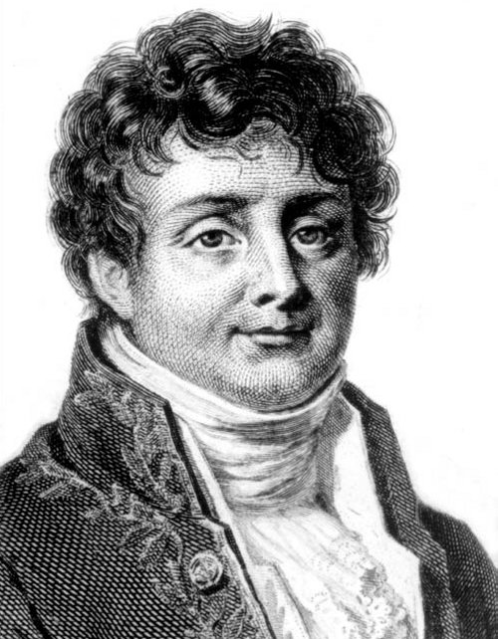

Converting from the time domain to the frequency domain
Any constant sound can be represented as a sum of a series of sinusoids (pure tones).
Any
. . !
DFT
Discrete Fourier Transform
Black box: a device, system, or object which can be viewed solely in terms of its input, output and transfer characteristics without any knowledge of its internal workings.
Joseph Fourier (1768 – 1830)
Notes:
(insert cake chemistry slide after this)

Slide 8
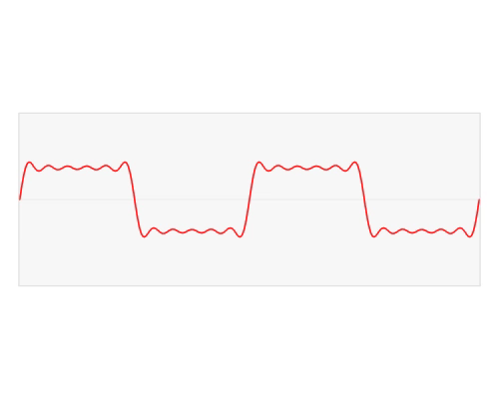
Time-domain and frequency-domain representations of sound
What M. Fourier taught us...
Any constant sound can be represented as a sum of a series of sinusoids (pure tones).
L. V. Barbosa via Wikipedia

Slide 9
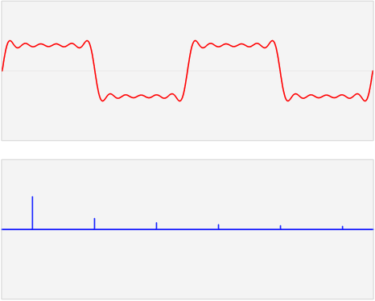
Time-domain and frequency-domain representations of sound
Sound pressure
Time
Sound power
Frequency

Slide 10
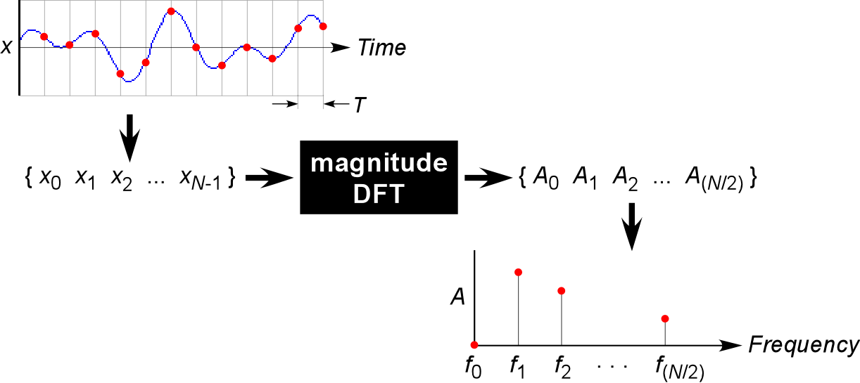
The Discrete Fourier Transform (DFT)
power values at
discrete frequencies
DFT
amplitudes
(∝ sound pressures)
at discrete times
The DFT converts a time-domain representation (waveform) of
N samples from a signal to a frequency-domain representation
(spectrum).
The spectrum is quantized: it shows powers at N/2 + 1
discrete frequencies, evenly spaced between 0 Hz and the
Nyquist frequency (F_{s}/2).
Notes:
Note what the axes are!

Slide 11
Introduction to spectrograms
Digital representation of sound
Time-domain and frequency domain representations of sound
Converting time-domain to frequency-domain: the DFT as a black box
Representing time-varying spectra: the spectrogram
Analysis resolution: the time-frequency tradeoff

Slide 12
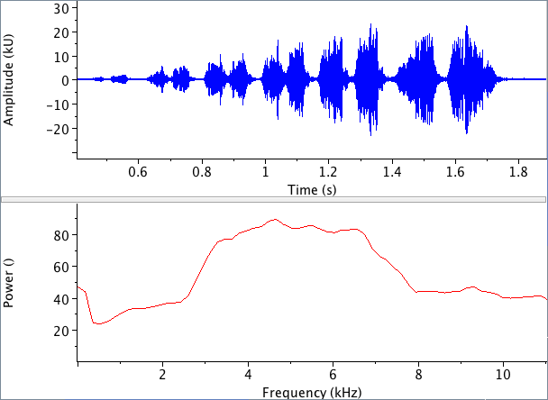
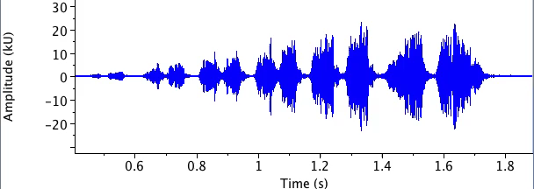
Representing time-varying spectra
PROBLEM:
Most biological sounds change in spectrum over time.
BUT...
A spectrum has no time dimension, so we can’t see these
interesting changes if we make a single spectrum of a sound.
Notes:
Remember the idealized transformation between time and freq domains– signal is infinitely long, and doesn’t vary over time.

Slide 13
Representing time-varying spectra
PROBLEM:
Most biological sounds change in spectrum over time.
BUT...
A spectrum has no time dimension, so we can’t see these
interesting changes if we make a single spectrum of a sound.
SOLUTION:
Chop the signal up into very short time segments, use the DFT to
compute the power spectrum of each segment (or “window”, “slice”).
The sequence of power spectra is called the spectrogram.
Spectrograms are usually displayed with successive spectra
side by side, using color to indicate relative power.
Notes:
Remember the idealized transformation between time and freq domains– signal is infinitely long, and doesn’t vary over time.
[simplification– the spectrogram is just the magnitude portion of the STFT; but we ignore and don’t mention the phase spectrum]

Slide 14
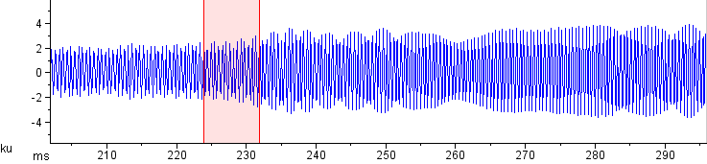

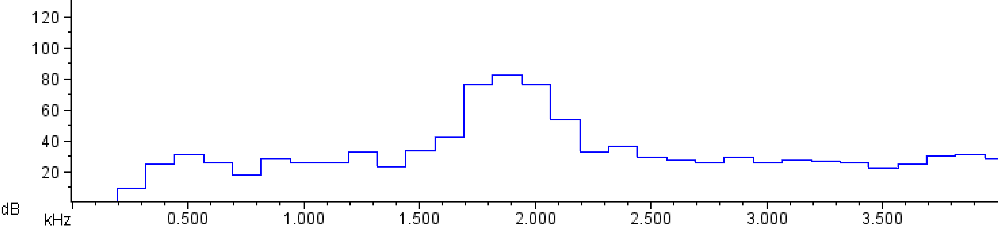
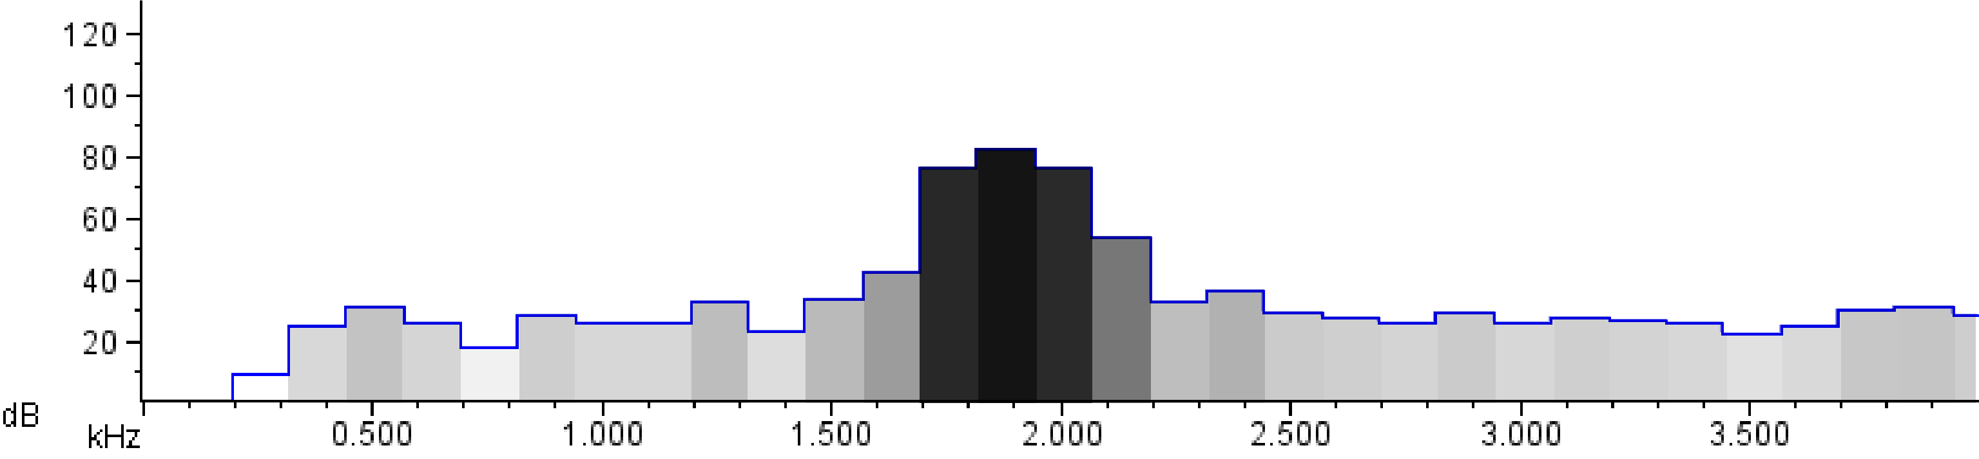
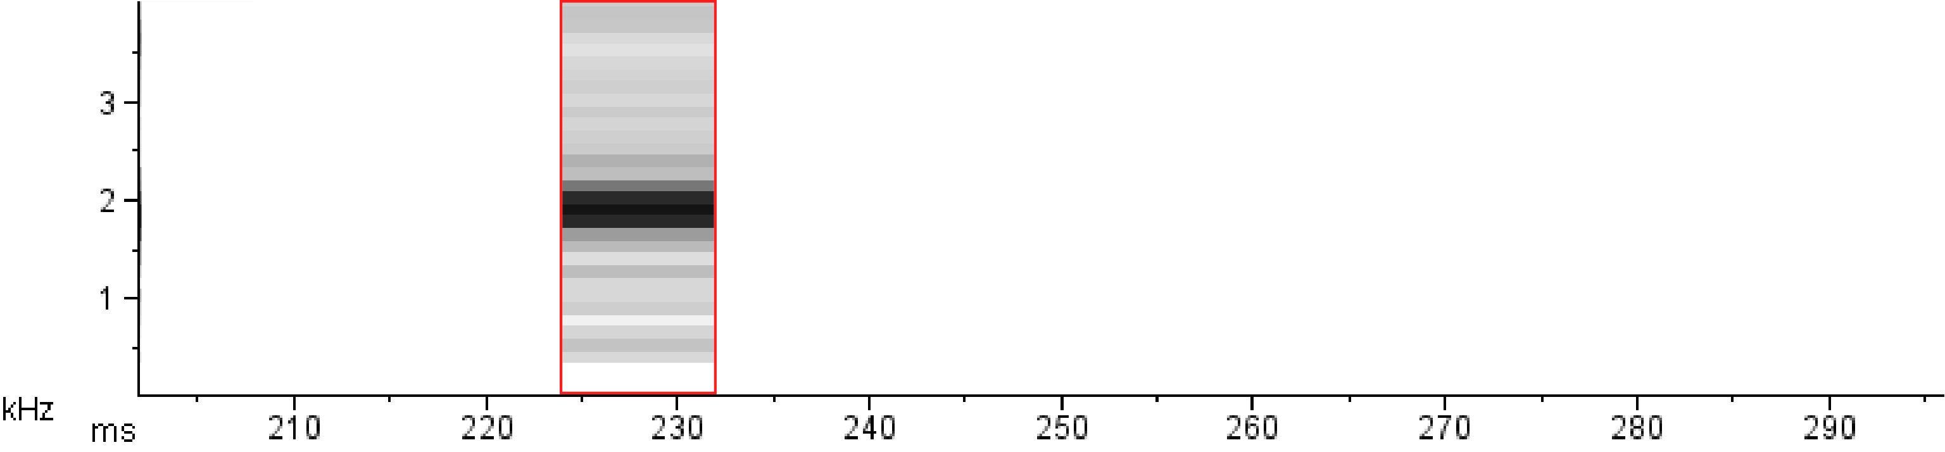

Representing time-varying spectra
Notes:
Note the axes in the spectrum: X= frequency, Y = amplitude. Note– NO TIME AXIS!

Slide 15
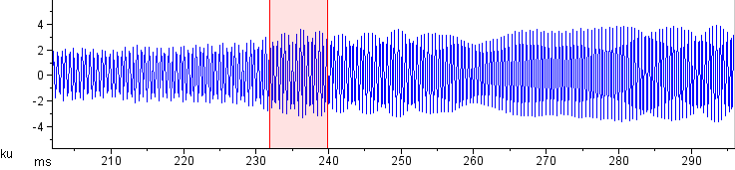
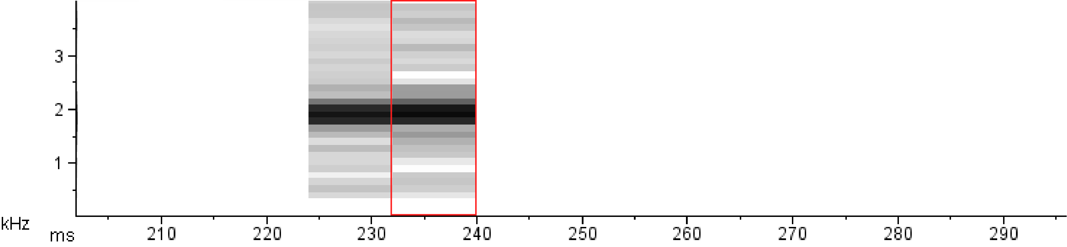
Representing time-varying spectra

Slide 16
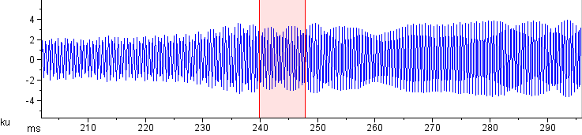
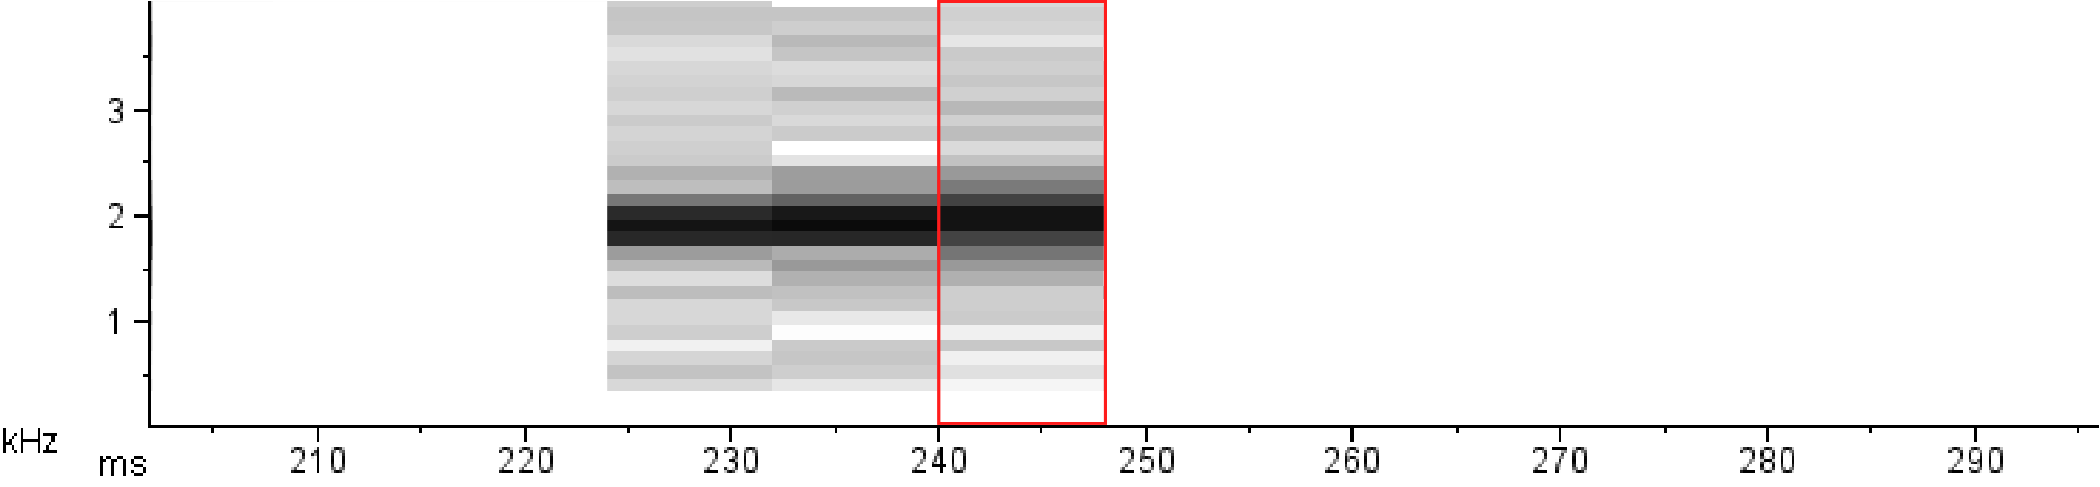
Representing time-varying spectra

Slide 17
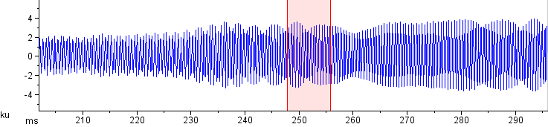
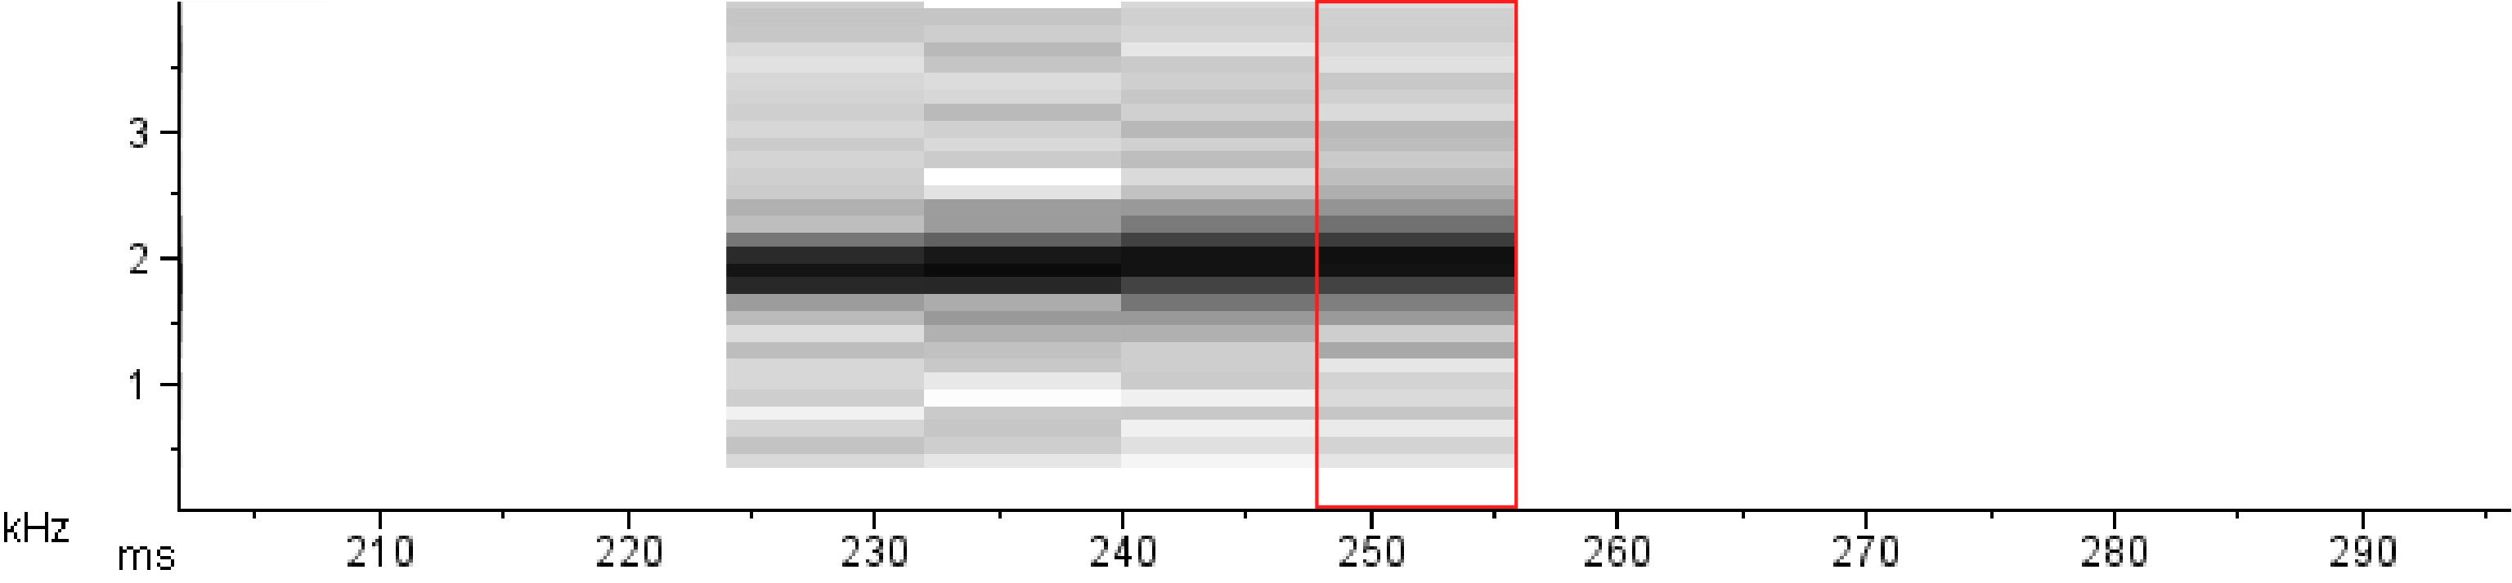
Representing time-varying spectra

Slide 18
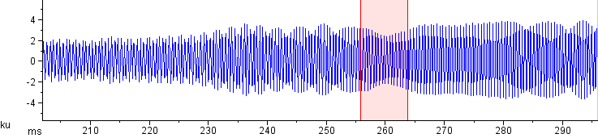
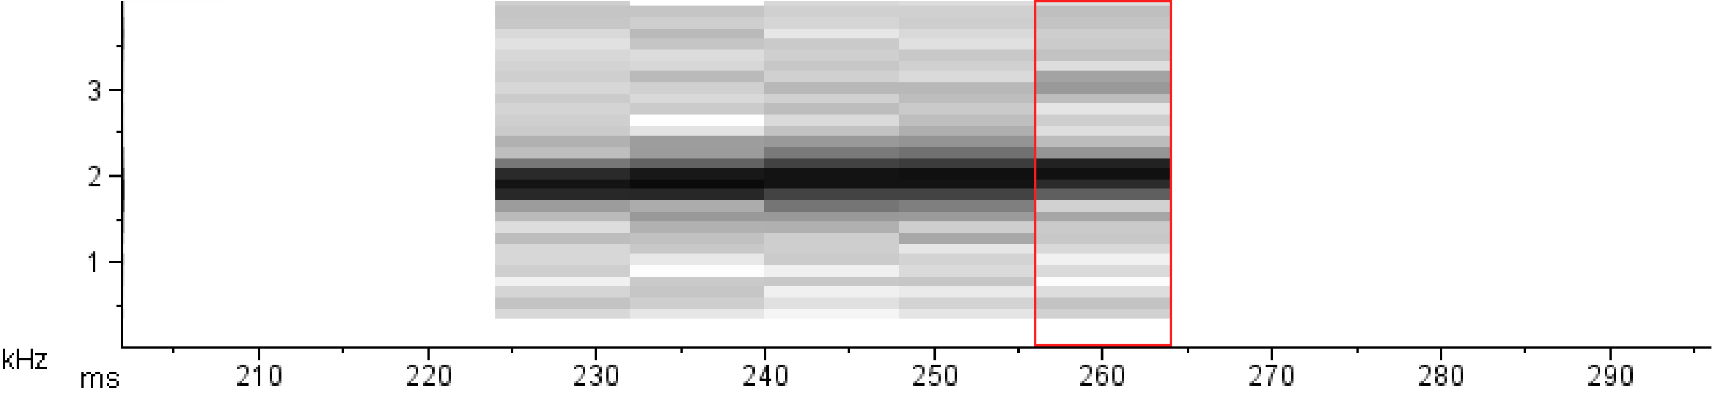
Representing time-varying spectra
Notes:
Notice that this is discrete, quantized– discrete time slice w/ particular duration, and frequency bins w/finite height.

Slide 19
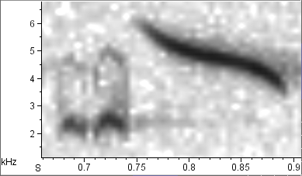

Spectrograms
A spectrogram is a matrix of numbers.
Each number represents the intensity in a discrete (short)
time period and a discrete (narrow) frequency band.
The matrix is usually visualized as a spectrogram image.
Each column or time bin contains one spectrum,
the output of a single DFT.
By default, Raven displays smoothed spectrograms
that obscure the true discrete structure of the spectrogram:
Notes:
DO IT:
(1) export samples to Excel, do color coding.

Slide 20
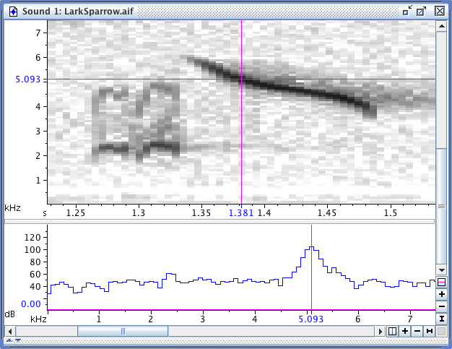
Spectrograms
Raven’s spectrogram slice view shows one individual spectrum
from a spectrogram.
Notes:
DO IT:
(1) open a signal in Raven, turn off smoothing, zoom in, make a slice, drag position marker around.

Slide 21
Spectrograms
There is no such thing as the spectrogram of a signal;
many different spectrograms can be made of a signal.
There is (often) no such thing as the best spectrogram
of a signal.
Making spectrograms involves tradeoffs.
Notes:
There are lots of ways to vary a a spectrogram; for now, let’s look at just one...

Slide 22
Spectrograms
How long? (How many samples?)
Notes:
Note the axes in the spectrum: X= frequency, Y = amplitude. Note– NO TIME AXIS!
** we can take a longer or shorter piece to make the spectrum; let’s see what happens when we vary that...

Slide 23
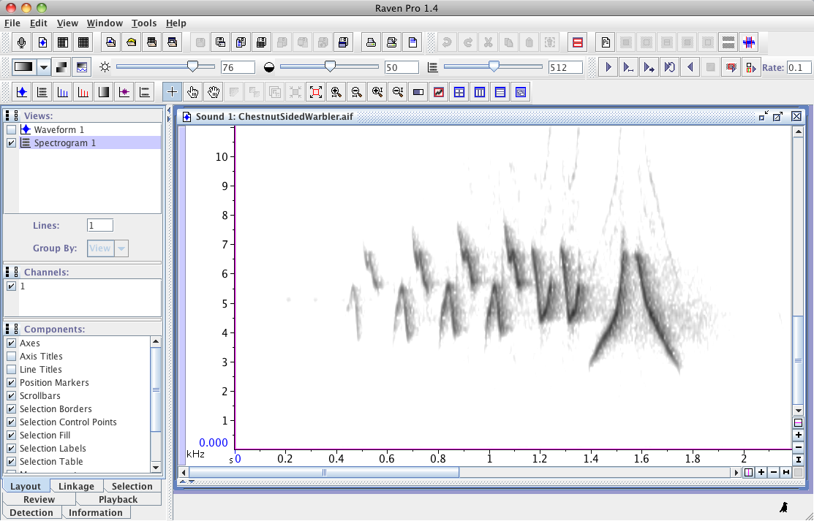
Spectrograms
number of samples used
to make each spectrum
(“window size”)
Notes:
go to Raven, have them play w/window size slider– what happens? describe effect

Slide 24
Spectrograms
There is an inescapable tradeoff between a spectrogram’s sharpness (or resolution) in time and frequency.

Slide 25
Spectrograms
Rules of thumb for adjusting spectrogram parameters
Time-frequency tradeoff
Spectrogram too smeared in time → smaller window size
Spectrogram too smeared in frequency → larger window size

Slide 26

Spectrograms
Questions?

Slide 27
