Slide 1
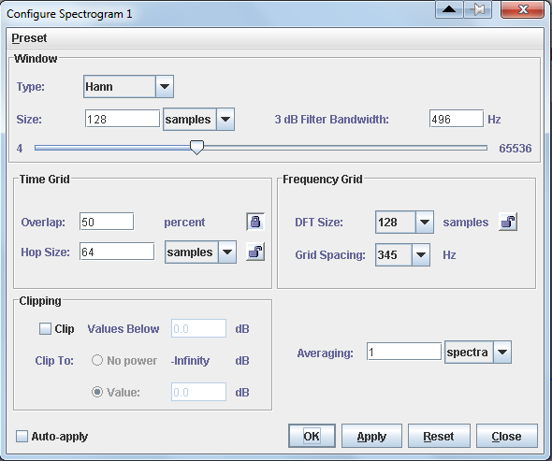
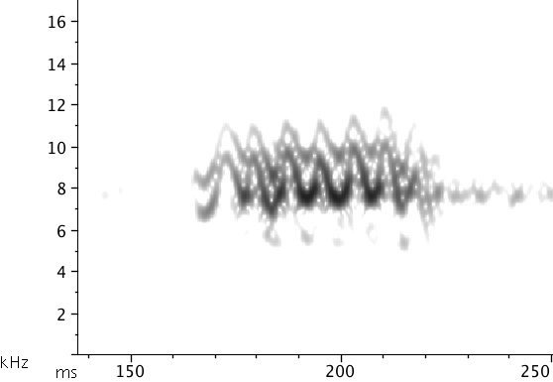
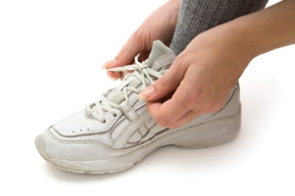

Spectrogram Parameters
Sound Analysis Workshop
Ithaca, NY
3 – 7 April 2017
© 2007-17, Cornell Bioacoustics Research Program
Bioacoustics Research Program

Slide 2
Spectrogram parameters
Why not just use the defaults?

Slide 3
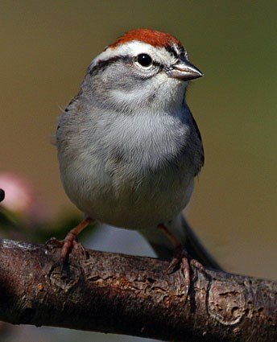
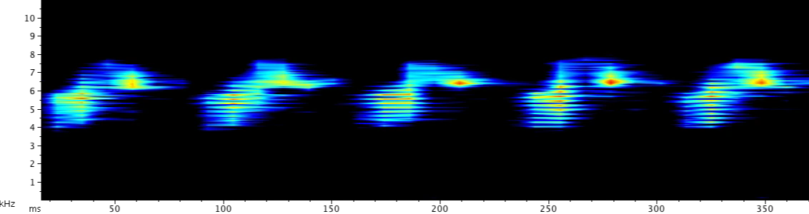

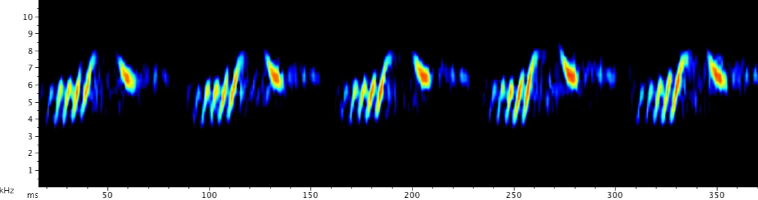
Spectrogram parameters
Why not just use the defaults?
Chipping sparrow
© Michael Hogan, 2006
1/10 speed:
Notes:
(need additional examples; CHSP?)

Slide 4
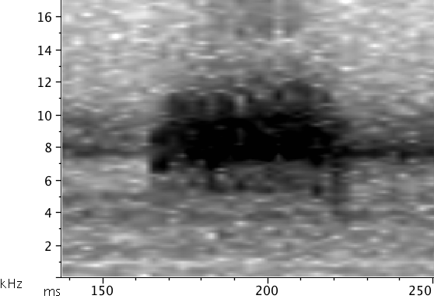
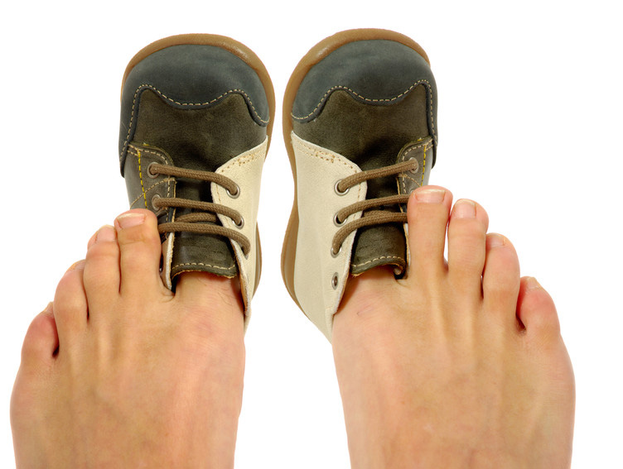

How is a spectrogram like a pair of shoes?

Slide 5
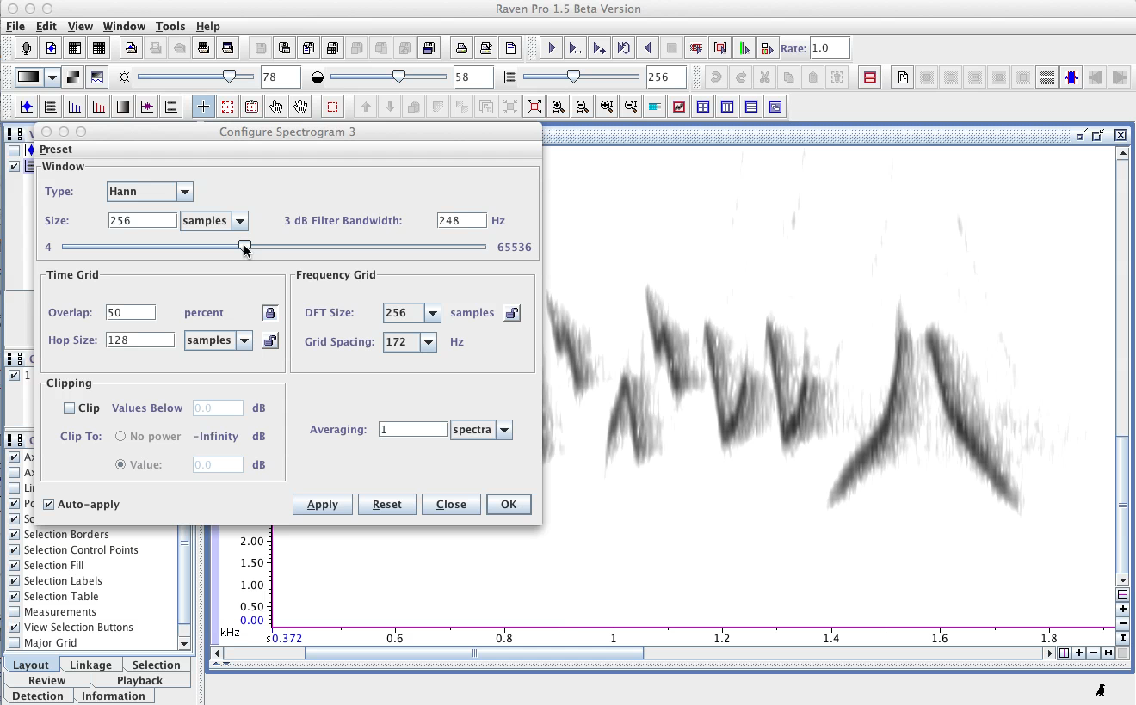
Spectrogram parameters
Window Size
Window Size controls the tradeoff between time and frequency
sharpness in spectrum analysis.
Notes:
Note “Record Length” used in Raven manual

Slide 6
Spectrogram parameters
Window Size
(aka Window Length)
Window Size: the length of the audio segment used to make
each individual spectrum.
Window Size can be expressed either in samples or
in time units (s, ms).
Window Size controls the tradeoff between time and frequency
sharpness in spectrum analysis.

Slide 7
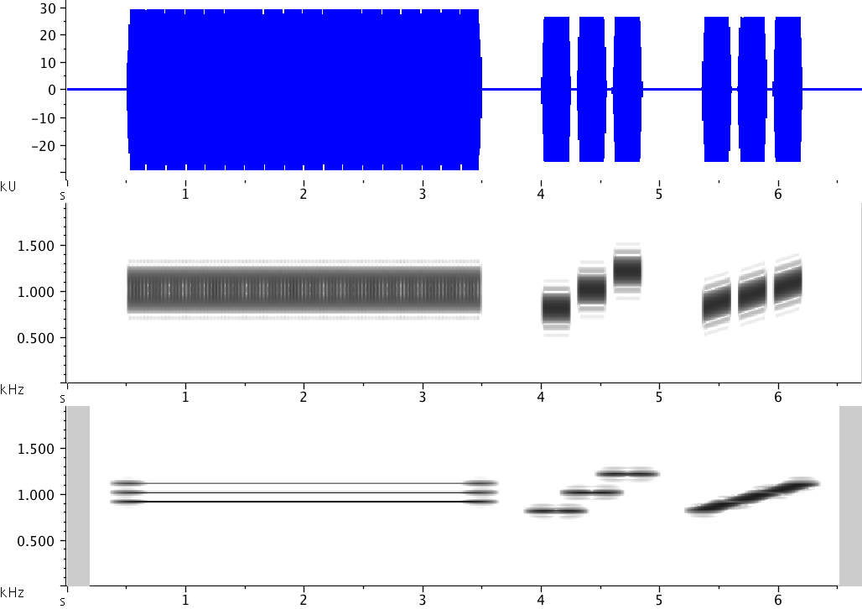
Spectrogram parameters
Window Size and the time-frequency resolution tradeoff
(aka “uncertainty principle”)
Gap = 51 ms
= 1125 samples
Window length = 256
Hop Size = 128 samples
DFT Size = 8192
Freq Grid = 2.7 Hz
Window length = 8192
Hop Size = 128 samples
DFT Size = 8192
Freq Grid = 2.7 Hz
Notes:
DO IT:
- open “Time-Frequency tradeoff.wav”

Slide 8
Spectrograms
Rules of thumb for adjusting spectrogram parameters
Time-frequency tradeoff
Spectrogram too smeared in time → smaller window size
Spectrogram too smeared in frequency → larger window size

Slide 9
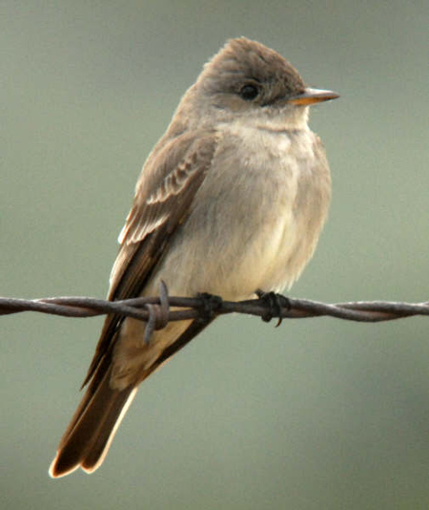
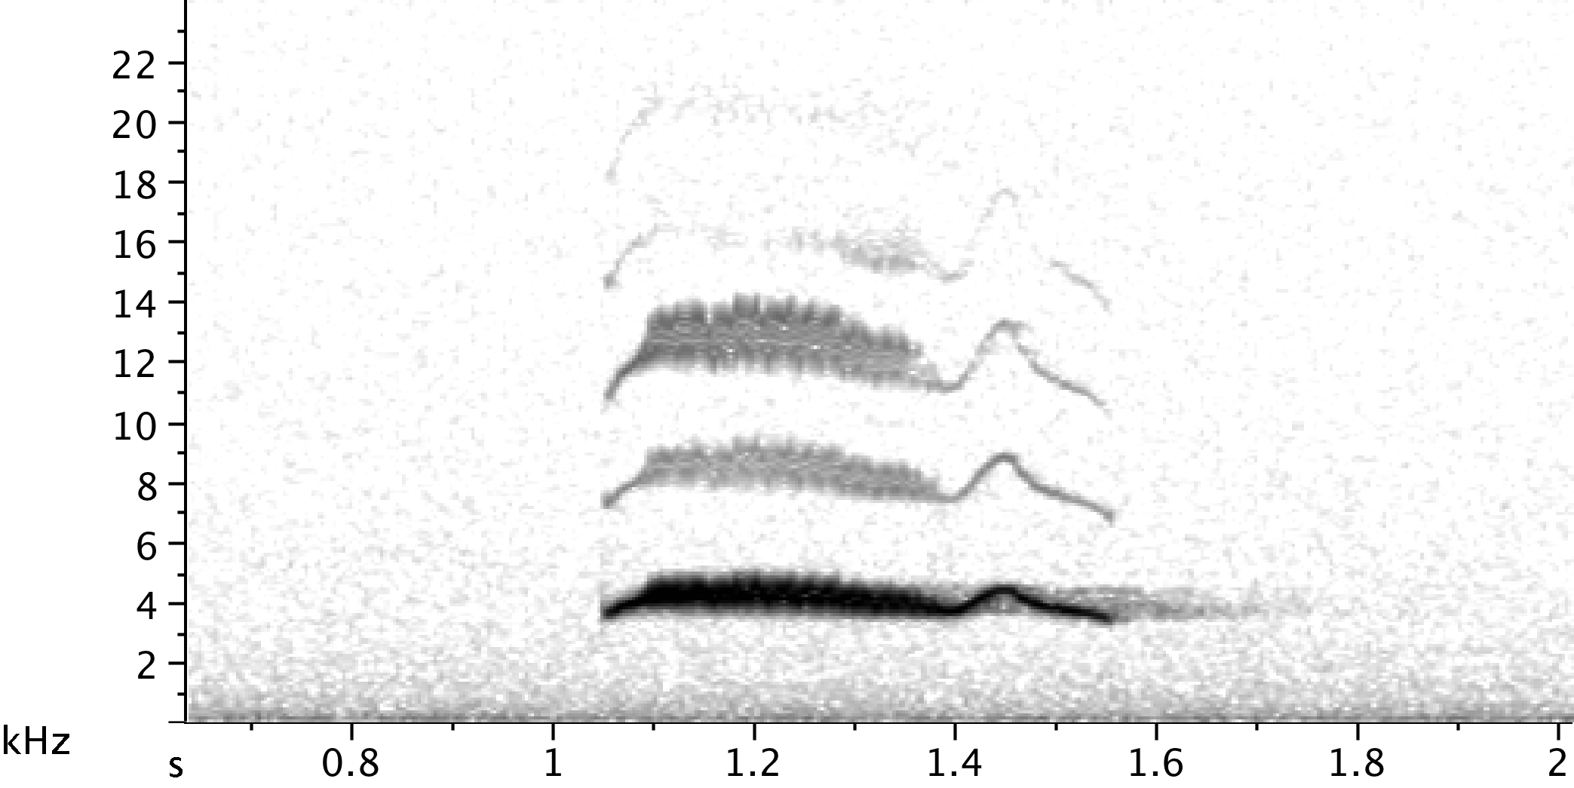
Spectrogram parameters
Window Size and the time-frequency resolution tradeoff
(aka “uncertainty principle”)
Western Wood Peewee
Ryan Houston, utahbirds.org
Recording by Laura Gooch
Notes:
DO IT:
- open and work through in Raven; CHANGE ONLY WINDOW SIZE

Slide 10
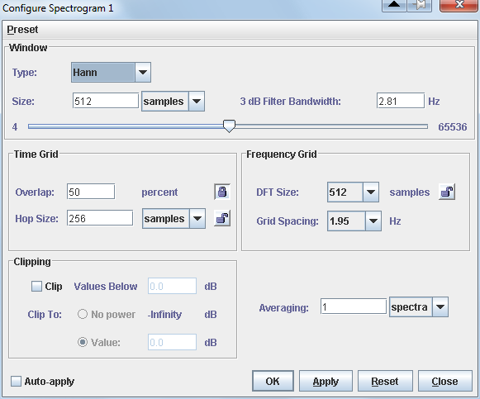
Spectrogram parameters
Window Size and the time-frequency resolution tradeoff
T-F sharpness
tradeoff

Slide 11
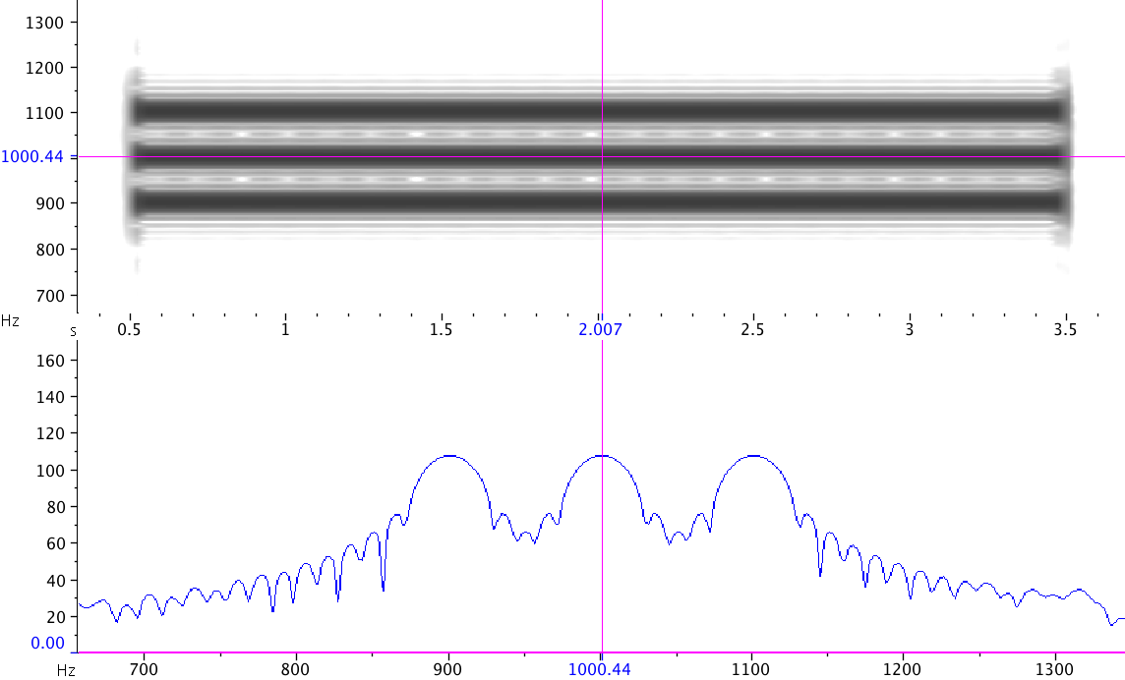
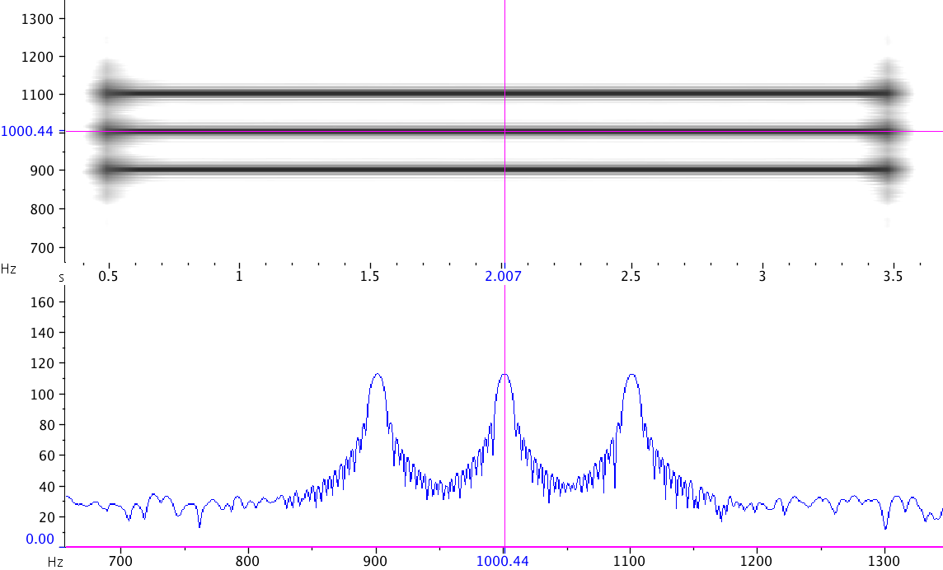
Spectrogram parameters
3 dB Filter Bandwidth
Window Size = 1500 pts
3 dB Filter Bandwidth is a measure of the “sharpness” of frequency lines in a spectrum
Window Size = 5000 pts
Notes:
(illustrate on whiteboard)

Slide 12
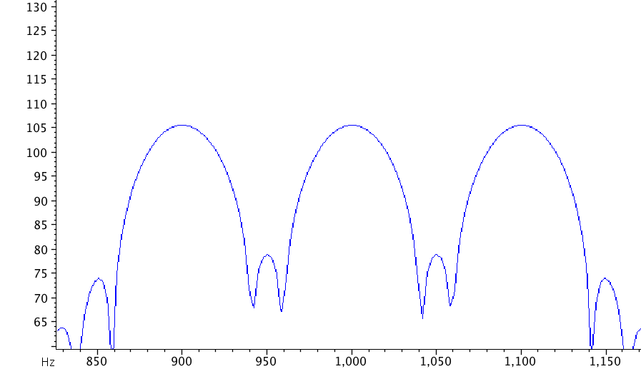
Spectrogram parameters
3 dB Filter Bandwidth
a measure of the “sharpness”
of frequency lines in a spectrum
peak
peak–3 dB
3 dB BW
measures the “sharpness” of frequency lines in a spectrum
depends on Window Size and Window Function
specify Filter Bandwidth directly, and Raven will choose
the appropriate Window Size

Slide 13
Spectrogram parameters
Window Size and the time-frequency resolution tradeoff
T-F sharpness
tradeoff
Notes:
– in Raven, notice that:
(1) DFT options are powers of 2

Slide 14
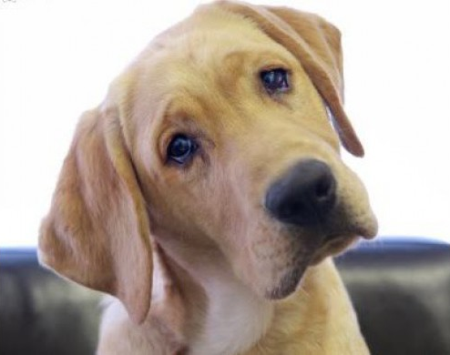
Spectrograms
Questions?

Slide 15
Spectrogram Parameters
PART 2
Sound Analysis Workshop
Ithaca, NY
3 – 7 April 2017
© 2007-17, Cornell Bioacoustics Research Program
Bioacoustics Research Program

Slide 16
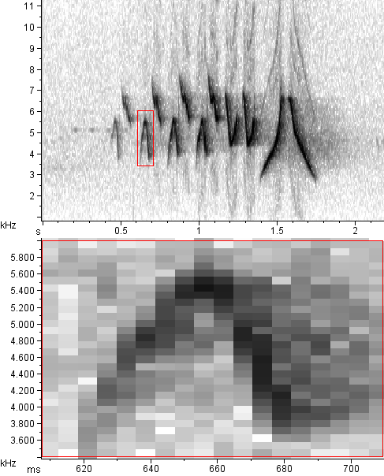
Spectrogram parameters: grid resolution
Frequency
Grid Spacing
(freq. bin size)
Notes:
– freq grid spacing not only affects how the image looks zoomed in; also affects measurement precision
– in Raven: zoom way in, notice that
(1) power value shown for mouse position don’t change within a spectrogram cell
(2) freq grid resolution changes in discrete jumps as you change window size; why is this?

Slide 17
Spectrogram parameters
Frequency Grid
freq resolution
(measurement
precision)
Notes:
– in Raven, notice that:
(1) DFT options are powers of 2
(2) DFT values change as you change window size, but not smoothly; they jump:
> Raven by default chooses the smallest DFT ≥ Window Size
(3) each time DFT Size changes,

Slide 18
Spectrogram parameters
Frequency Grid
Grid Spacing dropdown lets you directly choose
Grid Spacing depends on DFT Size
DFT Size determines
the number of frequency bins in the spectrogram: N = DFT/2 + 1
height of each frequency bin
= F_{s} / DFT; units: Hz;
Larger DFT
➔ finer “frequency grid spacing”, hence finer precision of
frequency measurements;
all measurements are
± gridSpacing/2
Available DFT sizes are powers of 2
By default, Raven uses the smallest DFT Size that is
≥ Window Size
You can improve measurement precision by choosing a smaller Frequency Grid Spacing
Notes:
– in Raven, notice that:
(1) DFT options are powers of 2
(2) DFT values change as you change window size, but not smoothly; they jump:
> Raven by default chooses the smallest DFT ≥ Window Size
(3) each time DFT Size changes,

Slide 19
Spectrogram parameters
DFT Size / Frequency Grid
(aka FFT Length, Transform Size)
Remember:
frequency measurements are quantized into discrete bins
DFT Size determines how many bins the total frequency space is divided into
larger DFT ➔ more (hence smaller) frequency bins, greater precision in frequency measurements
Frequency
Grid Spacing
(freq. bin size)

Slide 20
Spectrograms
Rules of thumb for adjusting spectrogram parameters
Time-frequency tradeoff
Spectrogram too smeared in time → smaller window size
Spectrogram too smeared in frequency → larger window size
Spectrogram smoothness (measurement precision)
Spectrogram too coarse in frequency → larger DFT size
(smaller frequency grid (bin) size)

Slide 21
Spectrogram parameters
DFT Size and frequency “smoothness”
Western Wood Peewee
Ryan Houston, utahbirds.org
Recording by Laura Gooch
Notes:
DO IT:
- make 2 spgs; unlink spectrogram parameters
open and work through in Raven;
UNSMOOTH
CHANGE ONLY DFT

Slide 22
Spectrogram parameters: grid resolution
Hop Size
(time bin size)

Slide 23
Spectrogram parameters
Time Grid
time resolution
(measurement
precision)

Slide 24
Spectrogram parameters
Time Grid
Hop Size is the width of each time bin or column in the spectrogram;
units: samples, ms, or s.
Hop Size determines the precision
of time measurements:
measurements are ± HopSize/2
Determined by Window Size and Overlap between successive
windows:
hop size = (100% - overlap%)
* WindowSize
Raven lets you specify hop size directly (in either ms or samples)
or by setting % window overlap.
You can improve time measurement precision by specifying a
higher Overlap (Raven’s default is 50% Overlap).

Slide 25
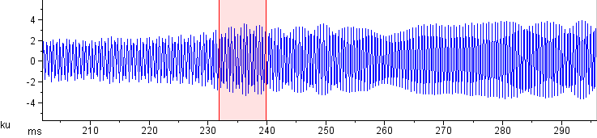
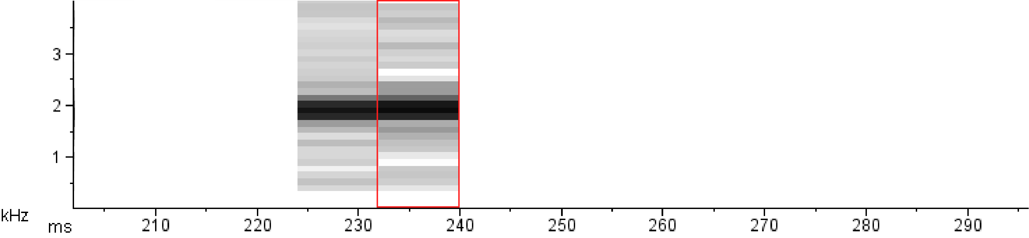
Representing time-varying spectra
Notes:
• Remember this?

Slide 26
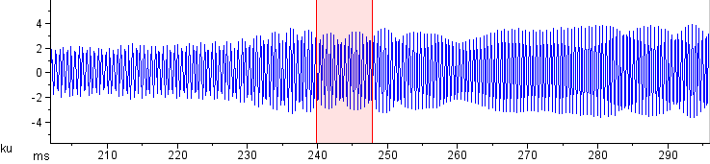
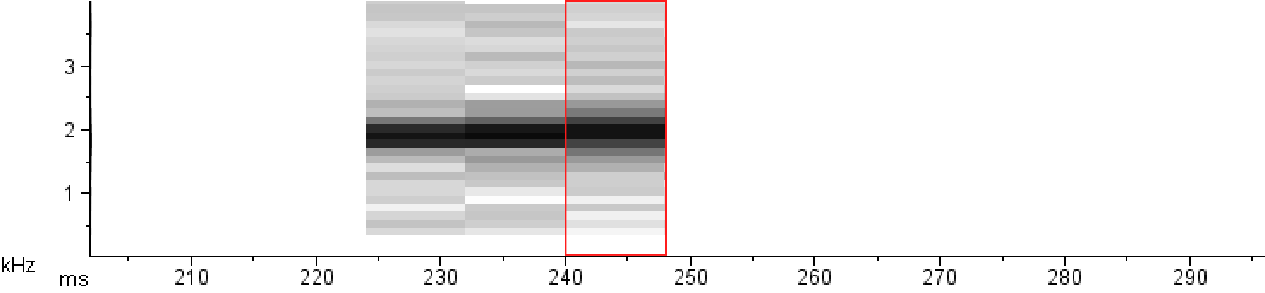
Representing time-varying spectra
Notes:
• this was an oversimplification; this would suggest that the hop size equals the window length
• but in fact, we usually overlap successive windows/slices; let’s take a look at how this works...

Slide 27
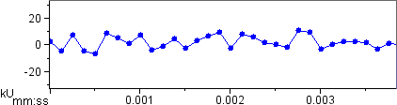
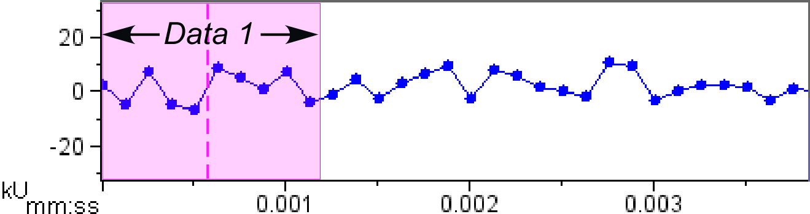
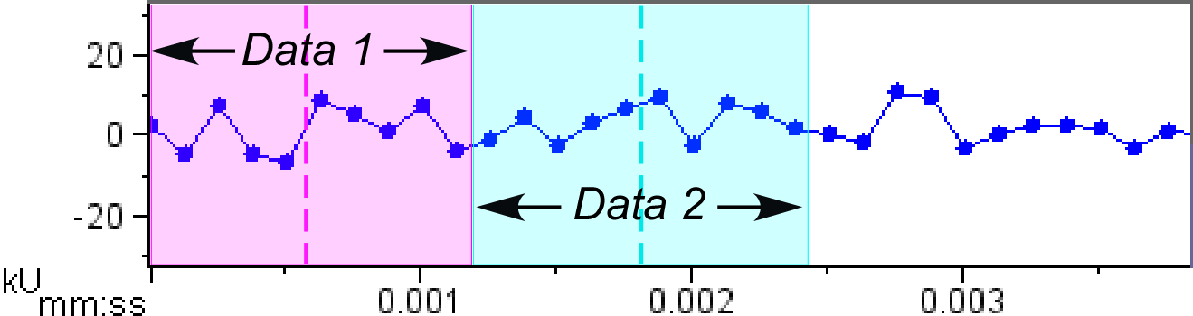
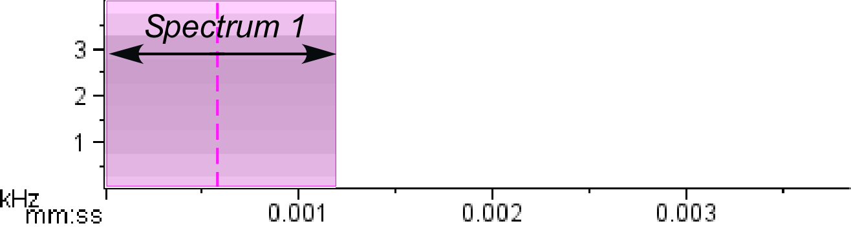
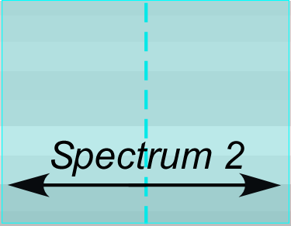
Spectrogram parameters
Window Overlap and Hop Size
window length = 10
overlap = 0, hop size = 10

Slide 28
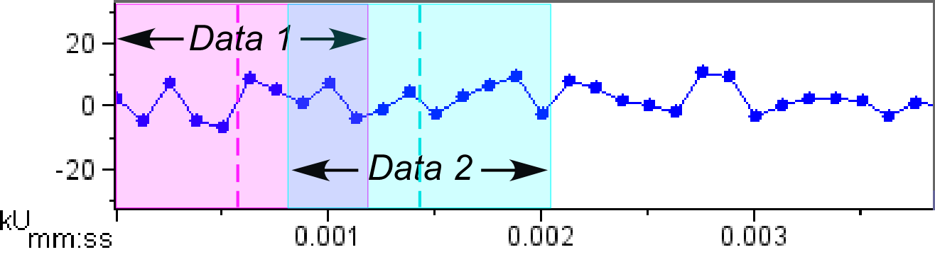
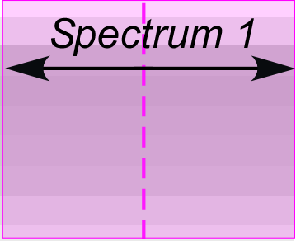
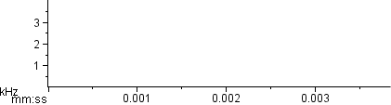
Spectrogram parameters
Window Overlap and Hop Size
window length = 10
overlap = 3, hop size = 7

Slide 29
Spectrogram parameters
Window Overlap / Hop Size
(aka Hop Length)
Remember:
time measurements are quantized into discrete bins
Window Length and Overlap together determine
Hop Size
higher Overlap ➔ smaller time bins,
greater precision in time measurements
Hop Size
(time bin size)

Slide 30
Spectrograms
Rules of thumb for adjusting spectrogram parameters
Time-frequency tradeoff
Spectrogram too smeared in time → smaller window size
Spectrogram too smeared in frequency → larger window size
Spectrogram smoothness
Spectrogram too grainy in frequency → larger DFT size
(smaller frequency grid (bin) size)
Spectrogram too grainy in time → higher overlap (smaller hop size)

Slide 31
Spectrogram parameters
Hop Size and time “smoothness”
Western Wood Peewee
Ryan Houston, utahbirds.org
Recording by Laura Gooch
Notes:
DO IT:
- make 2 spgs; unlink spectrogram parameters
- open and work through in Raven; CHANGE ONLY OVERLAP

Slide 32
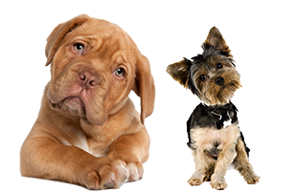
Questions?
Notes:
BREAK HERE

Slide 33
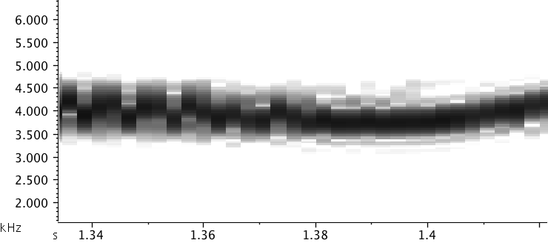
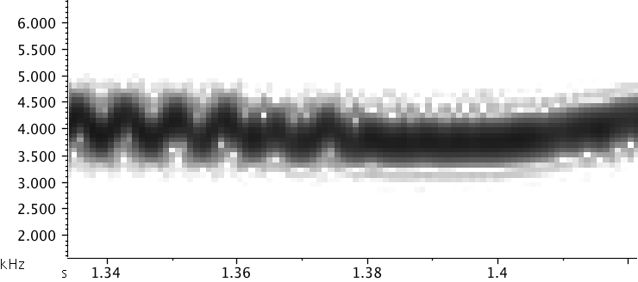
Spectrogram parameters
Summary
Visible features of the spectrogram
Determined by parameters
Time-Frequency smearing tradeoff
Window Size (Length)
Frequency bin size
DFT (FFT) size
Time bin (hop) size
Overlap
relative to Window Size

Slide 34
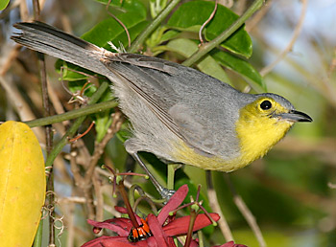
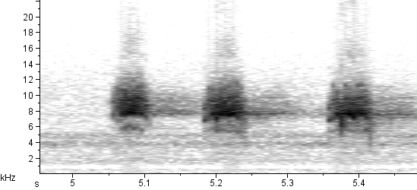
Spectrogram parameters in practice
Oriente Warbler
surfbirds.com
Notes:
“Now you try...”

Slide 35
Spectrogram parameters
Window Function
T-F sharpness
tradeoff
time resolution
(measurement
precision)
freq resolution
(measurement
precision)

Slide 36
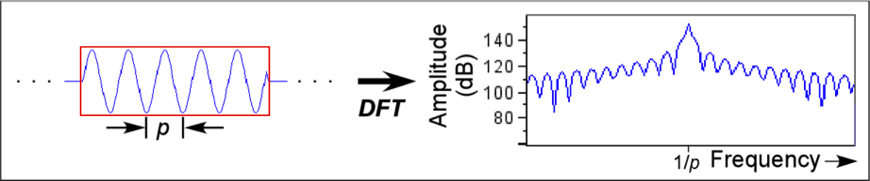
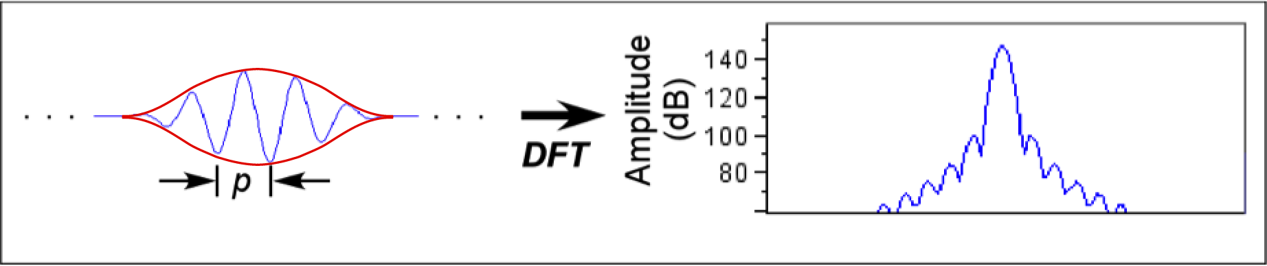
Spectrogram parameters
Window Functions
The spectrum of a rectangular chunk of a sinusoid contains large
sidelobes: energy appears at frequencies below and above
the center frequency:
rectangular window
sidelobes
If we taper the amplitude values at the start and end of the chunk,
the sidelobes become smaller:
tapered window
To taper the signal, we multiply the samples in it by a window function.

Slide 37
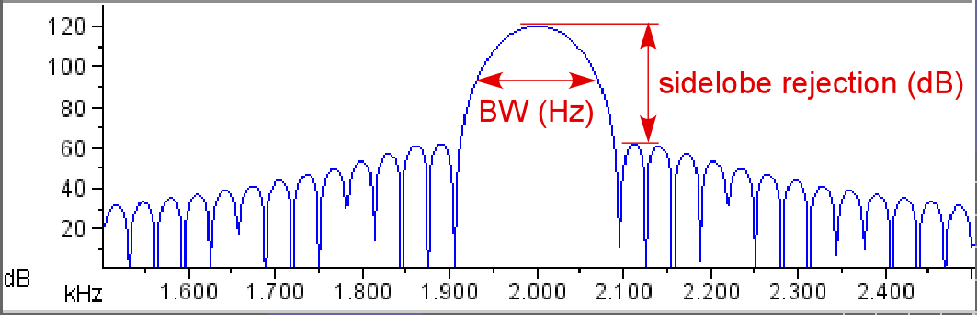
Spectrogram parameters
Window Functions
Different window functions (types) are characterized by different
bandwidths and sidelobe heights relative to the height of the
main lobe (sidelobe rejection).
Remember that bandwidth varies with window size;
larger window size → narrower bandwidth.
Notes:
REVISE THIS SLIDE:
There are two measurements we can use to describe this spectrum: BW and sidelobe rejection

Slide 38
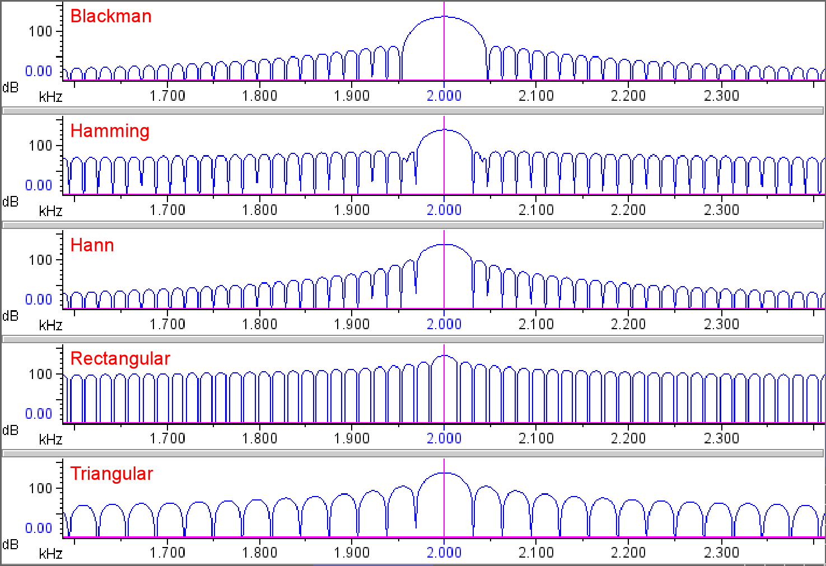
Spectrogram parameters
Window Functions
Window types differ in main-lobe bandwidth, and in height
and width of sidelobes.

Slide 39
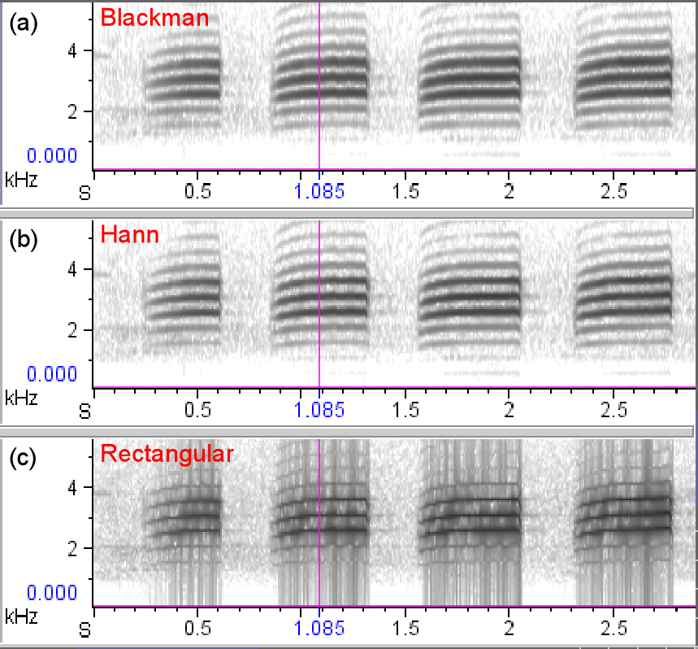
Spectrogram parameters
Effects of window type in spectrograms
(Sidelobes can often be suppressed or minimized in spectrogram
images by adjusting brightness and contrast.)

Slide 40
Spectrogram parameters
Summary
main lobe-
sidelobe
tradeoff
T-F sharpness
tradeoff
time resolution
(measurement
precision)
freq resolution
(measurement
precision)
That’s all, folks!

Slide 41
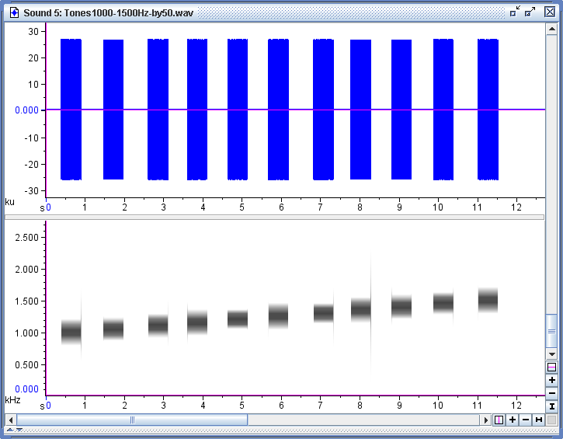
Spectrogram parameters
A puzzle...
Notes:
long window gives very sharp frequency resolution, but sloppy time– look at edges
in long window, a single window is longer than the gap
do exercise with 1000 Hz tones by +50

Slide 42
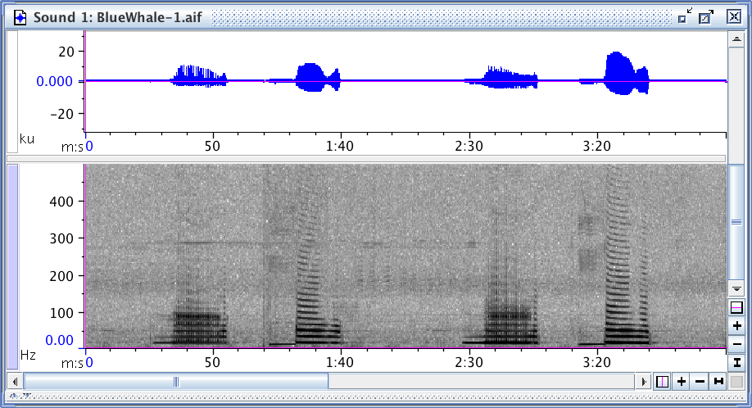
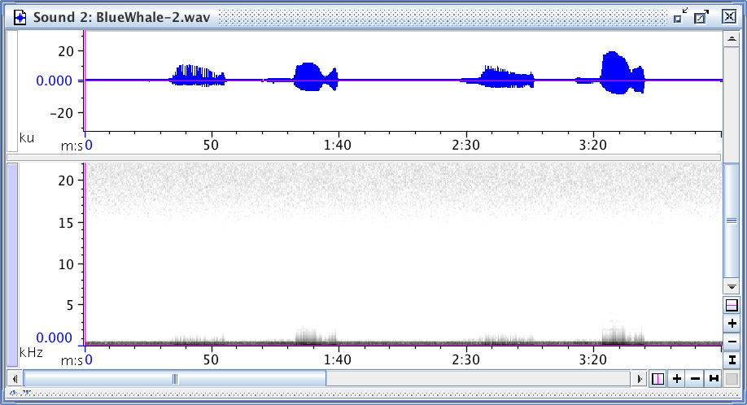
Spectrogram parameters
A puzzle...

Slide 43
