Slide 1
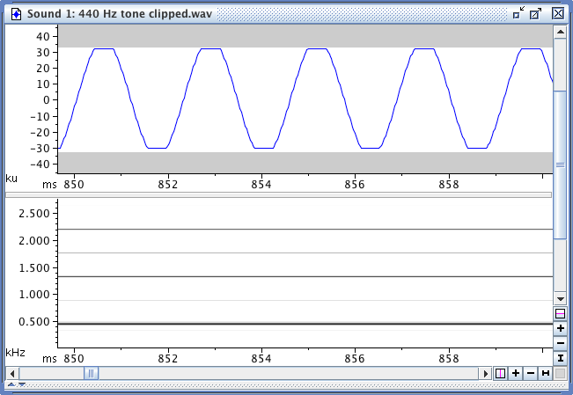
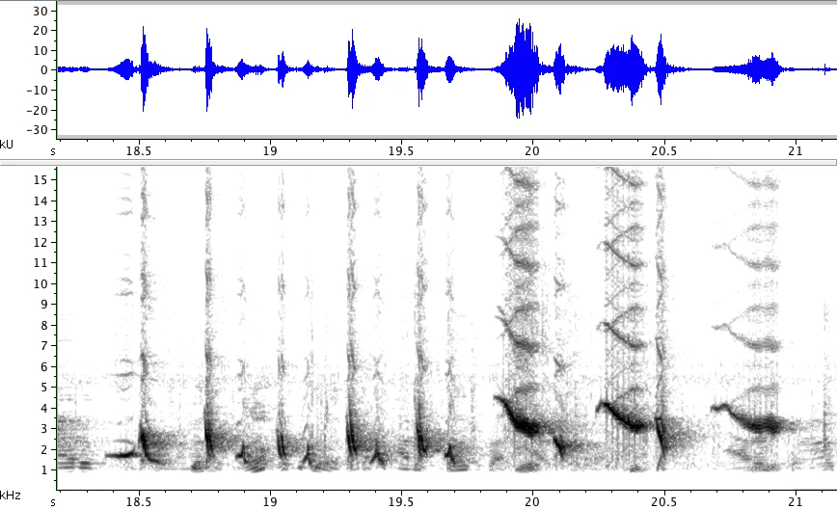

Digital Recording Artifacts
Sound Analysis Workshop
Ithaca, NY
3 – 7 Apr 2017
© 2007-16, Cornell Bioacoustics Research Program
Bioacoustics Research Program

Slide 2
Digital recording artifacts
What do we mean by “artifacts”?
Specific types of distortions in a recording that result from errors
in the recording process
Failure to recognize these artifacts can result in erroneous
descriptions and measurements!

Slide 3
Digital recording artifacts
Clipping:
bit depth insufficient to represent the high-amplitude portions
of a sound
Aliasing:
sample rate too low to properly represent high frequencies
present in a sound

Slide 4
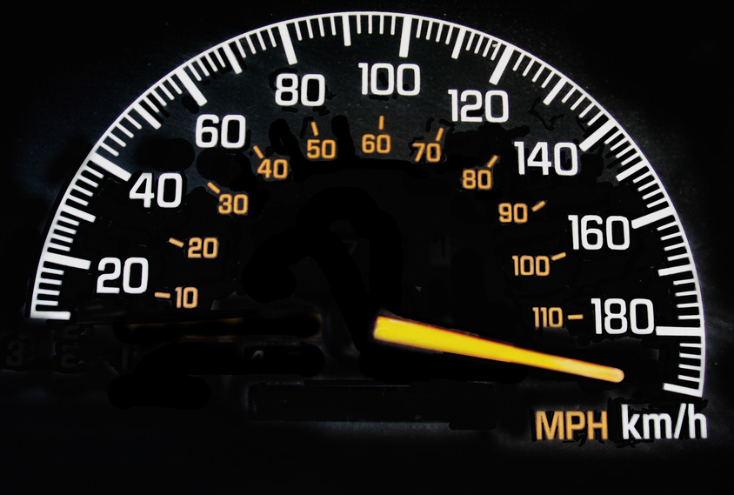
Digital audio artifacts: Clipping
The digitizer is “maxed out”-- the actual amplitude of the sound exceeds the maximum value that the digitizer can represent.

Slide 5
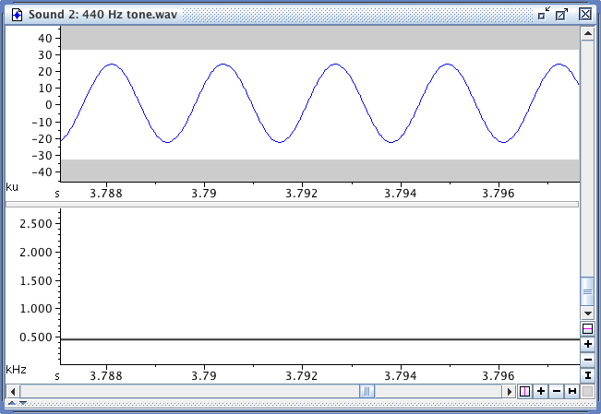
Digital audio artifacts: Clipping
If the amplitude of the sound presented to the digitizer exceeds the maximum value that can be represented with the current bit depth, the waveform is clipped, and ...
limits of sample size
clipping
spurious harmonics
440 Hz, clean
440 Hz, clipped
... spurious harmonics appear in the digitized signal.
Notes:
• the clipped version starts to look like a square wave; recall that a square wave is a sum of a bunch of harmonically related sin waves; hence spurious harmonics.
DO IT:
in Raven, look at 440 Hz clean & clipped, fin whale pulses clean & clipped

Slide 6
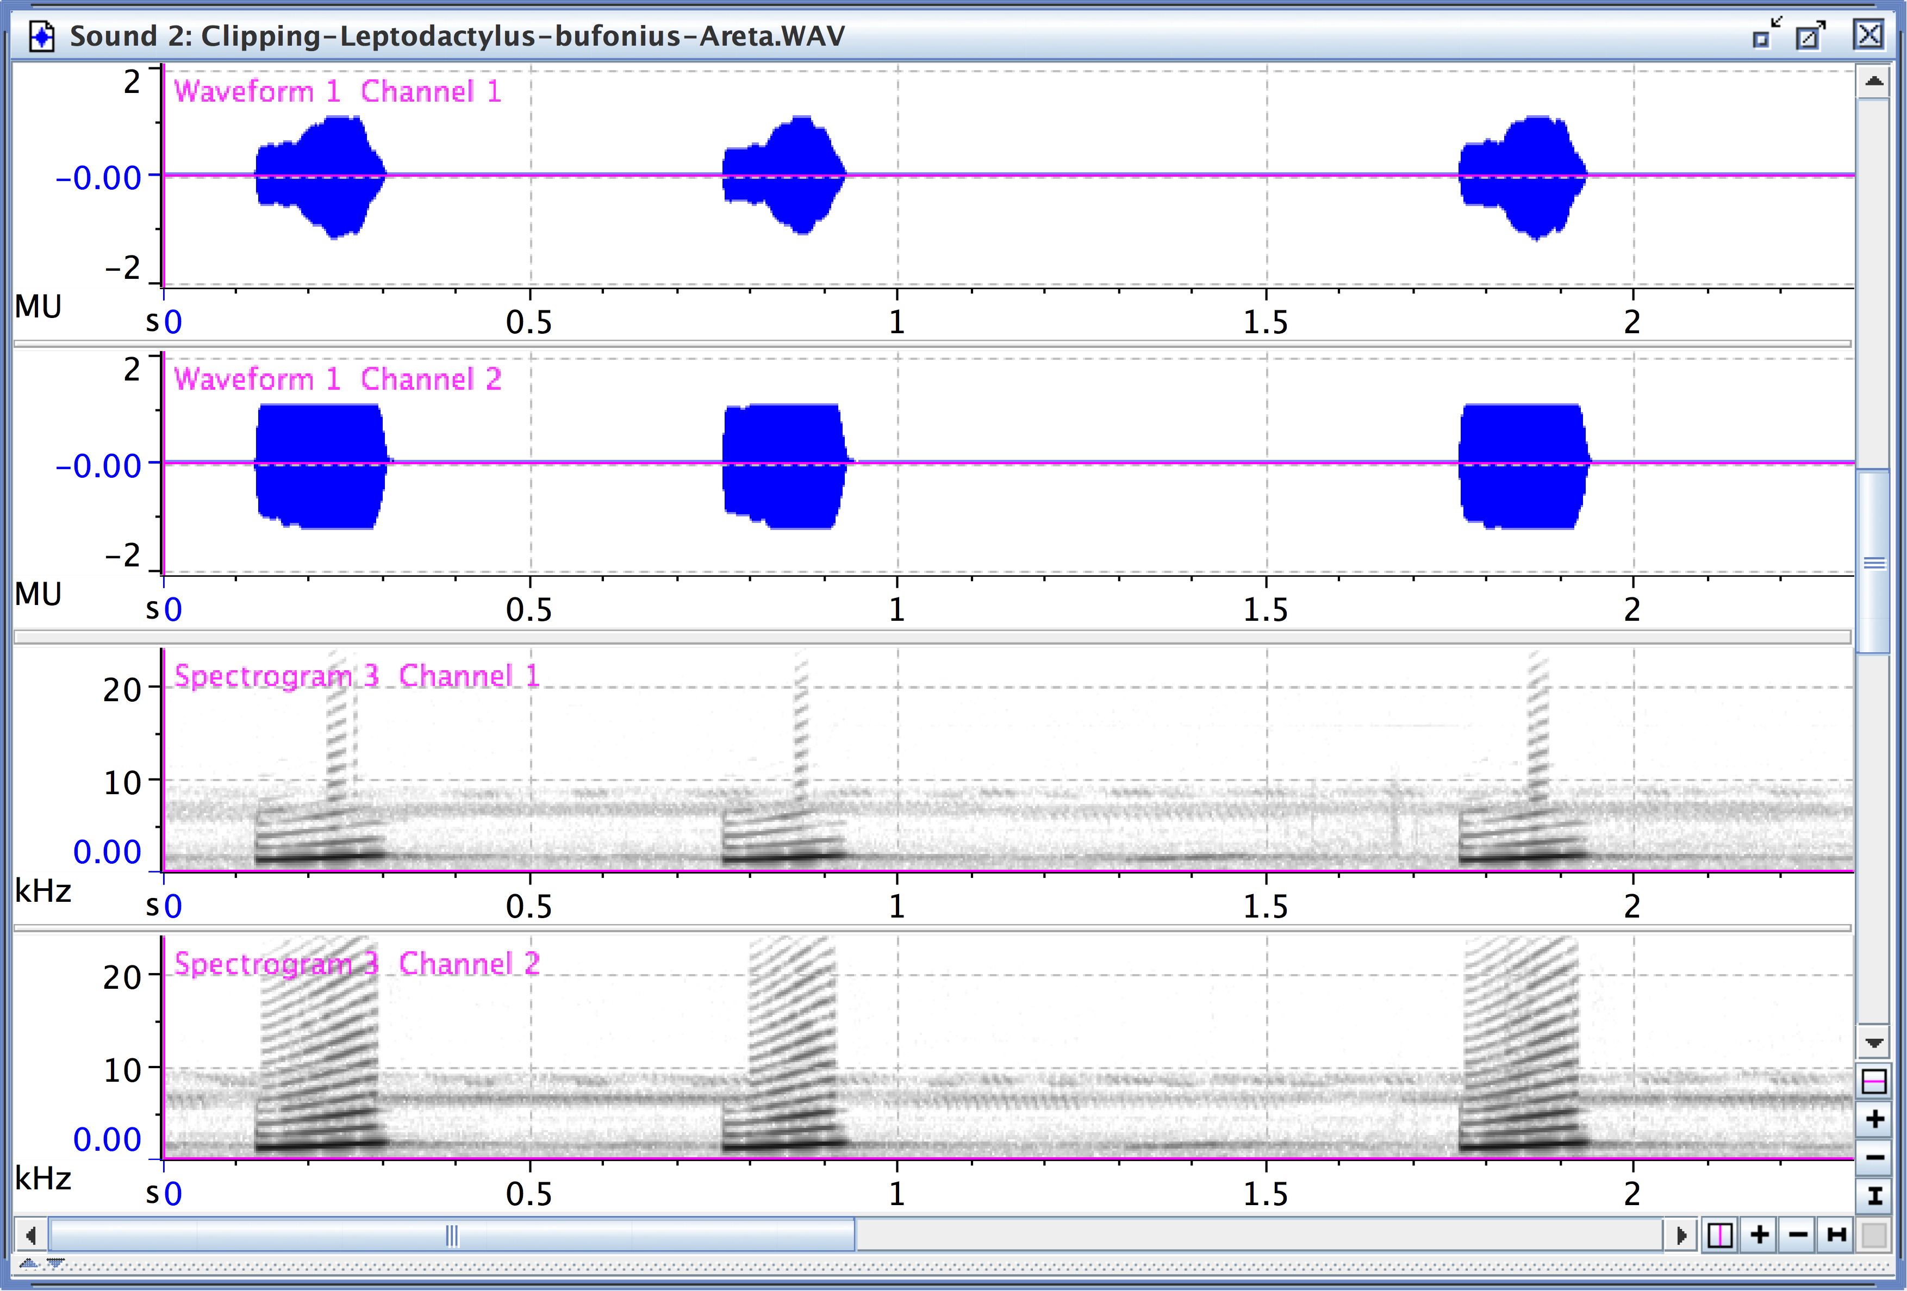
Digital audio artifacts: Clipping
Clipping can occur if mic or preamp is maxed out, even if digitizer isn’t …
Notes:
• the clipped version starts to look like a square wave; recall that a square wave is a sum of a bunch of harmonically related sin waves; hence spurious harmonics.
DO IT:
in Raven, look at 440 Hz clean & clipped, stereo frog call & clipped

Slide 7
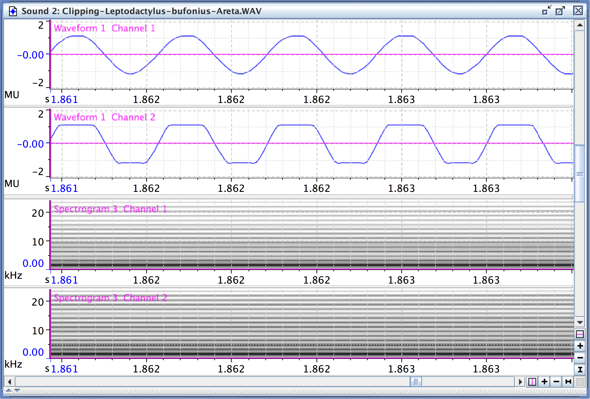
Digital audio artifacts: Clipping
Clipping can occur if mic or preamp is maxed out, even if digitizer isn’t …
clipping
Notes:
• the clipped version starts to look like a square wave; recall that a square wave is a sum of a bunch of harmonically related sin waves; hence spurious harmonics.
DO IT:
in Raven, look at 440 Hz clean & clipped, fin whale pulses clean & clipped

Slide 8
Digital audio artifacts: Aliasing
A digitized signal can only represent frequencies < F_{s}/2.
F_{s}/2 is called the Nyquist frequency: the highest frequency that can be represented with a given sampling rate.
If the original continuous signal contains energy at frequencies > Nyquist, the energy at these frequency components will erroneously appear at frequencies < Nyquist in the digitized signal.
This type of distortion is called aliasing.
If the sound contains significant energy at frequencies > Nyquist, use a low-pass anti-aliasing filter to remove them before digitizing.

Slide 9
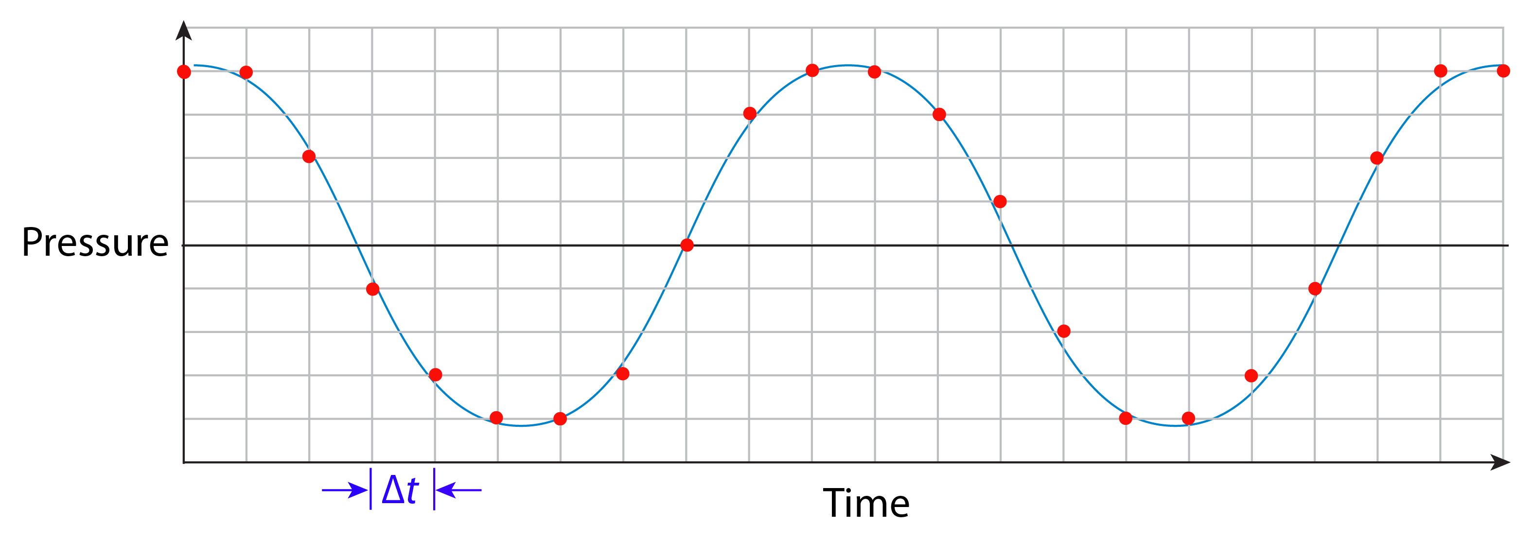
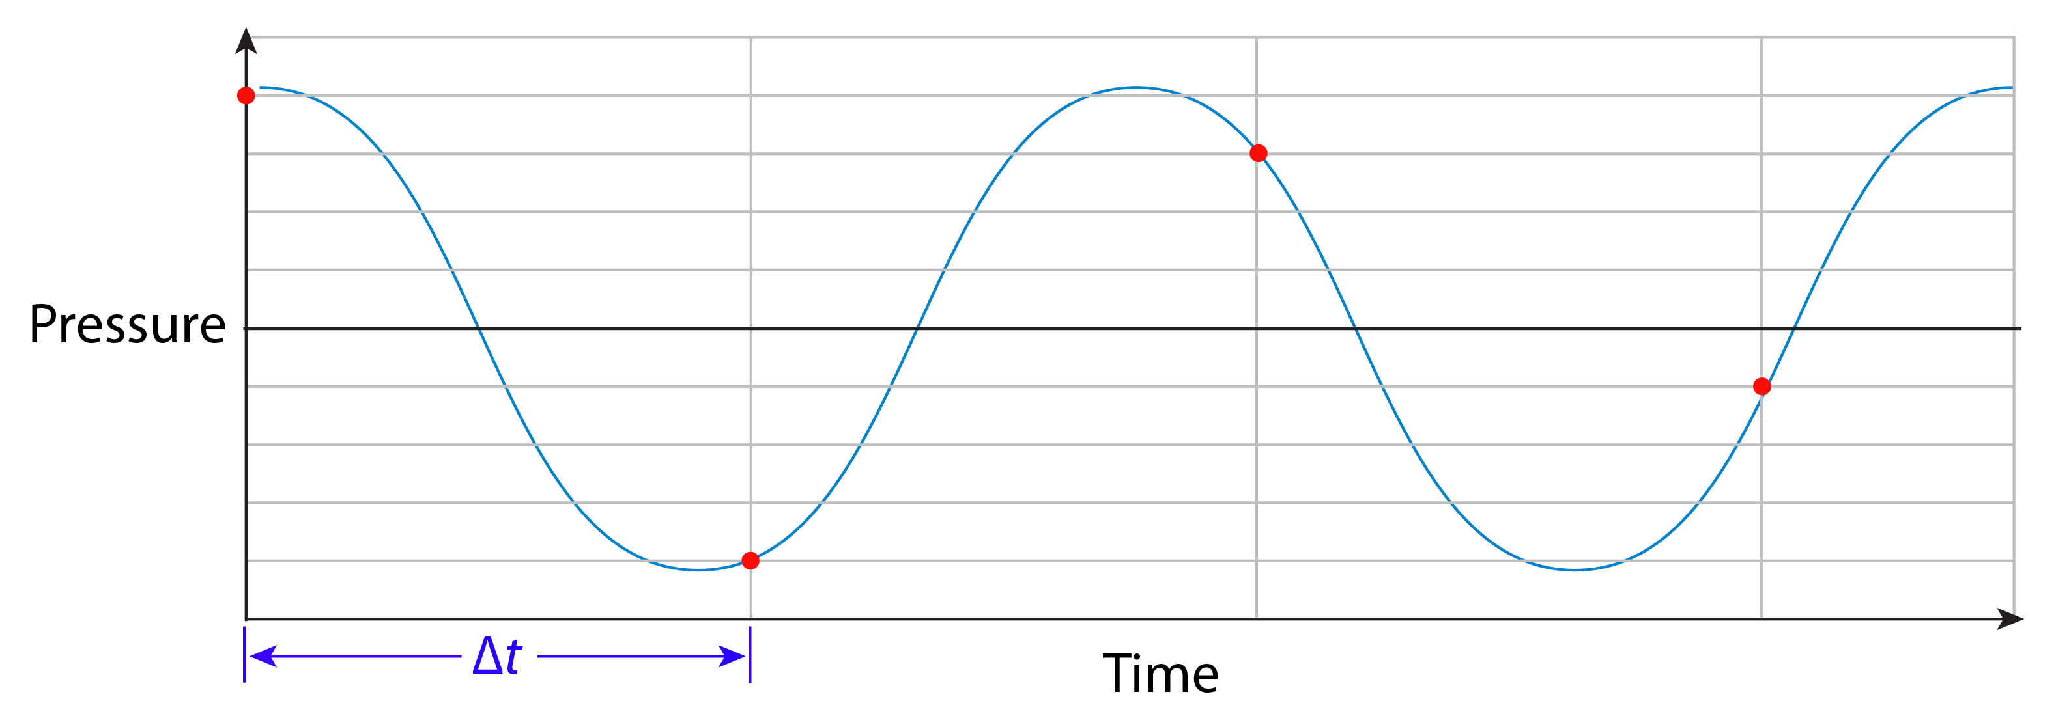
Digital audio artifacts: Aliasing
If the original continuous signal contains energy at frequencies > Nyquist, the energy at these frequency components will erroneously appear at frequencies < Nyquist in the digitized signal.

Slide 10
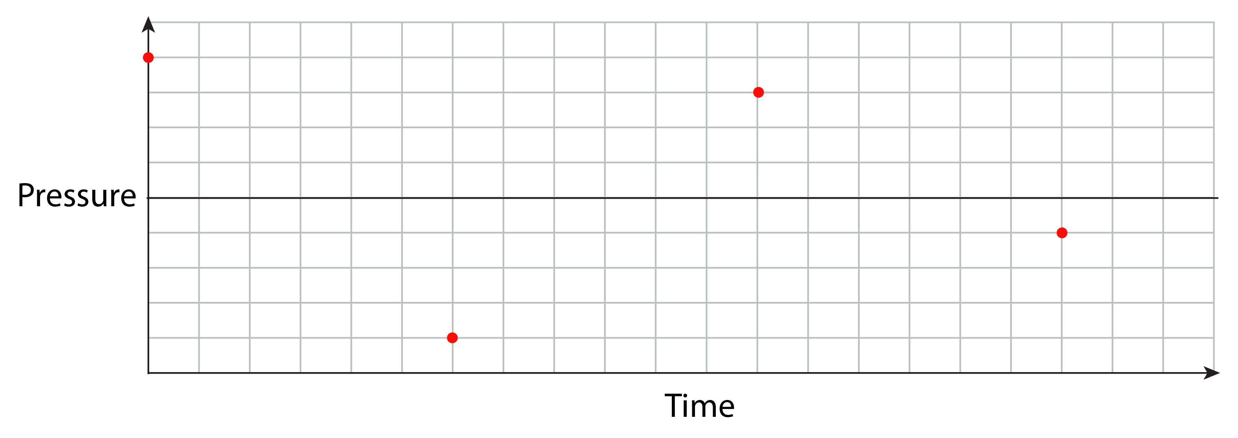
Digital audio artifacts: Aliasing
If the original continuous signal contains energy at frequencies > Nyquist, the energy at these frequency components will erroneously appear at frequencies < Nyquist in the digitized signal.

Slide 11
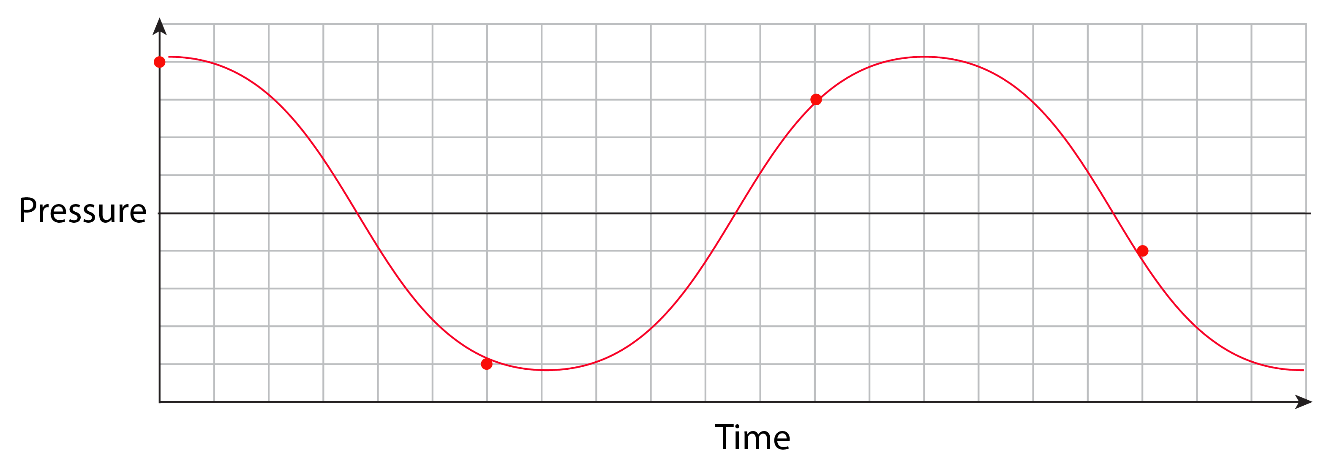
Digital audio artifacts: Aliasing
If the original continuous signal contains energy at frequencies > Nyquist, the energy at these frequency components will erroneously appear at frequencies < Nyquist in the digitized signal.

Slide 12
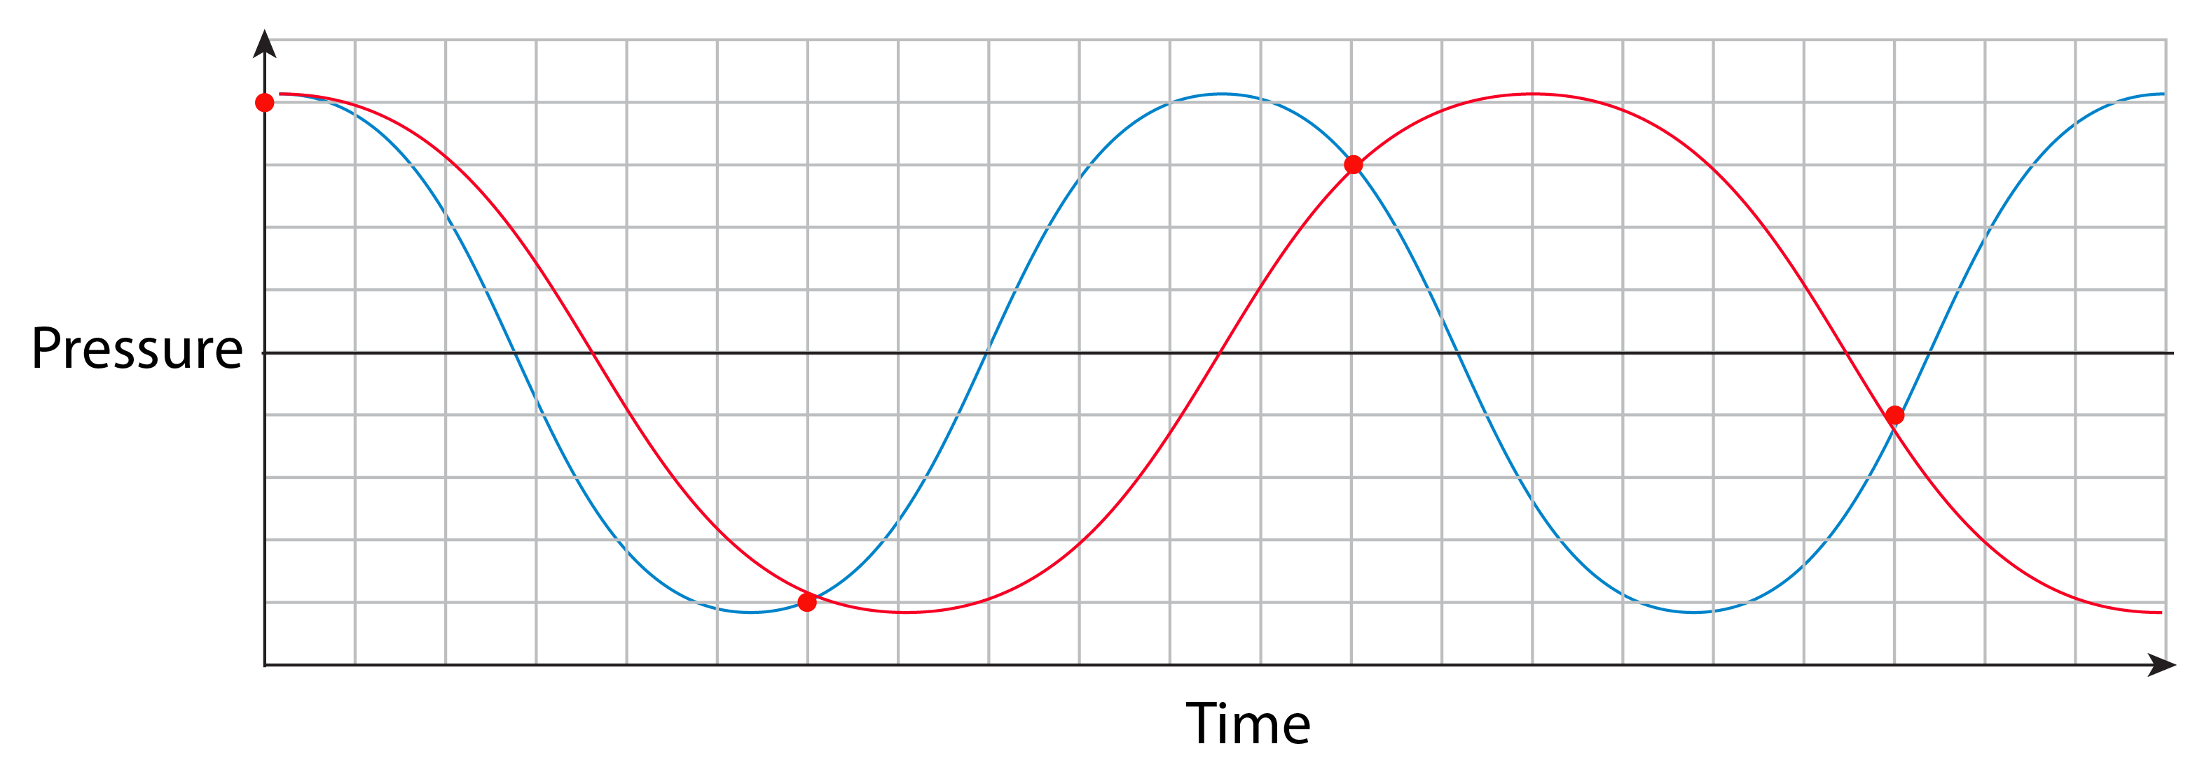
Digital audio artifacts: Aliasing
If the original continuous signal contains energy at frequencies > Nyquist, the energy at these frequency components will erroneously appear at frequencies < Nyquist in the digitized signal.
Reconstructed signal is too low in frequency!

Slide 13
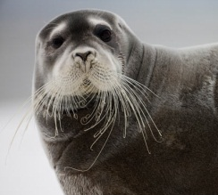
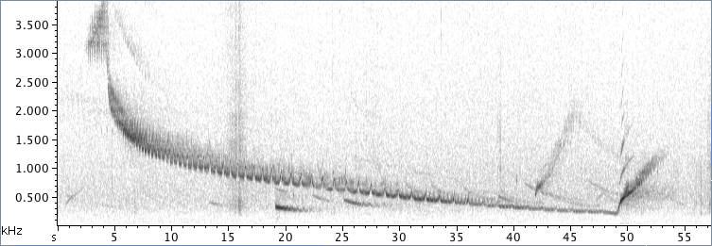
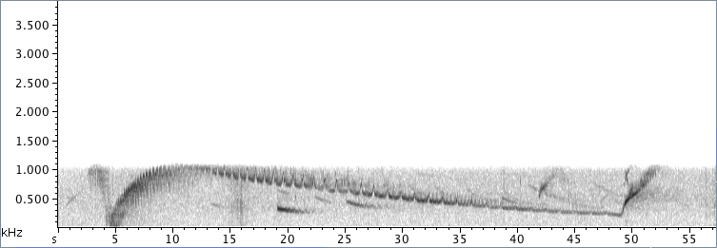
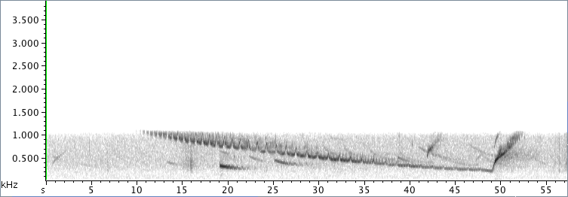
Digital audio artifacts: Aliasing
What does aliasing look like?
Paul Souders
(a) Sampling rate = 11025 Hz, Nyquist = 5512.5 Hz;
gram shows bottom half only.
(b) Sampling rate = 2205 Hz (1/5 of original), Nyquist = 1102.5 Hz.
Note aliasing in first 10 sec.
(c) Same as (b), but anti-alias filter applied before digitizing

Slide 14
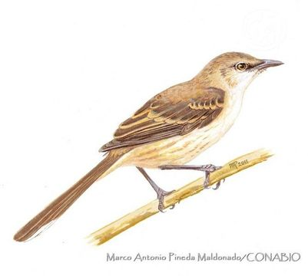
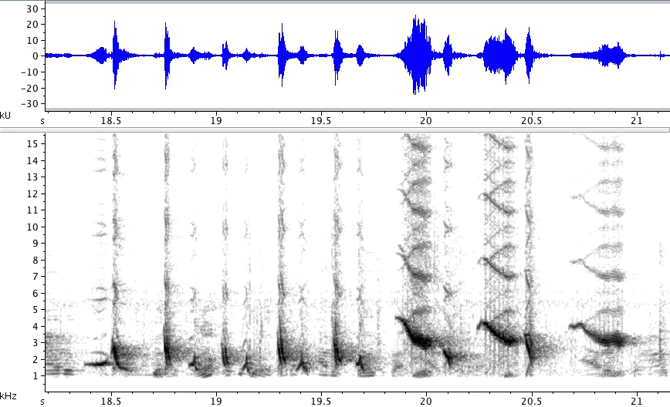
Digital audio artifacts: Aliasing
What does aliasing look like?
aliasing
recording by A. Hernández Ríos
Socorro mockingbird, recorded on Nikon D7000 DSLR video (1x)
Notes:
[replace w/scrolling spectrograms!]

Slide 15
Digital audio artifacts: Aliasing
What does aliasing look like?
aliasing
recording by A. Hernández Ríos
Socorro mockingbird, recorded on Nikon D7000 DSLR video (0.25x)
Notes:
[replace w/scrolling spectrograms!]

Slide 16
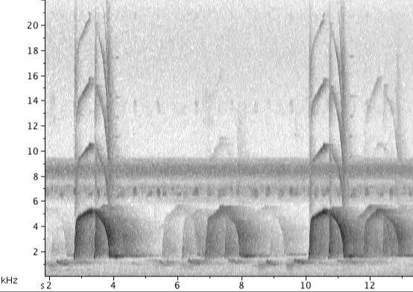
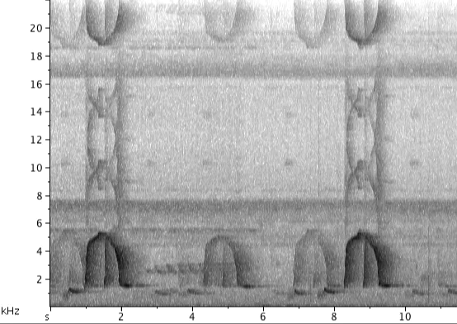
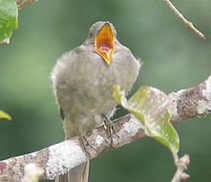
Digital audio artifacts: Aliasing
What does aliasing look like?
screaming piha - clean
screaming piha - aliased
Bradley Davis, ©2009
Notes:
[replace w/scrolling spectrograms!]

Slide 17
