Slide 1
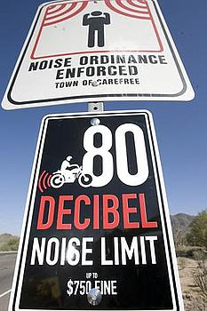
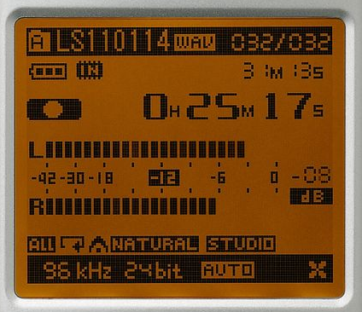
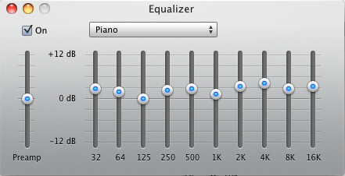

What are decibels (and why are they confusing)?
Sound Analysis Workshop
Ithaca, NY
3 – 7 April 2017
© 2007-17, Cornell Bioacoustics Research Program
Bioacoustics Research Program

Slide 2

What are decibels (and why are they confusing)?
Analysis of Biological Sounds Using Raven Pro
North American Ornithological Conference
Washington, DC
15 – 16 August 2016
© 2007-16, Cornell Bioacoustics Research Program
Bioacoustics Research Program

Slide 3
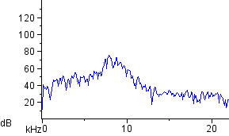
What is a decibel?
Decibels seem to mean different things depending on the situation...

Slide 4
Measuring sound: decibels
What is a decibel?
A decibel is not a physical unit!
A decibel is a logarithmic unit for expressing
the ratio of two quantities:
a quantity being measured and a reference quantity
(like percentage)
In acoustics, the two quantities being compared are
typically acoustic power or intensity.
“The decibel confers a number of advantages, ... . On the other hand, even some professionals find the decibel confusing and cumbersome.”
–– Wikipedia
Notes:
- familiar-- like a percentage

Slide 5
Measuring sound: decibels
What is a decibel?
A logarithmic unit for expressing the ratio between a measured quantity of interest, and a reference value.
(where P represents pressure)
P_{ref} depends on the context, and should always be stated
(unless the context makes it clear)
Notes:
- familiar-- like a percentage;
TO DO: add explanation of RMS

Slide 6
Measuring sound: decibels
Sound Pressure Level (SPL)
By convention, use threshold pressure of human hearing
as P_{ref}: 20 µPa
dB SPL is a common way of expressing the absolute intensity
of a sound
Examples:
Average background sound pressure in typical quiet library:
Average sound pressure of a jet engine at 50 m:
Notes:
SPL is one context where dB are used

Slide 7
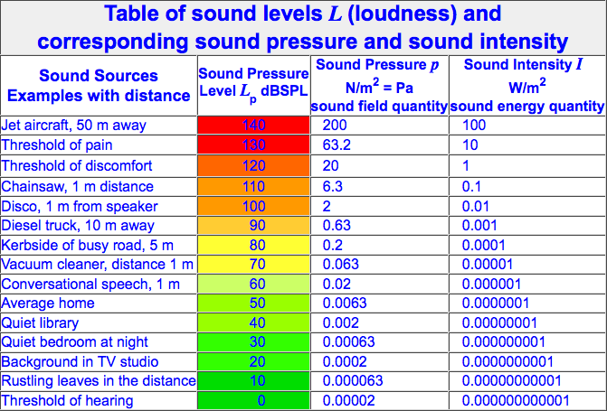
Measuring sound: decibels
“dB SPL” means “dB re 20 µPa”
http://www.sengpielaudio.com/TableOfSoundPressureLevels.htm
Notes:
So, one convenient property of dB is that they compress an awkward range of measurements into something manageable

Slide 8
Measuring sound: decibels
Useful properties of decibels
Make large numerical ranges of measurements more manageable
The sign of a dB value indicates whether the measured value is greater or less than the reference value:
positive dB: measurement > reference
0 dB: measurement = reference
negative dB: measurement < reference
The just-noticeable difference (jnd) in sound pressure between two sounds remains ≈ 1~2 dB irrespective of absolute sound pressures.
Notes:
RAVEN: dB tone pairs

Slide 9
Measuring sound: decibels
How are decibels used?
Sound pressure level: (almost) always > 0
standard reference pressure in air: 20 µPa (ALWAYS STATE!)
in water: 1 µPa
BEWARE! most sound level meters by default report sound levels with different frequencies weighted by human frequency-dependent hearing sensitivity! (dBA, dBB, dBC)
if you report sound level measurements of a particular sound source, ALWAYS STATE the microphone’s distance from the source!
Recording level (dBFS = dB full scale = dB re the maximum sample value): always ≤ 0
Signal-to-noise ratio (SNR): either ≤ 0 or ≥ 0
Uncalibrated power re arbitrary reference (Raven: always > 0)

Slide 10
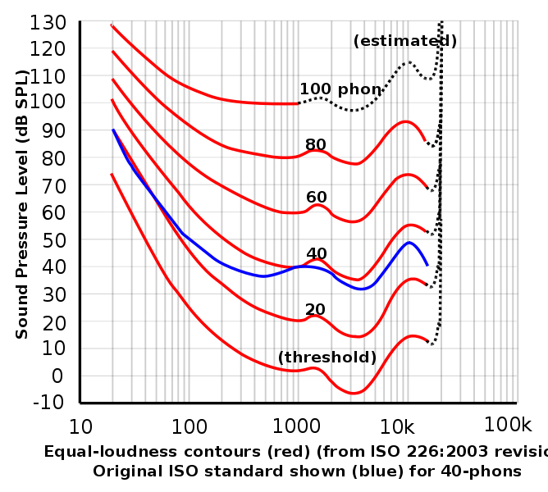
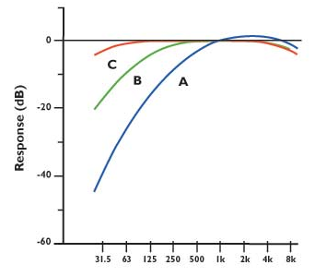
Measuring sound: decibels
A-, B-, C-, and Z-weighting
By default, most sound level meters report spectrally weighted levels based on human hearing sensitivity: “A-weighted” decibels, or dBA
dBA may not be appropriate in contexts unrelated to human perception!

Slide 11
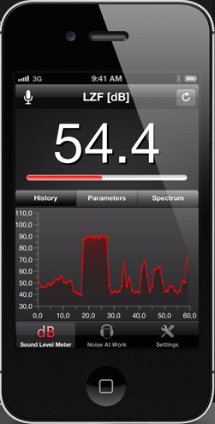
Measuring sound: decibels
Is that a sound level meter in your pocket?
One of the most widely read papers in 2014
in the Journal of the Acoustical Society of America:
“ This study showed that certain sound measurement apps for Apple smartphones and tablets may be considered accurate and reliable to be used to assess occupational noise exposures.”

Slide 12
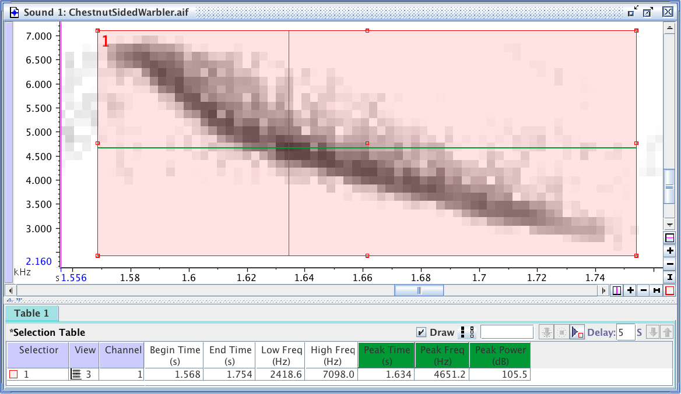
Are Raven’s dB measurements SPL?
By default, Raven’s dB measurements are relative to an arbitrary reference
and cannot be related to “real-world” measurement units (like SPL).
You can make true calibrated (SPL) measurements in Raven if you have
additional information available about the recording system.

Slide 13
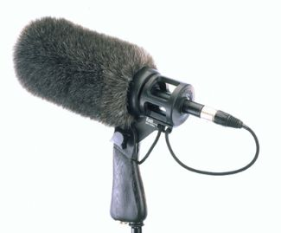
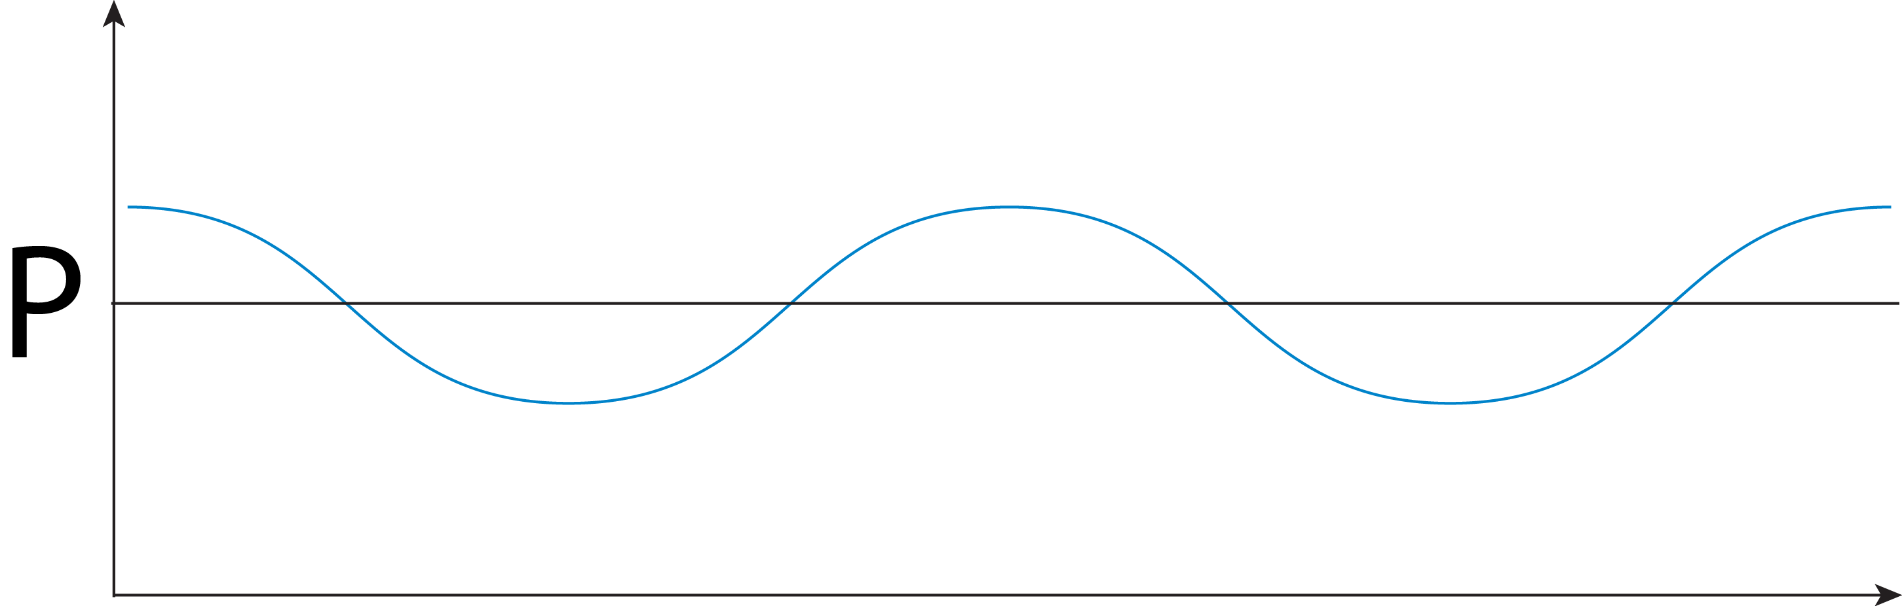
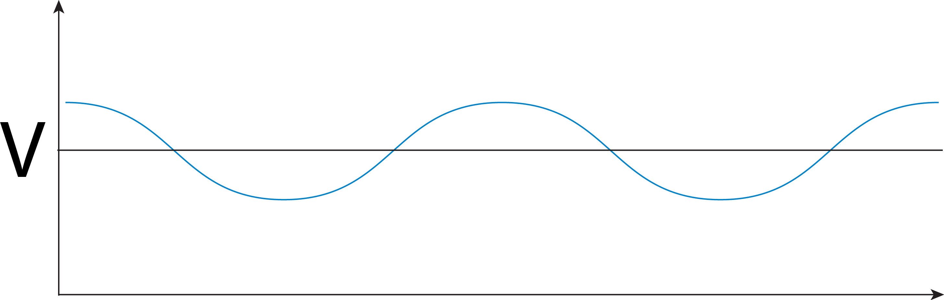
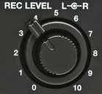
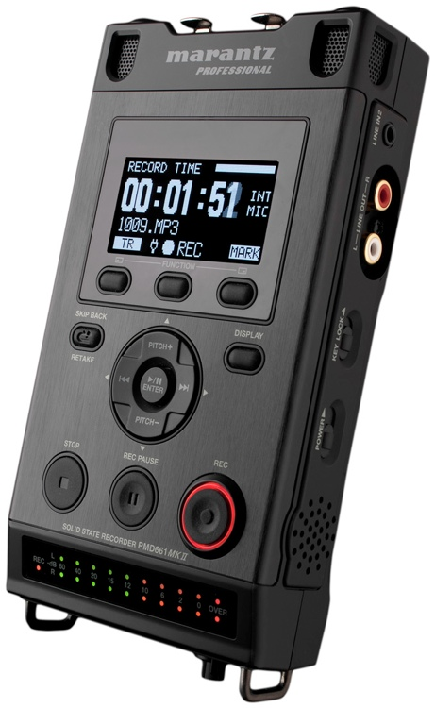
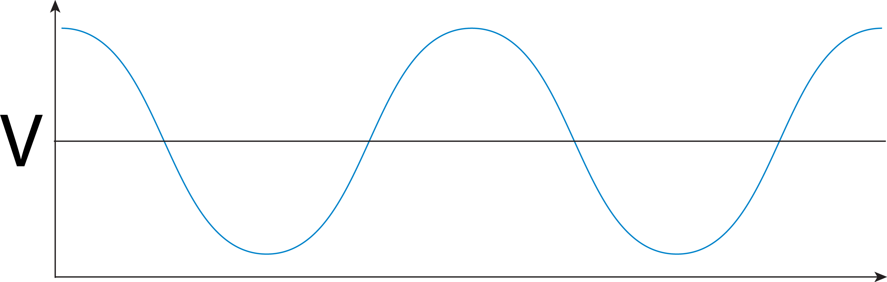
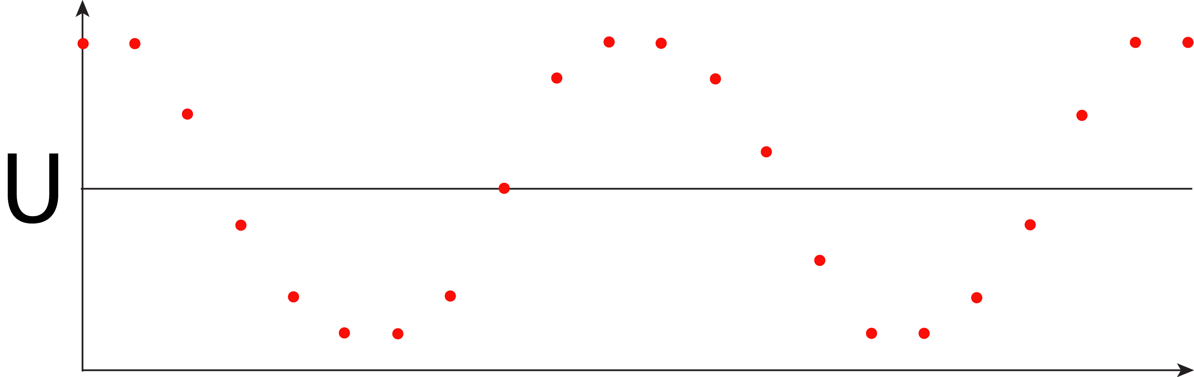
Why Raven’s dB measurements aren’t dB SPL
The digital recording chain
sound pressure (µPa) vs. time
1. microphone
voltage (mV) vs. time
2. preamplifier
(bigger) voltage (mV) vs. time
sample values vs. time
e.g., 16 bit: [-32768, 32767]
3. analog / digital
converter

Slide 14
Why Raven’s dB measurements aren’t dB SPL
What we want: µPa
sound pressure (µPa) vs. time
What Raven knows: sample units
Sample units are proportional to µPa
But what’s the proportionality constant?
sample values vs. time
e.g., 16 bit: [-32768, 32767]

Slide 15
Why Raven’s dB measurements aren’t dB SPL
sound pressure (µPa) vs. time
1. microphone
voltage (mV) vs. time
proportionality constant
depends on these
2. preamplifier
(bigger) voltage (mV) vs. time
sample values vs. time
e.g., 16 bit: [-32768, 32767]
3. analog / digital
converter

Slide 16
What you need to make true SPL measurements with Raven
Method 1: stepwise calibration
1. Microphone sensitivity:
How much voltage does the mic output for a given sound
pressure?
2. Preamp gain:
How much is the output voltage from the mic amplified?
3. Digitizer sensitivity:
What input voltage does the maximum sample value represent?
For field recordings, we often don’t know any of this!

Slide 17
What you need to make true SPL measurements with Raven
Method 2: end-to-end system calibration
sound pressure (µPa) vs. time
1. microphone
voltage (mV) vs. time
2. preamplifier
(bigger) voltage (mV) vs. time
sample values vs. time
e.g., 16 bit: [-32768, 32767]
3. analog / digital
converter

Slide 18
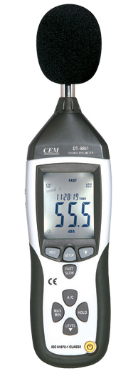
What you need to make true SPL measurements with Raven
Method 2: “end-to-end” system calibration
Record a calibration sound of known
SPL, use that known value to
determine the proportionality
constant to convert sample values to
sound pressure.
sound pressure (µPa) vs. time
1. microphone
“Black Box”
recording
system
[ mic +
preamp +
digitizer ]
For field recordings,
we often don’t have this!
2. preamplifier
sample values vs. time
e.g., 16 bit: [-32768, 32767]
3. analog / digital
converter

Slide 19
What you need to make true SPL measurements with Raven
Method 1: stepwise calibration
need detailed information on how the signal is transformed by:
(1) the microphone (sound pressure → voltage)
(2) the preamplifier (small voltage → bigger voltage)
(3) the A/D converter (voltage → sample units)
Method 2: end-to-end system (black box) calibration
need a recording of a signal with a known SPL that can be used
to calibrate other recordings made with the same system (including
the same gain setting)
• By either method, we need to take extra steps before and/or while
making field recordings in order to make true SPL measurements
with Raven.
• Without calibration info, we can make relative comparisons of dB within a
recording, but not absolute dB measurements.

Slide 20
Making true SPL measurements with digital recordings

Slide 21

Measuring sound: decibels
“The decibel confers a number of advantages, ... . On the other hand, even some professionals find the decibel confusing and cumbersome.”
–– Wikipedia
Why are decibels confusing?
Because the reference level is sometimes implied rather than stated,
people forget that a dB value is a comparison between two quantities.
(so always state the reference level!)
Logarithms are not intuitive– they are often confusing to people who don’t work with them on a regular basis!

Slide 22
Measuring sound: decibels
The most important thing to remember about dB...
Whenever decibels are used, ask:
“dB relative to what?”

Slide 23
What is a decibel, anyway?
presumably
dB re 20 µPa,
probably
A-weighted
dBFS
(i.e., dB re the recorder’s clipping level)
(at what distance?)
dB re arbitrary reference
dB re original signal

Slide 24


Slide 25


