Slide 1

Passive Acoustic Monitoring of Blue and Fin Whales through Machine Learning
Daniel De León, Danelle Cline & Dr. John Ryan

Slide 2
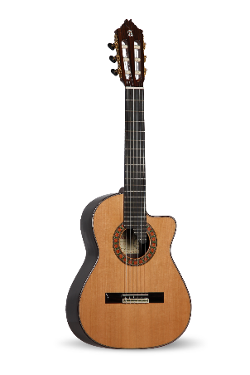
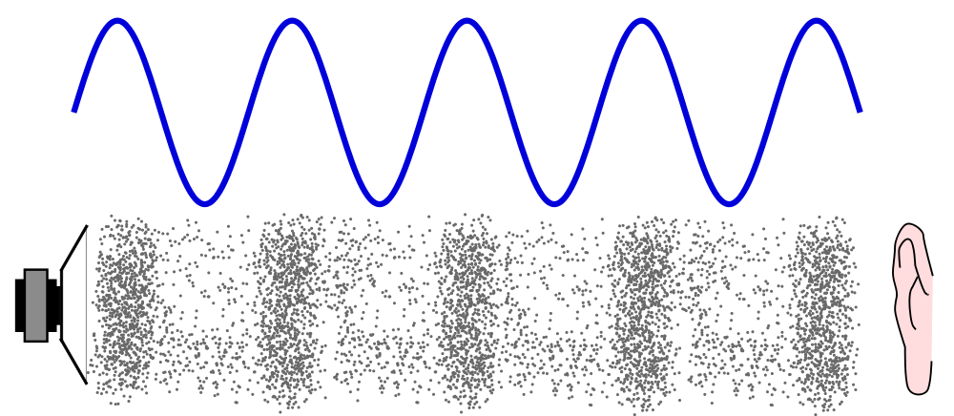
From Music to Vibrations

Slide 3
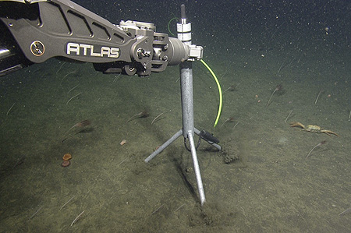
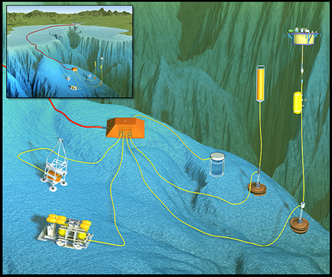
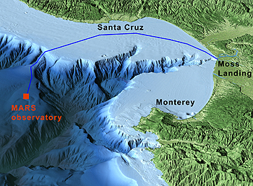
MARS & The Hydrophone
Located 32 km offshore
Depth of 891 m
Bandwidth of 10 Hz to 200 kHz
256 kHz sample rate
Continuous recording since July 28, 2015
Notes:
Oceans16 paper
Mp3 is 44.3 kHz

Slide 4
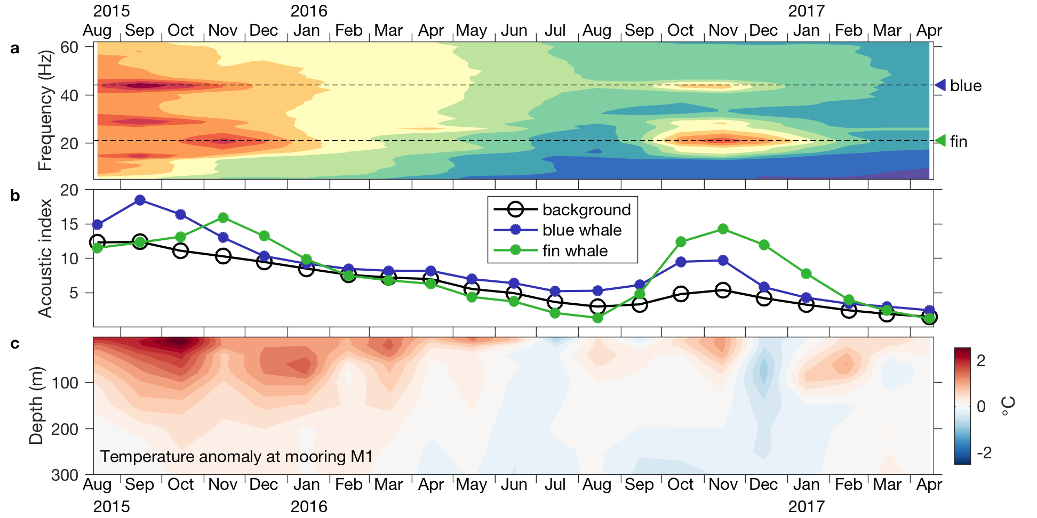
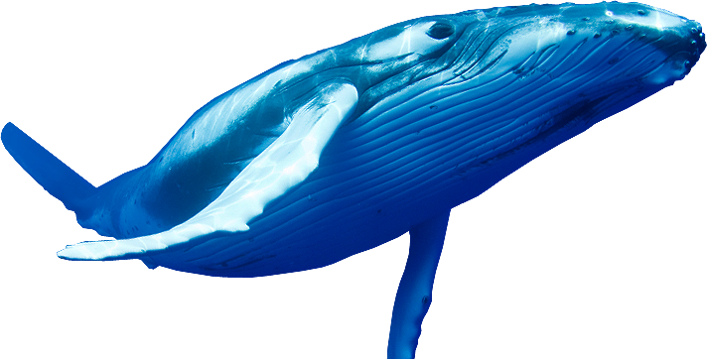
Blue and Fin Whales
The NE Pacific:
  Largest population of blue whales
Vocalizations between 13 -50 Hz
Observation of sound energy
Notes:
https://www.worldwildlife.org/species/directory

Slide 5
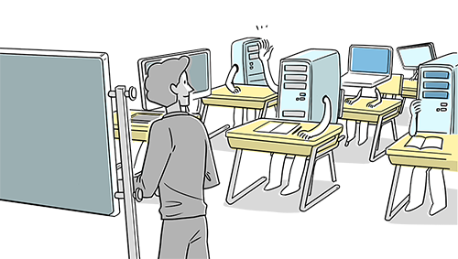
How effective is a machine learning algorithm in classifying blue and fin whale calls?

Slide 6
The Detection Classification System
Continuous Hydrophone Audio Recording
Detect Calls
Classify Calls

Slide 7
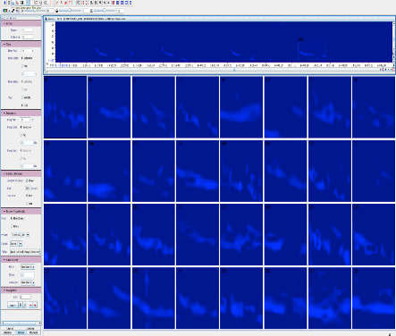
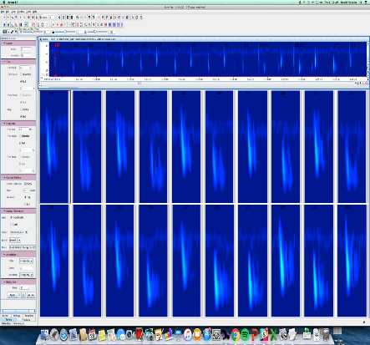

The Band Limited Energy Detector

Slide 8
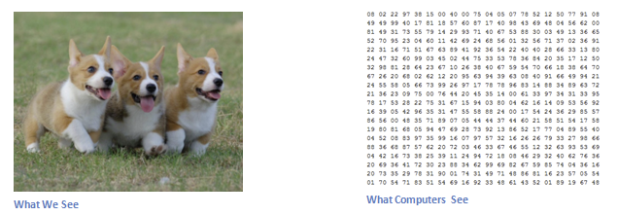
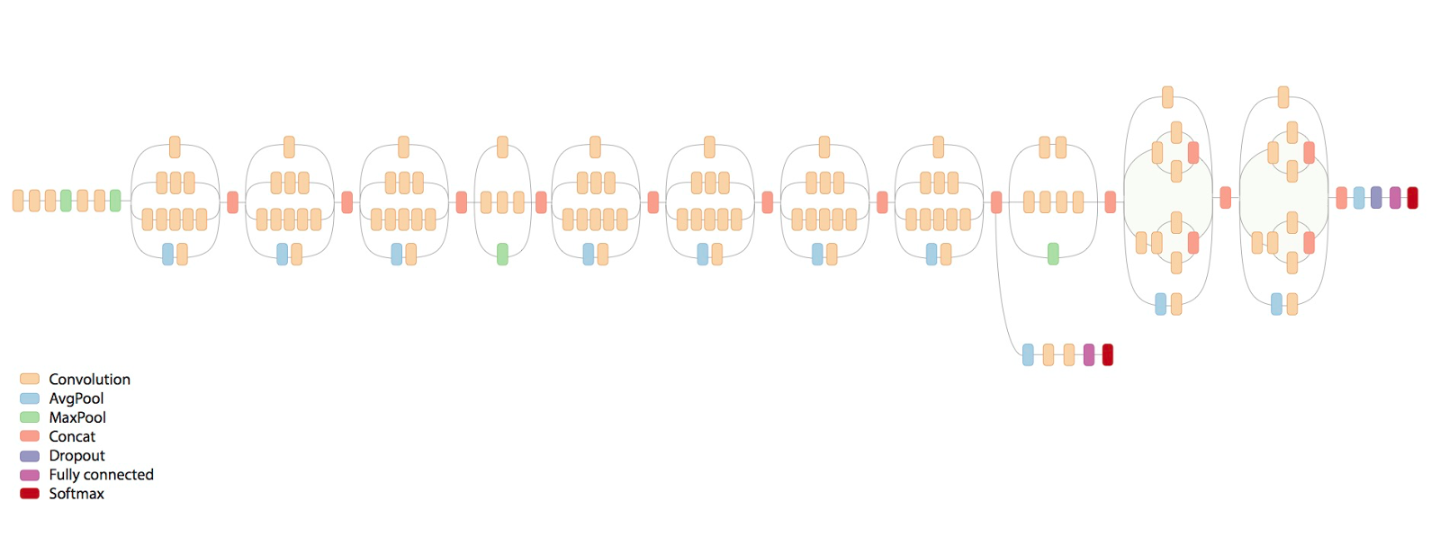
The Convolutional Neural Network Classifier
Inception V3
Notes:
https://adeshpande3.github.io/adeshpande3.github.io/A-Beginner's-Guide-To-Understanding-Convolutional-Neural-Networks/

Slide 9
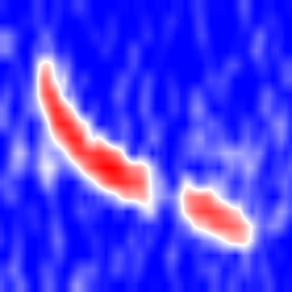
The Convolutional Neural Network Classifier
Inception V3
Notes:
https://adeshpande3.github.io/adeshpande3.github.io/A-Beginner's-Guide-To-Understanding-Convolutional-Neural-Networks/

Slide 10
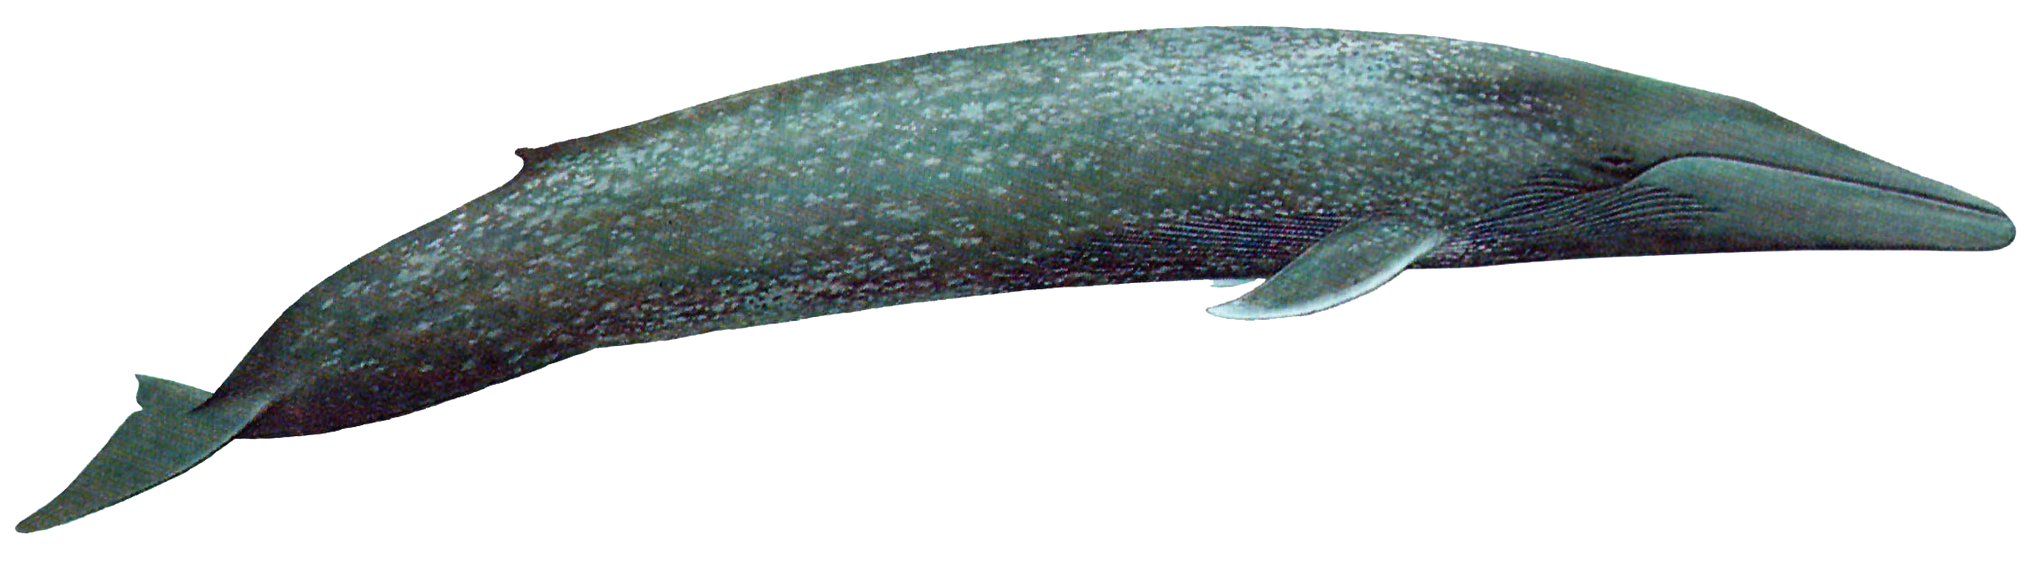
Classifications
Blue Whale B Call
bt
True
bf unk
False
bf lines
False

Slide 11
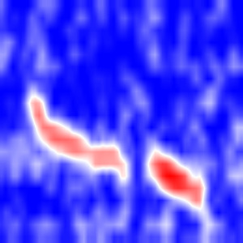
Results
n = 3073
n = 32
Overall Accuracy: 98.3%
Overall Precision: 98.4%
Notes:
Bt = 15364, bf_unk = 1,362, bf_line = 160

Slide 12
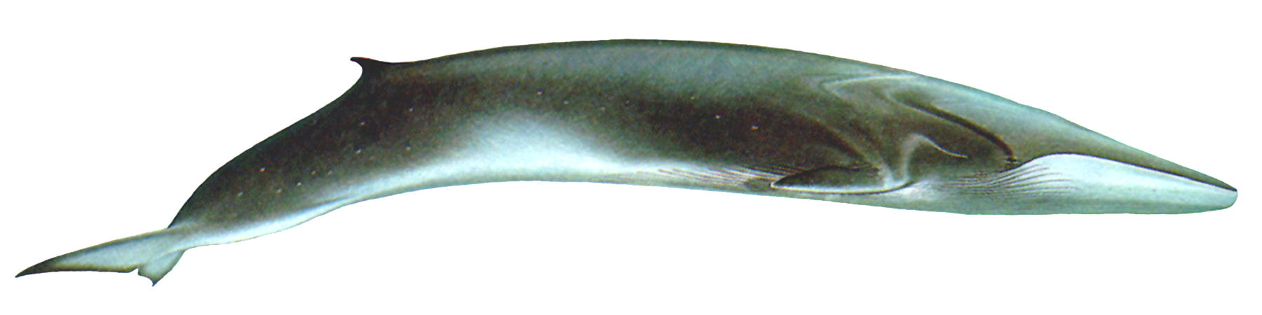

Classifications
Fin Whale Pulse Call
ft
True
ff blue
False
ff lines
False
ff unk
False

Slide 13
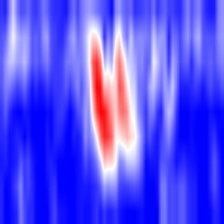
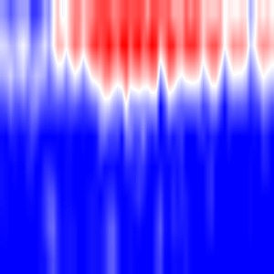
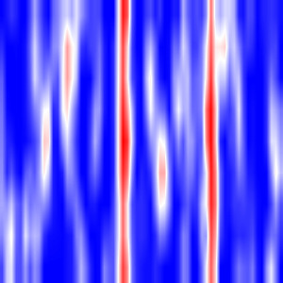
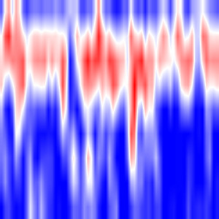
Results
n = 744
n = 59
n = 61
n = 321
Overall Accuracy: 97.7%
Overall Precision: 97.8%
Notes:
Ft = 3,721, ff_unk = 1,607, ff_blue = 294, ff_lines = 305

Slide 14
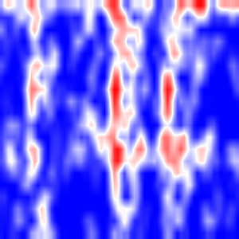
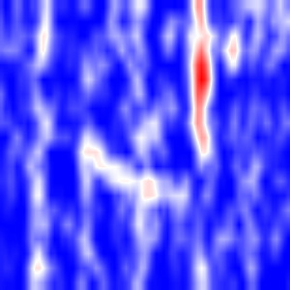
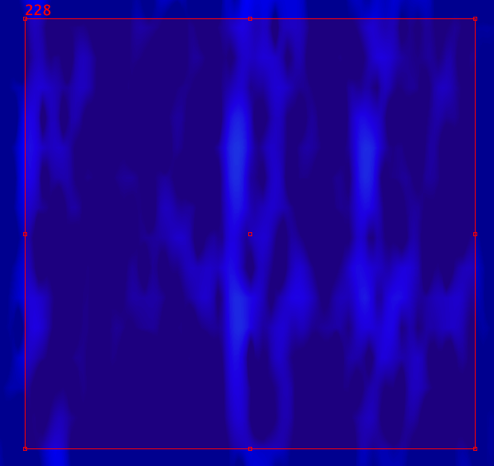
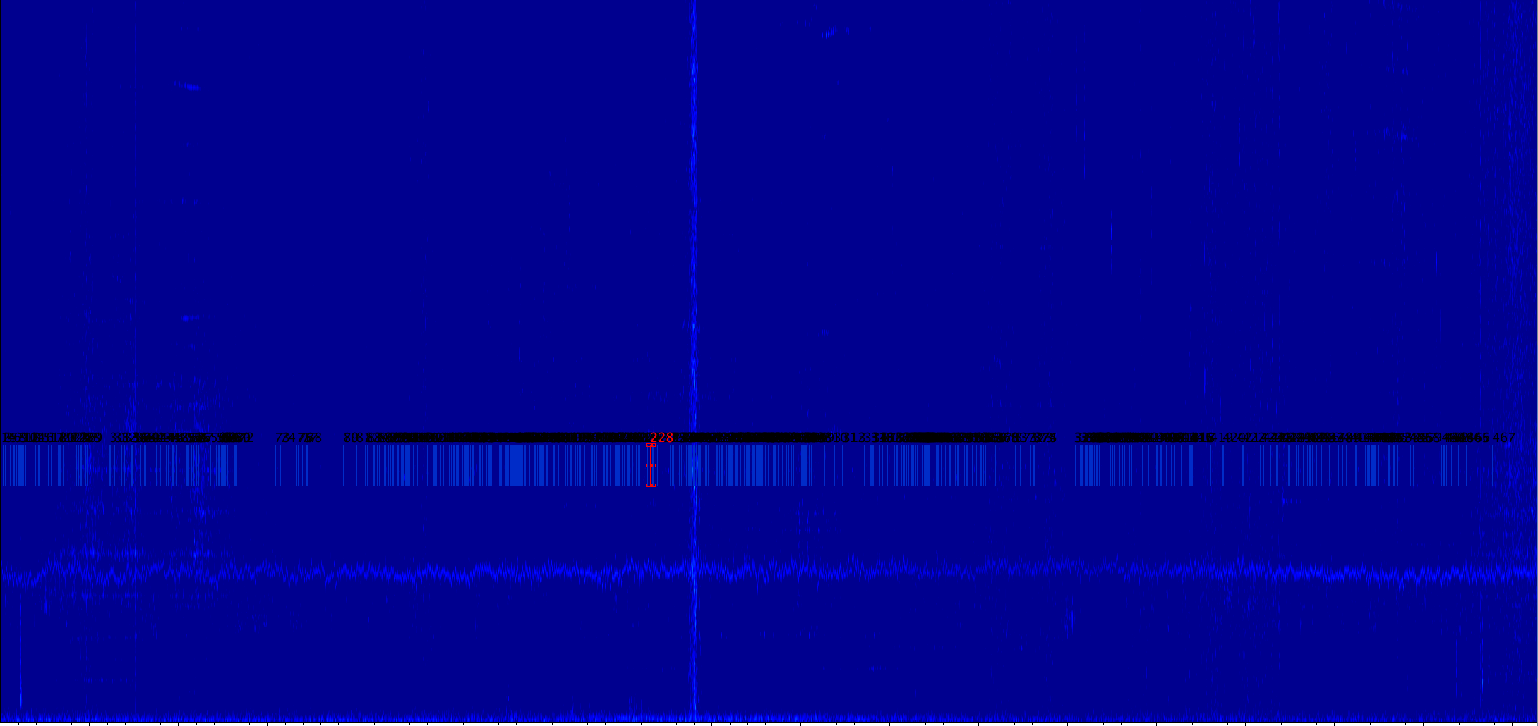
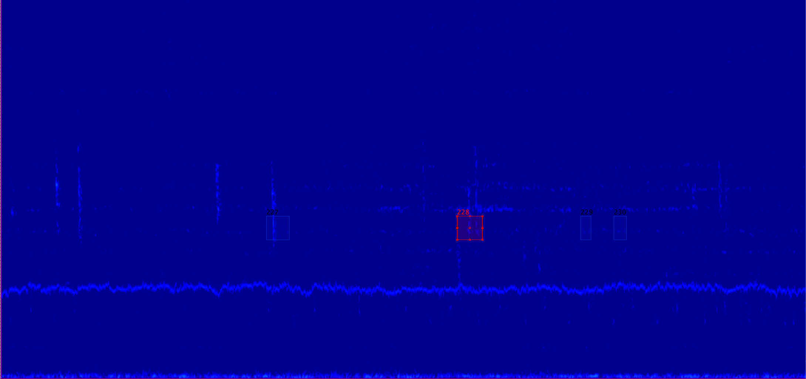
Misclassifications

Slide 15
Findings
average predicted
calls

Slide 16
Future Work
More complex calls
Noise exploration and filtering
Migratory behavior
Pattern recognition

Slide 17



Acknowledgements
REU:
  NSF: Grant OCE 1659628
  Dr. Corey Garza, Daniel Orr, Dr. Bridgette Clarkston & Megan Basset
MBARI:
  Packard foundation
  Dr. George Matsumoto & Linda Kuhnz
  Danelle Cline & Dr. John Ryan
Fellow interns

Slide 18
J. Ryan at al. “New Passive Acoustic Monitoring in Monterey Bay National Marine Sanctuary.” IEEE. 2016, pp. 1 – 7.
"Species List." WWF. World Wildlife Fund, 2017. Web. 30 June 2017.
Deshpande, Adit. "A Beginners Guide To Understanding Convolutional Neural Networks." A Beginners Guide To Understanding Convolutional Neural Networks – Adit Deshpande – CS Undergrad at UCLA (19). GitHub, 29 July 2016. Web. 30 June 2017.
"Monterey Accelerated Research System (MARS)". Mbari.org. N.p., 2017. Web. 30 June 2017.
"Precision-Recall — Scikit-Learn 0.18.2 Documentation". Scikit-learn.org. N.p., 2017. Web. 30 June 2017.
P.J. Dugan at al. “DCL System Using Deep Learning Approaches for Land-based or Ship-based Real-Time Recognition and Localization of Marine Mammals.” Department of the Navy Science and Technology. 2015.
https://whaletrips.org/wp-content/uploads/2016/05/fluke_nounproject.png

Slide 19
https://whaletrips.org/wpcontent/uploads/2016/05/fluke_nounproject.png
http://whaleopedia.org/baleen-whales/balaenopteridae-introduction/blue-whale/
http://whaleopedia.org/animalfund/baleen-whales/balaenopteridae-introduction/fin-whale/
https://www.lexalytics.com/technology/machine-learning

Slide 20
Questions?
Notes:
Bt = 15364, bf_unk = 1,362, bf_line = 160 …. 98.3% overall accuracy, 98.4% precision
Ft = 3,721, ff_unk = 1,607, ff_blue = 294, ff_lines = 305 … 97.8% overall accuracy, 97.7% precision

