Slide 1
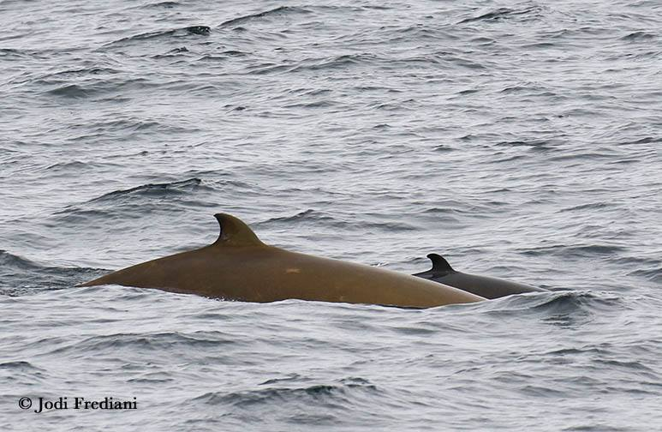
A Comparison of Detection and Classification Techniques of Cuvier’s Beaked Whales in Passive Acoustic Monitoring Data
Ellen Jacobs, Danelle Cline, John Ryan

Slide 2
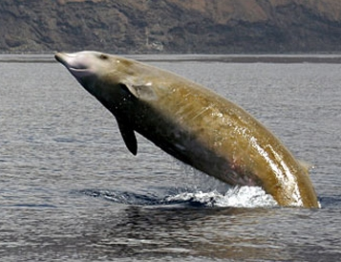
Ziphius cavirostris
Temperate to tropical offshore habitat
Most abundant species in Ziphiidae family
Highly sensitive to MFA sonar
Holds world record for longest and deepest dive by a mammal
© Cetacean Research & Rescue Unit
Notes:
High-profile, anti-submarine warfare training, vested interest
Lends itself well to PAM, short surface intervals, hard for visual surveys

Slide 3
Goals
To understand the technical side of click detection and classification
To determine which method of click detection and classification is most accurate
To determine strengths and weaknesses of each method
Notes:
--My experience: human-verification. Find a way to automate.

Slide 4
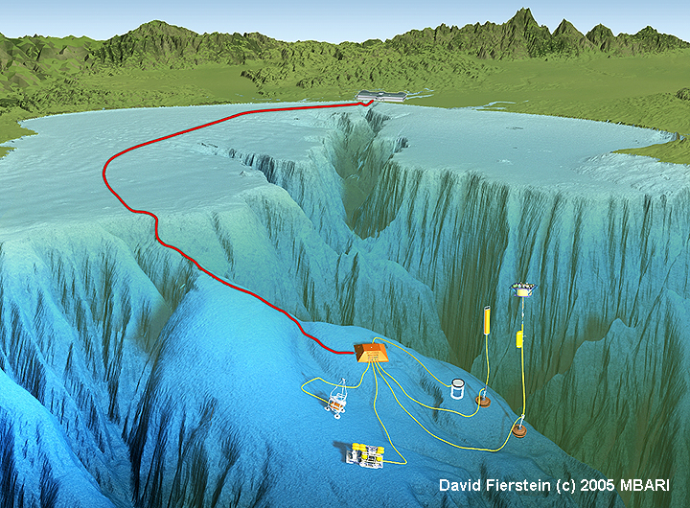

Monterey Canyon Soundscape
Recorded in a marine
sanctuary
Cetacean communication is more common than silence
Notes:
Data from MARS
No beaked whale clicks audible, out of human hearing range
Continuous acoustic data from hydrophone = big opportunity

Slide 5
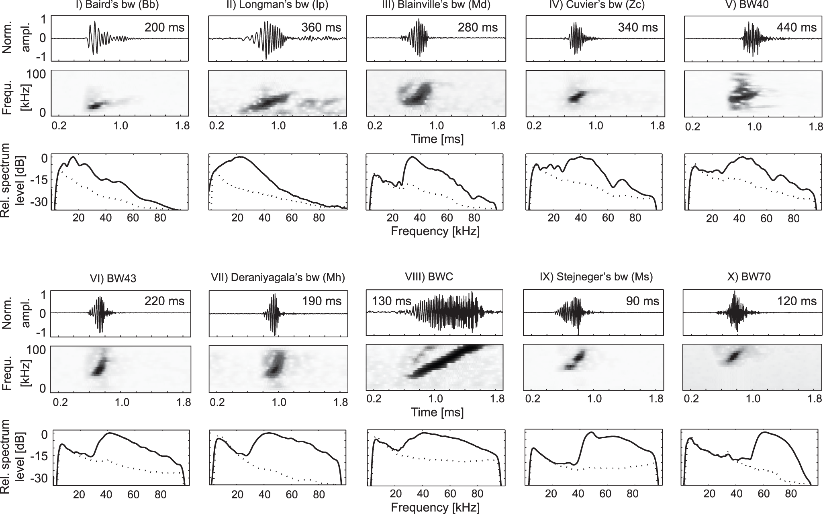
Beaked Whale Clicks
Species-specific clicks
Use echolocation for feeding
Potential use for communication
©Baumann-Pickering et al. 2014
Notes:
Waveform, Spectrogram, relative spectrum.
Baird’s beaked whale click, slowed down to be audible.

Slide 6
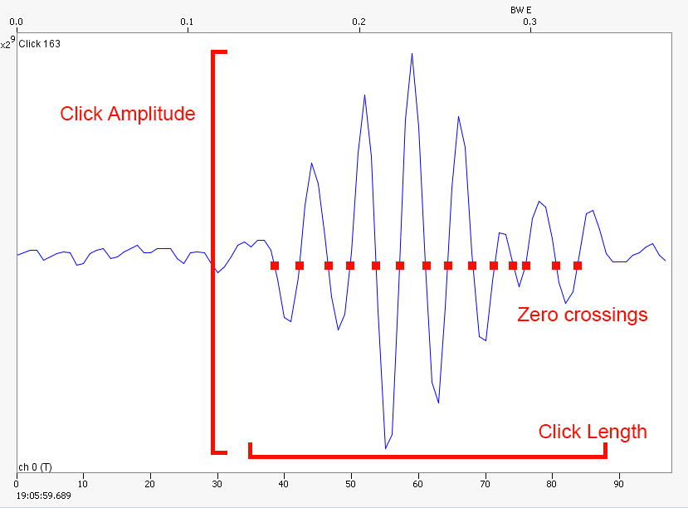
Methods: PAMGuard
Open-sourced software
Detects and classifies based on user-specified parameters
Notes:
Made my own data

Slide 7

Methods: Wavelets
Represents a signal in time and frequency domains as a transform
Compare wavelet to known beaked whale clicks
Notes:
Didn’t make my own data, just compared

Slide 8
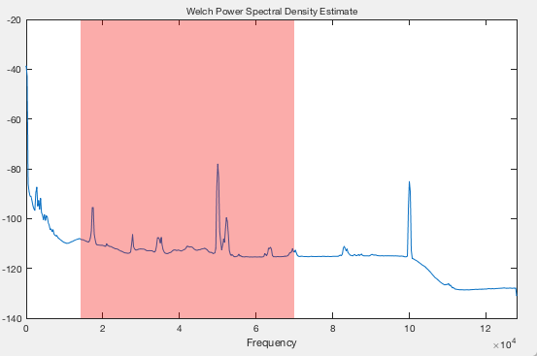
Tuning the PAMGuard Classifier
Examine frequencies with Welch Power Spectral Density Estimate
Interference from MARS cabled observatory power supply
Notes:
Trial and Error
Filtering was successful, but not useful—maybe PG is compensating
Then with a good classifier, fed one 10-min file through to get data for comparison to wavelets

Slide 9
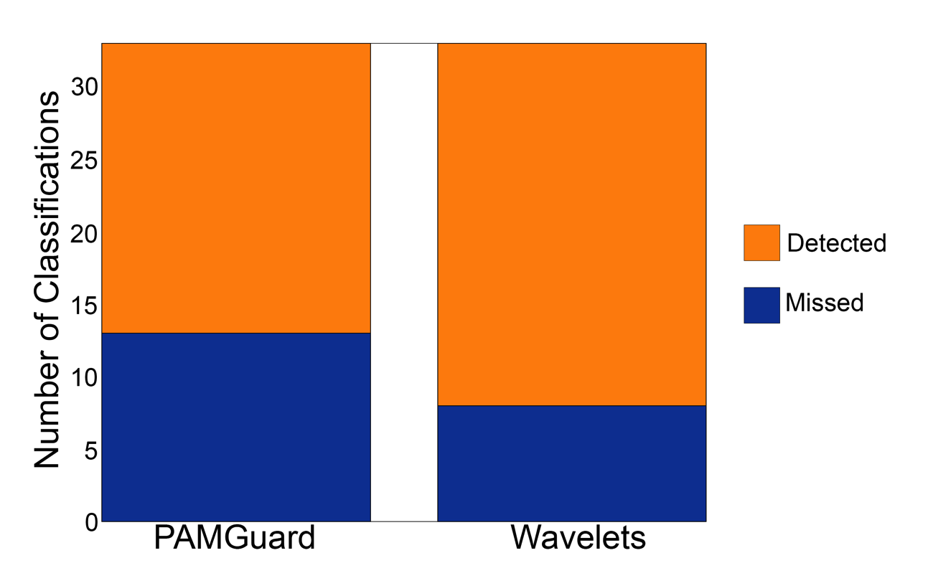
Results: PAMGuard vs Wavelets
Wavelets classified a larger number of ground truth classifications
Notes:
In terms of GROUND TRUTH—expert annotations, she went through and looked on a spectrogram by hand
EXPLAIN GRAPH– y axis is ground truth annotations, orange is detected by method, blue is missed
Wavelets is more accurate in terms of ground truth

Slide 10
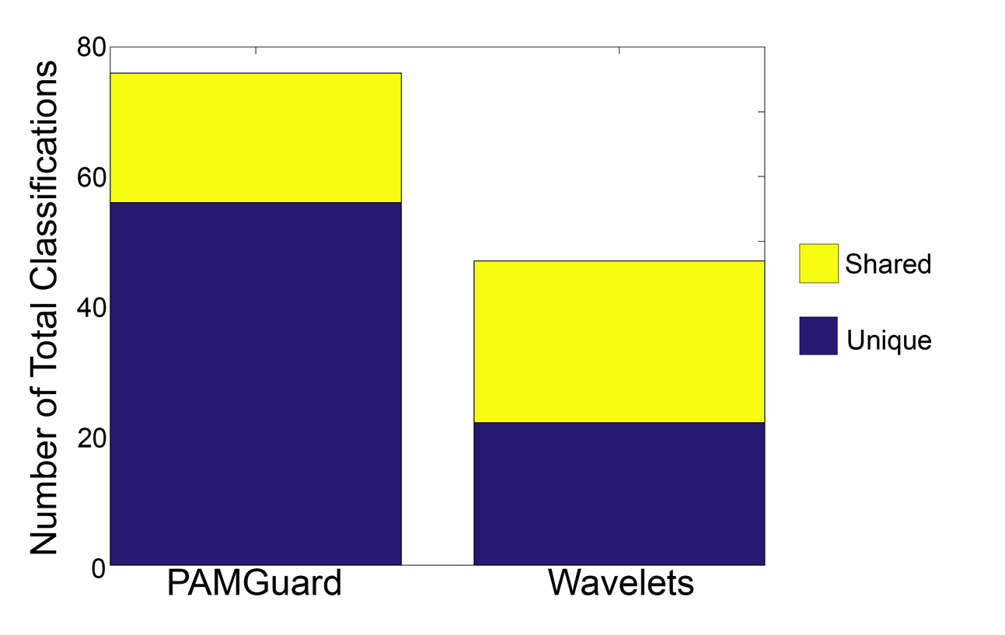
Results: PAMGuard vs Wavelets
PAMGuard detected many more clicks overall
Notes:
EXPLAIN GRAPH:Y-axis is total number of clicks detected by ground truth OR method. Yellow is a match, purple is only found by the method OR ground truth
Error on PG clicks looked pretty low
PG has more powerful detector?

Slide 11
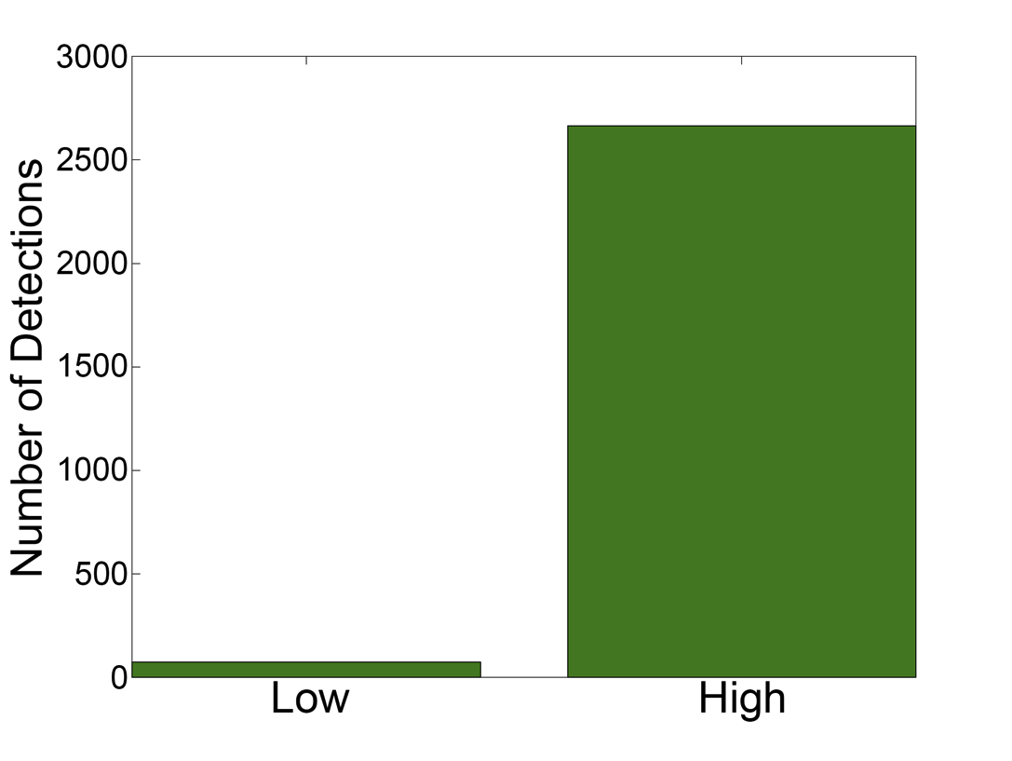
Low vs High Signal:Noise
Combined detections were much higher in high signal:noise file
Notes:
SIGNAL TO NOISE RATIO, file previously analyzed was low.
No ground truth, so compared to each other.
Only 74 clicks in the low signal:noise but 2600 in high signal:noise
Error in high signal:noise was higher than in low

Slide 12
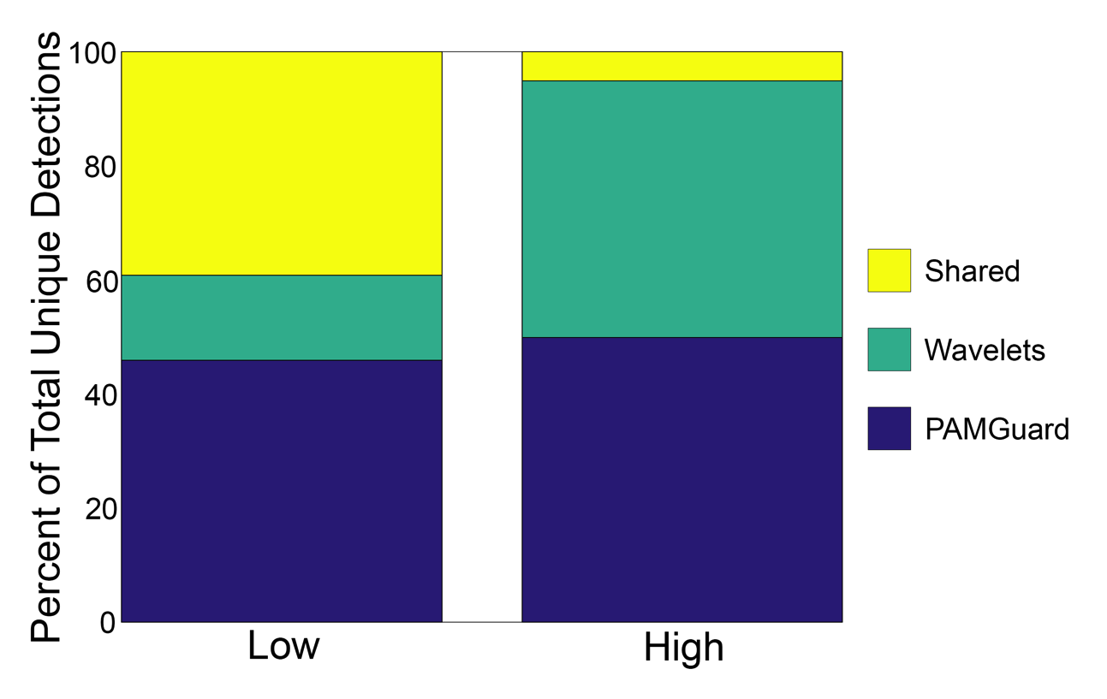
Low vs High Signal:Noise
Agreement between methods was much lower in high signal:noise
Notes:
EXPLAIN GRAPH: Showing the proportion of total detections made by each method. Yellow is agreement, green is just wavelets, PAMGuard is purple.
Higher agreement = better performance, agree on click not random noise
Weakness = sound environment mattes

Slide 13
Conclusions
Ground Truth is difficult to obtain
User-friendliness creates problems for specific analyses
Minute changes greatly affect classification outcomes
Parameter and filter-based methods might not be the right approach
Notes:
I only scratched the surface, but I accomplished my goals—got under the hood of PAMGuard, found out why it was working poorly, and tried to fix it.

Slide 14
Future Directions
Joint application of PAMGuard detection and wavelets classification
Neural networks could choose pertinent parameters for detection
Notes:
Sitting at my desk wondering why I couldn’t just highlight clicks and make the computer pick the parameters—but aha! I can! Sort of.
PG/Wav used for training set
PAM is an exciting field with a lot of potential for cetacean research and biology, so I’m glad I had a chance to explore it for the last couple weeks.

Slide 15
Special thank you
Danelle Cline and John Ryan
Marjolaine Caillat, Mark Fischer, and Tetyana Margolina
George Matsumoto and Linda Kuhnz
MBARI Summer Intern Crew

