Slide 1
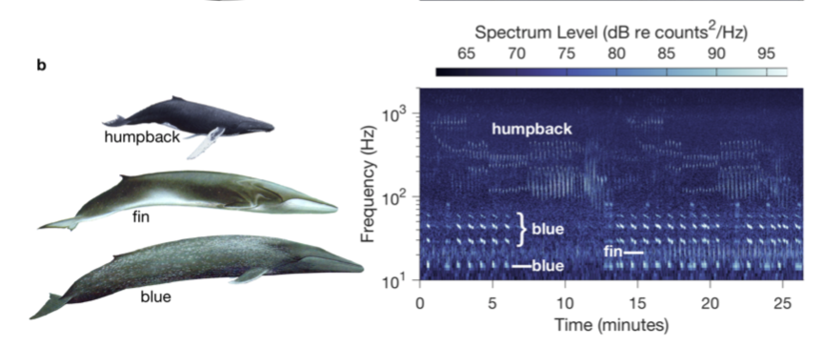
Other Baleen Whale Vocalizations
Ryan, John. ”Temporal variations in humpback whale song in Monterey Bay National Marine Sanctuary, northeast Pacific.”

Slide 2
143 Total Units
~ 7 Min
Notes:
Total: 143 units ; 11 diff unit types , 24% gurgles (most popular unit type) w/in song

Slide 3
Song Selection
2015
2016
2017
Oct 22
Oct 23
Nov 21
Dec 07
Dec 28
Nov 01
Dec 07
Jan 07
Jan 16
Apr 24
2017
Oct
Nov
Dec
Nov
Dec
Jan
Apr
2018
17 days
Today
68%
24 days
35%
High signal to noise ratio
10 labeled songs
429 songs
34 days
30%
23 days
25%
Fri 9/8/17 - Sat 9/30/17
35 days
22%
Wed 10/4/17 - Tue 11/7/17
31 days
17%
Notes:
How I chose songs- high signal to noise, least amt background noise
Fill space here

Slide 4
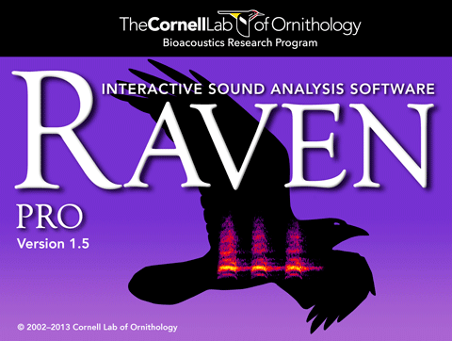
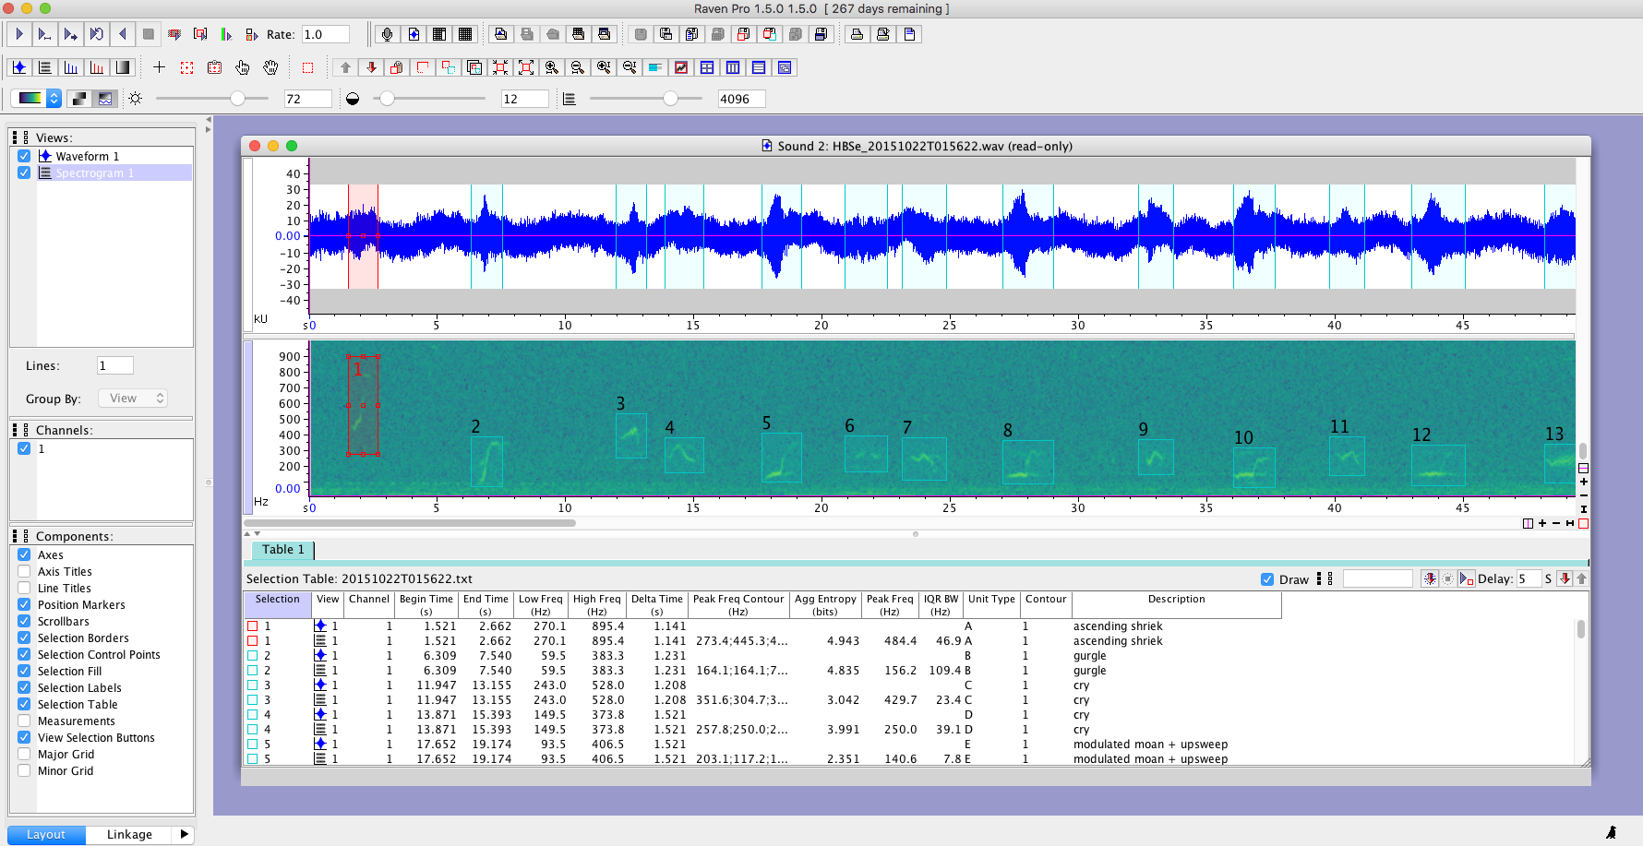
What is a spectrogram?
Raven
Traditional method
What is a unit?
Waveform
Spectrogram
Selection table
Notes:
Time span- time consuming
Labeled 10 songs in 8 weeks
Drew boxes around all units– listened, compared spectrograms, labeled units

Slide 5
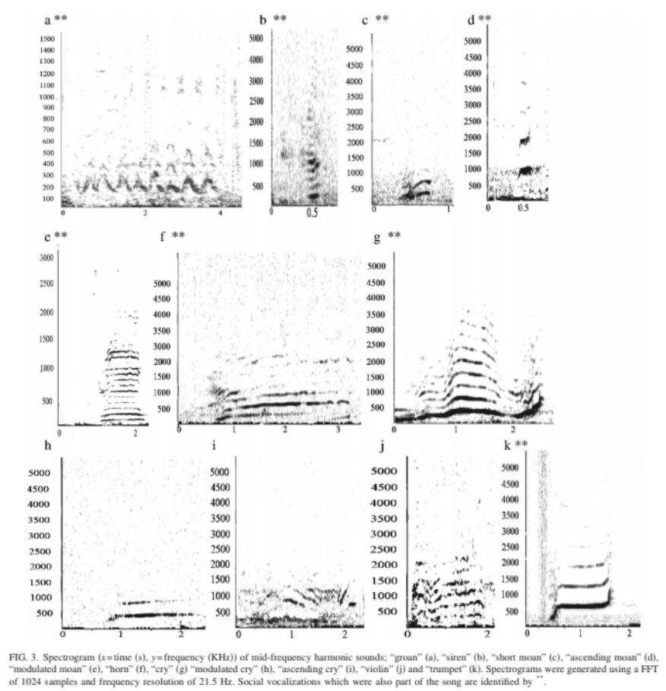
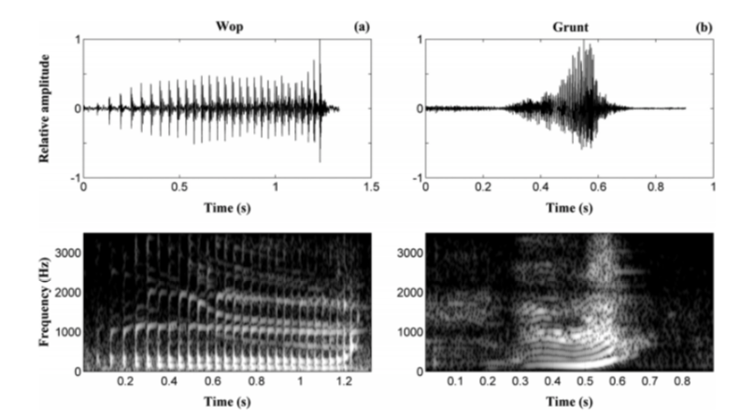
Labeling Units
Table (unit durations, low and high frequencies) and spectrograms
Audio
Frequency (Hz)
Time (sec)
Dunlop et al, 2007
Stimpert et al, 2011

Slide 6
Results
26 different unit types
Notes:
Song Selection- 1-10- October 2015- April 2017
Talk ab why this frequency range
429 total songs, labeled 10

Slide 7
An increase in song duration does not correlate with an increase in complexity of the song.
Notes:
**no correlation b/w length of song and increasing complexity,, no relation- random
This shows that the longer the song doesn’t mean the song is more complex. No correlation bw length of song and complexity.

Slide 8
To sing or not to sing
Song duration does not relate to a greater or lesser percentage of time spent actually singing.
Notes:
Even though longer song, whales aren’t necessarily taking more pauses/breaks b/w units.

Slide 9
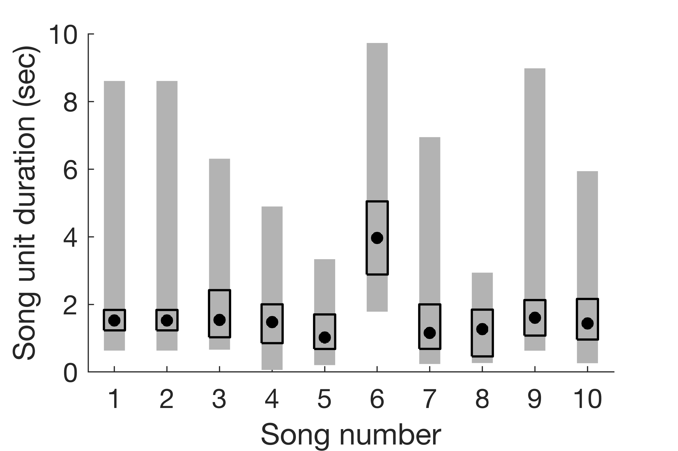
Song unit duration median seems to remain fairly constant despite the wide song unit duration range.
Notes:
Nonparametric box plots b/c not normal distribution so can’t use mean and std dev
Grey bars - song unit duration range (min and max) , boxes represent 1st and 3rd quartiles (25% and 75%) , dot represents median
Song # 6: lot of descending moans, growl, grunt (6, 8-9 sec→ median shift higher)

Slide 10
Harmonics
- groan, moan, cry, purr, bellow, grunt, trill
Notes:
Show spectrogram w/ harmonic circled (percentage)
3 songs that don’t contain over half units w/ harmonics

Slide 11
As song length increases, percentage of units containing harmonics does not necessarily increase.

Slide 12

Conclusion
Summary
“Ground truth” for machine learning
26 different unit types
Increase in song duration does not correlate to
  Increase in song complexity
  Increase in % units w/ harmonics
  Increase/decrease in time spent singing
Majority of songs contain harmonics
Song unit duration median constant
Consistent song unit classification requires reference audio files
Future work
  Explore patterns and evolution of song with larger data set
  Replace human with machine learning

Slide 13
Frequency Comparison
Frequency (Hz) | Pitch | Comment
28 | A0 | Lowest note on piano
41 | E1 | Lowest note on bass
49 | G1 | Low freq bound
196 | G3 | Lowest note on violin
262 | C4 | Middle C
440 | A4 | Tuning note reference
2093 | C7 | High freq bound
Notes:
Freq range covers 5 octaves! Advanced violinist can play 4 octaves.

Slide 14
Composition
Credit to Kim Fulton-Bennett
3 unit types: descending shriek, descending moan, trill

