Slide 1


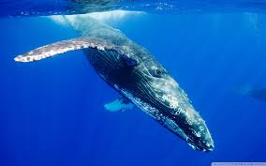
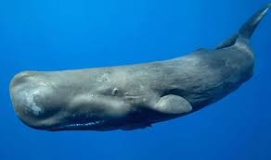
AUTOMATIC CLASSIFICATION OF CETACEANS THROUGH THEIR VOCALIZATIONS
Mentors:
Danelle E.Cline
John Ryan
Prateek Murgai

Slide 2
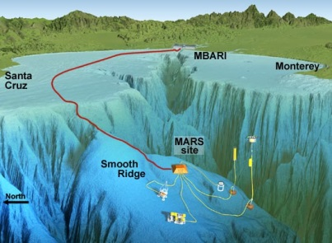
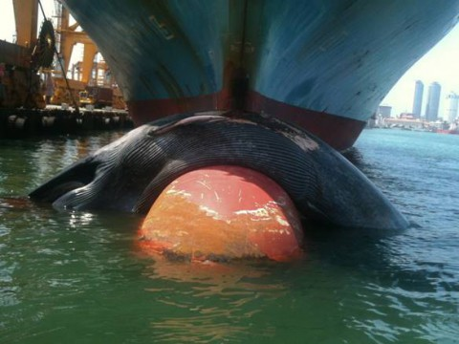
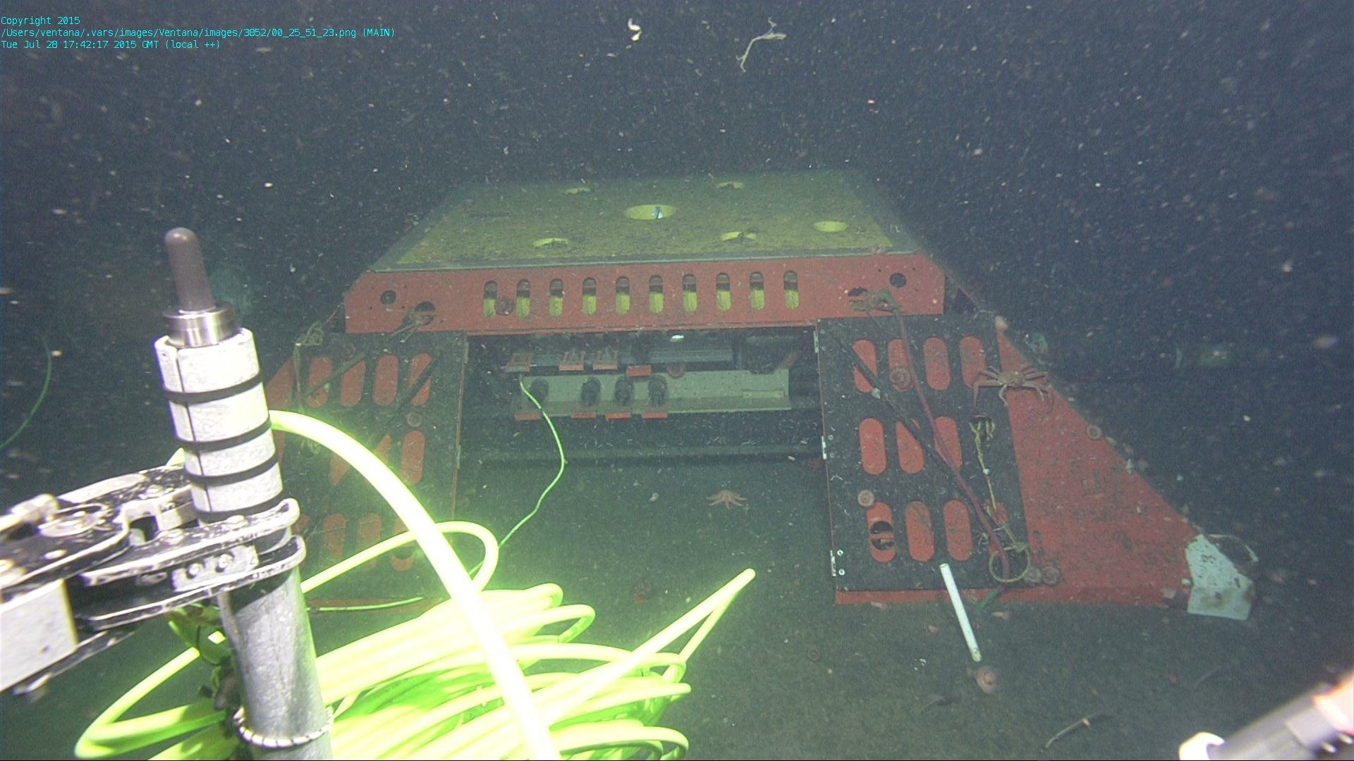
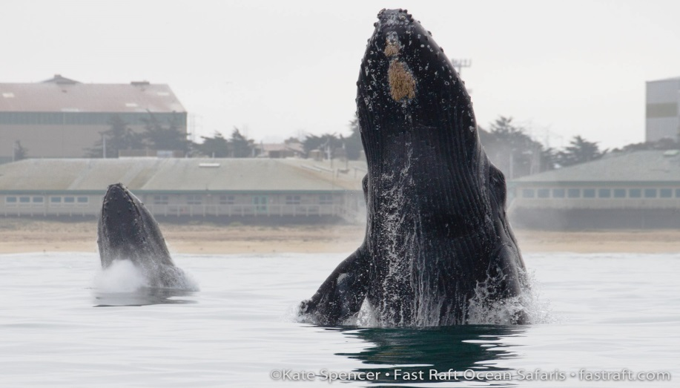

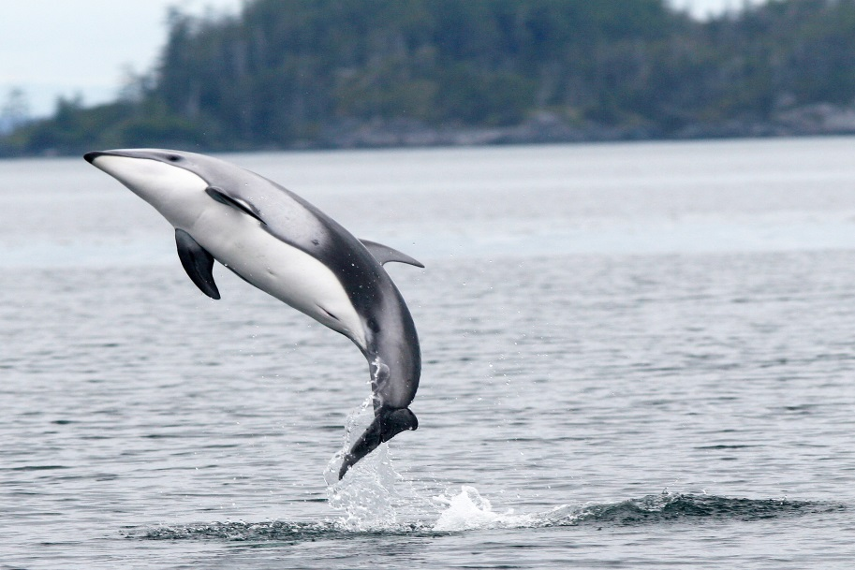
MOTIVATION
Acoustics!!
That’s Me!!!!

Slide 3



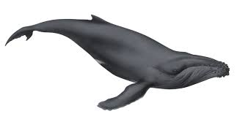

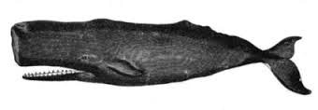
The Aquatic Siri
Aquatic Siri
Humpback Whale
Sperm Whale

Slide 4
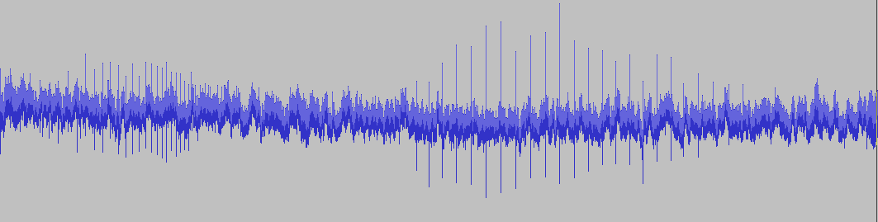



The Big Picture
Recorded Sound
900m

Slide 5
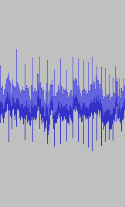
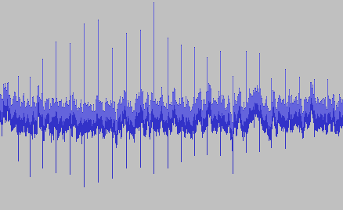
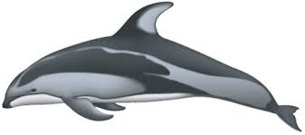
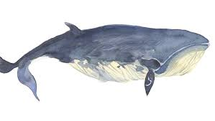
Feature Extraction
Classifier
0.5 | 0.7 | 1.1 | -2 | -3 | 0.1

Slide 6
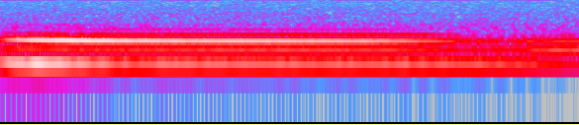
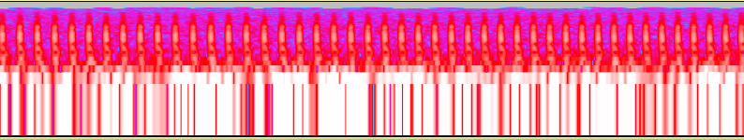
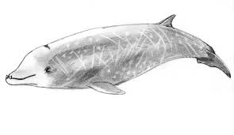
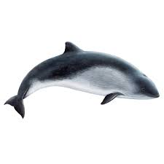
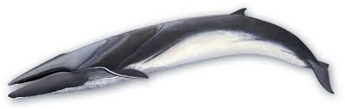
Data Extracted
SCRIPPS
DATASET
MYSTECETI
ODONTOCETI

Slide 7
Features
Features
MFCC
Zero Crossing Rate
Energy
Spectral Entropy
Spectral Roll-off
Spectral Flux
Spectral Spread
Time Domain

Slide 8

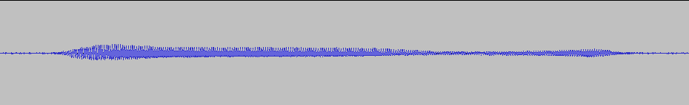
Feature Extraction
50ms
Spectral Features
0.2
0.78
0.45
0.42
0.31
0.33
 | 1-50ms | 25-75ms | 50-100ms | 75-125ms | 100-150ms | 125-175ms
Energy
ZCR
Spectral Entropy
Spectral Centroid
MFCC
Spectral Flux
Spectral Spread

Slide 9
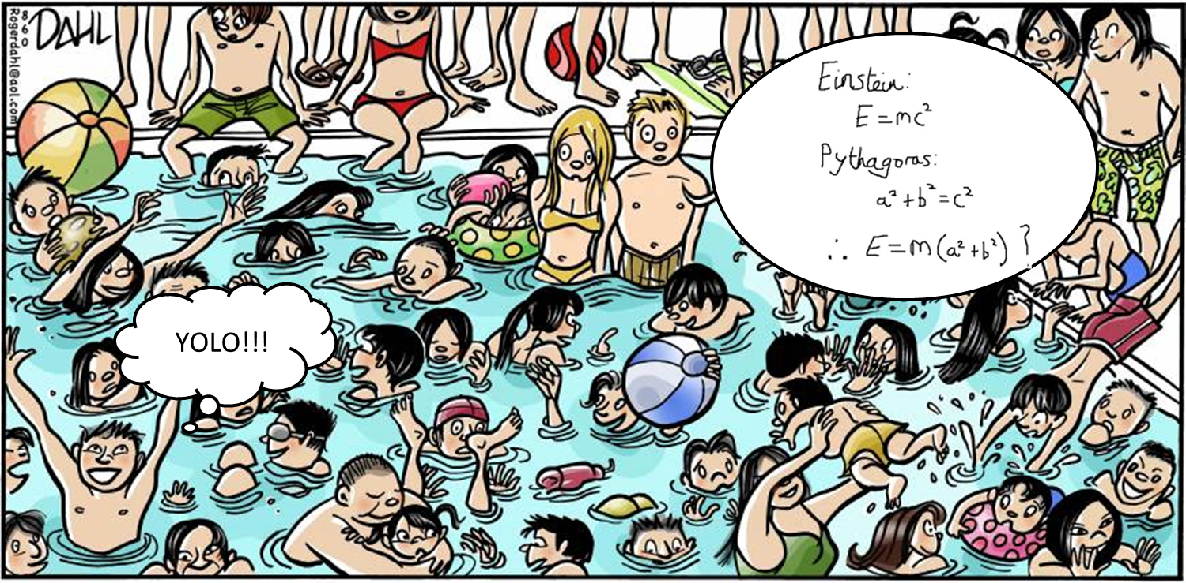


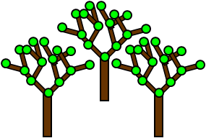
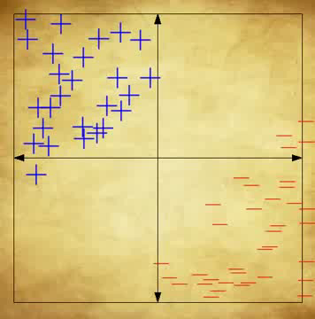
Classifiers
Support Vector Machines
Random Forest Classifier
Decision Plane
Decision Trees

Slide 10
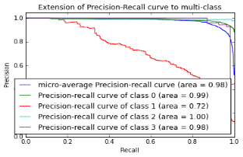
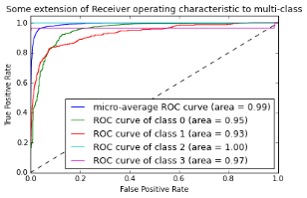

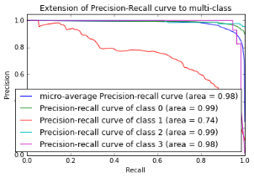
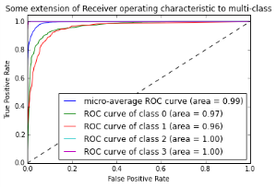
Classifier Testing
Feature Extraction
TEST DATA
AUDIO DATA
SVM
TRAINING DATA
Feature Extraction
RFC

Slide 11
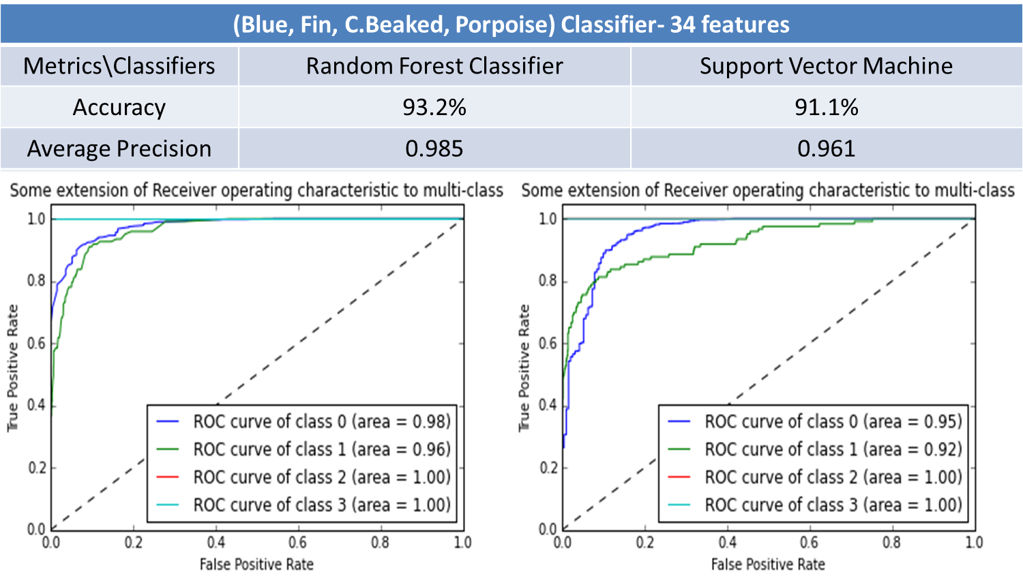
Blue
Blue
Fin
Fin
C.Beak
C.Beak
Porpoise
Porpoise

Slide 12
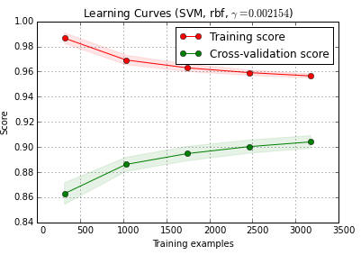
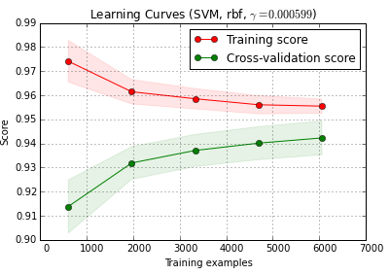
(Blue, Fin, C.Beaked, Porpoise) Classifier- Data Augmented
Metrics\Classifiers | Actual Data | Actual + Artificial Data
Accuracy | 93.2% | 94.7%

Slide 13
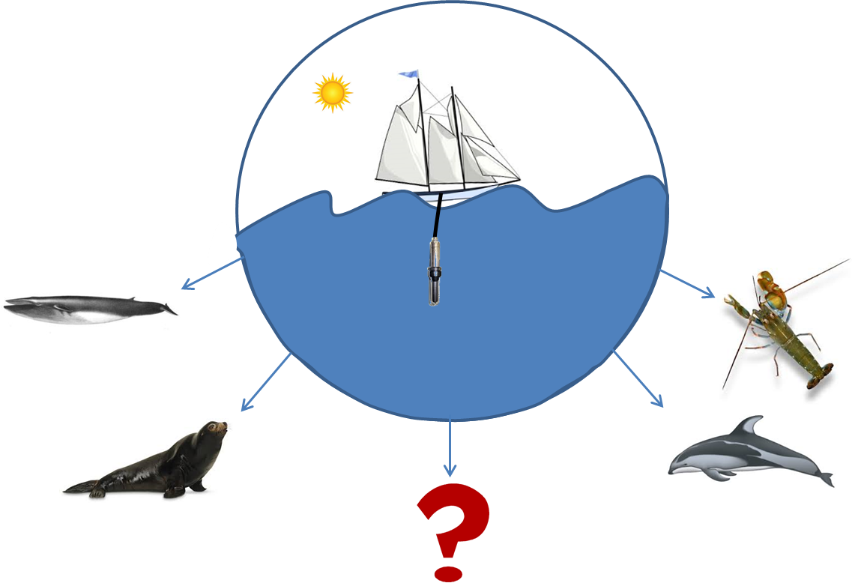
Soundscape

Slide 14
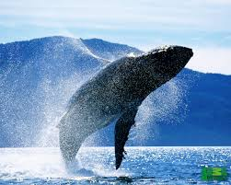


Thanks!!!
George Matsumoto
Linda Kuhnz
Danelle Cline
John Ryan
Paul McGill
Rachel Carson Crew
MBARI Interns!!!
And……………

Slide 15
Questions?

