Slide 1
Agenda
~10 am to noon
Updates
~ noon to 1 pm
Lunch
~ 1 pm to 3 pm
Finish updates?
Collaboration
Proposal(s)

Slide 2
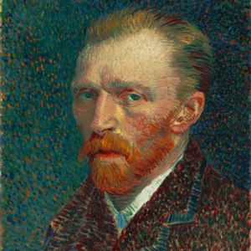
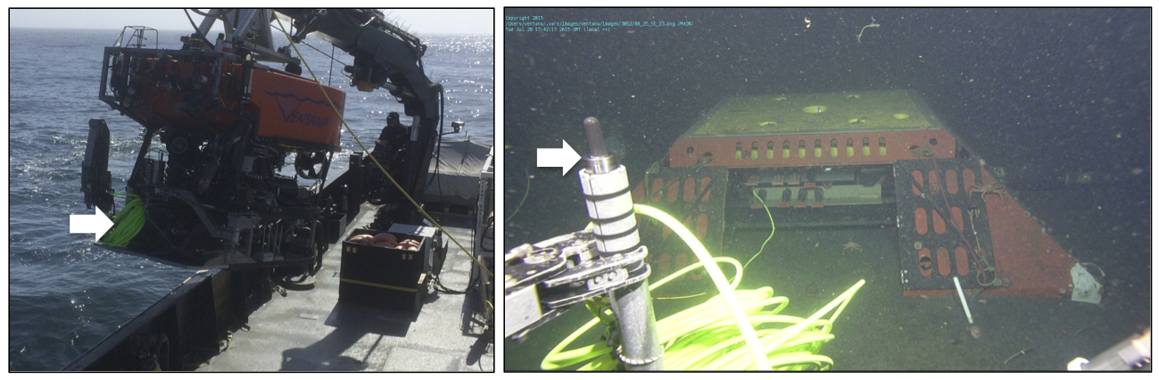
Listening
We plugged in our new ear on July 28. Nearly continuous recording since.

Slide 3
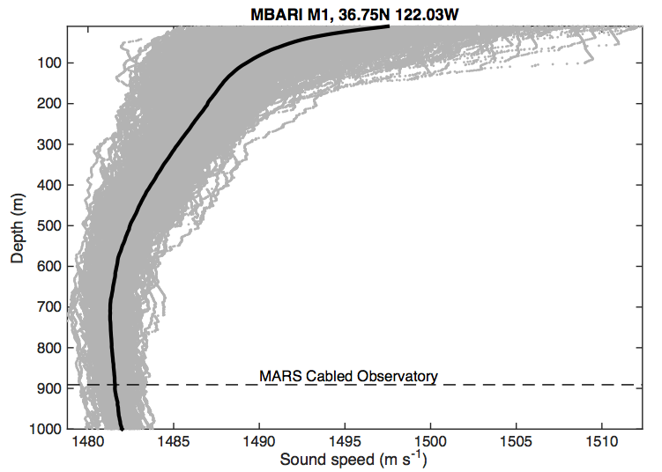
Listening

Slide 4
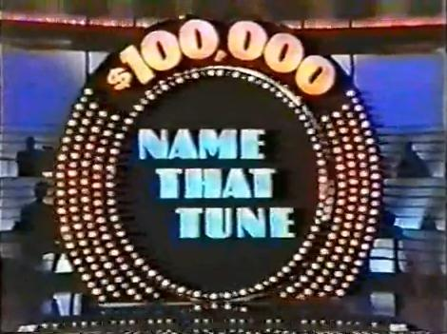
Name that tune

Slide 5
Reliable recording
Some work with Ocean Sonics (Lucy software):
Fixed bug causing inconsistent file size.
Discovered need for more robust recovery from temporary loss of network connection.
Recent stops in recording with CPU pegging.
Issues relate to running software on VM connected to network share? Ocean Sonics is testing.
Ocean Networks Canada (ONC) offered their custom driver for this hydrophone. They developed automatic notification of faults and attempted recovery.

Slide 6
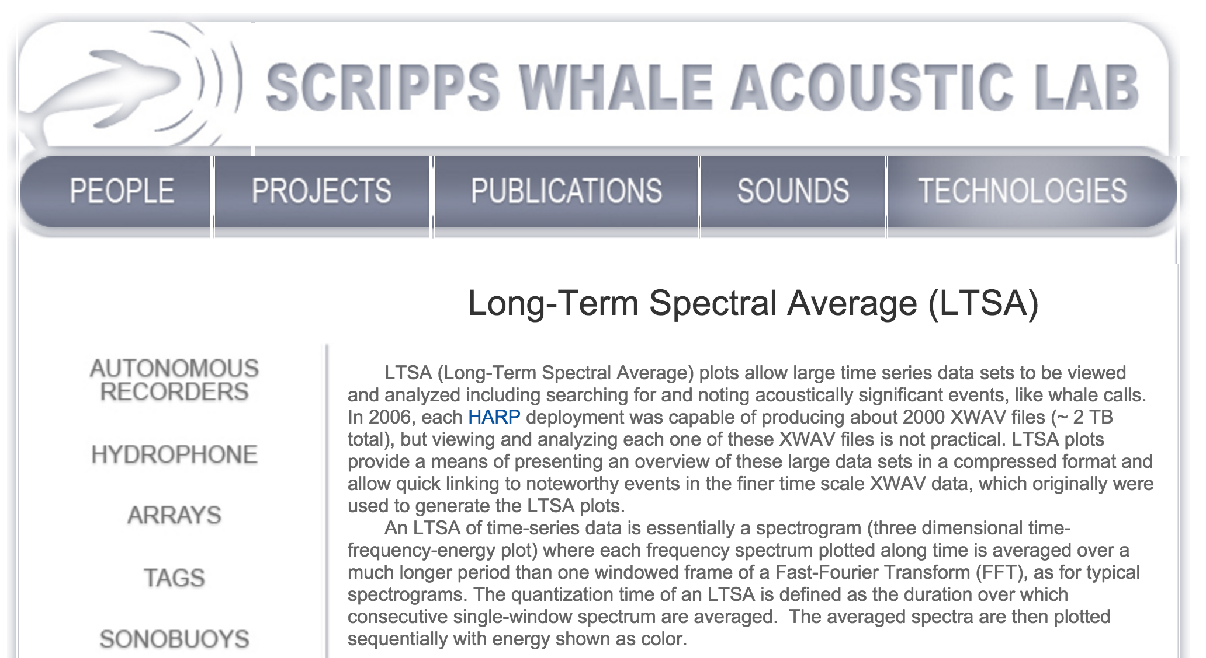
Research tools: 1. LTSA
http://cetus.ucsd.edu/technologies_LTSA.html

Slide 7
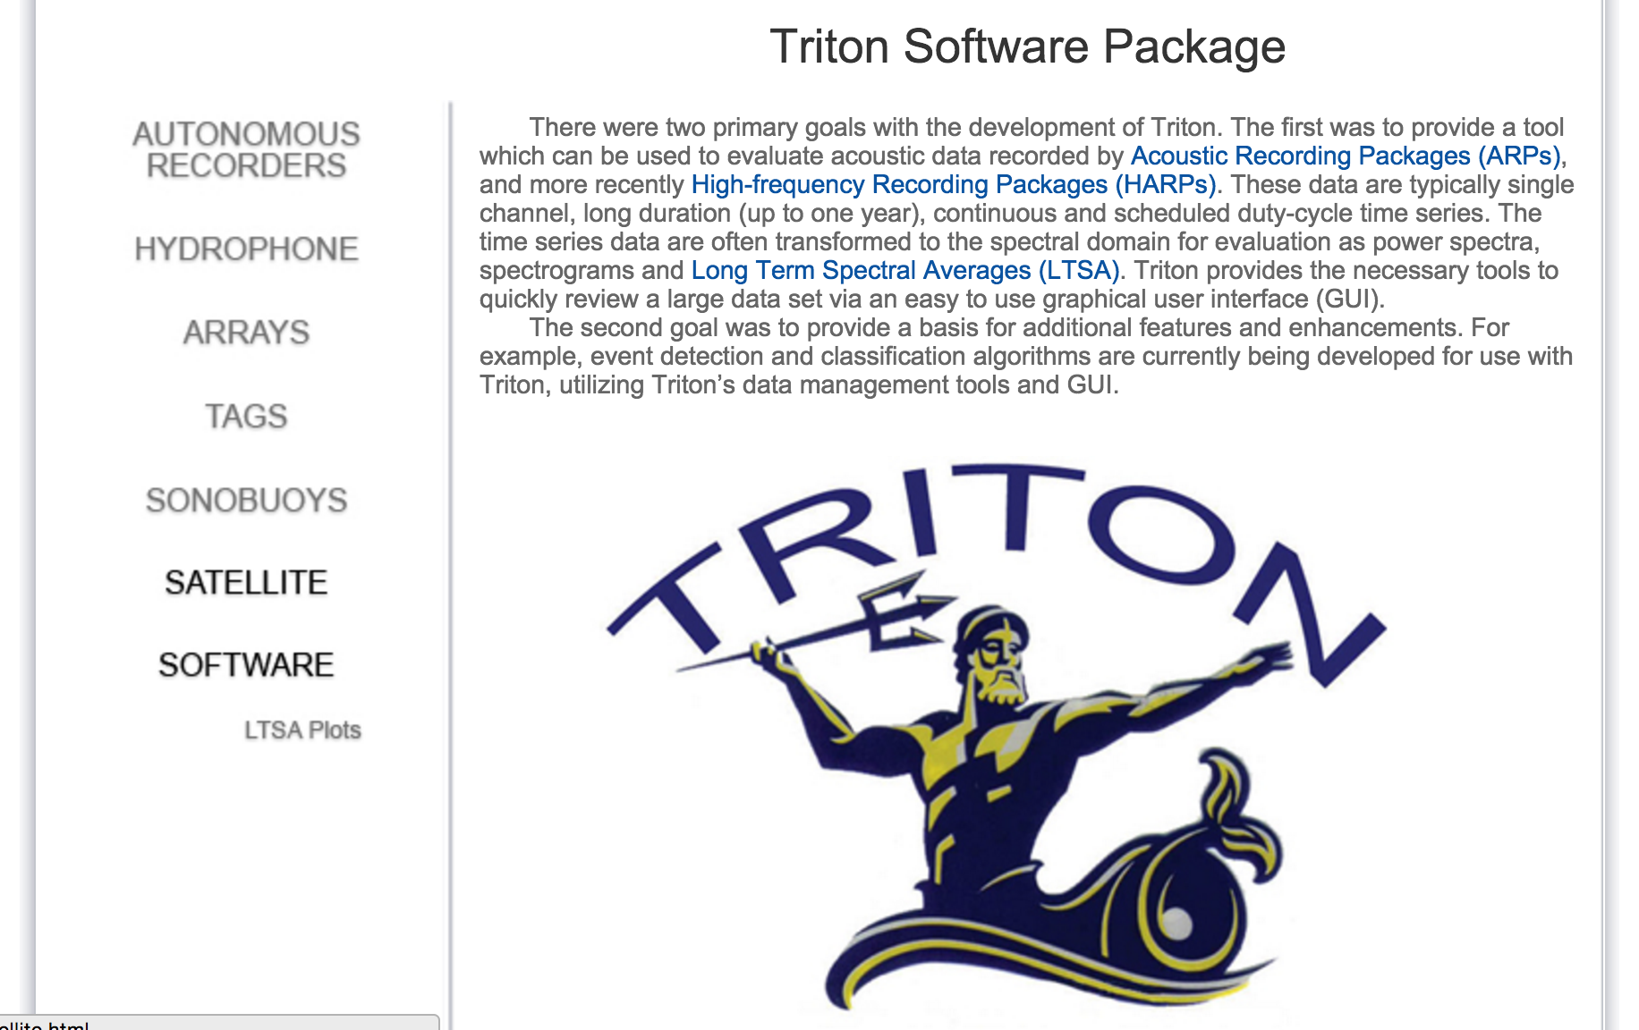
Research tools: 1. LTSA
http://cetus.ucsd.edu/technologies_Software.html

Slide 8
Research tools: 1. LTSA
Following NPS methods (thanks to Tetyana and JJ!), Danelle Cline established processing with 3 LTSA parameterizations, all using 5 second time bins.
Targeting dolphins, beaked whales, sperm whales
  No temporal decimation of input
  Frequency range 0 to 128 kHz, with 100 Hz frequency bins
Targeting Minke whales, humpback whales
  Temporal decimation of input by factor of 20
  Frequency range 0 to 5 kHz, with 10 Hz frequency bins
Targeting blue and fin whales
  Temporal decimation of input by factor of 100
  Frequency range 0 to 1 kHz, with 1 Hz frequency bins

Slide 9
“Soundscape surveying” via LTSA animation
Make very dense acoustic data visually accessible
Scan information content of recordings
Detect patterns in natural and anthropogenic sound
Generate and inform research questions
Direct other analysis methods to specific periods
Provide a collaborative resource

Slide 10
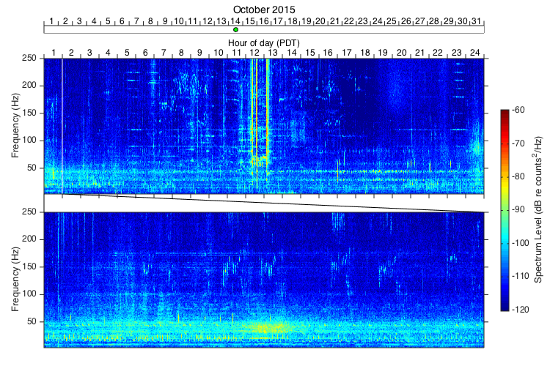
“Soundscape surveying” via LTSA animation

Slide 11
Other MBARI efforts
Analysis
Automated detection and classification (Danelle)
“Higher-altitude soundscape flyovers”: daily FFT animation (Yanwu)
Introduced to SQLX software, developed for seismometer data analysis by R. Boaz (may be useful for longer-term characterization of sound)
Listening
Listening for tagged animals from moorings and floats (Brent)

