Slide 1
GNC Timing
GNC refers to the Navigation, LayeredControl and DyamicControl tasks.
Navigation triggers DynamicControl with an EventCallBack.
LayeredControl is free running, but at the same frequency.

Slide 2
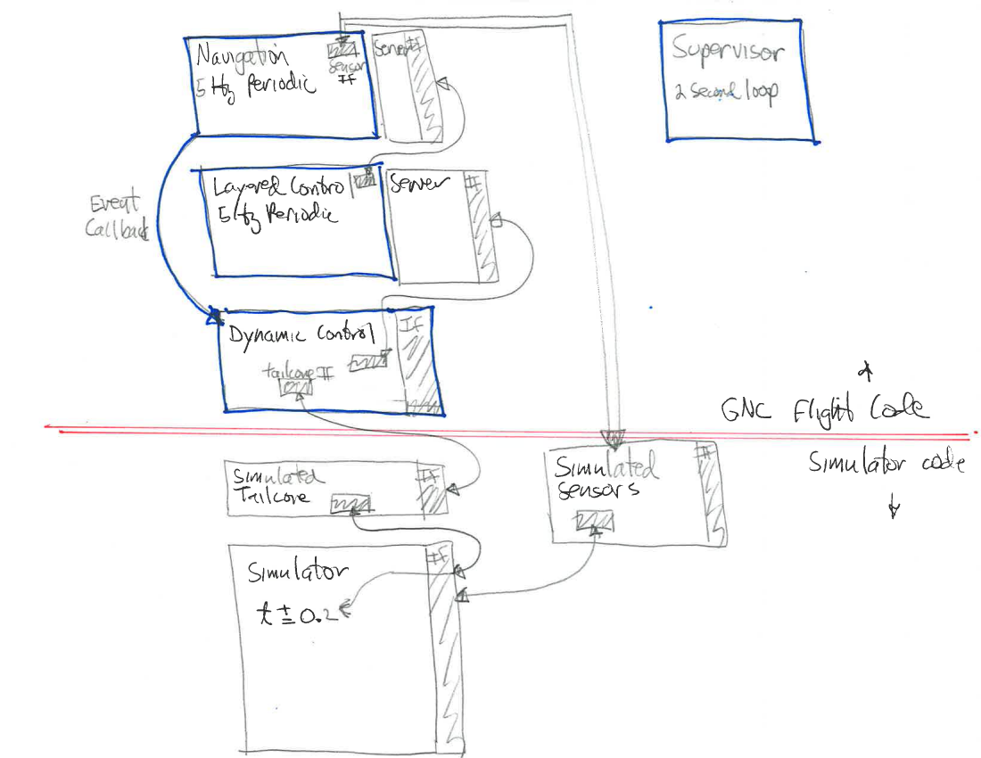
Existing GNC Timing

Slide 3
Existing GNC Timing
: ### Navigation t = 1421167722.87
: ### DynamicControl t = 1421167722.87
: ### LayeredControl t = 1421167723.06
: ### Navigation t = 1421167723.07
: ### DynamicControl t = 1421167723.07
: ### LayeredControl t = 1421167723.26
: ### Navigation t = 1421167723.27
: ### DynamicControl t = 1421167723.27
: ### LayeredControl t = 1421167723.46
: ### Navigation t = 1421167723.47
: ### DynamicControl t = 1421167723.47
: ### LayeredControl t = 1421167723.66

Slide 4
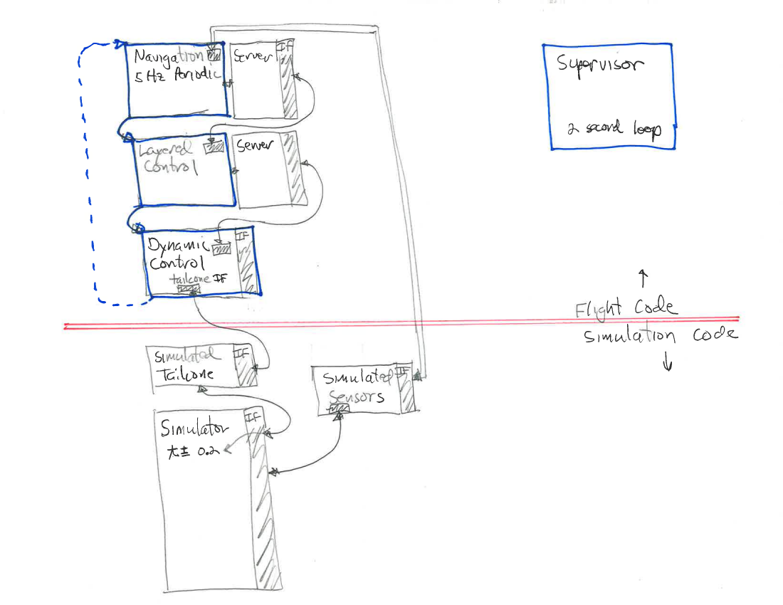
Proposed GNC Synchronization

Slide 5
Proposed GNC Synchronization
: ### Navigation t = 1421181198.36
: ### LayeredControl t = 1421181198.36
: ### DynamicControl t = 1421181198.36
: ### Simulator t = 1421181198.36
: ### Navigation t = 1421181198.56
: ### LayeredControl t = 1421181198.56
: ### DynamicControl t = 1421181198.56
: ### Simulator t = 1421181198.56
: ### Navigation t = 1421181198.76
: ### LayeredControl t = 1421181198.76
: ### DynamicControl t = 1421181198.76
: ### Simulator t = 1421181198.76
: ### Navigation t = 1421181198.96
: ### LayeredControl t = 1421181198.96
: ### DynamicControl t = 1421181198.96
: ### Simulator t = 1421181198.96

