Slide 1
Block Diagrams of the Code
Objective of this presentation:
  Understand the timing, sequence of execution, and data flow of:
  Flight code as it is now.
  Flight code with Layered Control fix.
  Flight code and simulator.
  With (temporary) Dynamic Control event callback.
  With all three moved into a single GNC process.

Slide 2
Legend
Process (or Task) with its own name space.
Triggered task.
Periodic task.
Event callback. Top task triggers the bottom.
Calling task does not pend.
No transfer of data.
Server
IF
Execution transfers from small red IF box to the large one, then back.
Calling Process pends.
Data may also flow either way.
Also called “synchronous message passing”
IF
Magenta means a vector: Many parallel paths may exist.

Slide 3
Timing as it is Now
GNC refers to the Navigation, LayeredControl and DyamicControl tasks.
Navigation triggers DynamicControl with an EventCallBack.
LayeredControl is free running, but at the same frequency.
The call to Tailcone in DynamicControl triggers the Simulator.

Slide 4
Flight Code
IF
Supervisor
2 Second Periodic
Navigation
5 Hz Periodic
IF
IF
Server
IF
LayeredControl
5 Hz Periodic
IF
Server
IF
IF
DynamicControl
Event Triggered
IF
IF
Flight Code
IF
IF
IF
Hardware
Clock
Tailcone Driver
IF Triggered
Sensor Servers
IF Triggered
Tailcone
Sensors

Slide 5
Flight Code: First Change
IF
Supervisor
2 Second Periodic
Navigation
5 Hz Periodic
IF
IF
Server
LayeredControl
Event Triggered
IF
Server
IF
IF
DynamicControl
Event Triggered
IF
IF
Flight Code
IF
IF
IF
Hardware
Clock
Tailcone Driver
IF Triggered
Sensor Servers
IF Triggered
Tailcone
Sensors

Slide 6
Real-Time Simulator
IF
Supervisor
2 Second Periodic
Navigation
5 Hz Periodic
IF
IF
Server
LayeredControl
Event Triggered
IF
Server
IF
IF
DynamicControl
Event Triggered
IF
IF
Flight Code
IF
IF
IF
Simulator
Clock
Simulated Tailcone Driver
IF Triggered
Simulated Sensor Servers
IF Triggered
IF
IF
Simulator
Tailcone IF Triggered
IF

Slide 7
Full-Speed Simulator – First Pass
IF
Supervisor
Initiates Navigation
Navigation
Event Triggered
IF
IF
Server
LayeredControl
Event Triggered
IF
Server
IF
IF
DynamicControl
Event Triggered
IF
IF
Flight Code
IF
IF
IF
Simulator
Sim Clock
Simulated Tailcone Server
IF Triggered
Simulated Sensor Servers
IF Triggered
IF
IF
Simulator
Tailcone IF Triggered
IF

Slide 8
Full-Speed Simulator – Second Pass
IF
IF
GNC
Server
IF
Supervisor
Initiates GNC
GNC Task
Navigation
Layered Control
Dynamic Control
IF
Flight Code
IF
IF
IF
Simulator
Sim Clock
Simulated Tailcone Server
IF Triggered
Simulated Sensor Servers
IF Triggered
IF
IF
Simulator
Tailcone IF Triggered
IF

Slide 9
Flight Code
IF
IF
GNC
Server
IF
Supervisor
2 Second Periodic
GNC Task
Navigation
Layered Control
Dynamic Control
IF
IF
Flight Code
IF
IF
IF
Hardware
Clock
Tailcone Driver
IF Triggered
Sensor Servers
IF Triggered
Tailcone
Sensors

Slide 10
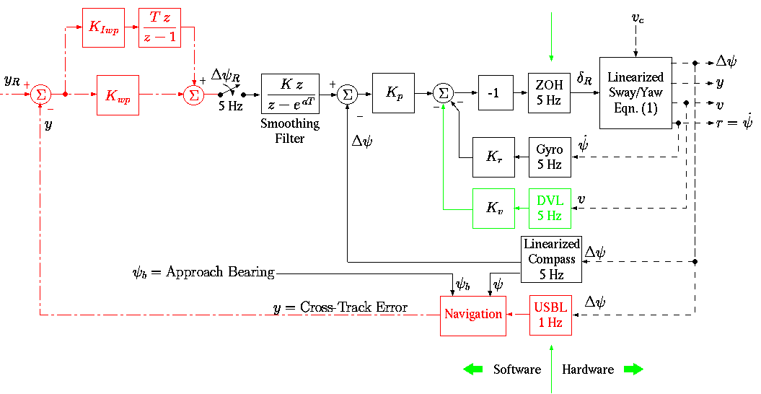
Control System (Math) Diagram

Slide 11
Italian Proverb
«Le meglio è l'inimico del bene»
(Paraphrased)
Do not let the perfect become the enemy of the good enough.

