Slide 1
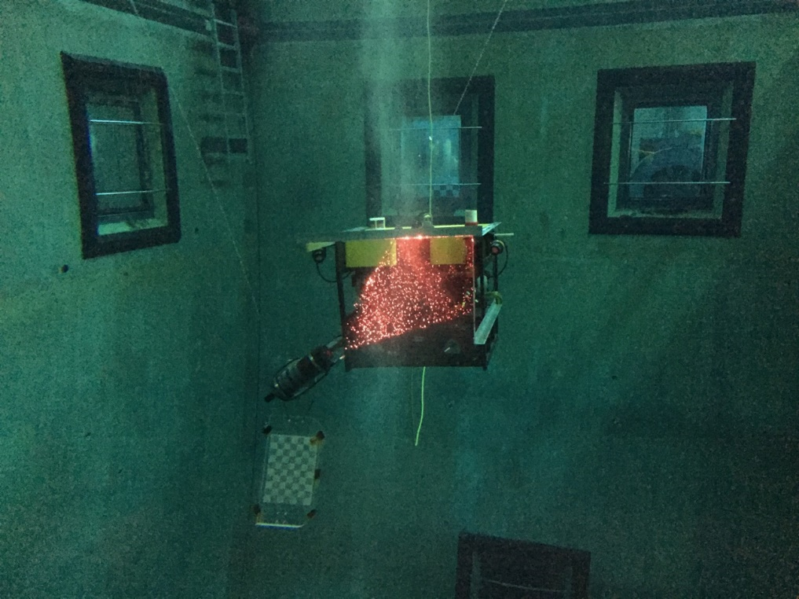
DeepPIV Subastian Integration

Slide 2
Project Goal
Goal: to deploy DeepPIV instrument on the ROV Subastian during 2 research cruises (10/19, 12/20)
Tasks: create interface can to operate DeepPIV.

Slide 3
Electrical Interfaces
Subastian Instrument Interface
  Comms: Fiber
    9/125 um
    Connector: Teledyne Omicron 5070
  Power:
    240 VAC
    Connector: Subconn MCBH3M
  Science Port
    24 V Power, 8A fuse?
    RS232 Comms
DeepPIV Interface
  Laser Housing
    110 VAC, 2A
    Ethernet
  Camera
    24 V, <1A
    RS232 comm ports (2)
  Dye Injector
    24 V, 2A
    RS232 comm port

Slide 4
System Block Diagram
DeepPIV v.3
240 VAC
Ethernet
LASER
Subastian ROV
240 VAC
Interface Can
Fiber
24V
RS232 (2)
Camera
Dye Injector
24 V, RS232

Slide 5
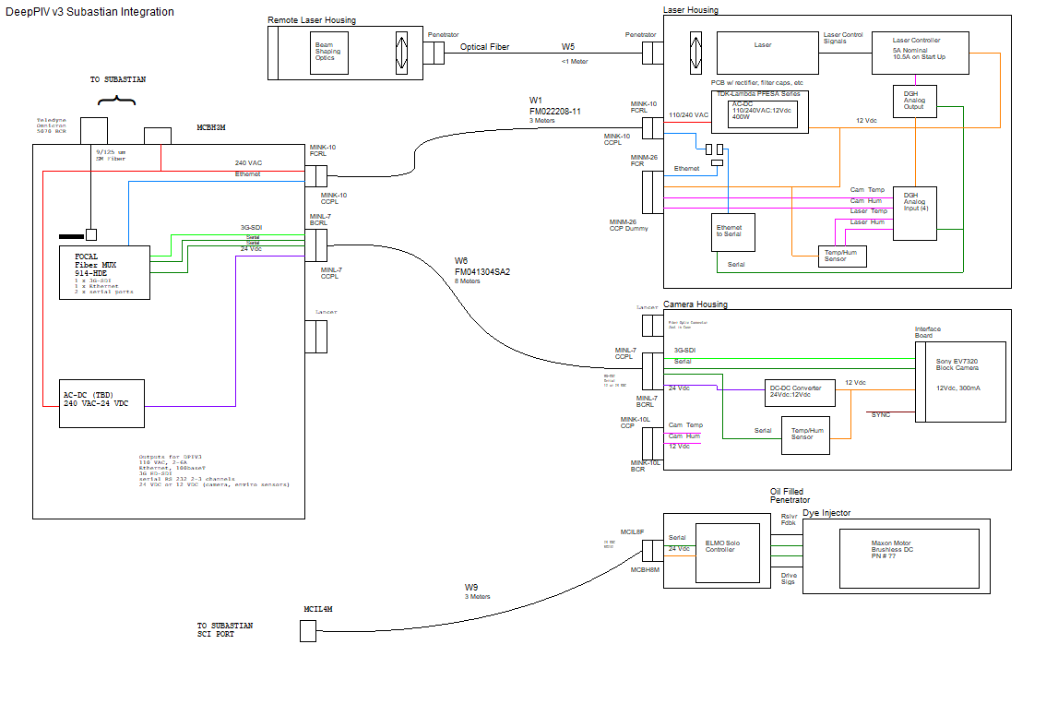
System Block Diagram

Slide 6
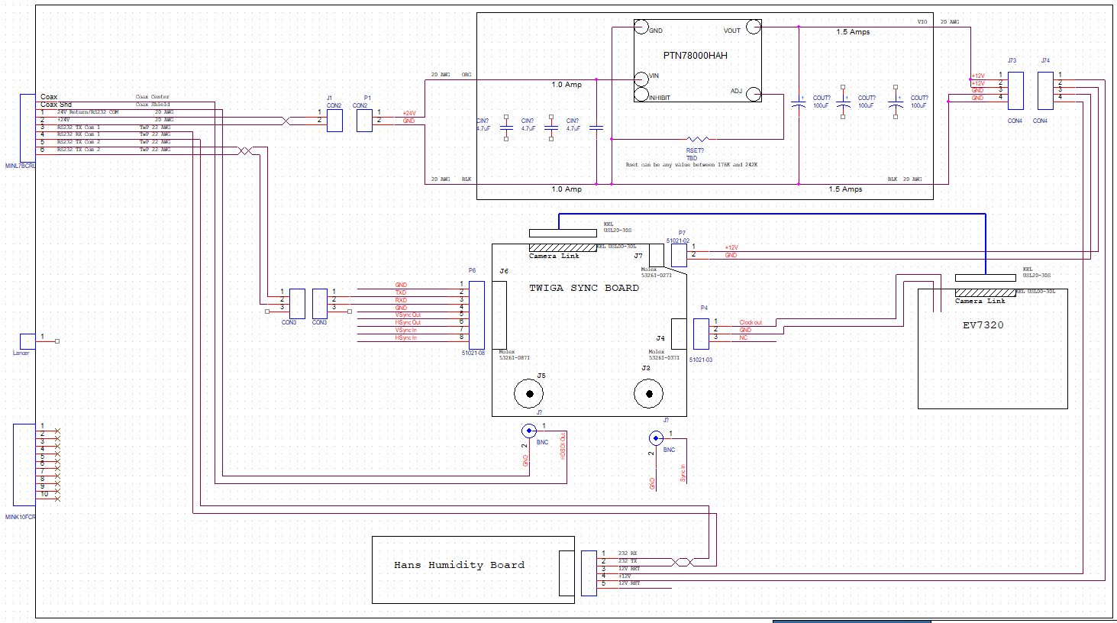
Camera Housing

Slide 7
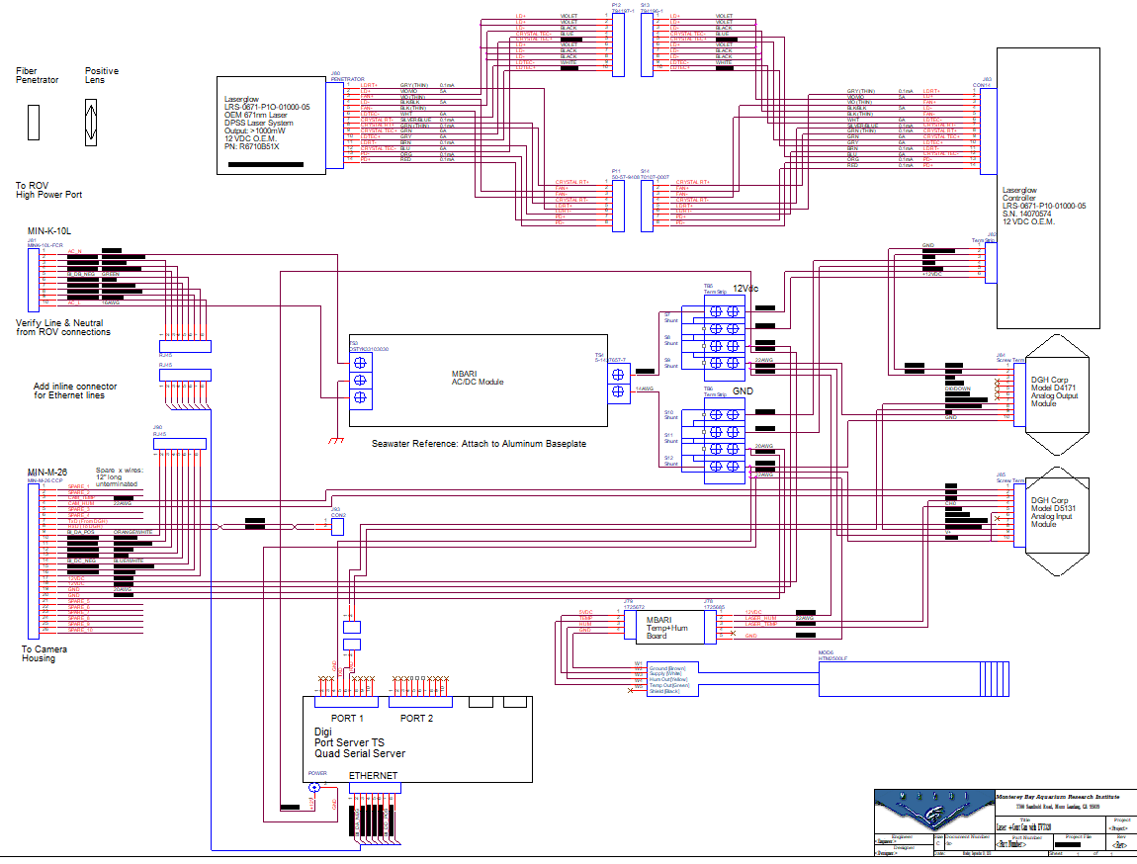
Laser Housing

Slide 8
DeepPIV + Integration Can Power Consumption
 | Voltage (V) | Current (A) | Power (W)
Laser Housing
Laser + Controller | 12 | 10.5 | 126
DGH Modules | 12 | 0.17 | 2.04
Digi Serial Server | 12 | 1.5 | 18
temp/humidity | 12 | 0.05 | 0.6
Total Laser Housing Power |  |  | 146.64
Camera Housing |  |  | 0
Camera | 12 | 0.3 | 3.6
Twiga Int Board | 12 | 0.2 | 2.4
Temp/humidity board | 12 | 0.05 | 0.6
Total Camera Housing Power |  |  | 6.6
Dye Injector
Elmo +Motor | 24 | 2 | 48
Total Dye Injector Power |  |  | 48
Interface Can
Focal stack | 5 | 1.5 | 7.5

Slide 9
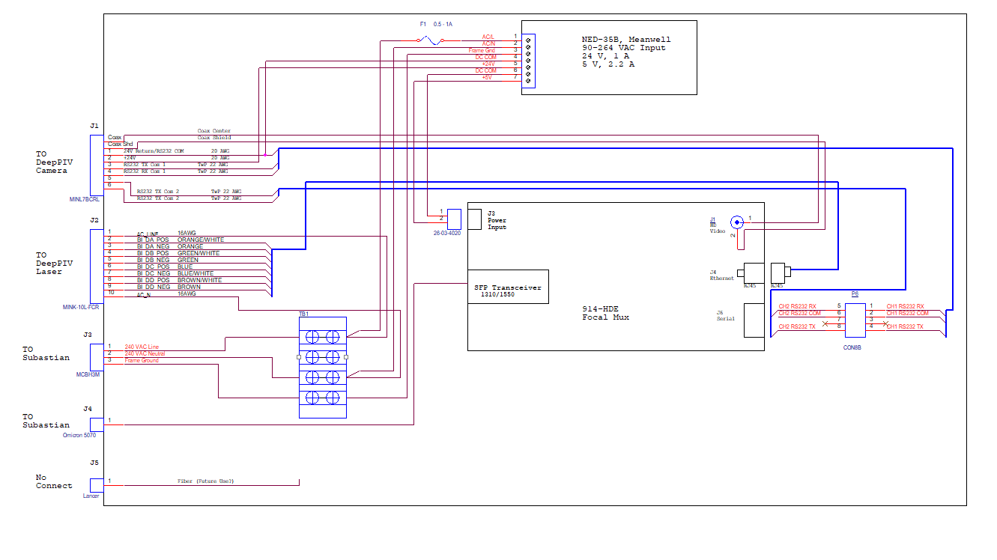
Integration Can

Slide 10
Focal Mux
Focal 914-HDE
  Supports:
    3G-SDI
    Ethernet (100Base-T)
    Serial Comms (2 Channels)
    Expansion interface (CWDM, Multiple Ethernet, Iso serial)
    Single or Dual single mode fibers 9/125 um

Slide 11
Interface Can AC-DC
Meanwell NED-35B
  Input 85-264 VAC
  Dual Output:
    5V, 2.2 A
    24V, 1 A
    35 W total
  Easily replaceable with other models at higher power if needed
  Mechanical: 99 cm x 97 cm x 36 cm

Slide 12
Top side
HD Recorder
NTP Server
3G-SDI
Fiber
Focal 914-HDE
Console
Ethernet
Laptop
RS232 (Camera)
RS232 (Temp/Humid)

Slide 13

Cables

Slide 14
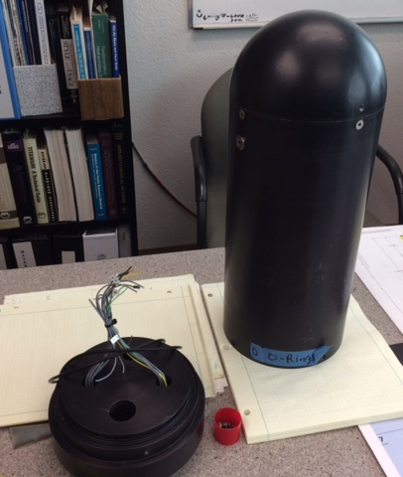
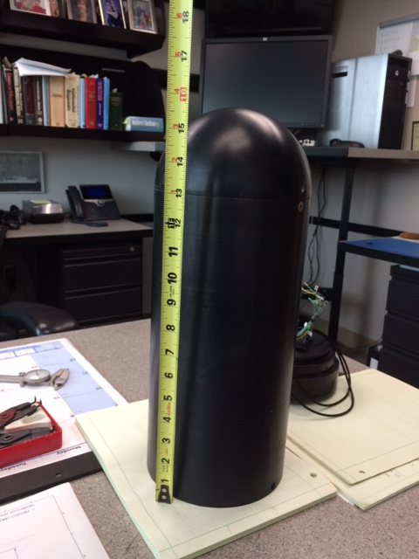
Integration Can Housing
Former Tiburon motor control housing – not one that imploded
Used at 4000m
OD ~ 6.5”
ID ~ 5.25 “
Length ~ 18”
New Endcap

Slide 15
Laser and Camera Housings
Weight (Total/Manip): Dry 84.8/25.4kg (187/56 lbs); In-water 20.4/9.1 kg (45/20 lbs)
Dimensions (OD/length): Camera (5.9/13.6 in), Laser Controller (8.4/29.4 in), Remote Laser (2.5/7.5)

Slide 16
Schedule – lead times
Connectors
  Impulse: have used Omicron 5070, expecting new ones 6/19 - ∞
  Seacon: have enough in house to start (order expected 7/1/19 - ∞)
  Subconn: have in house
Focal mux ~ 4 weeks
AC-DC readily available
Endcap manufacturing: 4-6 weeks

Slide 17
Schedule
Bench testing of DeepPIV + focal 914-HDE through MBARI ROV early July
Integration and testing of complete can in August (test with MBARI ROV using Lancer??)
Pieces ship to Hawaii late September
Cruise mid-October

Slide 18
TBD
Budget

Slide 19
Questions

Slide 20
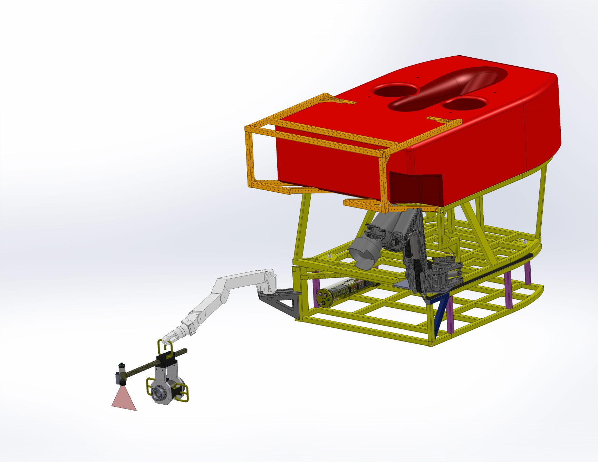
Coherent Laser Assmbly
Notes:
PURPOSE – X
Text(.8x1.4)

Slide 21
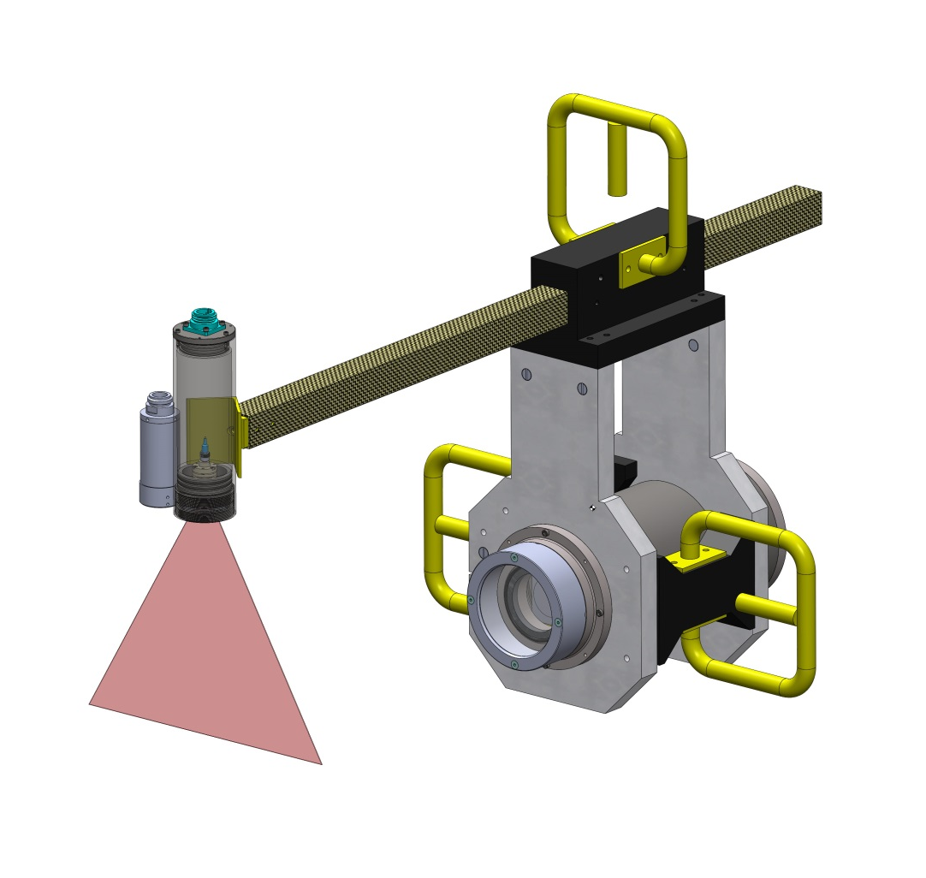
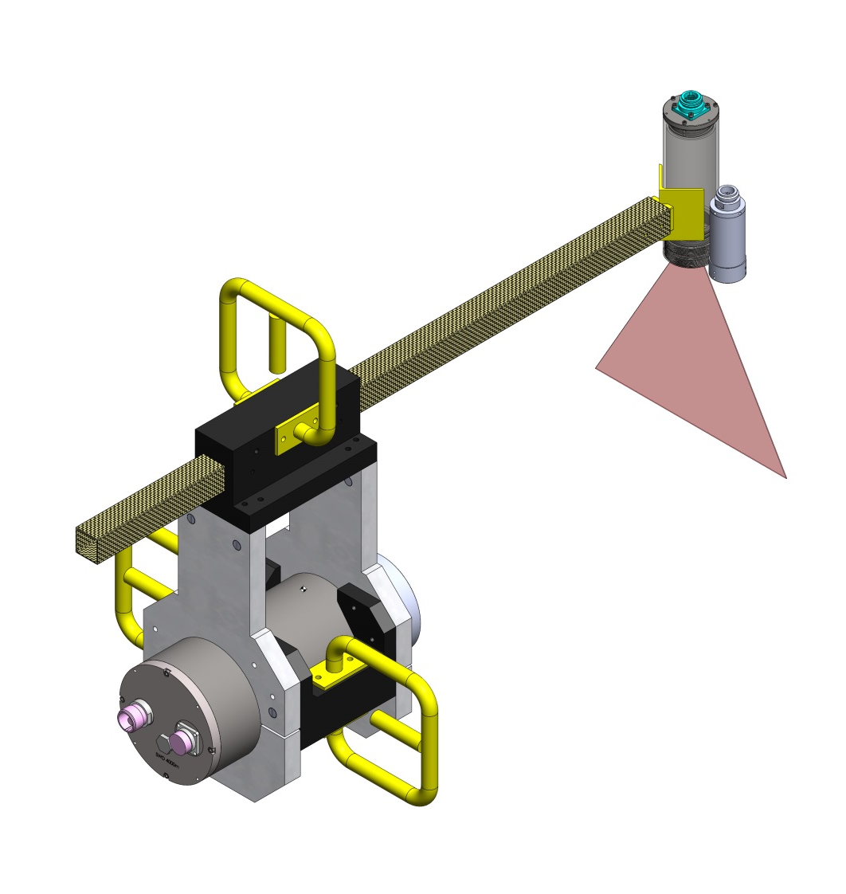
Laser Remote Head
Notes:
Text(.8x.14) (.8x5.4)

Slide 22
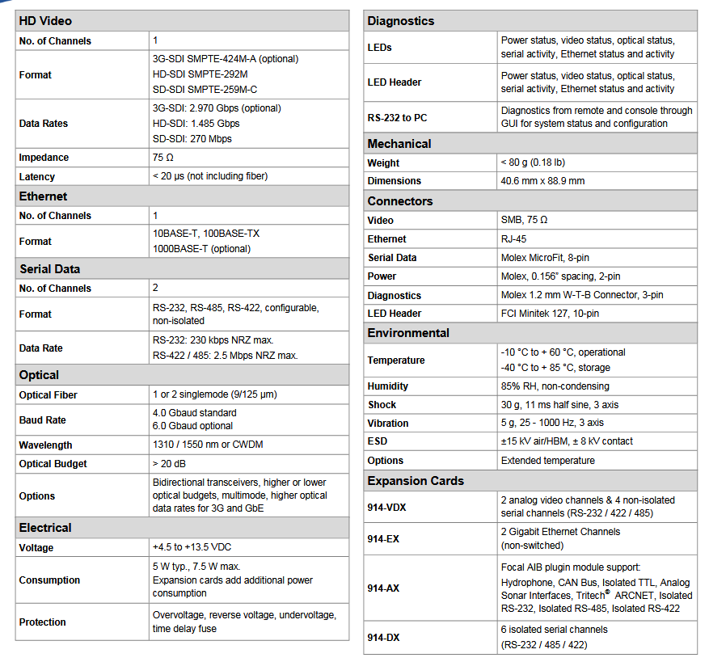
Focal 914-HDE

Slide 23
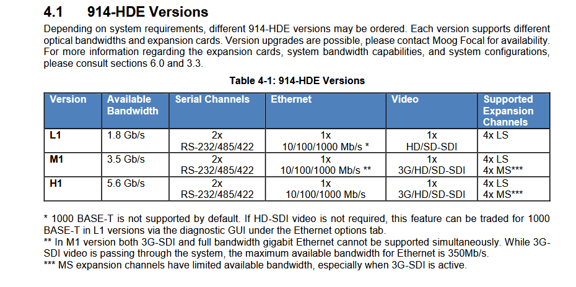
Focal 914-HDE

Slide 24
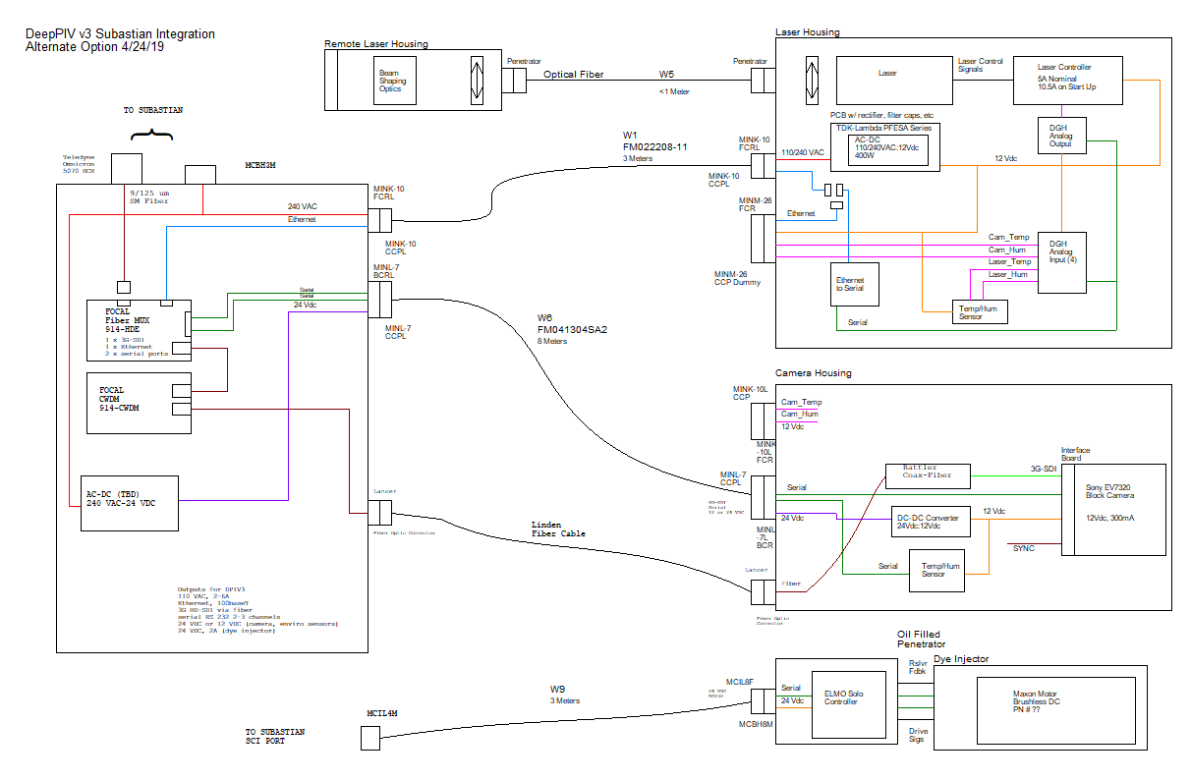
Alternate Plans

