Slide 1

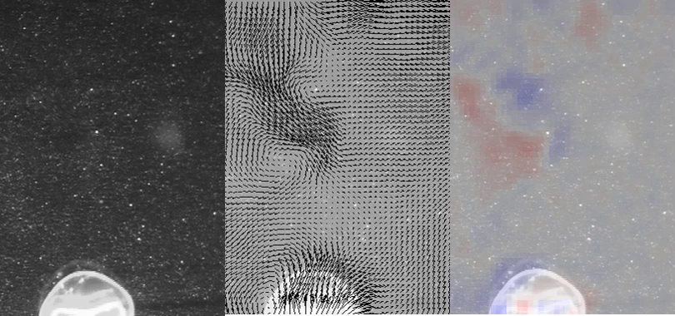
DeepPIV (Particle Image Velocimetry)
What is DeepPIV:
DeepPIV is an instrument that will optically capture the motion of suspended particles in fluid using a laser sheet and high-resolution camera.
Why build DeepPIV:
By measuring particle motion as a proxy for fluid motion, we can understand how organisms interact with their fluid environment. These interactions are relevant to mating, predation, feeding, biomechanics and swimming performance, and nutrient transport and fluxes.
MBARI relevance:
We plan to develop and adapt innovative technologies that are traditionally reserved for laboratory environments to allow researchers to identify and resolve important questions related to fluid mechanics and transport that will advance our understanding of the ocean.
3 cm
(Left): Raw particle images of free-swimming Aequorea victoria used for DPIV processing and animal kinematics investigations. (Center) Velocity and (right) vorticity fields from the DPIV analysis.
Video credit: Kakani Katija

Slide 2
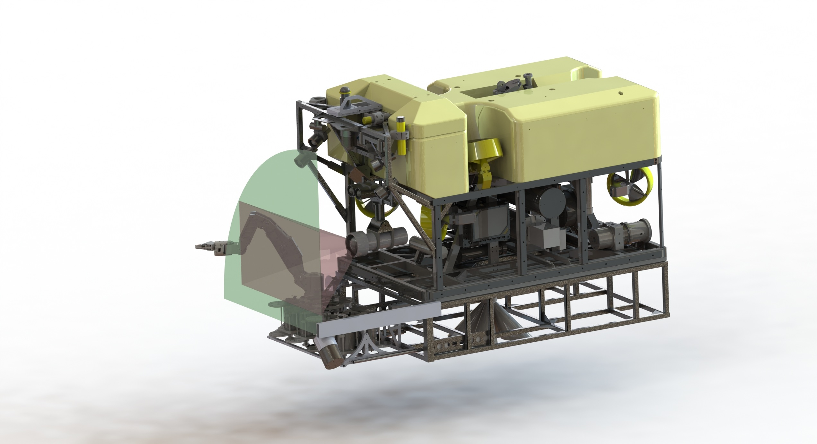
DeepPIV: ROV-deployable PIV
The ROV will be positioned such that the object of interest is centered on the laser sheet. The laser illuminates particles in the flow and the movement of fluid will be captured by the Science camera and recorded.
Science Camera
Laser plane
Camera FOV
Laser Housing
Laser housing deployed on ROV Doc Ricketts’ swing arm (port manipulator not shown).
Image credit: Dale Graves
Notes:
-Laser housing deployed on swing arm
-Port manipulator and flange maintain laser position
-Particle fields imaged by ROV science camera
-mount and operate DeepPIV components to minimize hydrodynamic disturbance of ROV: deploy off swing arm using MBARI mode
-maintain position relative to target for 5 sec durations using JellyTrack control algorithm developed by Steve Rock’s research group at Stanford University

Slide 3
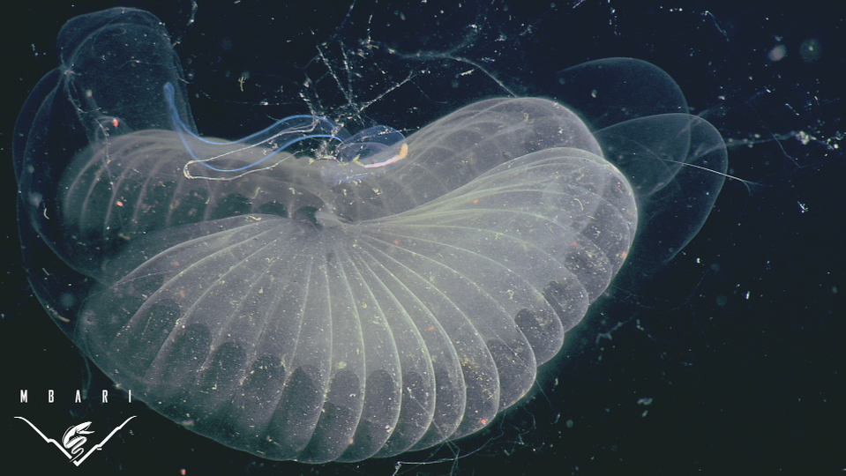
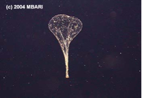
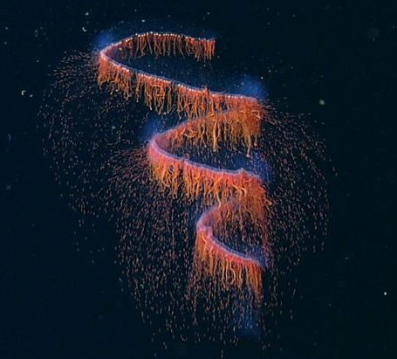
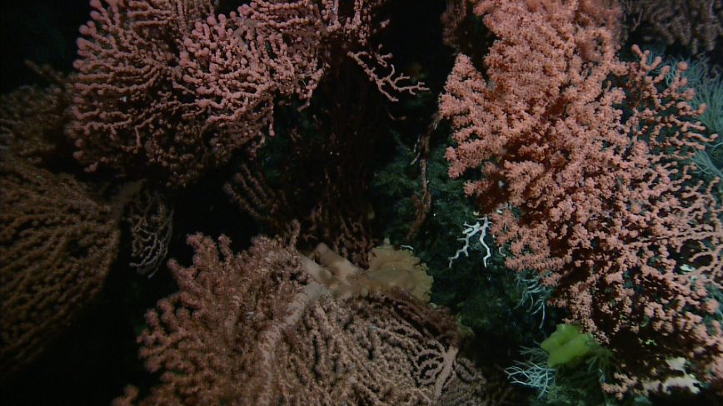
Potential Science Targets for DeepPIV
Larvacean house flow
  Quantify volume flow rates and
  structure during feeding
  Estimate filtration rates, energy
  expenditure, and carbon flux
Propulsion by siphonophores
  Quantify fluid interactions to estimate
  swimming efficiency
  Apply findings to bio-inspired design
  of underwater vehicles
Flow over soft coral on seamounts
  Quantify boundary layer flow
  Estimate filtration rates and
  nutrient/carbon flux
1 cm
Image credit: MBARI (Kyra Schlining, Rob Sherlock, and Susan von Thun)
Notes:
-starting with the primary and secondary initial targets, followed by general applications that may interest others at MBARI to expand the applicability of Deep PIV technology
-larvaceans are an important invertebrate to Monterey Bay and other ocean environments; during feeding, animals create giant houses comprised of mucus nets/meshes that serve to filter prey and particulate from the water column during feeding; once filters become clogged, animals abandon houses which later significantly contribute to carbon flux in the oceans; know little about the flow structure in the houses; can measure volume flux and clearance/filtration rates in situ to quantify fluxes in the ocean directly
-siphonophores found throughout the water column; possess nectophores of different sizes, arrays, etc, that provide propulsion without any significant change in body morphology to change directions, reverse, etc. - exceptional in the animal kingdom; coordination of jet propulsion? thrust production at small size scale? relationship between nectophore arrangement and size and vertical distribution or swimming ability?
-measurements can also be conducted in the benthic boundary layer to determine how fluid-structure interactions affect feeding and reproduction of benthic organisms; can also measure flow rates and volume flux directly of sponges, cold seeps, diffuse vents, and potentially hydrothermal vents; marine snow concentrations, etc.

