Slide 1
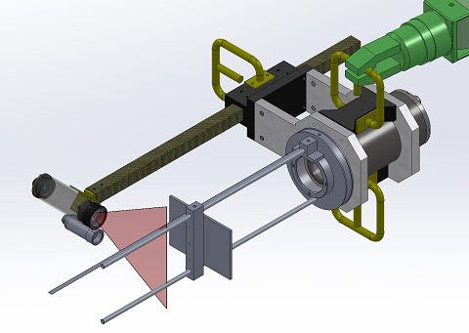
Laser Safety
Optical specifications (3), laser with light sheet forming optics
Beam waist, at lens (FW, 1/e2): 1.2 mm
Beam divergence, x-axis, far field 2.4 mrad
Beam far field threshold: ~ 500 mm
Beam divergence, y-axis (FW) 1.0 rad (60º)
Beam waist location: -35 mm
General specs:
Wavelength: 639.5+/-1 nm
Bandwidth: <0.5 nm
Visual color: Red
Optical power max: 2000 mW

Slide 2
Hazard Classification
Accessible Laser Radiation [mW]:
  At 100mm distance from edge of mechanical design
  Into 7mm aperture
  Calculated: 103 mW (at 2000mW laser power)
Class 3R AEL NTE 5mW < 103 mW < Class 3B AEL NTE 500mW
System is Class 3B
Calculated: NHZ = 5.8 meters
Class 3B:
  Control Measures: required
  Training: required
  LSO: required
  Engineering Controls: required

Slide 3
Power reduction
Accessible Laser Radiation [mW]: 103mW
  Accessible Radiation: 103mW
  Class 3R: NTE 5mW
  Calculated: K _{Class 3R} = 5mW/103mW = 4.8%
  Reduced Laser Power (Class 3R) = 2000mW x 0.048 = 96 mW
Class 3R:
  Control Measures: not required
  Training: not required
  LSO: not required
  Engineering Controls: not required
Assumptions:
  Power strictly limited
  7 mm aperture
  Is it really off?
  ???

Slide 4
SOPs
Class 3R: Laser Controlled Area is not required
Laser shall to be run at Reduced Laser Power Mode at all times
Remote Head Protective Cap:
  Remove for duration of the alignment procedure only
  Keep at all other times
Constant supervision of system during operation
  No unattended operation.
Orientation:
  Laser downward, if possible?
  Away from reflective surfaces.
Any optics in the Light Sheet Path strictly prohibited
  Microscopes, binoculars, loups, SLR cameras etc. Bird Watchers?
  Reflected light hazard / NHZ TBD
Avoid looking directly into beam paths.
  If exposed to collimated beam, close eyes or look away immediately
  0.25 s nominal natural aversion response time
Only authorized and trained personnel can operate the system.
Spectators could be present.
Ship deck personnel could be present.

Slide 5
Implementation
Software: clearly visible software controls
  “Reduced Laser Power Mode”
  “Interlock/ LASER Disable”
Hardware and software: default configuration on system boot-up
  “Reduced Laser Power Mode” mode enabled
  “Interlock/ LASER Disable” mode enabled
Hardware:
  Optical power Not-To-Exceed 96mW when Reduced Laser Power Mode is enabled.
  Independent real-time monitoring of true optical power is desirable
  Pump diode current (even under lasing threshold) is prohibited when “Interlock/ LASER Disable” mode is enabled
  Laser Head Protective Cap – rated for full power?
Physical barrier / curtain
  Spectators with optics?
  Binoculars – how far?
  SLR cameras – viewfinder exposure?

Slide 6
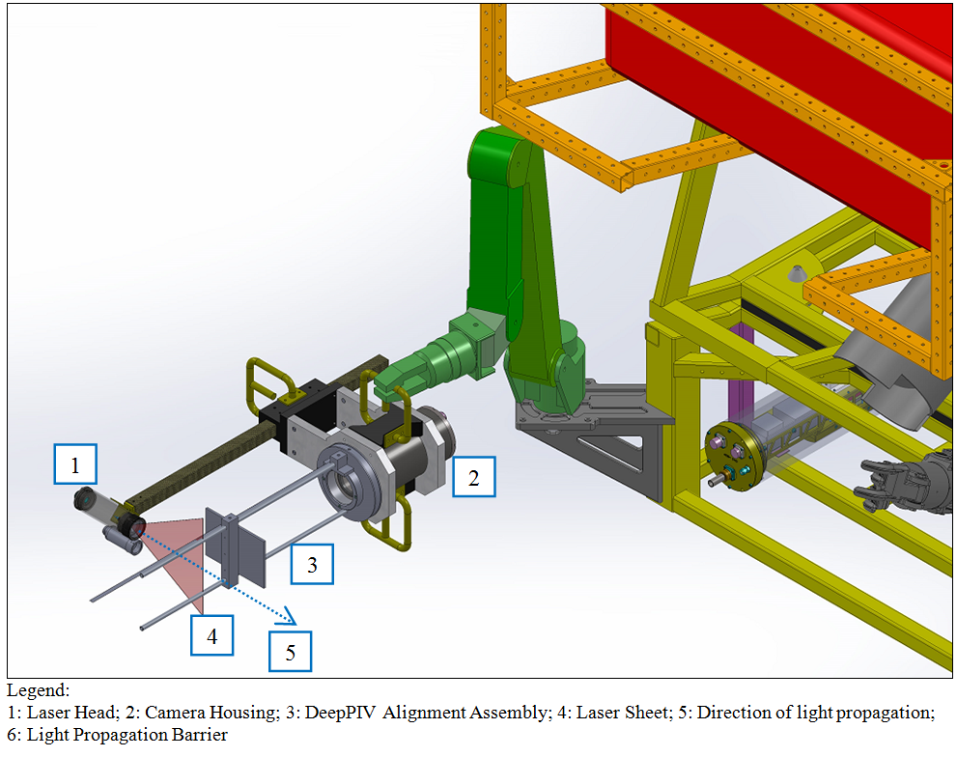
Model: isometric view

Slide 7
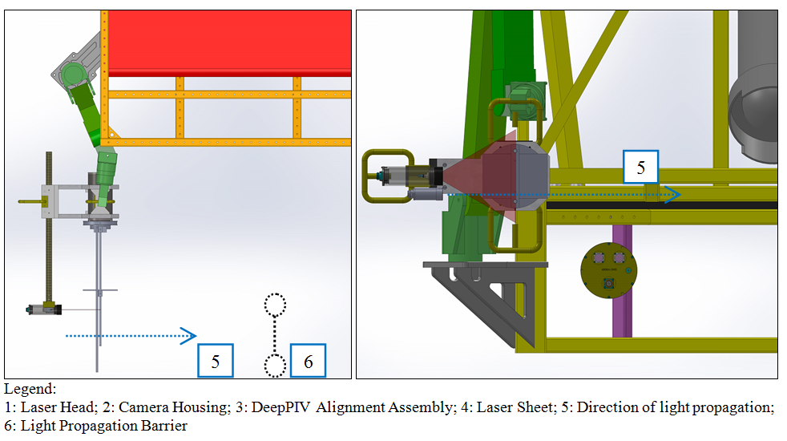
Model: Top View, Front View

