Slide 1
DPIV - Coherent Laser Housing Design Review
March 7, 2018

Slide 2
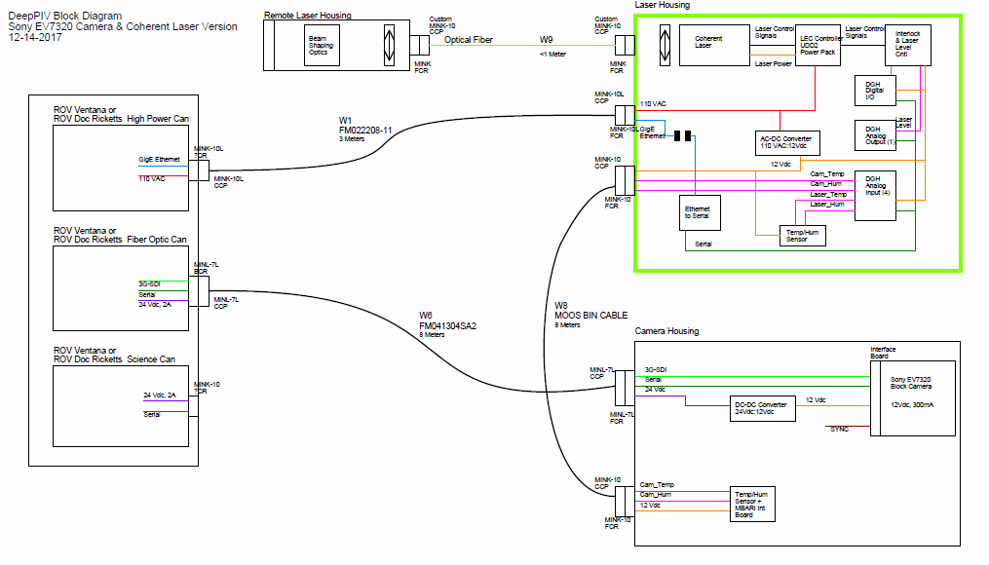
System Block diagram

Slide 3
New Coherent Laser
2 Watt, 639 nm laser
3rd party power supply and controller unit (UDD2 Power Pack) purchased from LEC
110 VAC input, 6 A max current (UDD2)
System must remain compatible with our existing DPIV components (Camera, probe head, ROV configuration)
First scheduled deployment mid-June

Slide 4
Laser Inputs/Outputs
Power: 110 VAC, 6A
Laser output level control: 0-5VDC analog
Laser interlock: two pin connection.
  Pins connected = laser enabled
  Pins disconnected = output disabled but temp stabilization still enabled

Slide 5
Interfaces
ROV specs – Power 110/120 VAC
  Fusing on VAC
    Ricketts: 10 A
    Ventana: 7 A
  Inrush current
    Ricketts: circuit breaker trips at 30 A between 1-5 sec
    Ventana: ?
ROV specs – Comms
  GigE

Slide 6
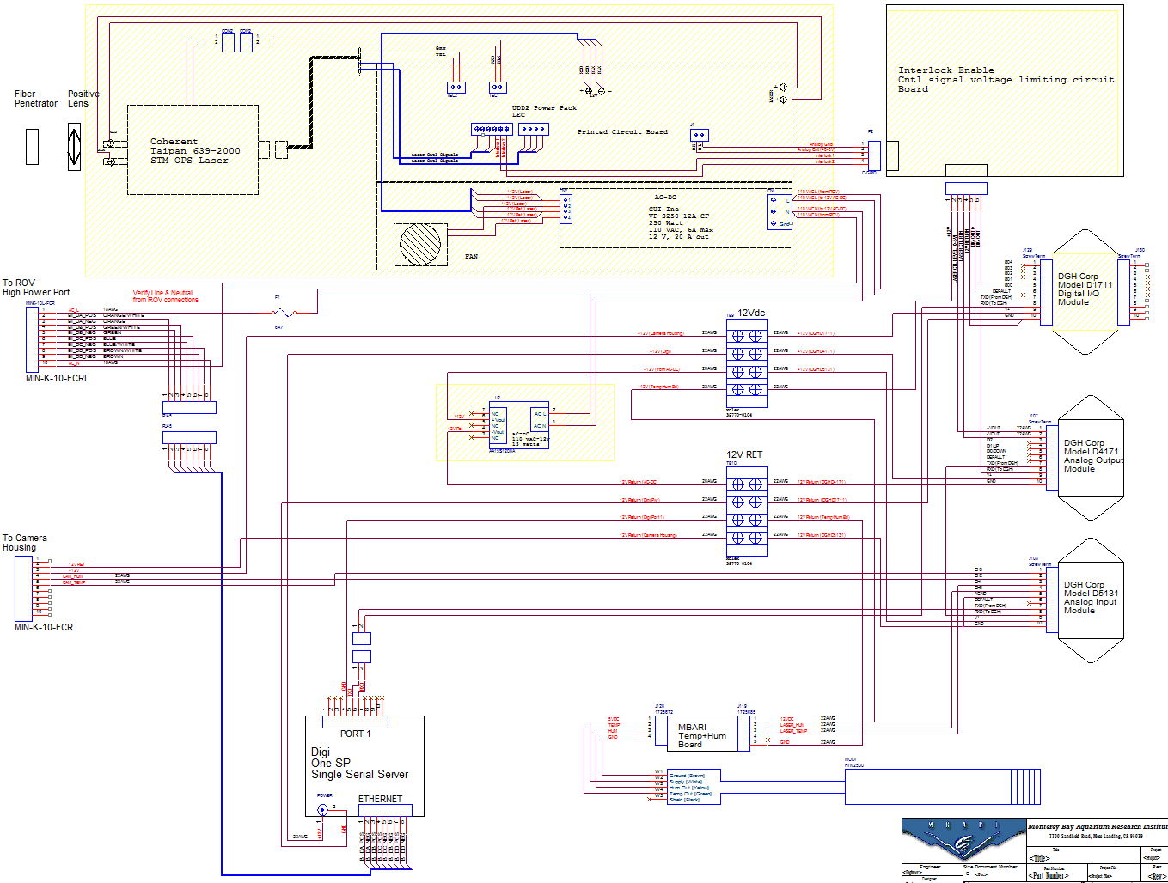
Laser Housing Schematic

Slide 7
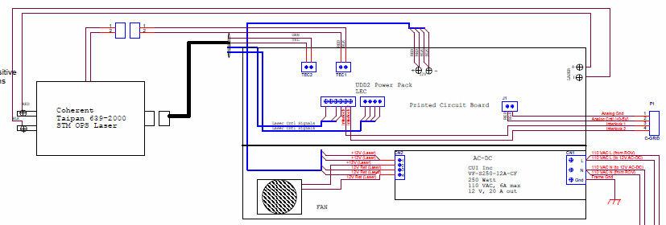
Laser + Controller
Frame Ground connected to laser housing
which will be connected to ROV frame

Slide 8
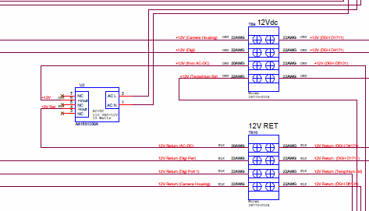
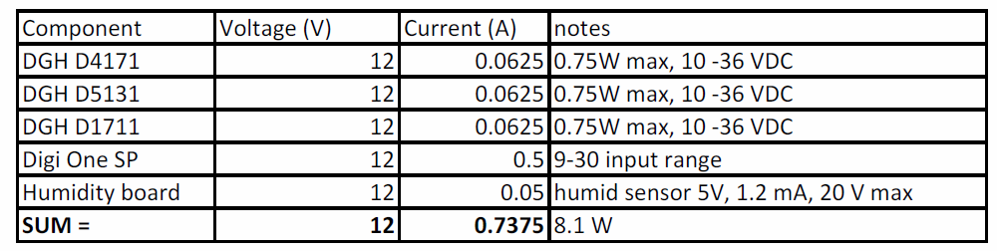
12V Power Supply

Slide 9
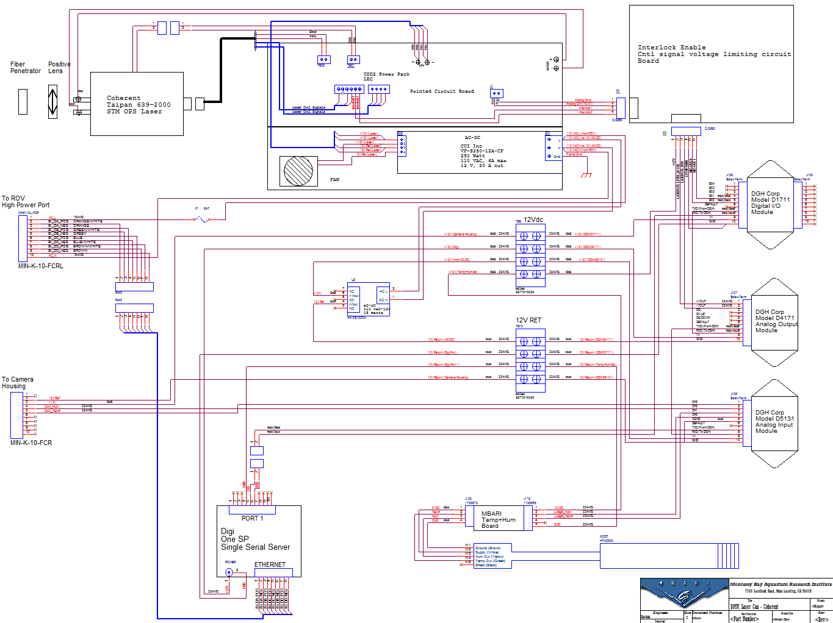
Laser Housing Schematic

Slide 10
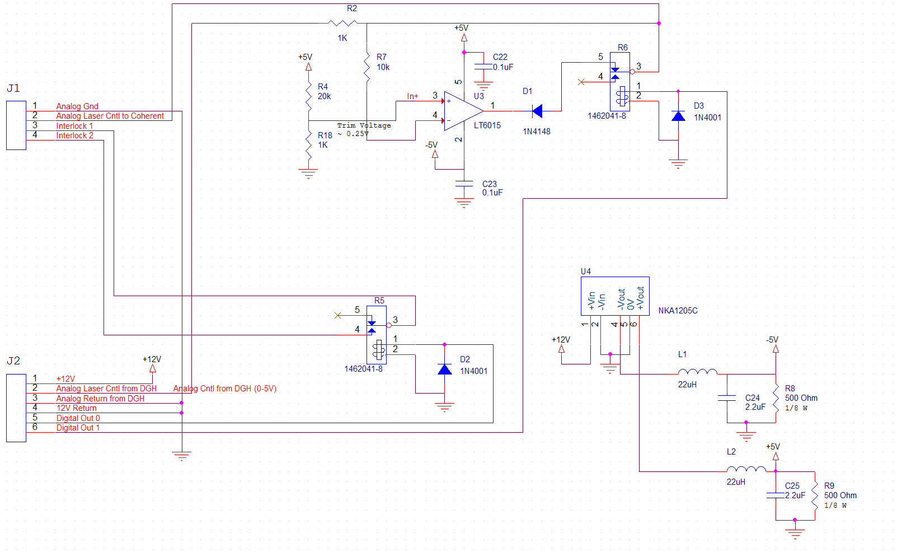
Laser Interlock and Cntl Board
To Laser
To DGH

Slide 11
Remaining Electrical Issues
Bench test of inrush current
  Measure current and pulse period
  Test with Ricketts PTC
Determine if simpler clipper circuit design possible using Schottky diode (to eliminate power supply)
Future upgrades:
  Replace Serial server and DGH modules with Ethernet Data Acq module
  Add second serial channel to camera housing and use serial temp/humidity sensor, so camera and laser cans are completely independent

Slide 12
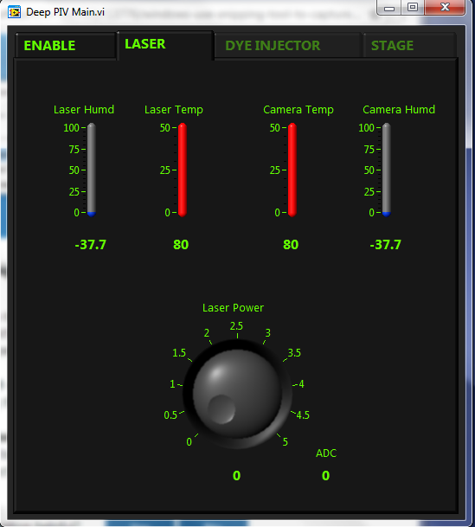
Software - Modifications to GUI
Current Laser controlling GUI would be modified to have:
Interlock enable/disable
Eye-safe mode button

Slide 13

Software - Modifications to GUI
Interlock Enable/Disable
Disable
Eye-safe mode

Slide 14
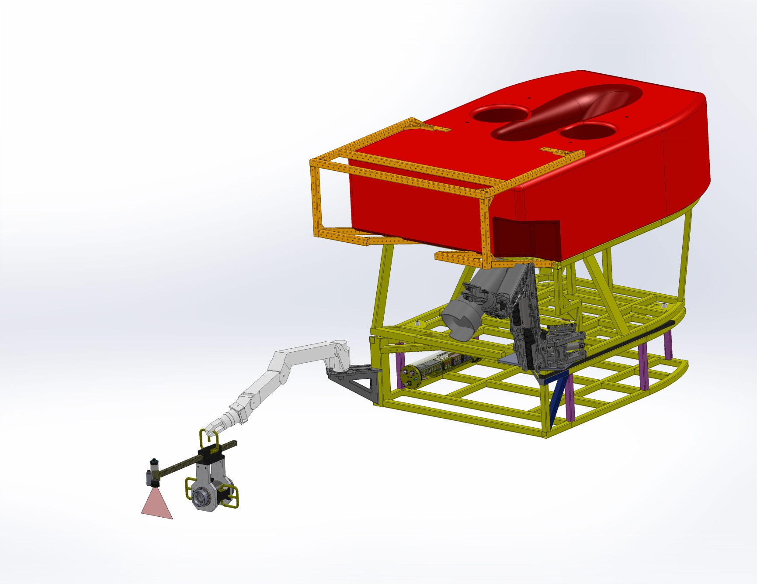
Coherent Laser Assmbly
Notes:
PURPOSE – X
Text(.8x1.4)

Slide 15
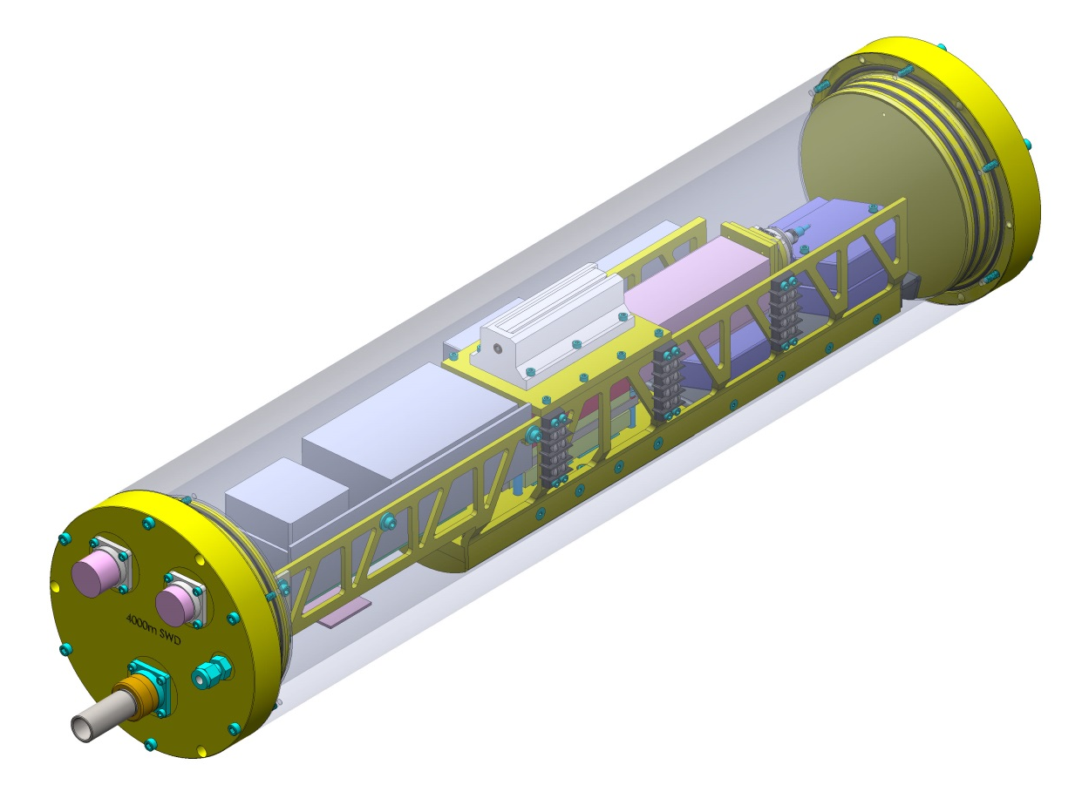
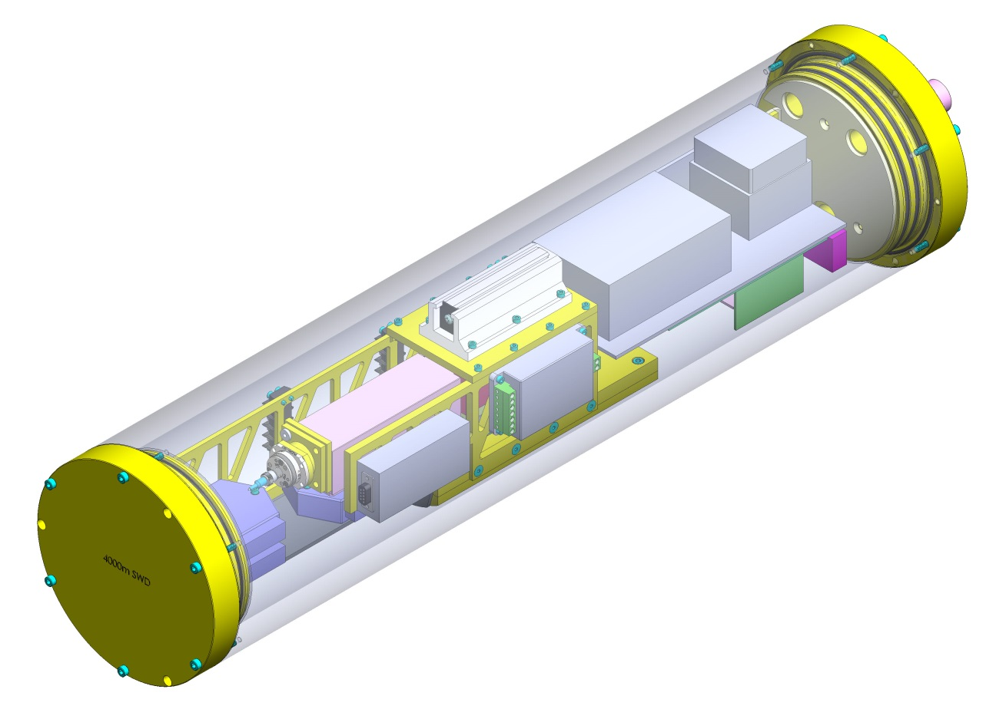
Coherent Laser PWR Can
Notes:
Text(.8x.14) (.8x5.4)

Slide 16
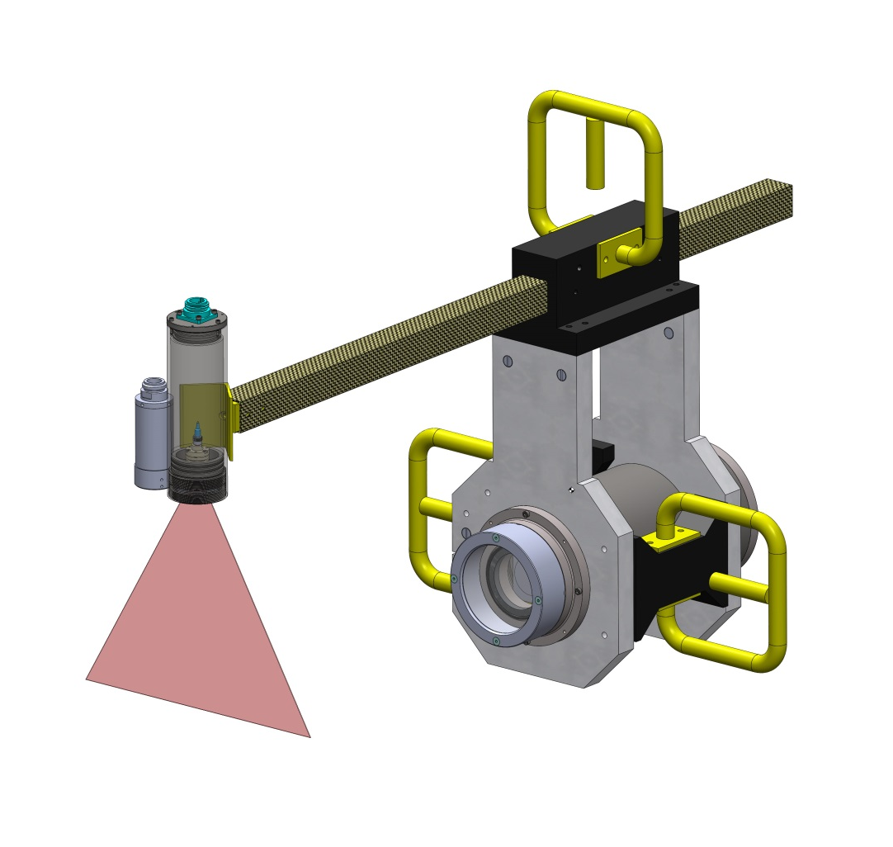
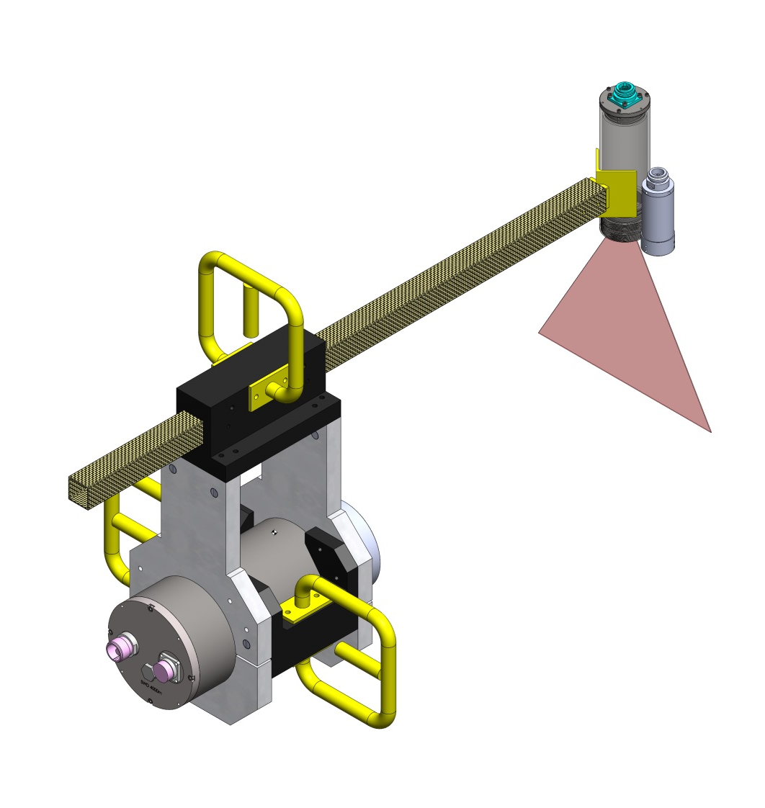
Laser Remote Head
Notes:
Text(.8x.14) (.8x5.4)

Slide 17
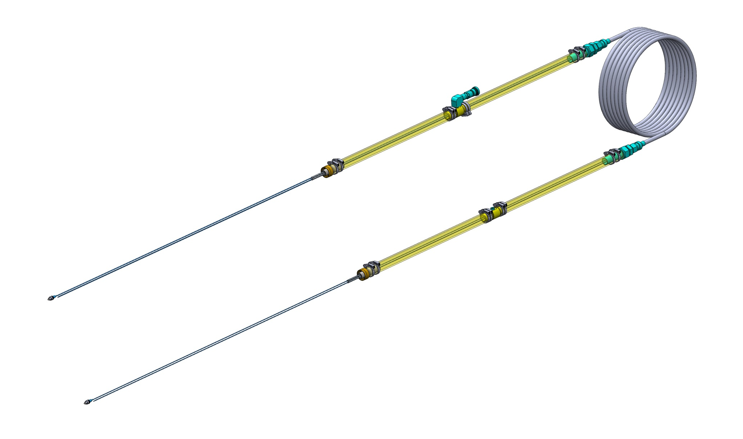
Comp’d Fiber Assembly
Notes:
Text(.8x.14) (.8x5.4)

Slide 18
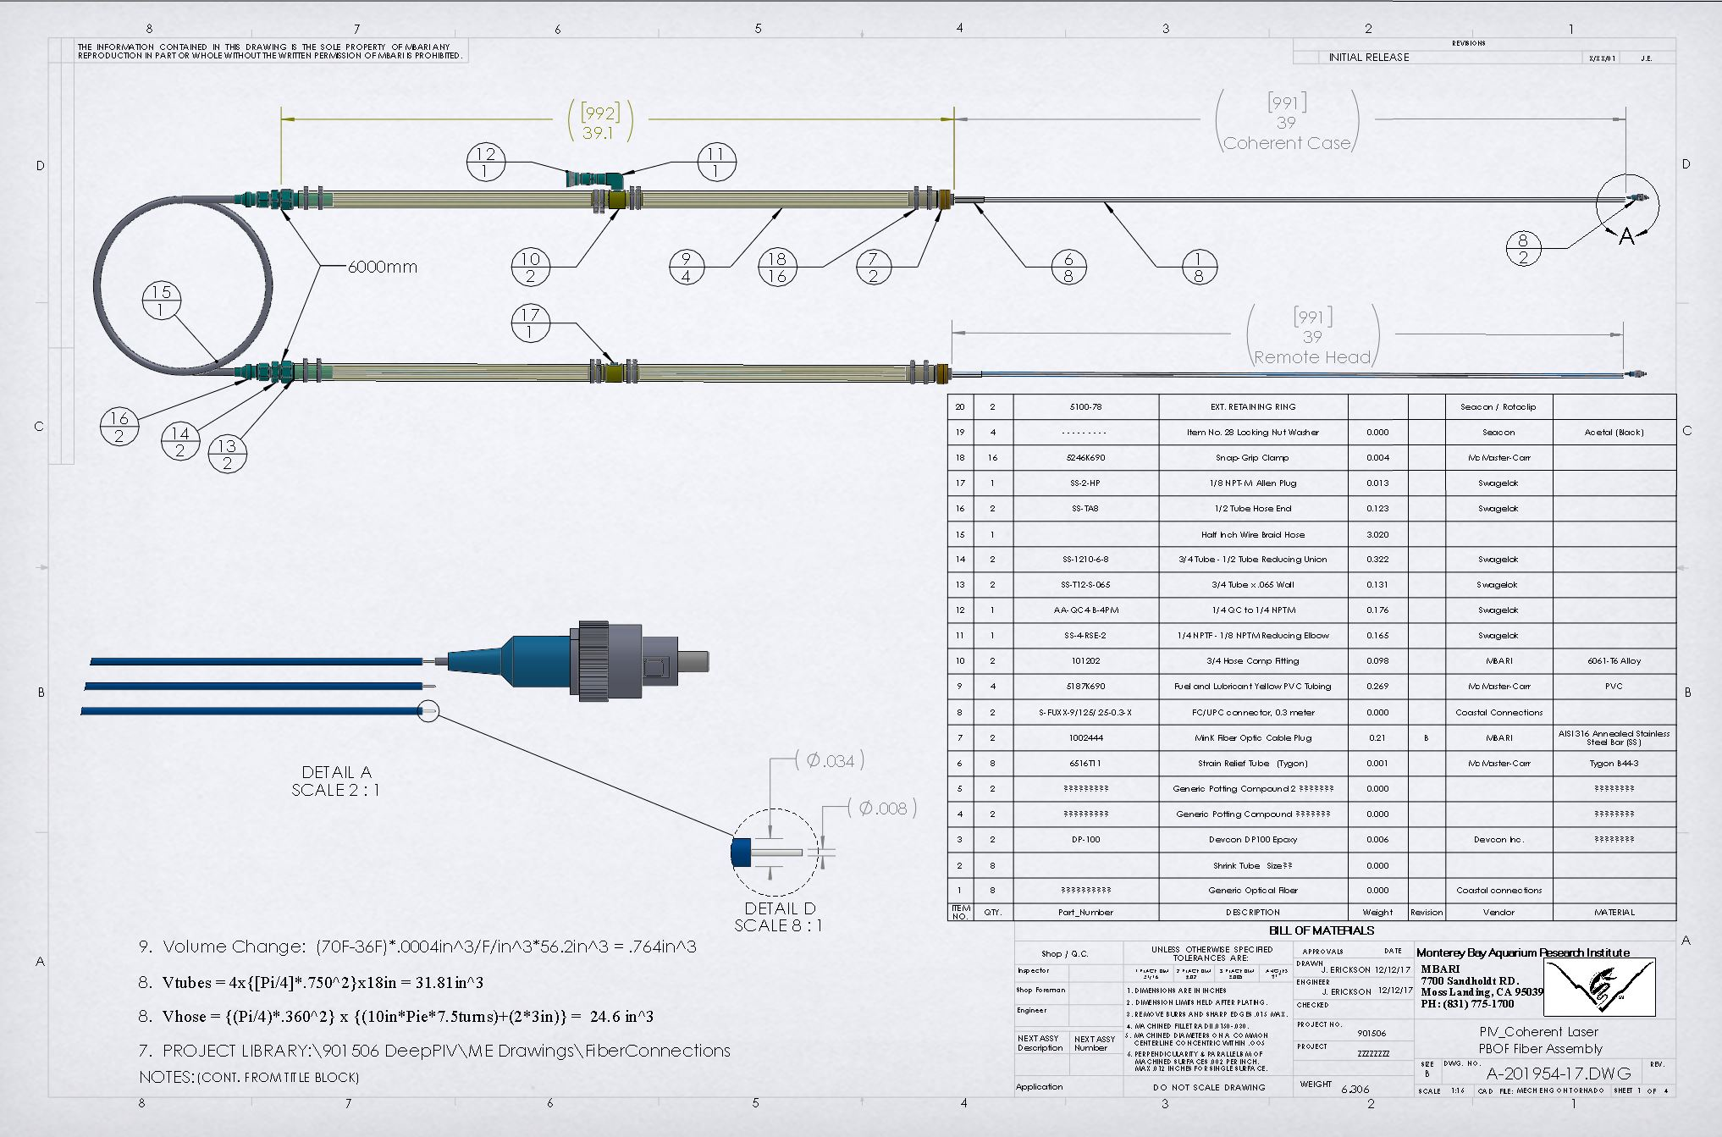
Comp’d Fiber Assembly
Notes:
Text(.8x.14) (.8x5.4)

Slide 19
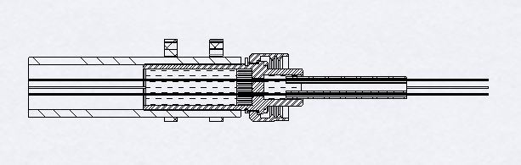
Potted Fiber Term.
Notes:
Text(.8x.14) (.8x5.4)

Slide 20
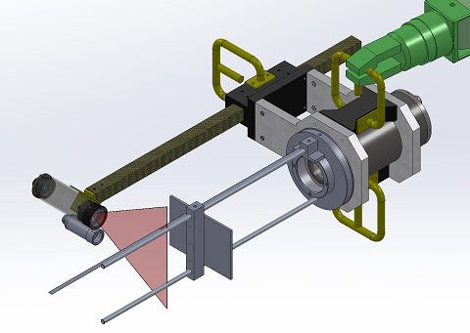
Laser Safety
Optical specifications (3), laser with light sheet forming optics
Beam waist, at lens (FW, 1/e2): 1.2 mm
Beam divergence, x-axis, far field 2.4 mrad
Beam far field threshold: ~ 500 mm
Beam divergence, y-axis (FW) 1.0 rad (60º)
Beam waist location: -35 mm
General specs:
Wavelength: 639.5+/-1 nm
Bandwidth: <0.5 nm
Visual color: Red
Optical power max: 2000 mW

Slide 21
Hazard Classification
Accessible Laser Radiation [mW]:
  At 100mm distance from edge of mechanical design
  Into 7mm aperture
  Calculated: 103 mW (at 2000mW laser power)
Class 3R AEL NTE 5mW < 103 mW < Class 3B AEL NTE 500mW
System is Class 3B
Calculated: NHZ = 5.8 meters
Class 3B:
  Control Measures: required
  Training: required
  LSO: required
  Engineering Controls: required

Slide 22
Power reduction
Accessible Laser Radiation [mW]: 103mW
  Accessible Radiation: 103mW
  Class 3R: NTE 5mW
  Calculated: K _{Class 3R} = 5mW/103mW = 4.8%
  Reduced Laser Power (Class 3R) = 2000mW x 0.048 = 96 mW
Class 3R:
  Control Measures: not required
  Training: not required
  LSO: not required
  Engineering Controls: not required
Assumptions:
  Power strictly limited
  7 mm aperture
  Is it really off?
  ???

Slide 23
SOPs
Class 3R: Laser Controlled Area is not required
Laser shall to be run at Reduced Laser Power Mode at all times
Remote Head Protective Cap:
  Remove for duration of the alignment procedure only
  Keep at all other times
Constant supervision of system during operation
  No unattended operation.
Orientation:
  Laser downward, if possible?
  Away from reflective surfaces.
Any optics in the Light Sheet Path strictly prohibited
  Microscopes, binoculars, loups, SLR cameras etc. Bird Watchers?
  Reflected light hazard / NHZ TBD
Avoid looking directly into beam paths.
  If exposed to collimated beam, close eyes or look away immediately
  0.25 s nominal natural aversion response time
Only authorized and trained personnel can operate the system.
Spectators could be present.
Ship deck personnel could be present.

Slide 24
Implementation
Software: clearly visible software controls
  “Reduced Laser Power Mode”
  “Interlock/ LASER Disable”
Hardware and software: default configuration on system boot-up
  “Reduced Laser Power Mode” mode enabled
  “Interlock/ LASER Disable” mode enabled
Hardware:
  Optical power Not-To-Exceed 96mW when Reduced Laser Power Mode is enabled.
  Independent real-time monitoring of true optical power is desirable
  Pump diode current (even under lasing threshold) is prohibited when “Interlock/ LASER Disable” mode is enabled
  Laser Head Protective Cap – rated for full power?
Physical barrier / curtain
  Spectators with optics?
  Binoculars – how far?
  SLR cameras – viewfinder exposure?

Slide 25
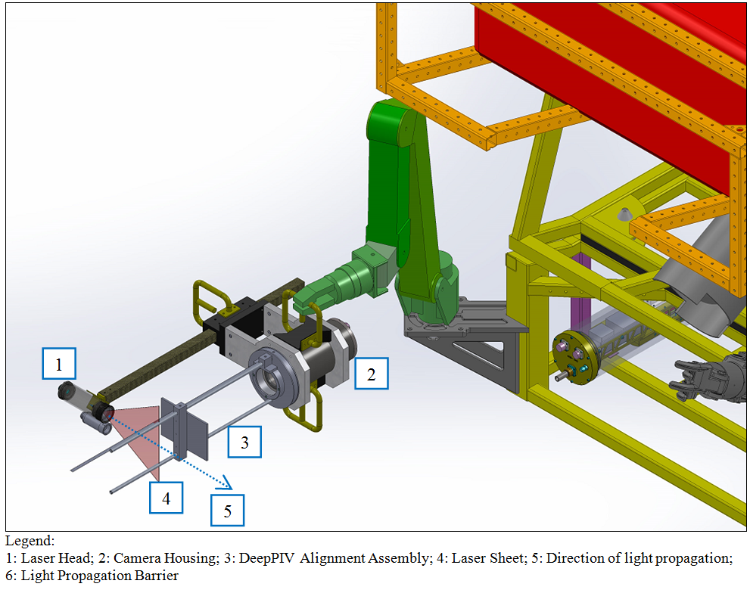
Model: isometric view

Slide 26
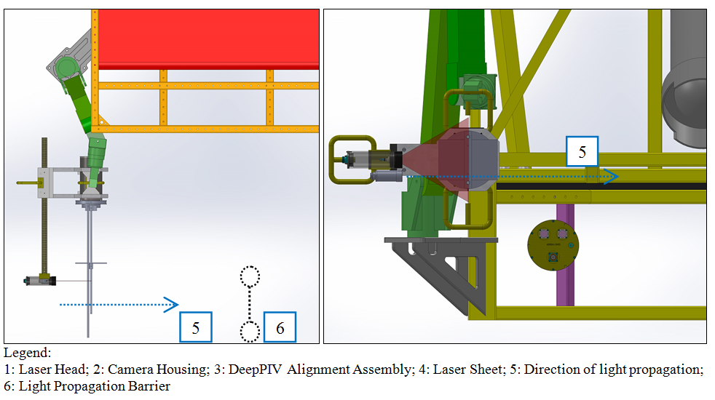
Model: Top View, Front View

Slide 27
Questions??

Slide 28
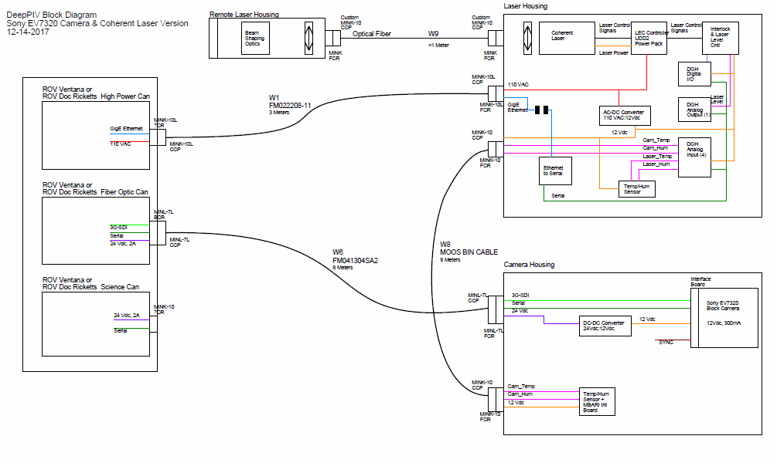
System Block Diagram

Slide 29
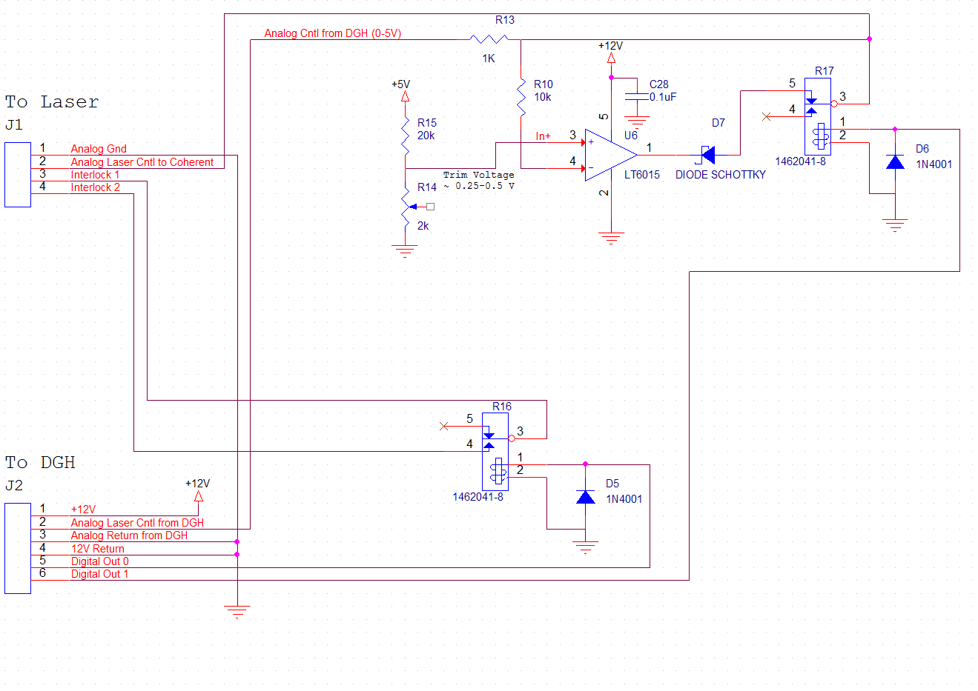
Alternate Clipper Circuit

