Slide 1
OASIS5 Controller
6/24/2014

Slide 2
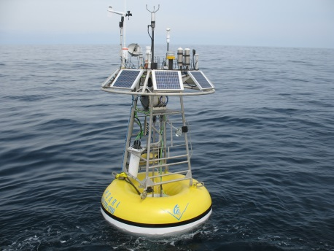
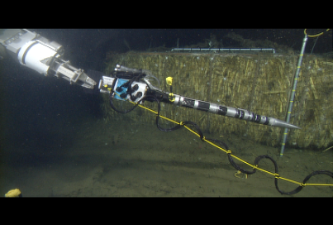
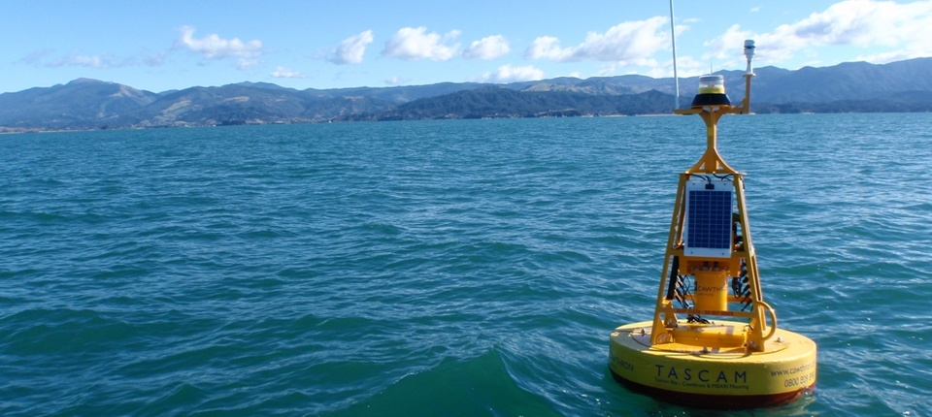
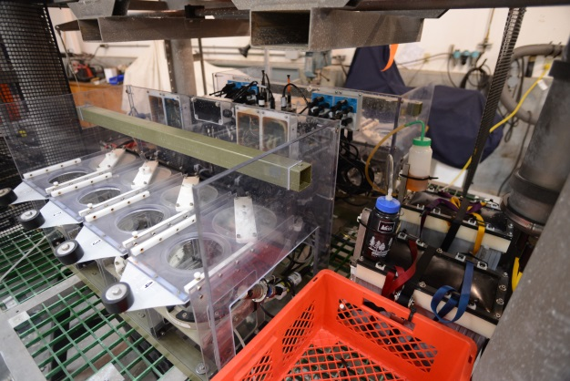
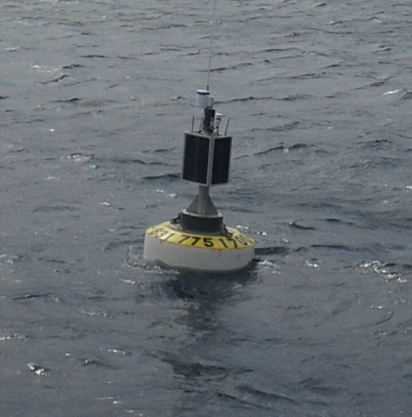
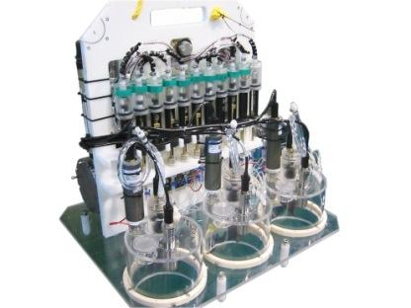
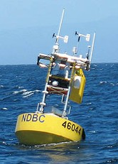
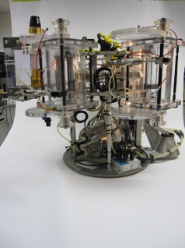
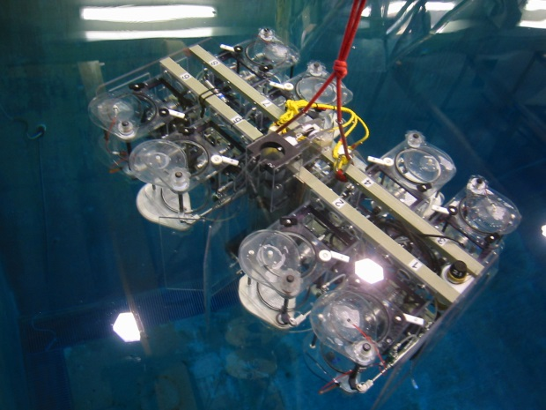
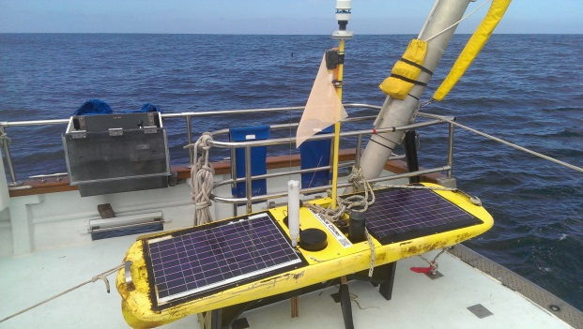
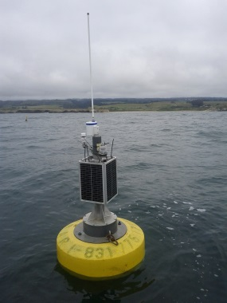
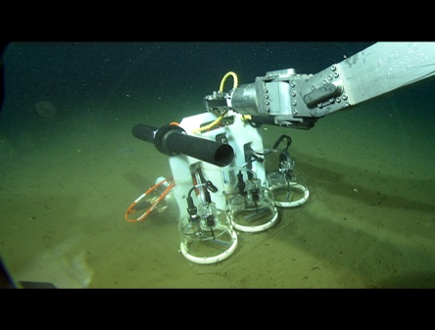
Background
OASIS has a 24 year history and is used in lots of places

Slide 3
Statement of Problem
The Persistor CF2 used on O3 and O4 uses an end-of-life CPU. It’s only a matter of time before it’s unavailable
Both O3 & O4 have other obsolete parts. We can no longer build either controller
Barry lab, Robison lab, and Chavez lab need additional controllers
Cannot export the technology. E.g. Cawthron wants to expand their program

Slide 4
Proposed solution
Build on the success of O3/O4 system design and the project model
Use common industrial CPU for longer availability
Lower system cost in hardware and software
  Important for exportability and wider acceptance

Slide 5
Proposed scope of work
Hardware is a refresh, update are remove unused features
Choices include PIC24 or Persistor CF3, if it’s available before the end of the year
Will use existing OASIS drivers and MRS/BRS scripting
COTS open source RTOS
Reuse most of Bob’s code, port to new OS
Resource requirements Similar to the O3 development
Not a totally new design

Slide 6
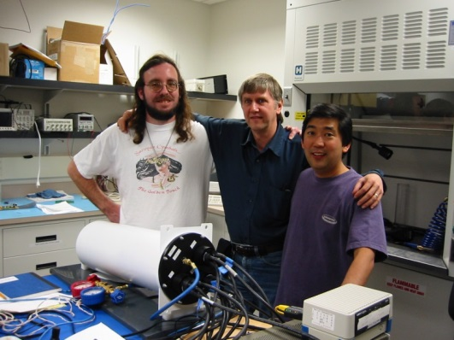
Questions?
OASIS3 12 years ago!

