Slide 1
OASIS5 Controller

Slide 2
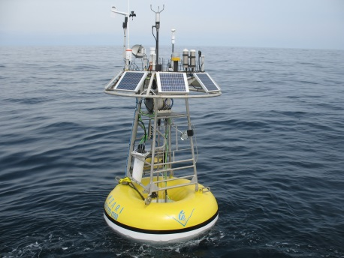
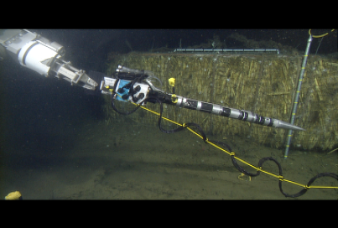
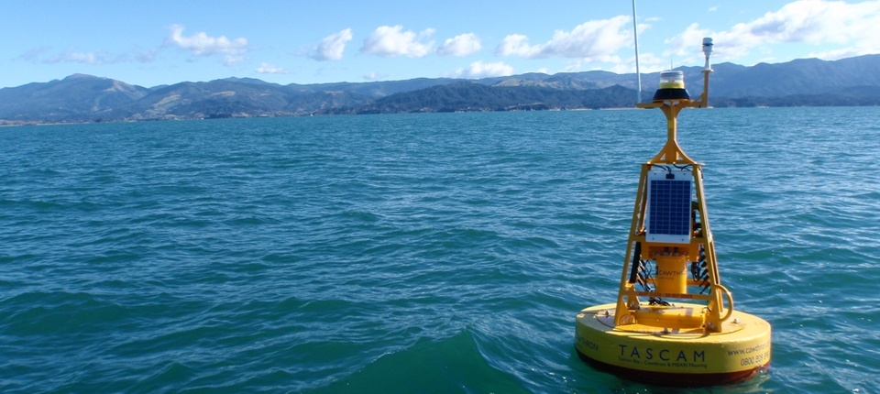
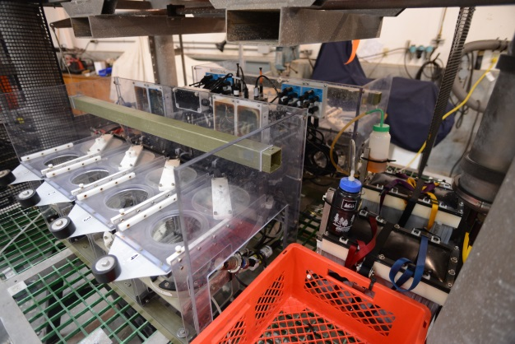
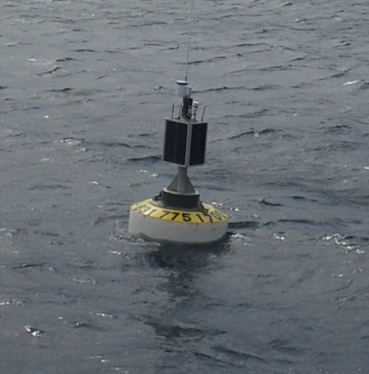
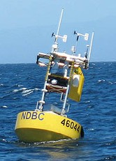
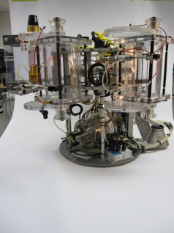
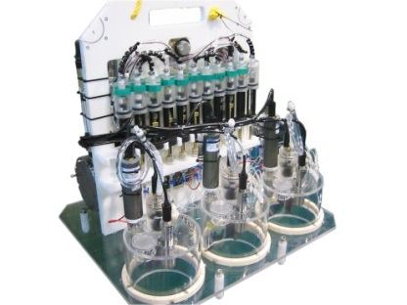
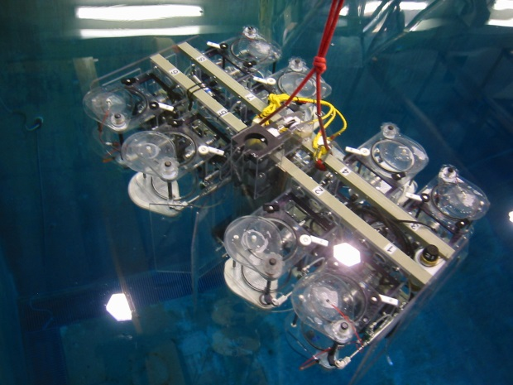
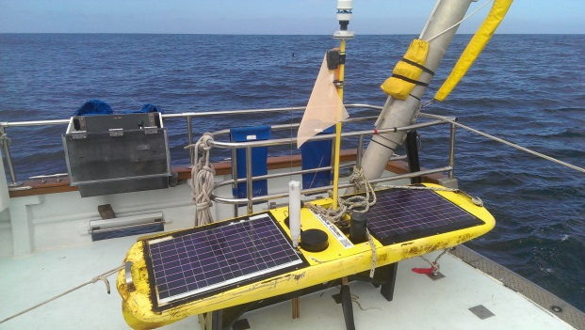
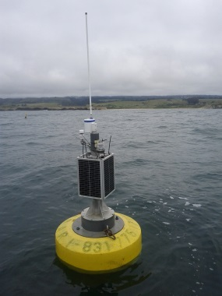
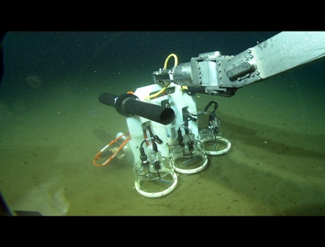
Background
OASIS 24 year history, used lots of places

Slide 3
Proposed solution
Build on the success of O3/O4 system design and the project model
Use common industrial CPU for longer availability
Lower system cost in hardware and software
  Important for exportability and wider acceptance

Slide 4
Proposed scope of work
Hardware is a refresh, update are remove unused features
Will use existing OASIS drivers and MRS/BRS scripting
COTS open source RTOS
Reuse most of Bob’s code, port to new OS
Resource requirements Similar to the O3 development
Not a totally new design

Slide 5
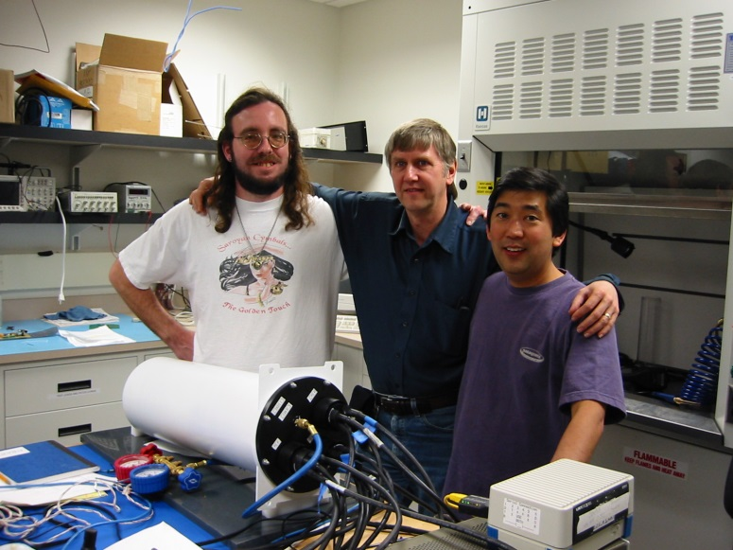
Questions?

