Slide 1
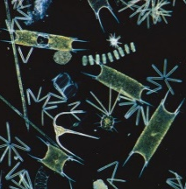

Temporal variability and environmental forcing of surface, midwater and benthic communities in the California Current System
Monique Messié, R. Sherlock, C. Huffard, J.T. Pennington,
A. Choy, R. Michisaki, K. Gomes,
F. Chavez, B. Robison, K. Smith
Monterey Bay Aquarium Research Institute
Closing the gap between wind stress and ecosystem productivity in eastern boundary upwelling regions

Slide 2
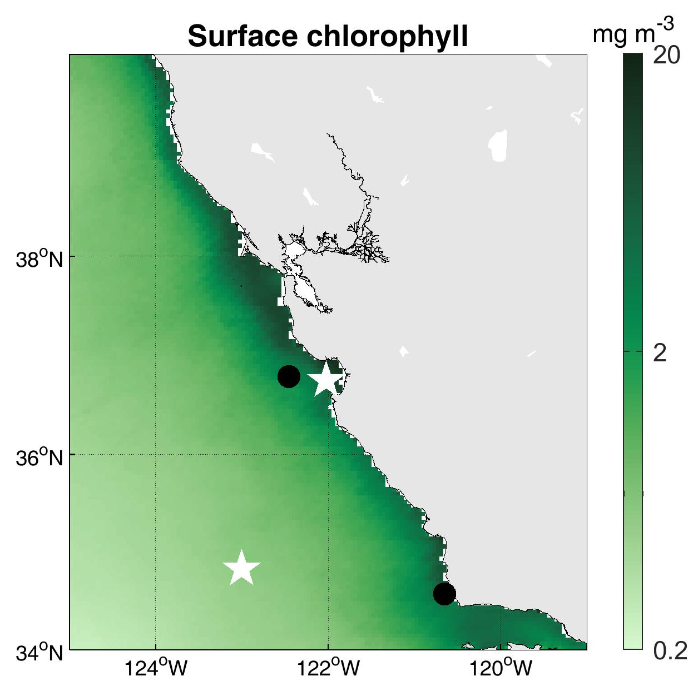
Surface, midwater and benthic time series
Surface (PI Chavez)
Central California
Midwater (PI Robison)
Benthos (PI Smith)
wind stations

Slide 3
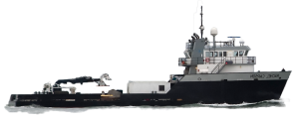
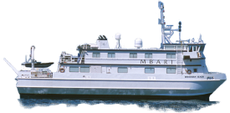

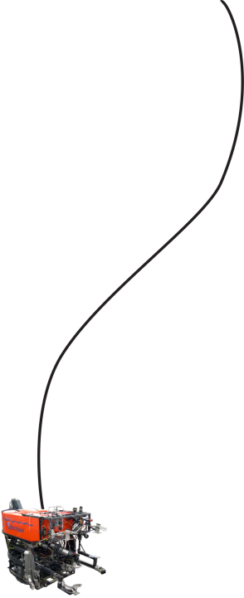
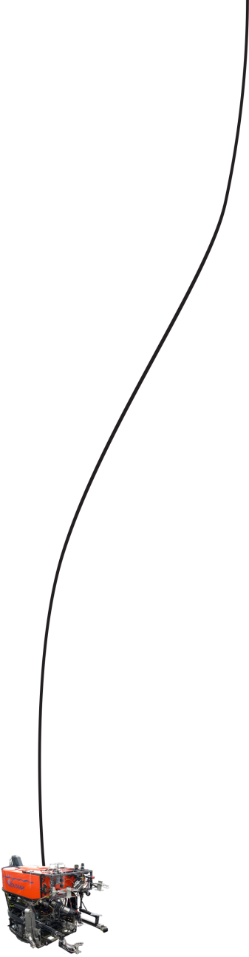
1989
1997
2007
present
TIME
winds
DEPTH
0
Surface plankton microscopy
200m
Midwater ROV video transects
1000m
Benthic echinoderm community imaging
4000m
from towed camera-sled images
then ROV video

Slide 4

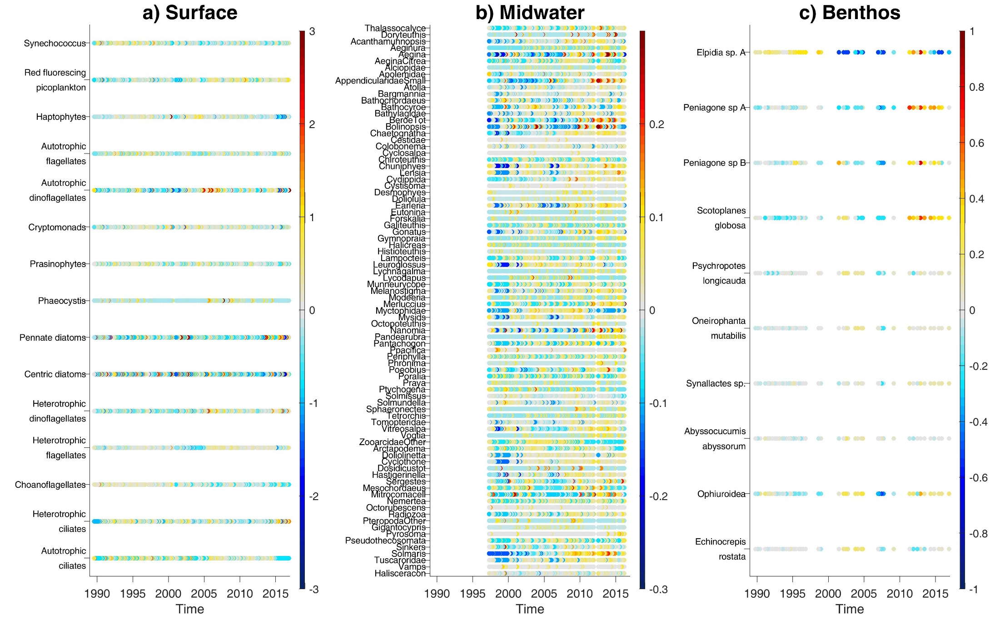
mgC /m³
counts /m³
counts /m²
SURFACE
MIDWATER
BENTHOS

Slide 5
1- Community analysis from PCA
PCA = Principal Component Analysis

Slide 6
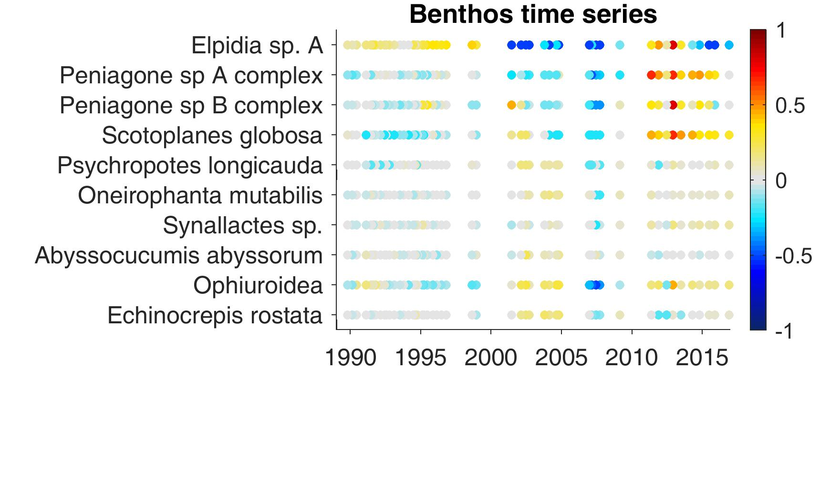
PCA – method

Slide 7
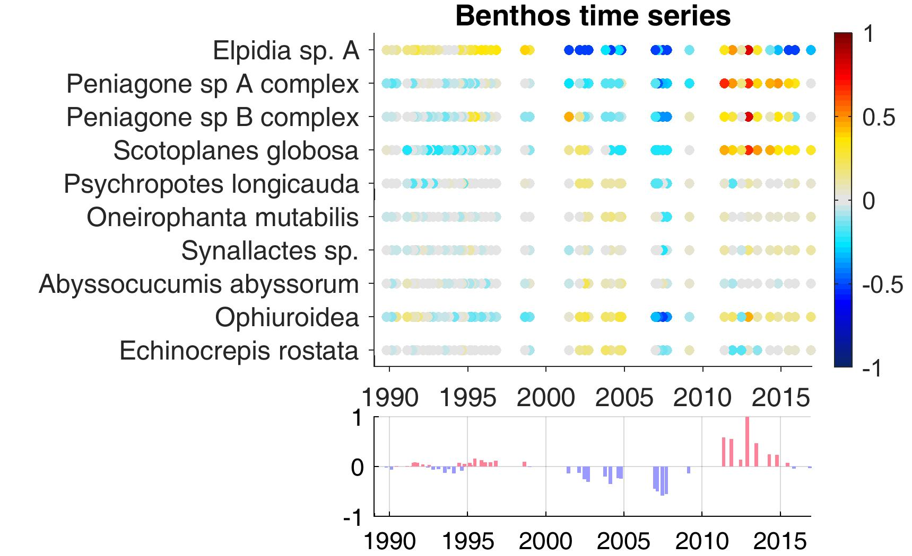
PCA – method
varex
50%

Slide 8
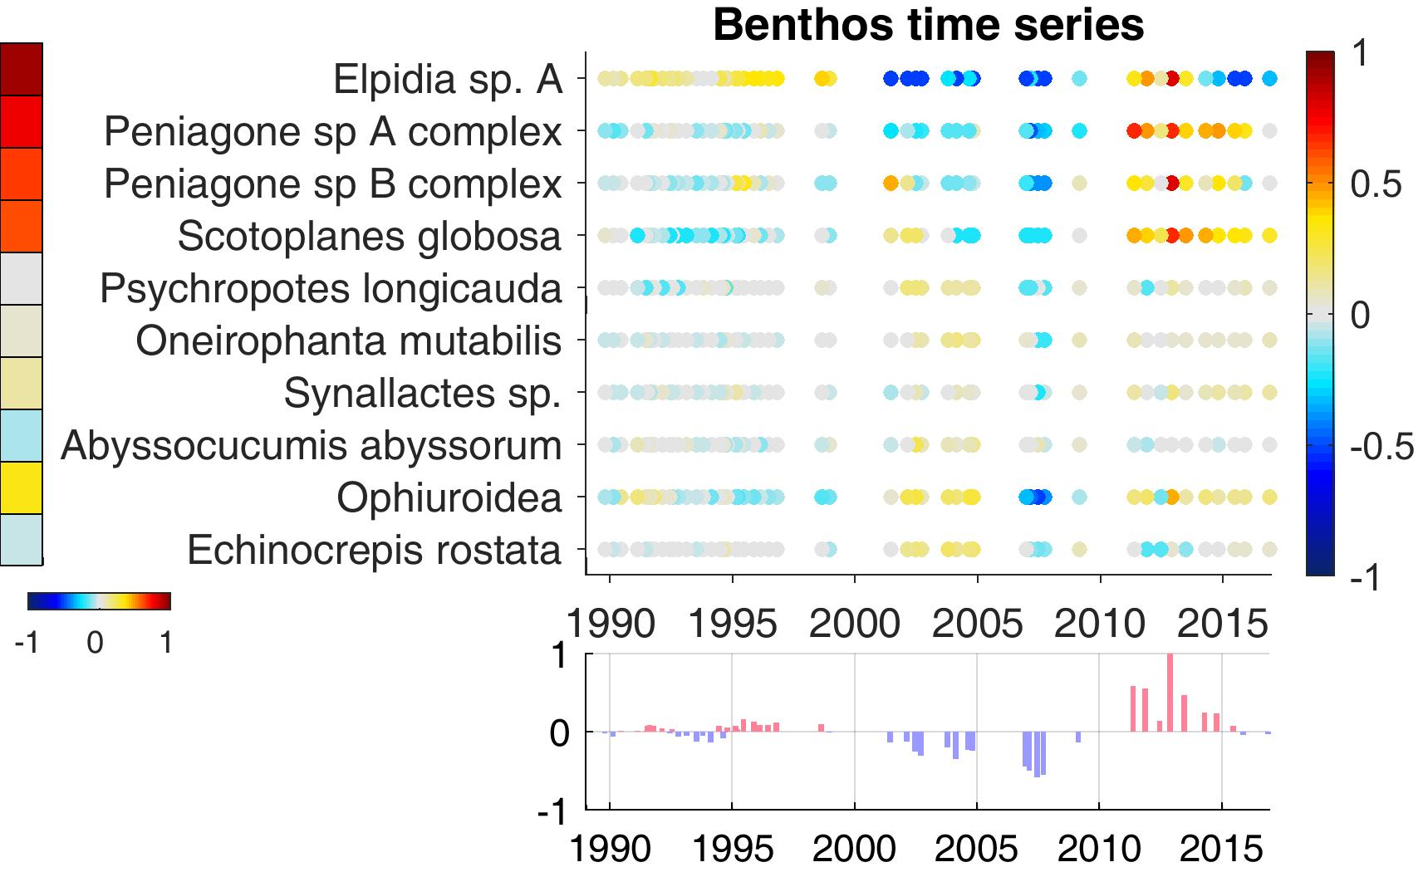
PCA – method
varex
50%

Slide 9
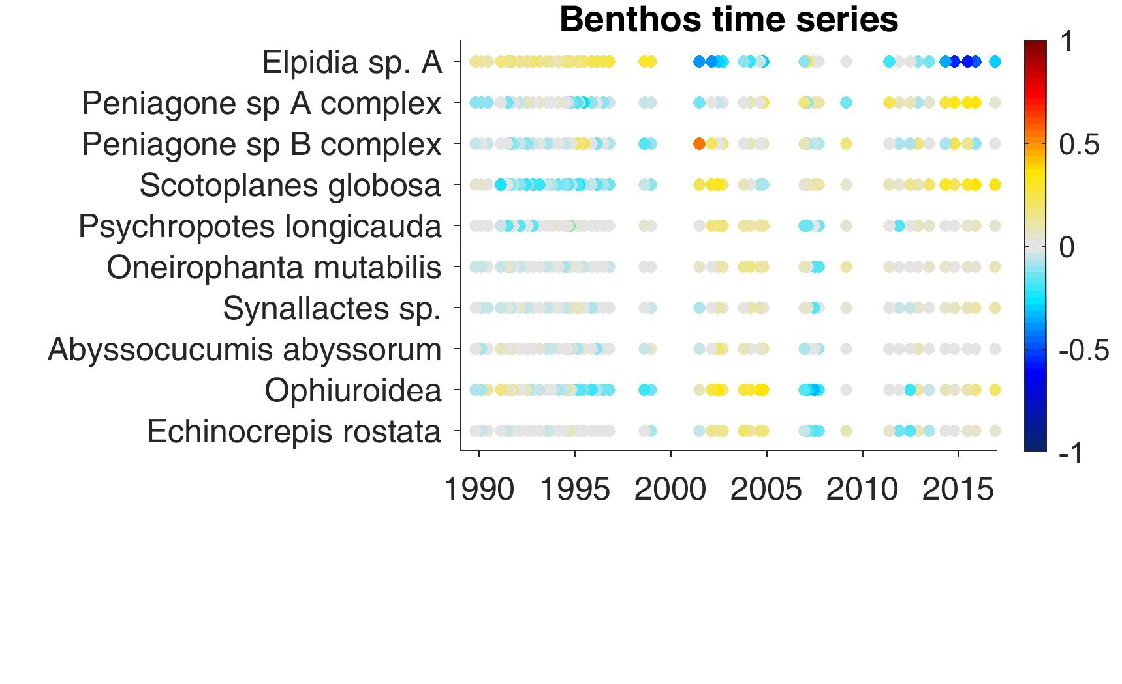
PCA – method

Slide 10
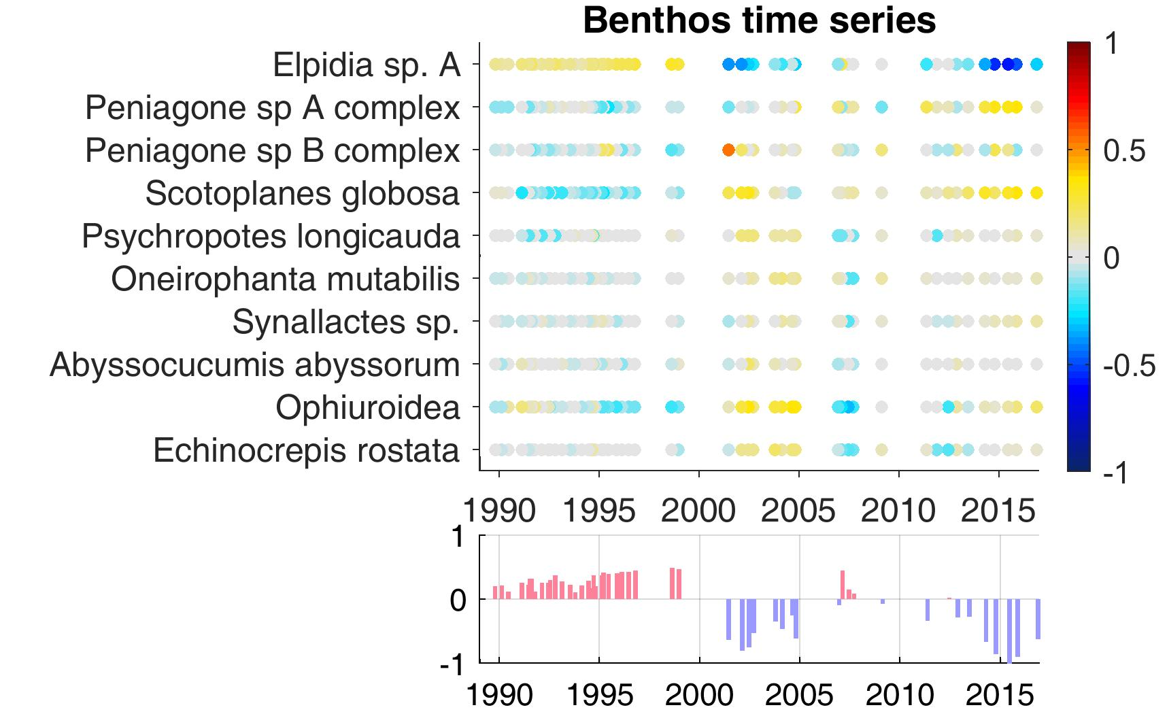
PCA – method
varex
29%

Slide 11
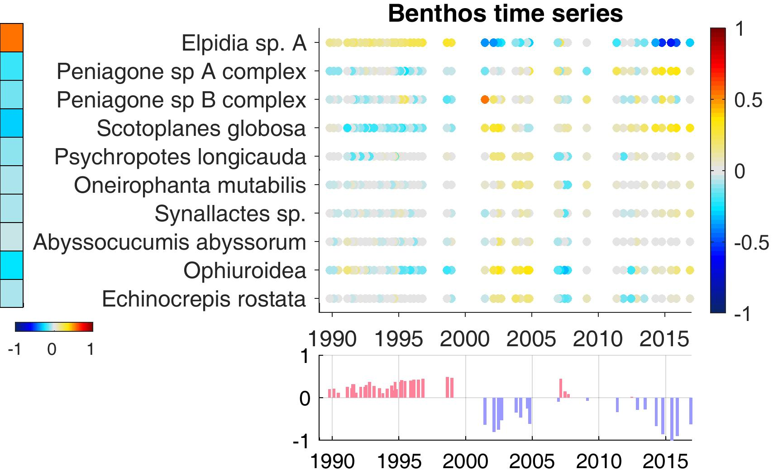
PCA – method
varex
29%

Slide 12
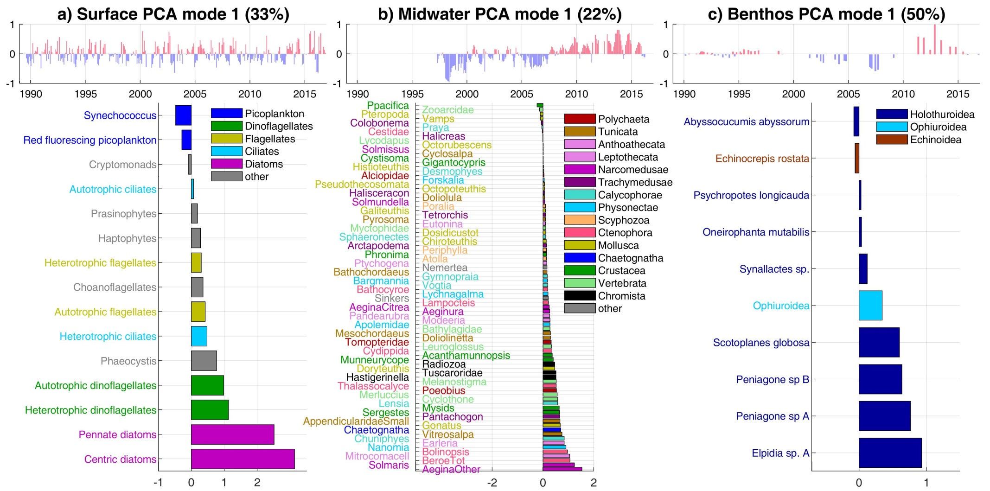
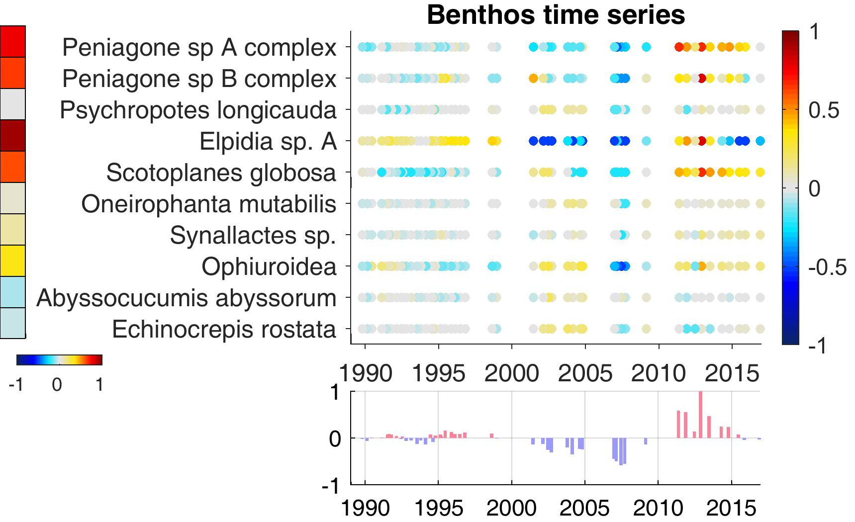
PCA – mode 1
BENTHOS (50%)
varex
50%

Slide 13
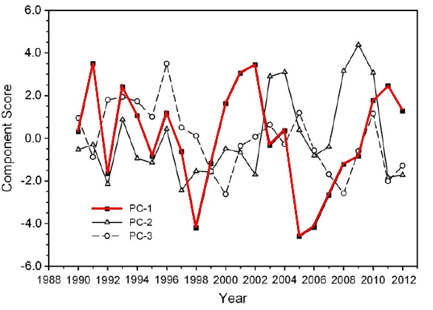
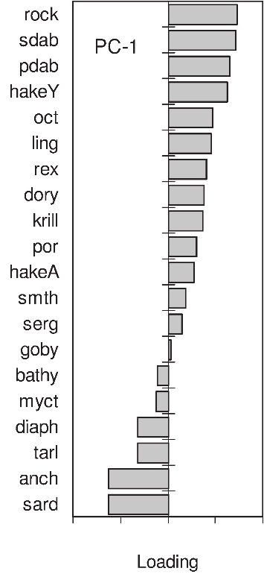
PCA – mode 1
MIDWATER (22%)
BENTHOS (50%)
pelagic forage
(Ralston et al., 2015)

Slide 14


PCA – mode 1
SURFACE (33%)
MIDWATER (22%)
BENTHOS (50%)
Mode 1 = overall changes in biomass and/or density

Slide 15
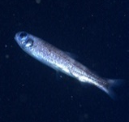
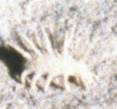
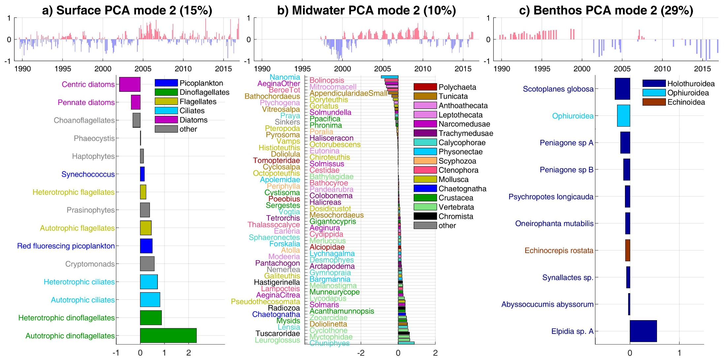
PCA – mode 2
SURFACE (15%)
MIDWATER (10%)
BENTHOS (29%)
Mode 2 = changes in community composition

Slide 16
2- Environmental forcing: upwelling

Slide 17
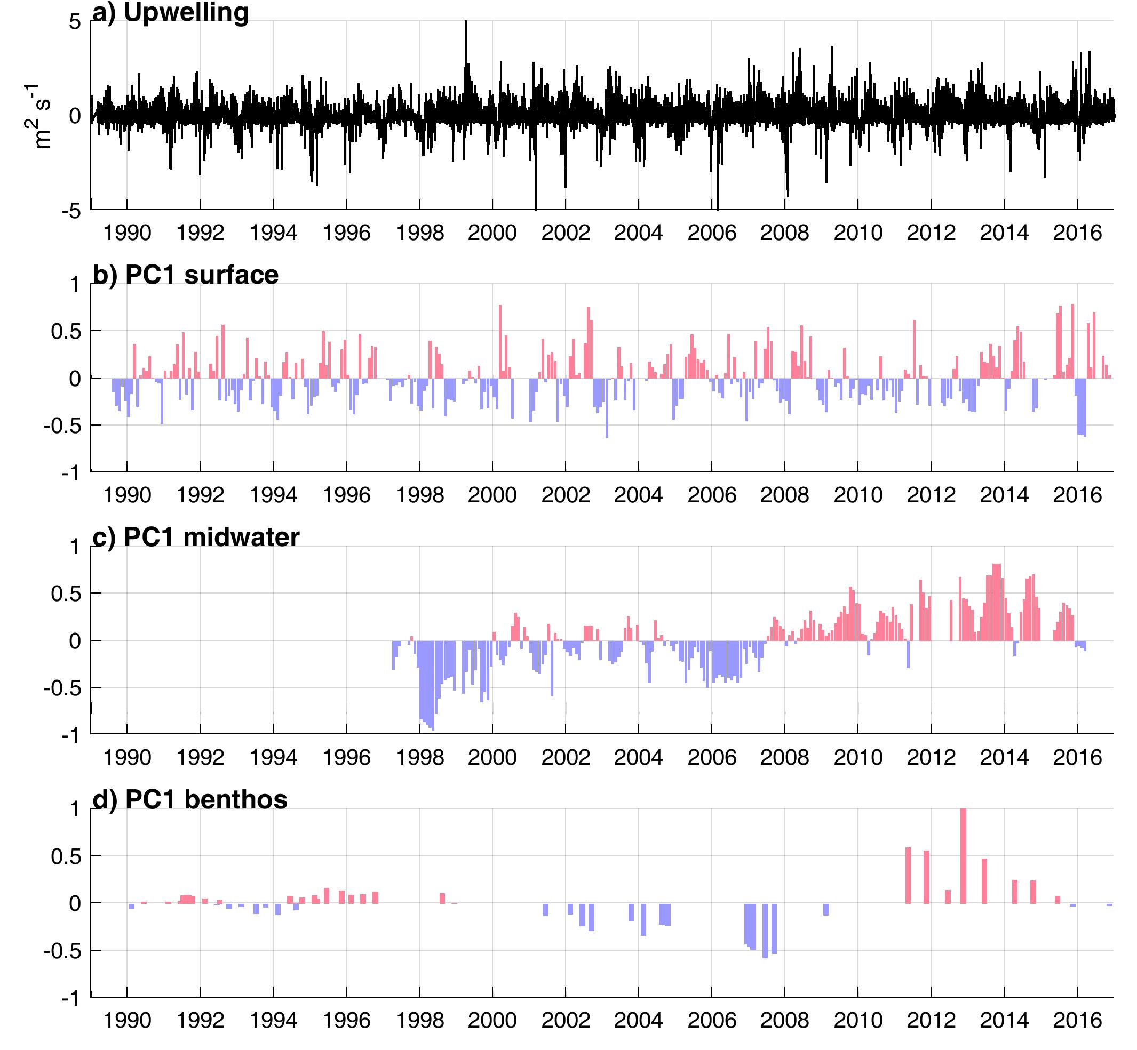
SURFACE
MIDWATER
BENTHOS

Slide 18
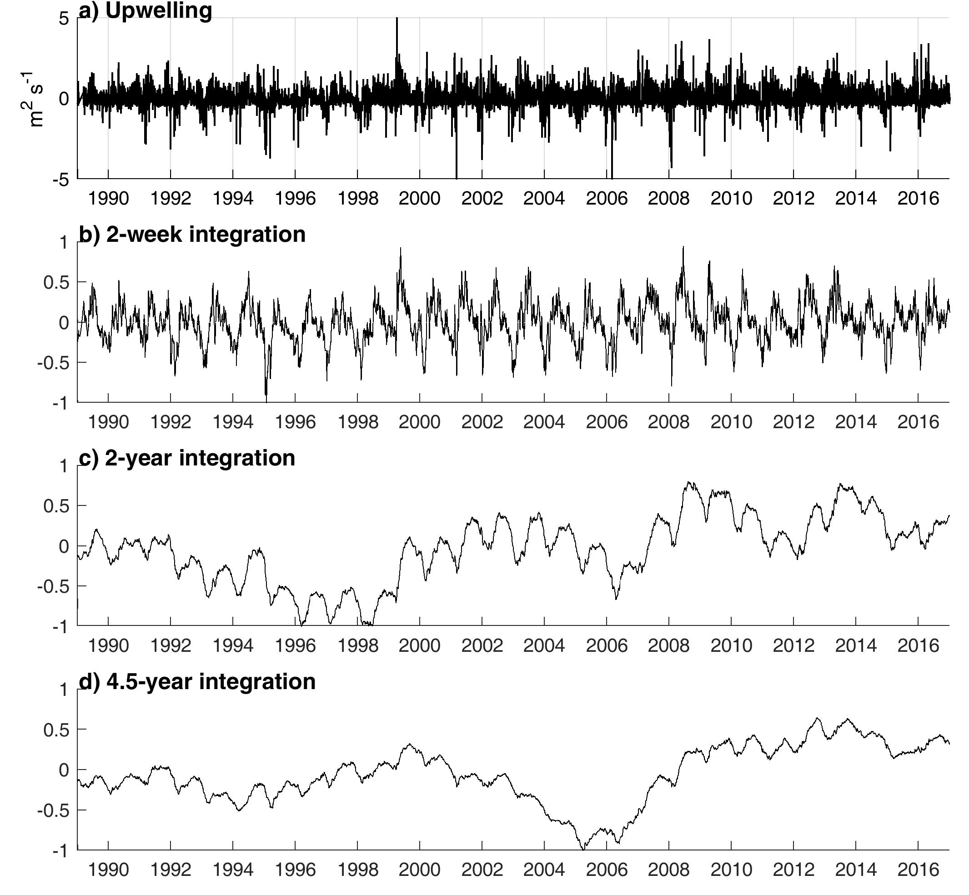
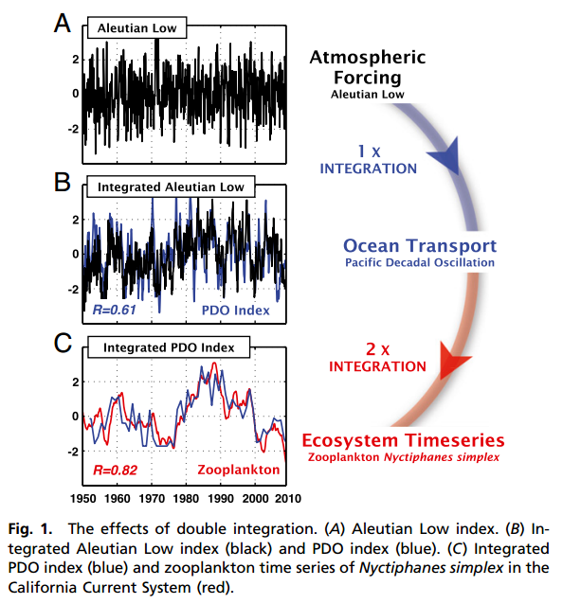
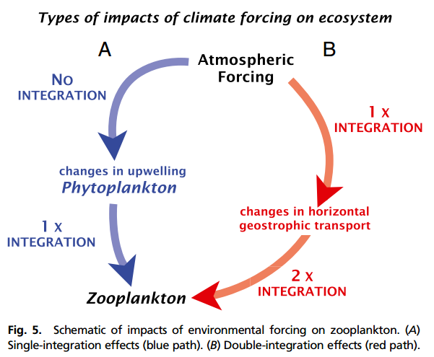
Τ = 6 months
Τ_{bio} = 2 years
(Nyctiphanes simplex)
Di Lorenzo and Ohman (2013)

Slide 19
Upwelling/relaxation cycle ~ 2 weeks
Midwater?? Mesopelagic animals ~ 2 years
SURFACE
MIDWATER
Benthos?? Might be several years
How long are upwelling effects felt in each ecosystem?
BENTHOS

Slide 20
SURFACE
MIDWATER
BENTHOS

Slide 21
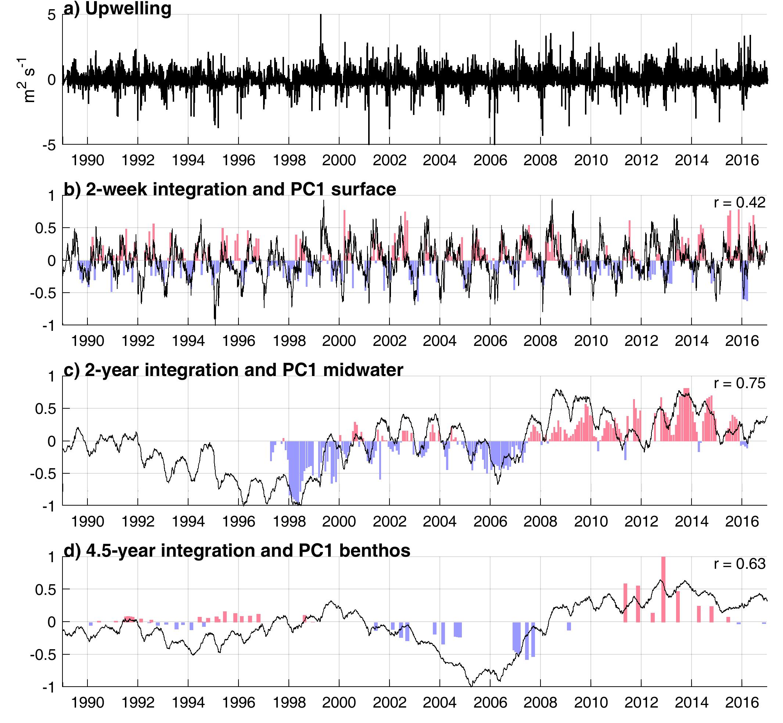
SURFACE
MIDWATER
BENTHOS

Slide 22
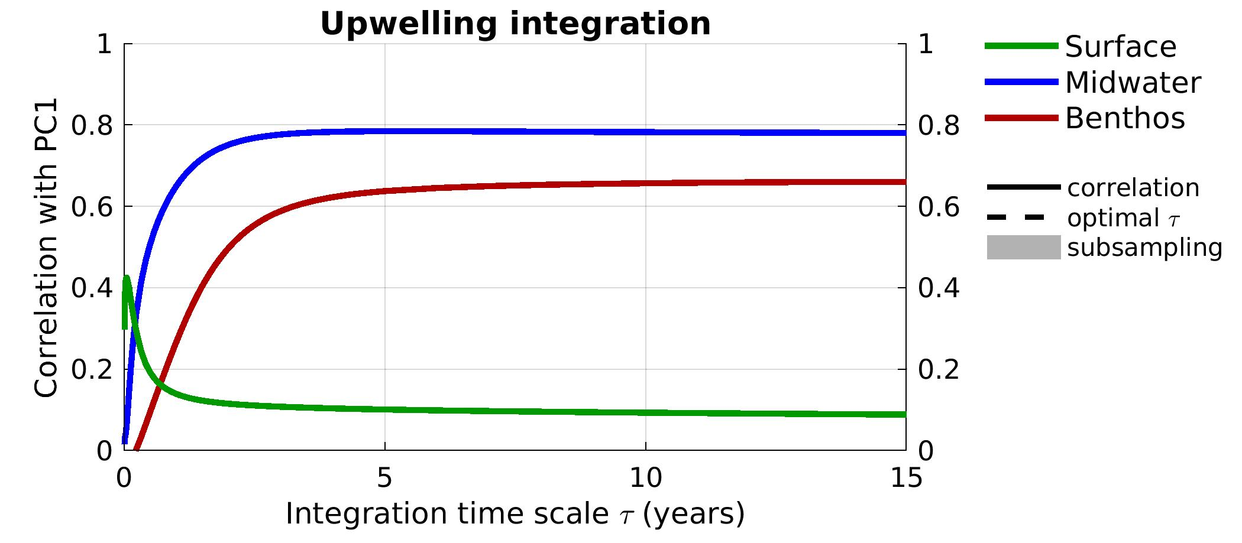
Upwelling integration time scale

Slide 23
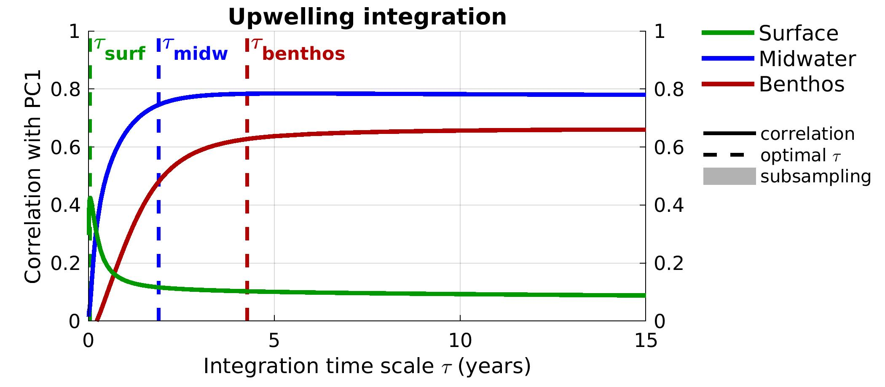
Upwelling integration time scale

Slide 24
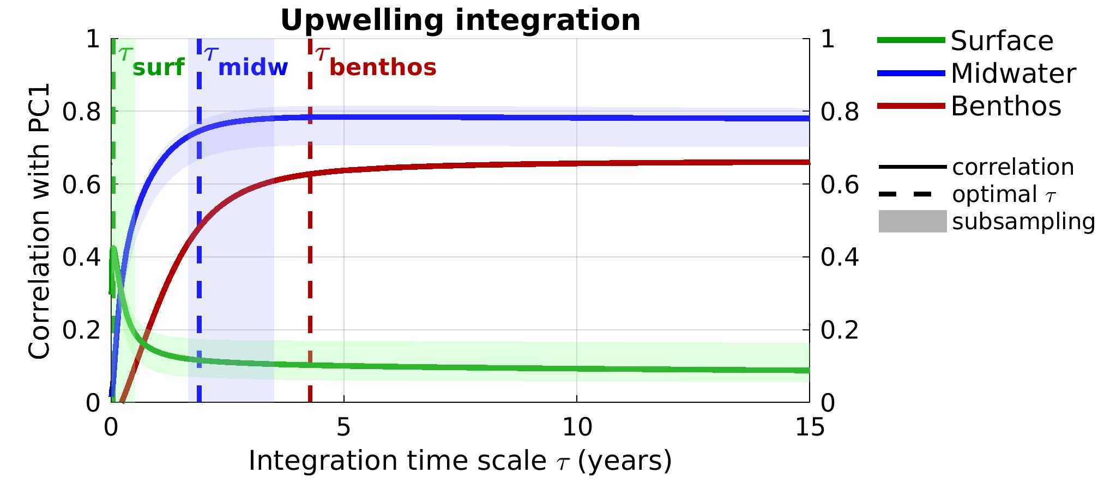
Upwelling integration time scale
Significant differences between ecosystems

Slide 25
Comparing PC1 predictors (with integration)
CORRELATION | surface | midwater | benthos
MEI | 0.04 | -0.77 | -0.43
PDO | 0.08 | -0.77 | -0.57
NPGO | -0.07 | 0.66 | 0.19
upwelling | 0.43 | 0.79 | 0.66
TIME SCALE | surface | midwater | benthos
MEI |  | 4 yr | 11 yr
PDO |  | 3 yr | 17 yr
NPGO |  | 9 yr
upwelling | 16 days | 2 yr | 4.5 yr
Upwelling is the best PC1 predictor

Slide 26

Conclusions
Long-term, high-resolution time series are needed!!
Strongest changes in ecosystem communities are overall changes in biomass/density, rather than community changes
Local upwelling explains 18% of surface PC1, 56% of midwater PC1 and 40% of benthos PC1
Links exist with climate indices, but not as strong

