Slide 1
List of datasets
Types of data:
  Ecosystem data (species)
  carbon fluxes
  other ecosystem data (eg. Chl)
  environmental data (associated with each TS, eg. M1 or ROV oxygen)
  external data (climate indices, satellite)
Type of data processing:
  average monthly
  time series integration (Di Lorenzo & Ohman 2013)
Raw or curated data?

Slide 2
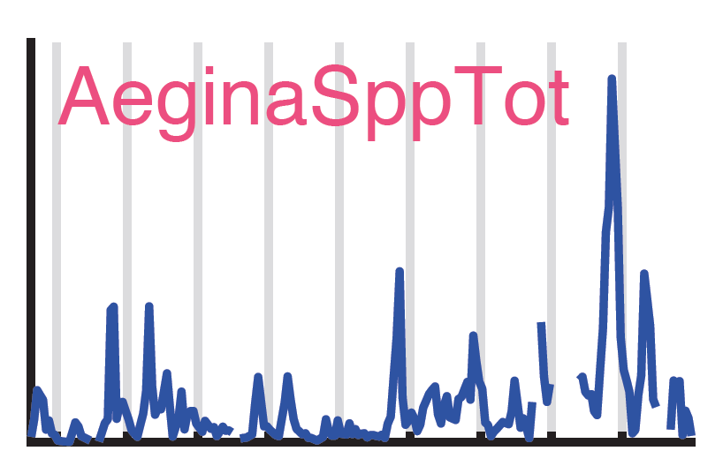
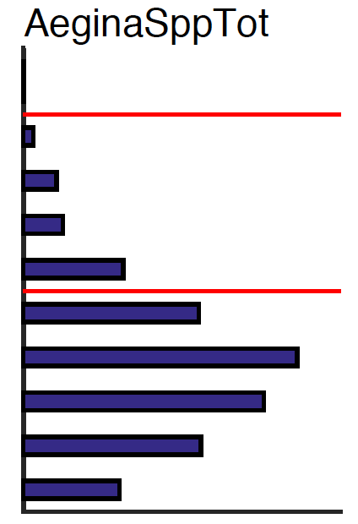
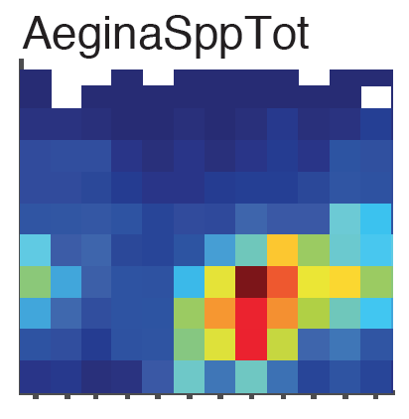
List of products
Time series (depth-avg for midwater?)
Average depth distribution (midwater)
Seasonal cycle
Parameter/parameter?
QC products?

