Slide 1
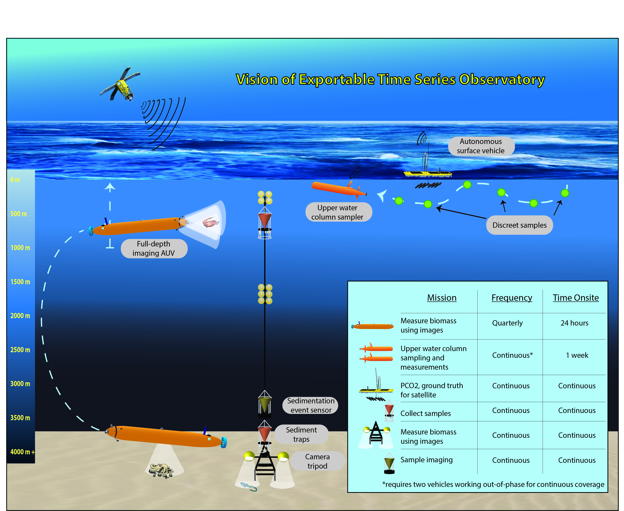
An integrated time series project
three MBARI times series
Vision of Exportable Time Series Observatory
Surface communities
Midwater communities
Benthic communities

Slide 2
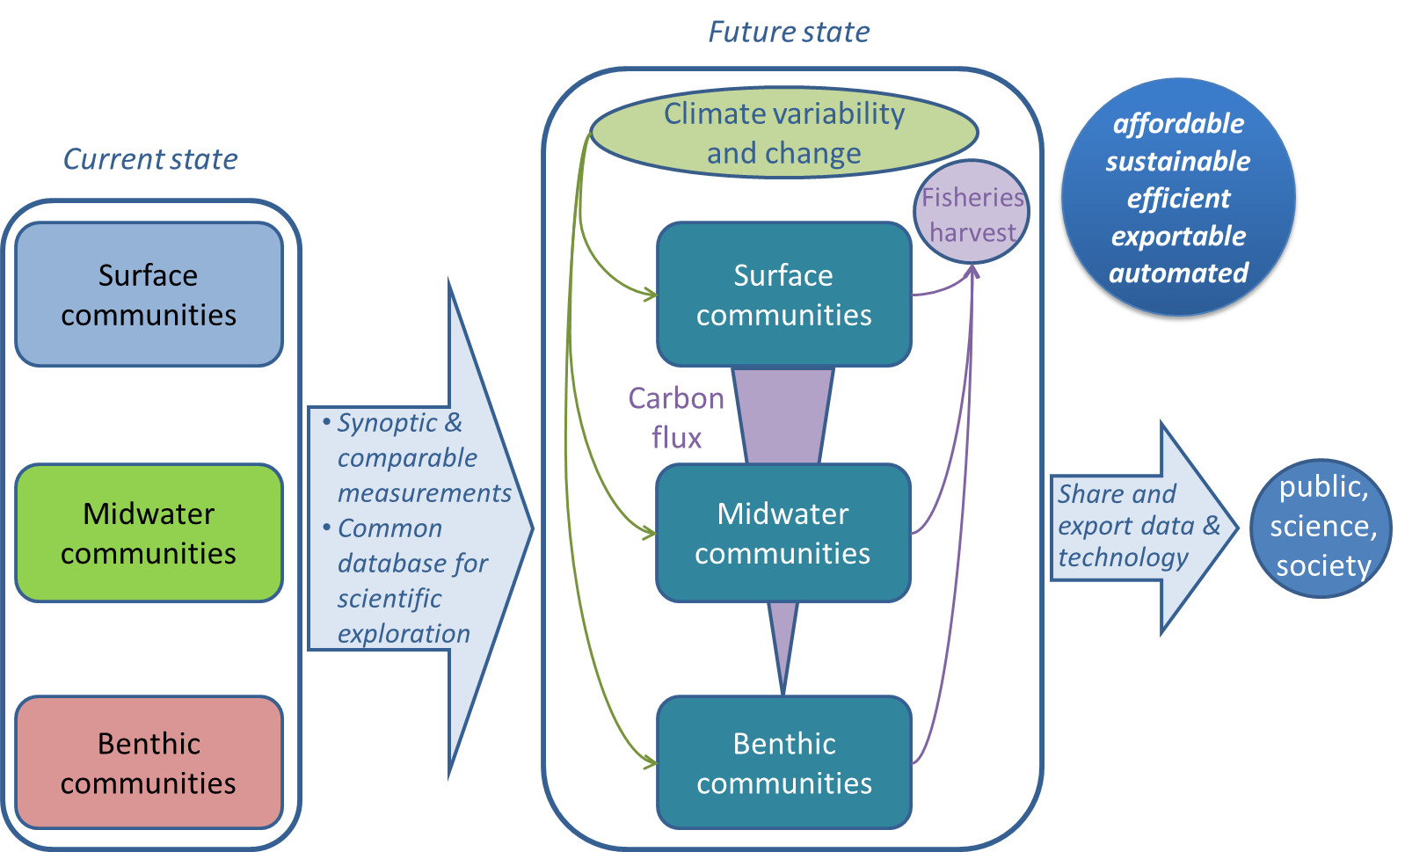
Integrating MBARI time series

Slide 3
Near-term objectives
Technical
data integration
Scientific
data integration
data aggregation into a central database, exportability of data and technologies
data synthesis, synchronous variability analysis, development of societally relevant proxies
Monthly science & engineering meetings
scientific coordination, discussions of sampling techniques and data integration

