Slide 1
Integrated Time Series
Monique Messié
Kevin Gomes
Notes:
Monique starts it off.

Slide 2
Outline
Background
  Why an integrated time series project?
  Towards sustainability, export and novel science
  Connection to strategic plan / tech roadmap
  Project overview (next steps and project linkages)
Feasibility results to date
  Early promise of integrating time series and path forward
Project Goals
  Continued monthly science/engineering meetings
  Scientific analysis
  Engineering development
Notes:
Monique introduces

Slide 3
The Integrated Time Series vision
Climate variability and change
affordable
sustainable
efficient
exportable
automated
Surface
Surface
Synchronous & comparable measurements
Common database for scientific exploration
Carbon flux
Midwater
Midwater
Share & export
Public
Benthos
Benthos
Notes:
Monique talks about the benefits of an integrated time series

Slide 4
The Integrated Time Series vision
“ The three MBARI studies when combined will provide an unprecedented time-series dataset to track organic carbon production and utilization throughout the oceanic water column allowing us to interpret the impact of global warming on the oceanic carbon cycle.”
-- (time series white paper)
Notes:
Monique talks about the benefits of an integrated time series

Slide 5
Integrated time series & MBARI goals
“Aims to comprehensively study productivity and transfer of matter and life between the ocean surface and the deep sea”
-- (MBARI Strategic Plan)
Directly related to MBARI
research themes
  Ecosystem processes
  Ocean Visualization
Addresses Technical
Needs in Roadmap
  Advancing a persistent presence
A unique opportunity at MBARI
“No other time-series program worldwide now provides the requisite measurements with high temporal resolution to conduct such studies throughout the water column and on the seafloor.”
-- (time series white paper)
“Relate water-column conditions and variability to the abundance, distribution, and activity of organisms”
-- (MBARI Tech Roadmap)
new technologies
& data integration
⇒ sustainability
“Developing tools for preserving, exploring, and mining multi-disciplinary data sets.”
-- (MBARI Tech Roadmap)

Slide 6
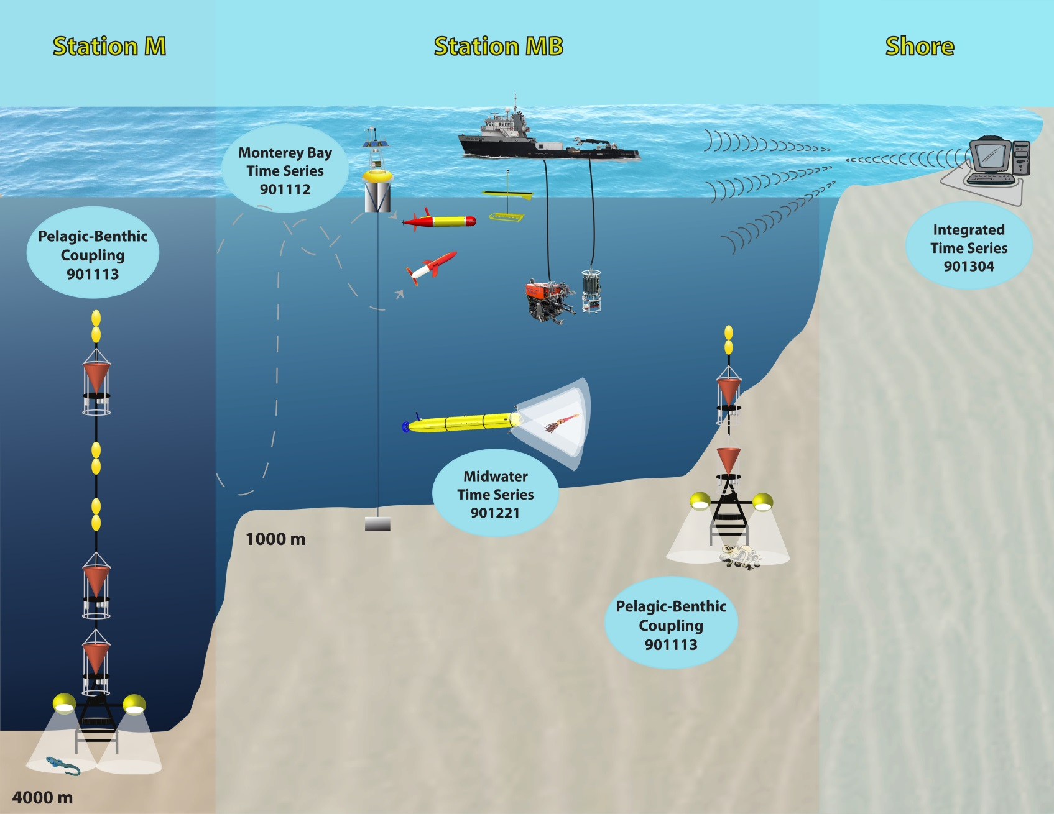
Overview and Linkages
Notes:
Monique speaks to this one and covers how this project interacts with the other projects. The main points:
The actual sampling, experimental work, and some development will be done under the time series projects themselves
The integrated time series has two main components:
it provides the umbrella project to gather all the scientists and engineers and to examine the results of each individual time series and determine how to best analyze and integrate the data from each
Monique will work on developing the analysis algorithms and visualizations of the integrated data
Kevin (and others?) will work on the application(s) to make the data available to the institute (and outside)

Slide 7
Overview and Linkages
Notes:
Monique picks up here and talks specifics about what specifically is being done in the time series and development projects and how they feed into the work in the integrated time series.
*** I think we need to put a box above the “Common database design and implementation” that includes what the ‘think tank’ does to guide the process of parameterization and analysis.

Slide 8
Feasibility Results to Date
Many productive discussions about parameters, planning and sampling technologies
White paper summarizing goal for time series integration and technology development
Prototyping Efforts:
  Data cataloging and extraction
  Scientific analysis
  Data visualization
Notes:
Kevin will talk to this and the next 3

Slide 9
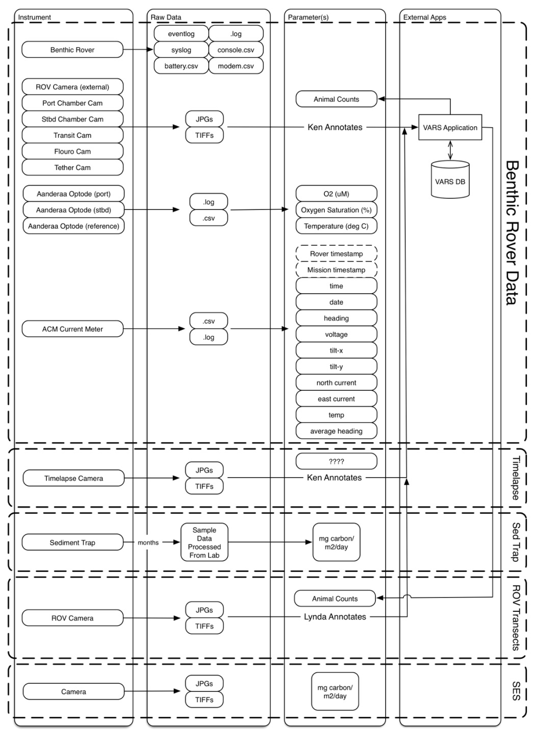
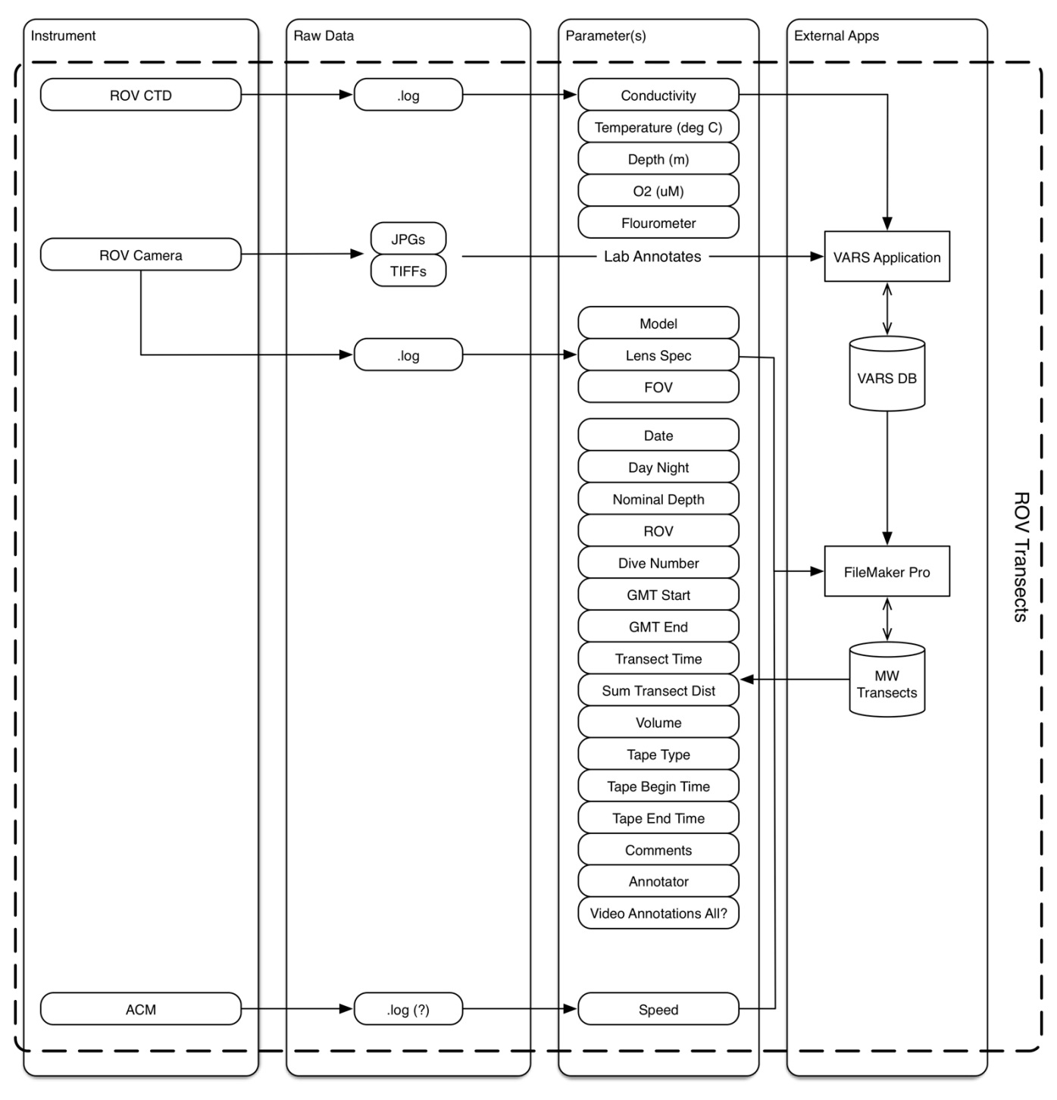
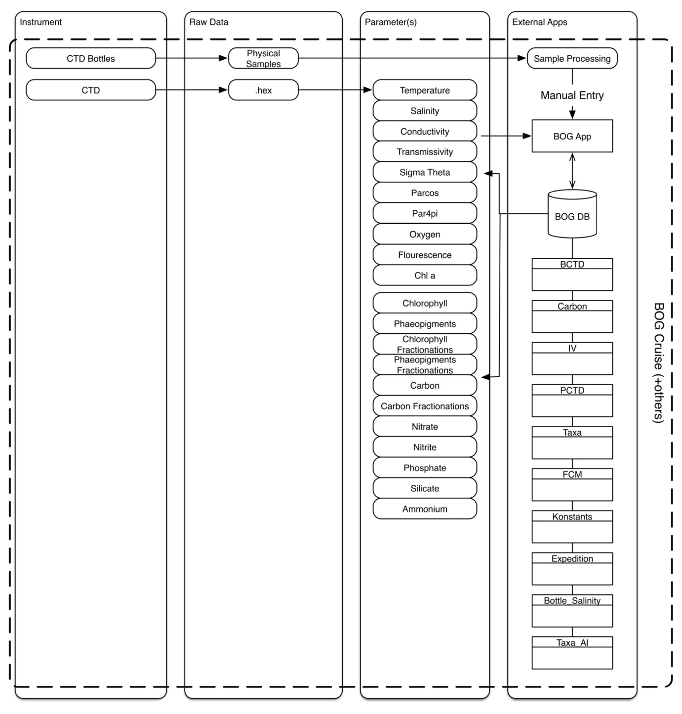
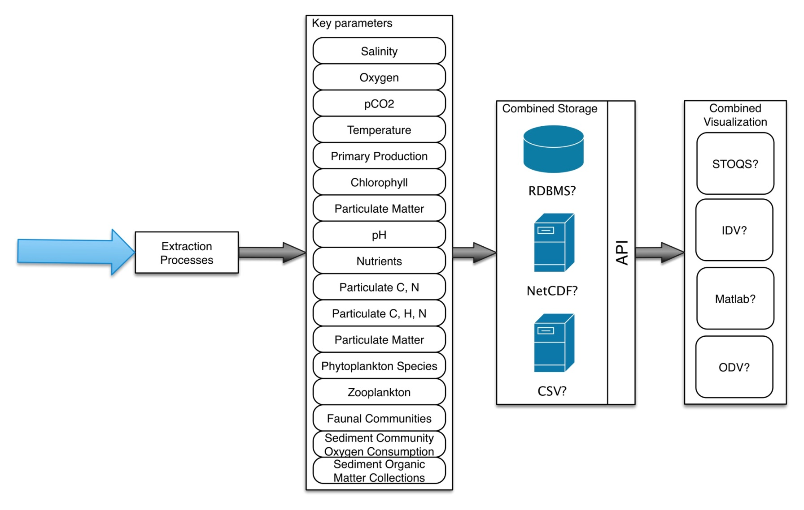
Feasibility Results to Date
Data Cataloging
Notes:
Kevin

Slide 10
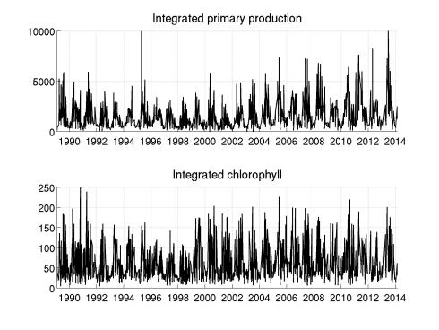
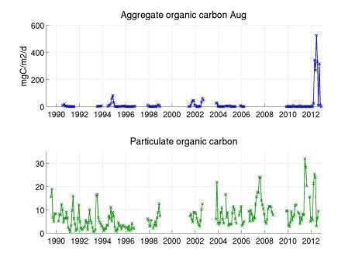
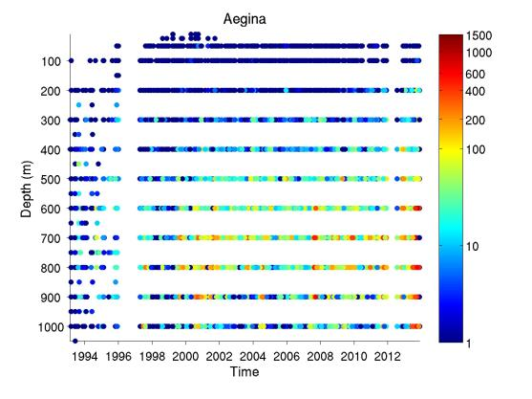
Feasibility Results to Date
Analysis
Notes:
Kevin

Slide 11
Feasibility Results to Date
Web Application Demo
Notes:
Kevin

Slide 12
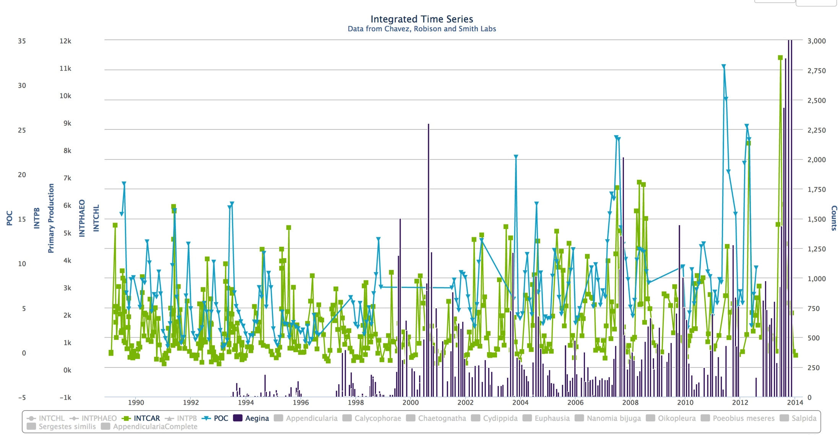
Scientific Analysis
Surface primary production
Midwater Aegina counts (medusa)
Benthic particulate organic carbon flux
Synchronous variability
El Niño, Pacific Decadal Oscillation, etc
Interannual variations
Seasonal scale
Notes:
Monique will speak to this one and the next 2

Slide 13
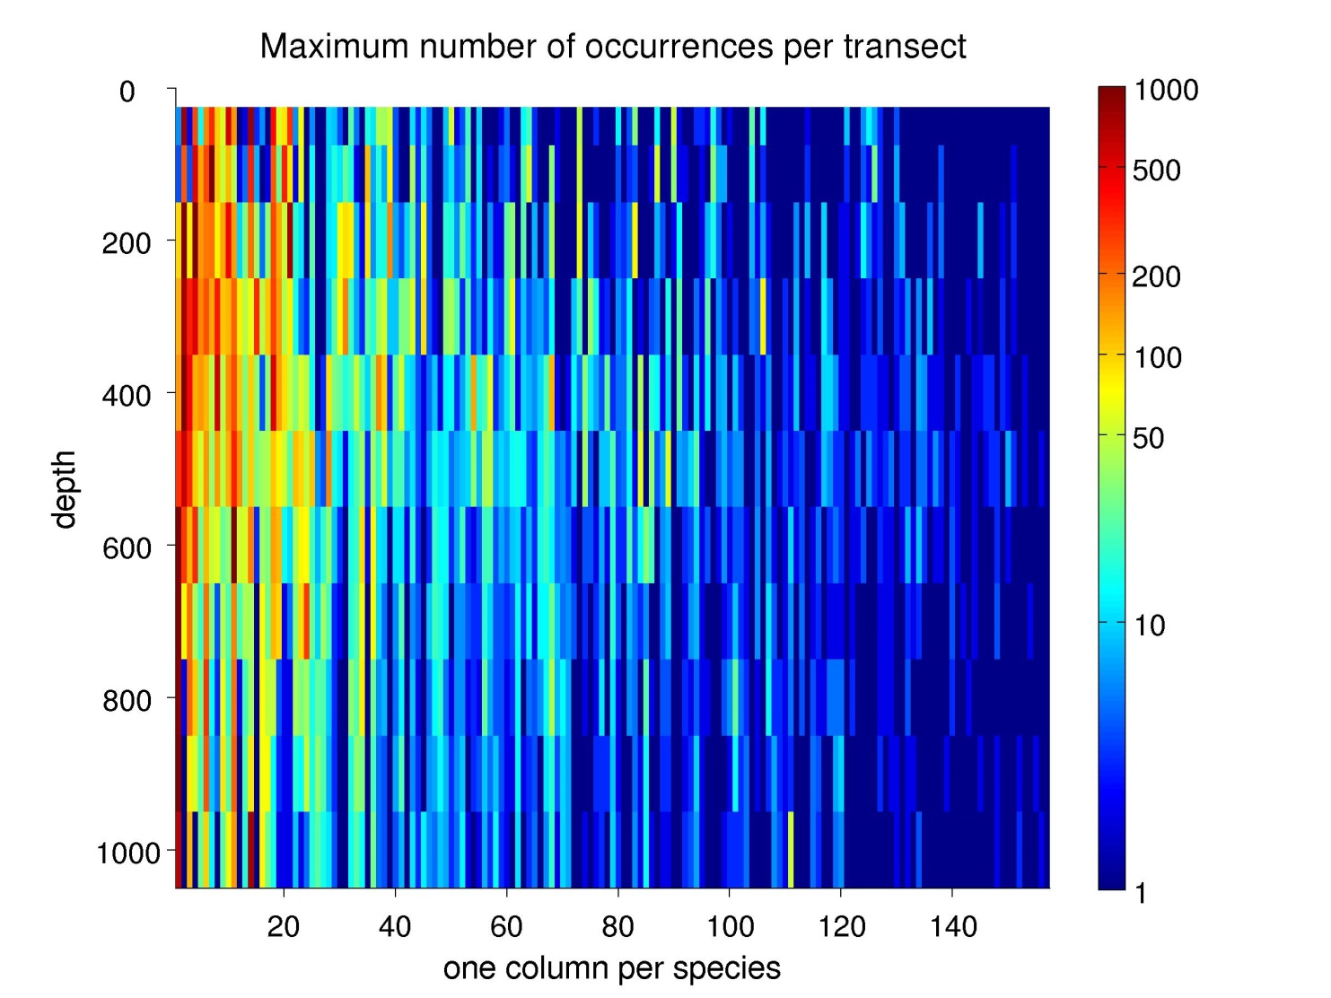
Scientific Analysis
Synthesize information
Notes:
Monique

Slide 14
Scientific Analysis
Carbon fluxes
Photosynthesis
Phytoplankton
Respiration
Grazing
Midwater fauna
Respiration
Carbon export
Benthic communities
Respiration
Notes:
Monique

Slide 15
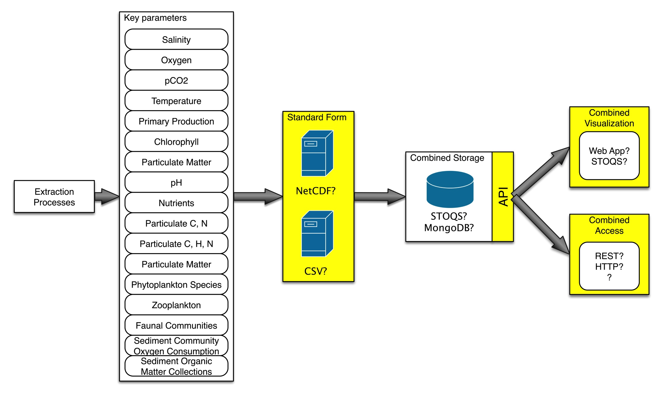
Engineering Development
Select central storage/API (STOQS?)
Automate extraction and loading (eye towards export)
Application/Visualization development and connection to central store
Integration of science analysis into application
Notes:
Kevin talks to the development stuff

Slide 16
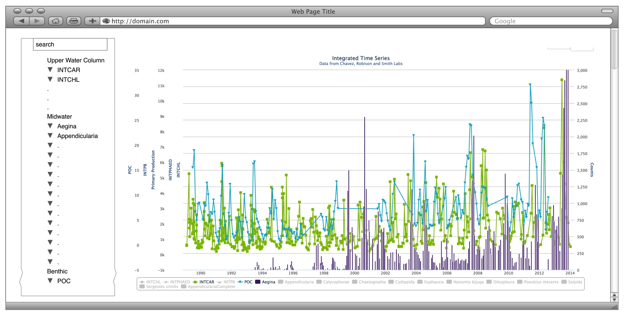
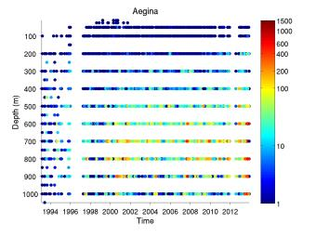
Engineering Development
?
Notes:
Kevin

Slide 17
Conclusion
Integrating the time series will increase MBARI reach, generate new science and lower the costs – directly related to MBARI strategic plan & tech roadmap
Feasibility study identified a path forward
Project goals: science/engineering meetings, scientific and technical data integration
Ken, Bruce and Francisco are actively engaged in combining their research and data
… Questions?

