Slide 1
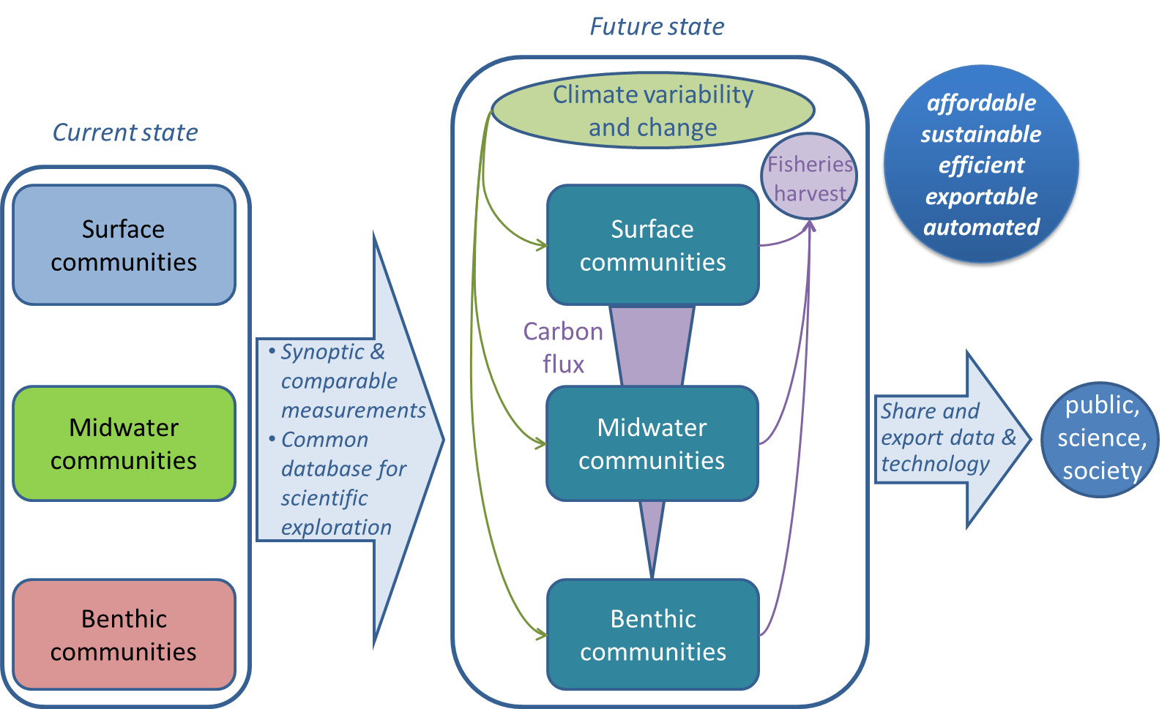
Integrating MBARI time series

Slide 2
Integrating MBARI time series
3 MBARI time series monitor ecosystems at the surface (F. Chavez), in the midwater (B. Robison) and in the benthos (K. Smith) since 1989
MBARI is the only place in the world where ecosystems and carbon fluxes have been monitored from top to bottom for decades – unique opportunity to assess long-term ecosystem changes through the oceanic food web.
The ITS project brings these datasets together in a common repository and explores links between them.
The common data repository and analysis will be made available to the public in a standard format.
In 2016 we will continue the data integration and focus on El Niño as a case study.

Slide 3
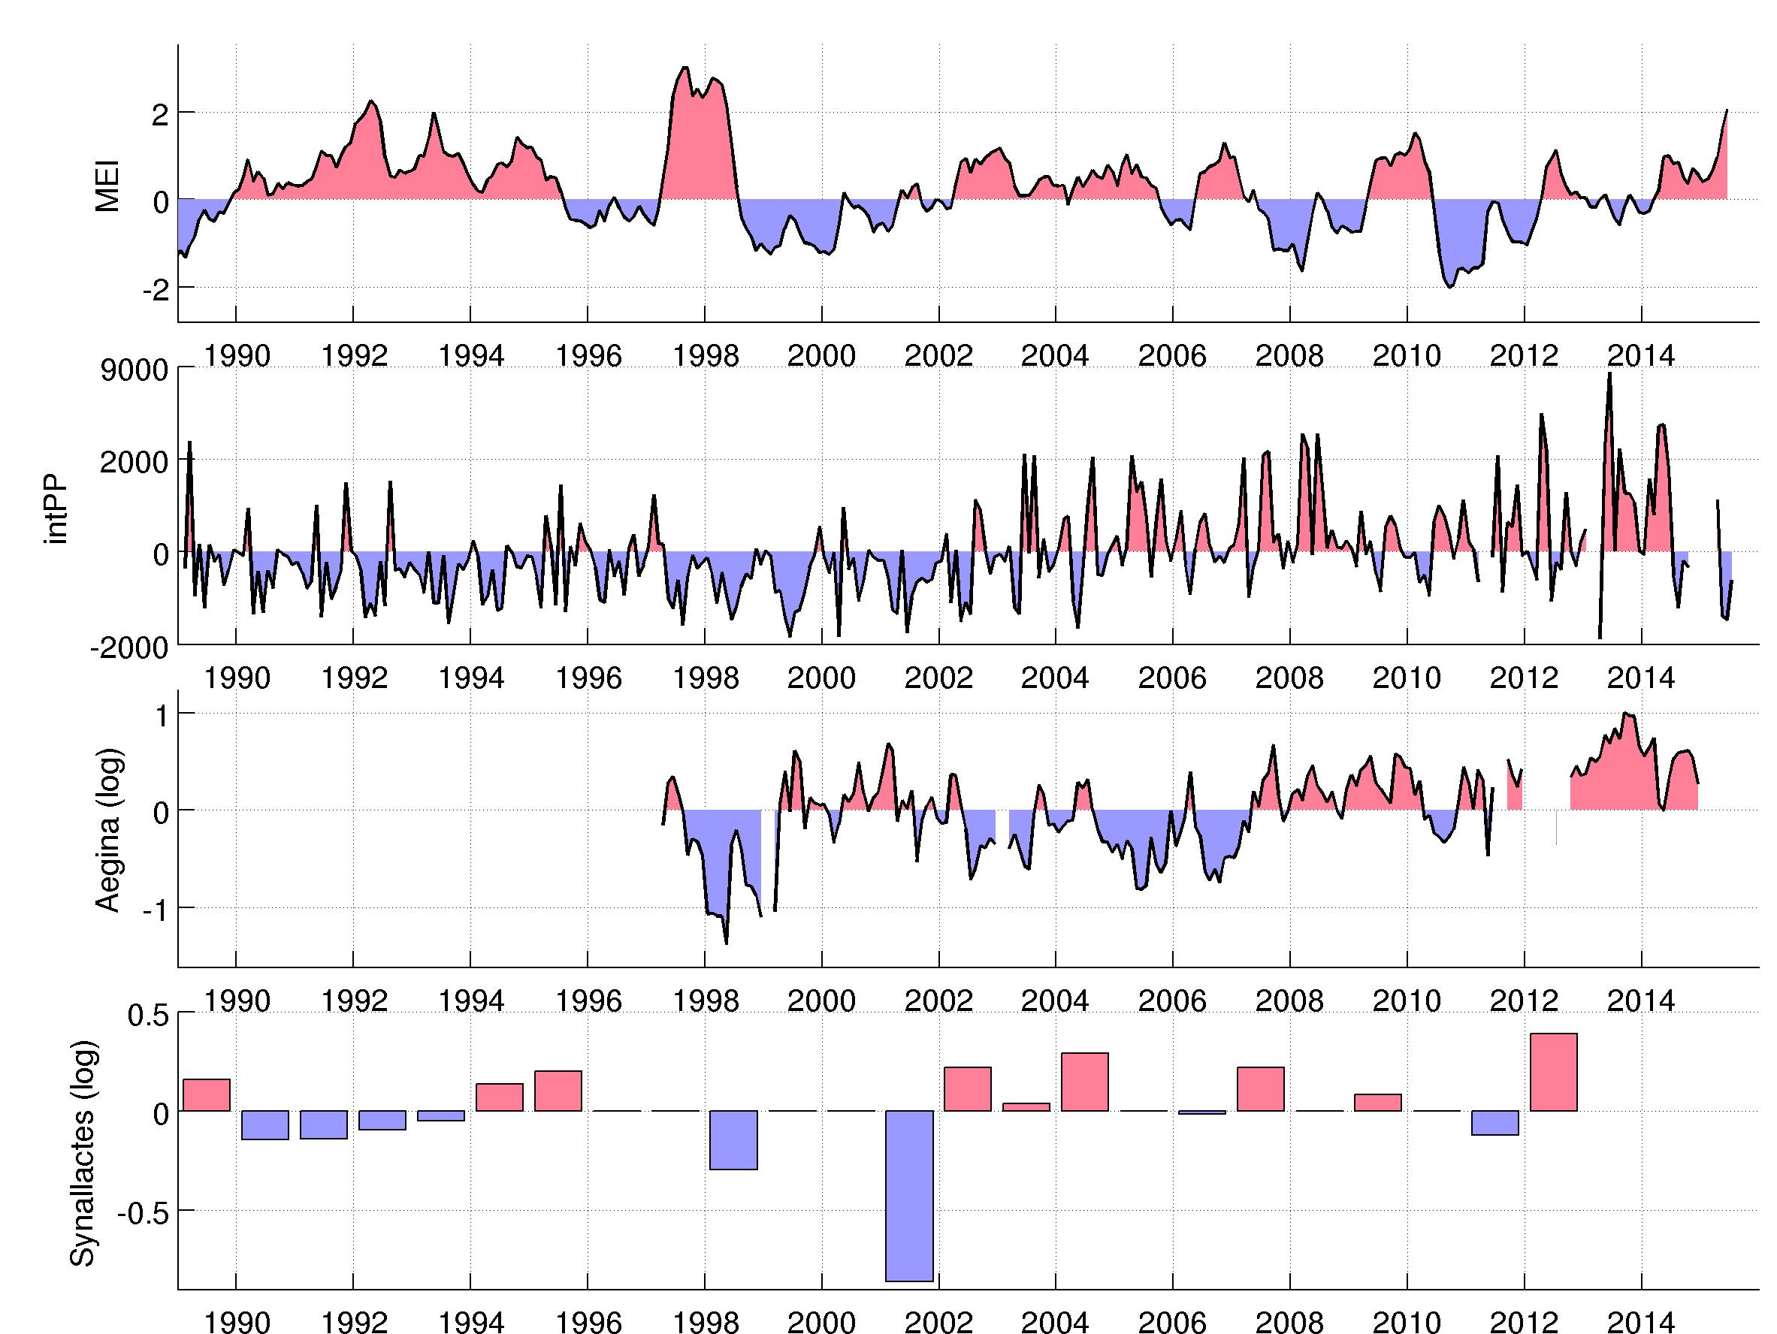
Integrating MBARI time series:
El Niño as case study for 2016
1997-98 El Niño
2015-16 El Niño
El Niño index
Revisit the impacts of the 1997-98 El Niño on ecosystems monitored by the 3 time series
Monitor the current 2015-2016 El Niño, examine similarities and differences
Plankton productivity (surface)
Abundance of a common medusae (midwater)
Abundance of a sea cucumber (benthos)

