Slide 1
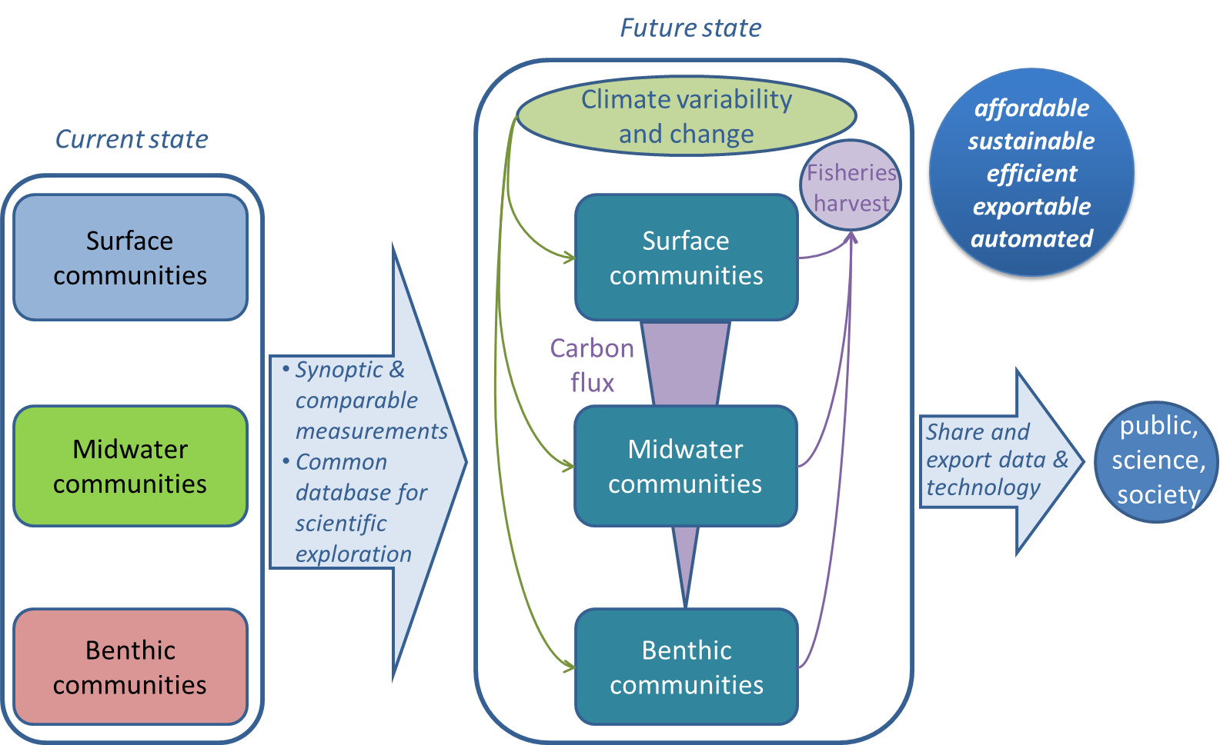
Integrating MBARI time series

Slide 2
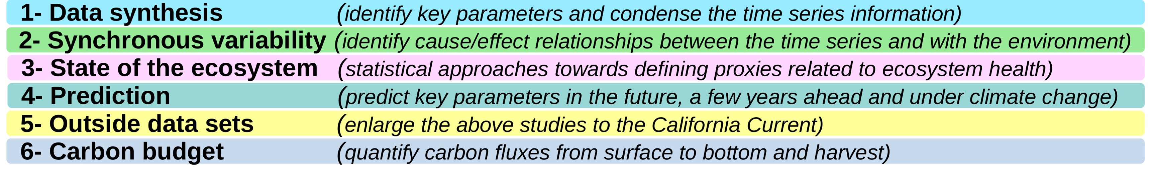
Integrating MBARI time series
MBARI is supporting 3 time series– only place in the world where ecosystems and carbon fluxes have been monitored from top to bottom for decades (1989-present) :
  at the surface (F. Chavez),
  in the midwater (B. Robison),
  in the benthic boundary layer (K. Smith).
The ITS project brings these datasets together in a common repository and explores links between them, presenting a unique opportunity to identify links and quantify carbon fluxes through the water column.
Five goals:

Slide 3
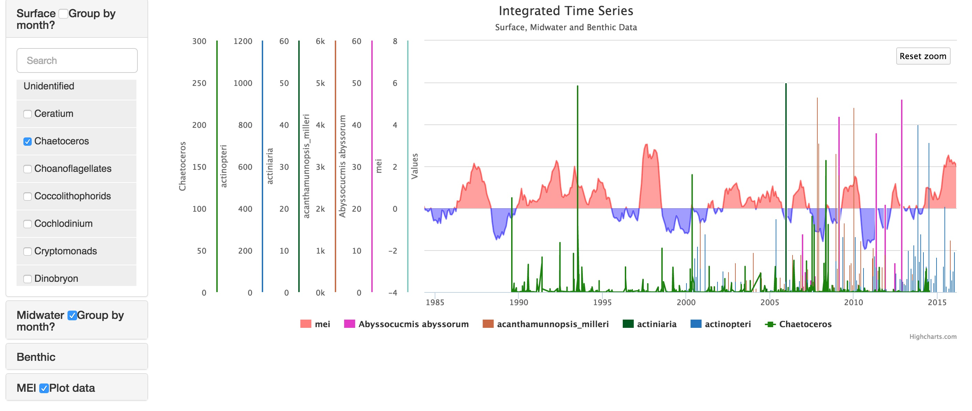
Integrating MBARI time series:
plans for 2017
Continued work: El Niño case study, ecosystem indices development, data visualization and exploration interface.
Look for higher-level relationships (“text book theories”)
Define a strategy to derive a carbon budget of the water column

