Slide 1
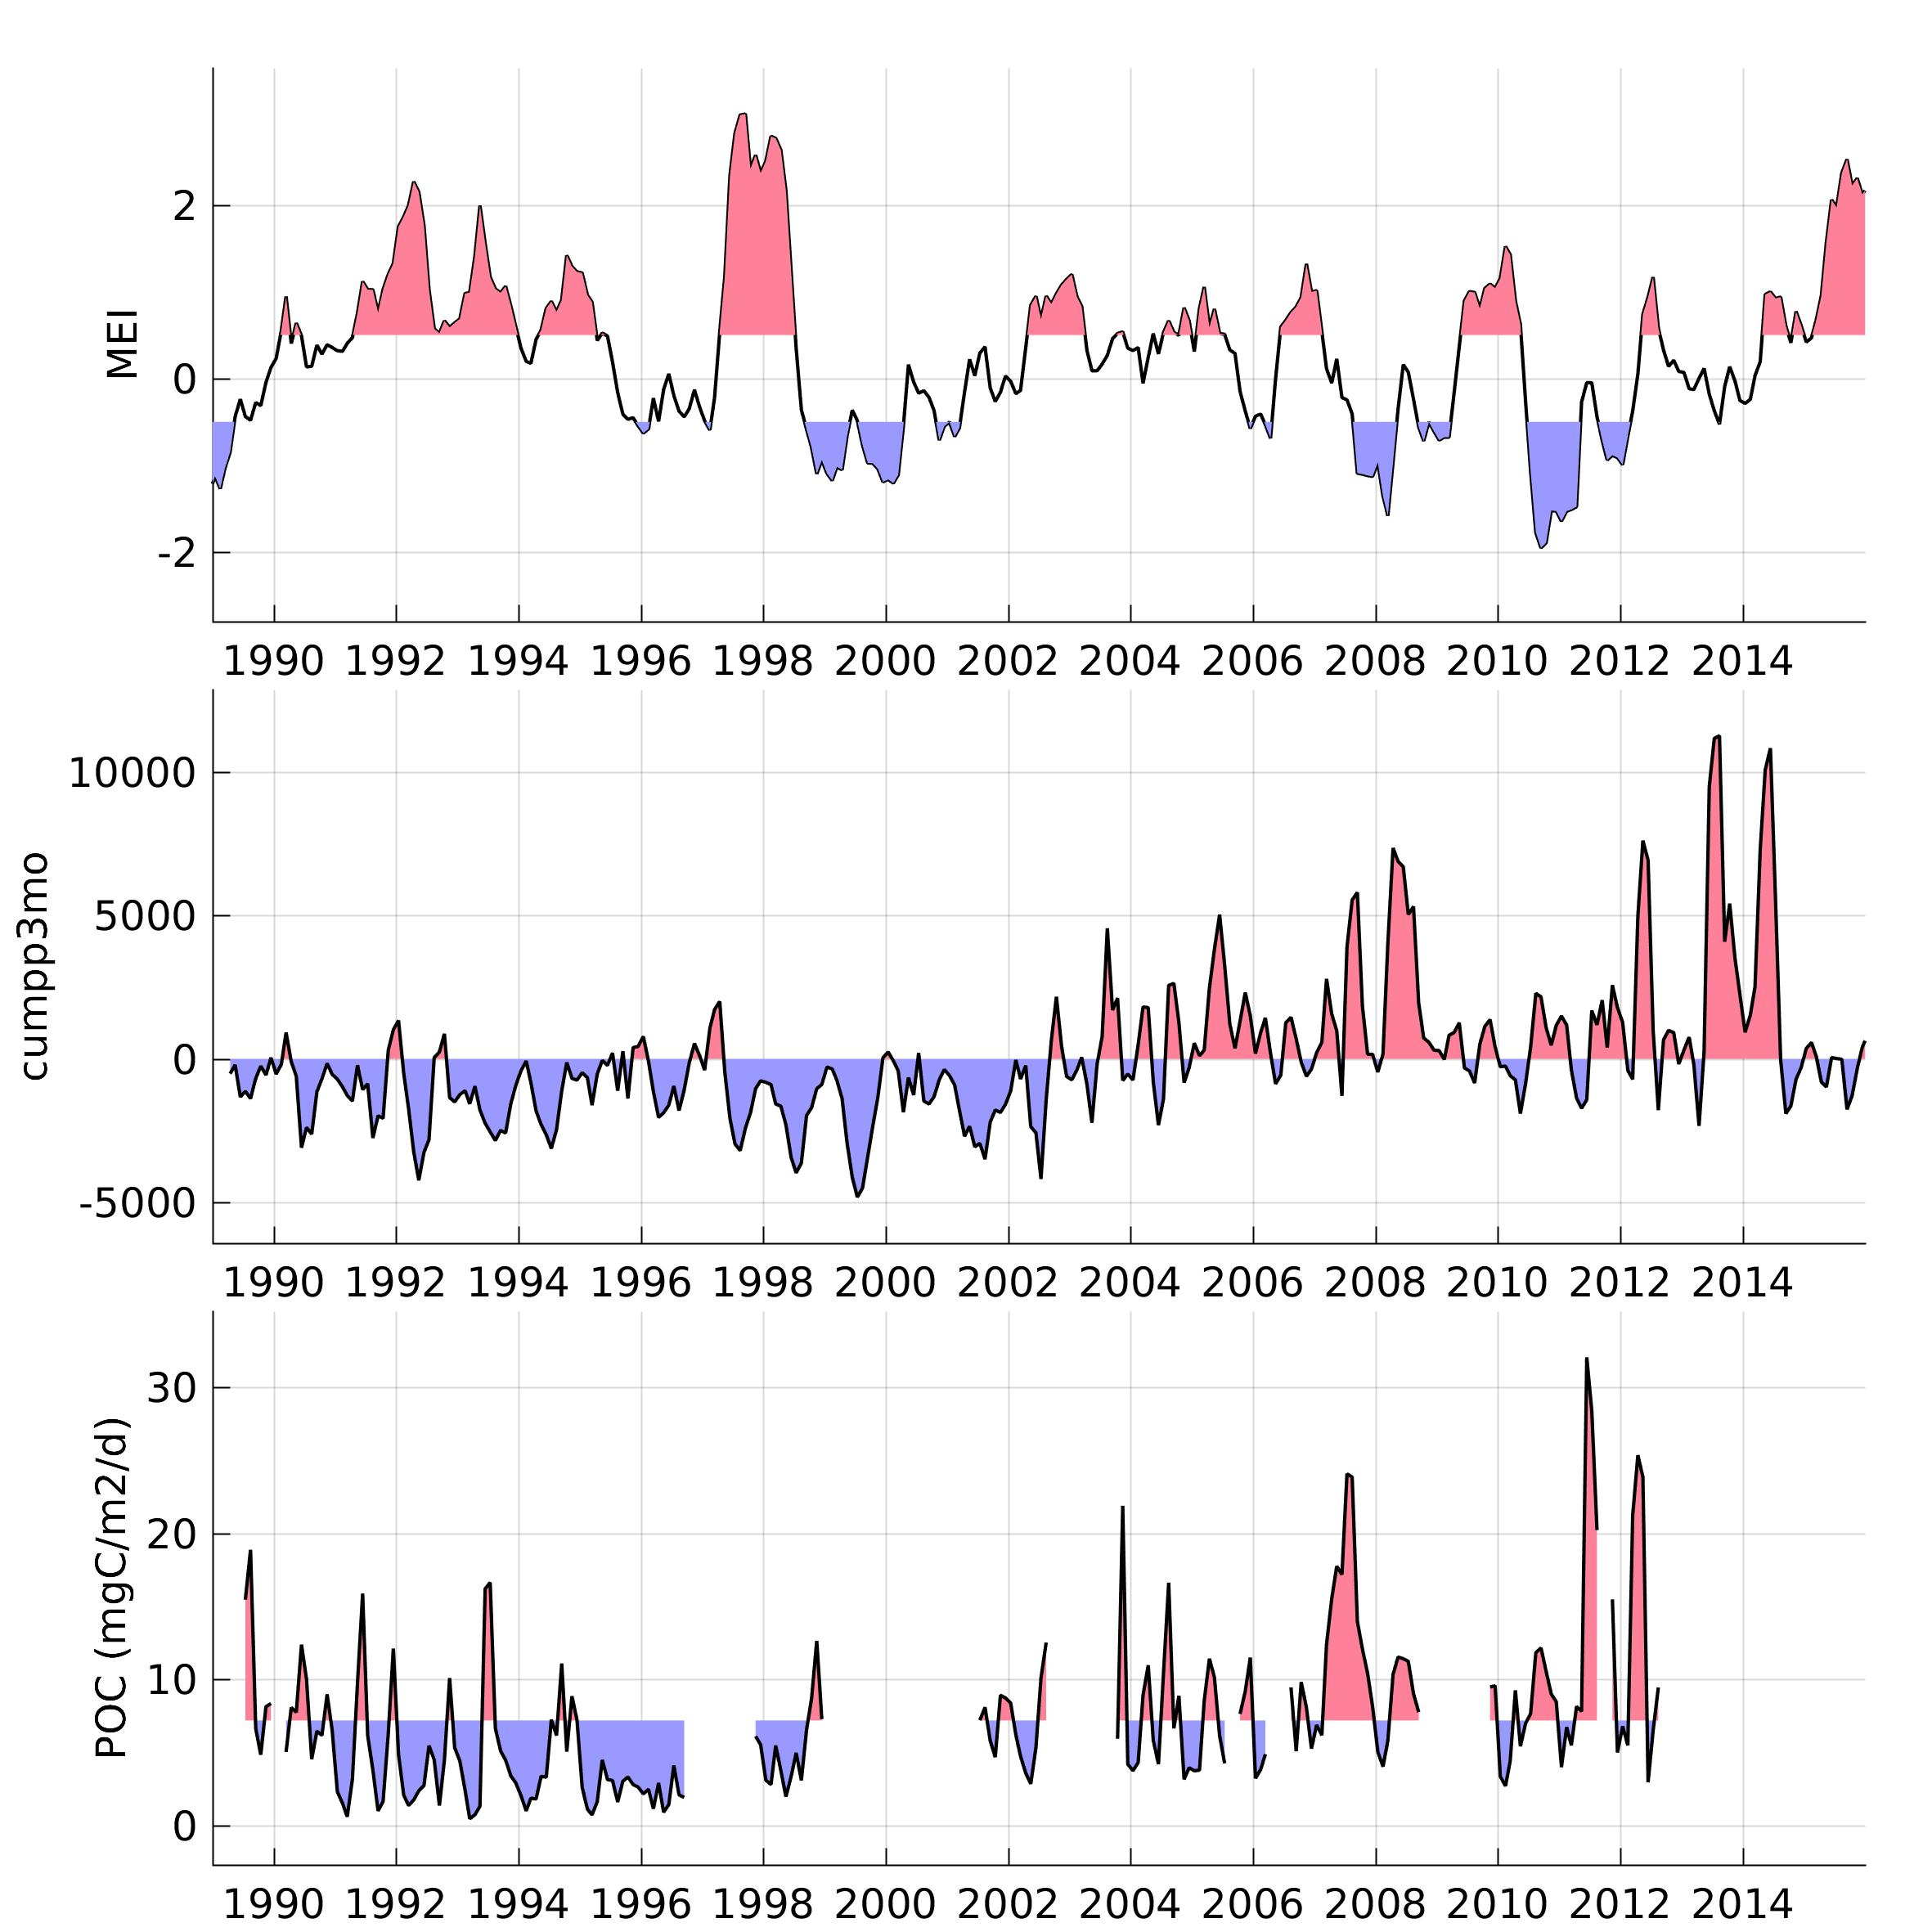
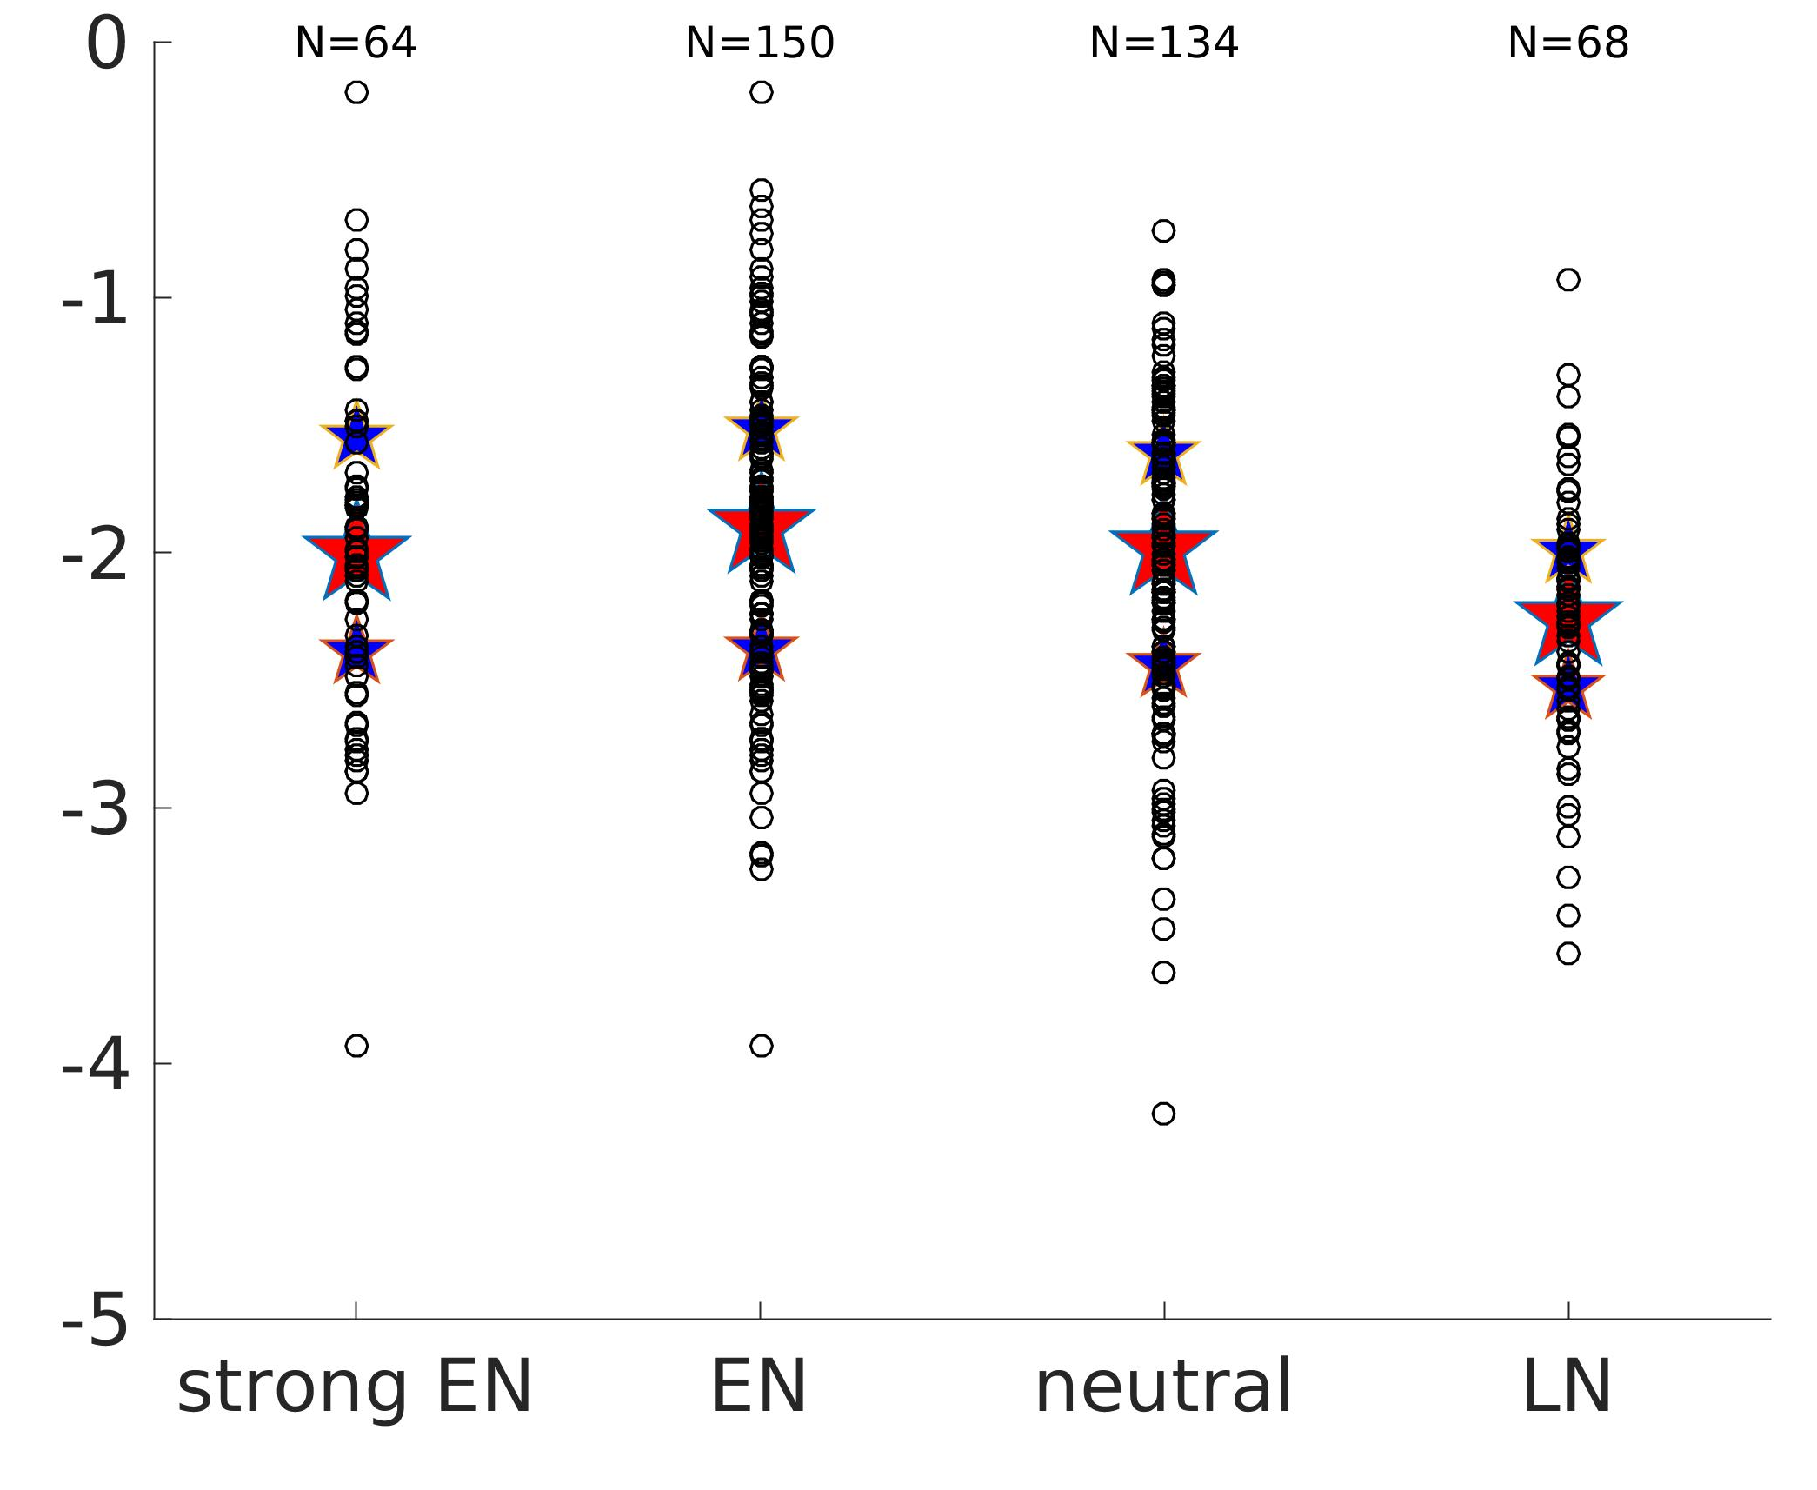
Multivariate ENSO Index
3-months cumulated phytoplankton primary production
75th percentile
Phytoplankton size slope during strong El Niño, moderate
El Niño, neutral and La Niña conditions.
median
25th percentile
benthos particulate organic carbon flux

Slide 2
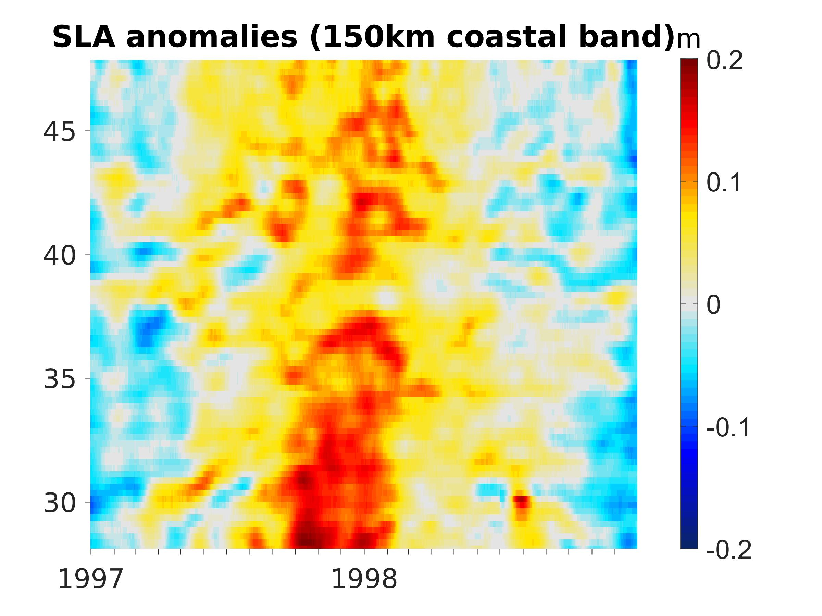
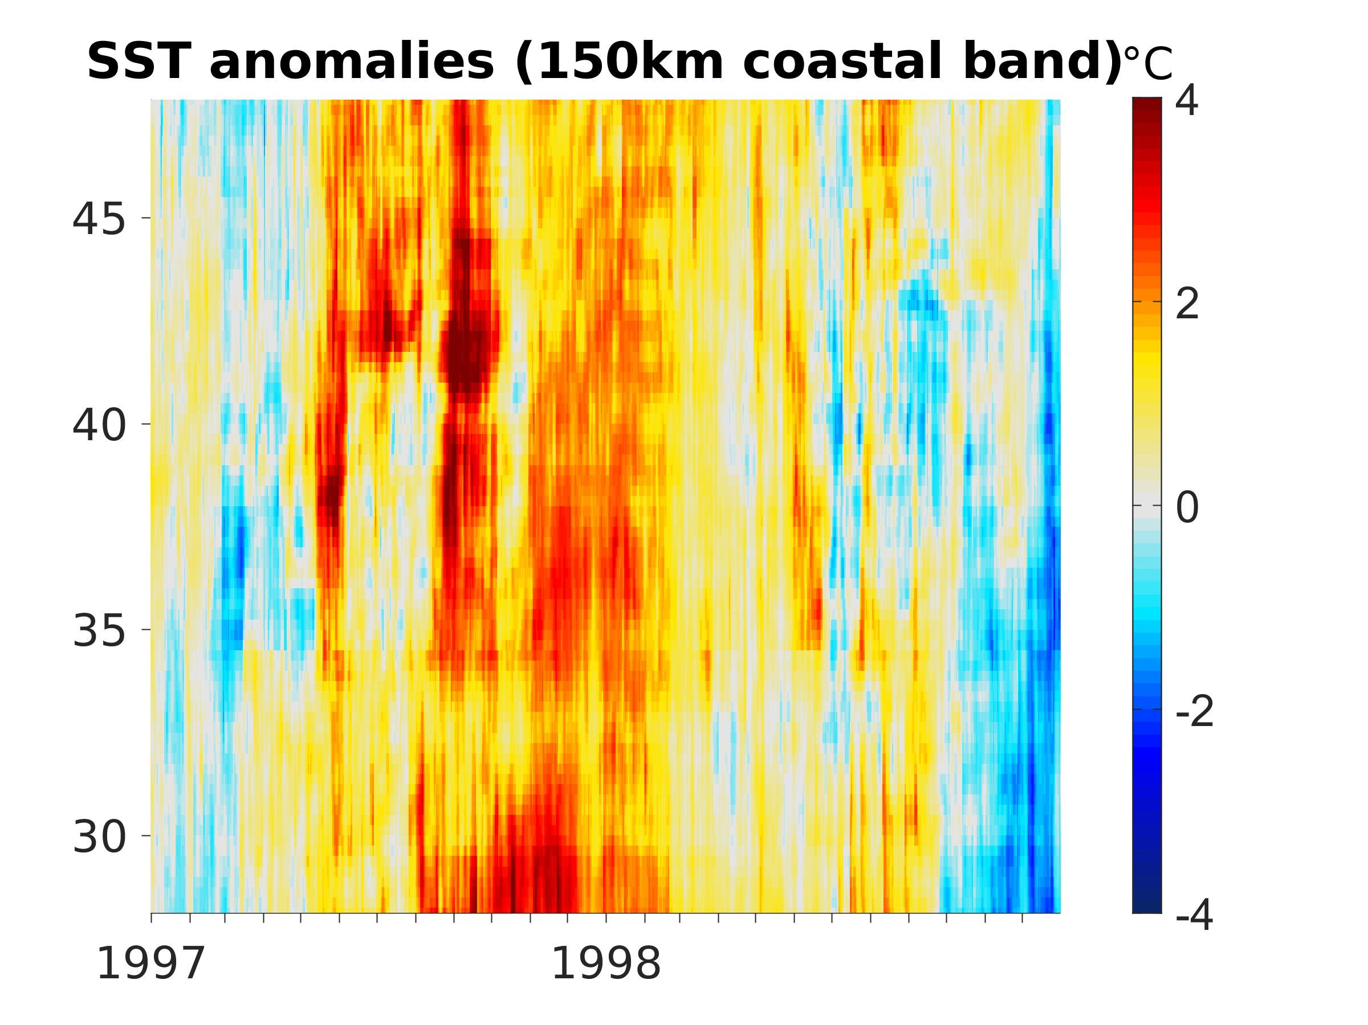
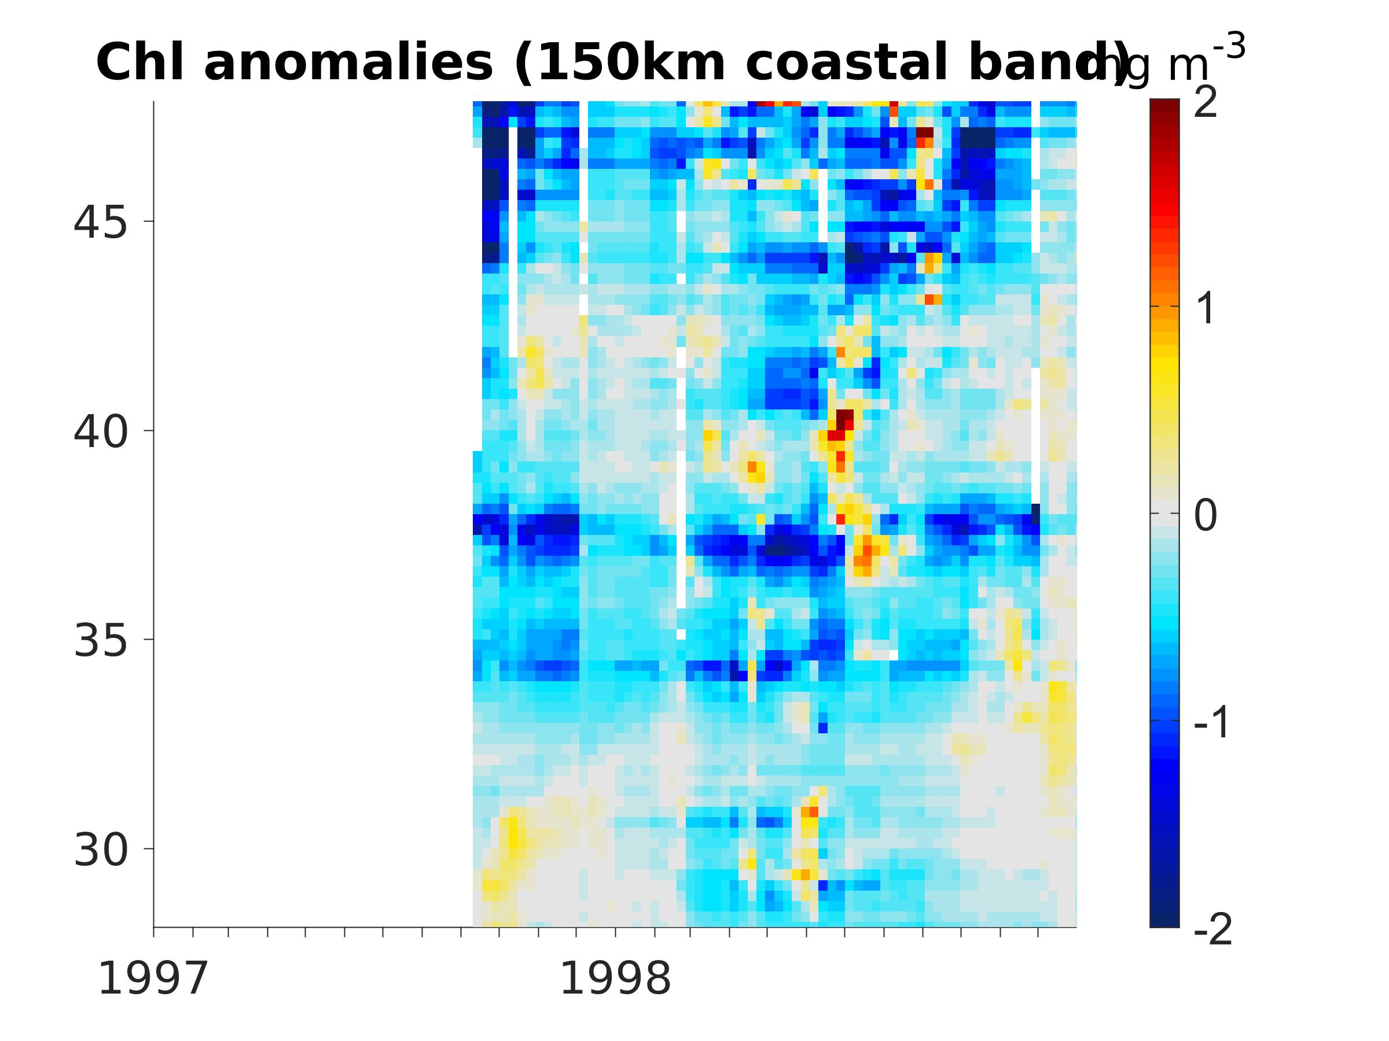
latitude

