Slide 1
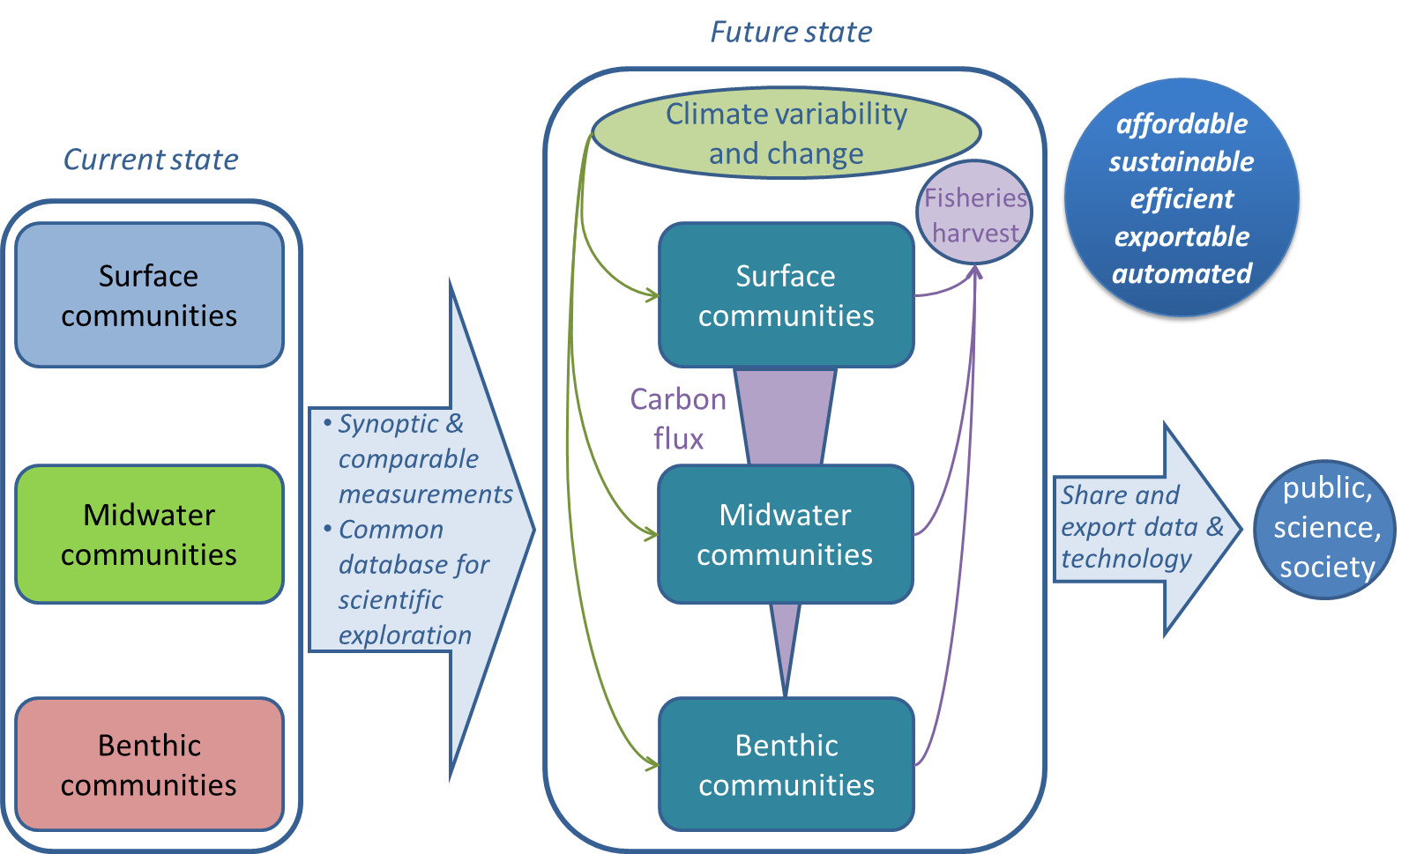
Integrating MBARI time series

Slide 2
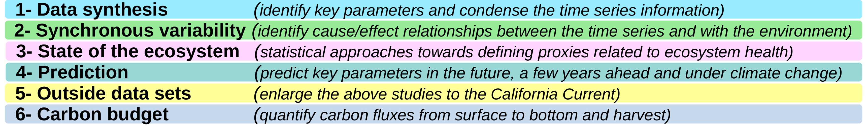
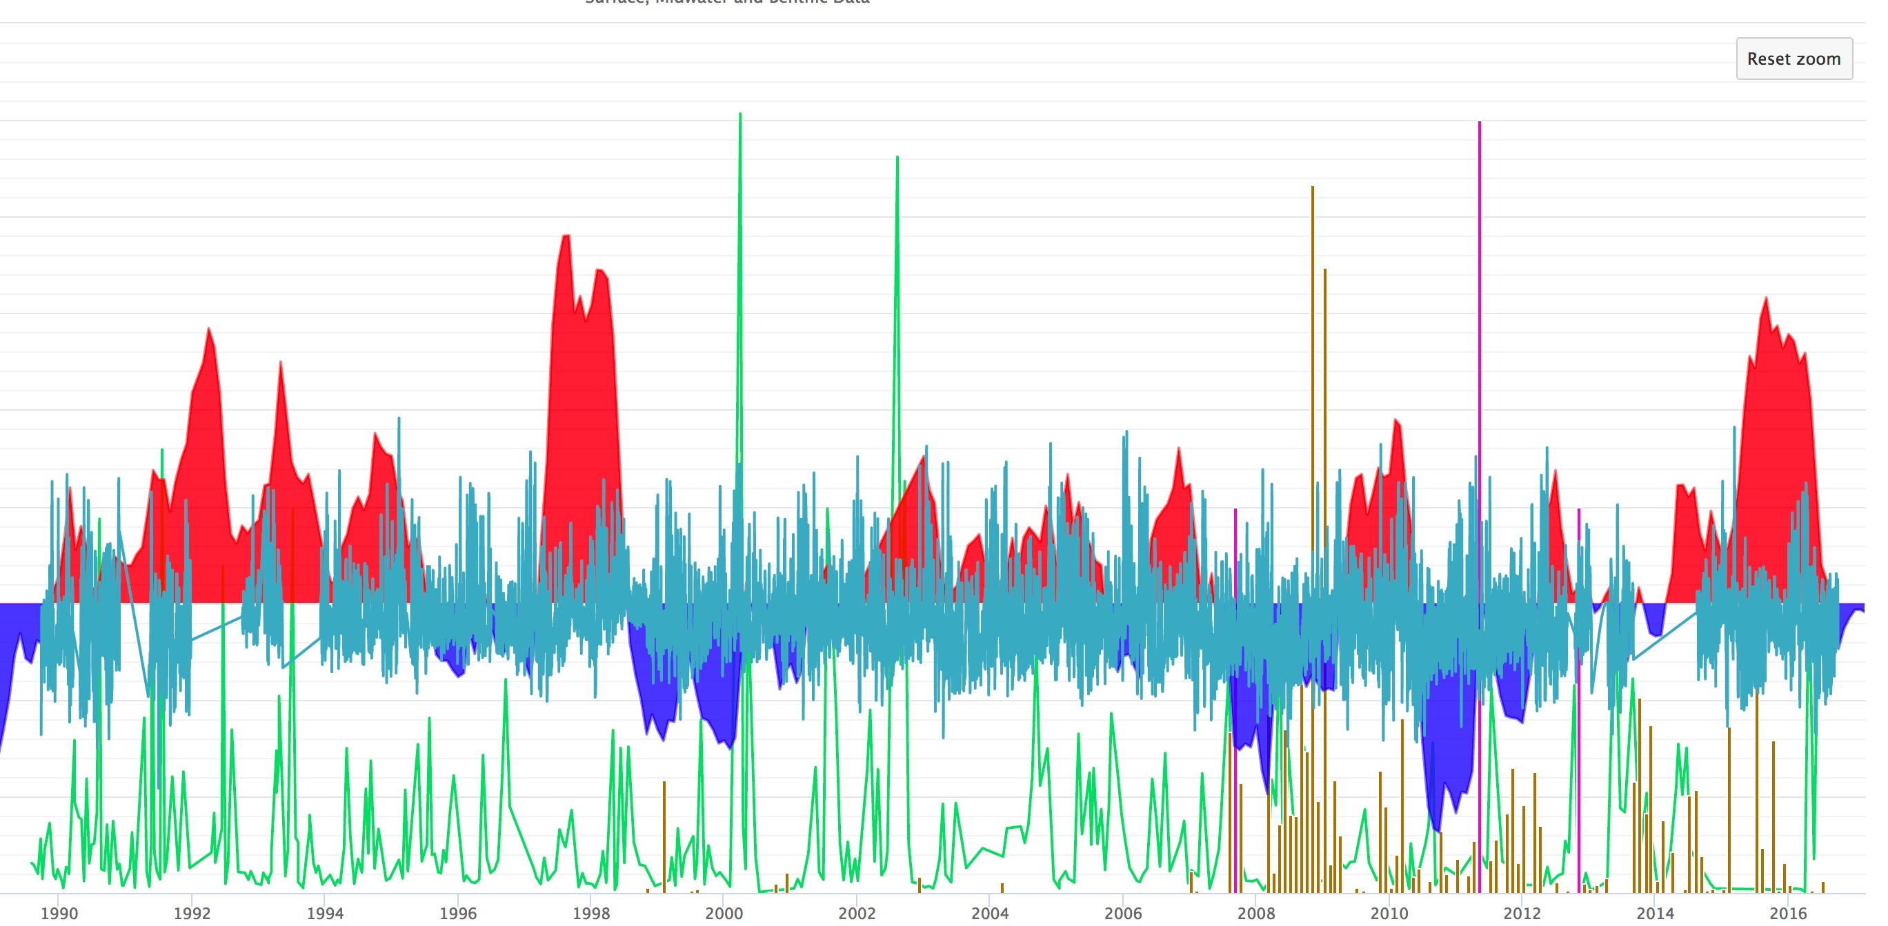
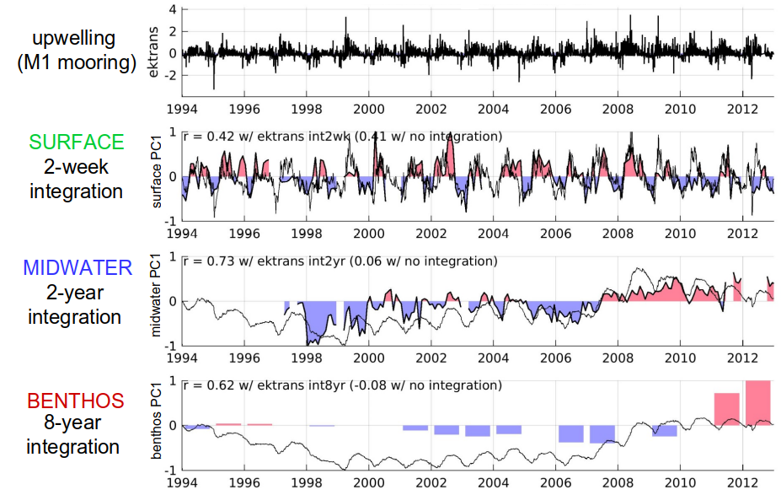
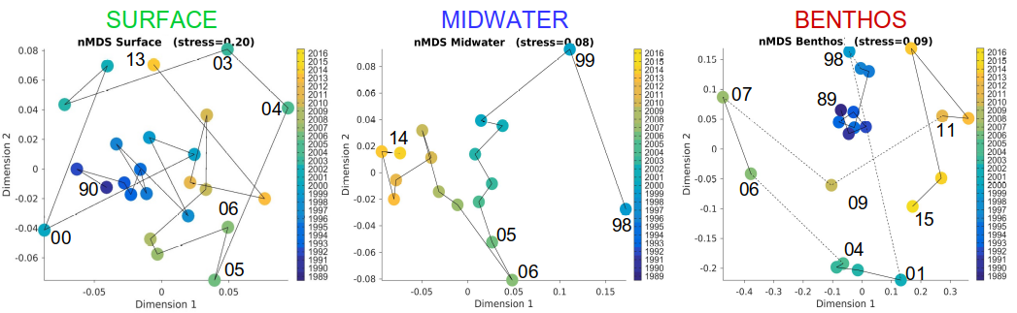
Integrating MBARI time series
The ITS project brings these datasets together in a common repository and explores links between them, presenting a unique opportunity to identify links and quantify carbon fluxes through the water column.
6 Goals: 2017 work developed analytical methods for state of ecosystem and expanded data synthesis, repository and visualization

Slide 3
Integrating MBARI time series
MBARI is supporting 3 time series– only place in the world where ecosystems and carbon fluxes have been monitored from top to bottom for decades (1989-present) :
  at the surface (F. Chavez),
  in the midwater (B. Robison),
  in the benthic boundary layer (K. Smith).
Establishing linkages between these time series is key to understanding long term climate change
Plans for 2018:
  Attempt to understand and communicate mechanisms for patterns discovered in ecosystem analyses
  Develop and refine state of ecosystem analyses
  Work with researchers to integrate external data and analytical methods into the data repository and visualization interface
  Define a strategy to derive a carbon budget of the water column to sea floor (i.e. identify gaps and strategies)

