Slide 1
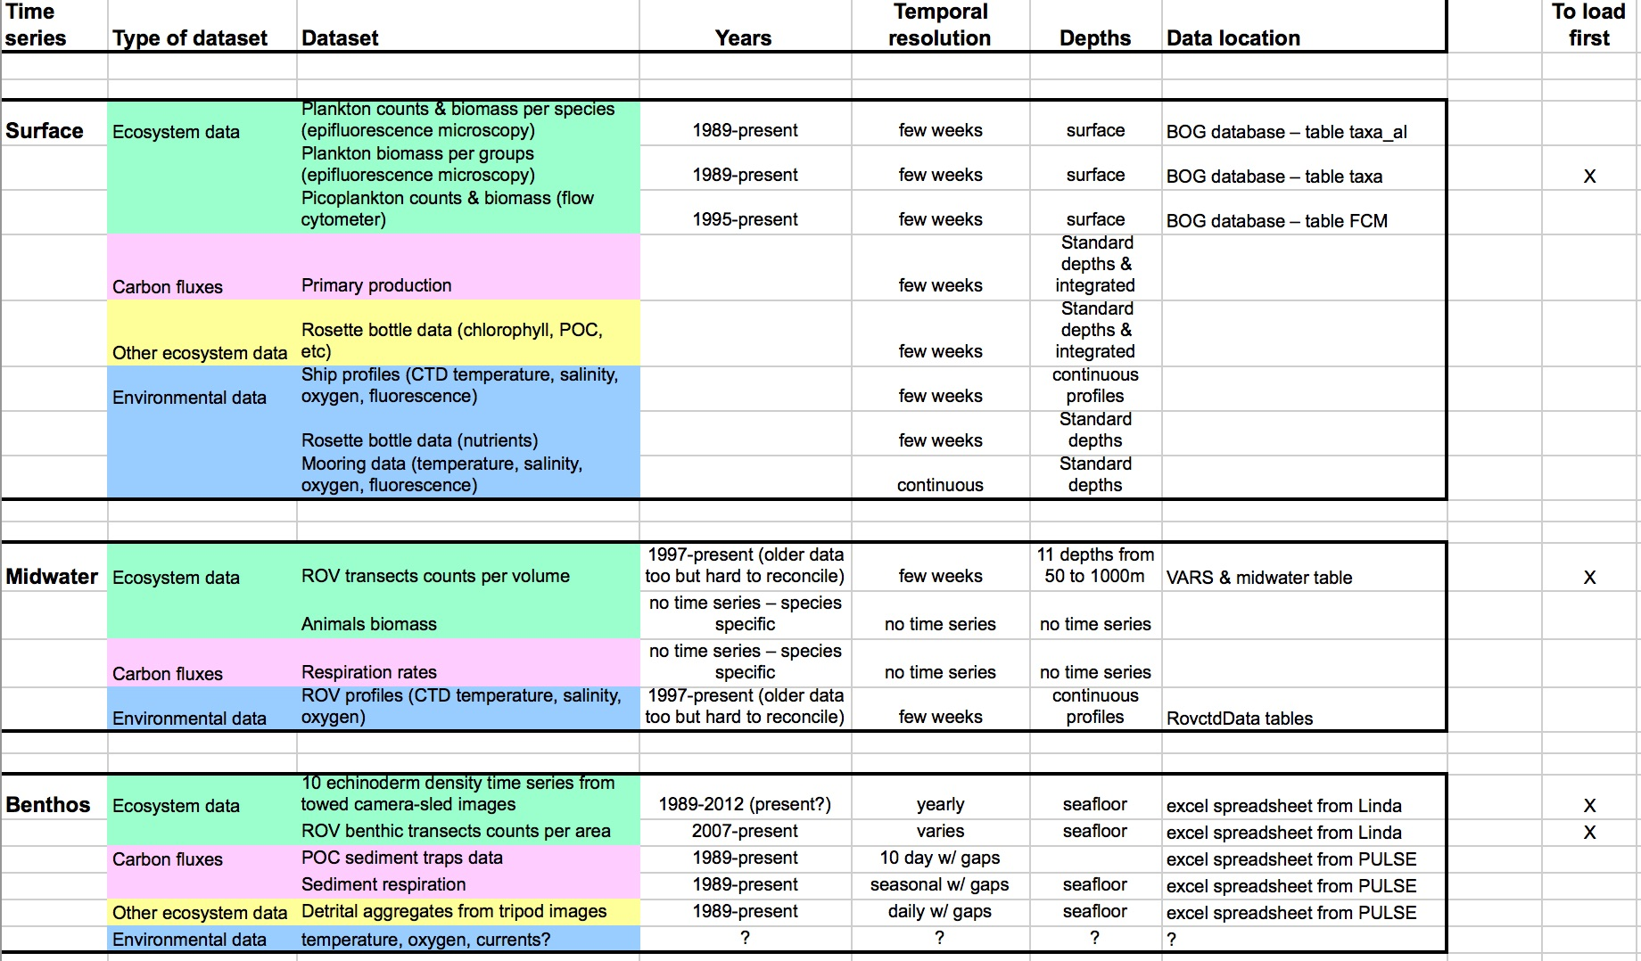
BOG
Midwater
VARS
Linda
Benthic XLS

Slide 2
BOG
Midwater
Java
MongoDB
VARS
Raw Data
Linda
Benthic XLS

Slide 3
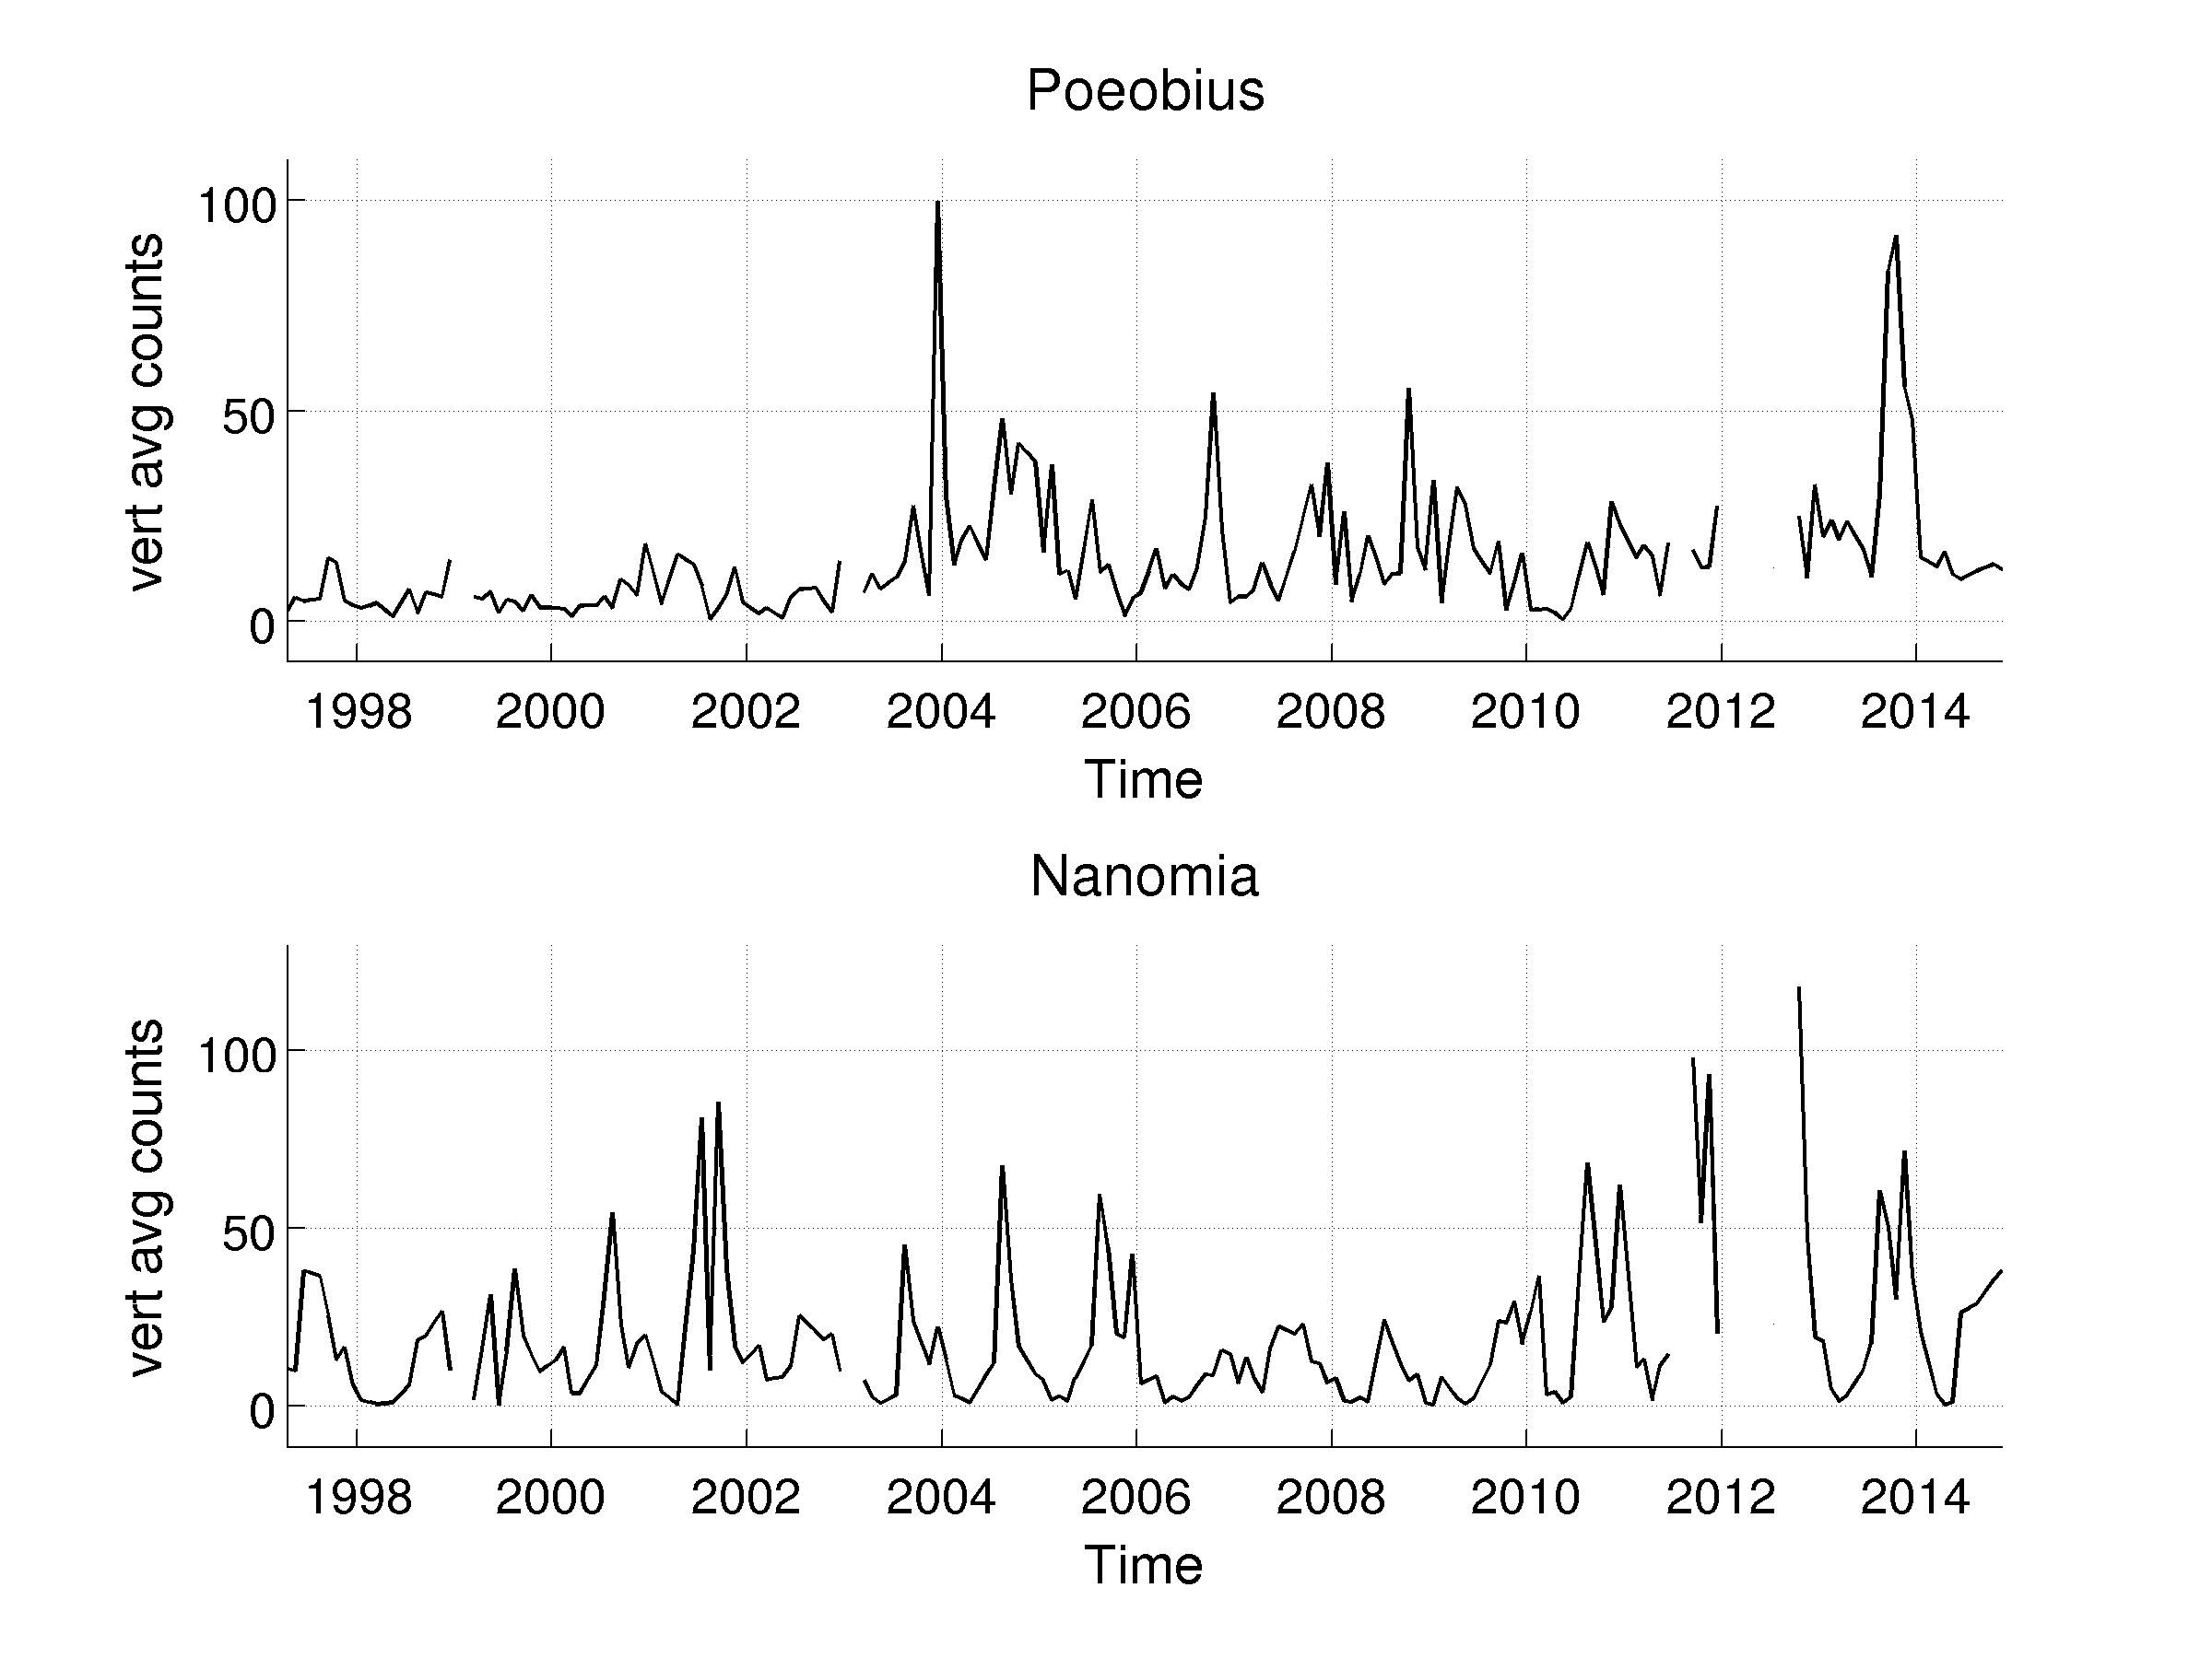
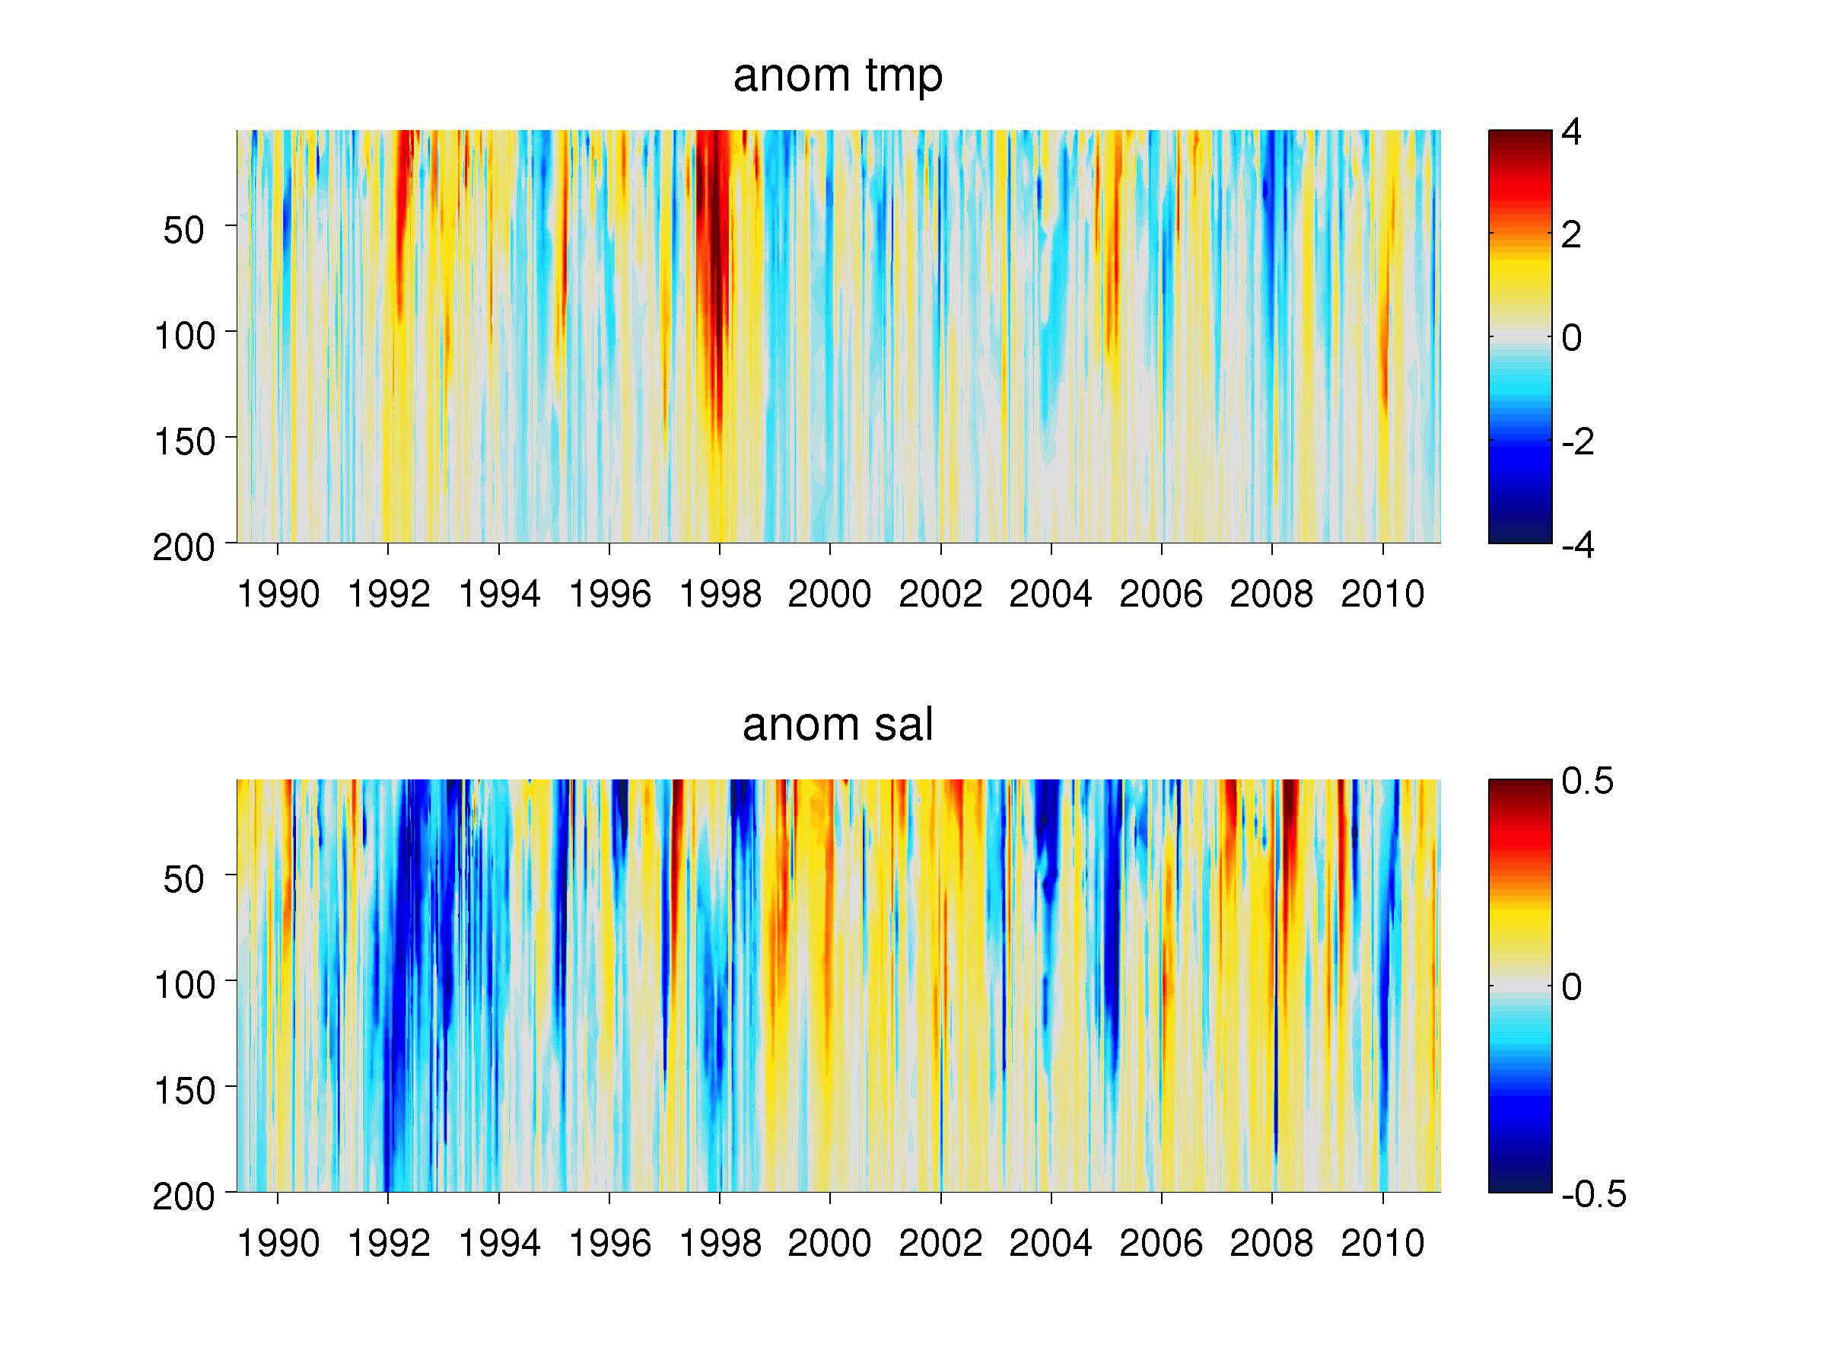
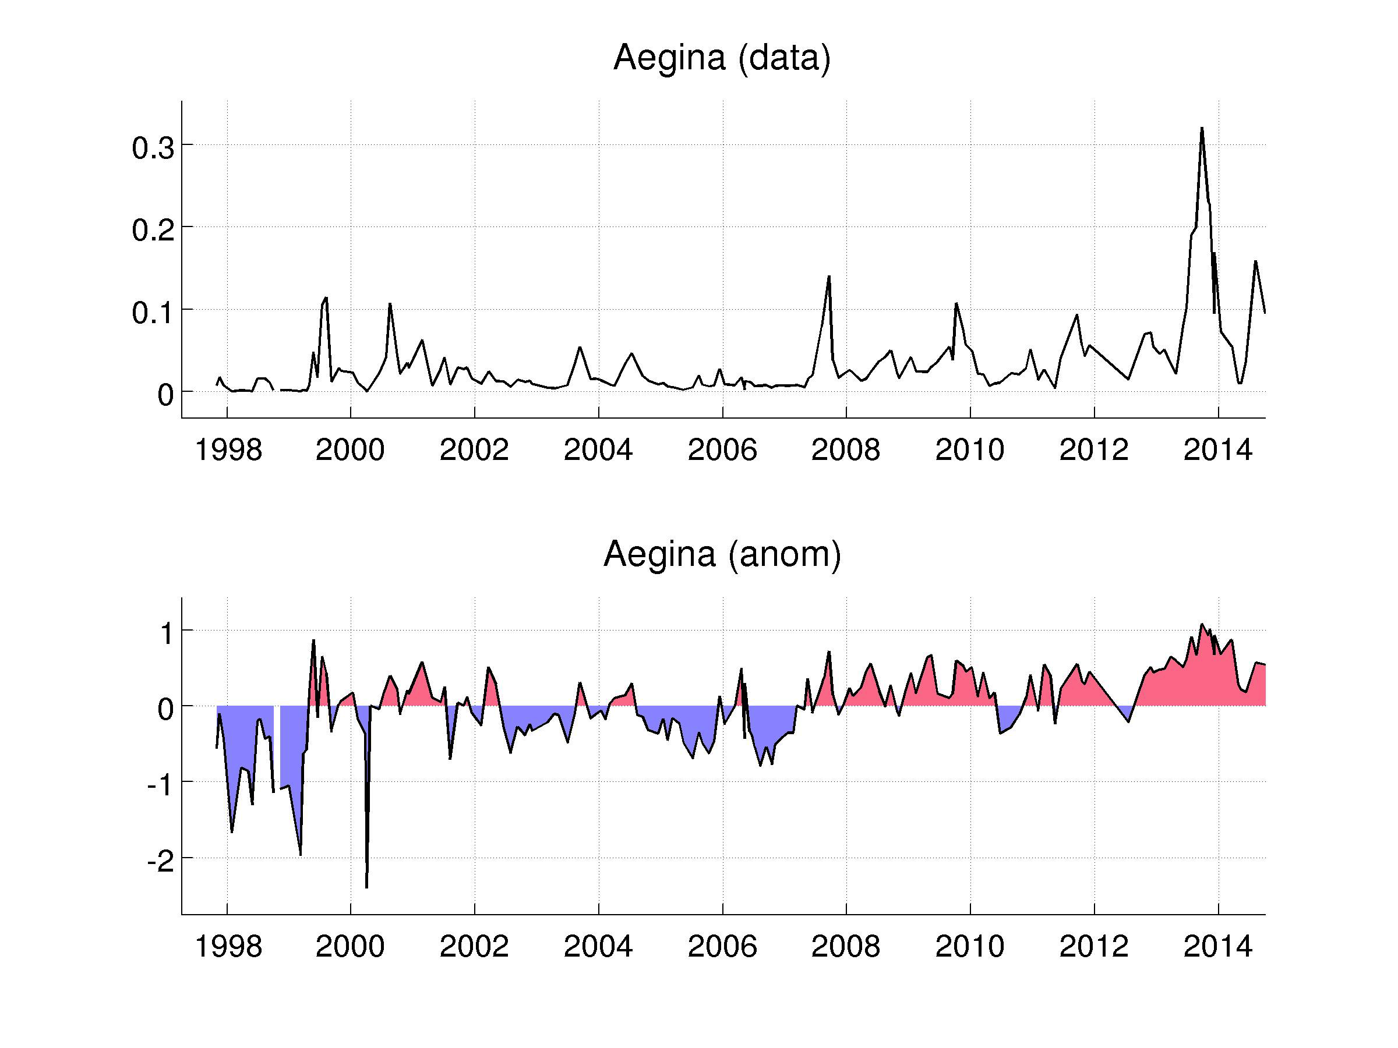
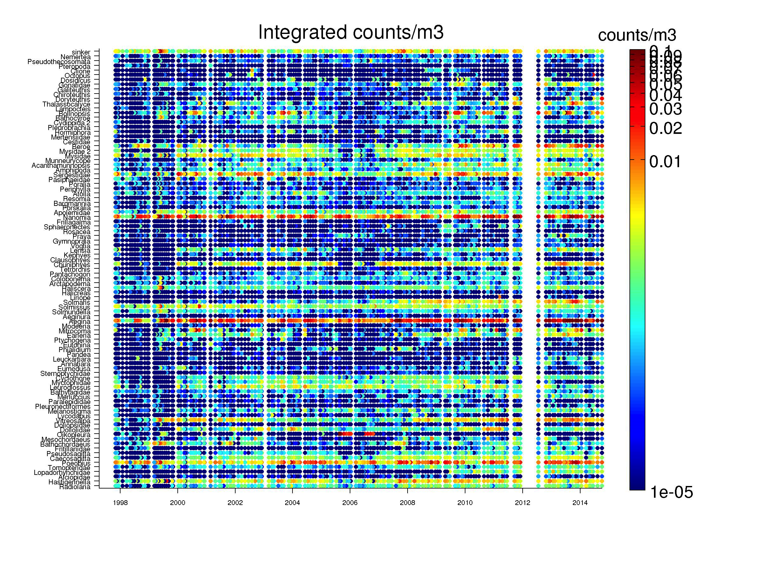

Slide 4
BOG
Midwater
Java
MongoDB
VARS
Raw Data
Linda
Aggregation/Map-Reduce
Benthic XLS
Counts By Month
Counts By Depth
.
.
.

Slide 5
BOG
Node
Server
External
Clients
HTTP
API
Midwater
Java
MongoDB
VARS
Raw Data
Linda
Aggregation/Map-Reduce
Benthic XLS
Counts By Month
Counts By Depth
.
.
.

Slide 6
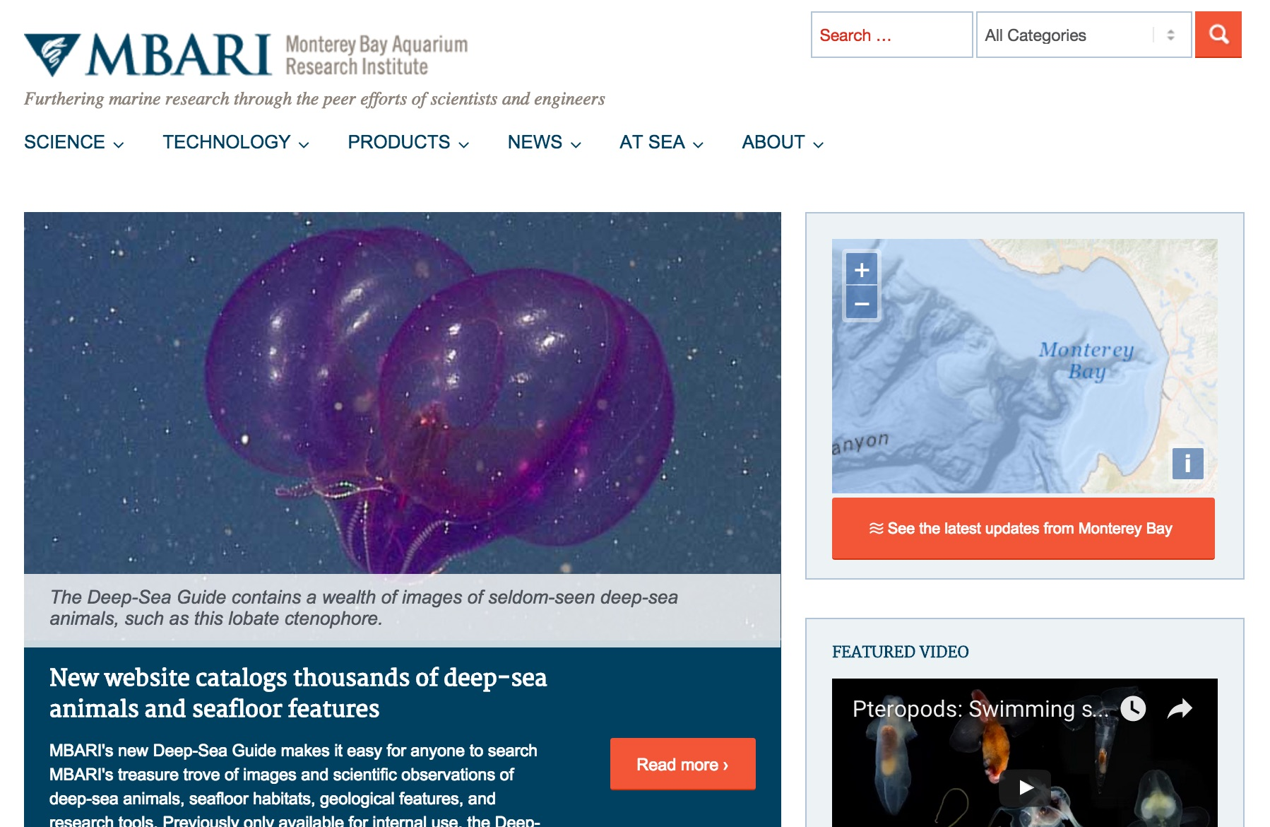
BOG
Node
Server
External
Clients
HTTP
API
Midwater
Java
MongoDB
MBARI WordPress
VARS
Web App
Raw Data
Linda
Aggregation/Map-Reduce
Benthic XLS
Counts By Month
Counts By Depth
.
.
.

Slide 7
BOG
Node
Server
External
Clients
HTTP
API
Midwater
Java
MongoDB
MBARI WordPress
VARS
Web App
Raw Data
Linda
Aggregation/Map-Reduce
Benthic XLS
Counts By Month
Counts By Depth
Mooring
ROVCTD
.
.
.

Slide 8
Working Towards Carbon

