Slide 1
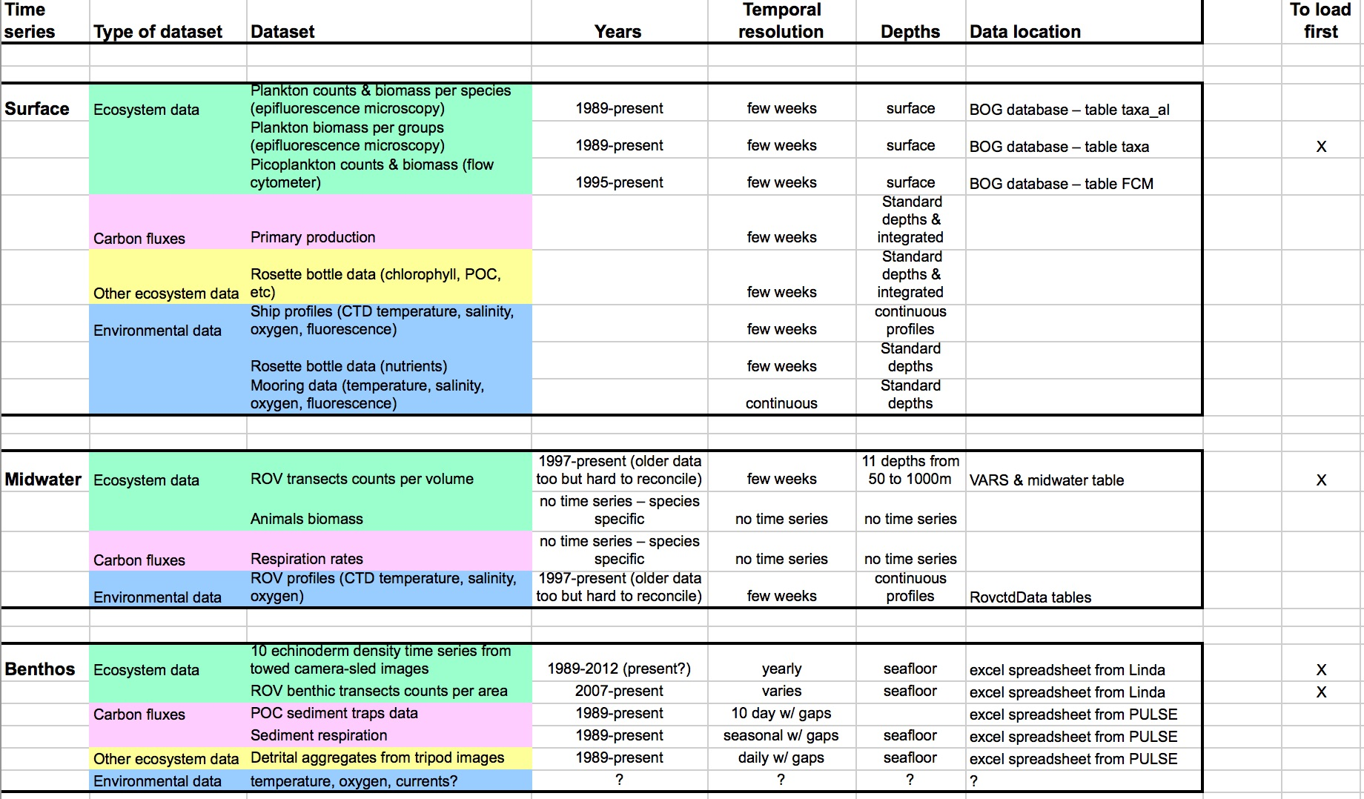
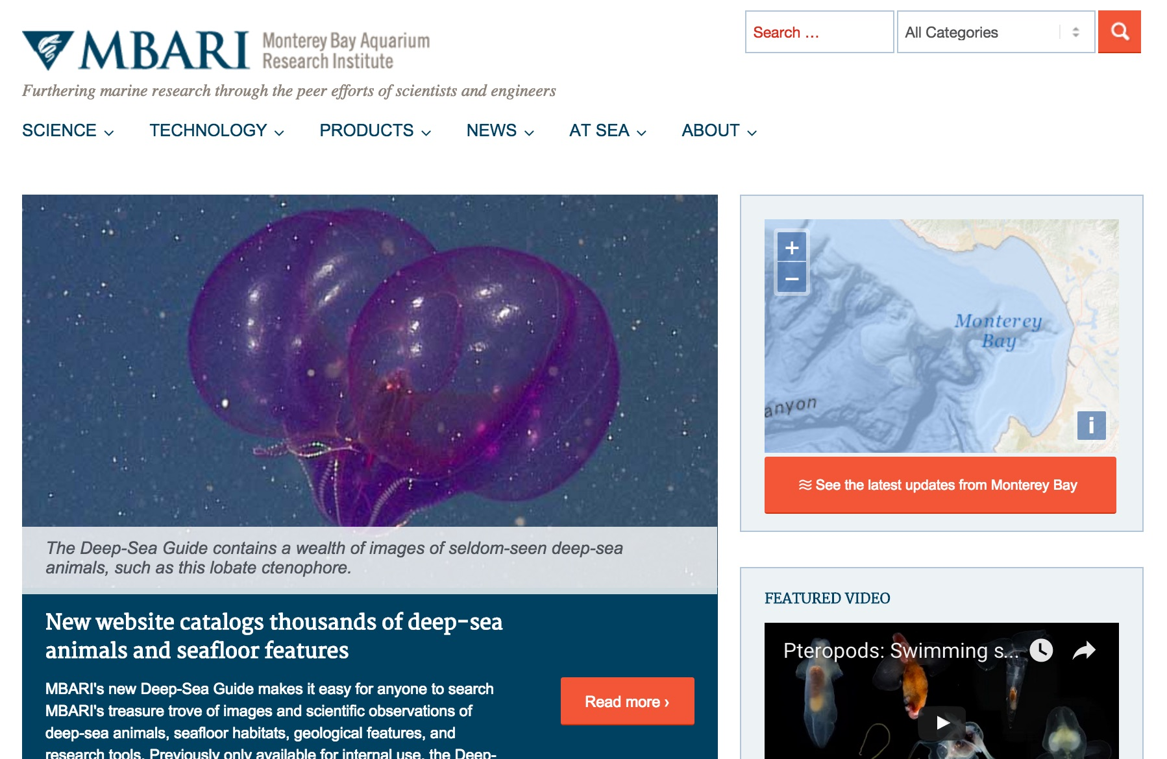
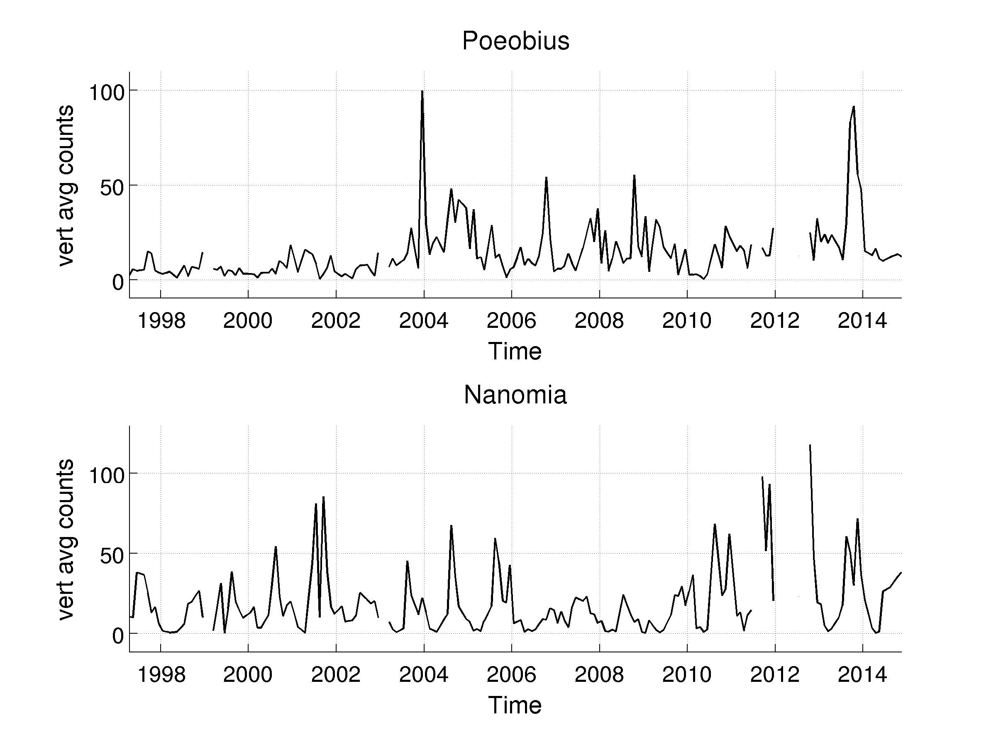
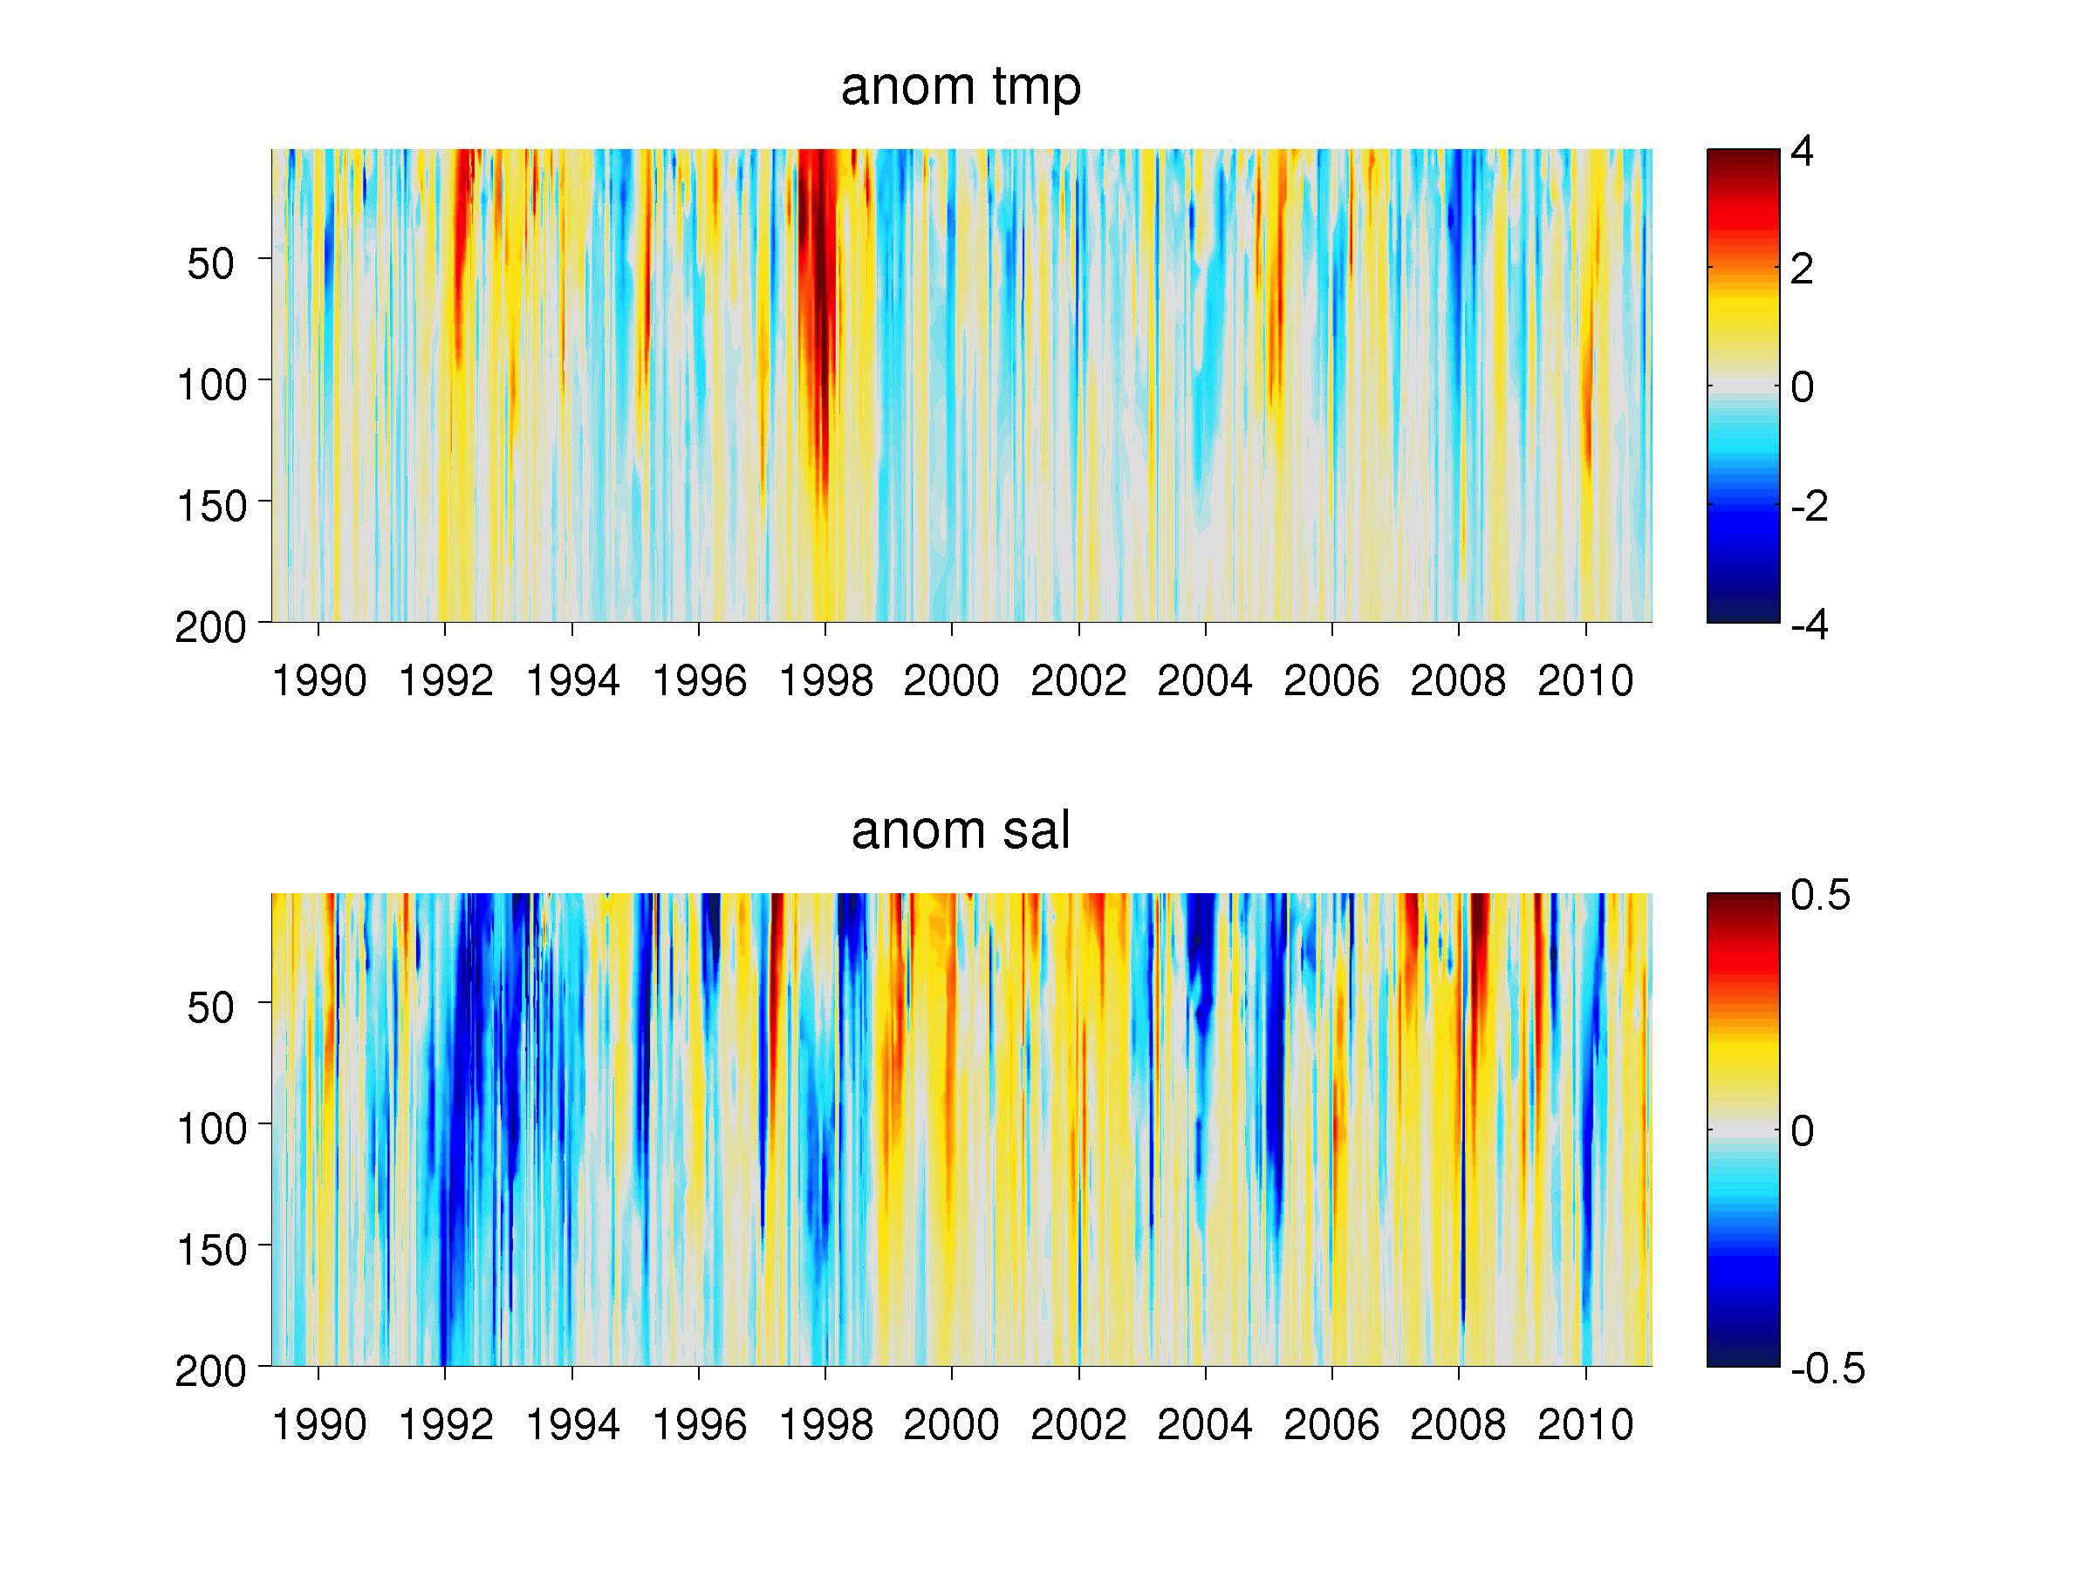
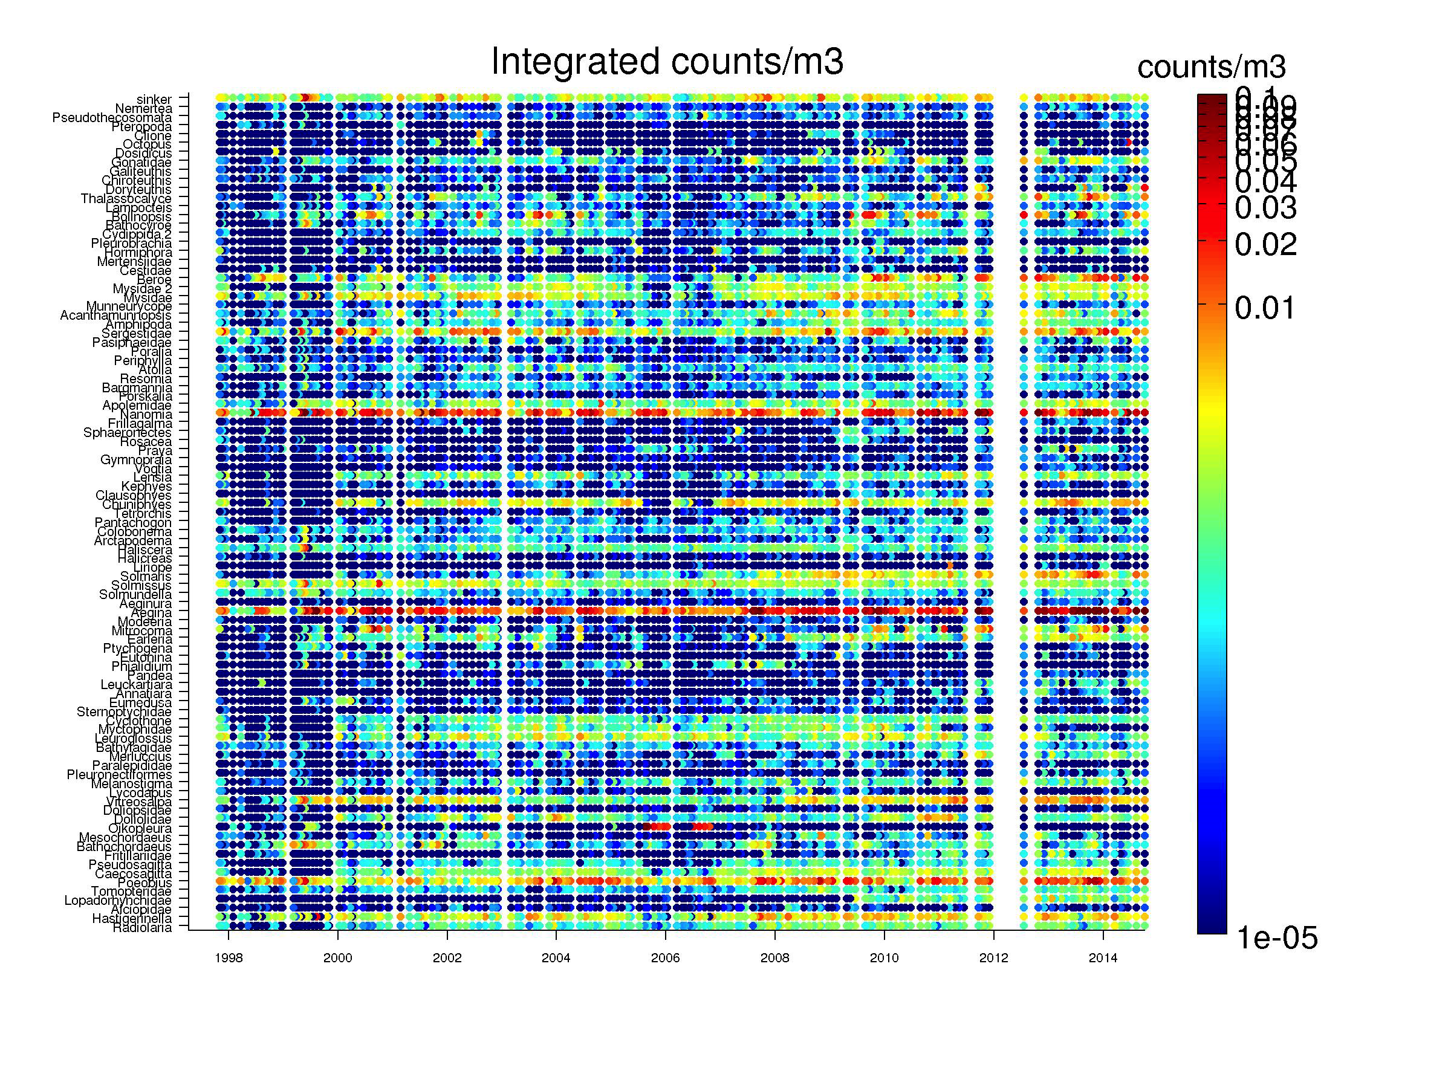
BOG
Node
Server
External
Clients
HTTP
API
Midwater
Java
MongoDB
MBARI WordPress
VARS
Web App
Raw Data
Linda
Aggregation/Map-Reduce
Benthic XLS
Counts By Month
Counts By Depth
Mooring
ROVCTD
.
.
.

Slide 2
BOG
Node
Server
External
Clients
HTTP
API
Midwater
Java
MongoDB
MBARI WordPress
VARS
Web App
Raw Data
Linda
Aggregation/Map-Reduce
Benthic XLS
Counts By Month
Counts By Depth
Mooring
ROVCTD
.
.
.

Slide 3
BOG
Node
Server
External
Clients
HTTP
API
Midwater
Java
MongoDB
MBARI WordPress
VARS
Web App
Raw Data
Linda
Aggregation/Map-Reduce
Benthic XLS
Counts By Month
Counts By Depth
Mooring
ROVCTD
.
.
.

Slide 4
BOG
Node
Server
External
Clients
HTTP
API
Midwater
Java
MongoDB
MBARI WordPress
VARS
Web App
Raw Data
Linda
Aggregation/Map-Reduce
Benthic XLS
Counts By Month
Counts By Depth
Mooring
ROVCTD
.
.
.

Slide 5
BOG
Node
Server
External
Clients
HTTP
API
Midwater
Java
MongoDB
MBARI WordPress
VARS
Web App
Raw Data
Linda
Aggregation/Map-Reduce
Benthic XLS
Counts By Month
Counts By Depth
Mooring
ROVCTD
.
.
.

Slide 6
BOG
Node
Server
External
Clients
HTTP
API
Midwater
Java
MongoDB
MBARI WordPress
VARS
Web App
Raw Data
Linda
Aggregation/Map-Reduce
D3?
Benthic XLS
Other?
Matlab, Octave,
R?
Counts By Month
Counts By Depth
User Data
Mooring
ROVCTD
.
.
.

