Slide 1
ITS data synthesis:
El Niño 1997-98 study
ITS data team – Crissy, Rob, Kevin, Duane, Anela, Tim, Monique
3 data synthesis meetings so far

Slide 2
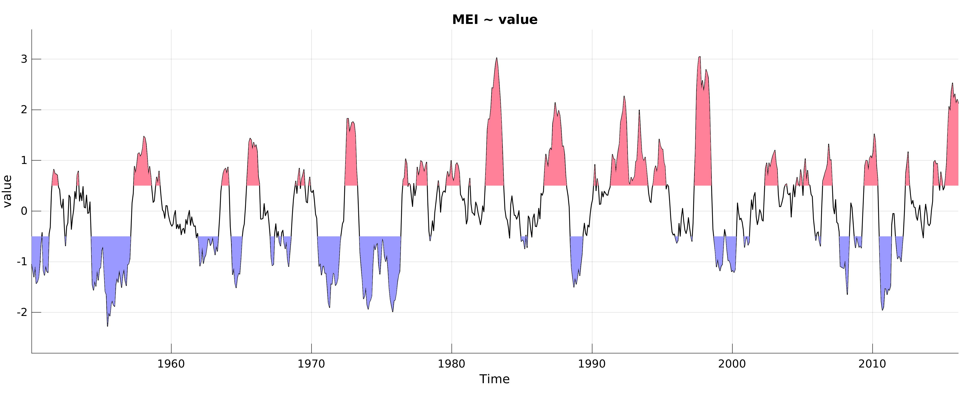
Multivariate ENSO Index (MEI)
Based on 6 variables: SLP, zonal & meridional wind, SST, air temperature, cloudiness.
Monthly from 1950-present.

Slide 3
El Niño 1997-98 study
3 research themes:
Changes during El Niño / La Niña: food supply
  Is there a difference in food supply between El Niño / La Niña?
Changes during El Niño / La Niña: timing
  How do changes propagate across the system?
Community structure and change
  How can we define the types of ecosystems observed; are changes consistent across the 3 time series? (related to ENSO or not)

Slide 4
1) Changes during El Niño / La Niña: food supply
Is there a difference in food supply between El Niño / La Niña?
Plankton size spectrum: plankton size in El Niño vs. La Niña vs. neutral conditions
Primary production (base of the food chain)
Investigating good/bad years for midwater particle feeders
Salps datasets – in progress

Slide 5
BOG plankton counts
Sample analyzed by epifluorescence microscopy
Plankton species identified and sized
Volume computed based on shape & dimensions
Carbon per cell computed from volume & group-specific relationships
Spherical diameter = [(volume * 3/(4π))^{1/3}]*2

Slide 6
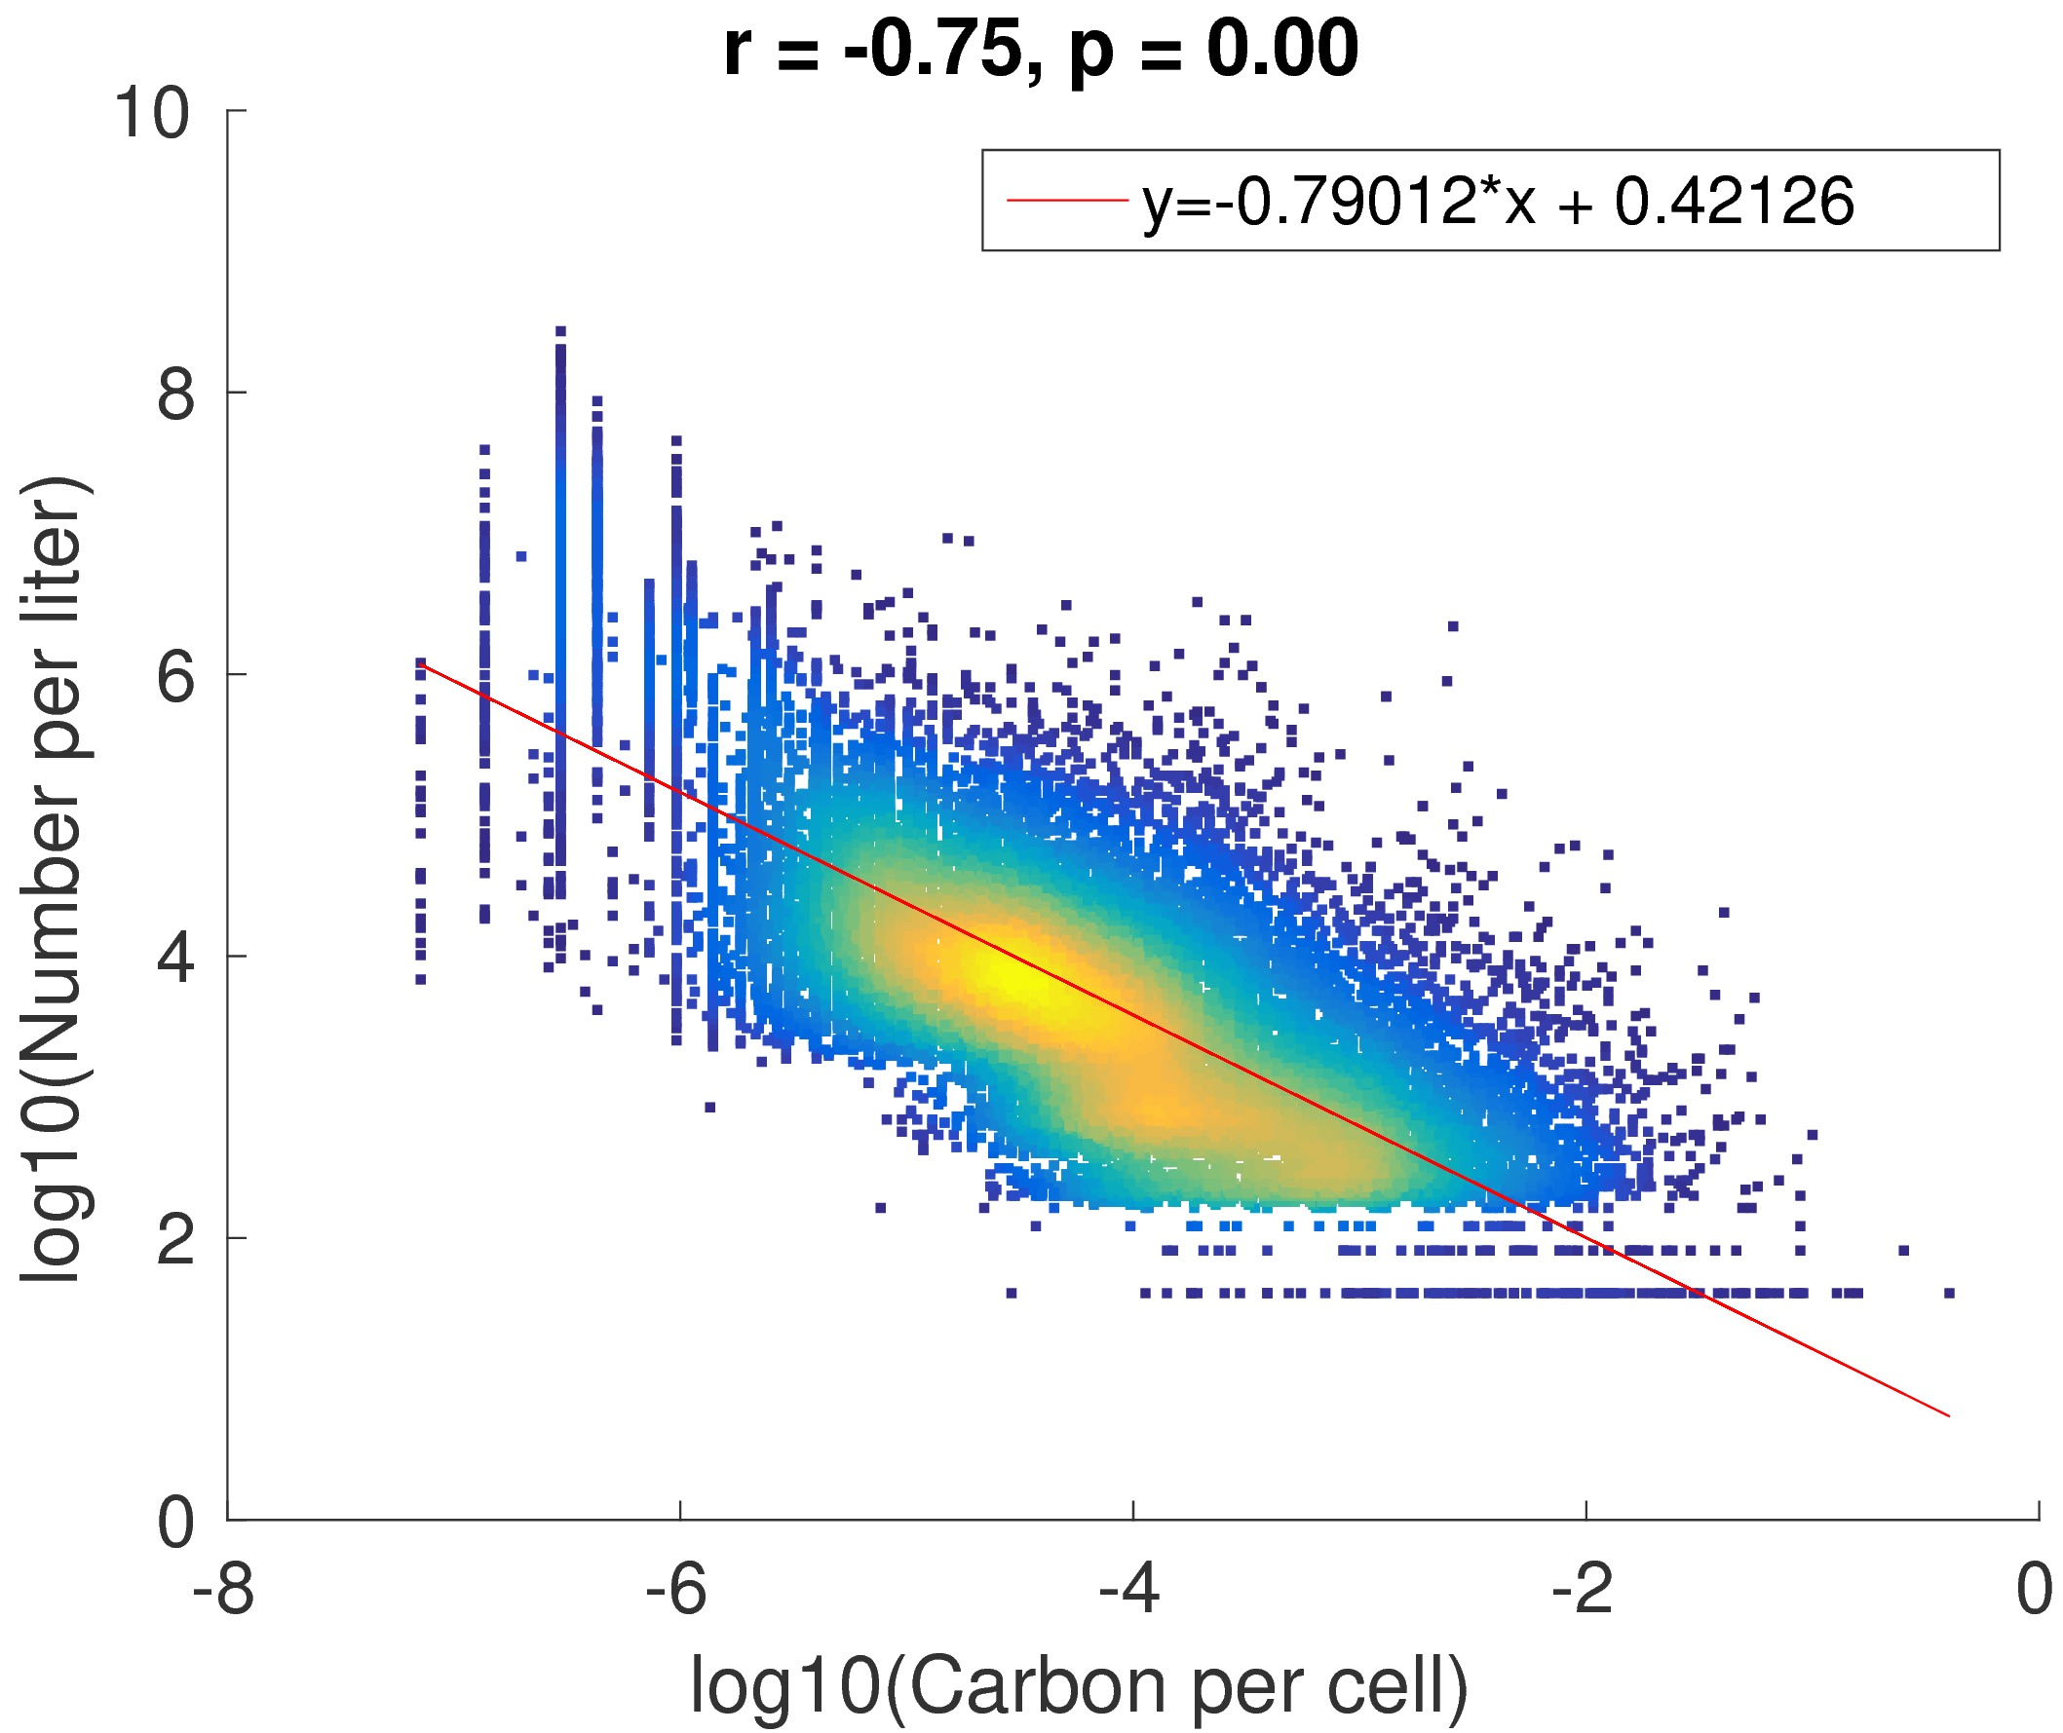
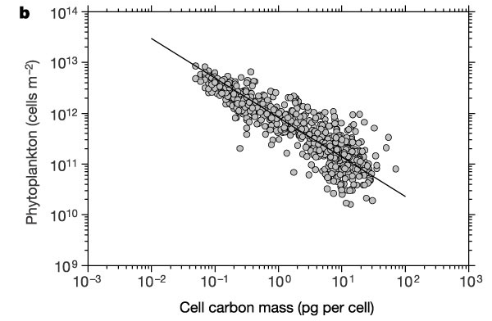
Plankton size spectrum: relation size/concentration
¾ power law: metabolic rate proportional to M^¾ where M = body mass
-> number of cells that can be supported by a rate of resource
supply proportional to M^(-¾)
Li et al., Nature 2002 (North Atlantic)
log N = - 0.78 log(C) + cste
BOG time series
log N = -0.79 log(C) + cste

Slide 7
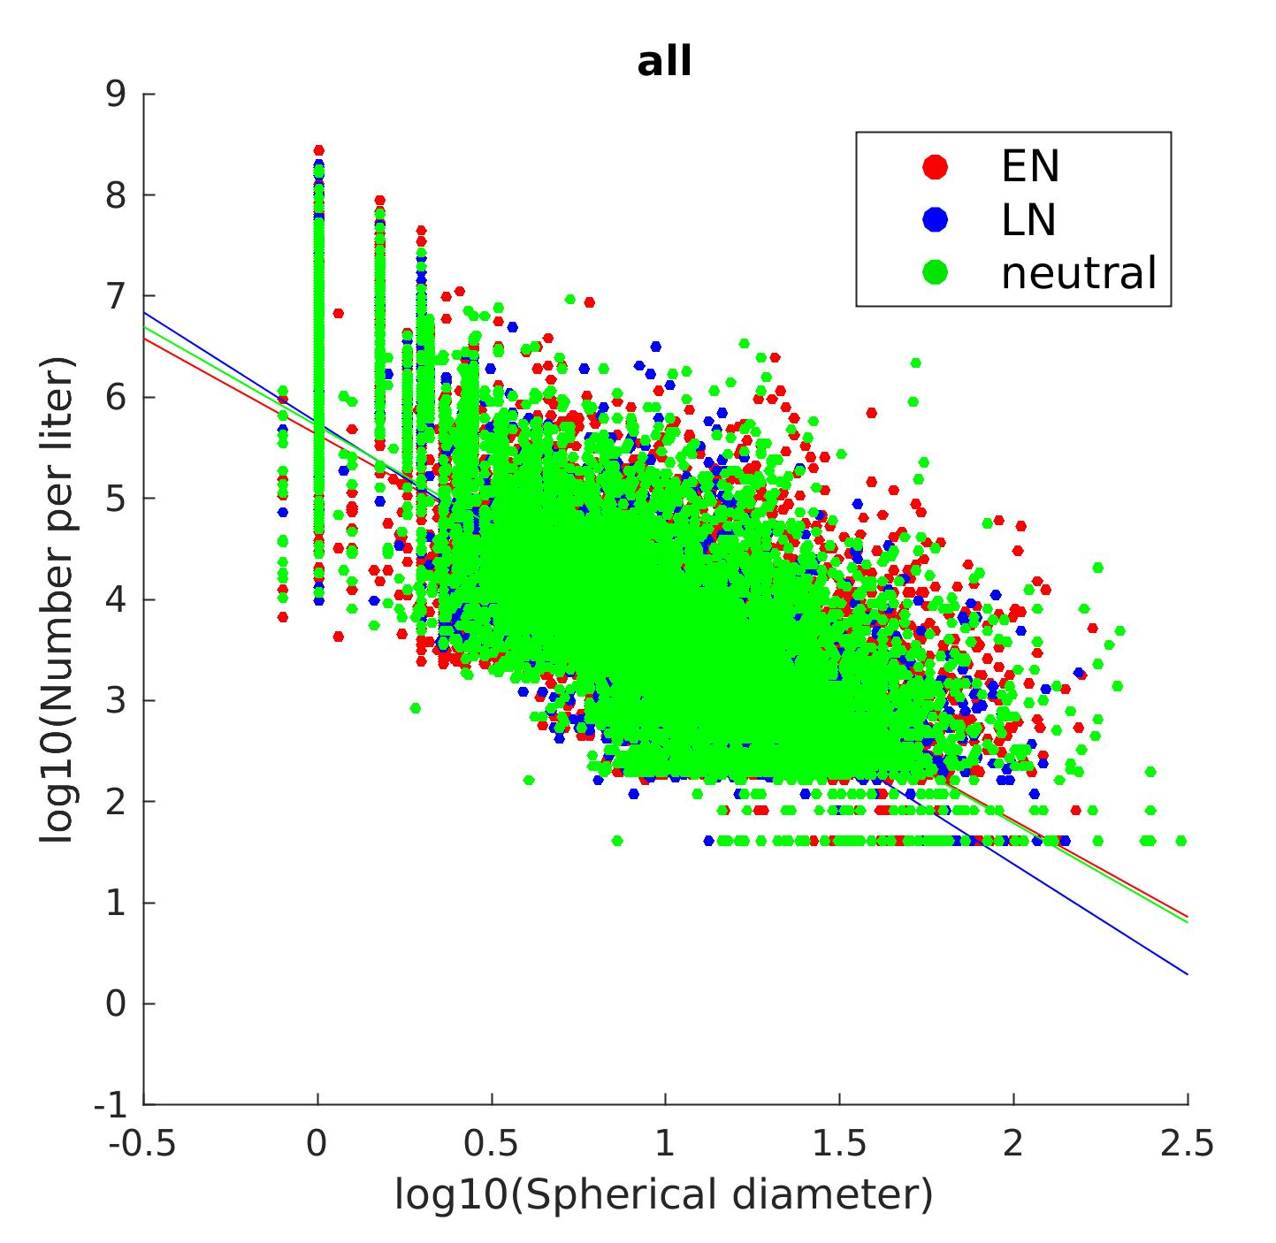
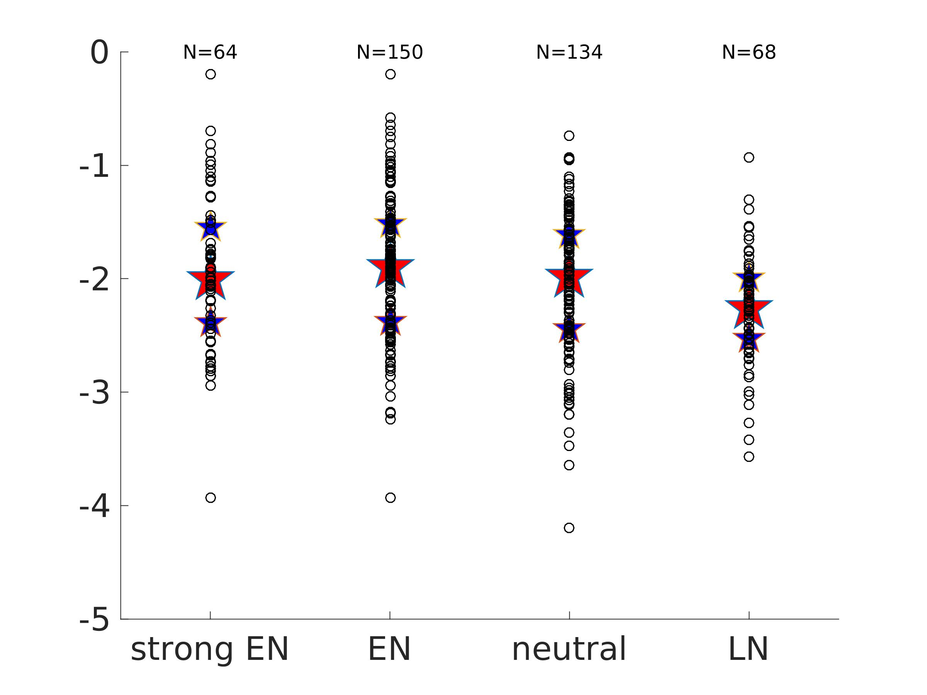
Size spectrum slope:
El Niño / La Niña / neutral conditions
Slopes for individual samples based on concurrent MEI values.
75th percentile
median
25th percentile
No significant differences.
MEI

Slide 8
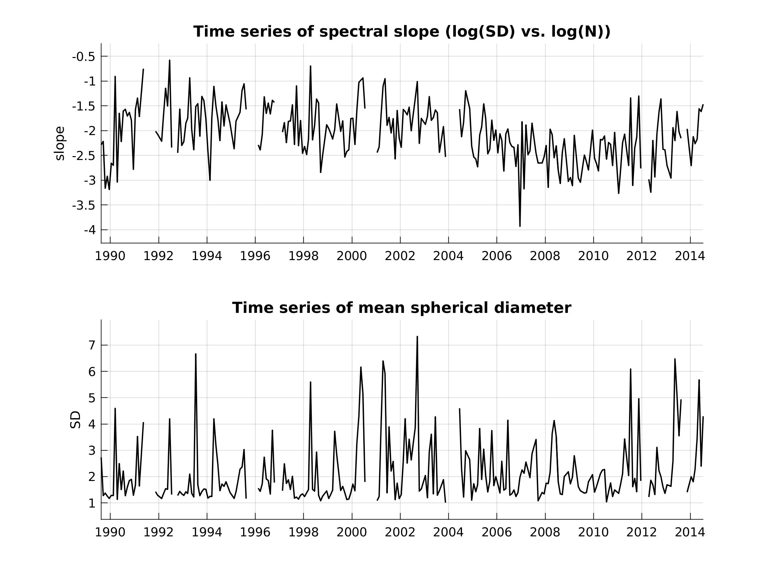
Size spectrum time series
No link with El Niño

Slide 9
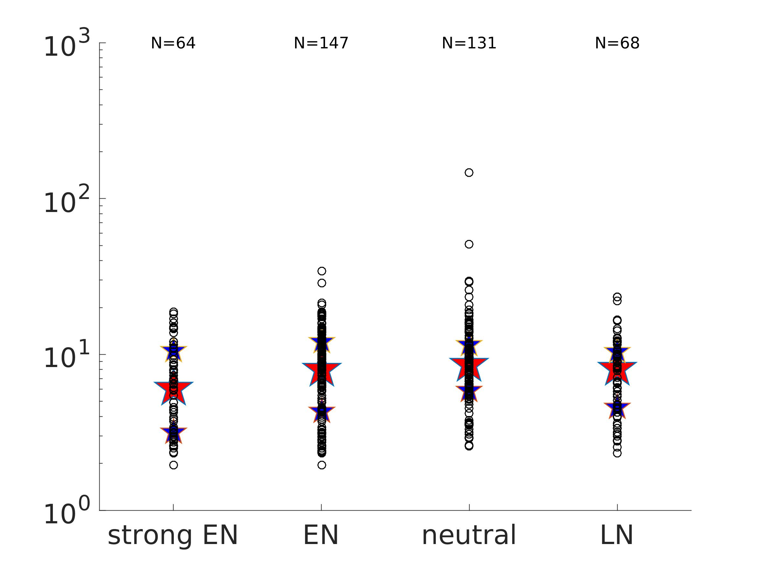
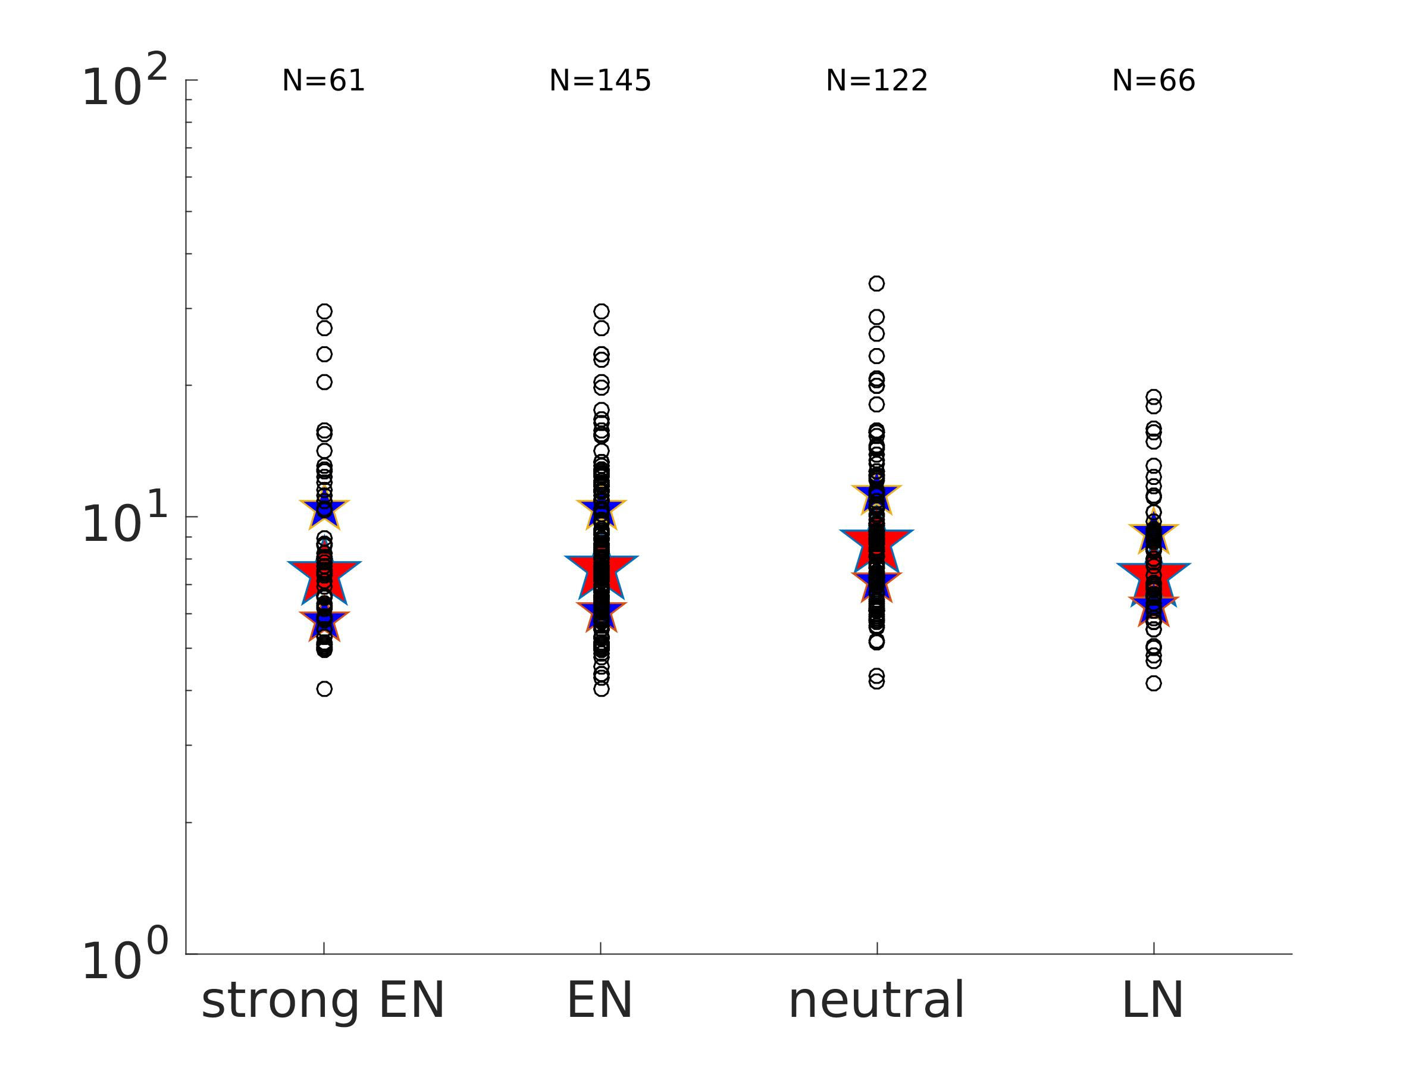
Plankton size per group
Centric diatoms
Autotrophic dinos
spherical diameter
Smaller cells for El Niño (and La Niña), but difference not significant.

Slide 10
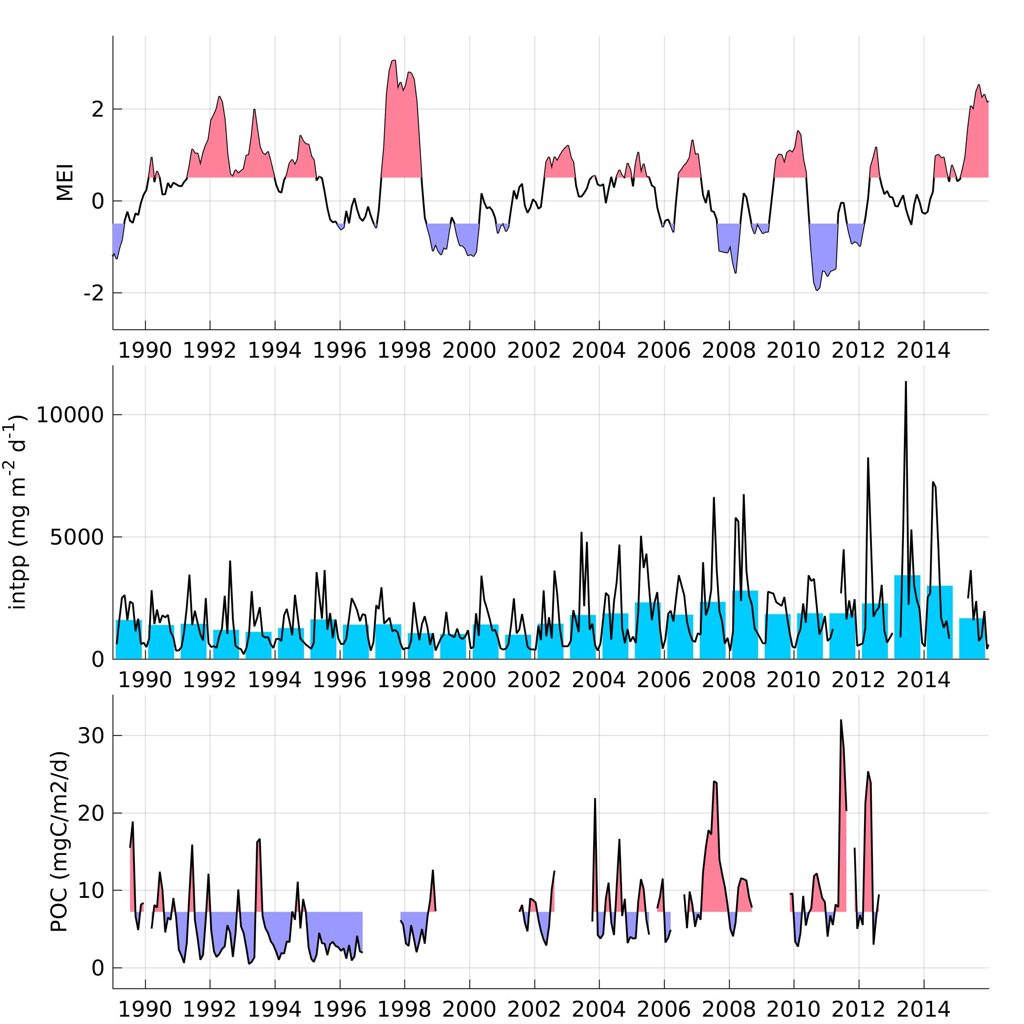
Primary production & carbon flux
MEI
Integrated primary production
POC
correlation PP / POC = 0.58 (yearly).

Slide 11
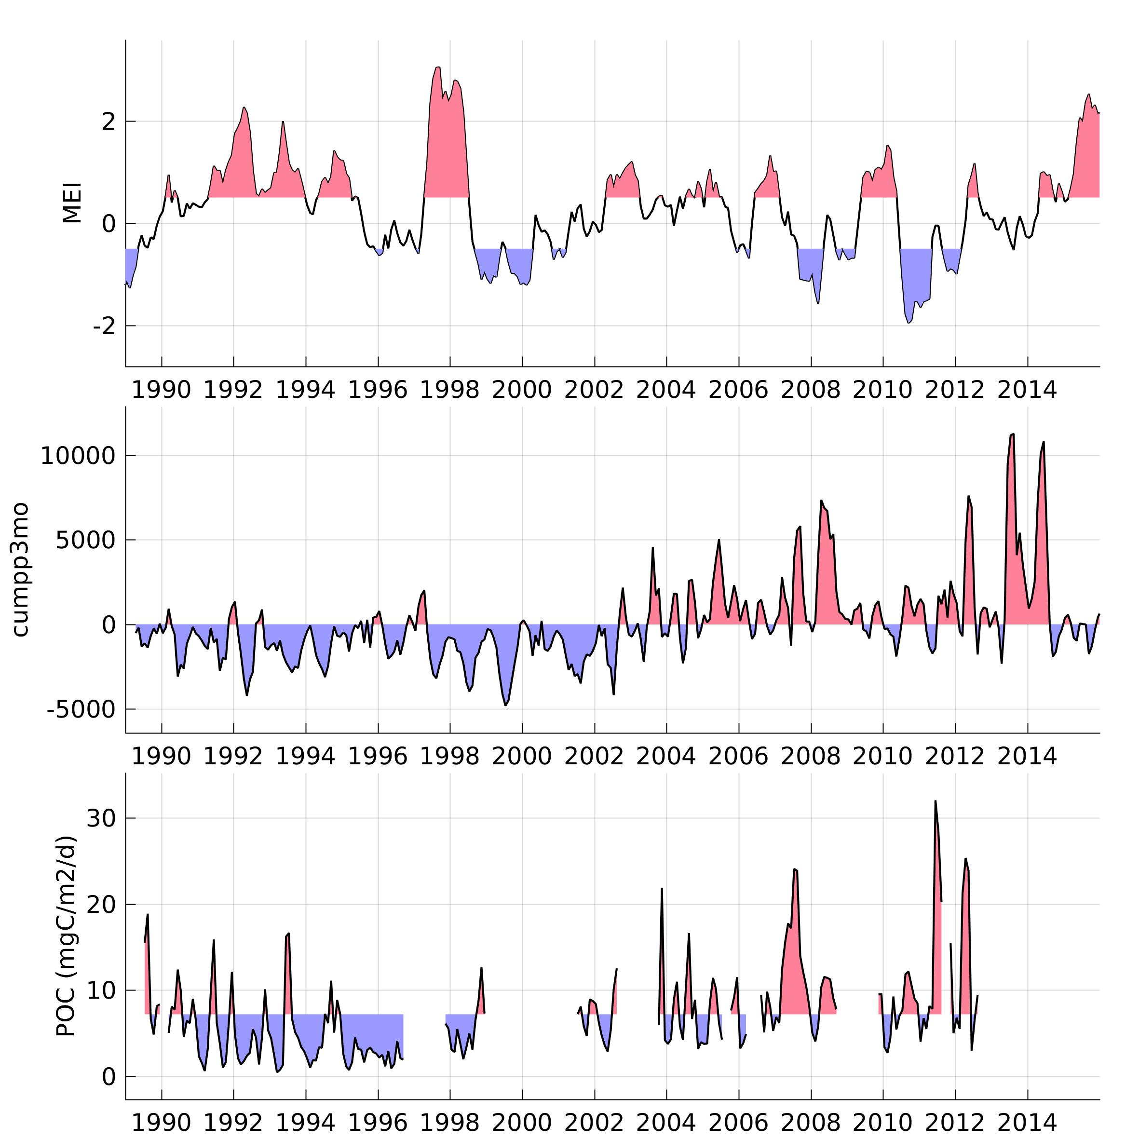
Primary production & carbon flux
MEI
Cumulated int PP (3 month) + anom
POC

Slide 12
2) Changes during El Niño / La Niña: timing
How do changes propagate across the system?
Anomalies propagation (satellite data) in 97-98
Lagged correlations between MEI and different datasets (1980-2016):
  Satellite: SST, SLA, Chl
  M1 mooring: temperature, salinity, currents
  Biology: BOG and midwater species.
  To do: biology-derived time series (eg. biodiversity)
To do: look at advection from surface currents (how?)

Slide 13
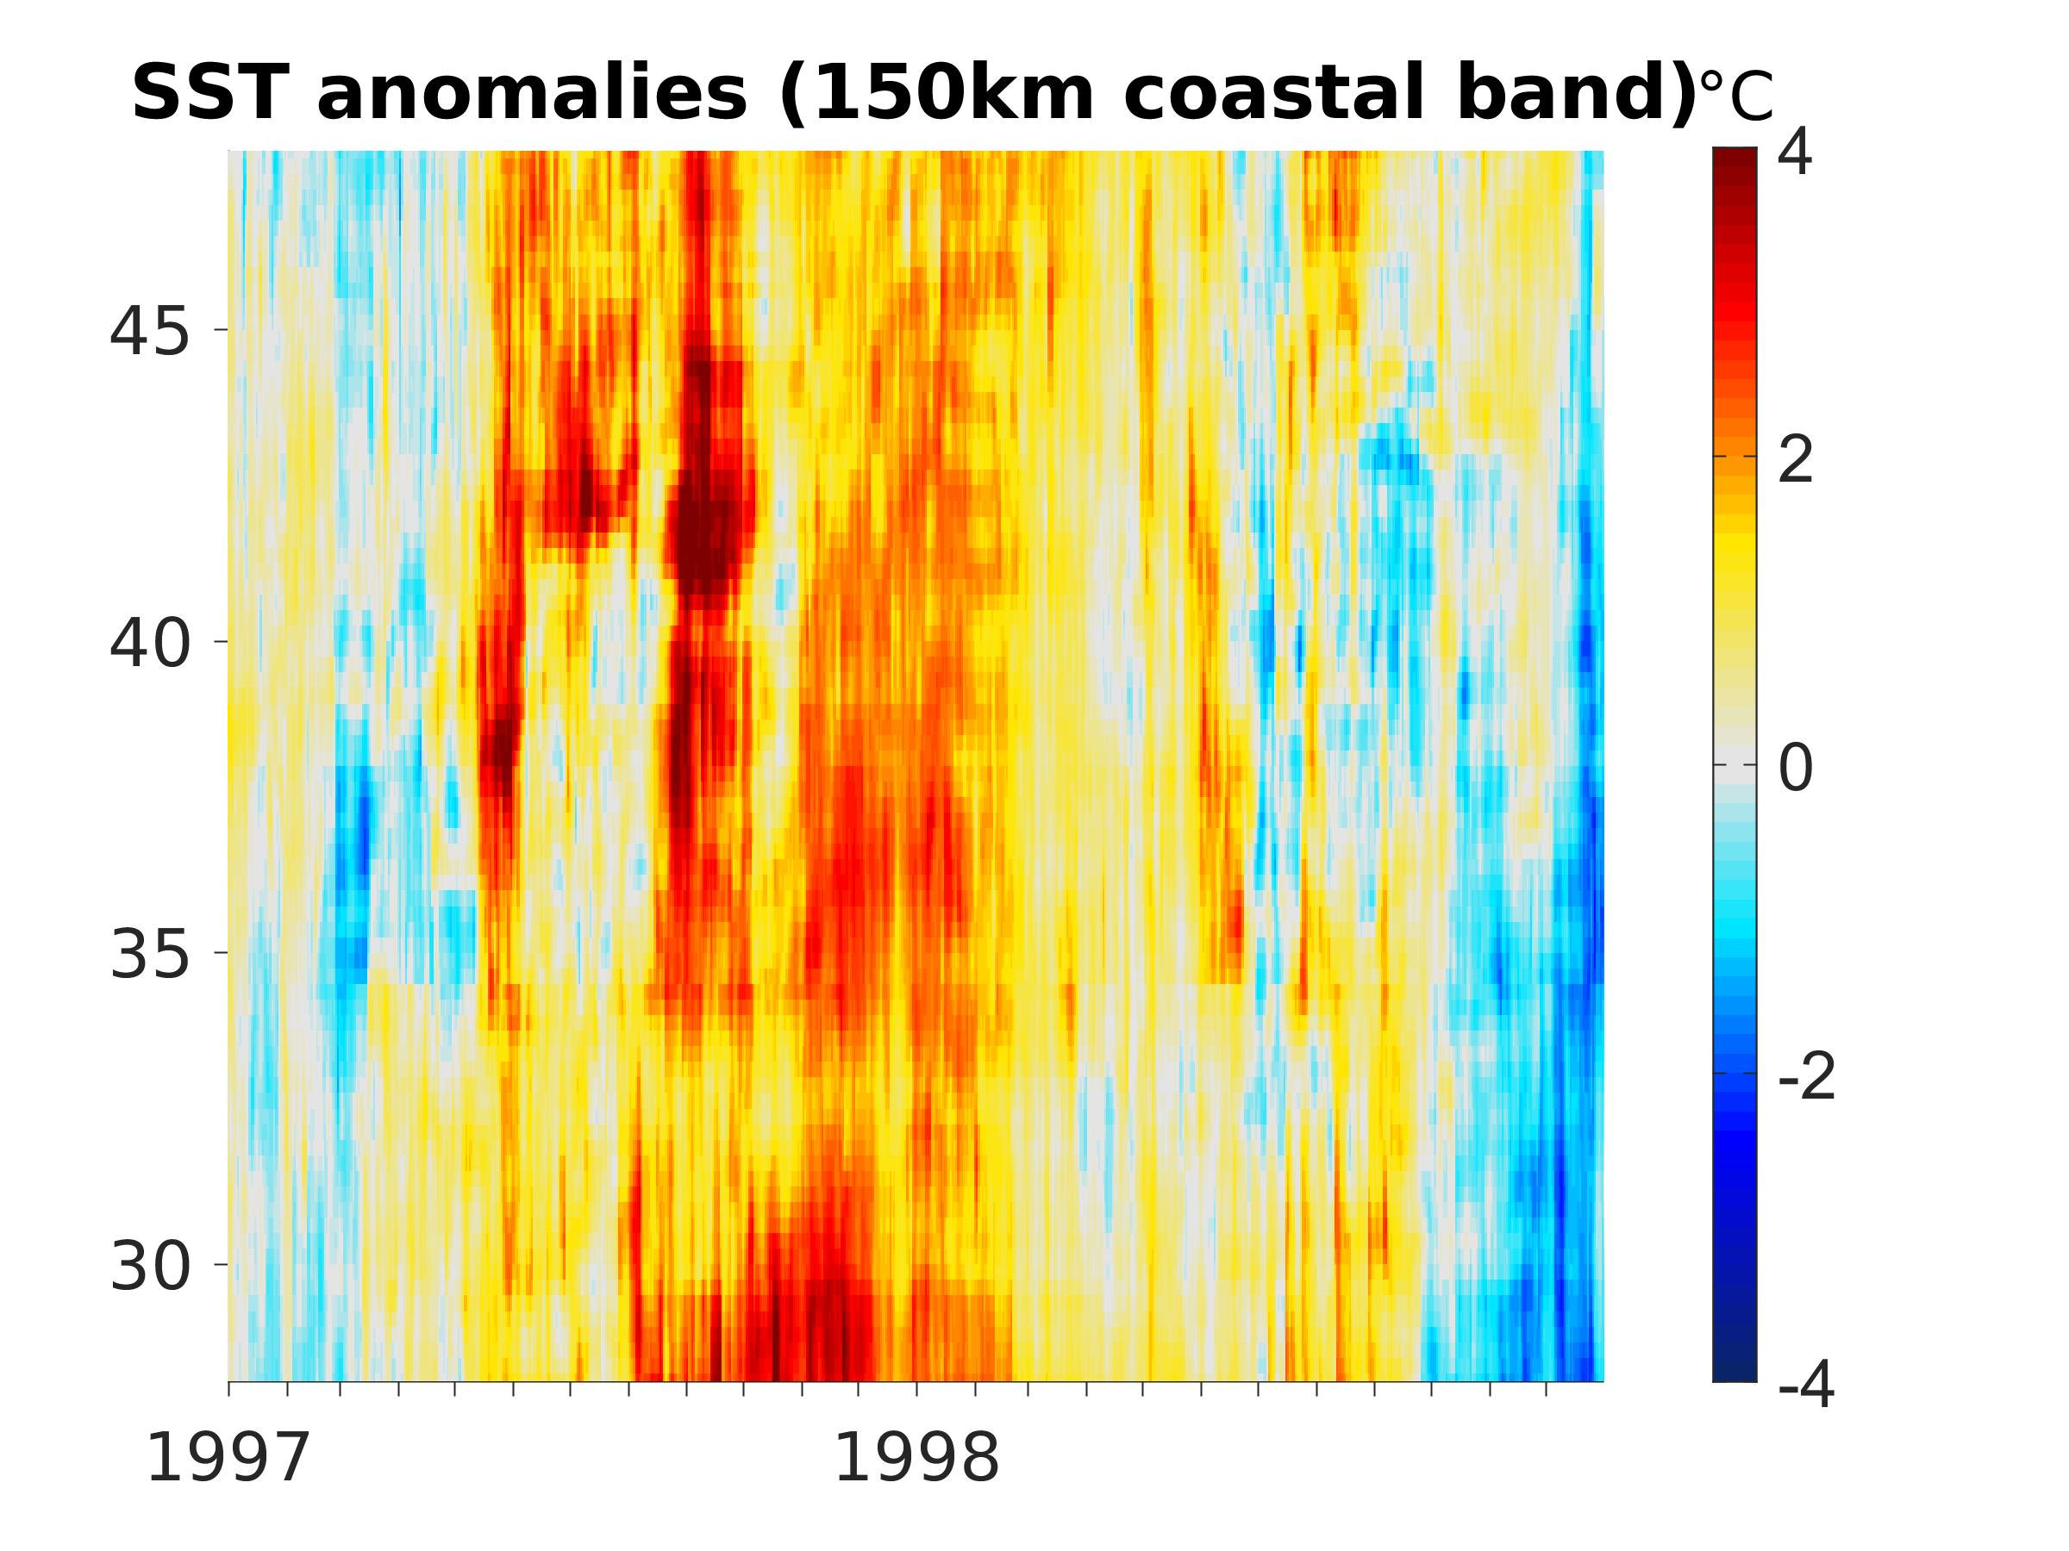
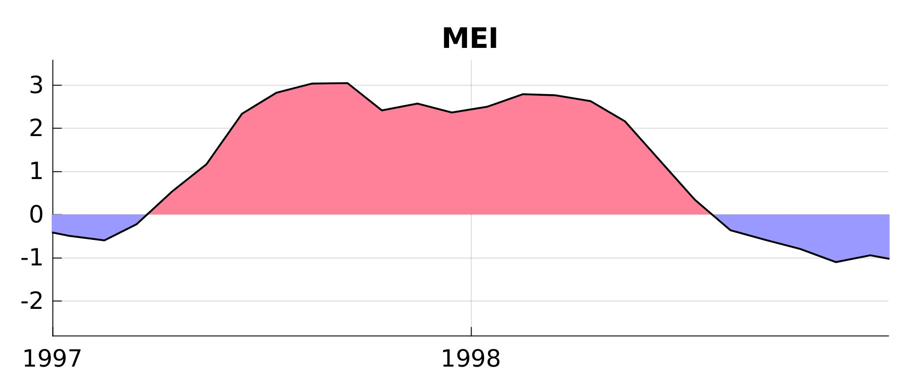
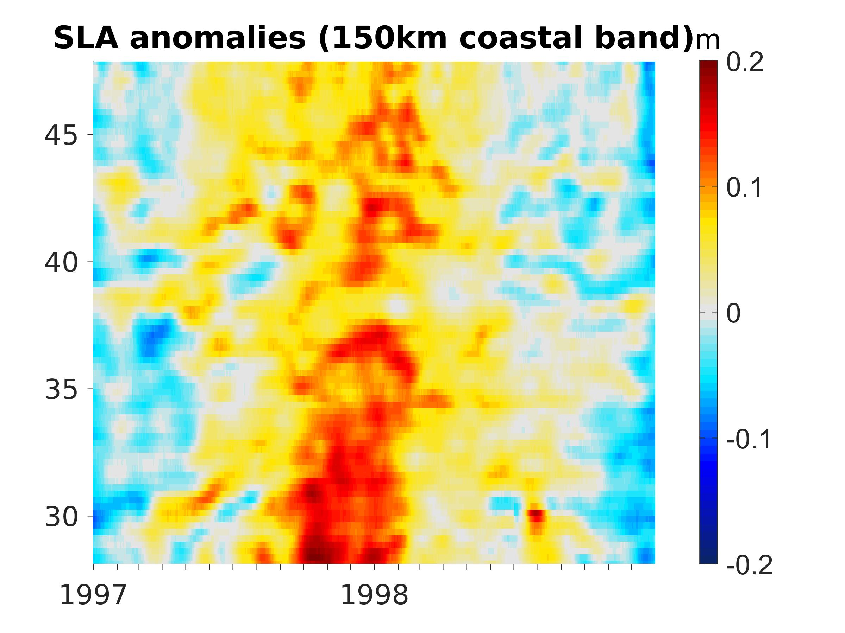
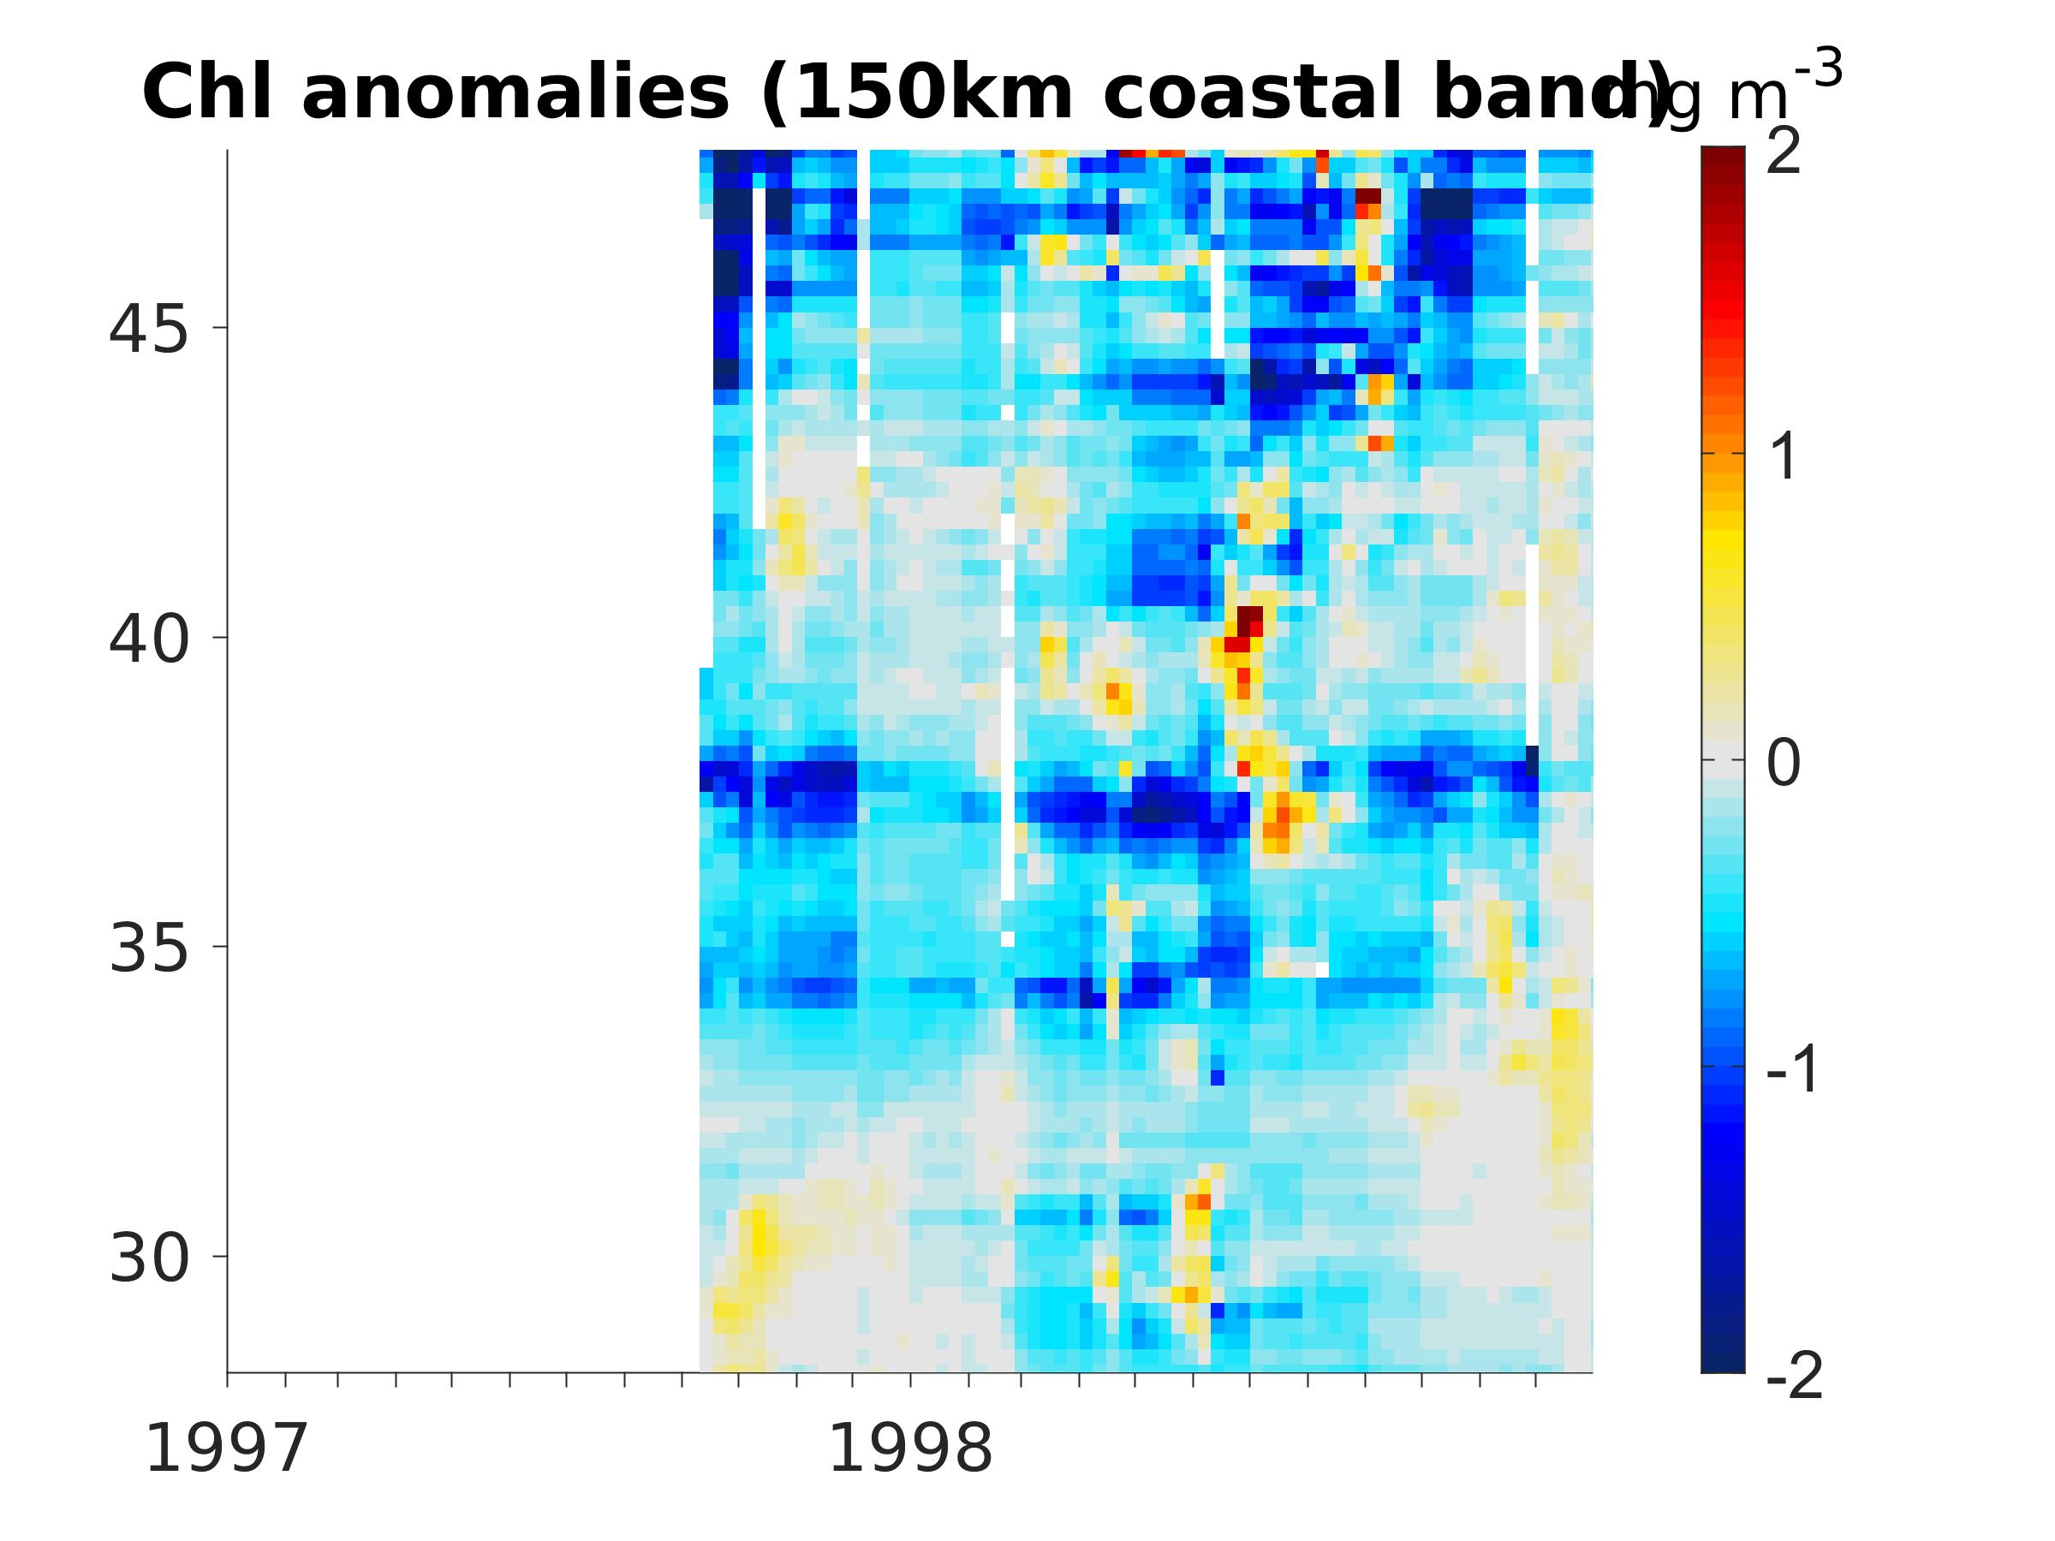
Signal propagation (satellite data)
SST (daily)
LATITUDE
TIME
Sea level (daily)
logChl (weekly)

Slide 14
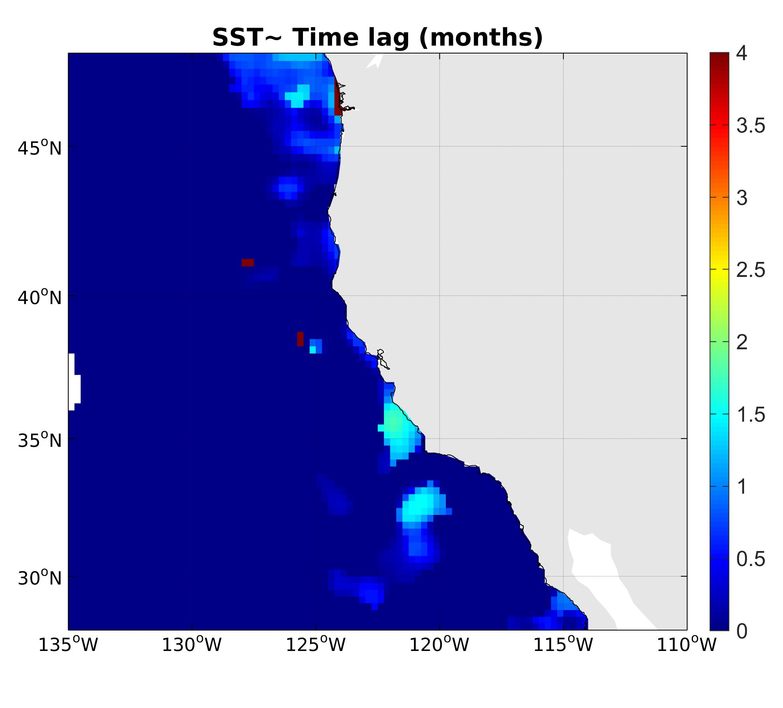
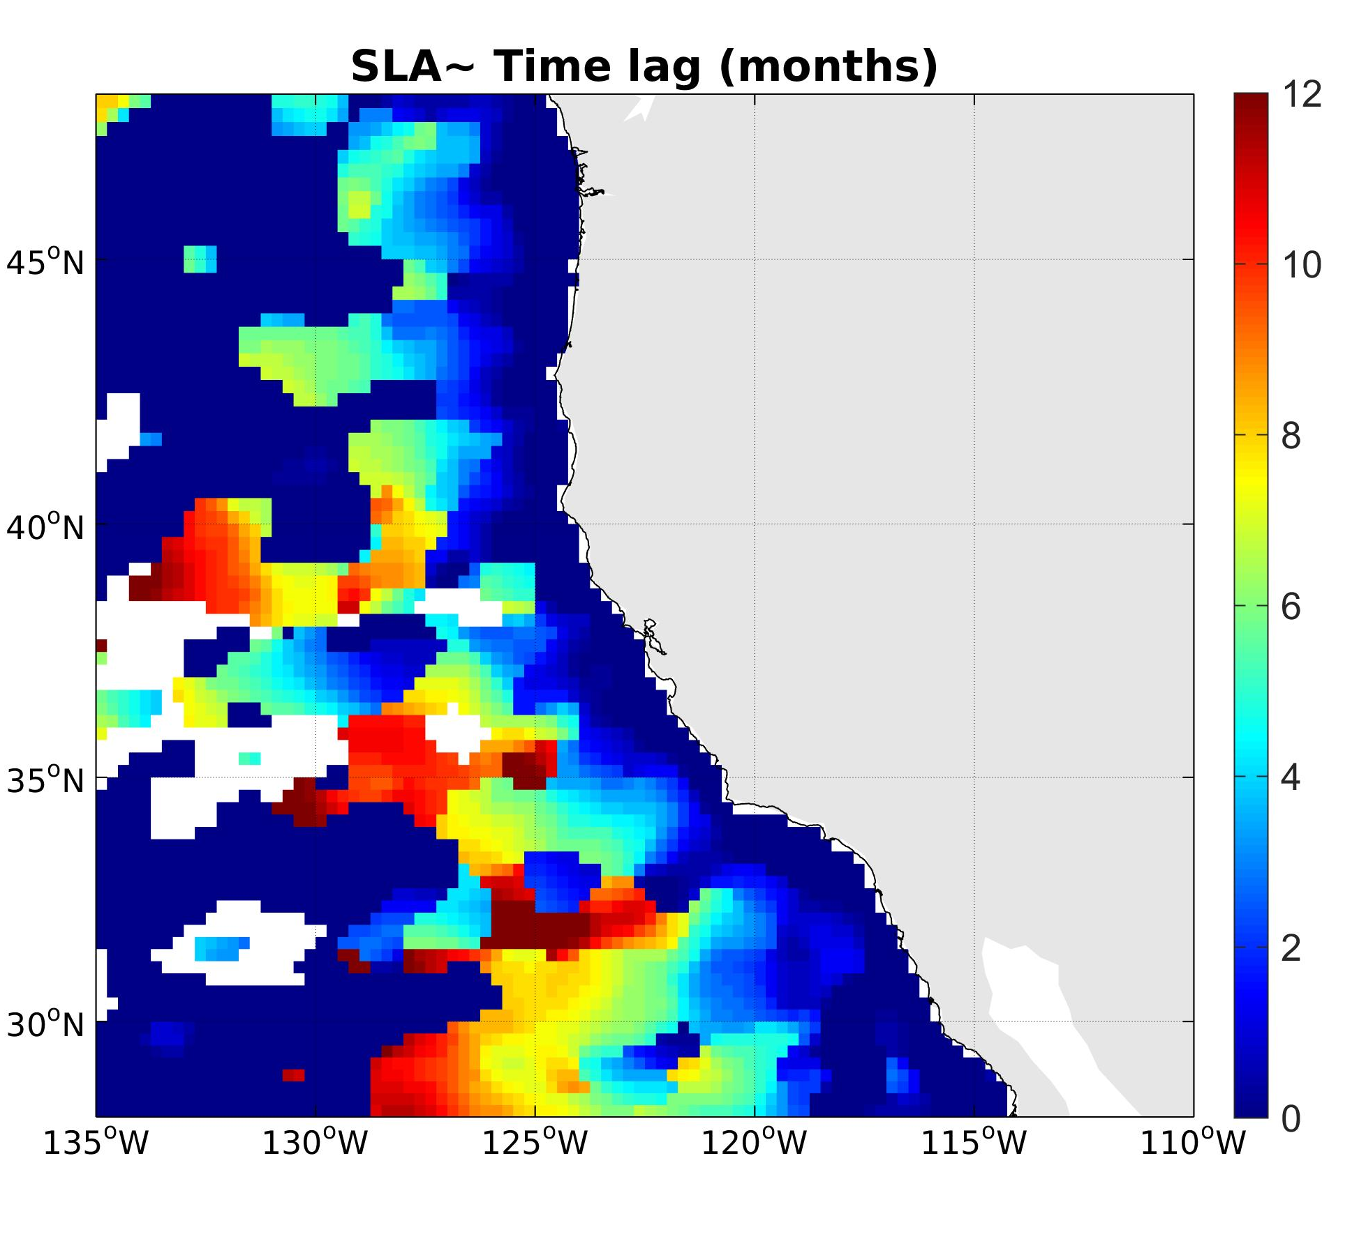
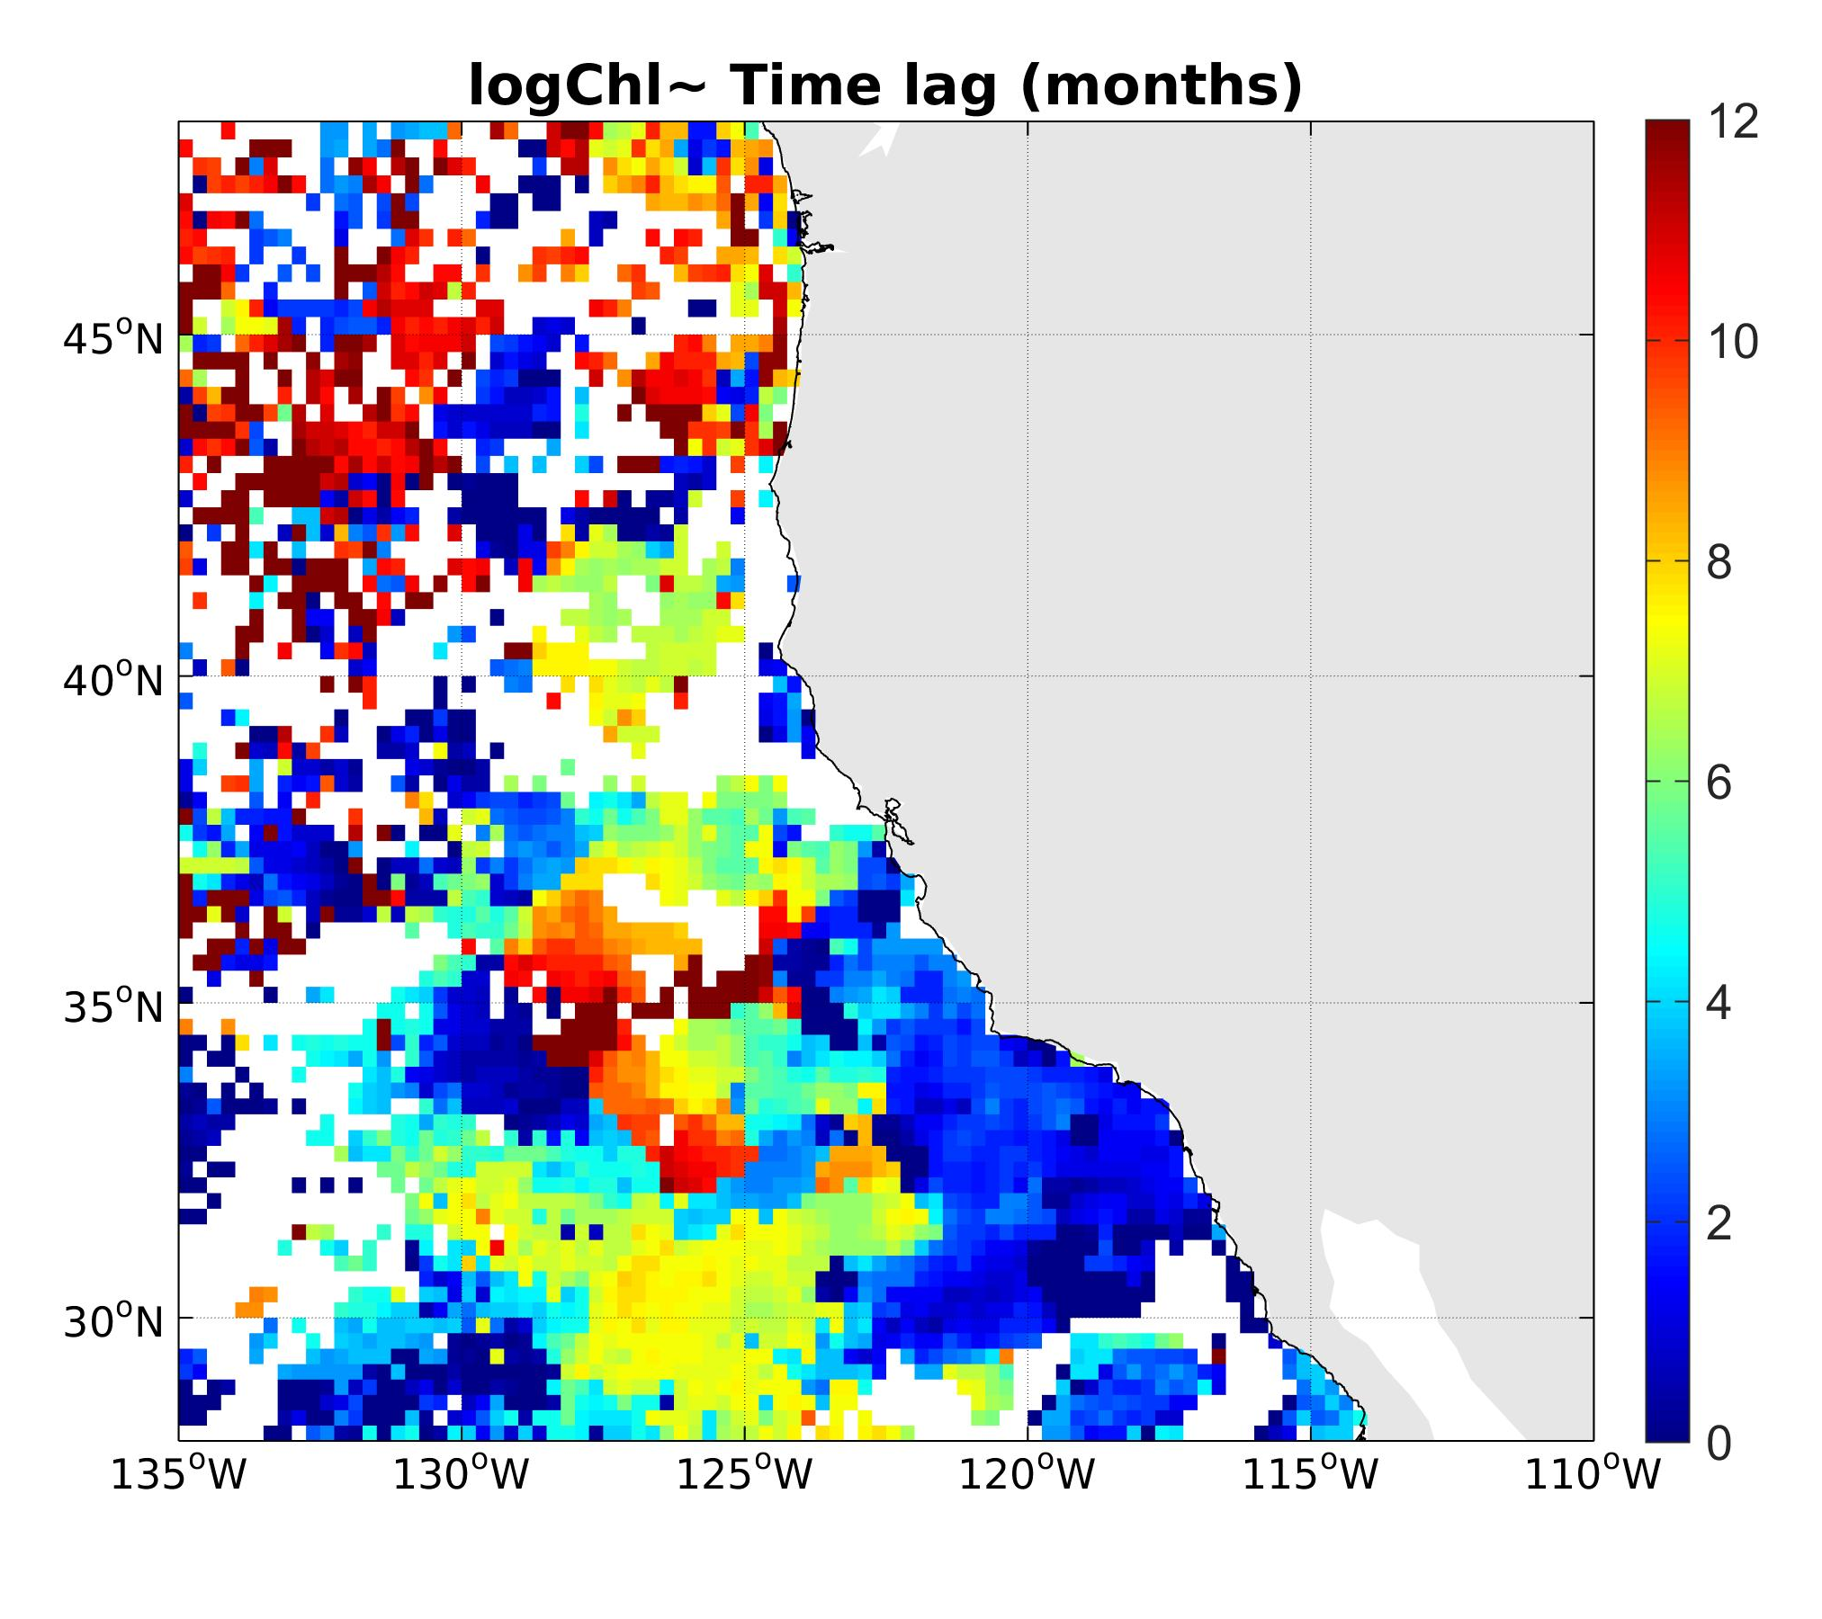
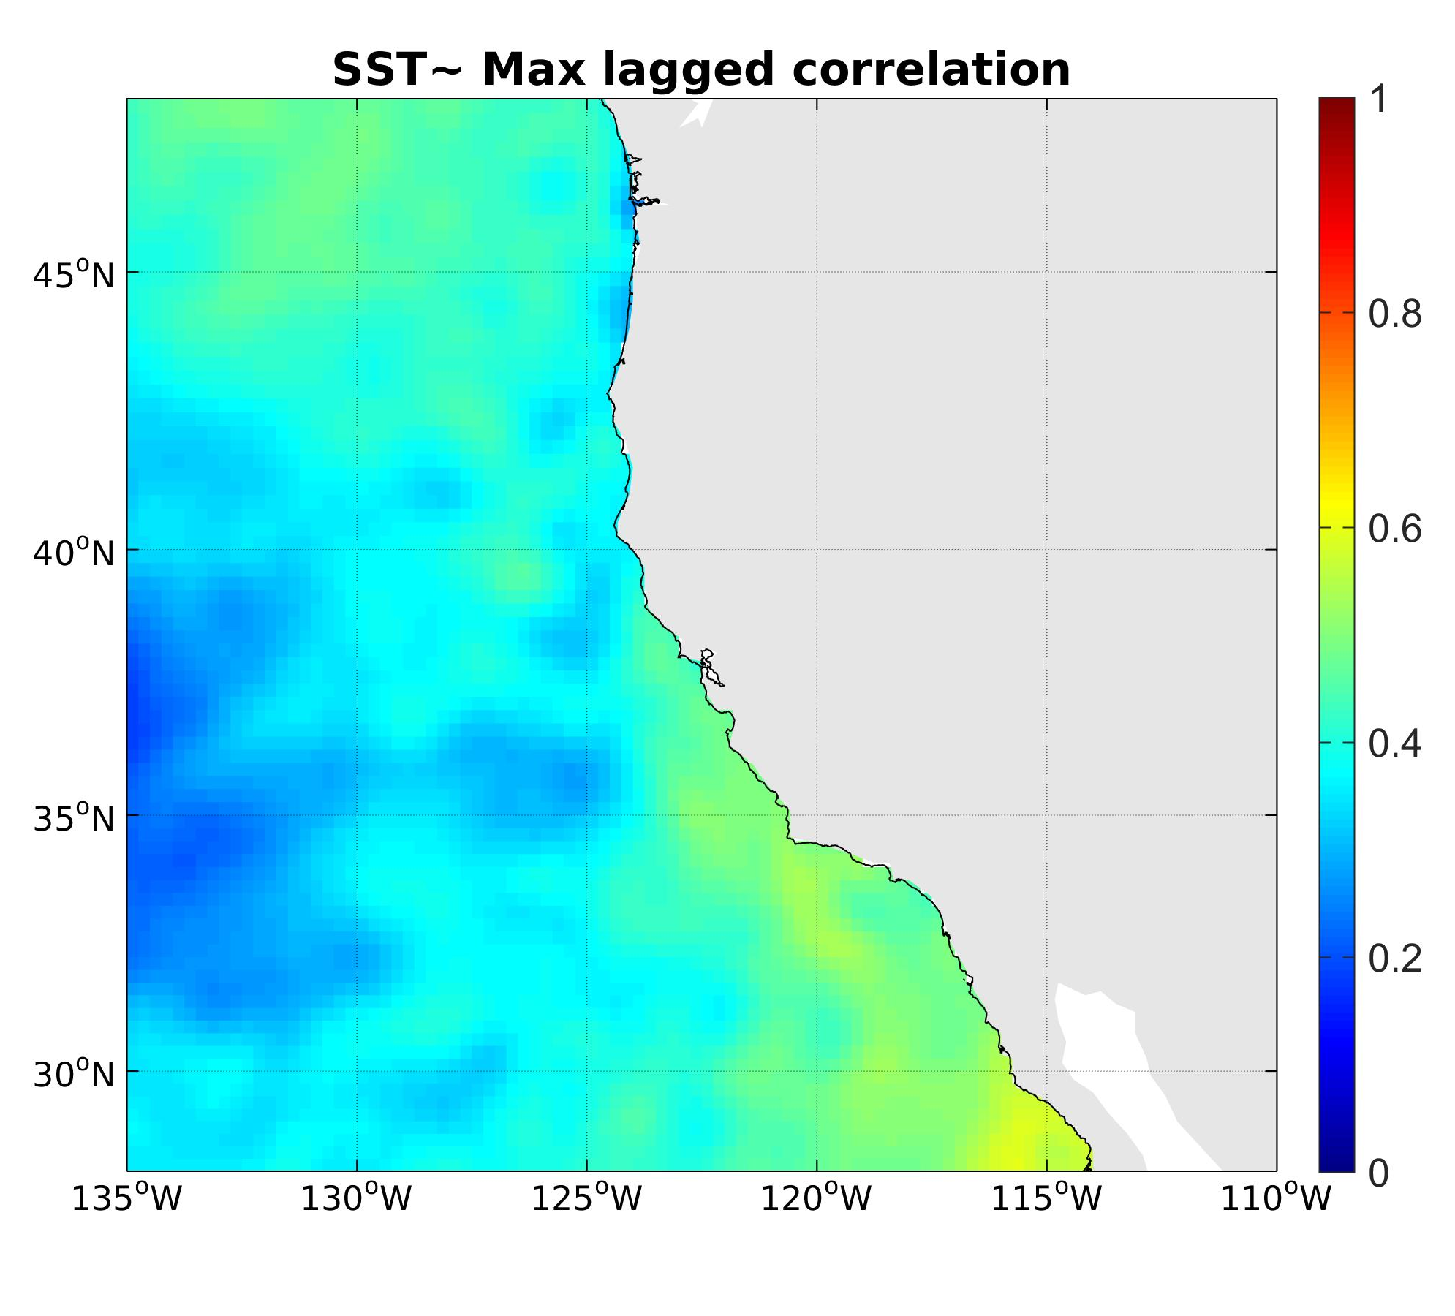
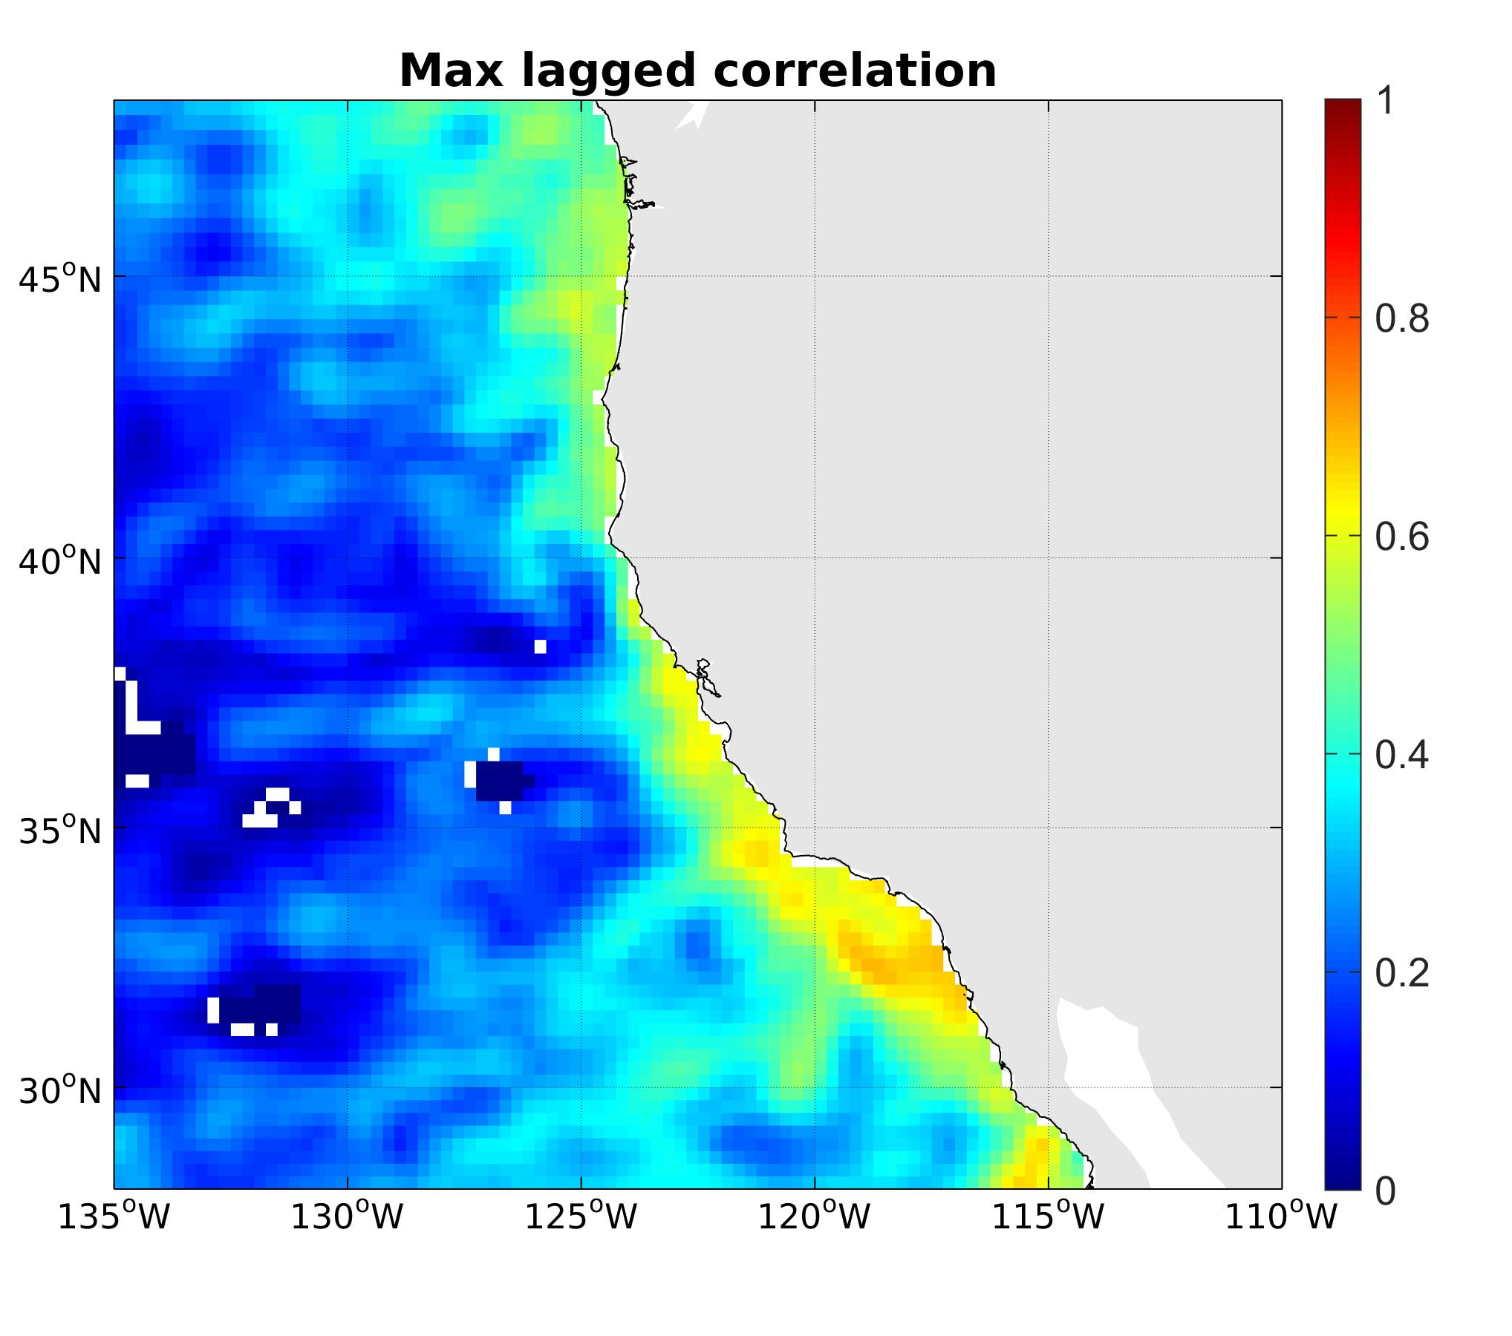
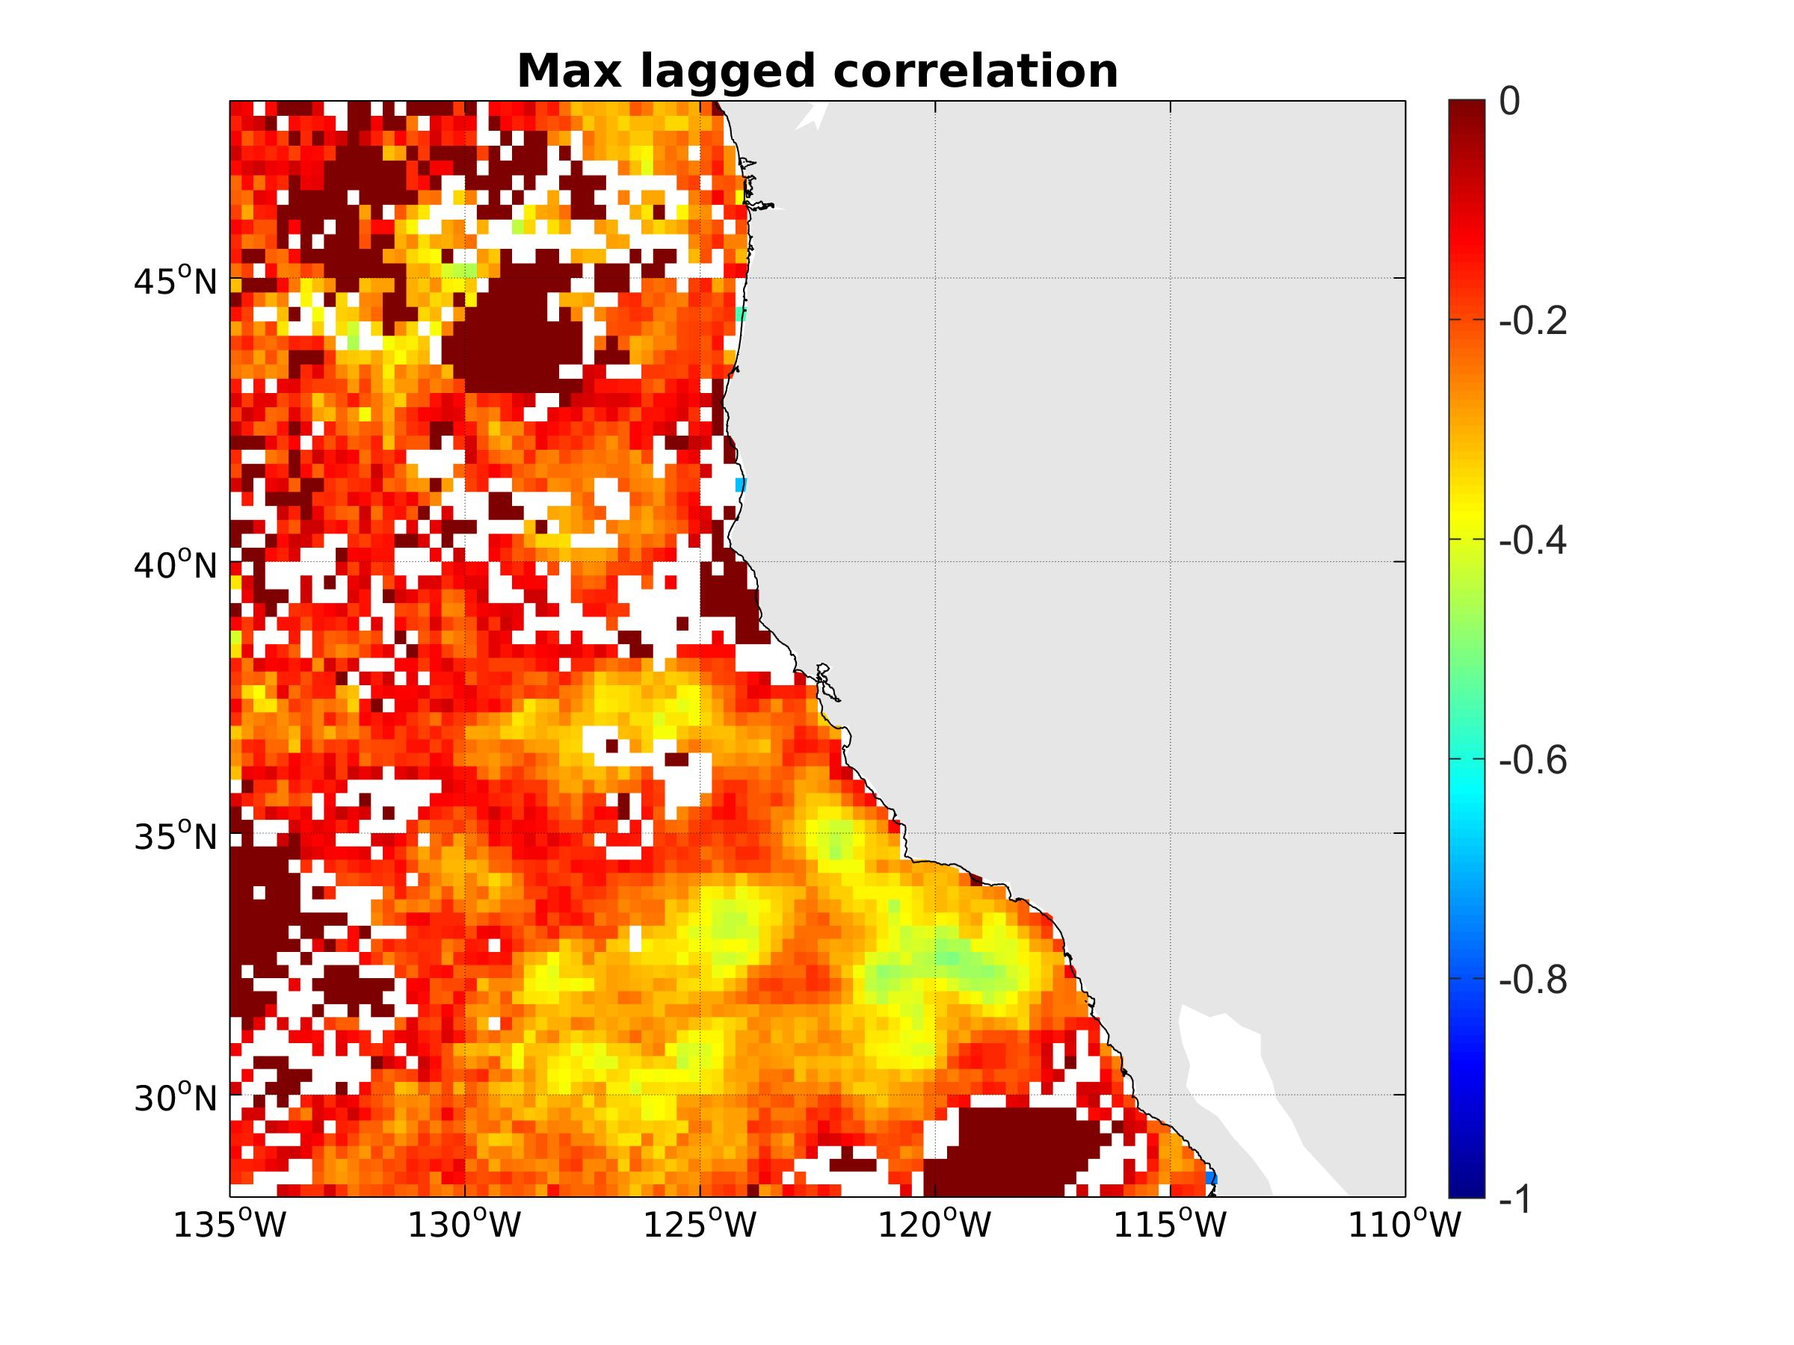
Lagged correlations (satellite data)
SST 1993-2016
SLA 1993-2016
logChl 1997-2010
lag
lagged
corr

Slide 15
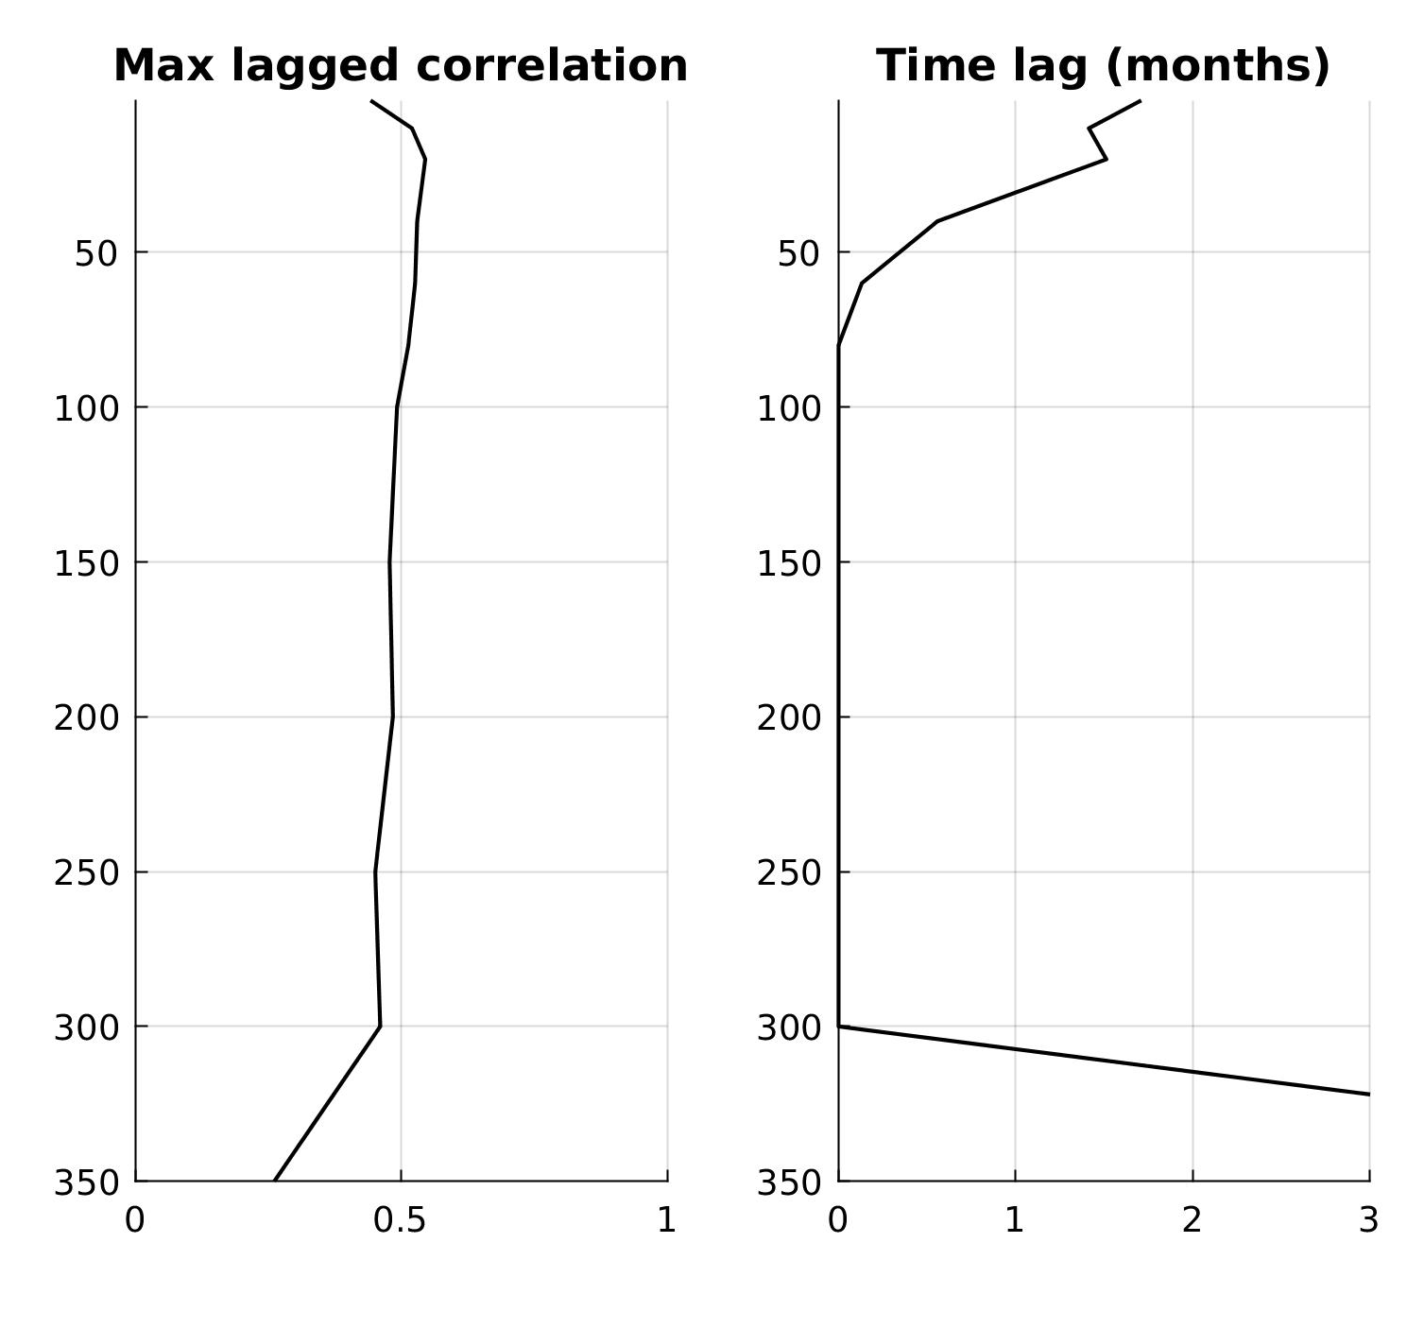
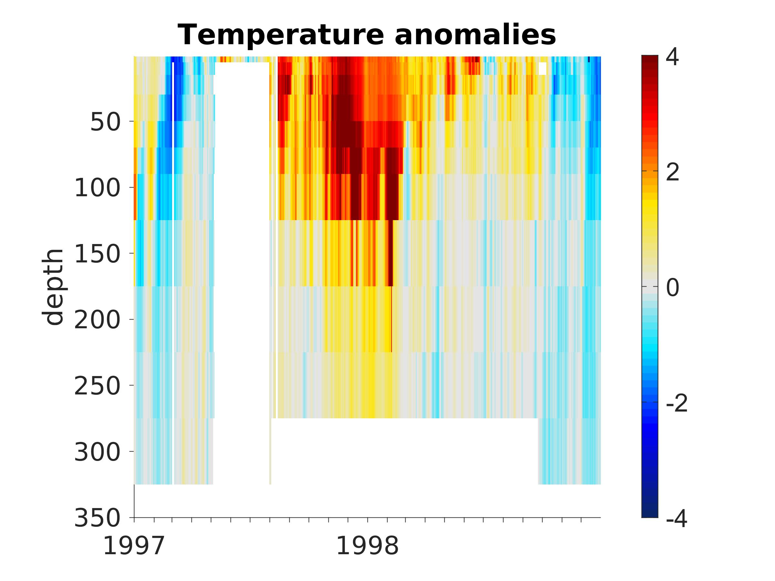
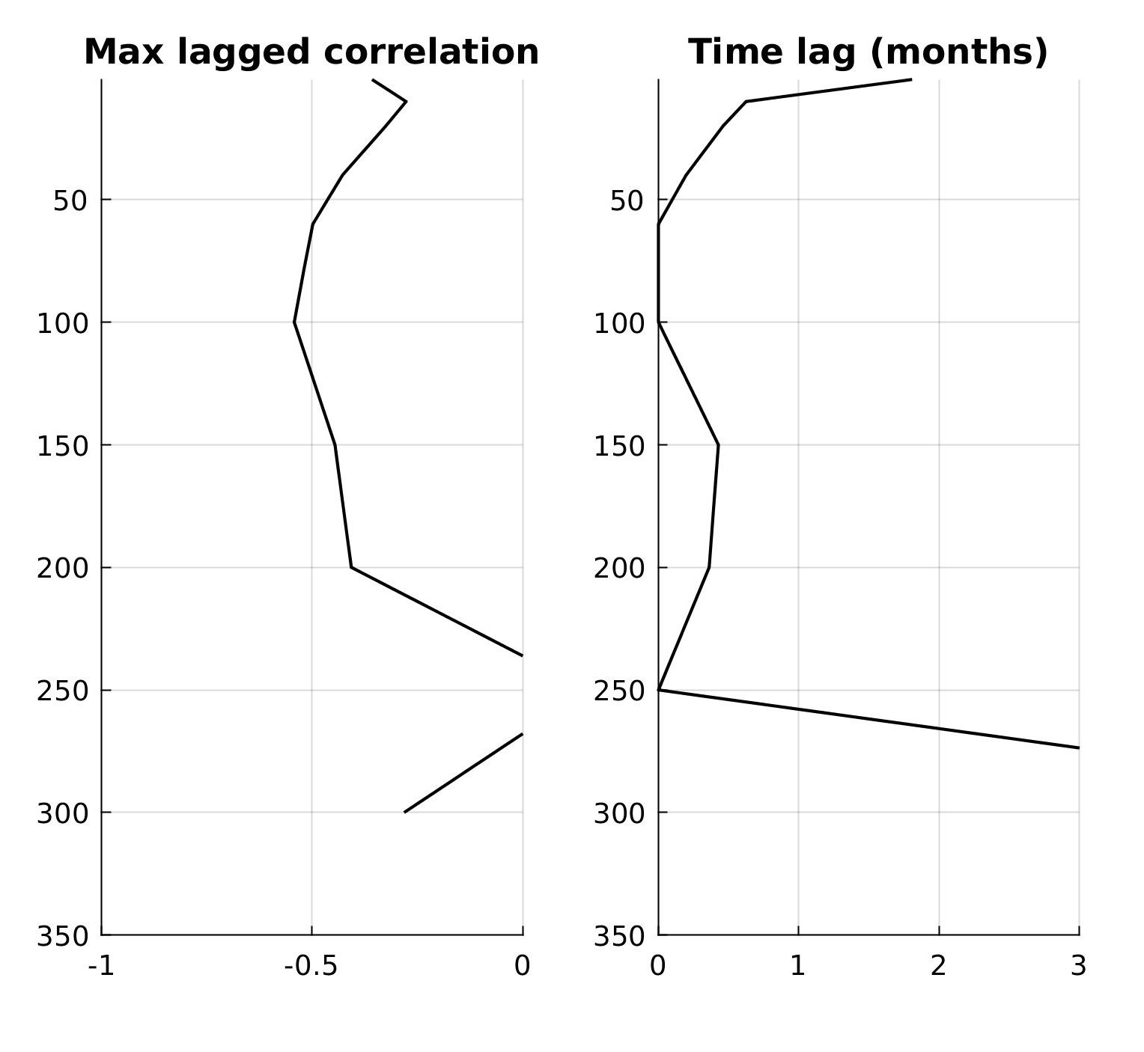
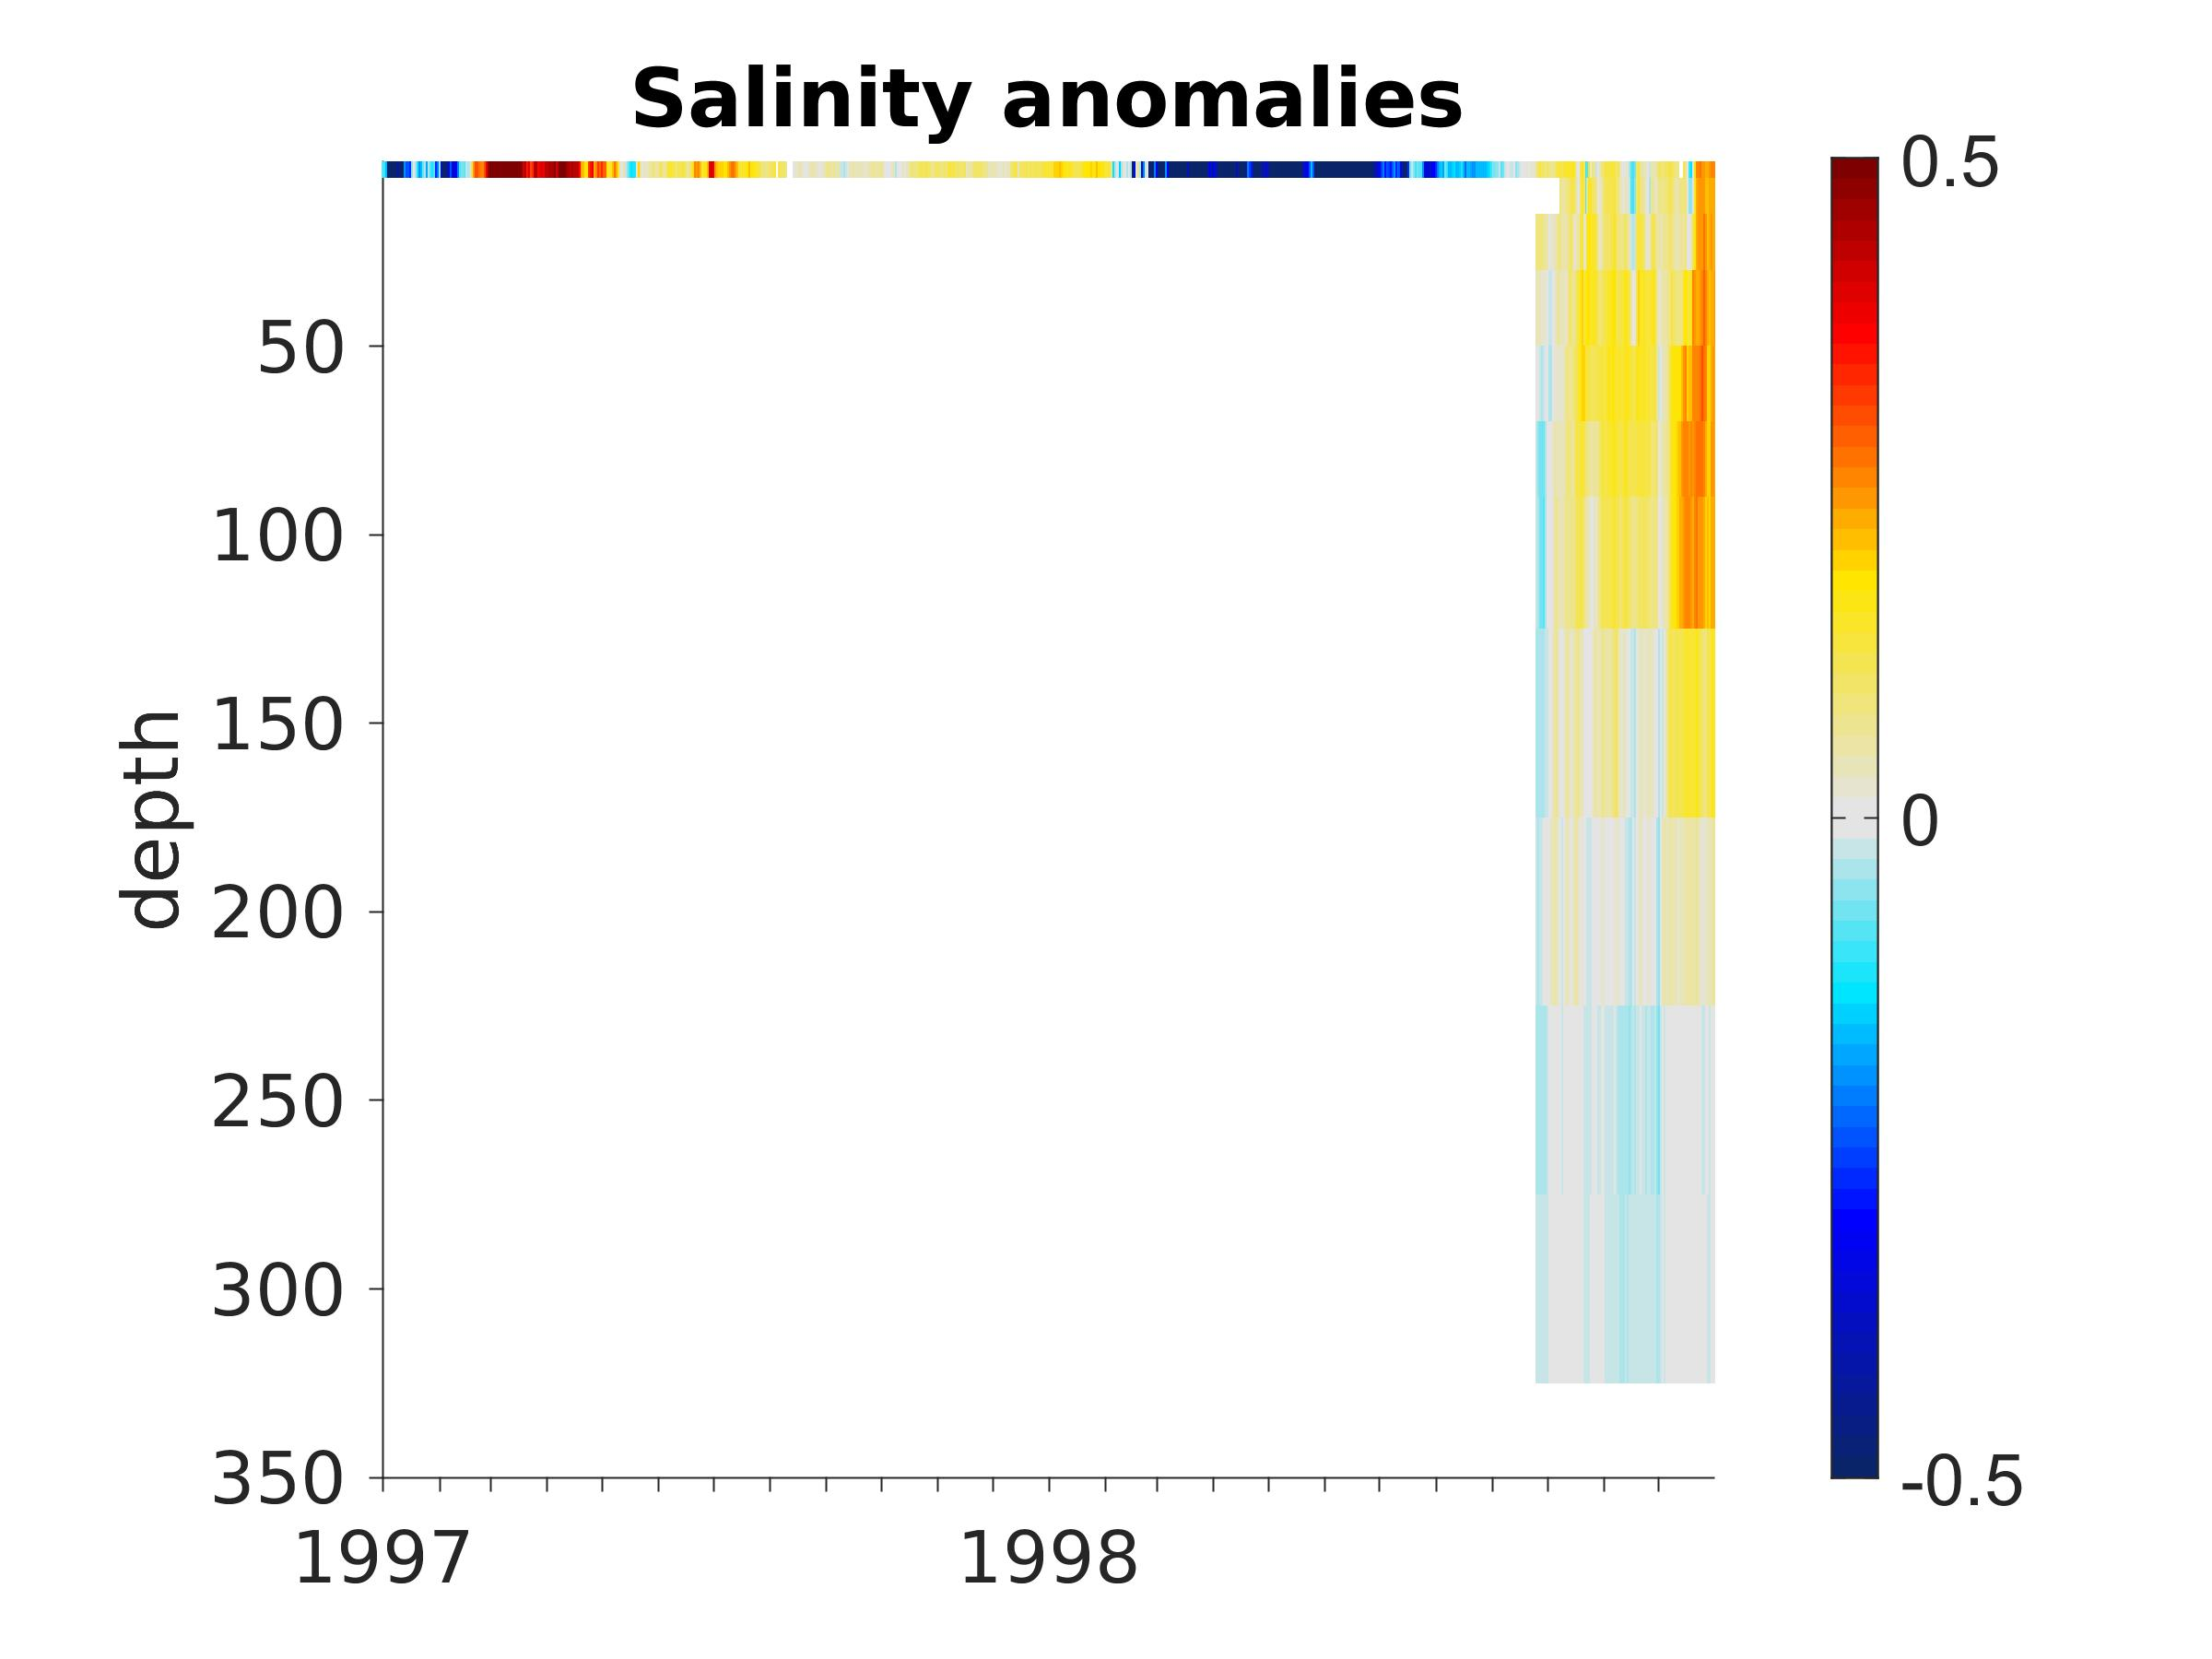
Lagged correlations (M1)
Temperature
-> max correlation at 20m (lag ~ 2 mo)
1989-2016
depth
Salinity
-> max correlation at 100m (lag = 0)
depth
1999-2016

Slide 16
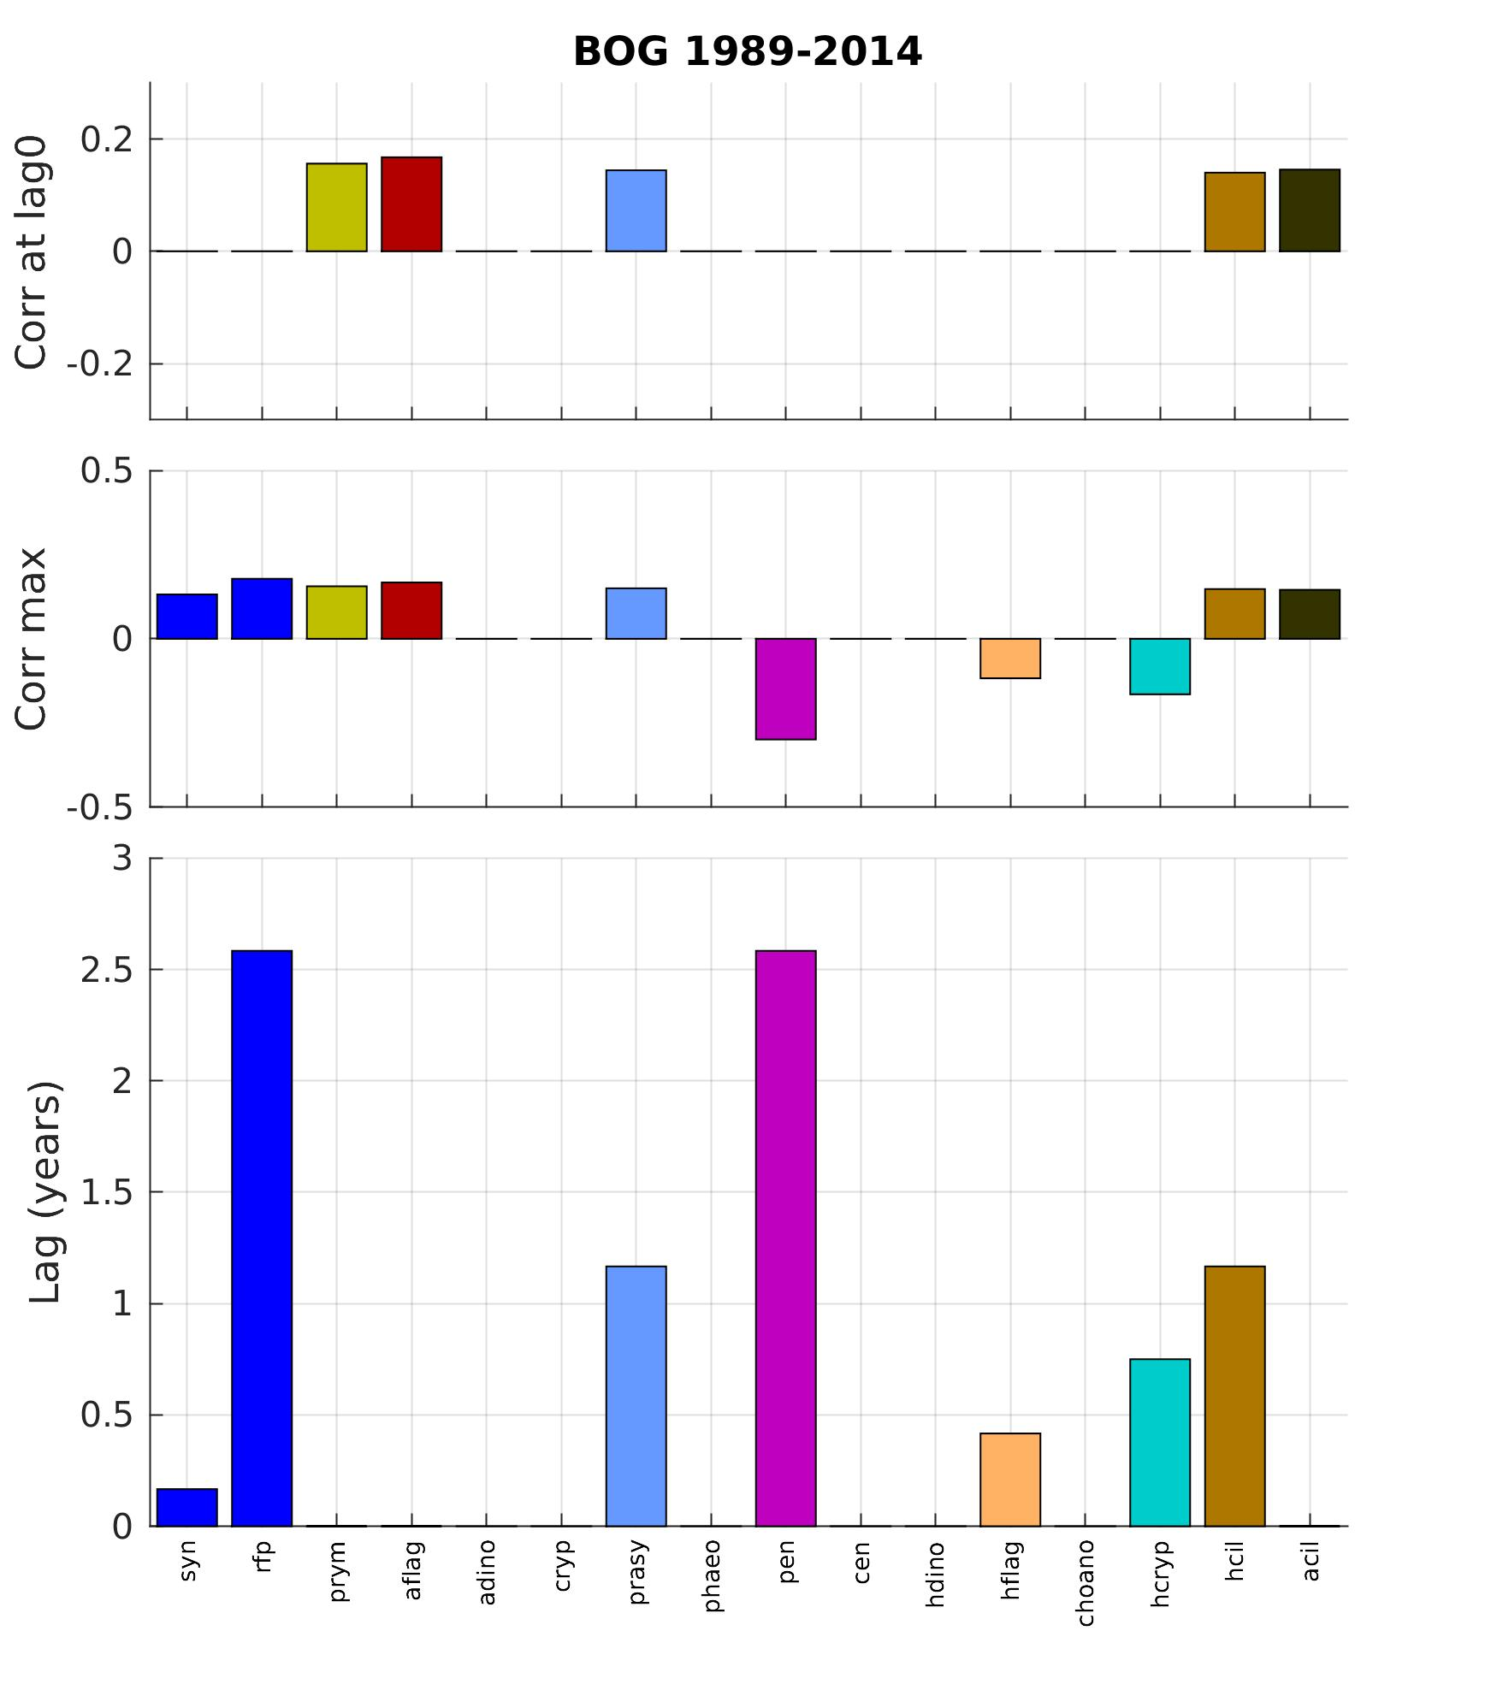
Lagged correlations (species)

Slide 17
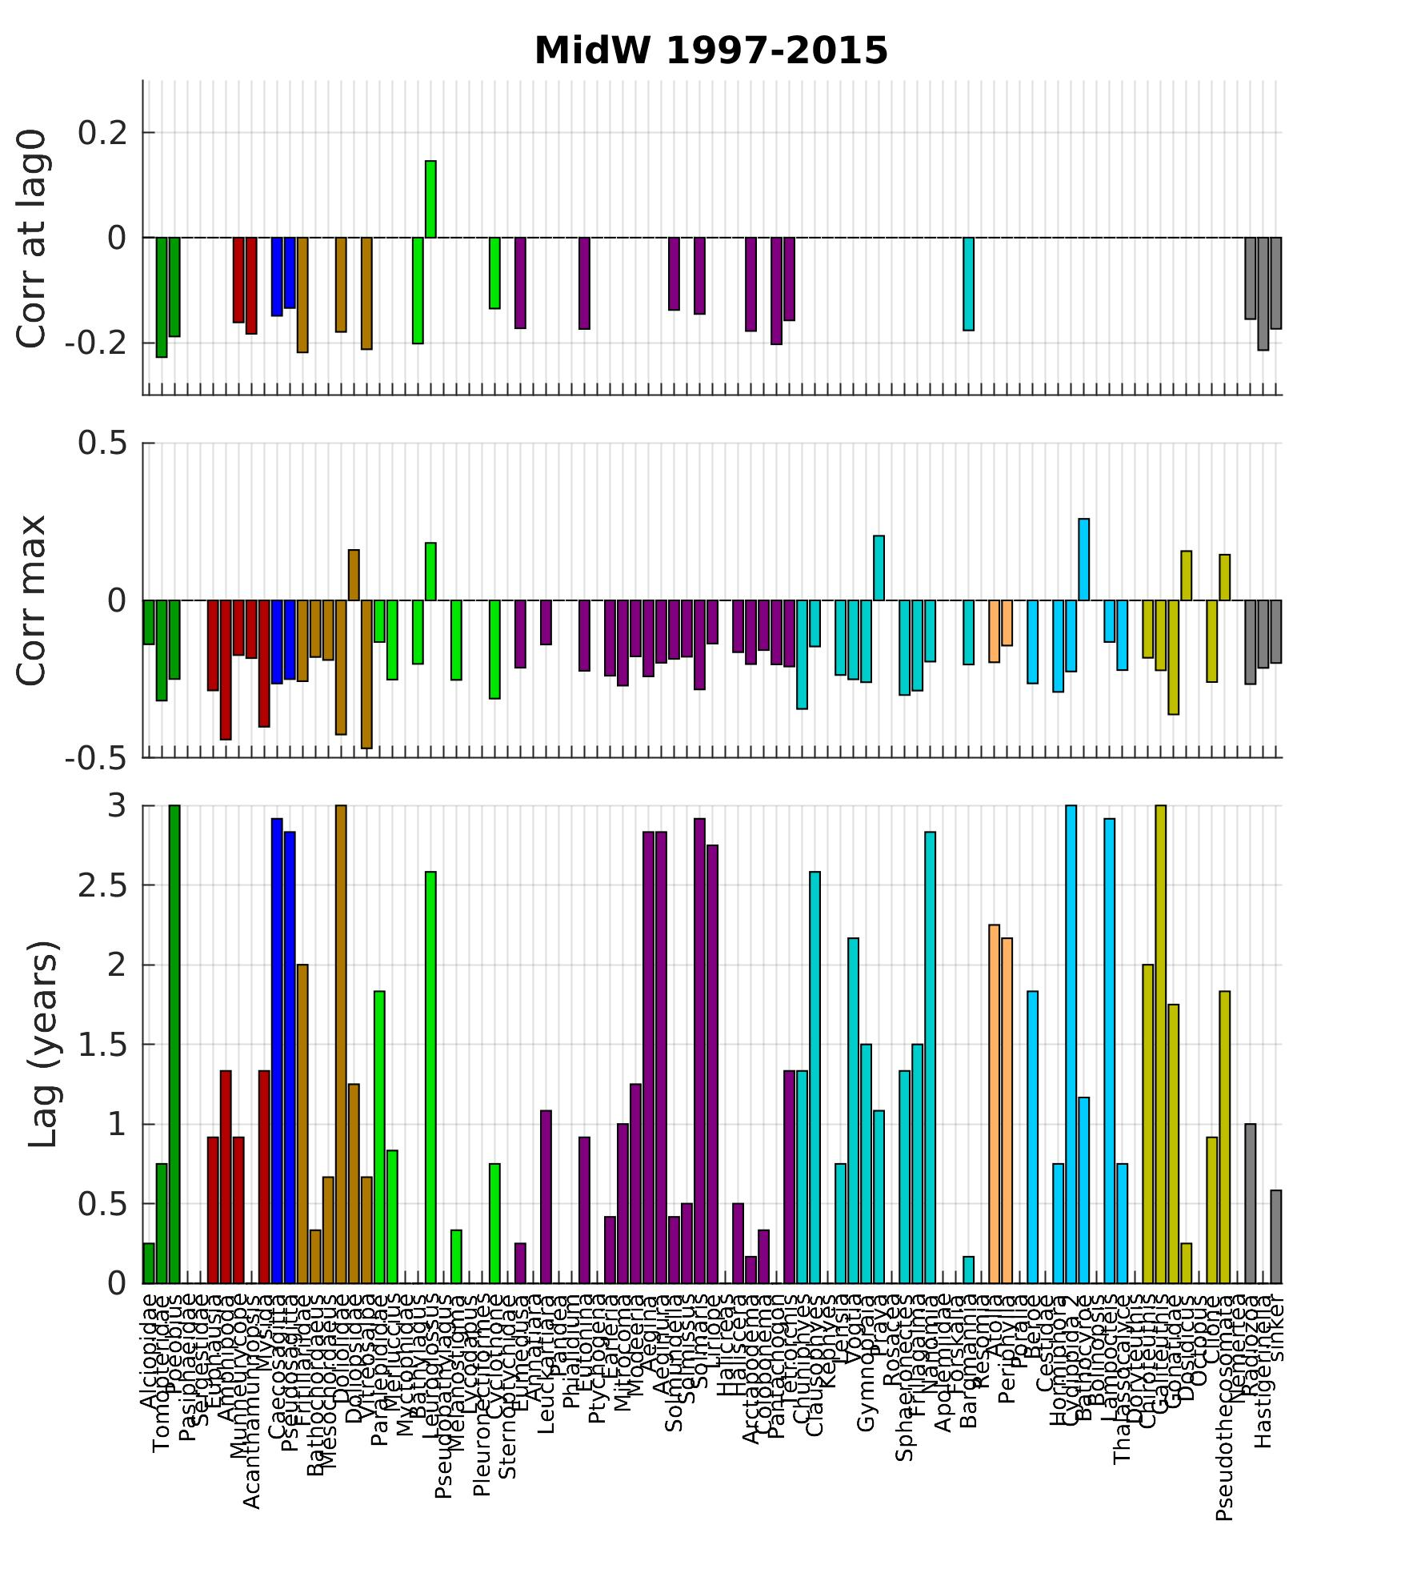
Lagged correlations (species)

Slide 18
3) Community structure and change
How can we define the types of ecosystems observed; are changes consistent across the 3 time series?
PCA analysis of midwater and surface species (also benthos but little El Niño data) – nothing new
Investigating clustering and neural networks on BOG data (MBON)
MDS analysis of midwater and surface species.

Slide 19
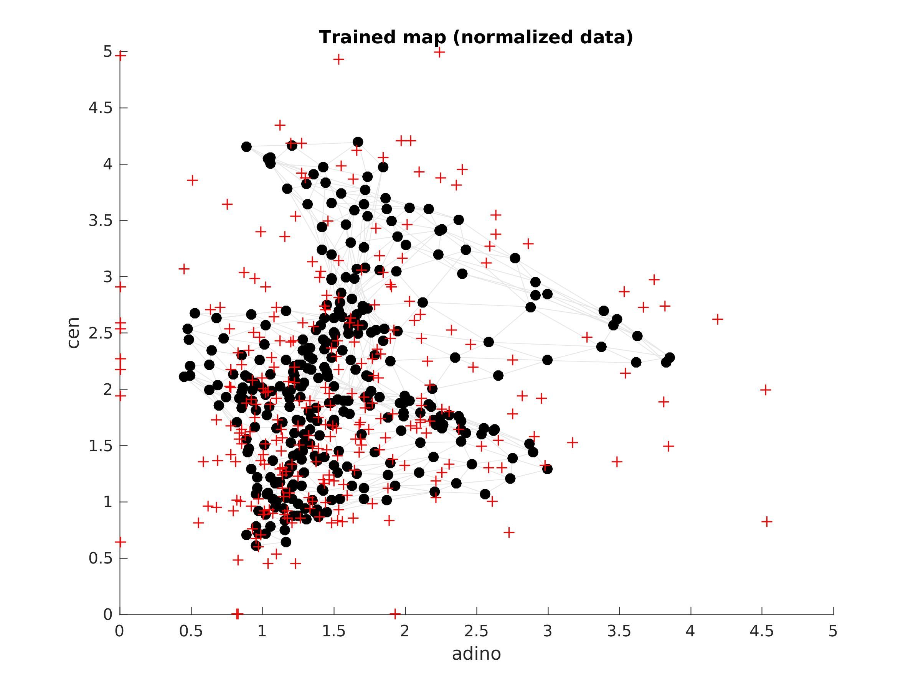
Clustering using self-organizing maps (BOG - MBON)
Self Organizing Maps (SOM):
trains a neural network to map 16 taxa time series (16-dimensions space)
Each neuron is a “virtual sample” with corresponding 16 concentrations
Clustering on neurons (here 5 clusters)
Centric diatoms
cross = data, dots = neurons
Autotrophic dinos

Slide 20
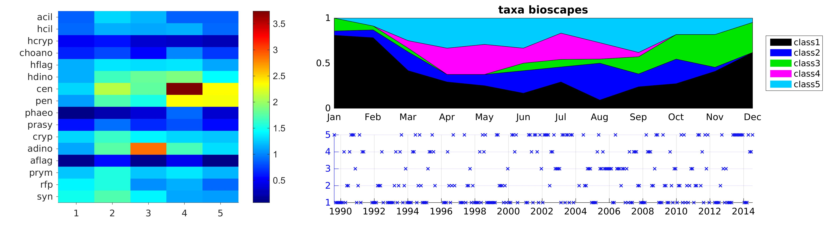
Clustering using self-organizing maps (BOG - MBON)
Self Organizing Maps (SOM):
trains a neural network to map 16 taxa time series (16-dimensions space)
Each neuron is a “virtual sample” with corresponding 16 concentrations
Clustering on neurons (here 5 clusters)
pico
mixed
dino
cen
diatoms
Average species biomass for each cluster

Slide 21
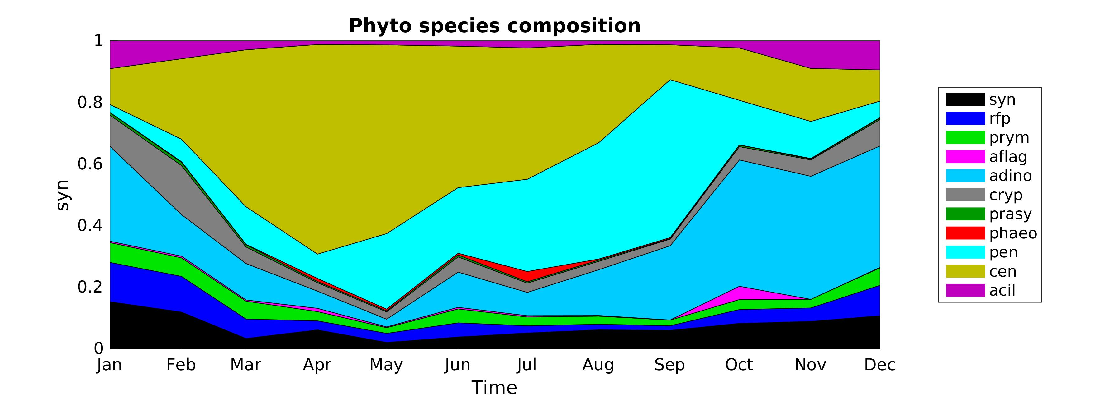
Clustering using self-organizing maps (BOG - MBON)
pico
mixed
dino
cen
diatoms
mixed diatoms
cen
dino
pico
mixed
diatoms
cen
dino
mixed
pico
cen
pen (diatom)
dino
pico

Slide 22
Clustering using self-organizing maps (BOG - MBON)
pico
mixed
dino
cen
diatoms
diatoms
cen
dino
pico
mixed
diatoms
cen
dino
mixed
pico
No clear link with El Niño either

Slide 23
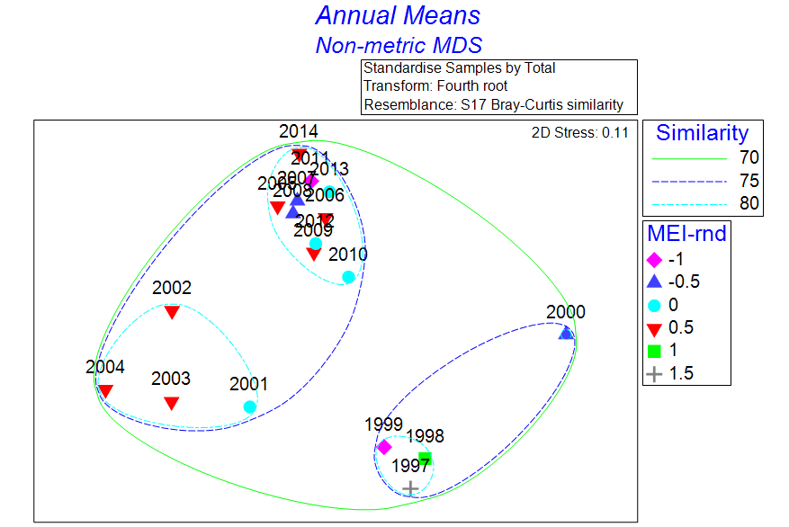
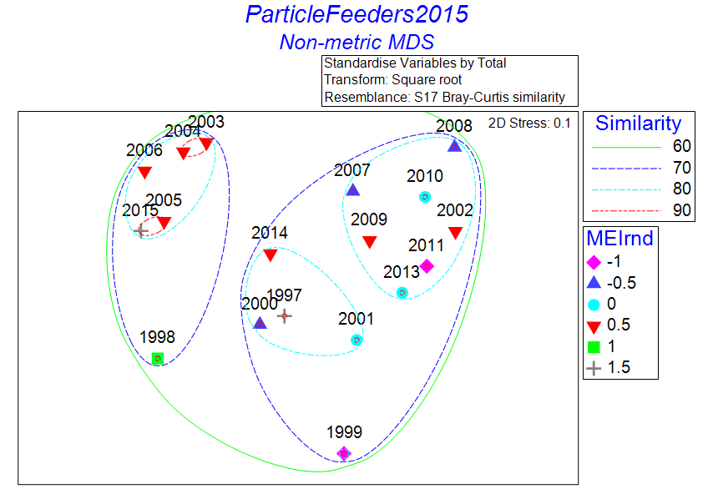
MDS analysis of midwater and surface species
Both MDS plots indicate community diffs between early and mid-late 2000s
MEI accounts for < 25% of (annual mean) variability in subset of MW particle feeders

Slide 24
Plot of log-anomalies now includes pyrosomes
2003-2006 typically below average abundance
2005-2006 warm, weak upwelling conditions - not due to tropical El Nino (and not captured by MEI, SOI, ONI)
Dinoflagellate years shown in BOG data
Anything at Station M?

Slide 25
El Niño 1997-98 study
Changes during El Niño / La Niña: food supply
  Is there a difference in food supply between El Niño / La Niña?
    answer appears to be ’No’ so far
Changes during El Niño / La Niña: timing
  How do changes propagate across the system?
    clear signals in physics, very hard to isolate for biology
Community structure and change
  How can we define the types of ecosystems observed; are changes consistent across the 3 time series? (related to ENSO or not)
    in progress, no clear link with ENSO or between time series for now

