Slide 1
Late 90s (?) regime shift in ITS
Time series: environment, carbon fluxes
Ecosystem composition from MDS
Time series from PCA
Notes:
12/7/16
1
1

Slide 2

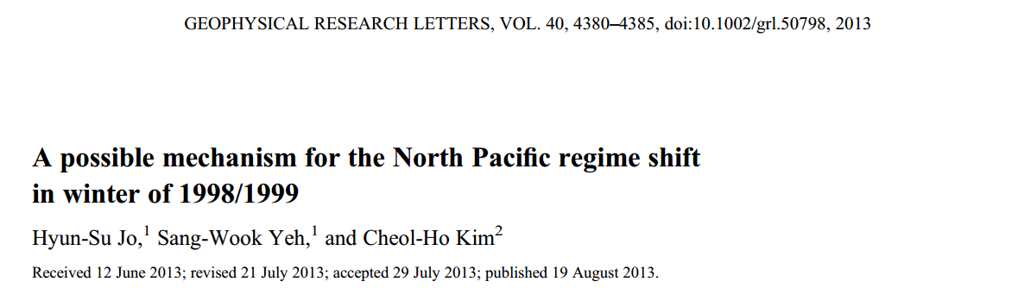
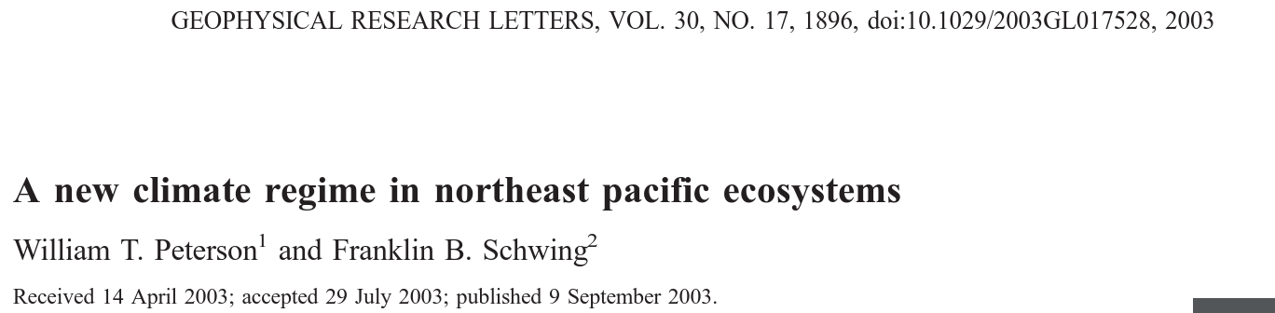
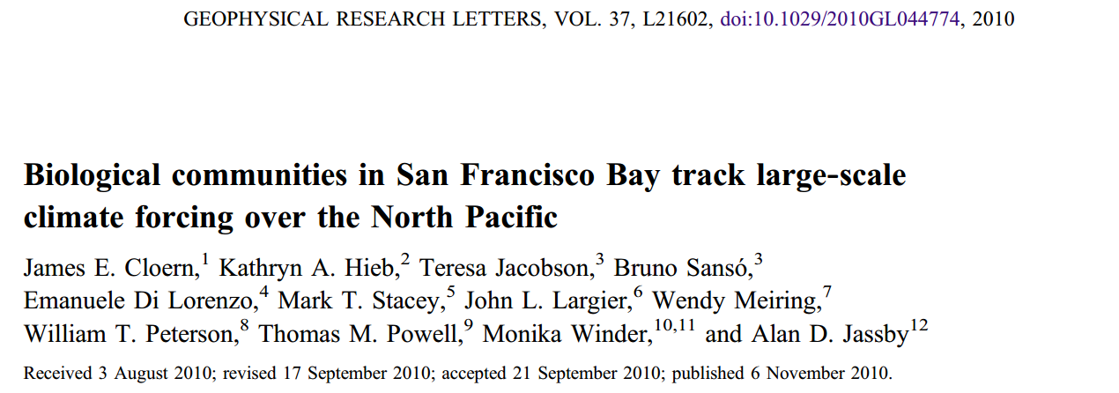
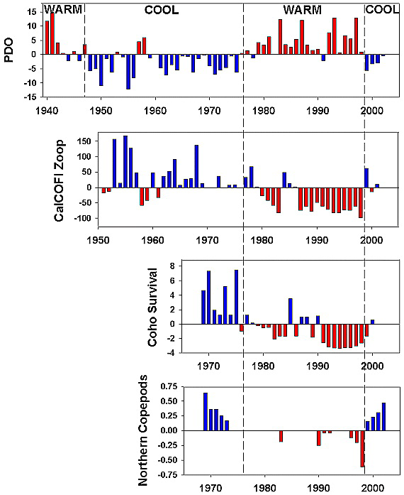
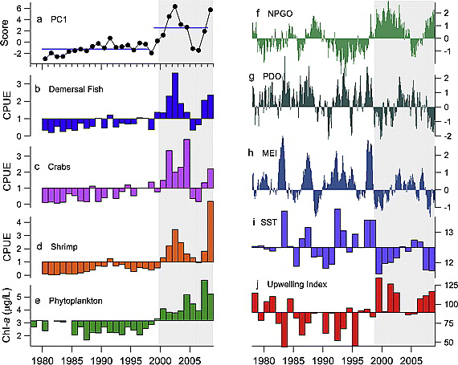
Notes:
12/7/16
2
2

Slide 3
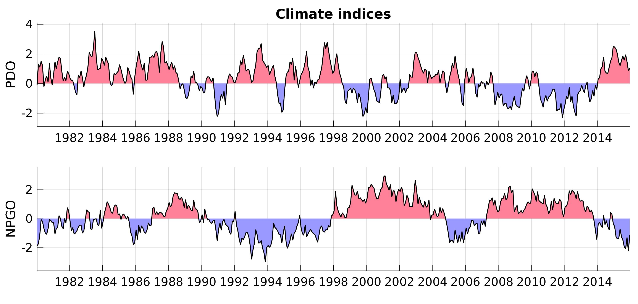
Time series: Pacific climate
Notes:
12/7/16
3
3

Slide 4
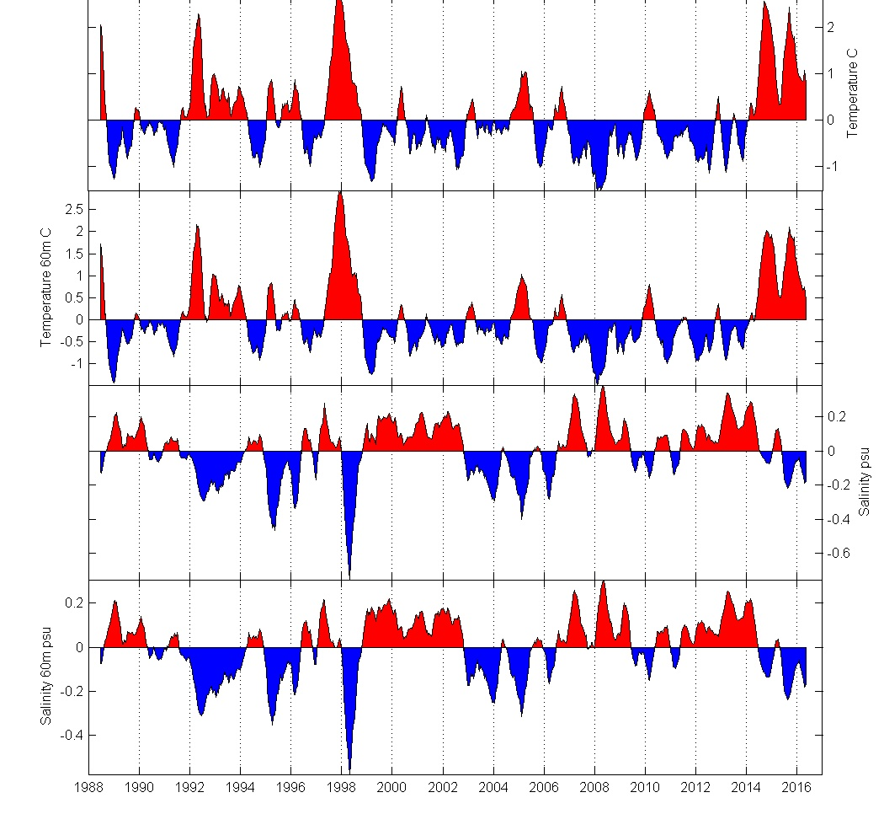
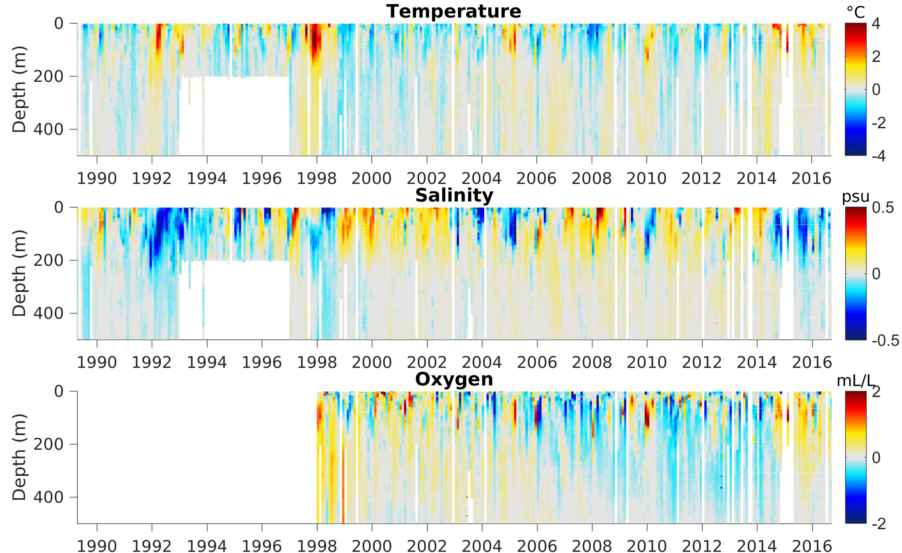
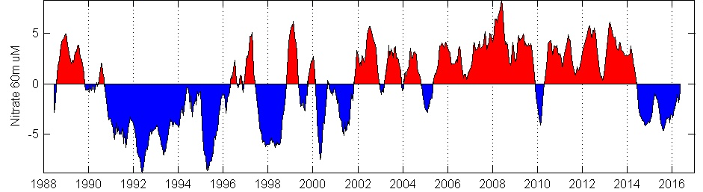
Time series: local environment
Surface temperature
Temperature 60m
Surface salinity
Salinity 60m
After late 90s: lower temperature, higher salinity and nitrate. Nitrate and oxygen change ~2002 rather?
Nitrate 60m
http://www3.mbari.org/bog/mb/Interannual.htm
Notes:
12/7/16
4
4

Slide 5
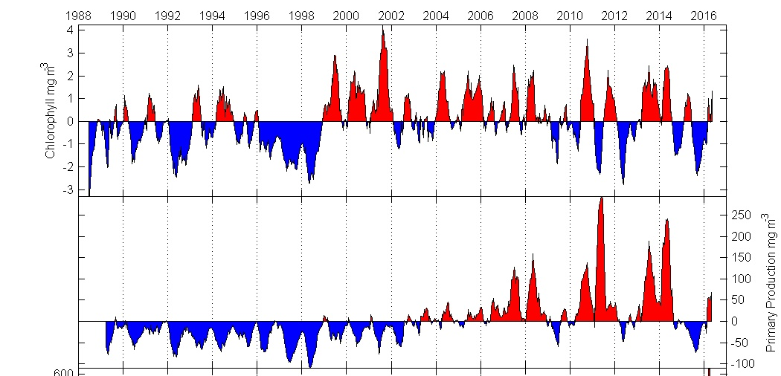
Time series: phytoplankton
Chl increase after 1998-99, PP more gradually / after 2002?
Notes:
12/7/16
5
5

Slide 6
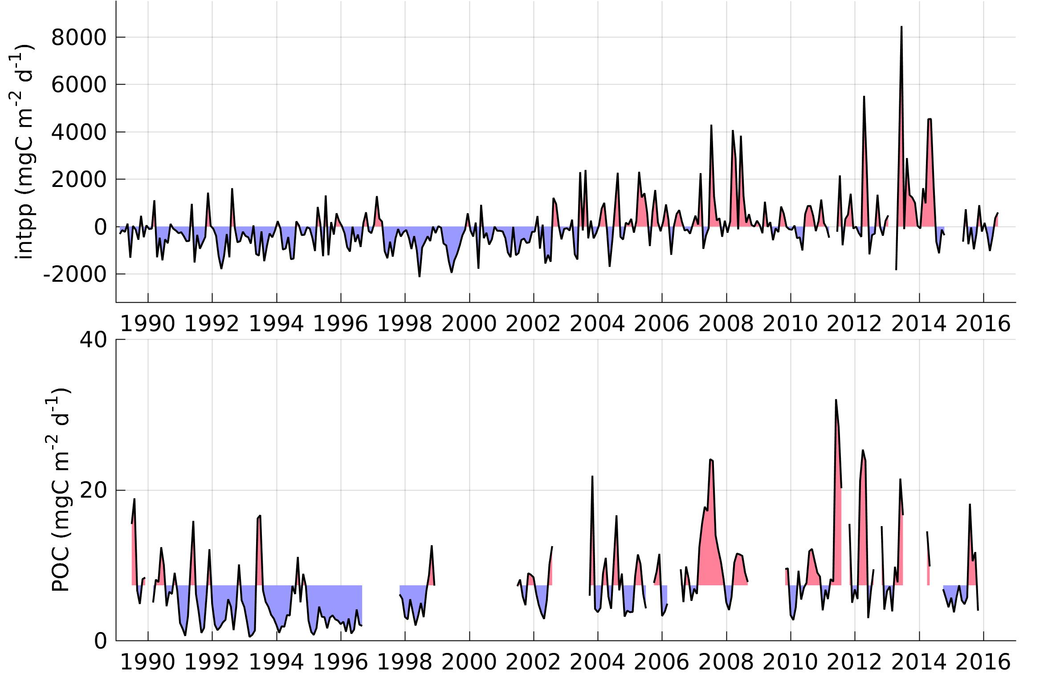
Time series: carbon fluxes
Primary production
POC
Notes:
12/7/16
6
6

Slide 7
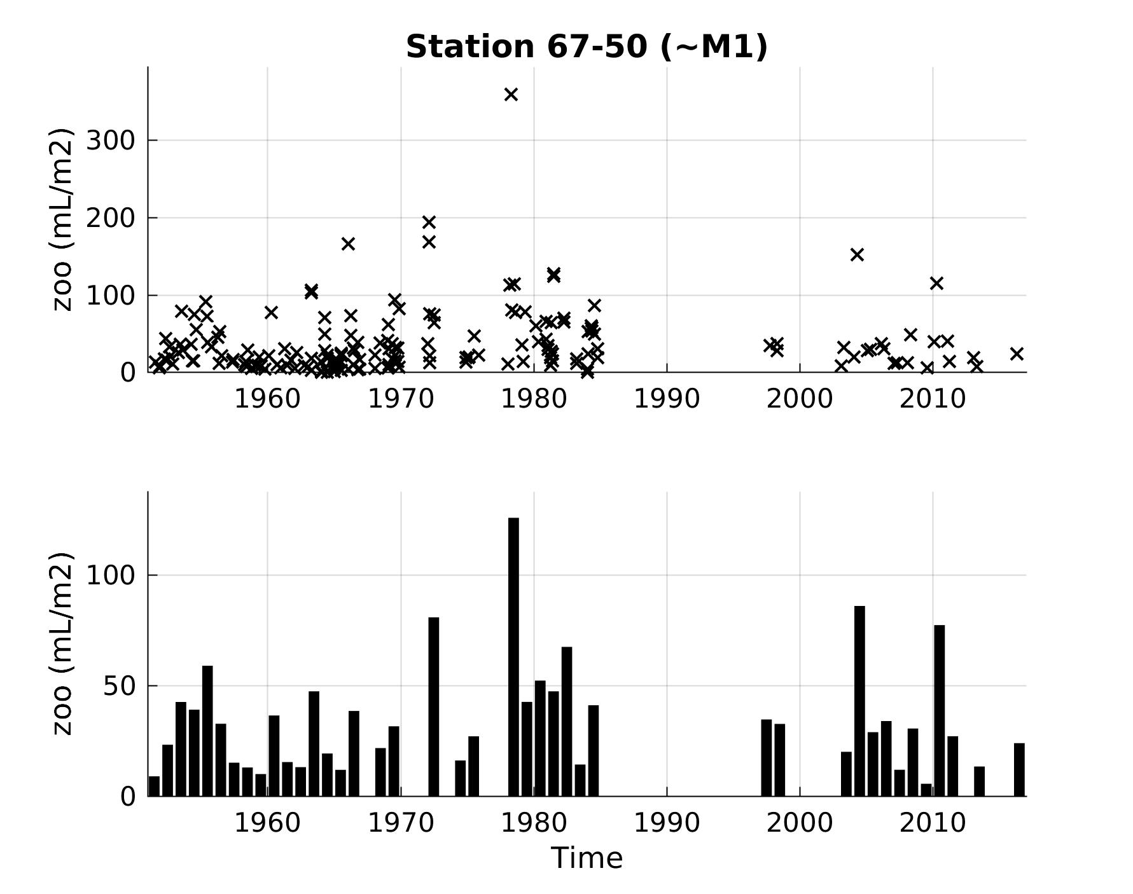
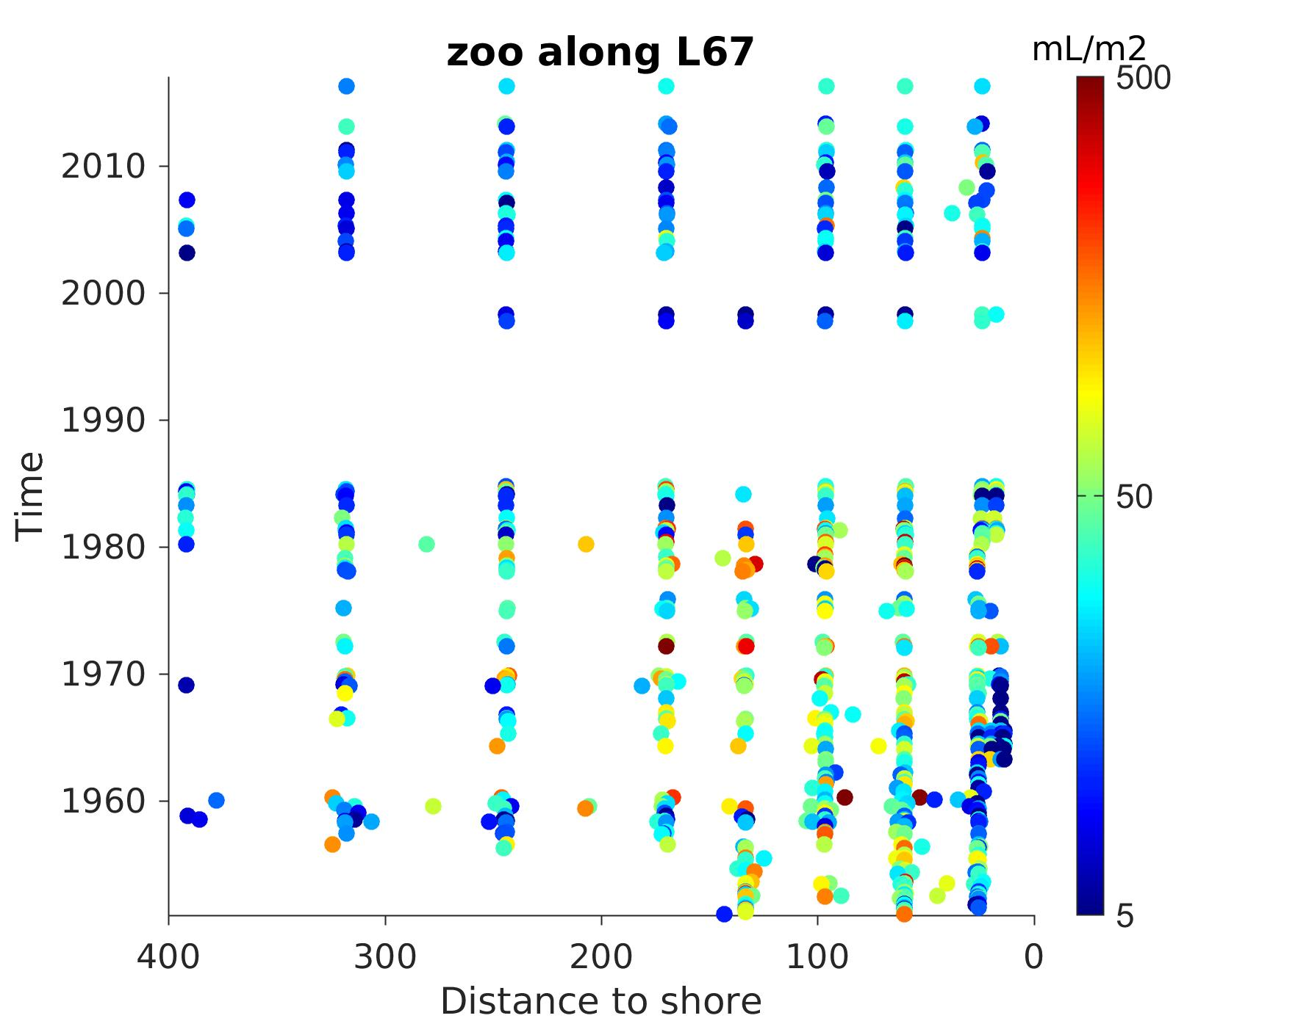
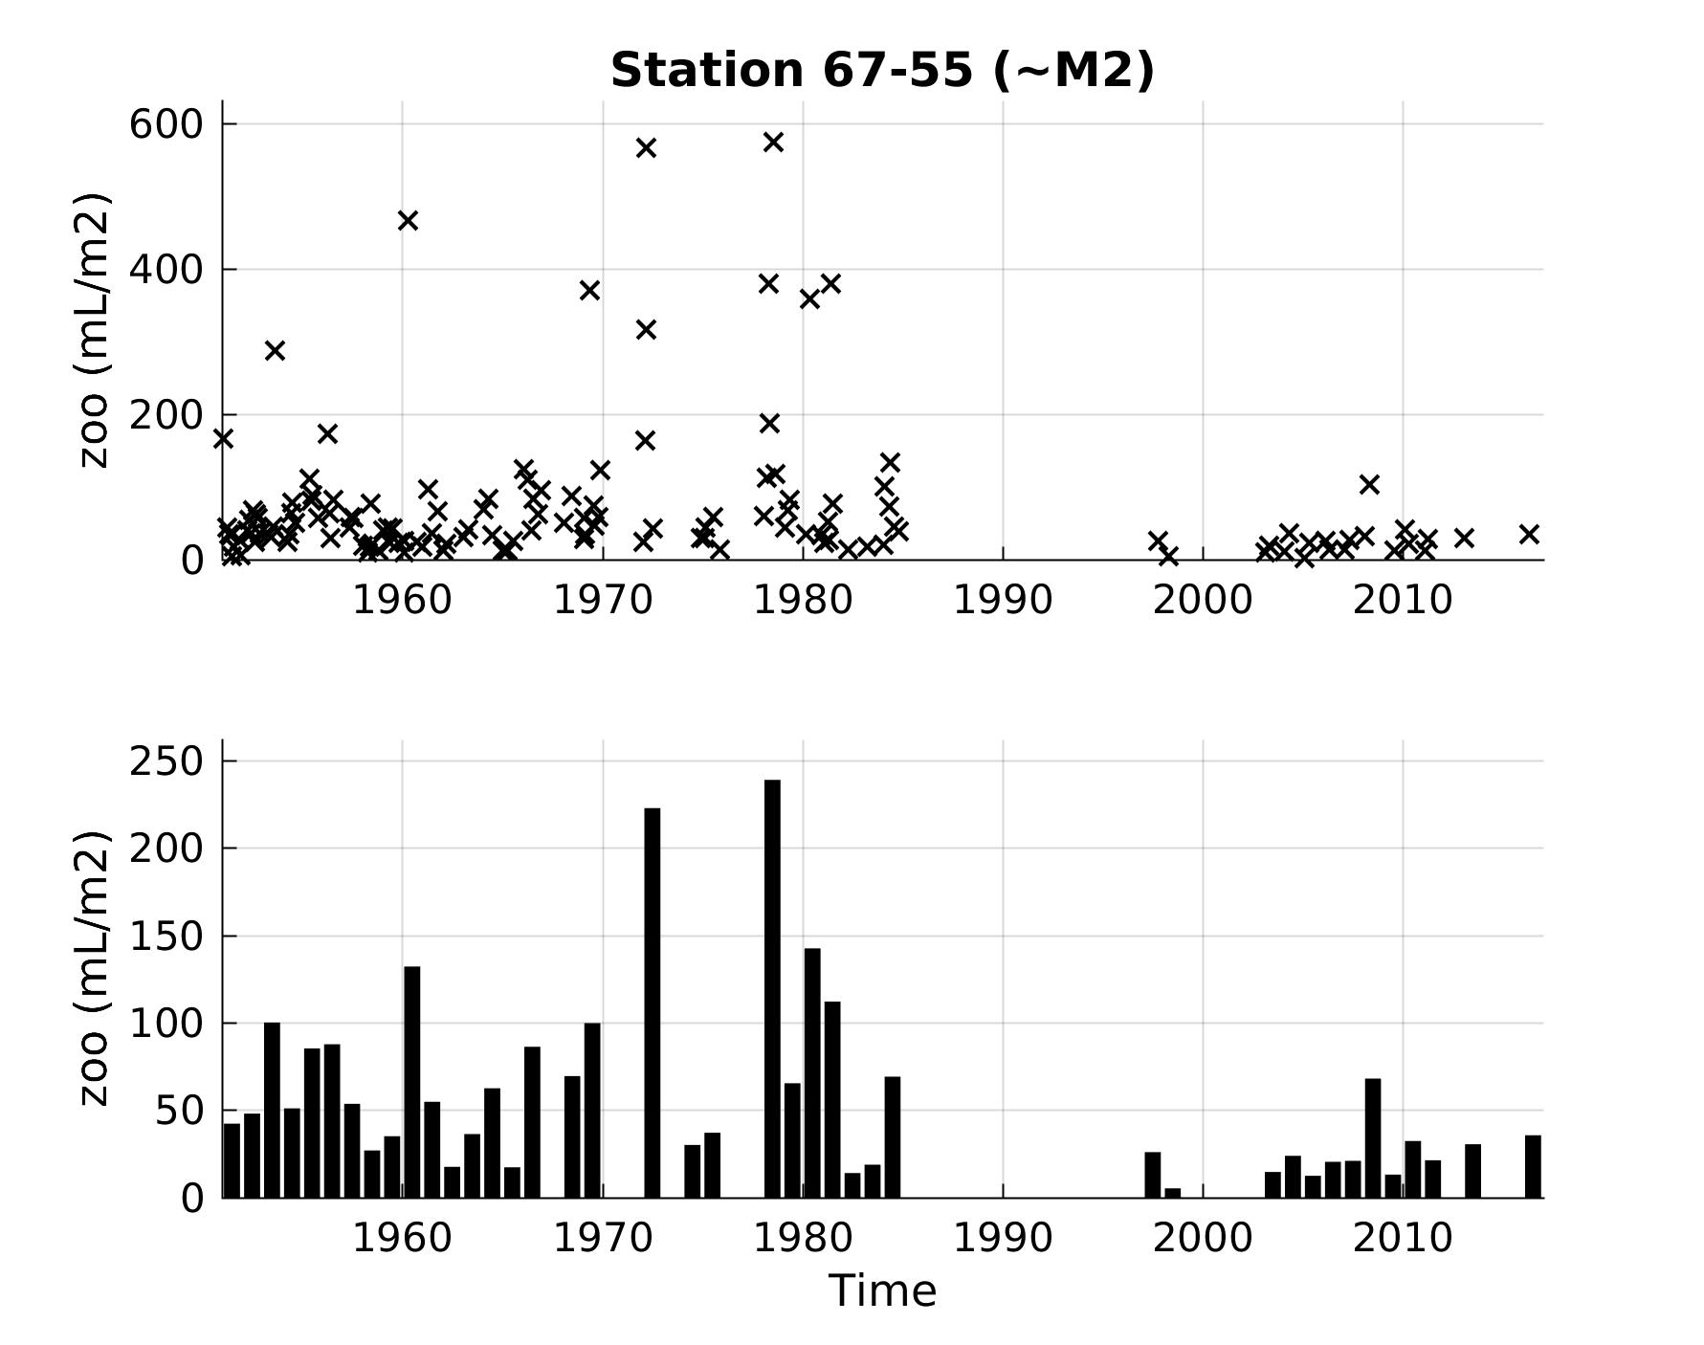
Time series: zooplankton
Notes:
12/7/16
7
7

Slide 8
Ecosytem composition
Method: MDS (similar results with PCA and clustering)
Minimum preprocessing: time series regridded monthly (1 gap filled), dataset-specific transform (√ or √√), Bray-Curtis distance
Time series:
      BOG plankton biomass
      MidW integrated counts per volume (200-1000m)
      Benthos echinoderm counts per area
Notes:
12/7/16
8
8

Slide 9
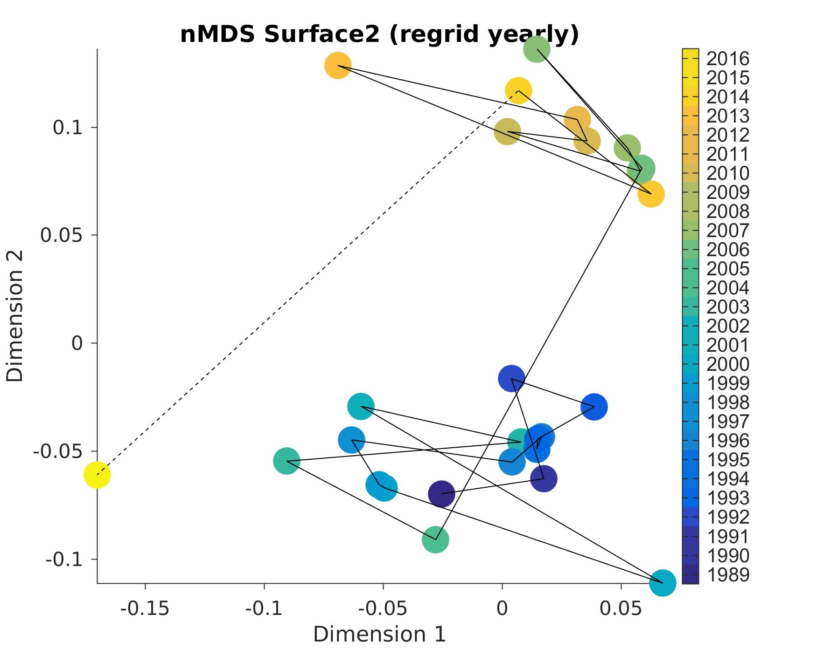
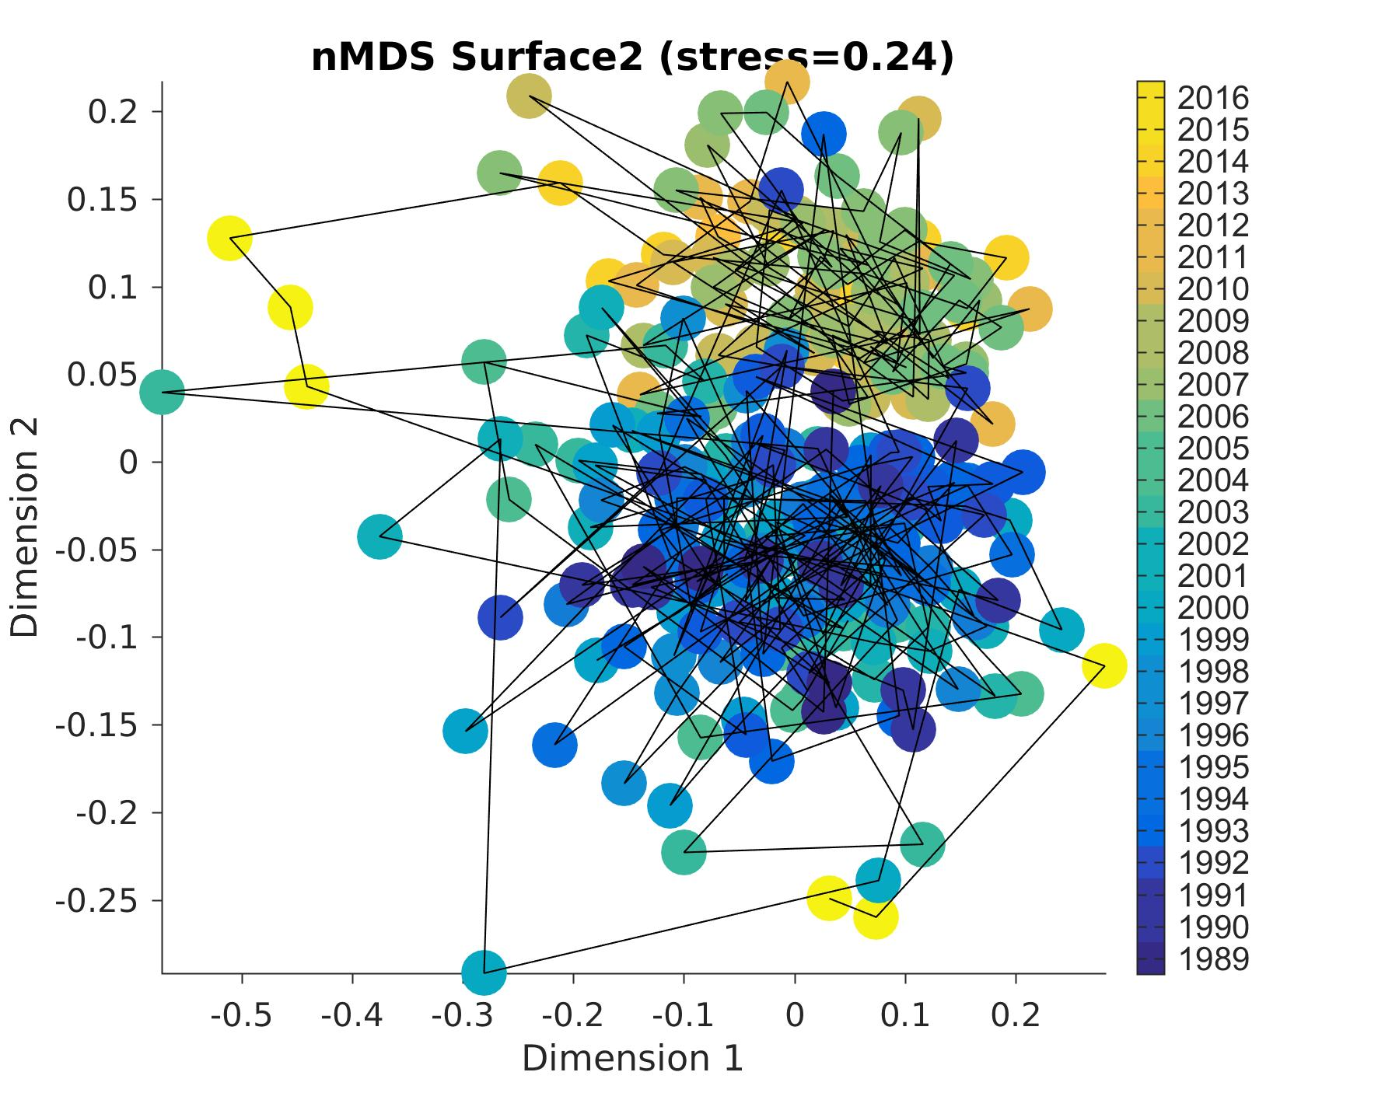
Missing year: 2015
BOG species
12
05
Monthly
16
89
00
Shift between 2004 and 2005??
(= change in counters…)
Notes:
12/7/16
9
9

Slide 10
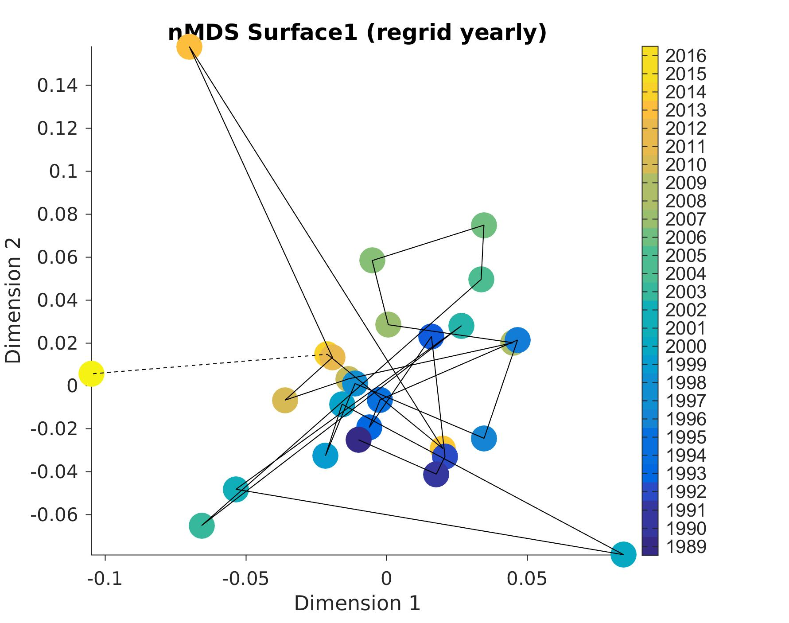
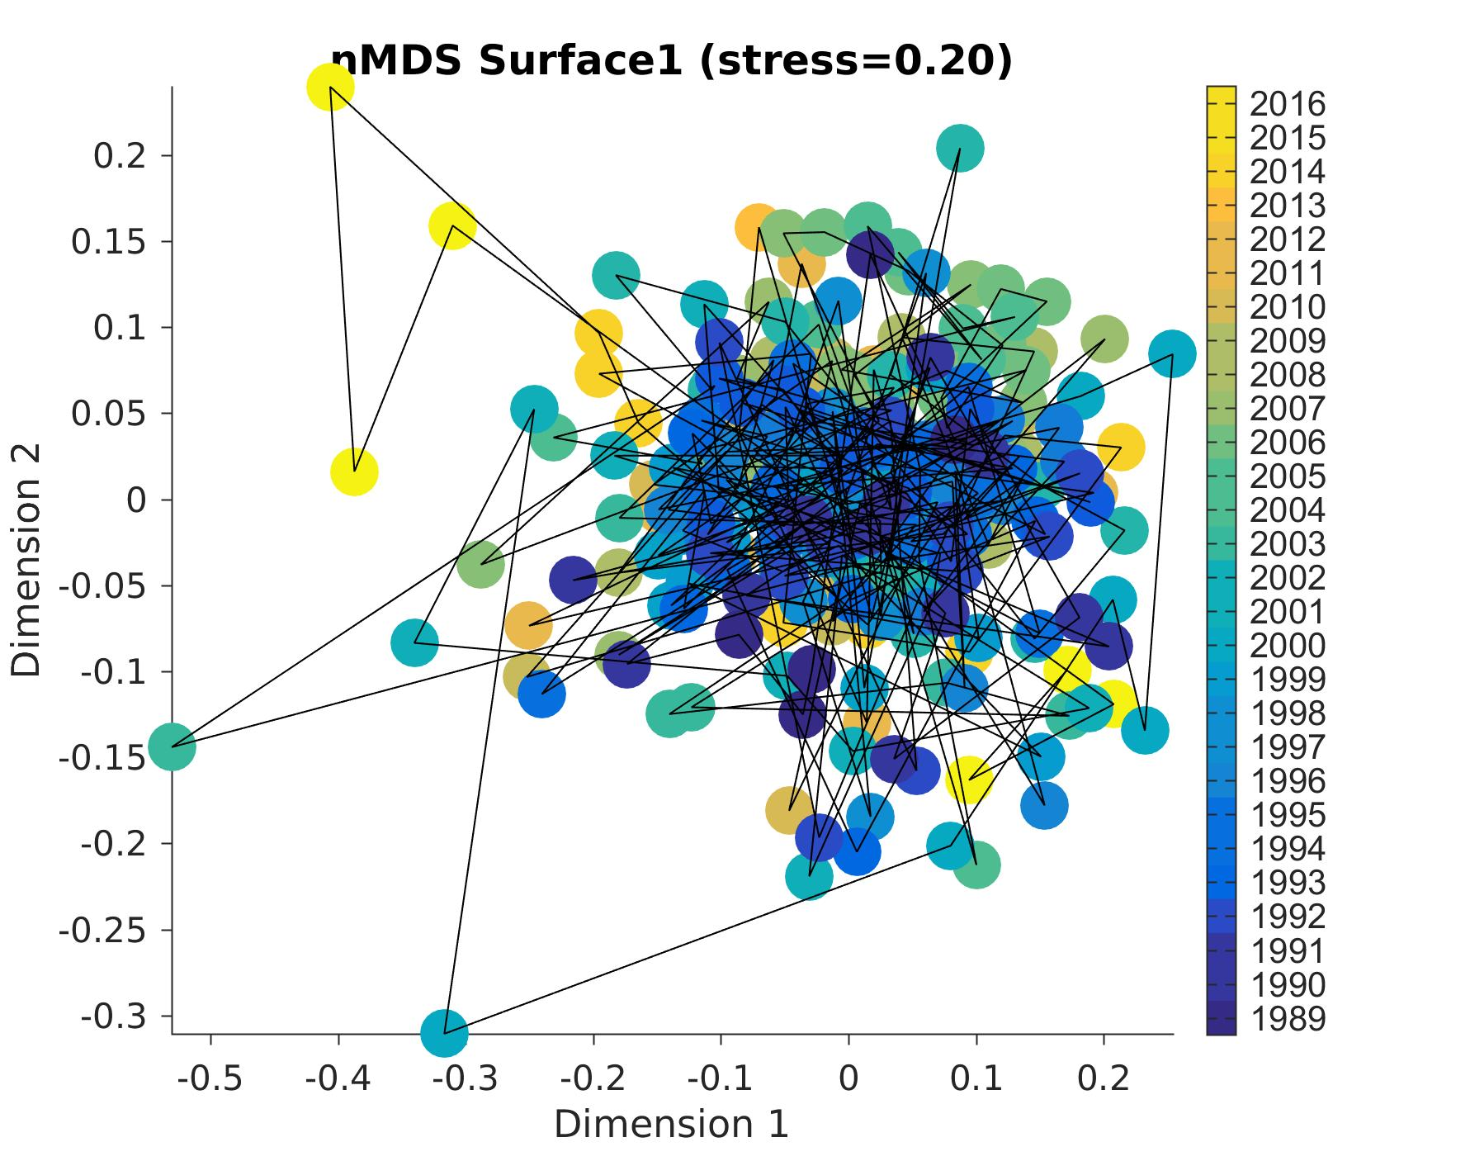
Missing year: 2015
BOG groups
12 (missing data)
04-06
Monthly
16
89
00
Age of the dinoflagellates
Notes:
12/7/16
10
10

Slide 11
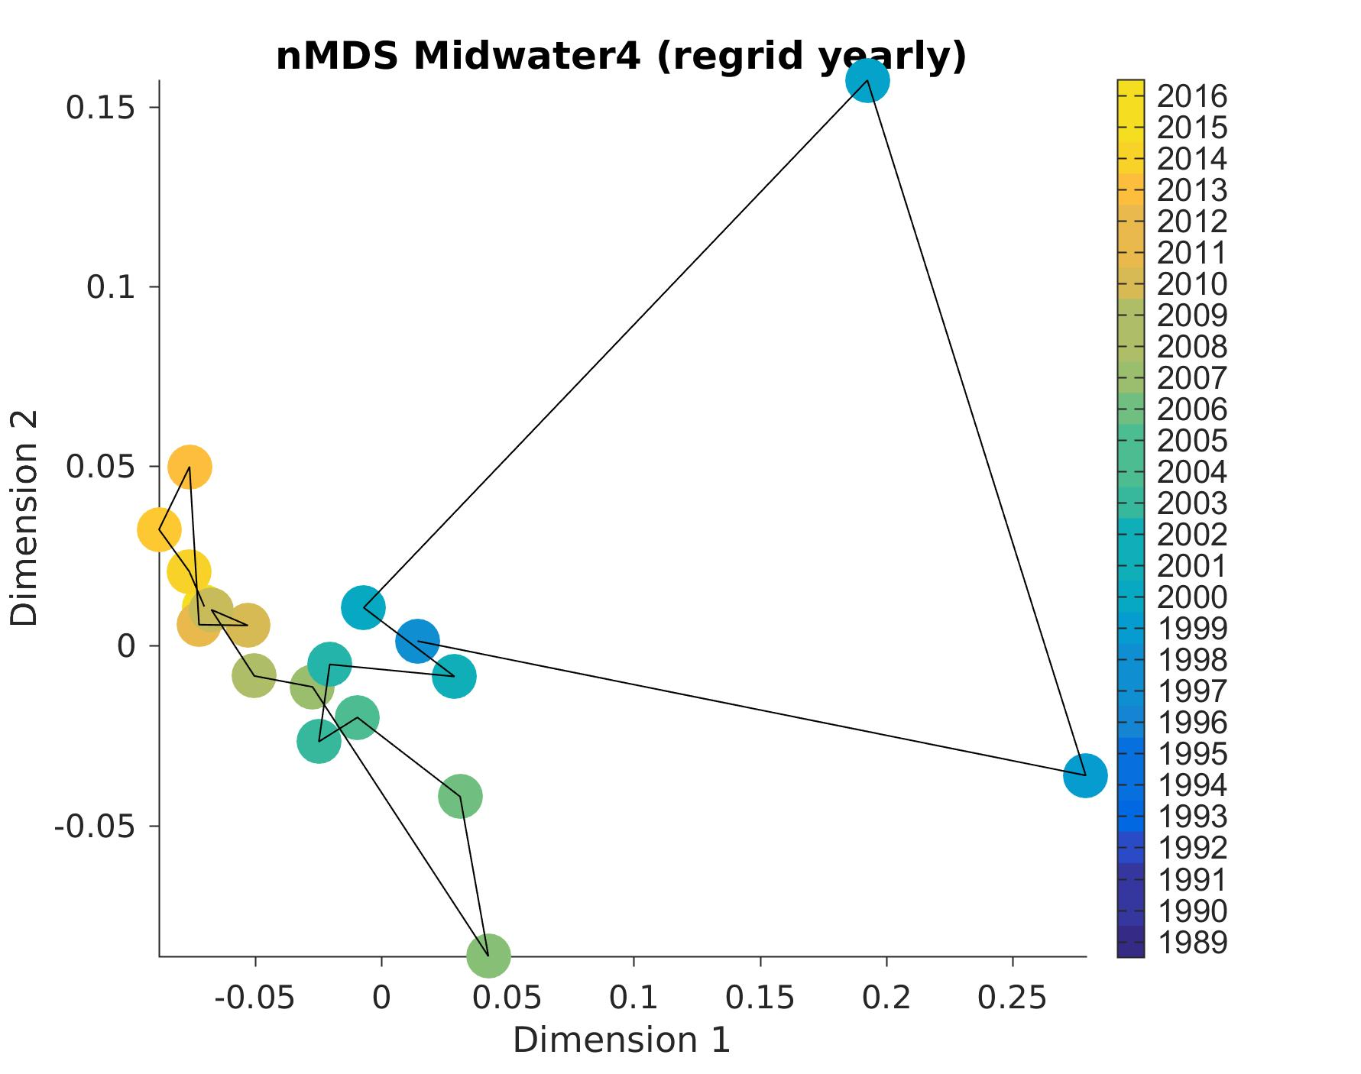
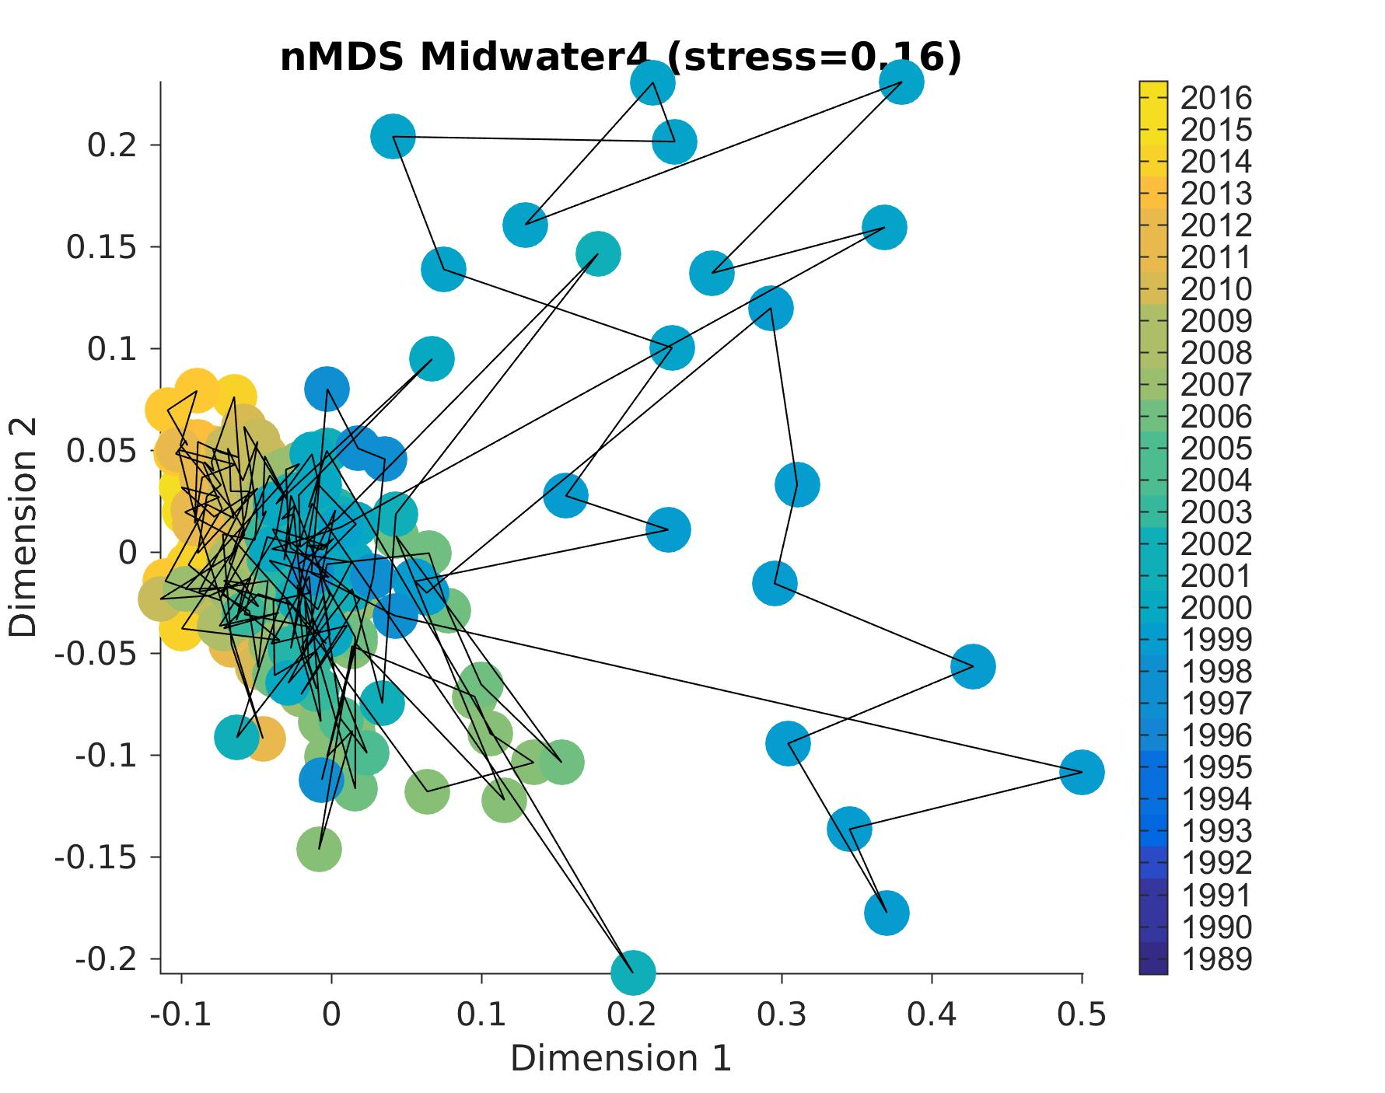
Midwater
99
Monthly
98
05
1998-99 anomalous
Recent years different
Notes:
12/7/16
11
11

Slide 12
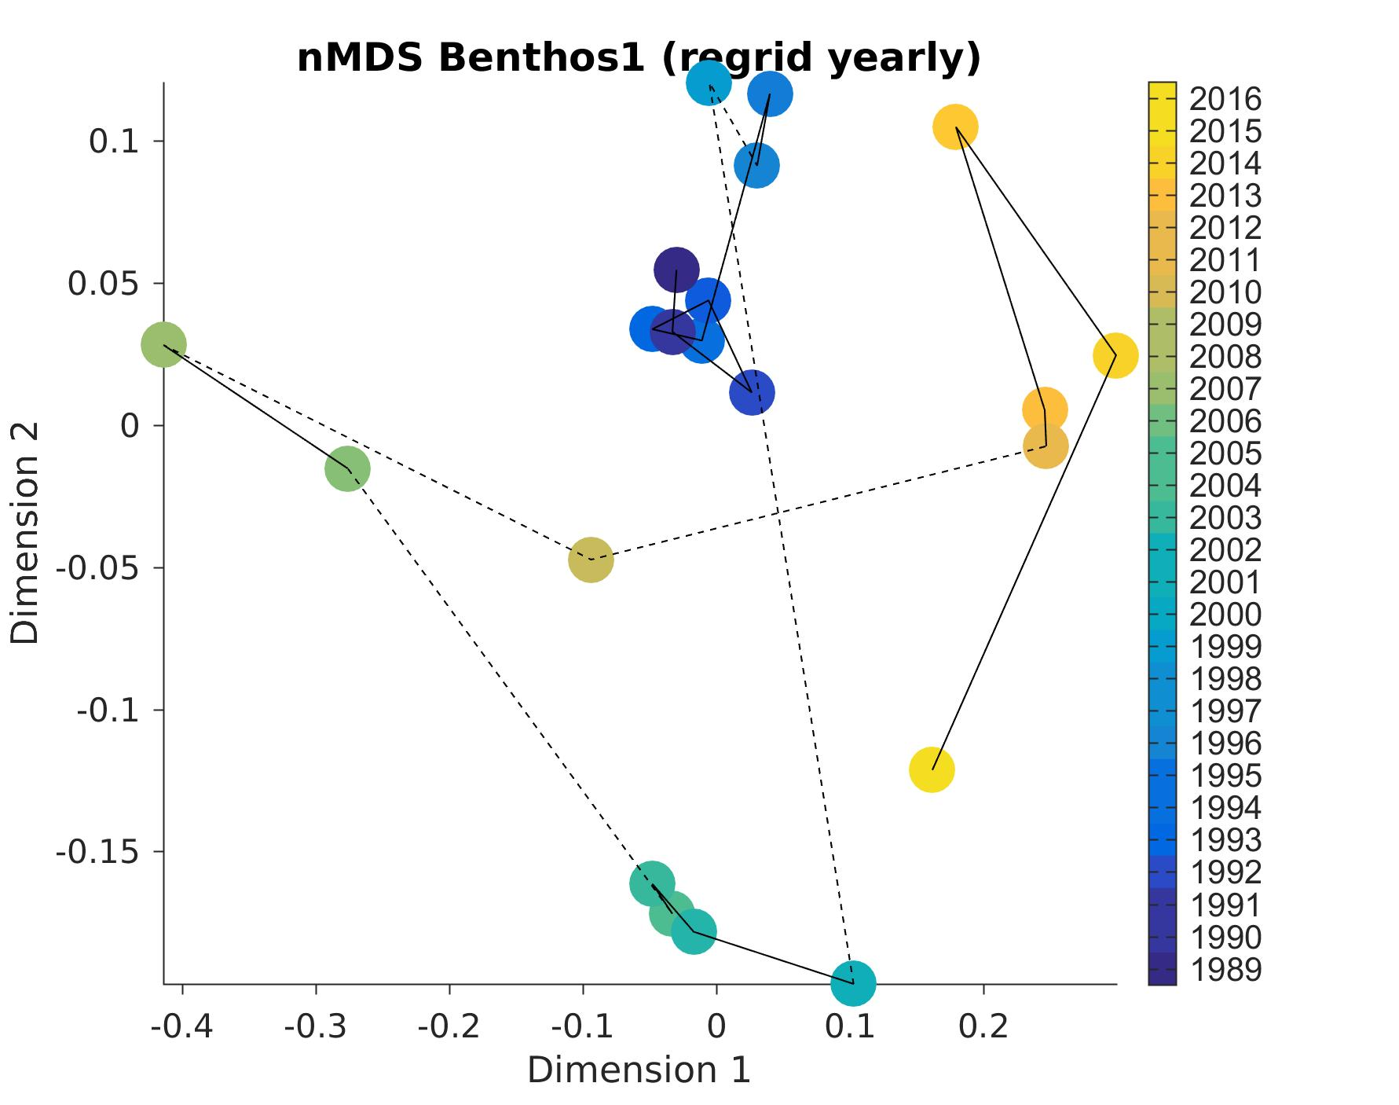
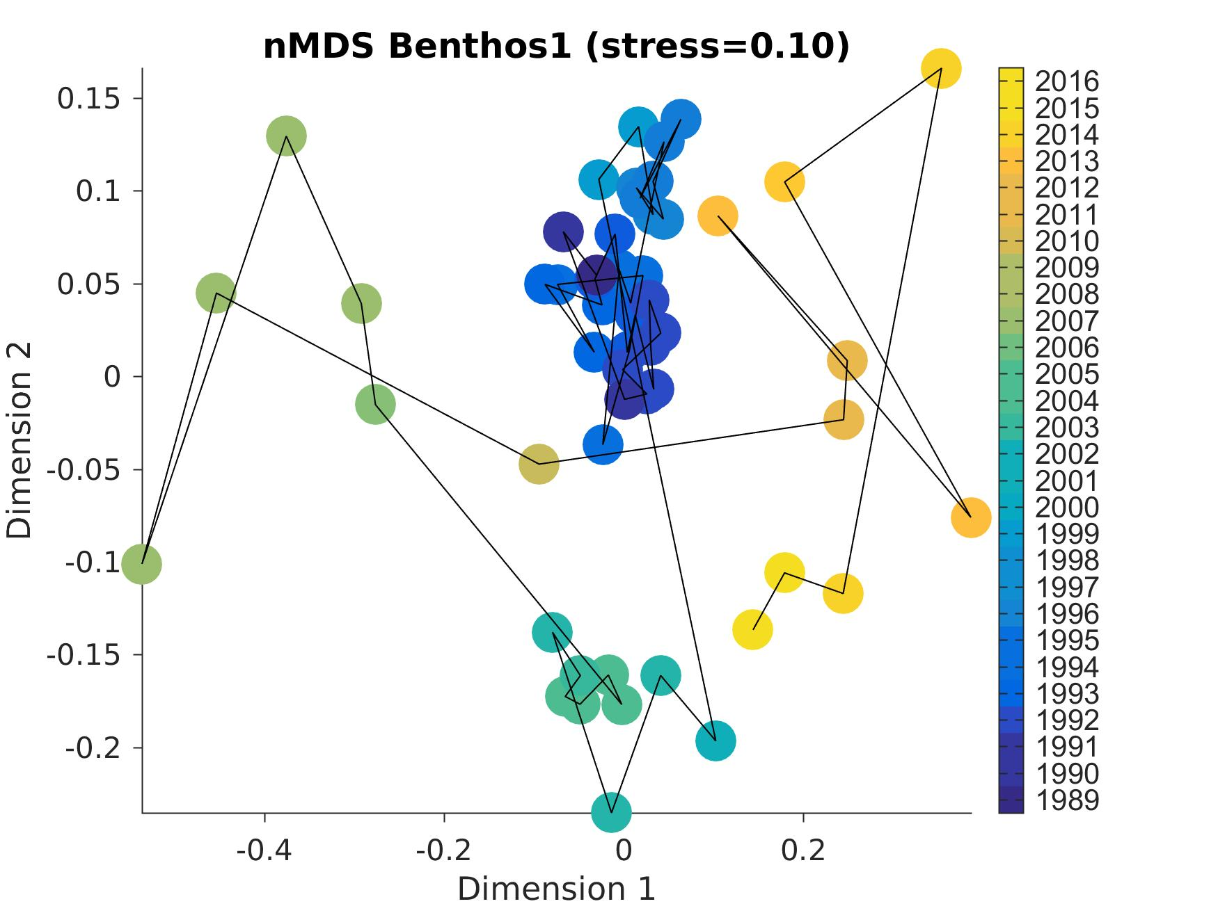
Missing years: 1997, 1999, 2000, 2005, 2008, 2010
Benthos
98
13
89
07
06
09
11
Monthly
15
01
Shift between 1998 and 2001,
then all over the place
Notes:
12/7/16
12
12

Slide 13
12 (missing data)
surface
Conclusion: no clear regime shift in the late 90s except in the benthos
04-06
16
89
midwater
00
benthos
99
98
13
07
89
06
09
11
15
98
05
01

Slide 14
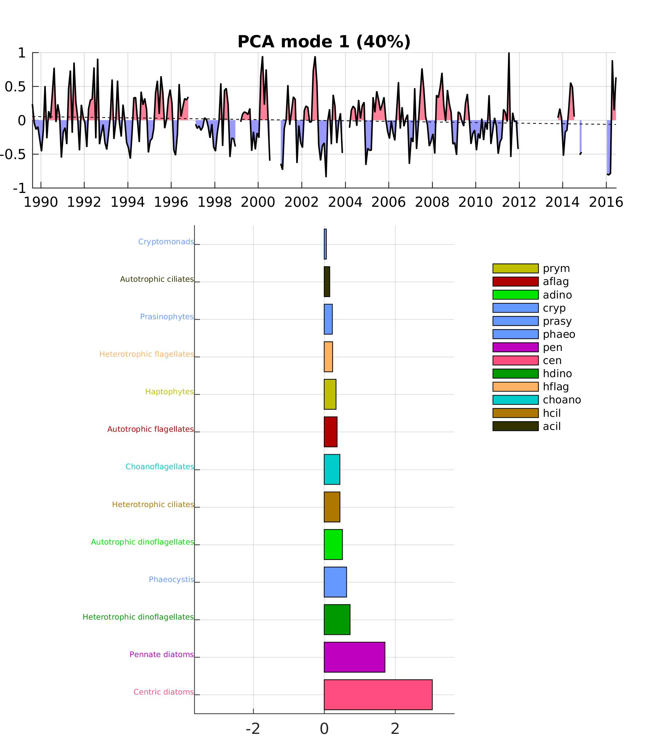
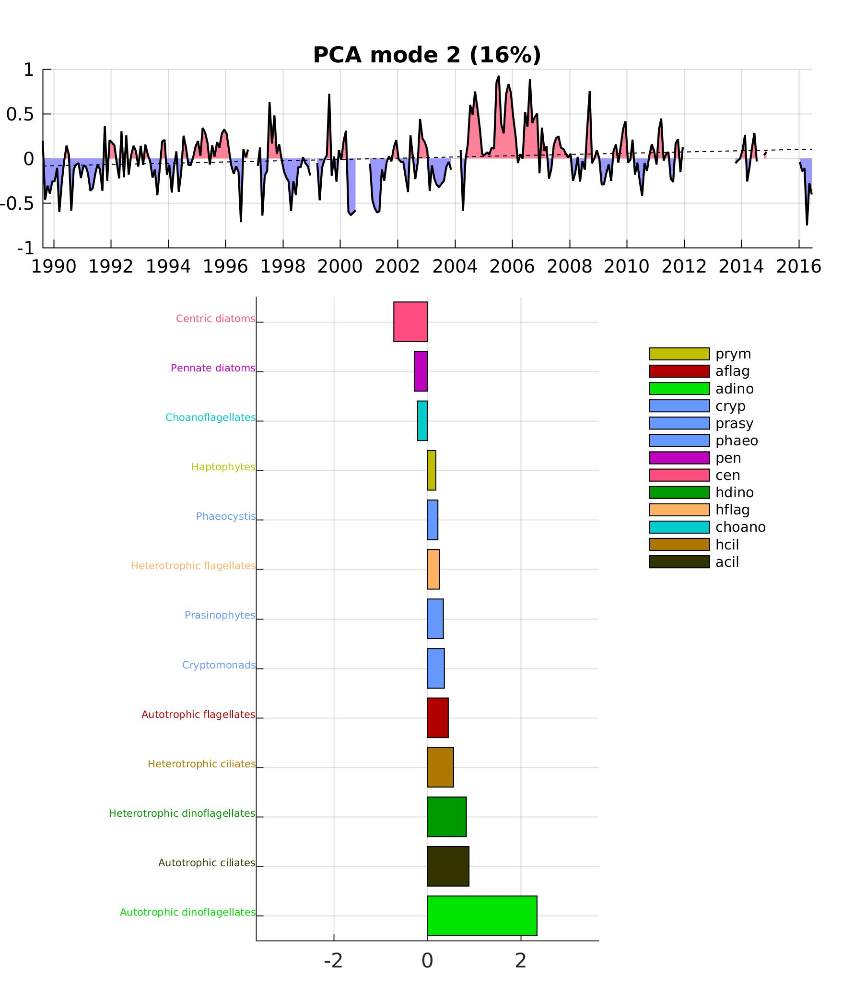
Time series from PCA: BOG groups
Mode 1 = diatoms blooms
Mode 2 =
dinos age

Slide 15
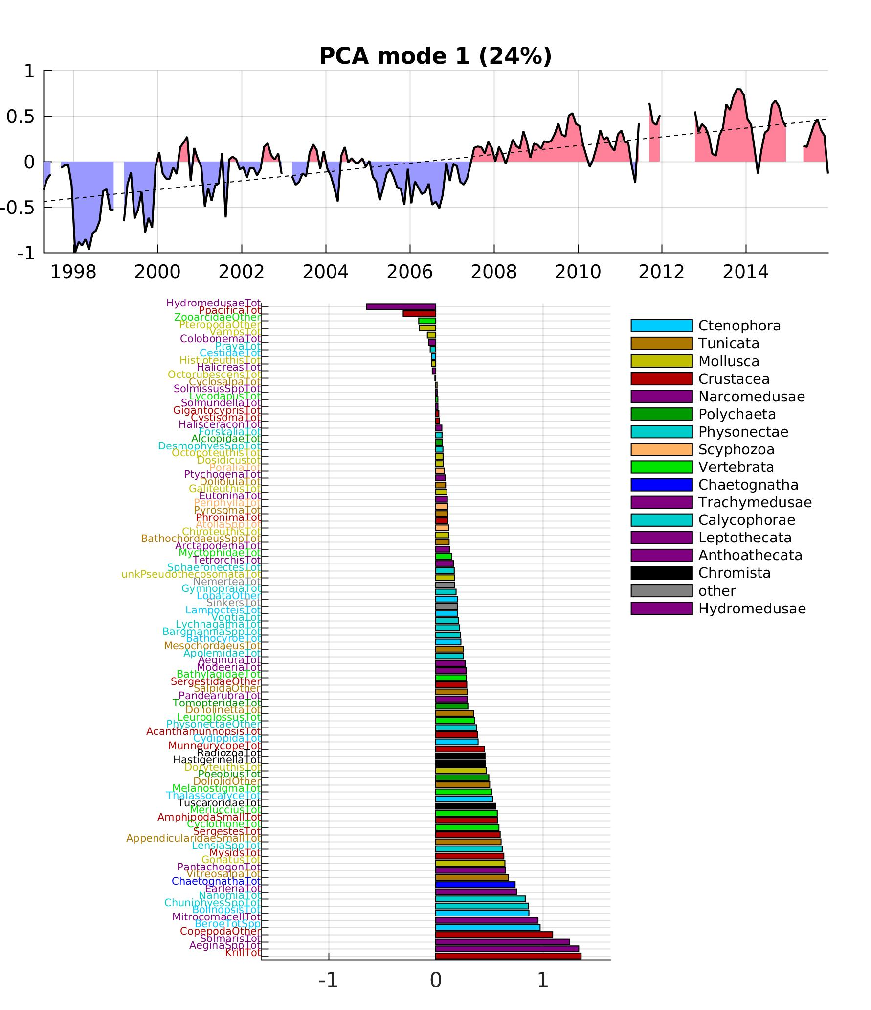
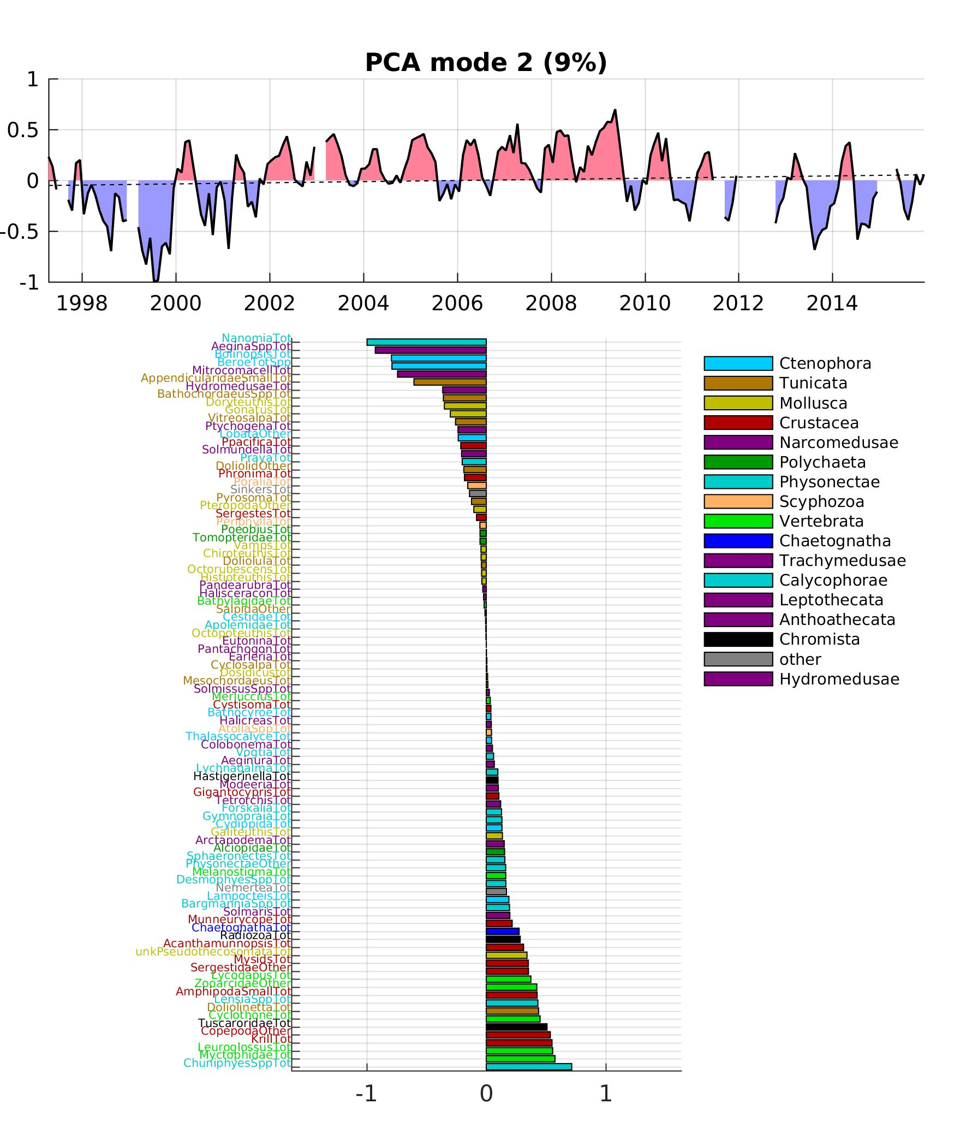
Time series from PCA: Midwater
Mode 2 =
seasonal cycle, alternance Vertebrata/Crustaceavs Ctenophora/Medusae /Tunicata
Mode 1 =
El Niño & 2005-06

Slide 16
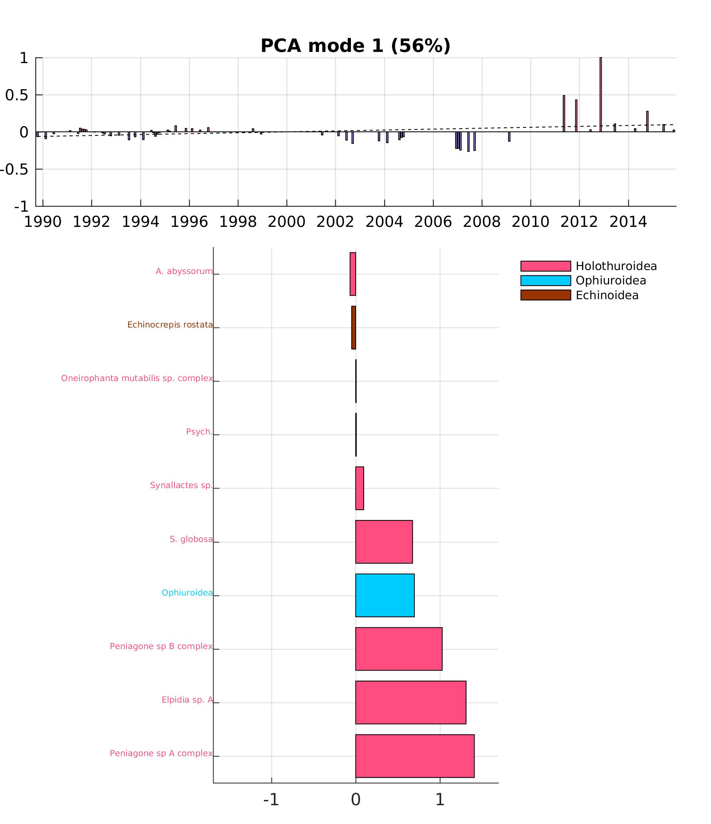
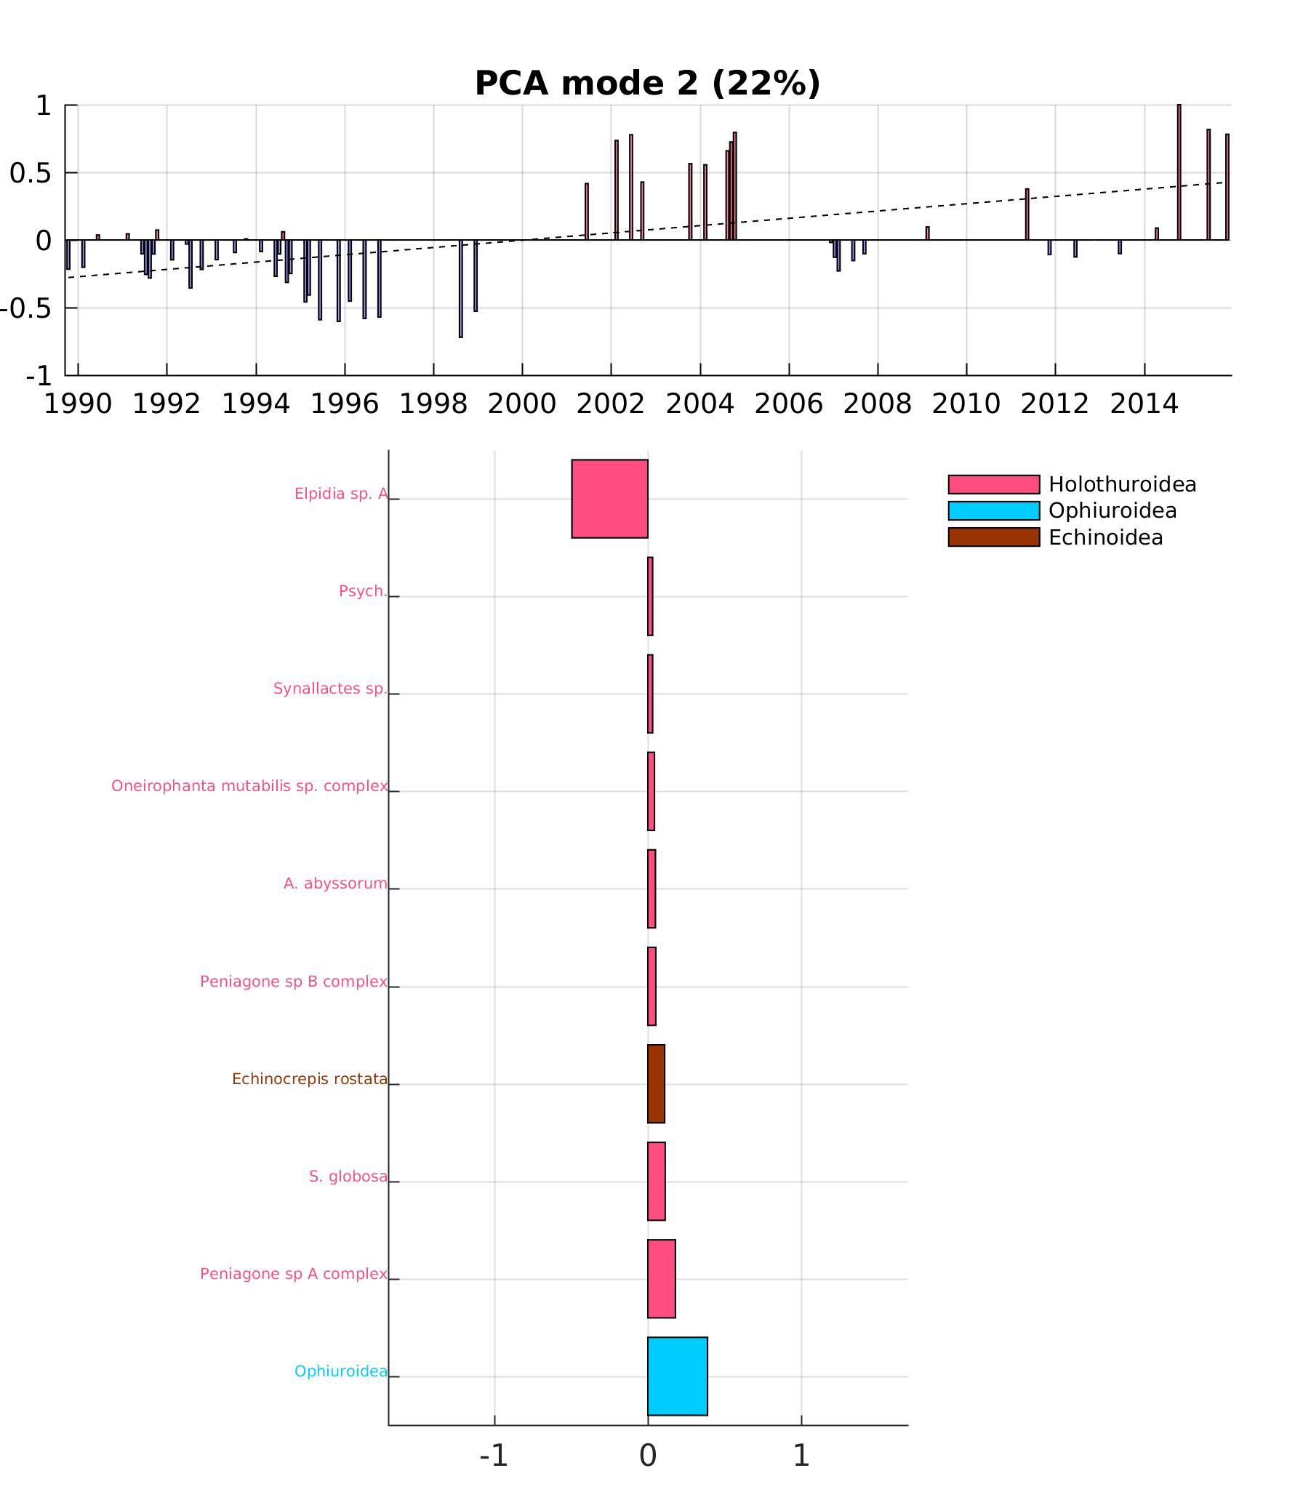
Time series from PCA: Benthos
Mode 1 =
high numbers in 2011-12
Mode 2 =
community shift around 2000

Slide 17
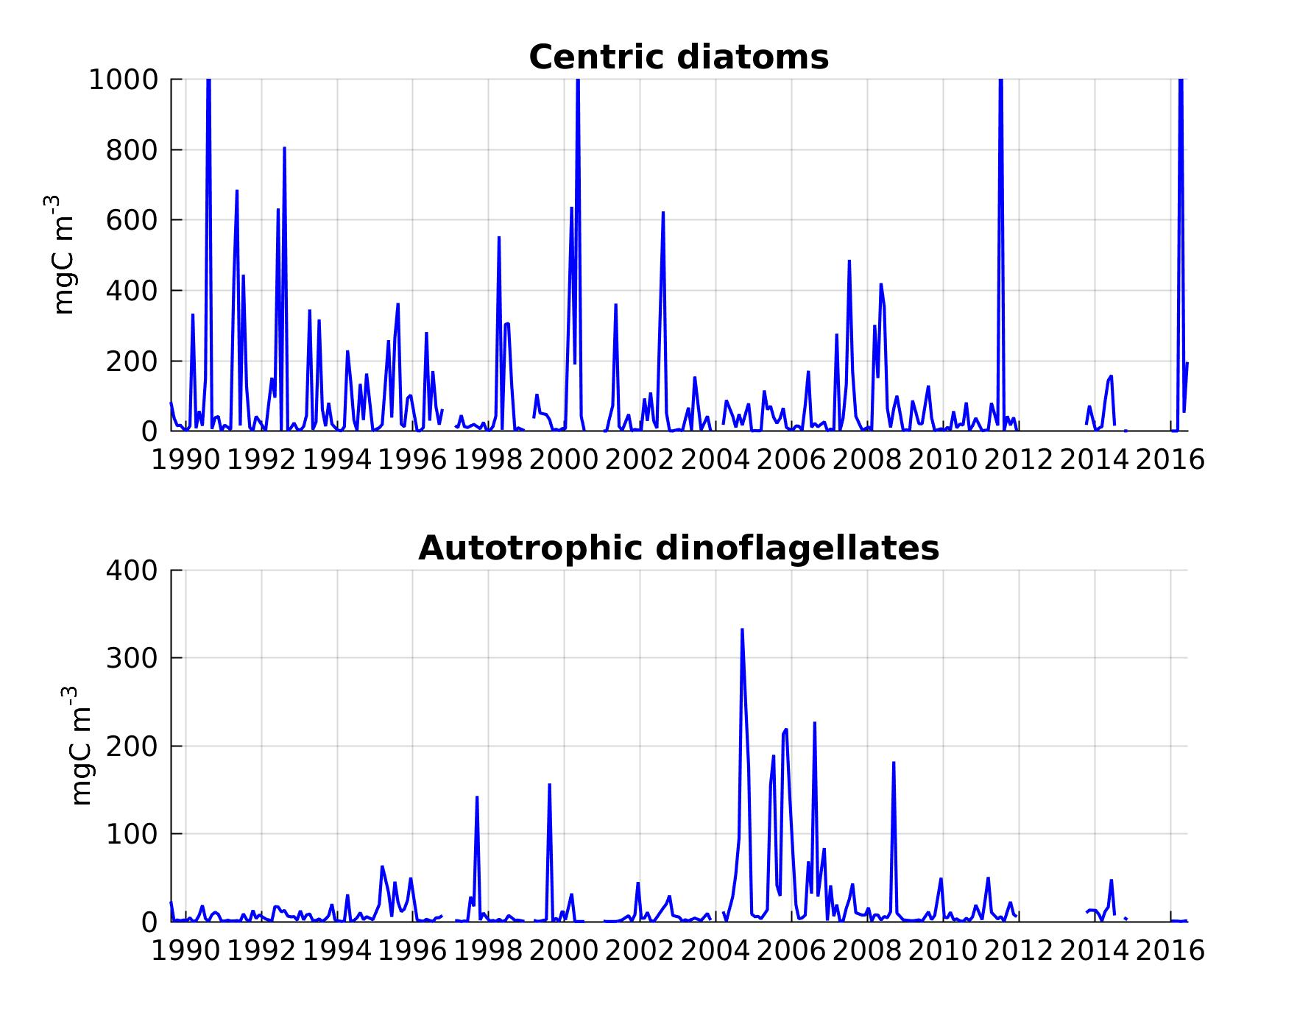
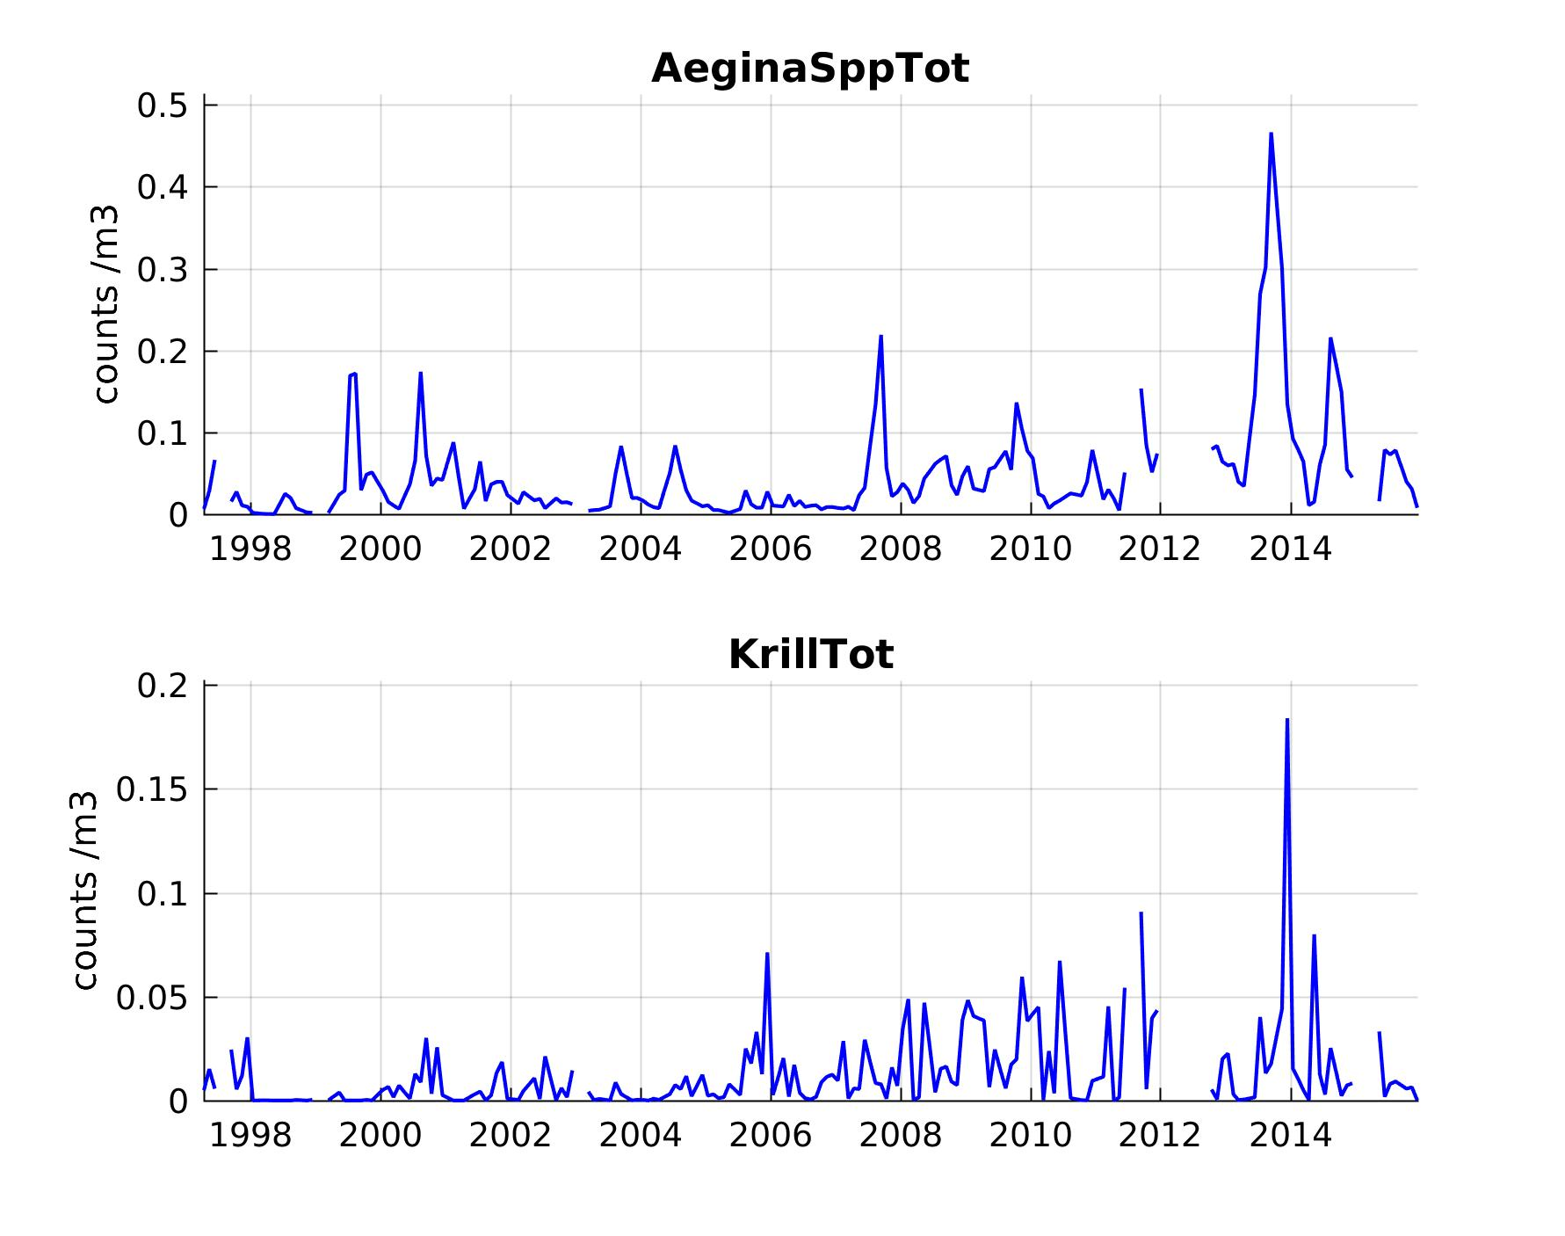
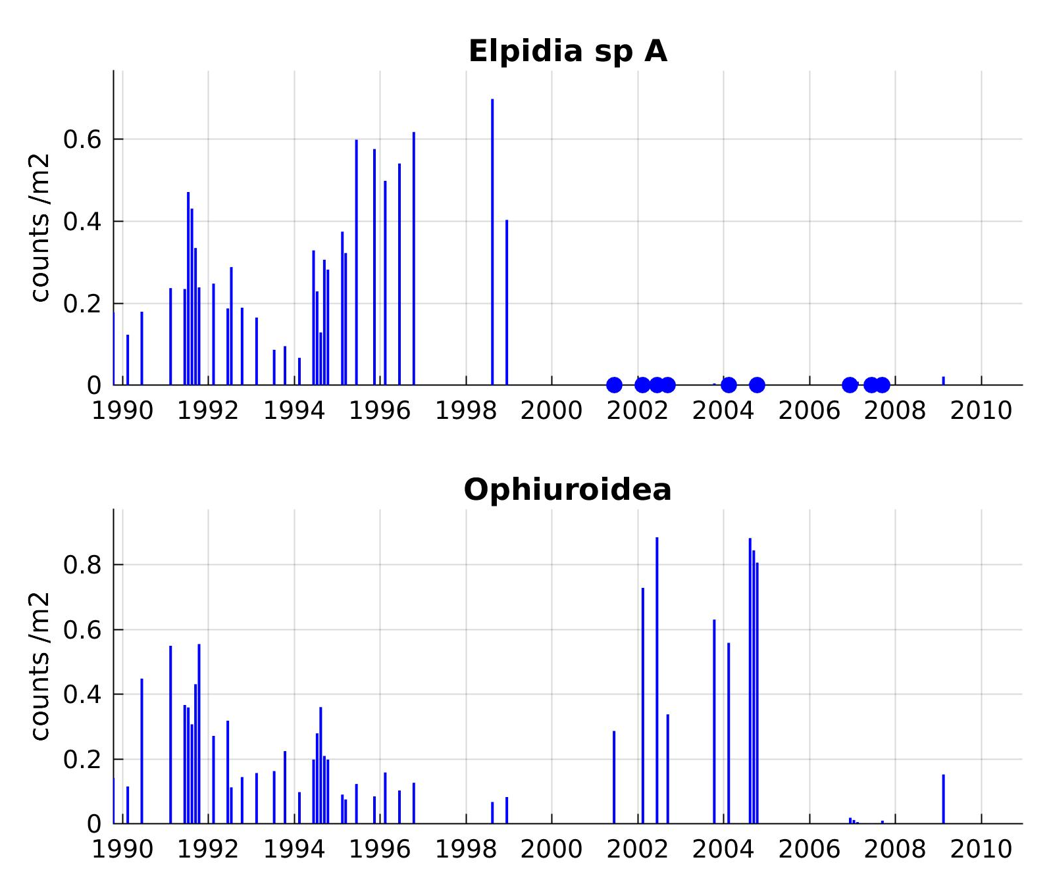
Notes:
12/7/16
17
17

