Slide 1
ITS scientific product? (= paper)
Options:
Ecosystem indices
El Niño
Dinoflagellates age
Carbon links
Testing textbook theories
Environmental variability integration across the water column
… else?
added after meeting (forgotten about): regime shift

Slide 2
1. Ecosystem indices
Concept: describe community composition changes over time in the 3 time series
Conclusion: some clear signals that make sense and capture known changes in each time series, but no real link between them except:
  community stable until late 90s, more variable afterwards (prob. not true for midwater)
  decreases in numbers & different community around the mid-2000s
  recent years (since ~ 2010) also different
To do: run yearly analysis with the 3 time series together (2001-present?)

Slide 3
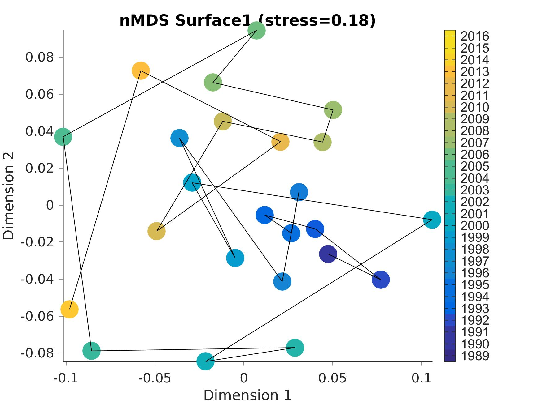
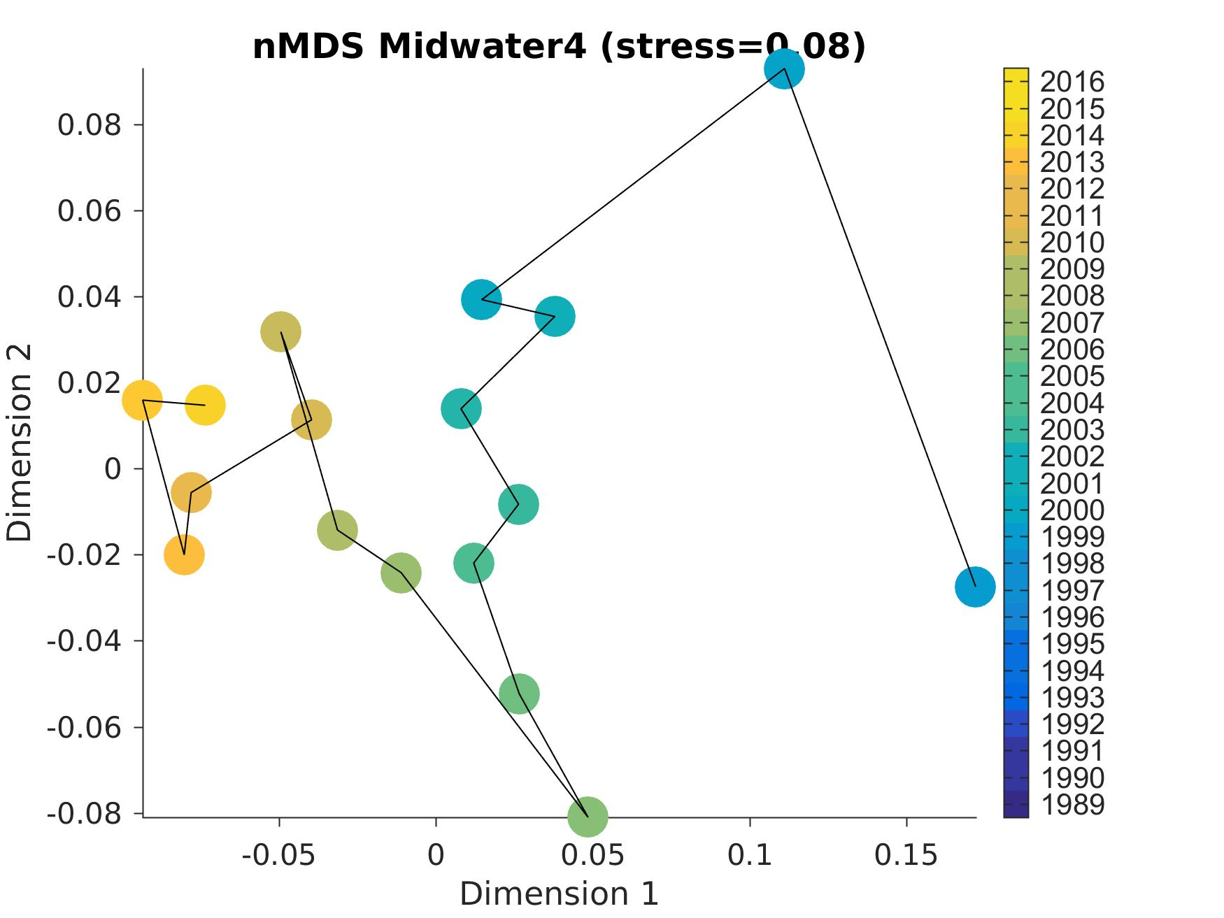
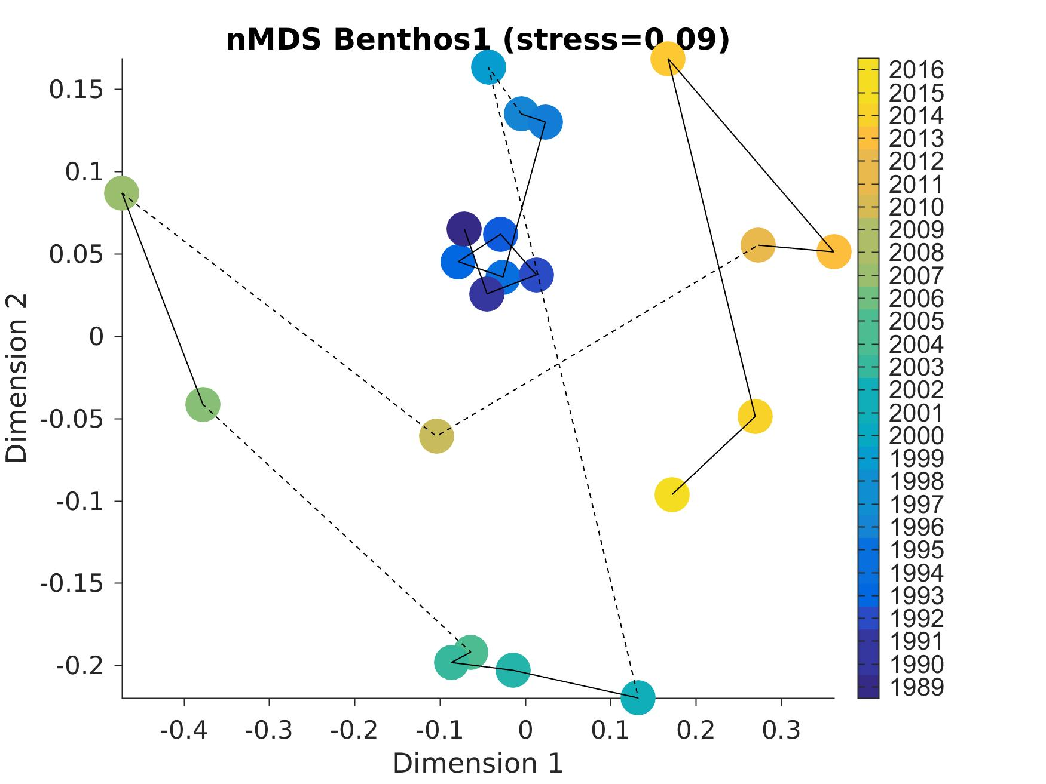
1. Ecosystem indices (MDS)
SURFACE
MIDWATER
05
99
06
04
14
00
90
98
13
05
03
BENTHOS
06
98
07
89
Community fairly stable until late 90s, then changes
05-07 tend to stand out, and recent years
11
06
09
15
MDS on yearly data
(custom definition per species for surface & MidW)
04
01

Slide 4
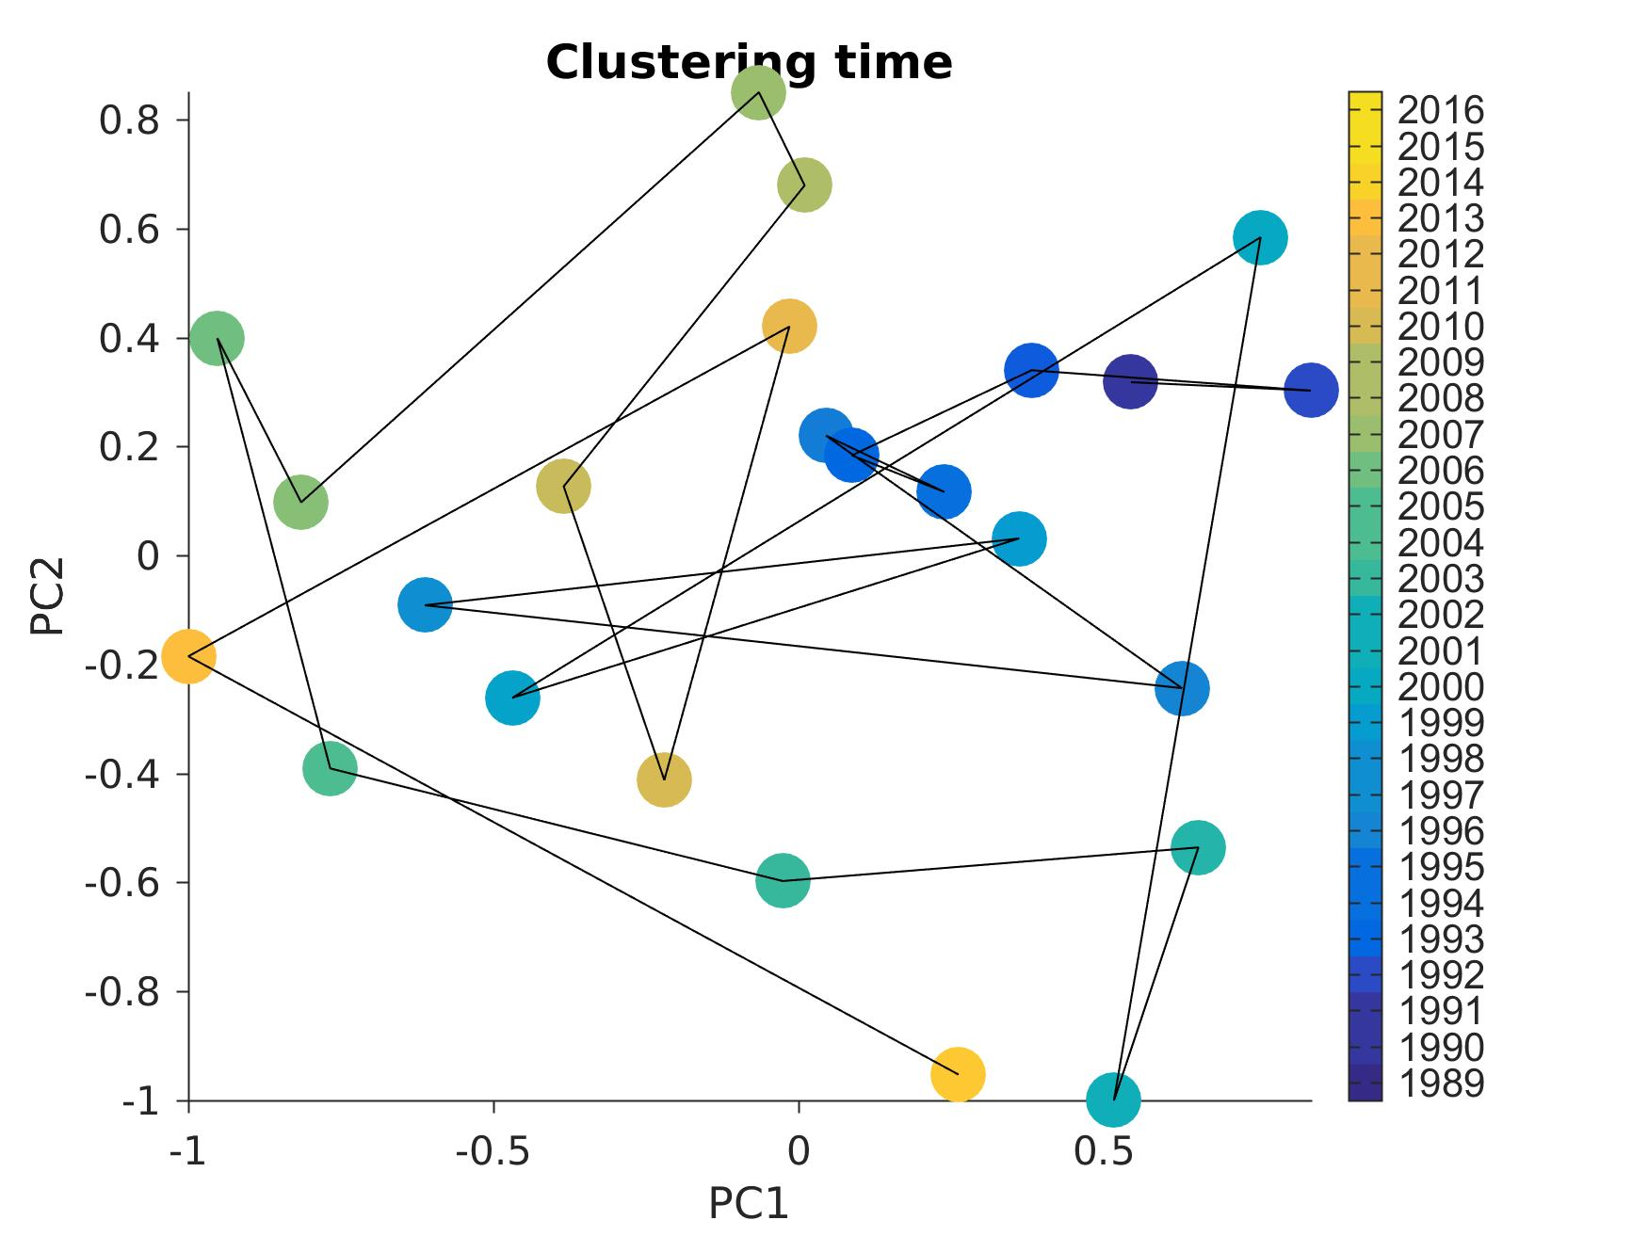
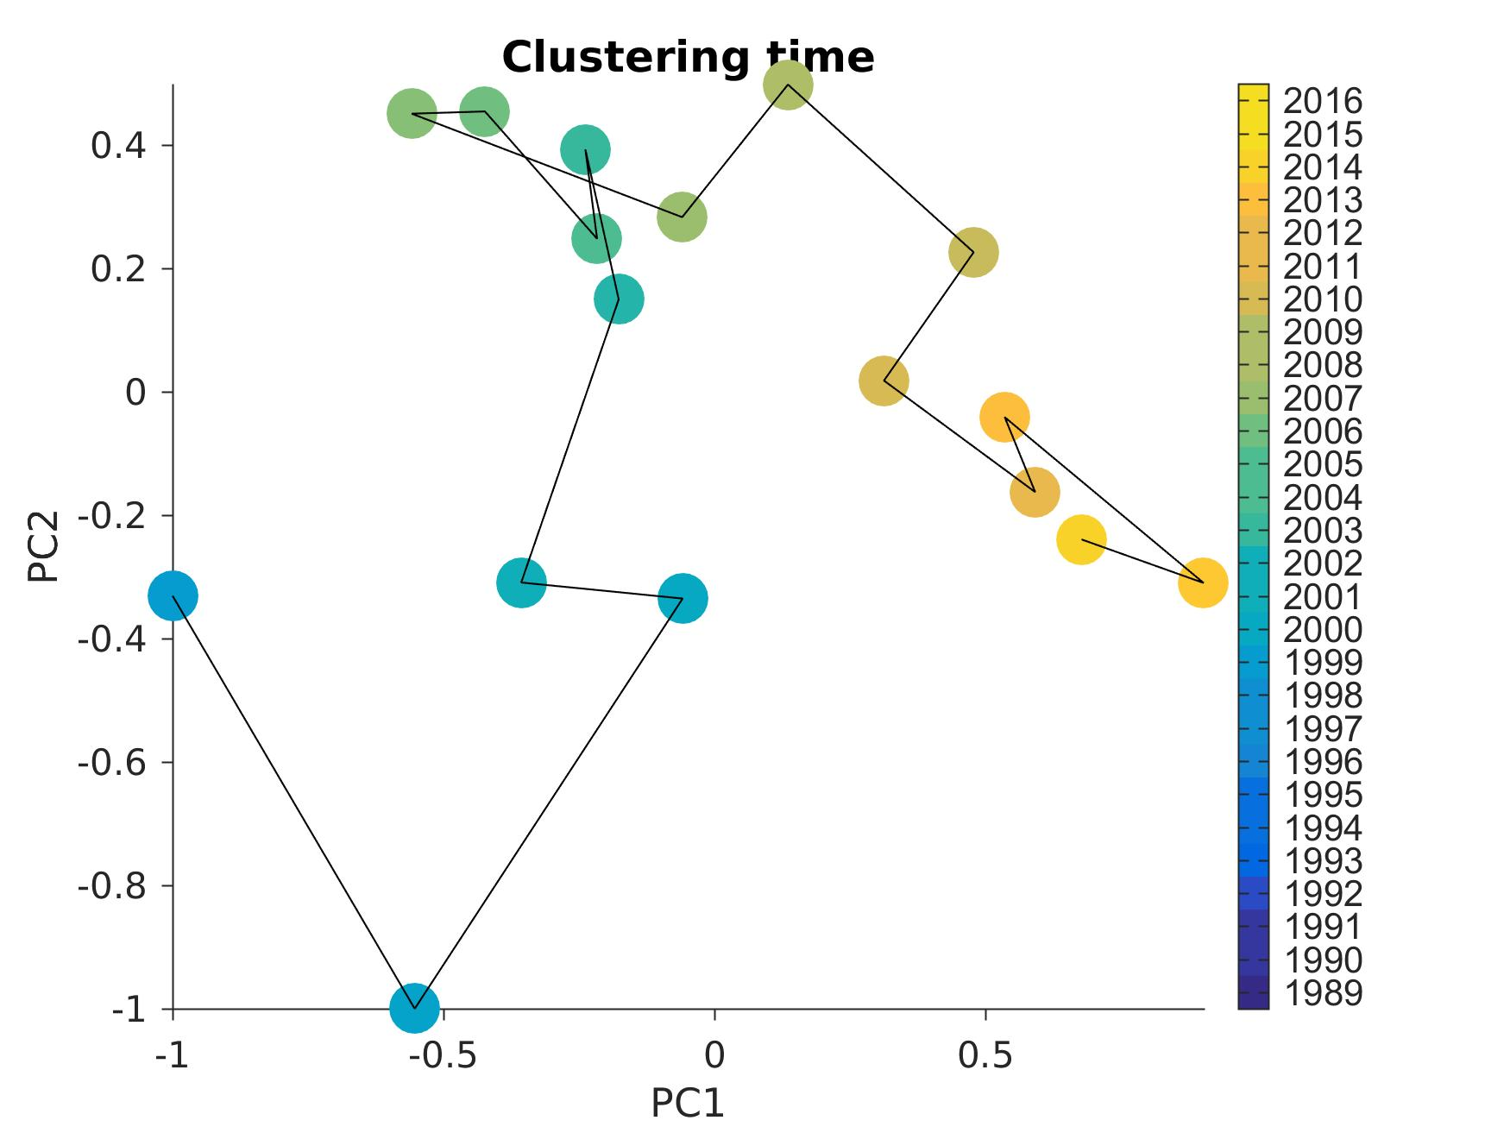
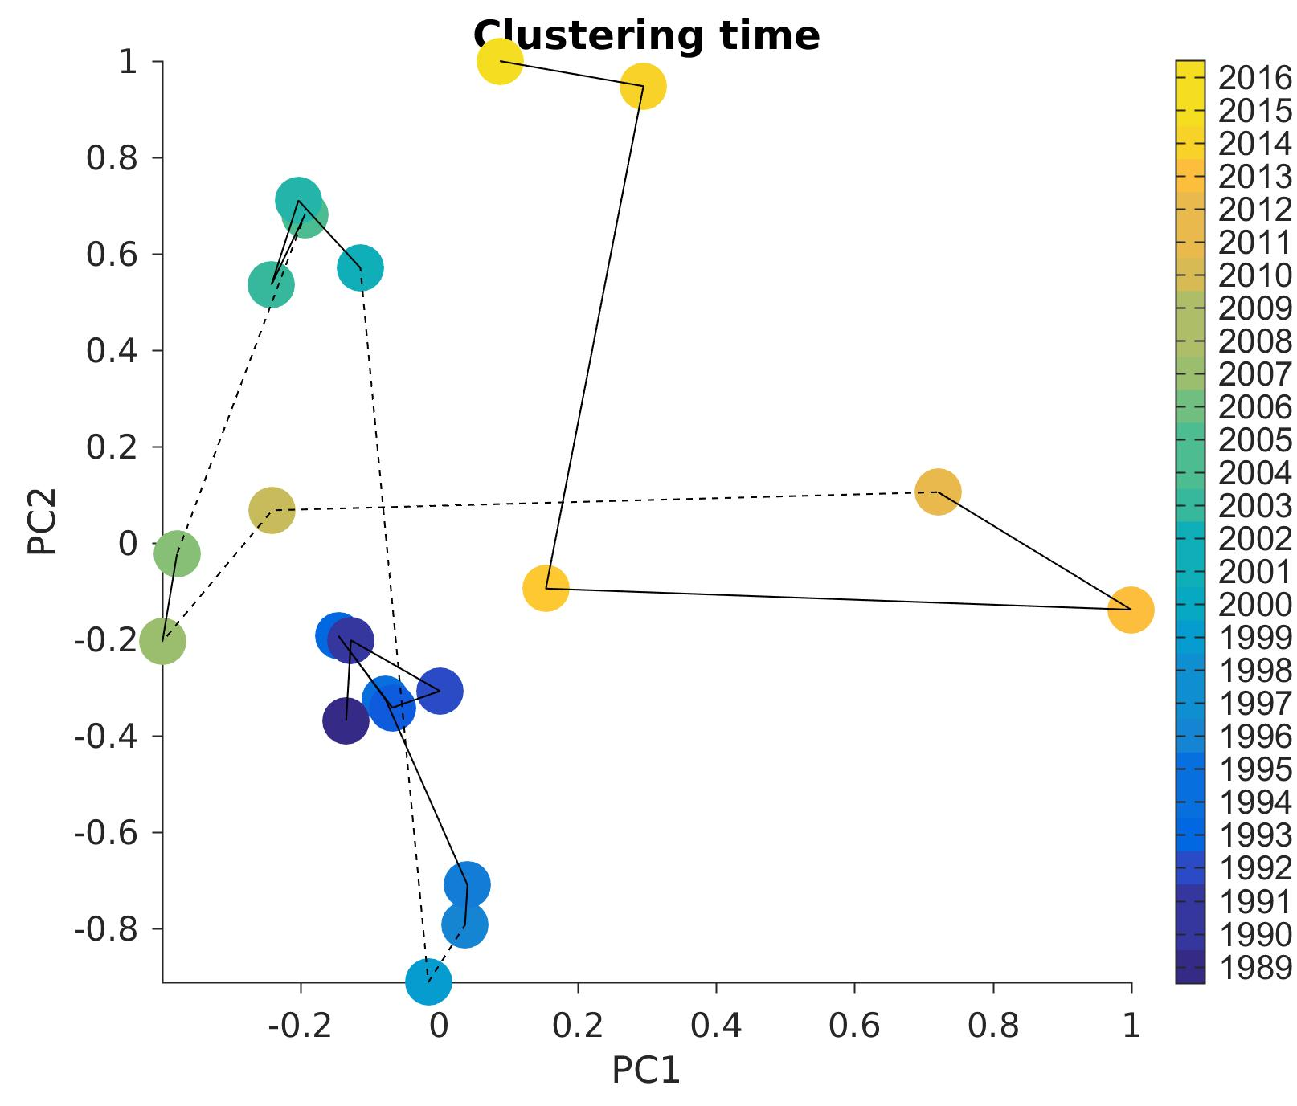
1. Ecosystem indices (PCA)
SURFACE
MIDWATER
05
06
00
05
06
90
98
14
04
13
BENTHOS
99
15
04
01
Community fairly stable until late 90s, then changes
05-07 tend to stand out, and recent years
11
06
09
07
89
MDS on yearly data
(custom definition per species for surface & MidW)
98

Slide 5
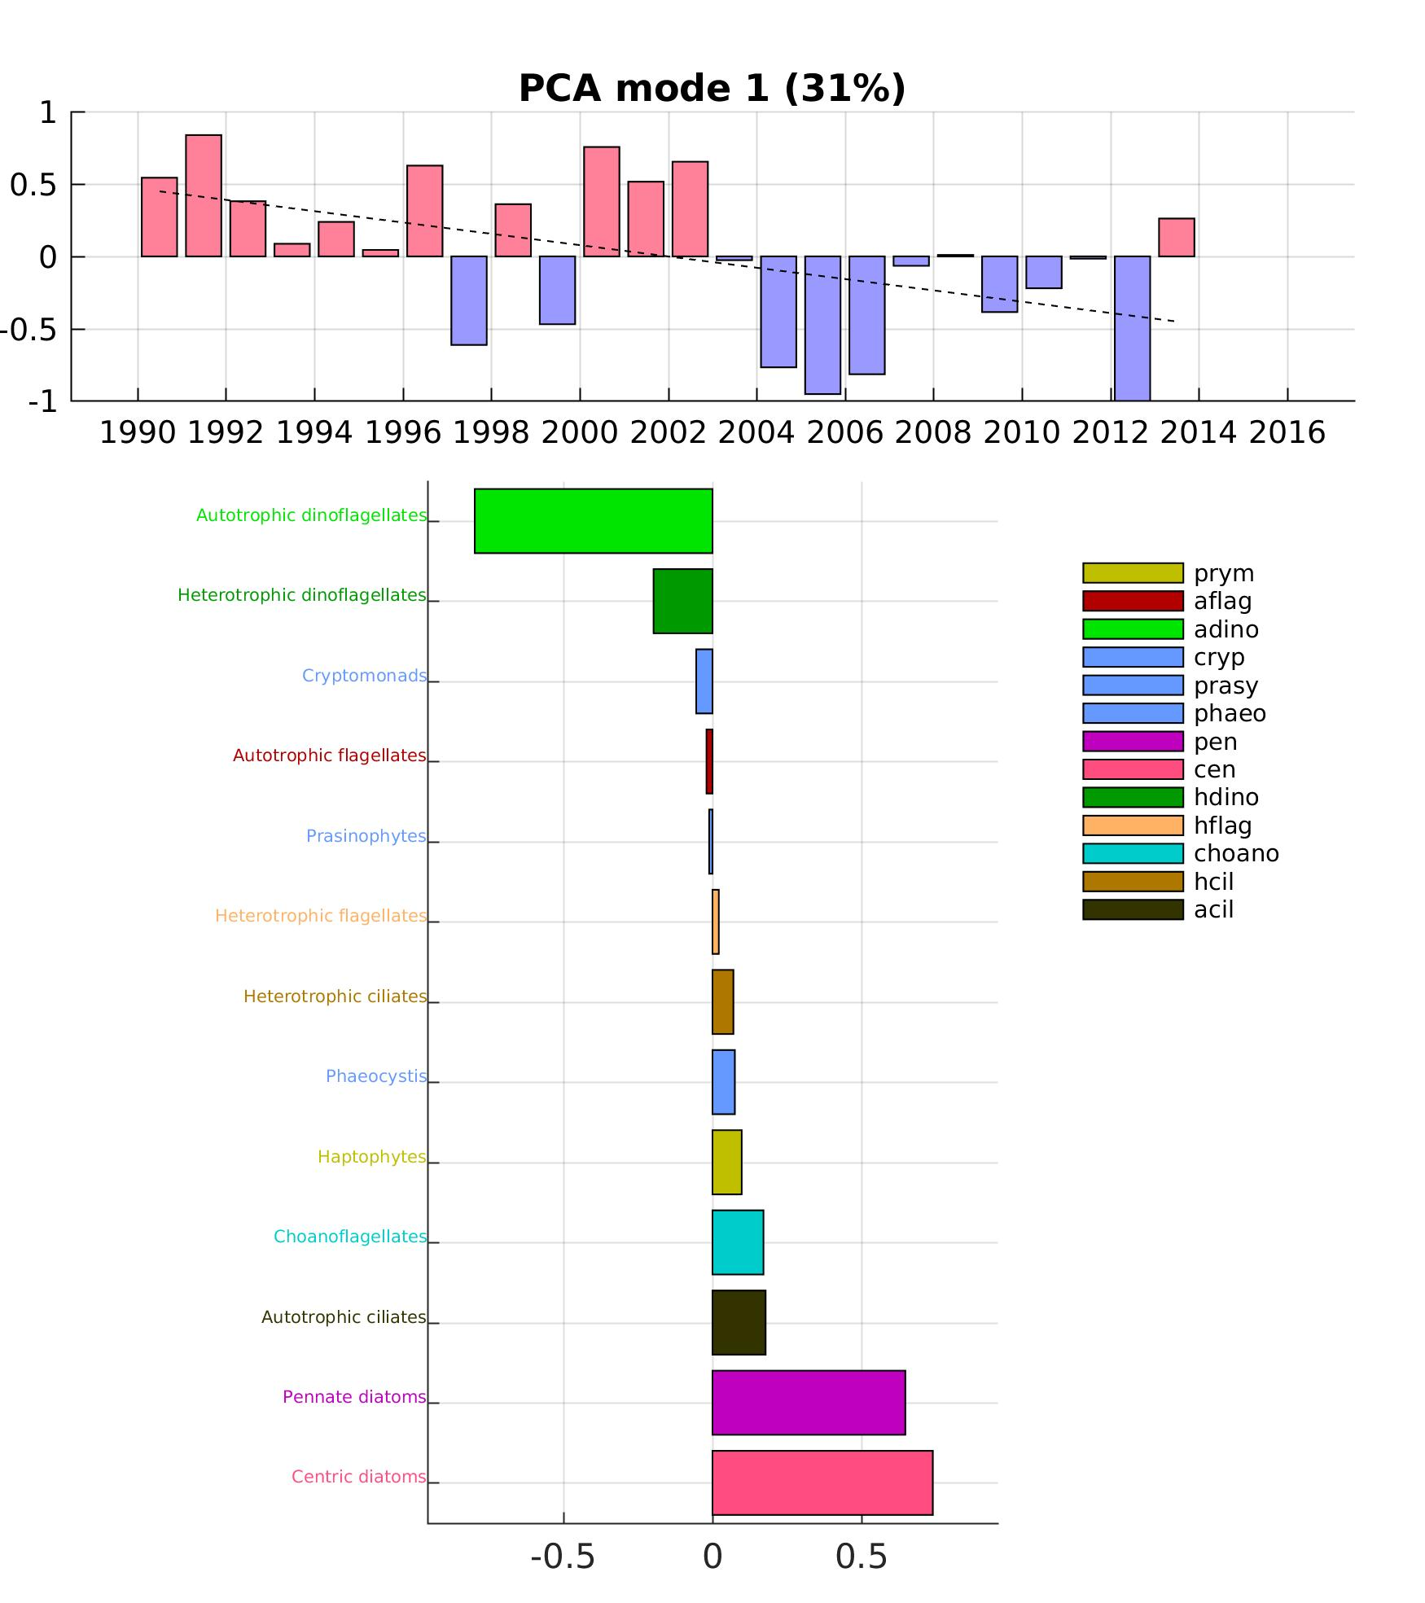
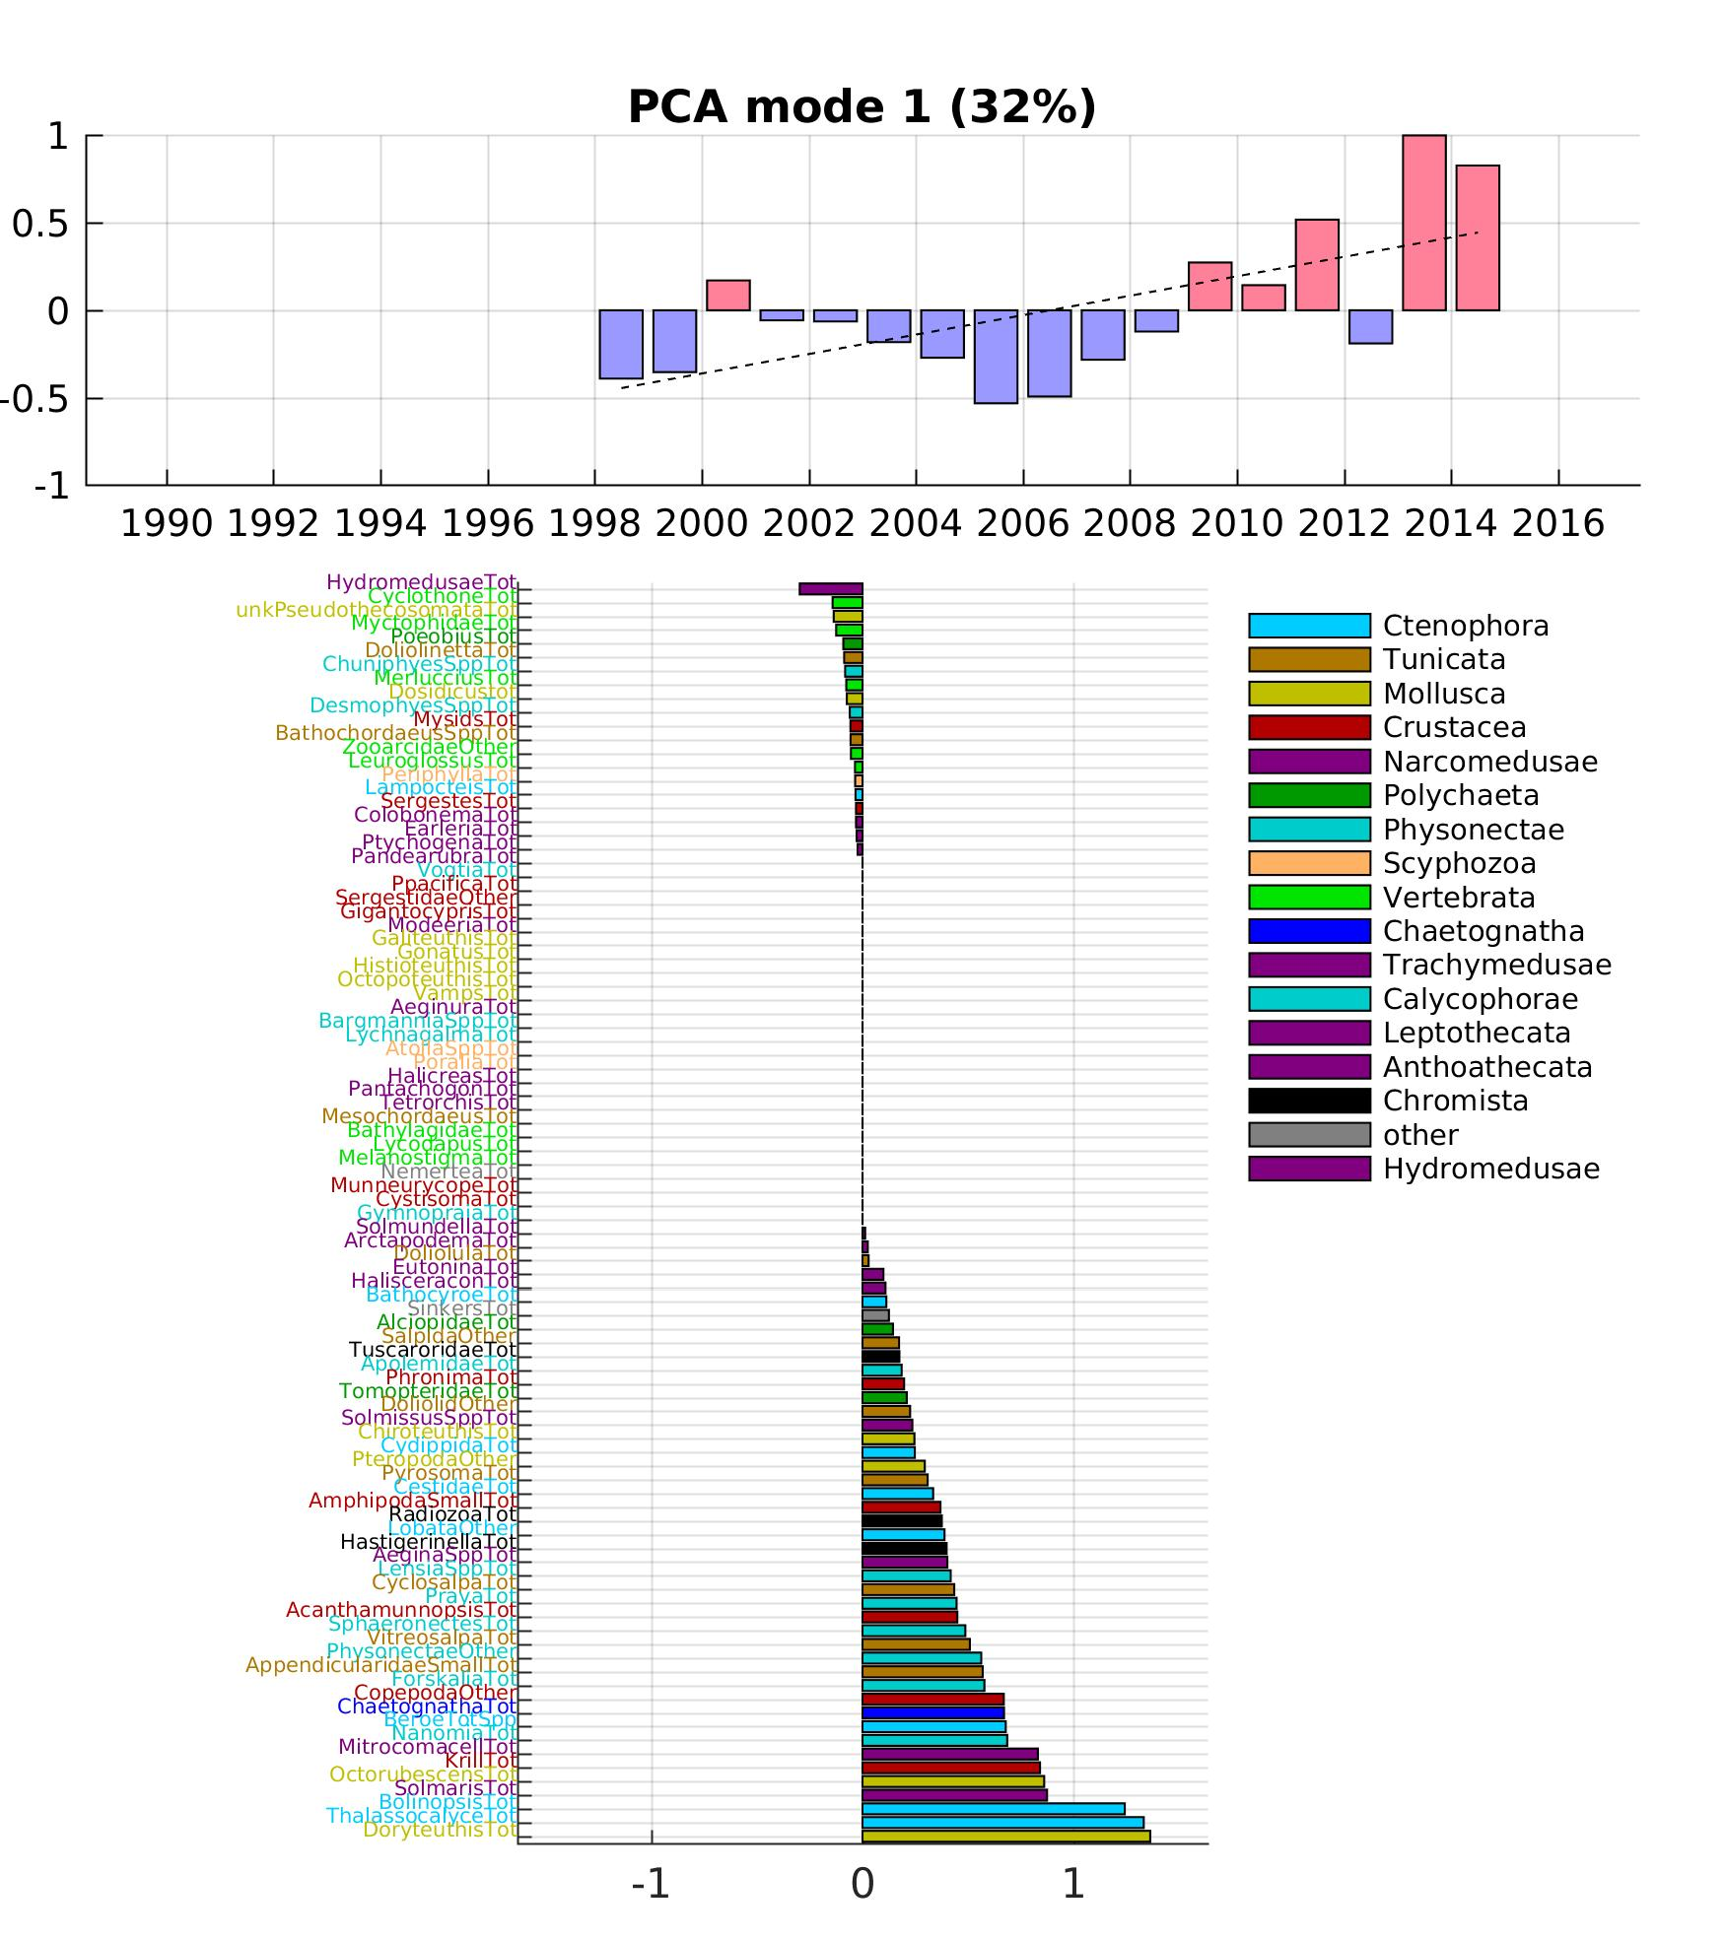
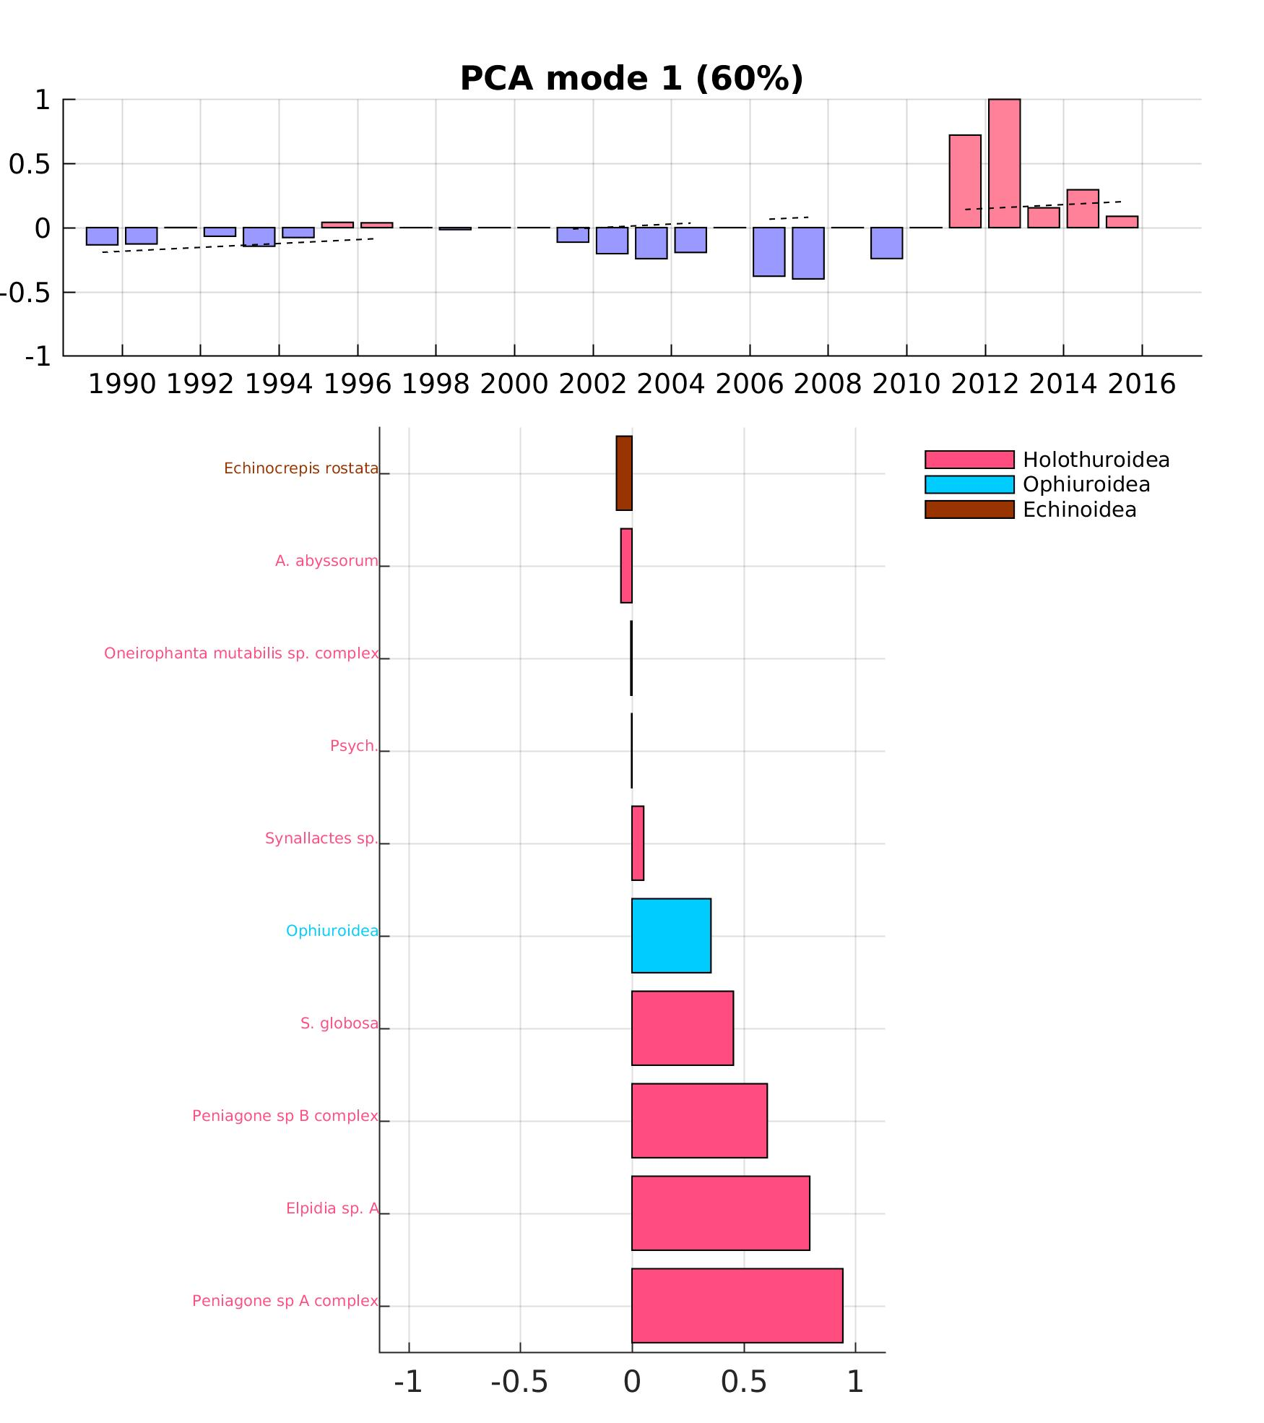
1. Ecosystem indices (PCA)
SURFACE
MIDWATER
BENTHOS

Slide 6
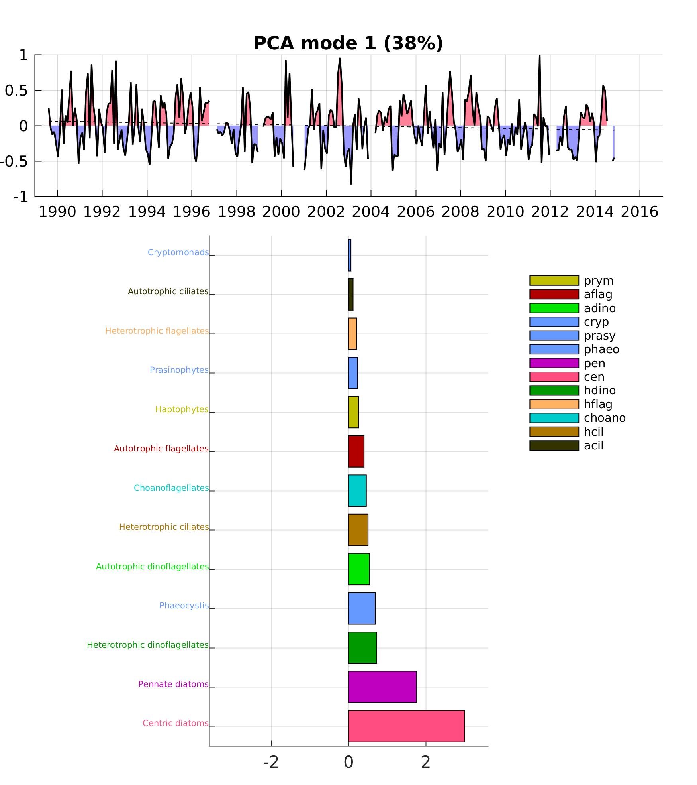
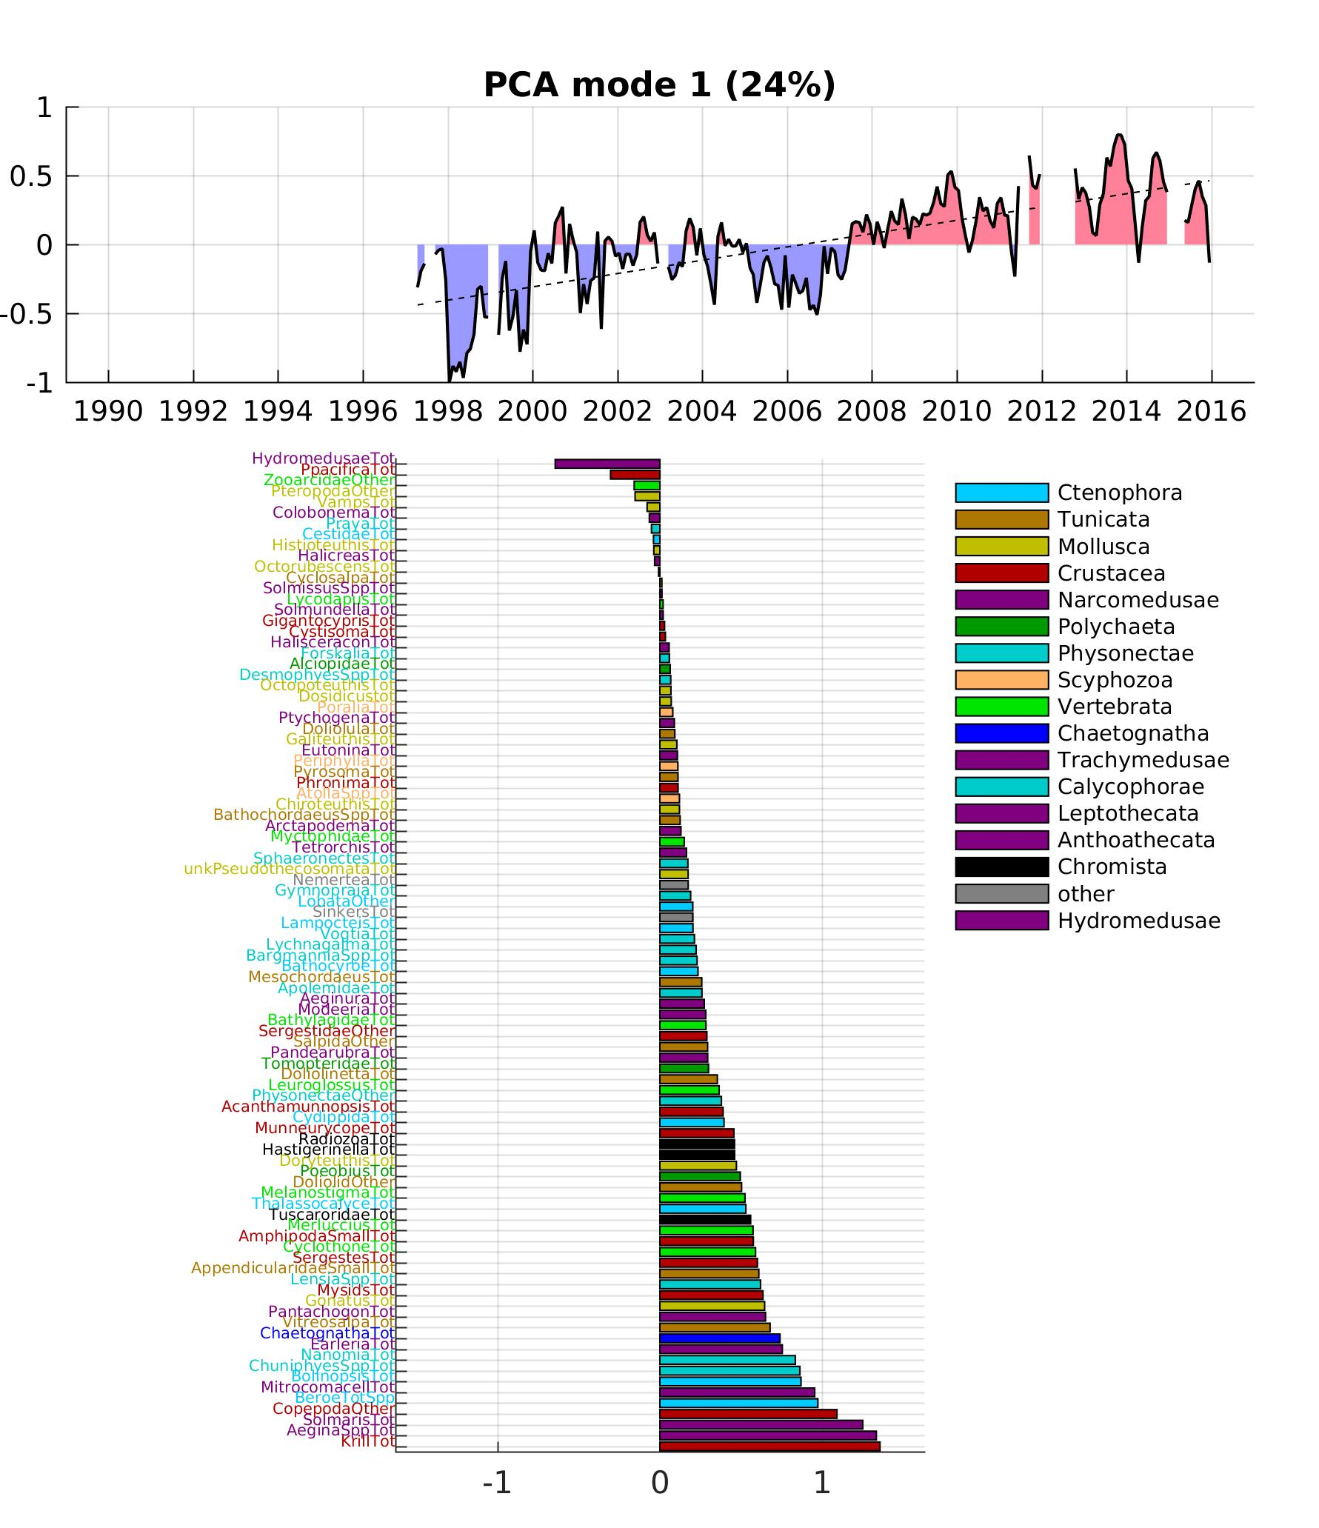
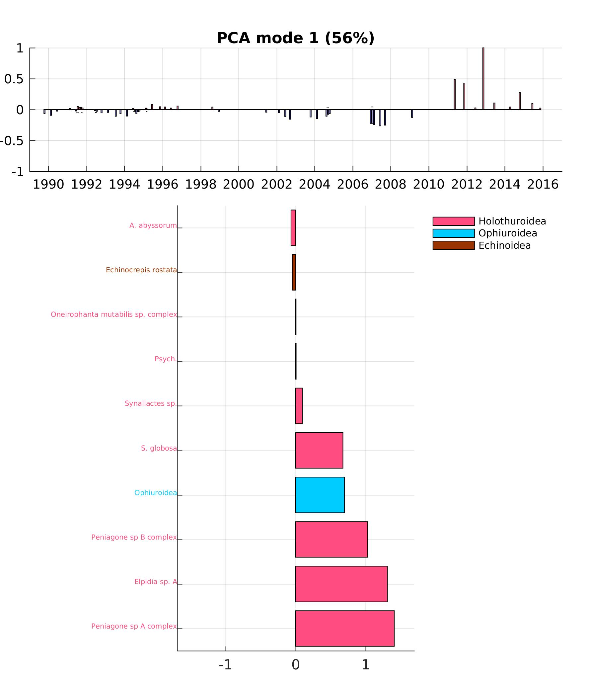
1. Ecosystem indices (PCA)
SURFACE
MIDWATER
BENTHOS
Peniagone sp. B
Elpidia sp. A
diatoms
Peniagone sp. A
Different time scales of variability (frequency decreases with depth?)
Surface: mode 1 = diatoms blooms, mode 2 = dinoflagellates/diatoms alternance
Midwater: mode 1 = decreases in 98-99 and in 05-06, mode 2 = seasonal & interannual species alternance
Benthos: mode 1 = big increases in recent years, mode 2 = community shift (?)

Slide 7
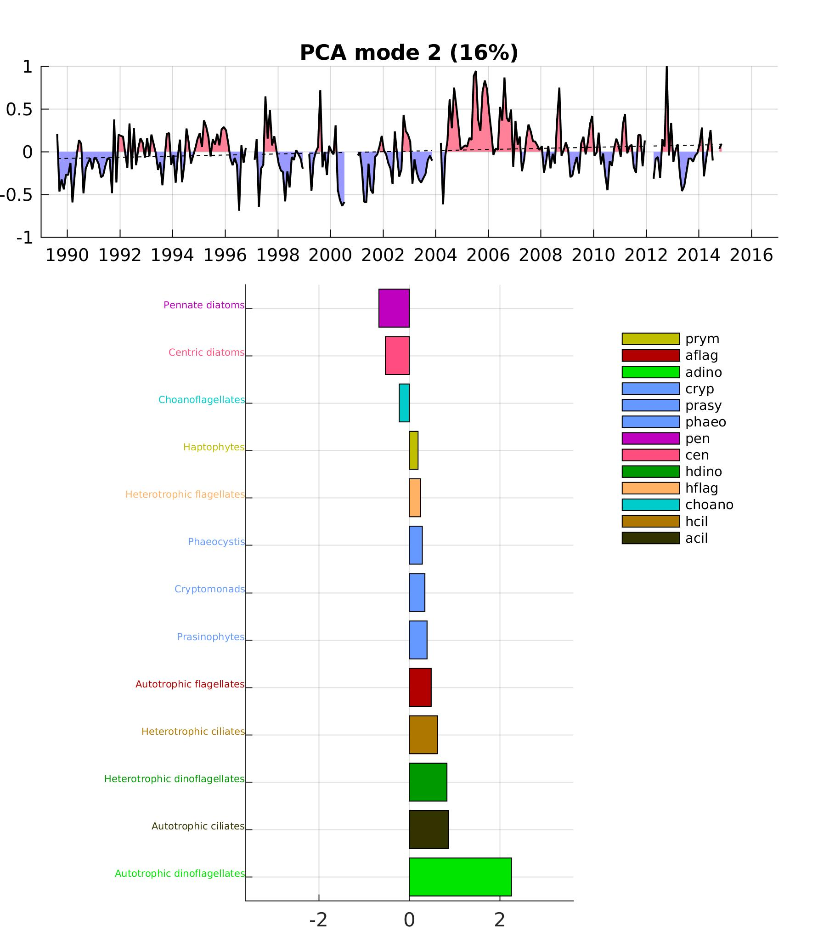
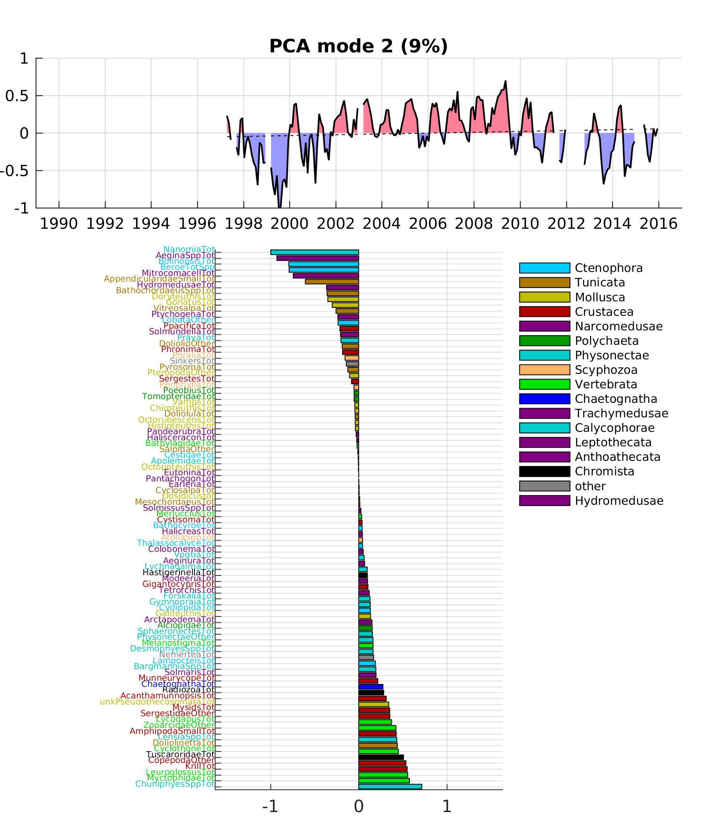
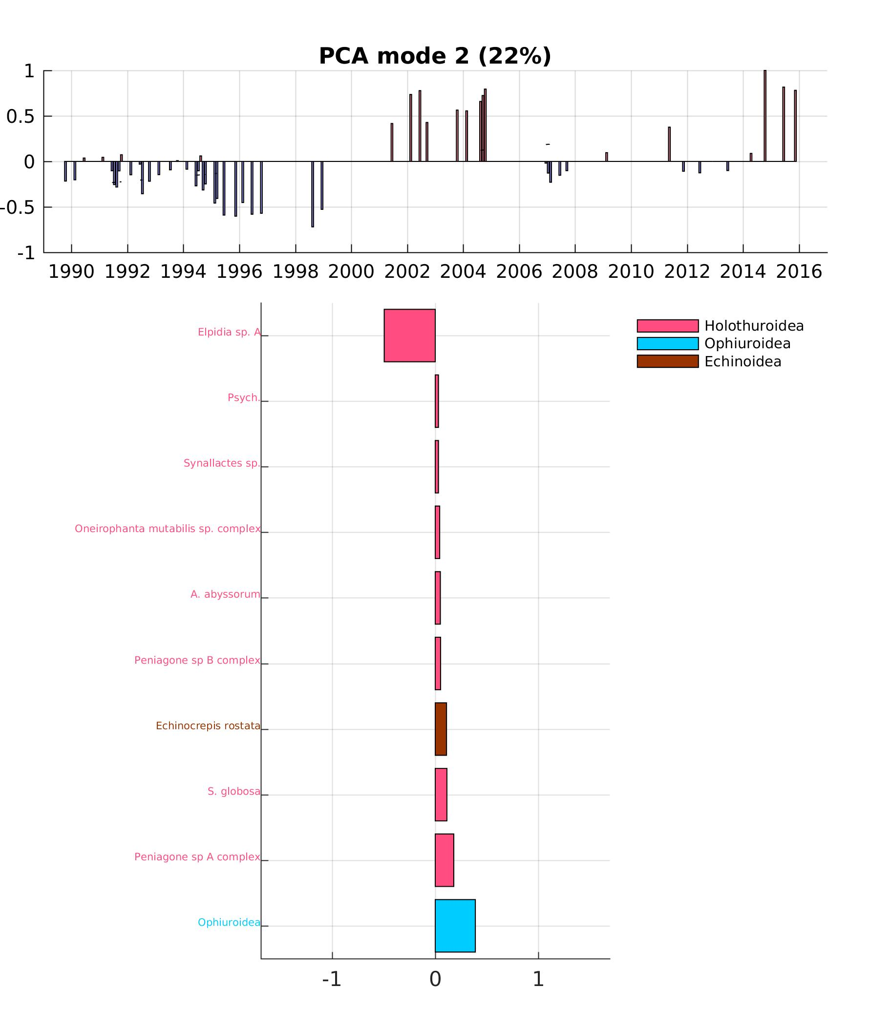
1. Ecosystem indices (PCA)
SURFACE
MIDWATER
BENTHOS
diatoms
jellies &
mollusks
Elpidia sp. A
dinos
& ciliates
Vertebrata
& Crustacea
Ophiures
Different time scales of variability (increases with depth?)
Surface: mode 1 = diatoms blooms, mode 2 = dinoflagellates/diatoms alternance
Midwater: mode 1 = decreases in 98-99 and in 05-06, mode 2 = seasonal & interannual species alternance
Benthos: mode 1 = big increases in recent years, mode 2 = community shift (?)

Slide 8
2. El Niño
Concept: compare & contrast changes observed at the surface/midwater/benthos during the 2 El Niño of 97-98 and 15-16.
Conclusion: some clear signals in physics, but less and less visible the deeper we go.
  Satellite & M1 data display physical/Chl anomalies & their propagation
  No significant change in plankton size, PP, POC
  No clear link with El Niño in ecosystem indices except for community change in late 90s (regime shift?), lagged correlations w/ species didn’t work. Clear drop in numbers in midwater (98-99).

Slide 9
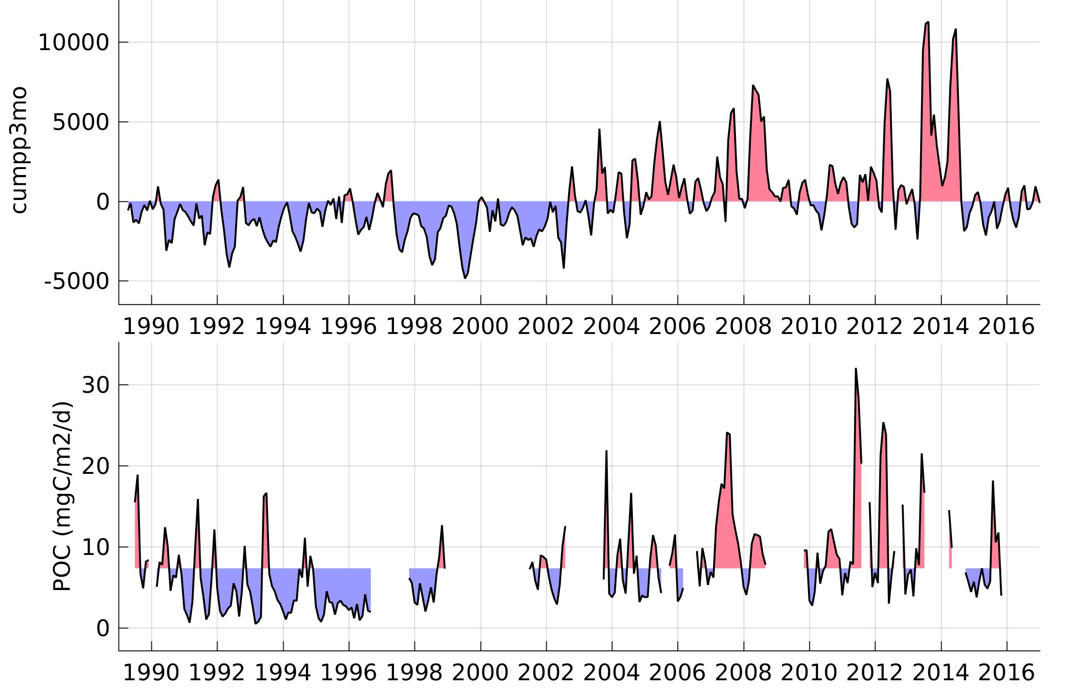
MIDWATER
Midwater PC1
SURFACE
Cumulated int PP
(3 month)
+ anom
BENTHOS
POC

Slide 10
3. Dinoflagellates age
Concept: describe the changes that occurred in the mid-2000s during the dinos age
Conclusion: some changes in community for all 3 time series, decreased abundance in the midwater
Question: how to prove whether changes were due to dinoflagellates? Quantify changes during that time?

Slide 11
4. Carbon links
Concept: derive a carbon budget for the water column
Issues:
    missing information for the midwater. Later?
    possible to link benthos w/ Monterey Bay time series?
    only “average” budget or also time variation?

Slide 12
5. Textbook theories
Concept: test hypothesis largely considered to be true. For instance, increased upwelling favors diatoms, increases in sediment community metabolism, and increased krill biomass.
Issue: might be confounded by the delayed, non-linear biological response to environmental forcing especially when considering long-living animals.
Not done yet (2017 ITS proposal).

Slide 13
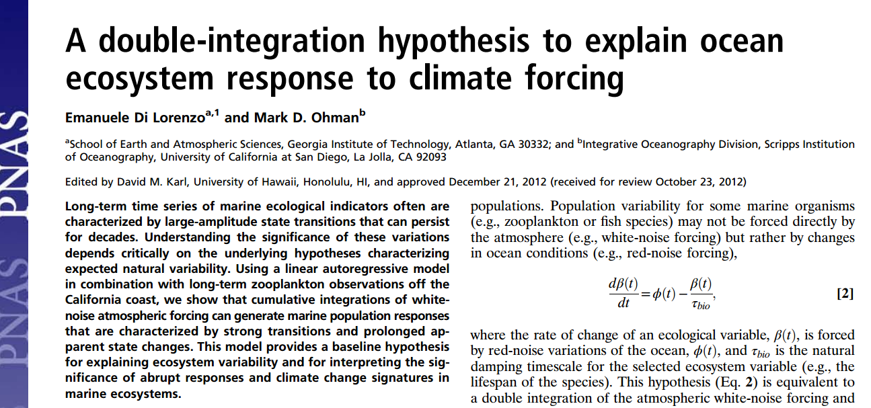
6. Environmental variability integration
Concept: describe how environmental forcing gets dampened as we move deeper / animals live longer

Slide 14
6. Environmental variability integration
The rate of change of an ecological variable, Y(t), is forced by oceanic variations, f(t), and τ_{bio} is the natural damping timescale for the selected ecosystem variable (e.g., the lifespan of the species).
Y(0) = f(0)
Y(t+1) = f(t) + Y(t)* (1 - 1/τ_{bio})
If τ_{bio} = 1, Y(t+1) = f(t) ie. the variable responds to f within one time step with no memory
If τ_{bio} = ∞, Y(t+1) = f(t) + Y(t) ie. the oceanic forcing stays with infinite memory (getting summed)

Slide 15
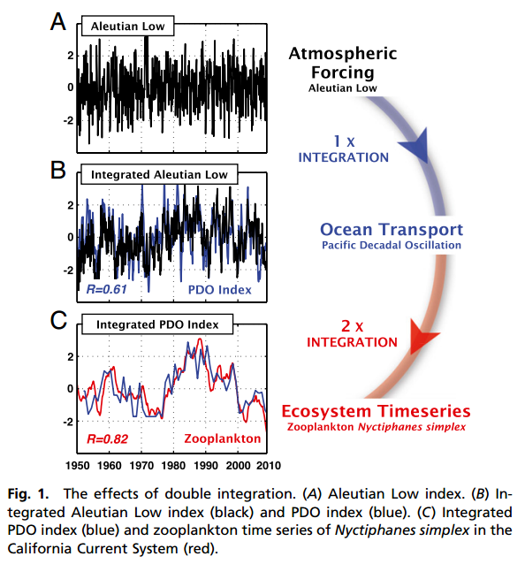
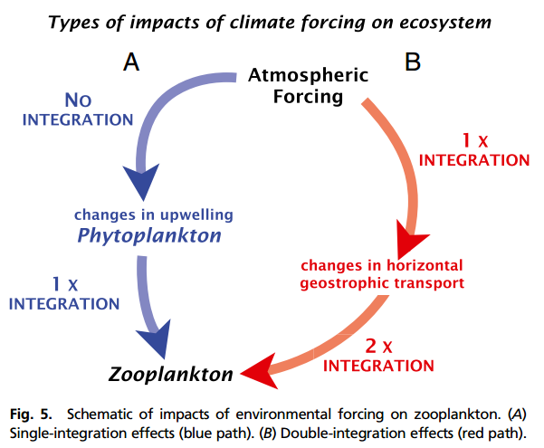
6. Environmental variability integration
Τ = 6 months
Τ_{bio} = 2 years

Slide 16
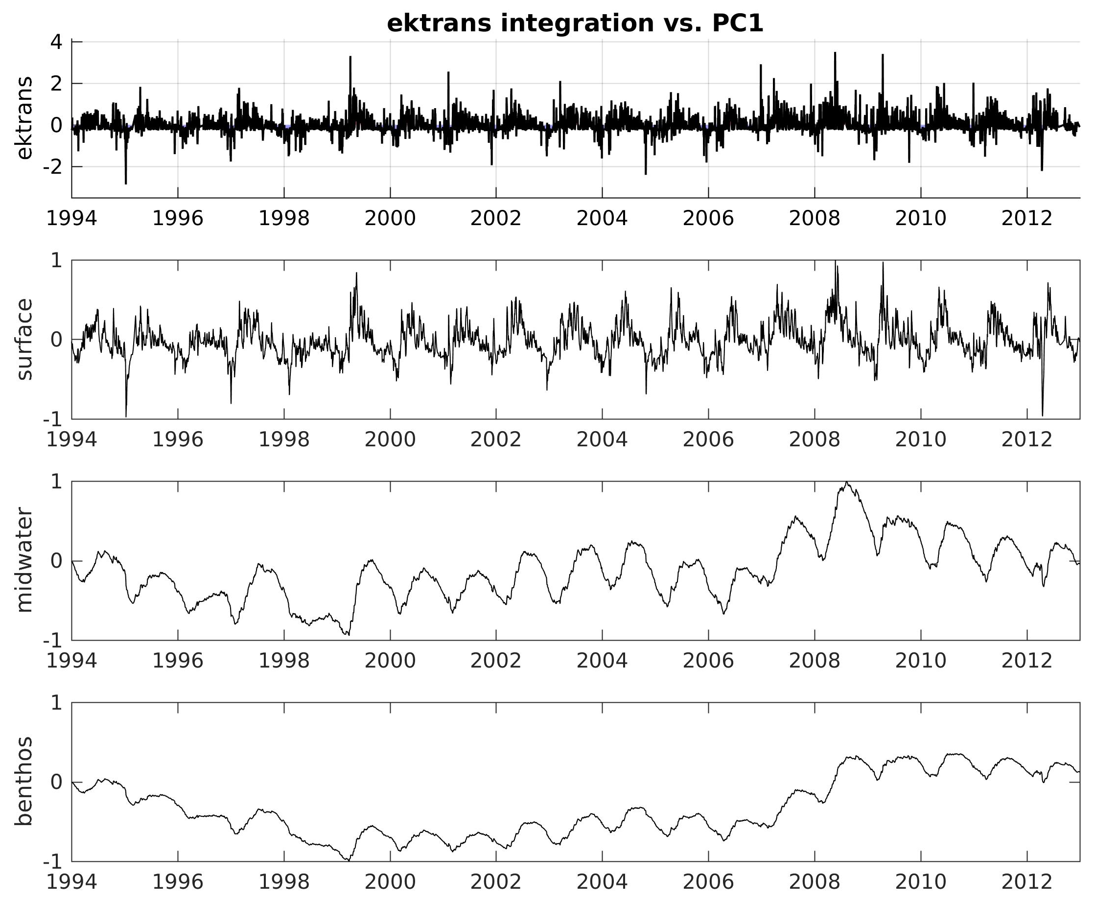
6. Upwelling integration (vs. PC1)
1-week integration
1-year integration
5-year integration

Slide 17
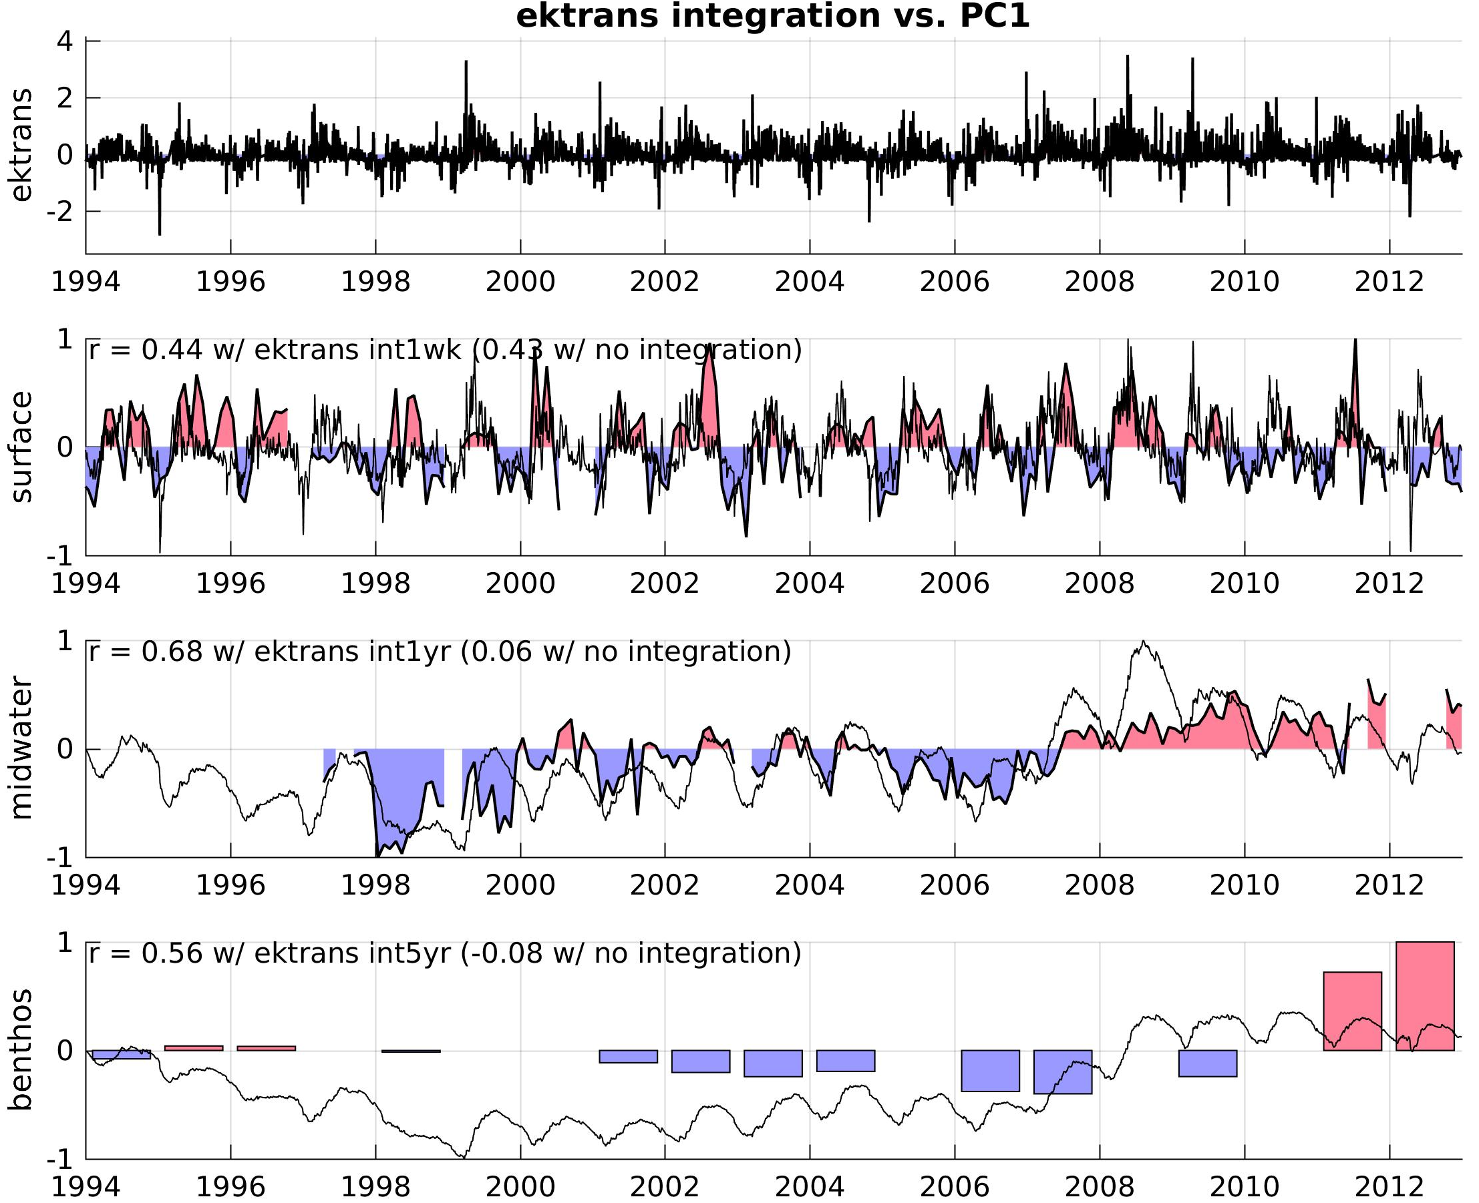
6. Upwelling integration (vs. PC1)
SURFACE
1-week integration
~20%
varex
MIDWATER
1-year integration
~46%
varex
BENTHOS
~30%
varex
5-year integration

Slide 18
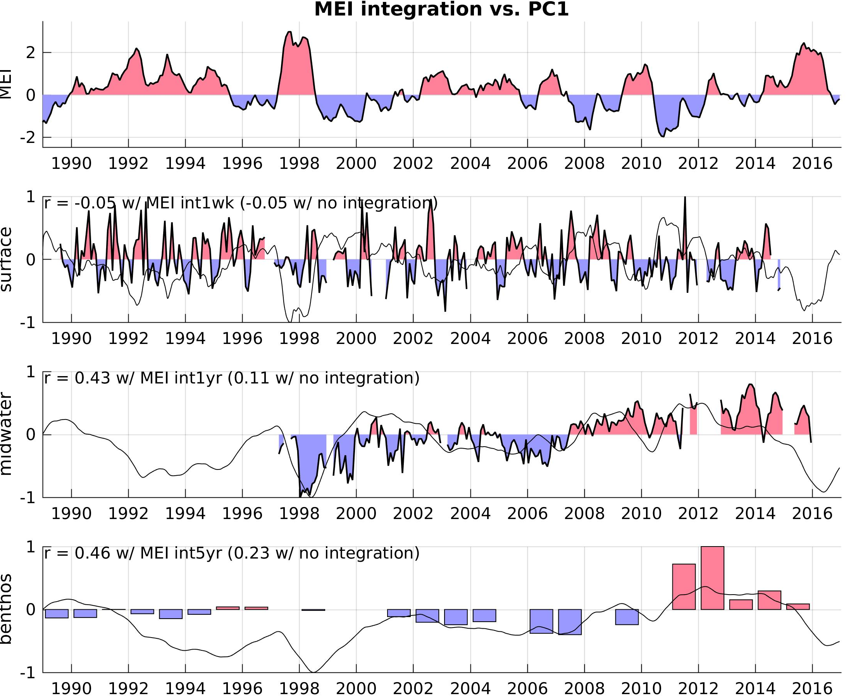
6. ENSO integration
SURFACE
1-week integration
~0%
varex
MIDWATER
1-year integration
~18%
varex
BENTHOS
~21%
varex
5-year integration

Slide 19
ITS scientific product? (= paper)
Options:
Ecosystem indices
El Niño
Dinoflagellates age
Carbon links – not done, missing midwater
Testing textbook theories – planned for 2017
Environmental variability integration across the water column
… else?

