Slide 1
Possible ITS paper
Would include:
Status of ecosystem composition from MDS and PCA
Time series of ecosystem status (ecosystem indices)
Physical forcing integration across the water column
Possibly vignette-type stories such as El Niño, the dinos age, regime shifts.

Slide 2
1. Ecosystem status (composition)
Method: MDS and PCA, yearly data
Goal:
  characterize years into “states” of the 3 ecosystems (in terms of ecosystem composition)
  look at common variations between the 3.

Slide 3
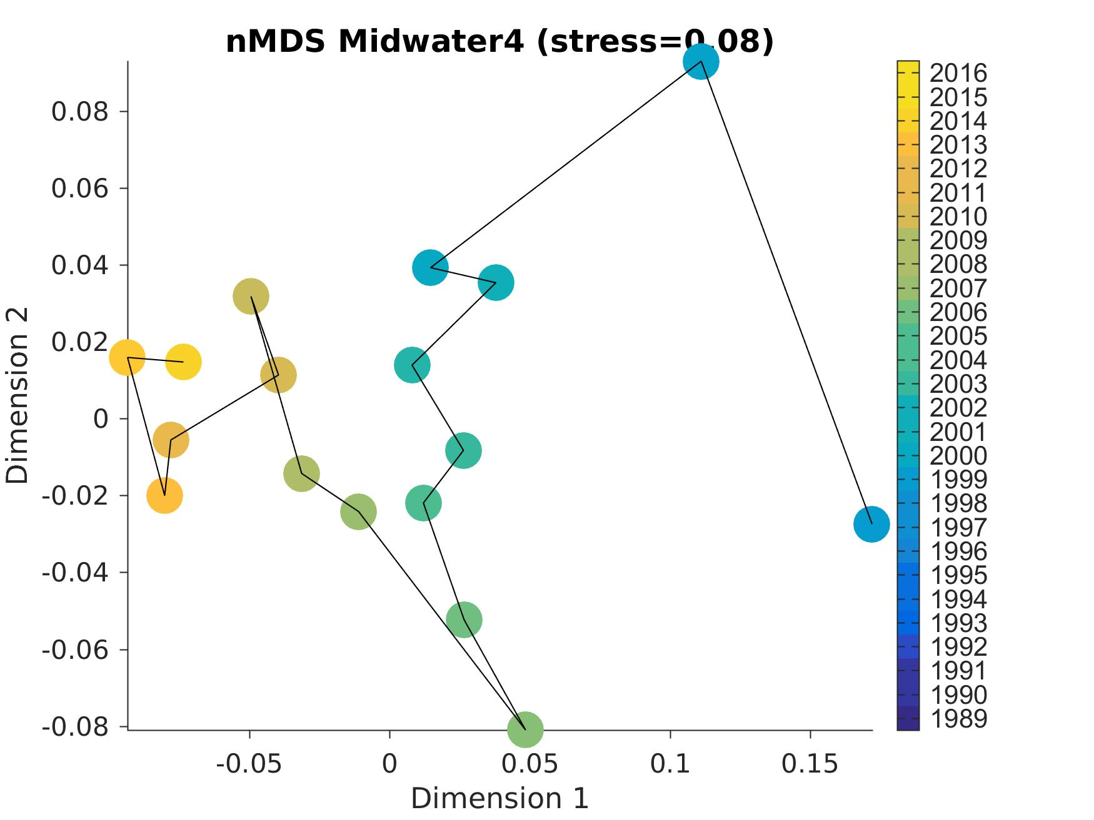
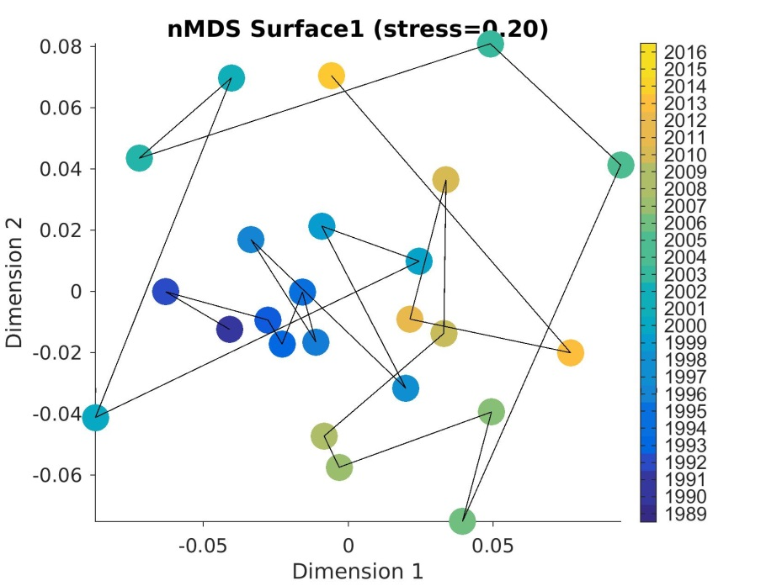
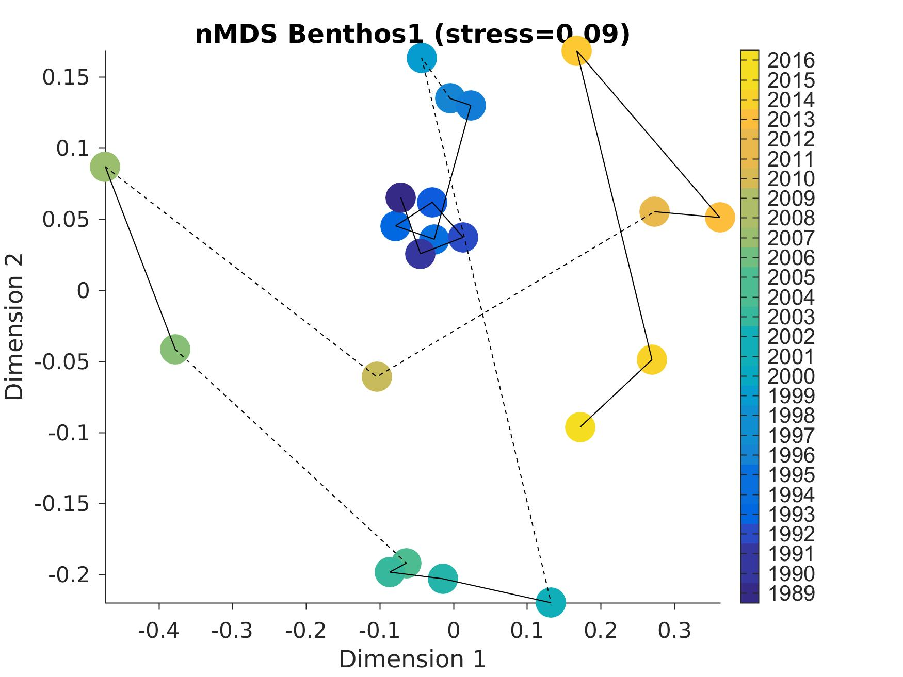
1. Ecosystem composition: MDS
SURFACE
MIDWATER
13
99
03
04
14
90
06
98
00
05
05
BENTHOS
06
98
07
89
Community fairly stable until late 90s, then changes
05-07 tend to stand out, and recent years
11
06
09
15
MDS on yearly data
(custom definition per species for surface & MidW)
04
01

Slide 4
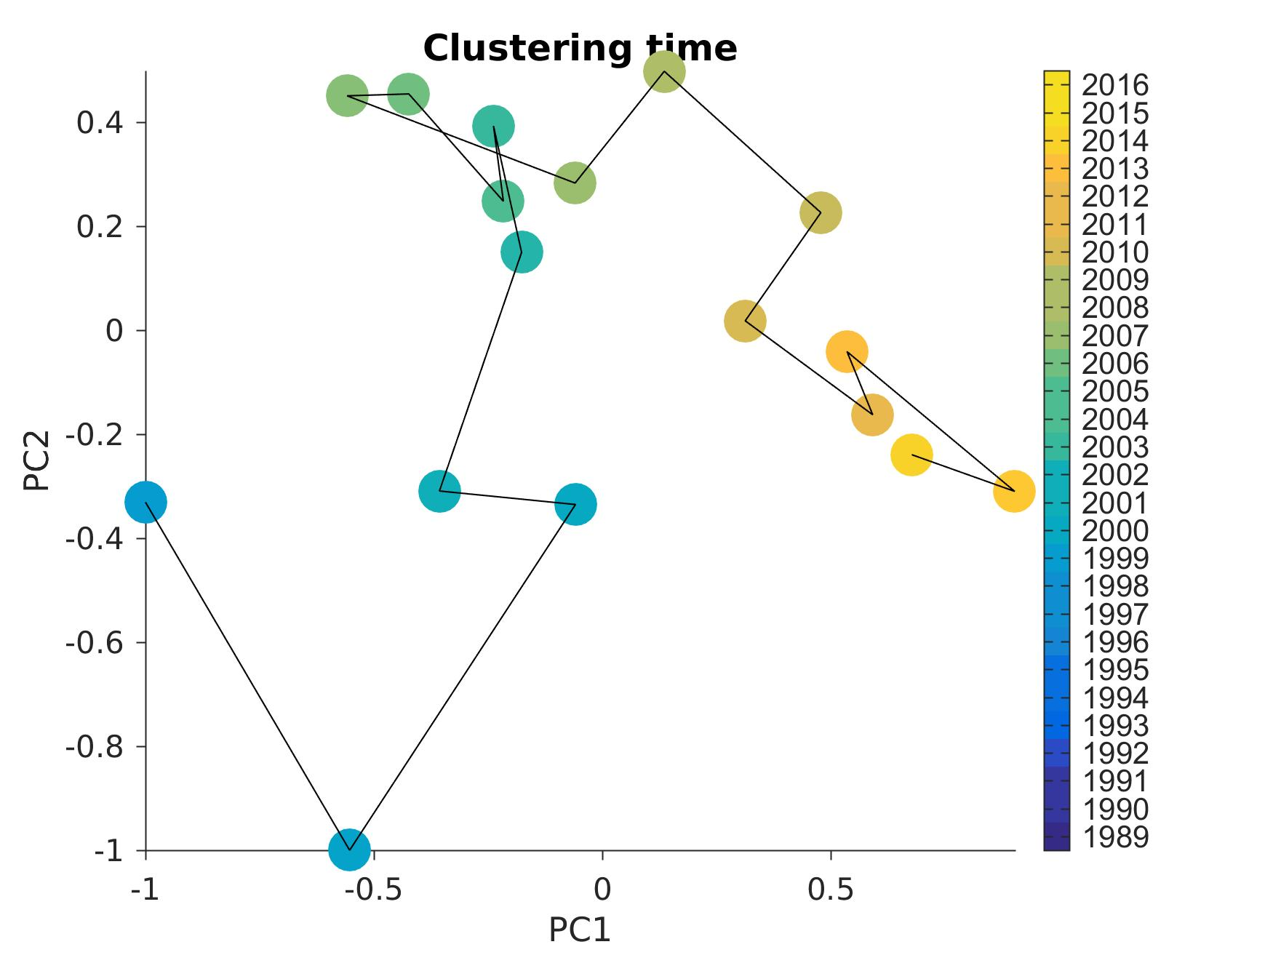
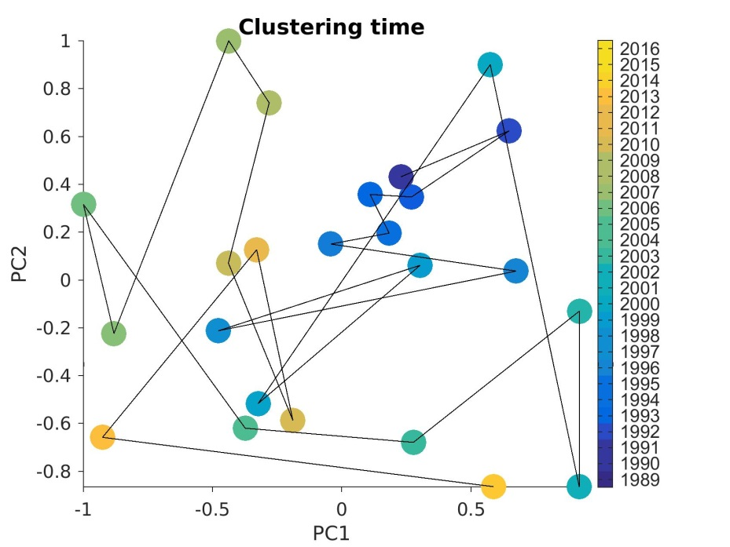
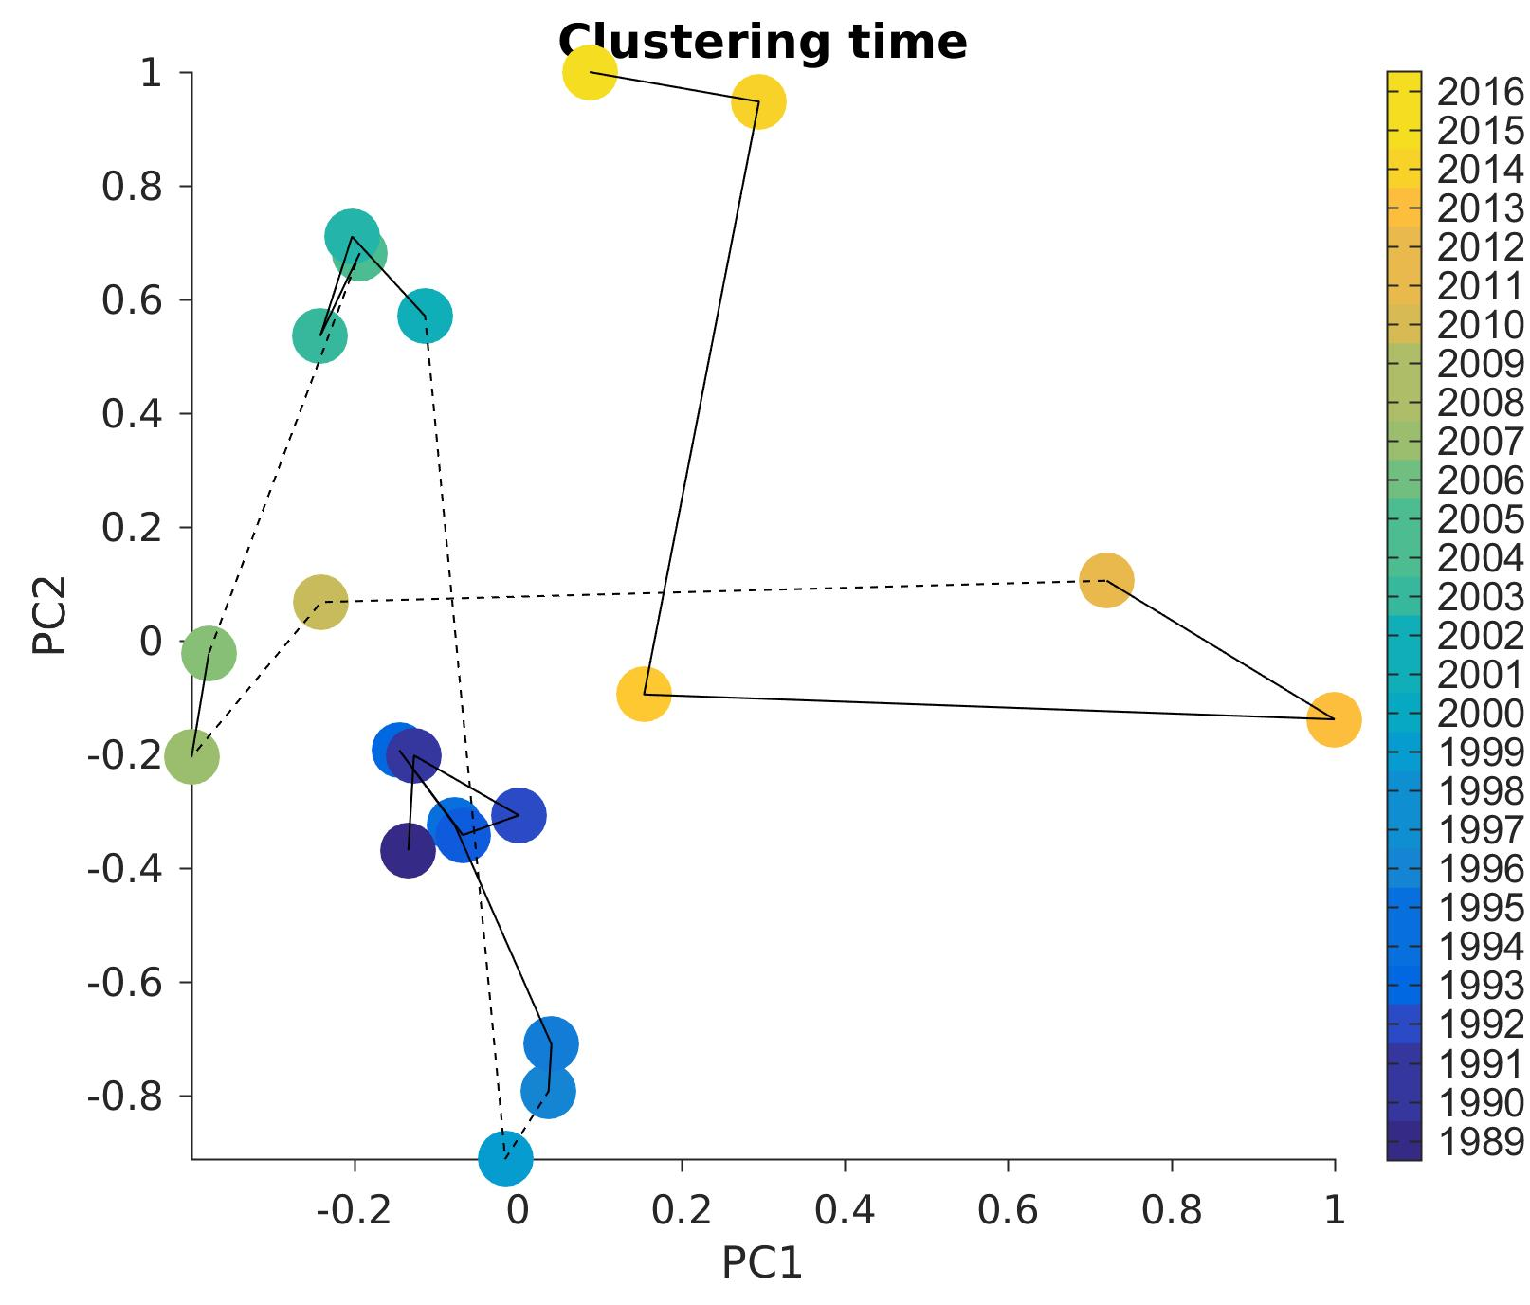
1. Ecosystem composition: PCA
SURFACE
MIDWATER
05
00
06
05
90
98
14
06
04
13
BENTHOS
99
15
04
01
Community fairly stable until late 90s, then changes
05-07 tend to stand out, and recent years
11
06
09
07
89
MDS on yearly data
(custom definition per species for surface & MidW)
98

Slide 5
1. Ecosystem composition: conclusion
Some clear signals that make sense and capture known changes in each time series, but no real link between them except:
  community stable until late 90s, more variable afterwards (prob. not true for midwater)
  decreases in numbers & different community around the mid-2000s
  recent years (since ~ 2010) also different
MDS & PCA give qualitatively similar answers, even though the tool is different and the metrics too (MDS = Bray-Curtis, PCA = Euclidean)
In the following, using PCA for time series which 1st mode captures the most variance by definition. Using monthly data for better temporal resolution.

Slide 6
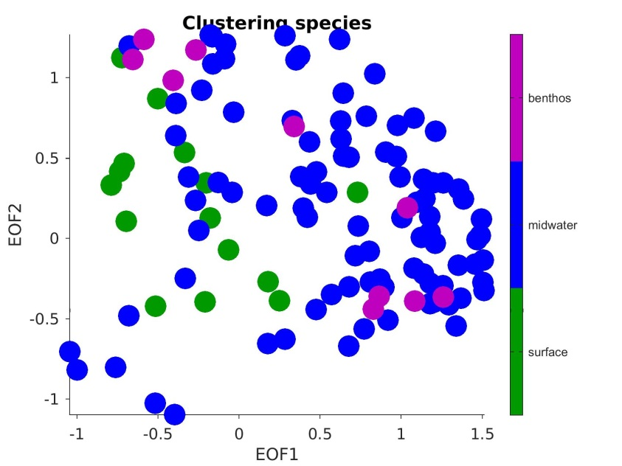
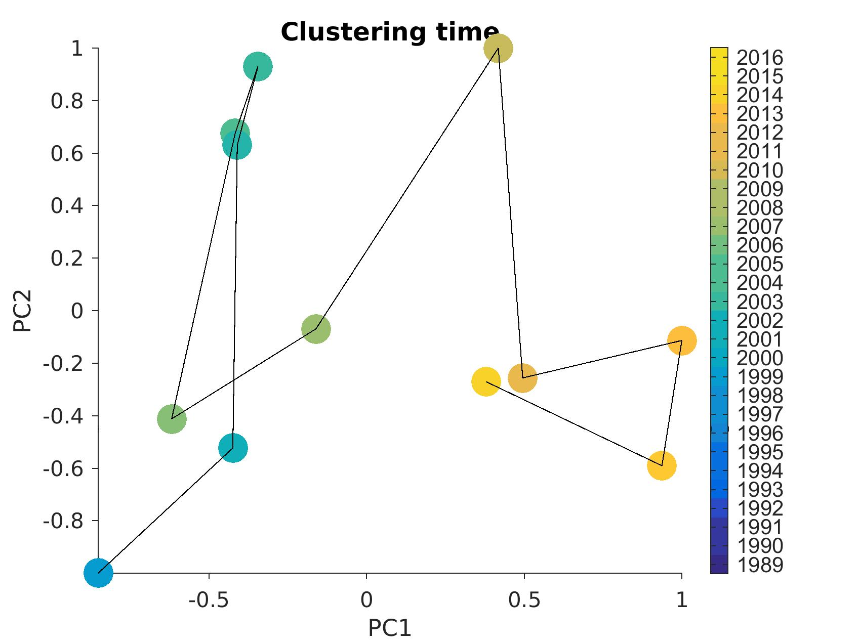
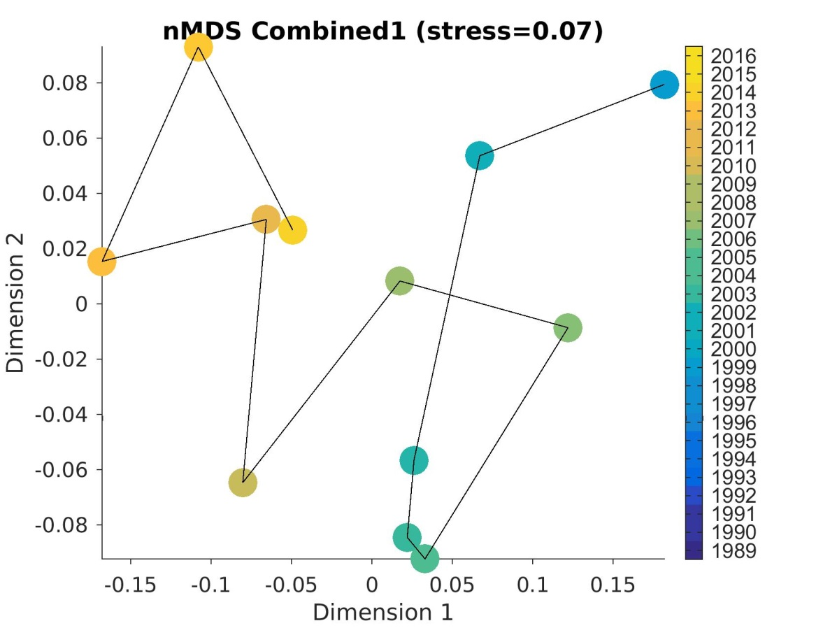
1. Ecosystem composition: side note
Running the analysis on the 3 time series together, yearly, only common years.
MDS
PCA
03
09
13
98
04
01
02
11
14
07
12
06
12
07
11
06
14
02
01
09
13
03
04
98

Slide 7
2. Ecosystem indices
Method: PCA, monthly data
Goal:
  construct time series that capture the ecosystem variations over time
Difference with previous analysis: instead of qualitatively looking at the ecosystem trajectory in 2D, we look at time series.

Slide 8
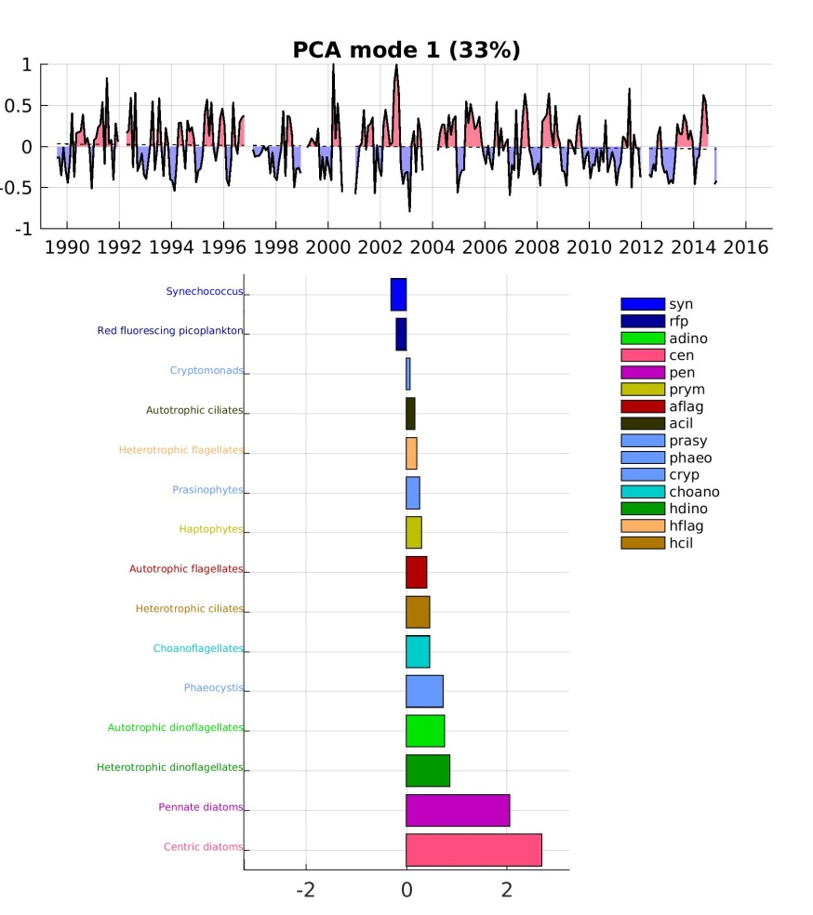
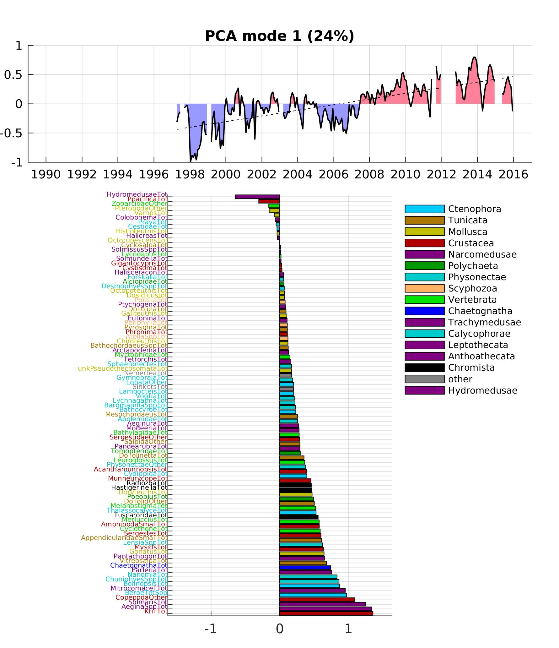
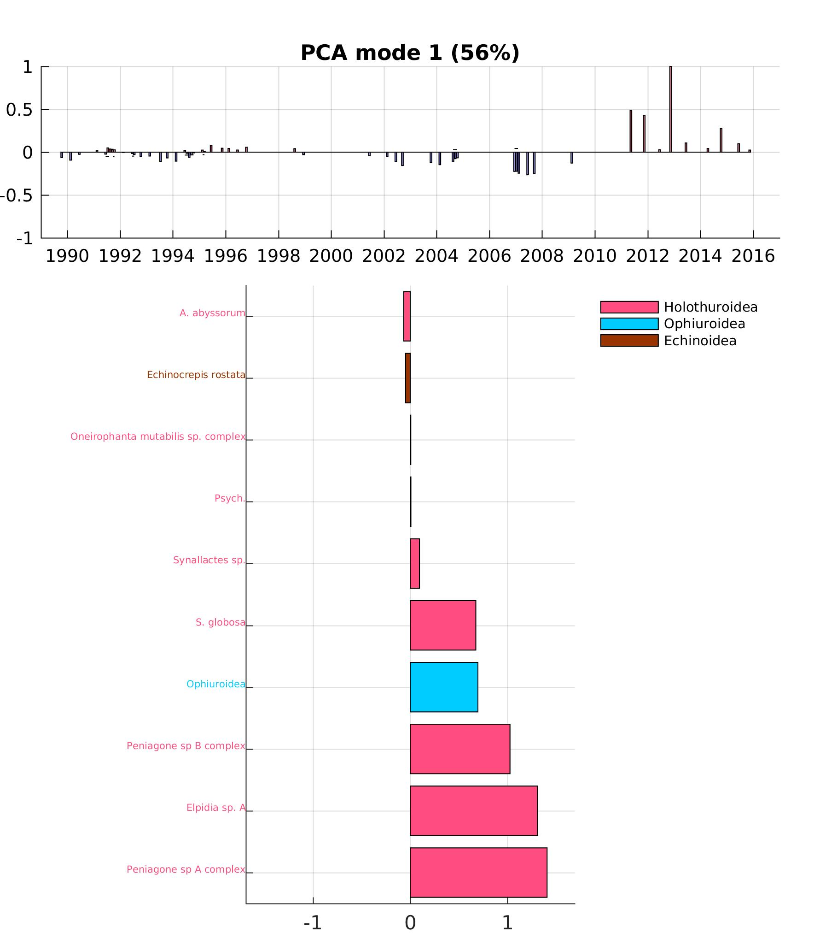
2. Ecosystem indices: mode 1
SURFACE
MIDWATER
BENTHOS
Peniagone sp. B
Elpidia sp. A
diatoms
Peniagone sp. A
Different time scales of variability (frequency decreases with depth?)
Surface: mode 1 = diatoms blooms, mode 2 = dinoflagellates/diatoms alternance
Midwater: mode 1 = decreases in 98-99 and in 05-06, mode 2 = seasonal & interannual species alternance
Benthos: mode 1 = big increases in recent years, mode 2 = community shift (?)

Slide 9
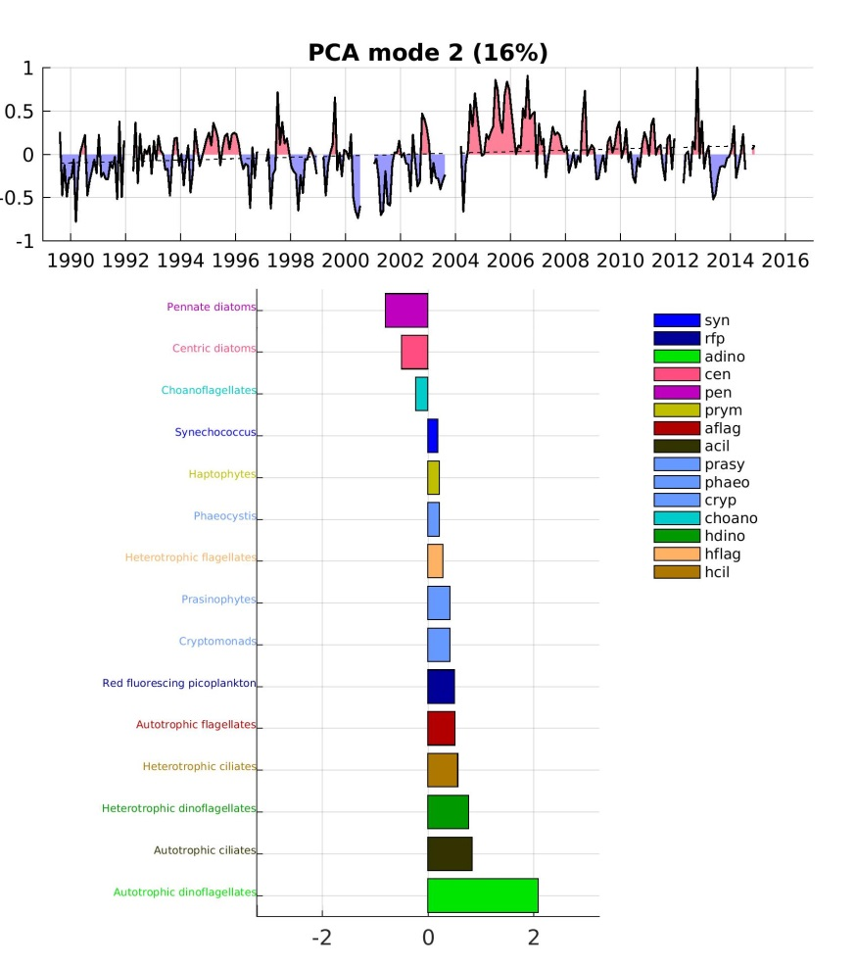
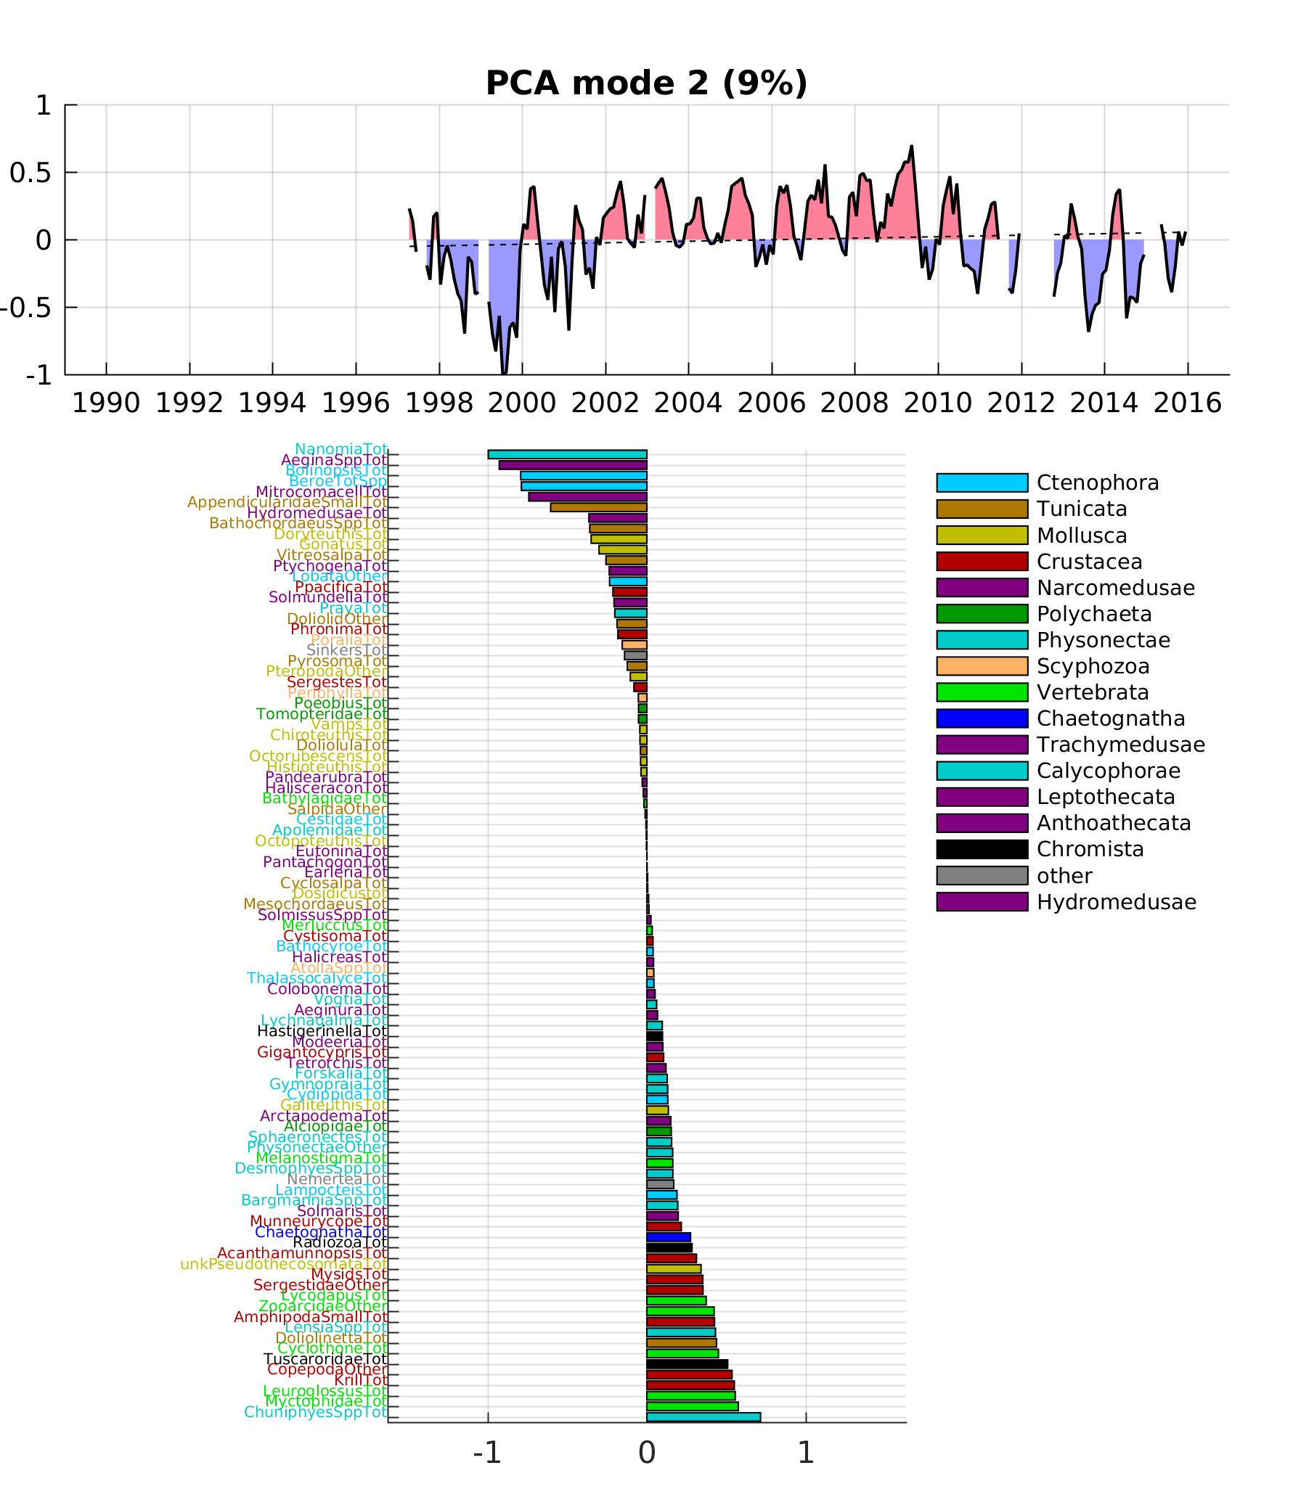
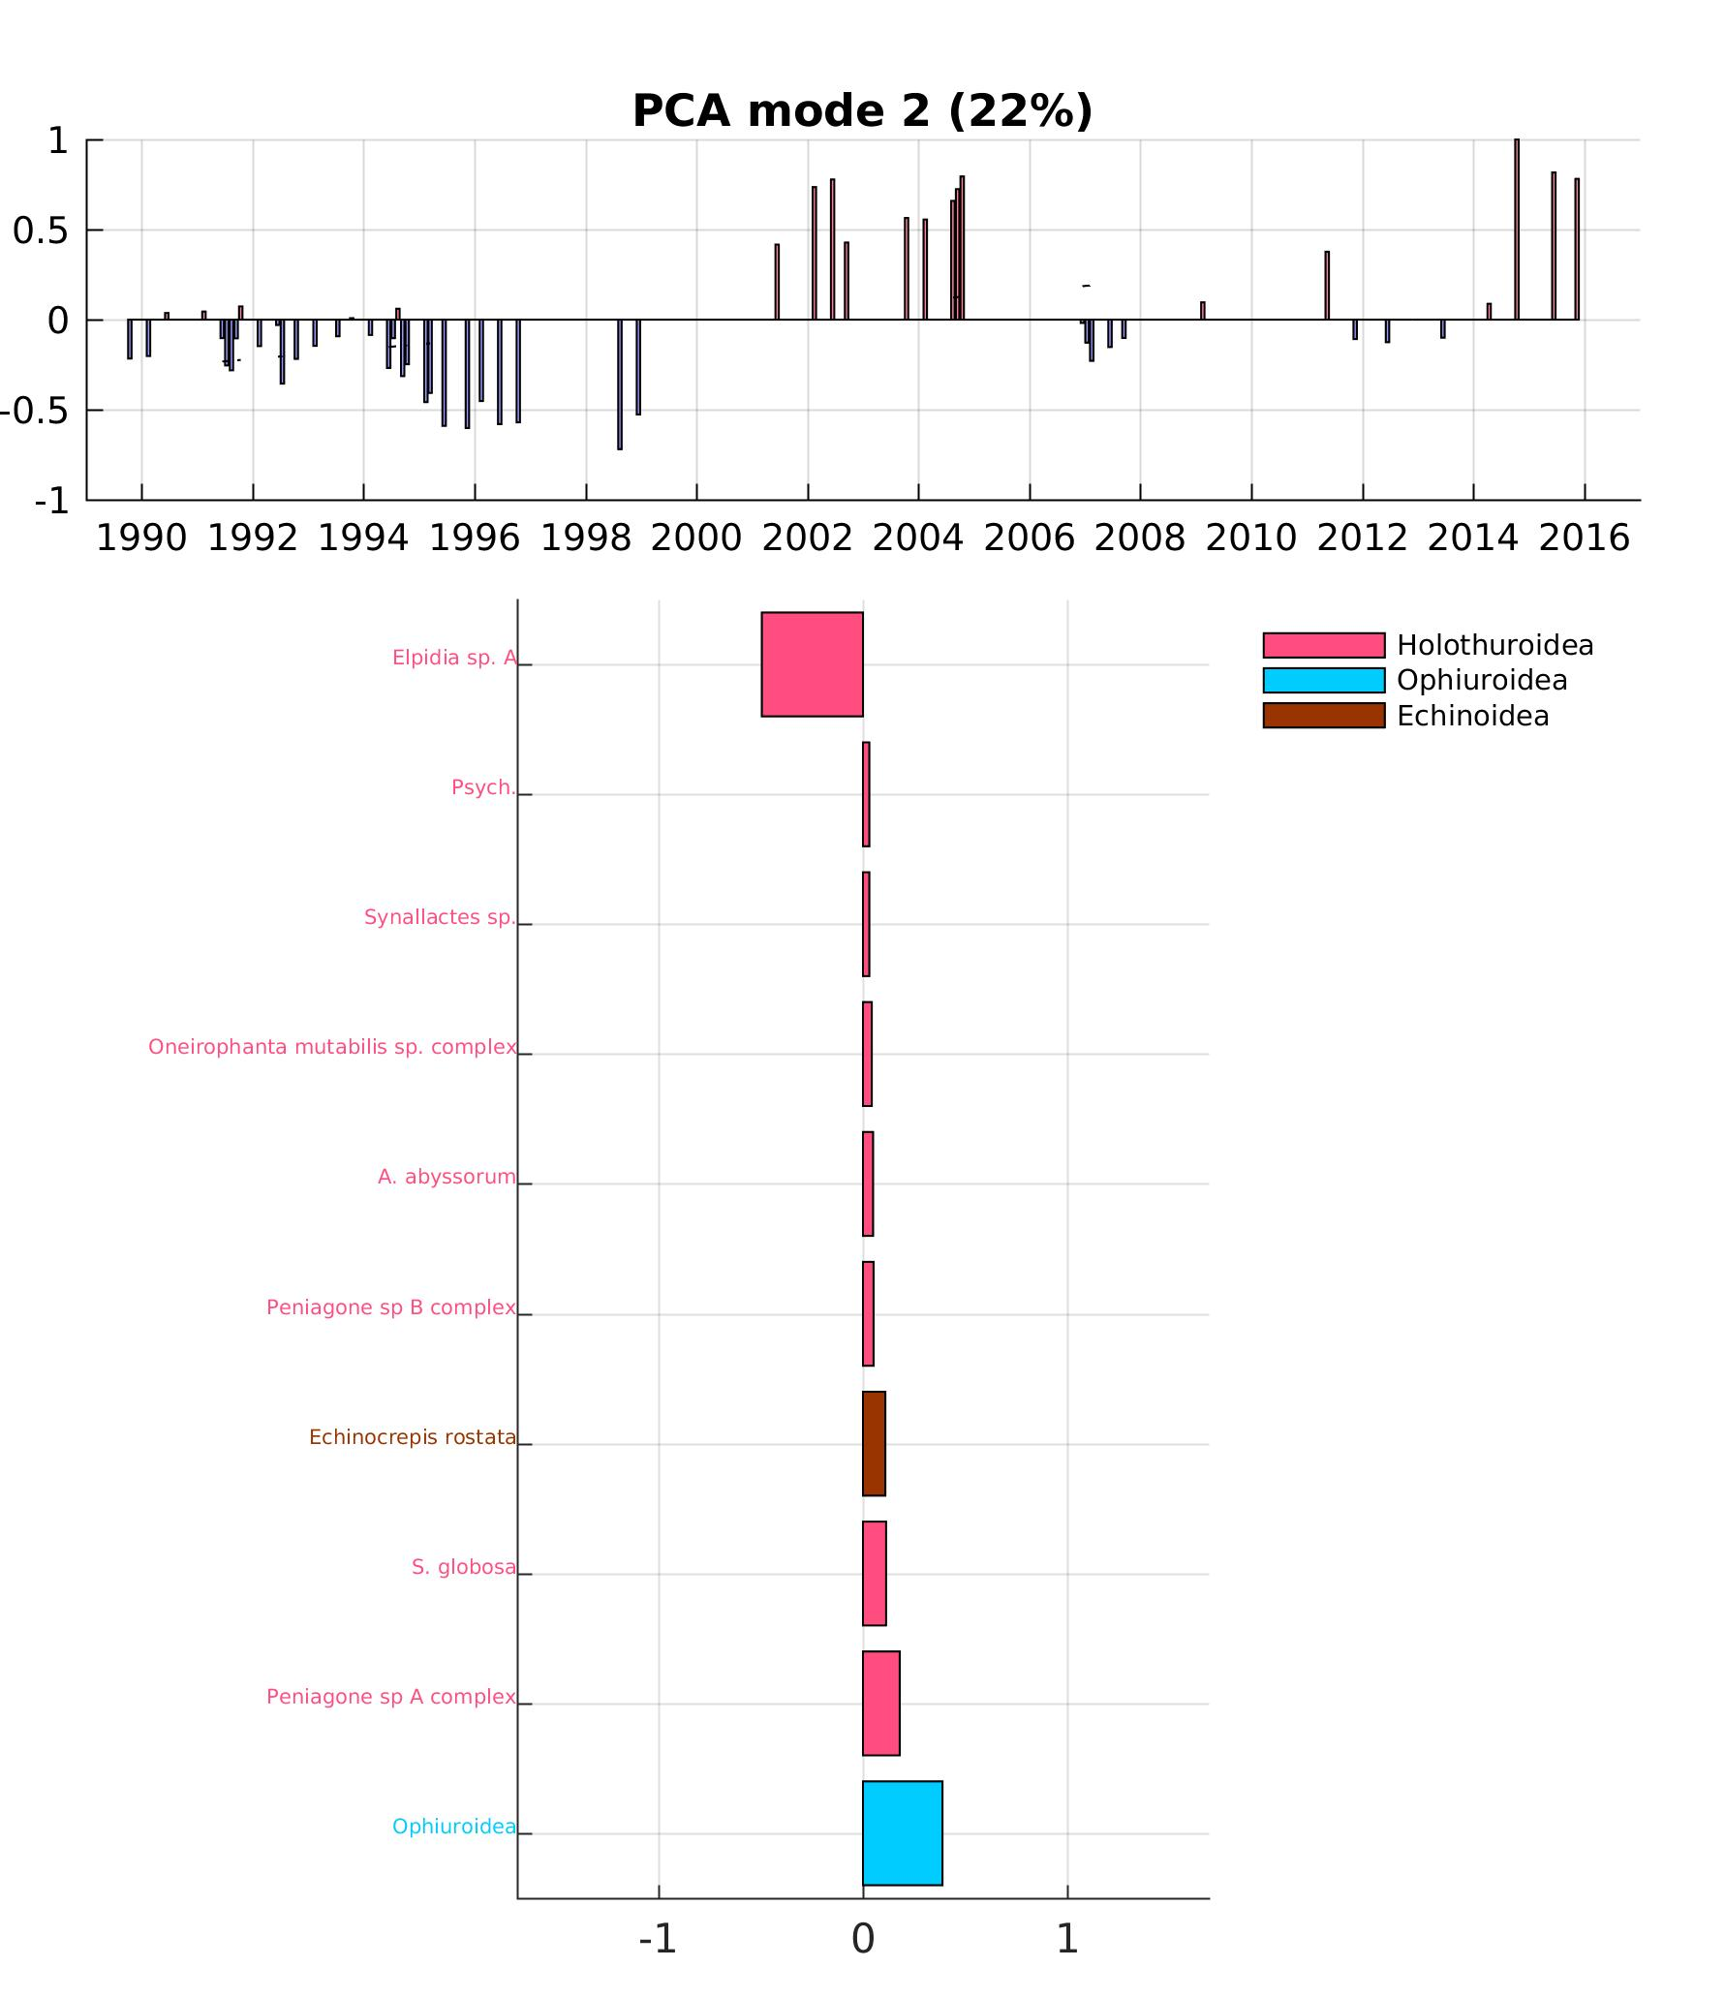
2. Ecosystem indices: mode 2
SURFACE
MIDWATER
BENTHOS
diatoms
jellies &
mollusks
Elpidia sp. A
dinos
& ciliates
Vertebrata
& Crustacea
Ophiures
Different time scales of variability (increases with depth?)
Surface: mode 1 = diatoms blooms, mode 2 = dinoflagellates/diatoms alternance
Midwater: mode 1 = decreases in 98-99 and in 05-06, mode 2 = seasonal & interannual species alternance
Benthos: mode 1 = big increases in recent years, mode 2 = community shift (?)

Slide 10
3. Integration through the water column
Analysis of mode 1 (from previous analysis)
Goals:
  Characterize the reddening of the signal as we go deeper
  Explain the 1st mode of variability by means of physical forcing (= upwelling)
  Question: is the frequency lower when going deeper, or when going up the food chain??

Slide 11
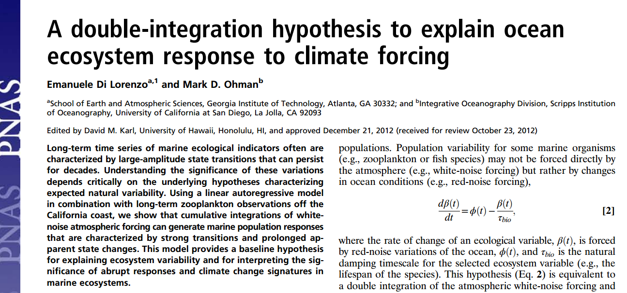
3. Integration through the water column: integration hypothesis
Concept: describe how environmental forcing gets dampened as we move deeper / animals live longer

Slide 12
3. Integration through the water column: integration theory
The rate of change of an ecological variable, Y(t), is forced by oceanic variations, f(t), and τ_{bio} is the natural damping timescale for the selected ecosystem variable (e.g., the lifespan of the species).
Y(0) = f(0)
Y(t+1) = f(t) + Y(t)* (1 - 1/τ_{bio})
If τ_{bio} = 1, Y(t+1) = f(t) ie. the variable responds to f within one time step with no memory
If τ_{bio} = ∞, Y(t+1) = f(t) + Y(t) ie. the oceanic forcing stays with infinite memory (getting summed)

Slide 13
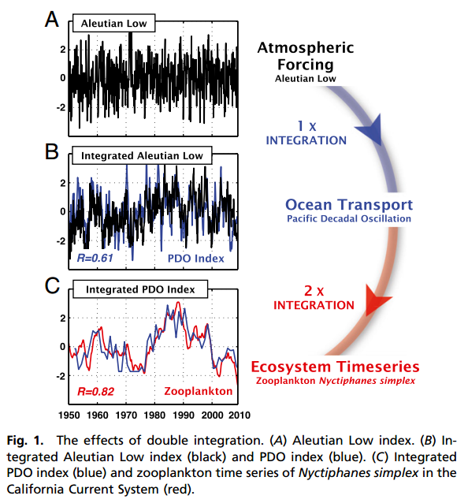
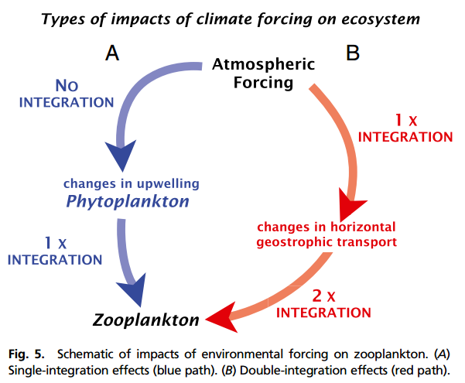
3. Integration through the water column: integration theory
Τ = 6 months
Τ_{bio} = 2 years

Slide 14
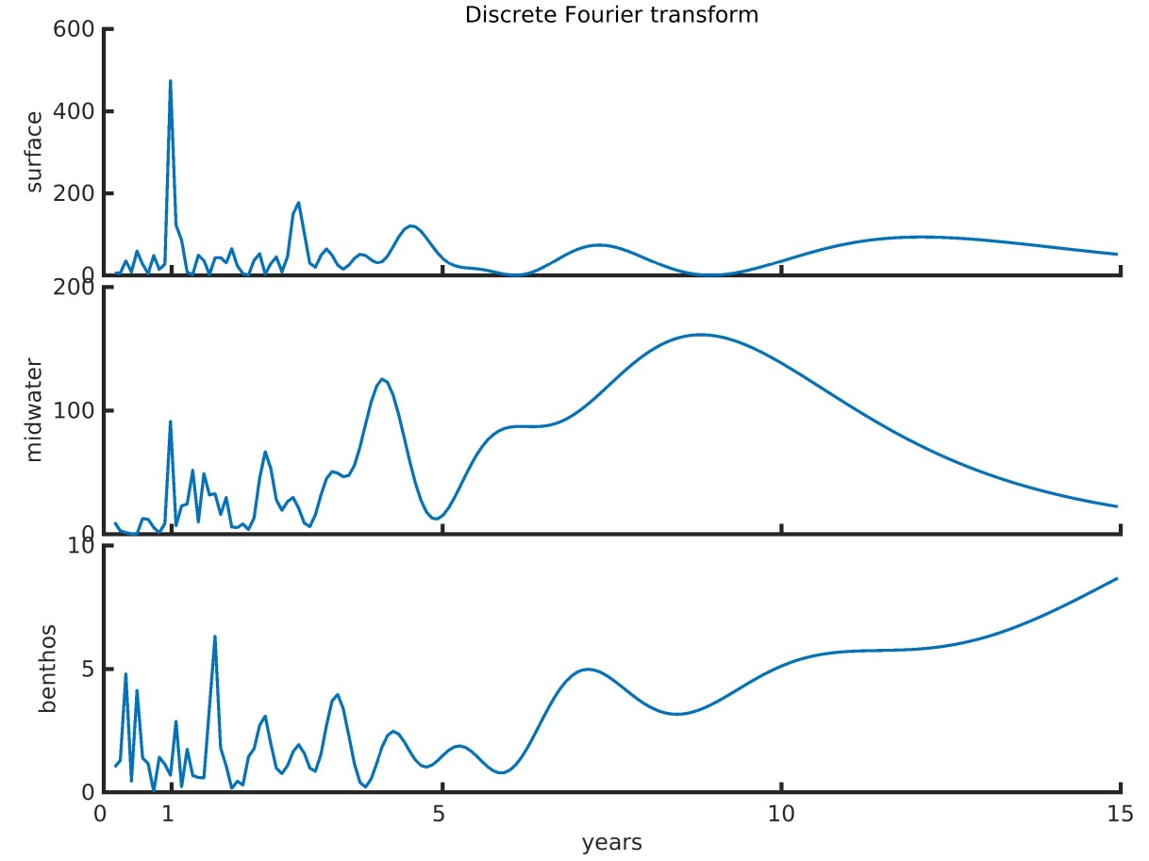
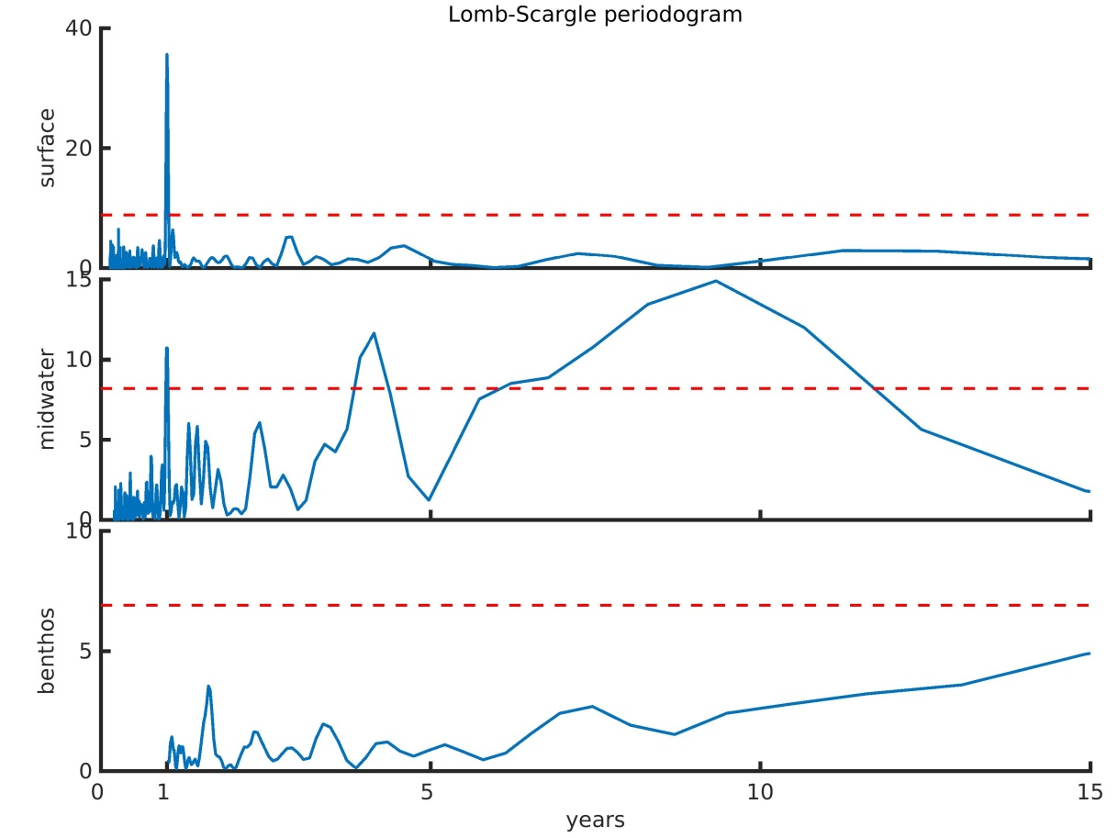
3. Integration through the water column: (a) frequency analysis
(analysis of principal components for mode 1, original sampling temporal resolution)
Discrete Fourier transform
Lomb-Scargle periodogram
SURFACE
SURFACE
MIDWATER
MIDWATER
BENTHOS
BENTHOS

Slide 15
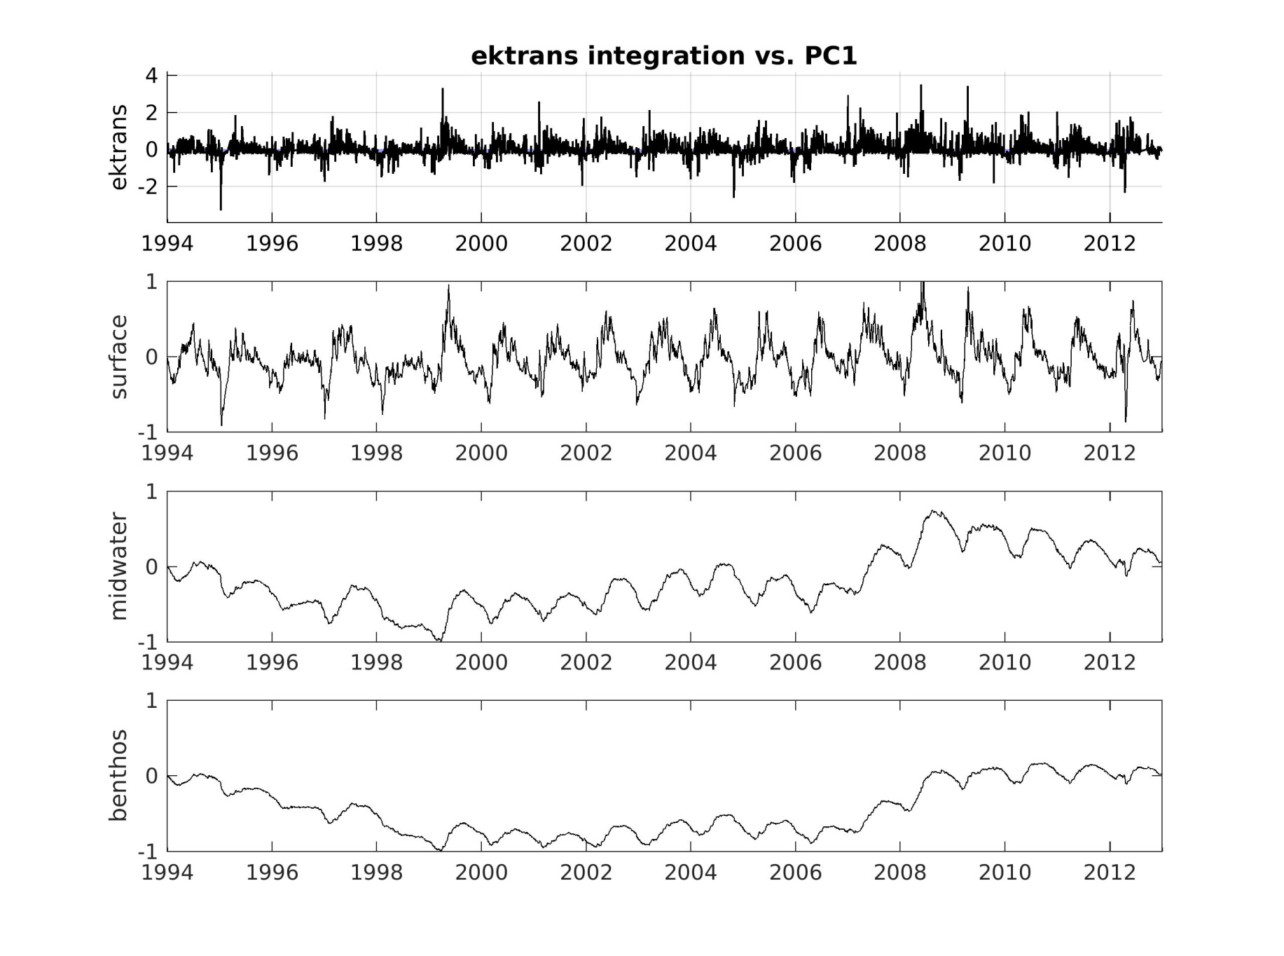
3. Integration through the water column: (b) upwelling forcing
Note – will re-run with NDBC buoy data instead of M1 (may provide a longer time series)
2-week integration
2-year integration
8-year integration

Slide 16
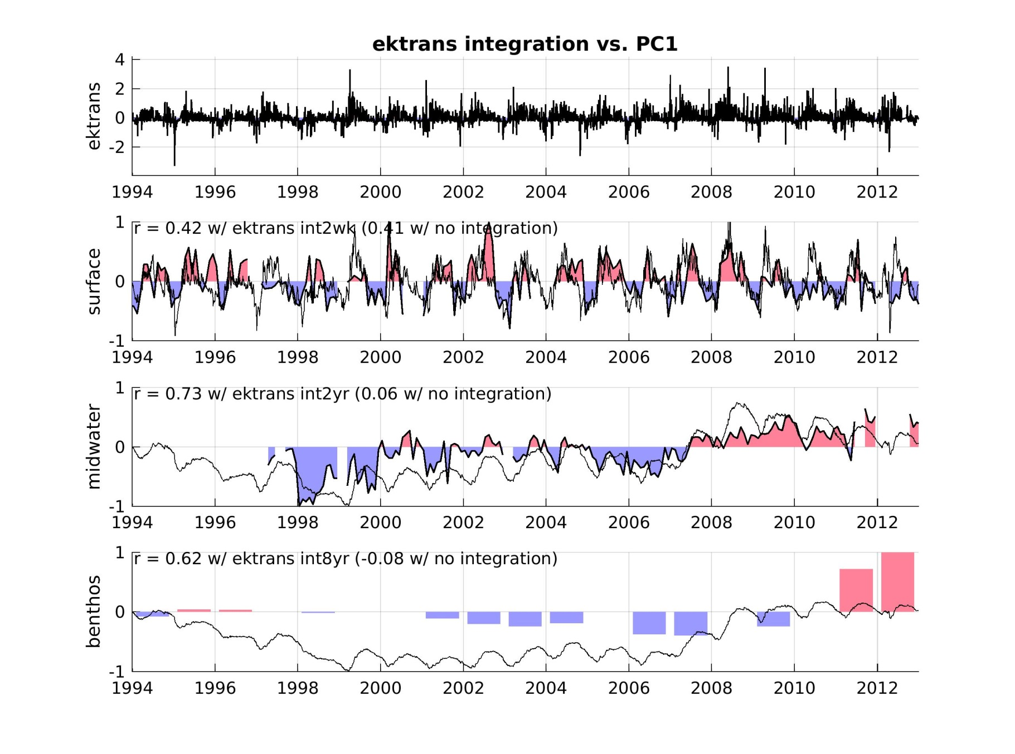
3. Integration through the water column: (b) upwelling forcing
SURFACE
2-week integration
~18%
varex
MIDWATER
~53%
varex
2-year integration
BENTHOS
~38%
varex
8-year integration

Slide 17
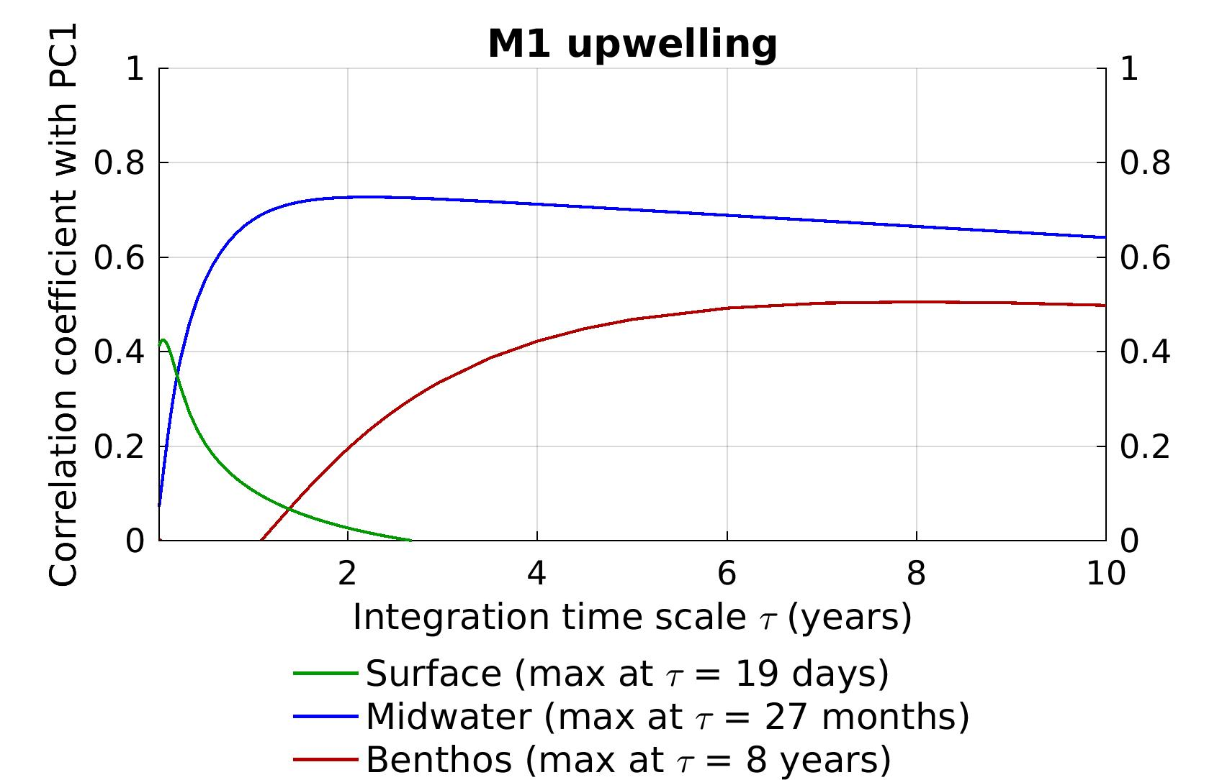
3. Integration through the water column: (b) upwelling forcing
MIDWATER
BENTHOS
SURFACE

Slide 18
3. Integration through the water column: (c) why?
Frequency increases with depth…
… because of forcing attenuation/reddening when going deeper?
… or because trophic levels increase from surface to midwater to benthos in ITS?
SURFACE
MIDWATER
→ Midwater has both depth and trophic resolution
BENTHOS
Note – integration time scales different from time series frequency!!

Slide 19
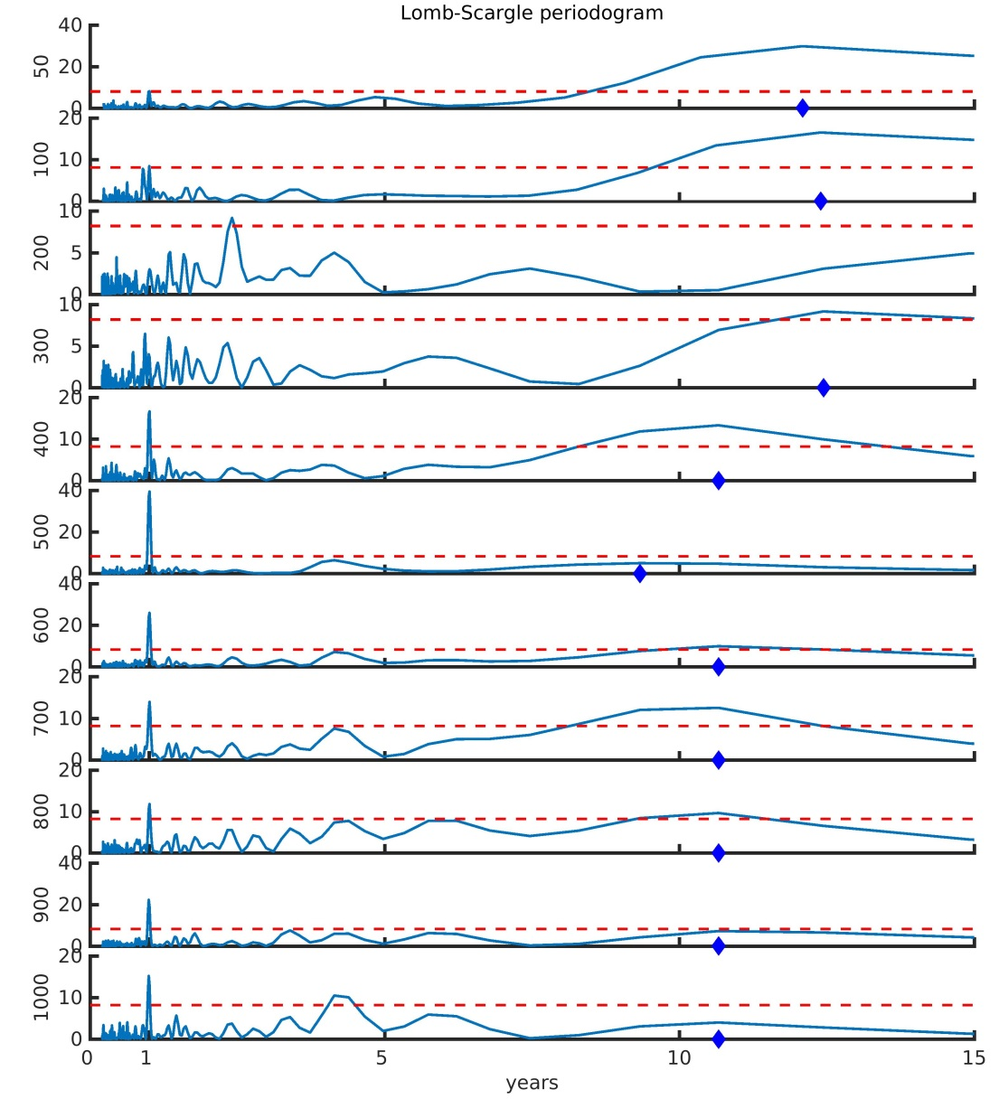
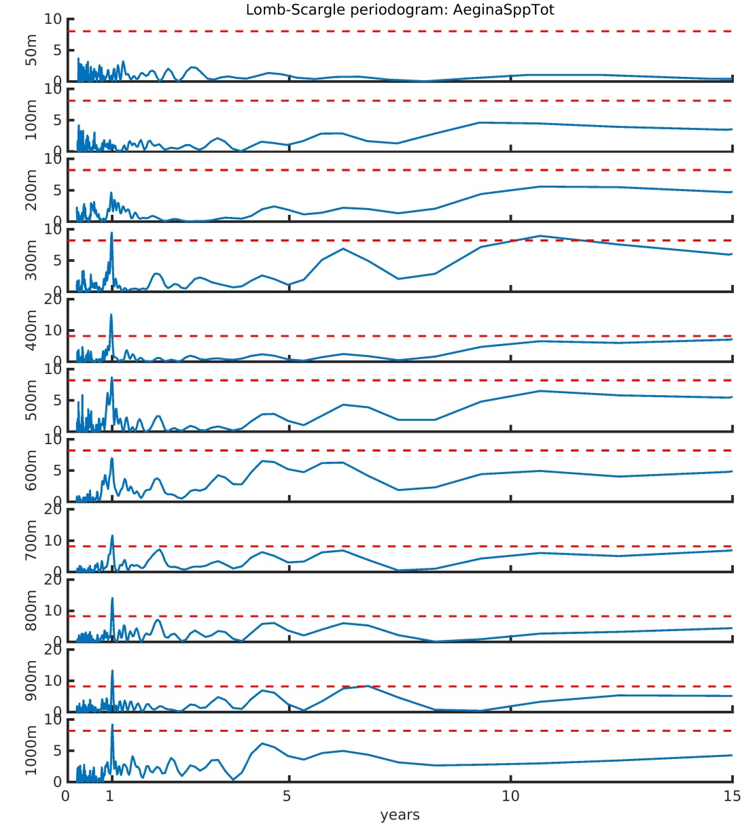
3. Integration through the water column: (c) with depth?
PCA analysis at each depth
Individual species: e.g. Aegina
50 m
100 m
200 m
300 m
400 m
500 m
600 m
700 m
800 m
900 m
1000 m

Slide 20
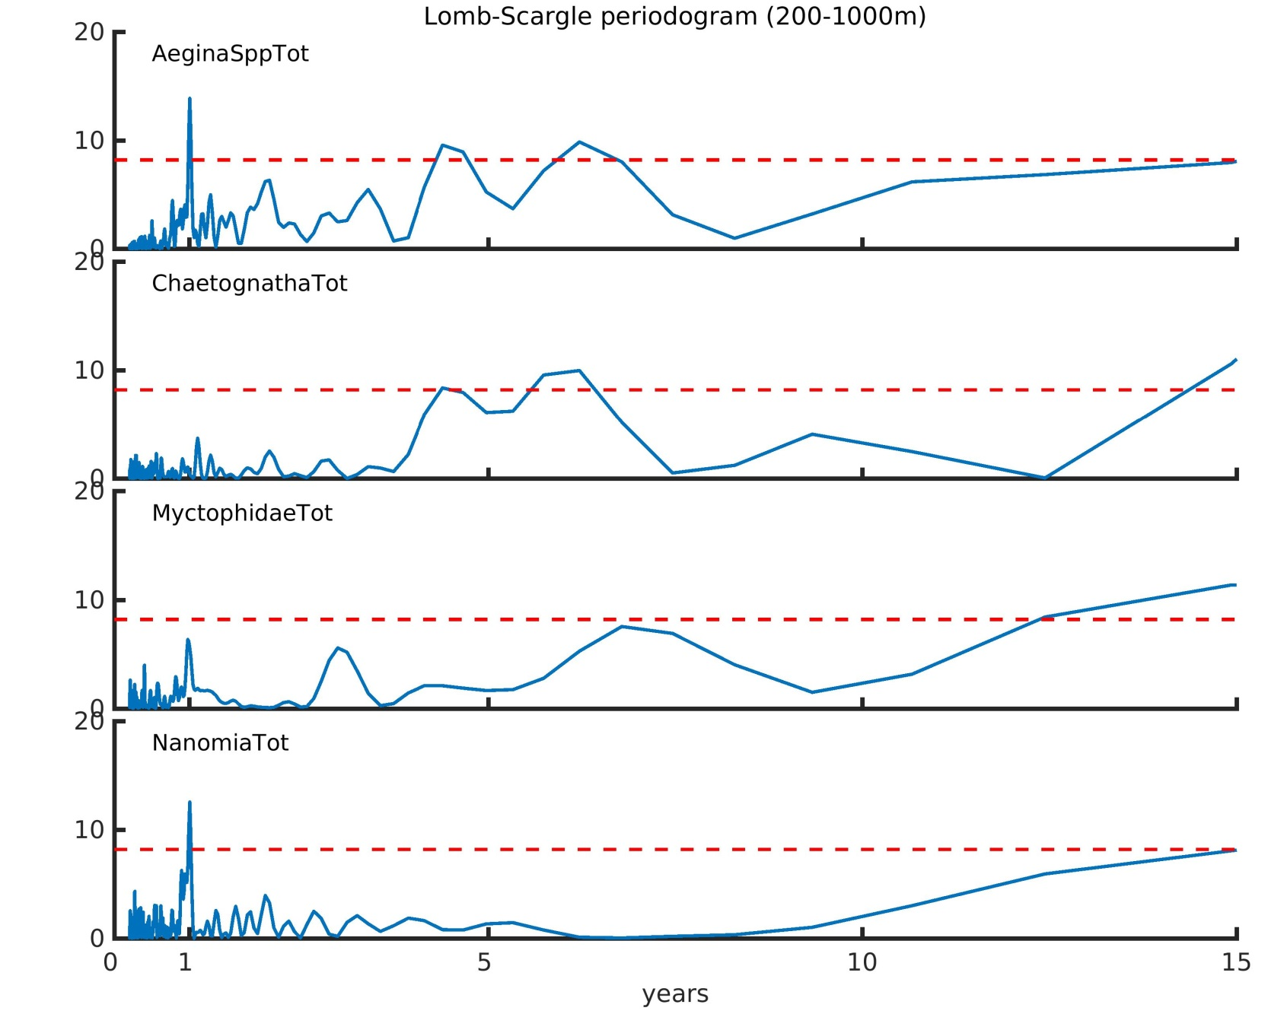
3. Integration through the water column: (c) with trophic level?
Aegina
Chaetognatha
Myctophidae
Nanomia

Slide 21
4. Vignette-type stories?
Possible highlights:
  El Niño
  Dinos age
  Regime shift
  Age of uncertainty

