Slide 1
Ocean Sciences abstract
Temporal Variability and Environmental Forcing of Surface, Midwater and Benthic Communities in the California Current System
Long-term marine biological time series are rare, and even more so are time series that monitor ecosystems through the water column, from surface to seafloor. Here, we present an unprecedented dataset integrating three time series (1997-present) spanning the surface, midwater and benthic habitats. Data were obtained from surface microscopic counts, video observations of midwater animals and benthic imaging of the seafloor. Taxon-specific time series of plankton biomass and midwater and benthic animal density were analyzed using principal component analysis (PCA) and non-metric multidimensional scaling (nMDS) to highlight temporal changes in ecosystem structure. The first mode of variability for each time series, as identified from PCA, was compared to environmental forcing including Pacific climate variability indices and local upwelling. We demonstrate how upwelling forcing propagates through the three time-series communities, which provides important understanding of how climate variability impacts ecosystems across the water column.

Slide 2
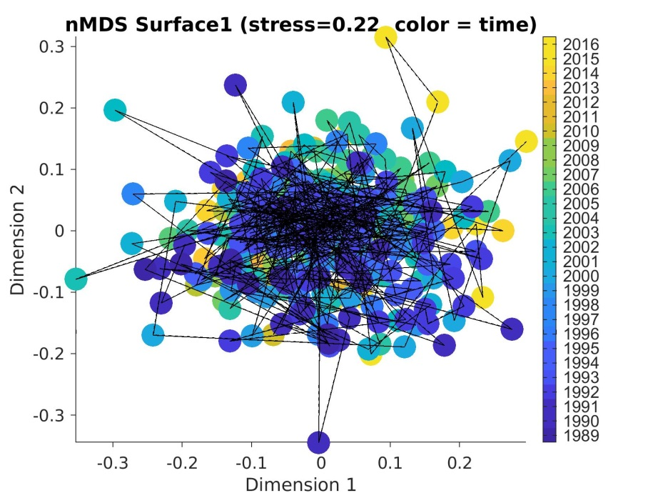
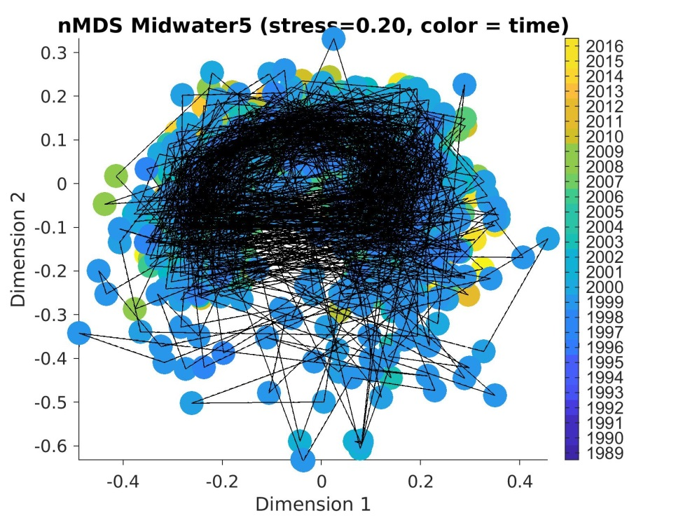
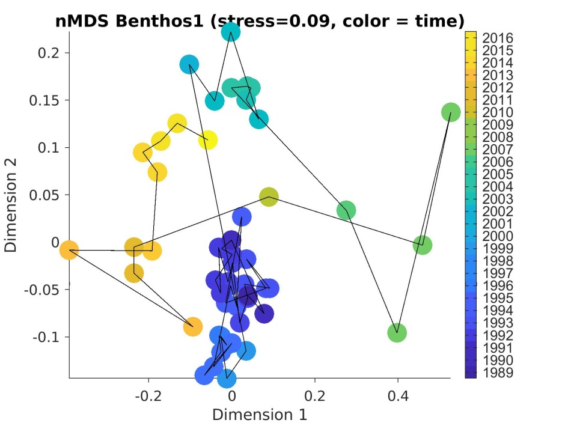
Ecosystem composition: MDS
SURFACE
MIDWATER
BENTHOS
Benthos: sqrt-transformed
Surface & MidW: sqrt4-transformed

Slide 3
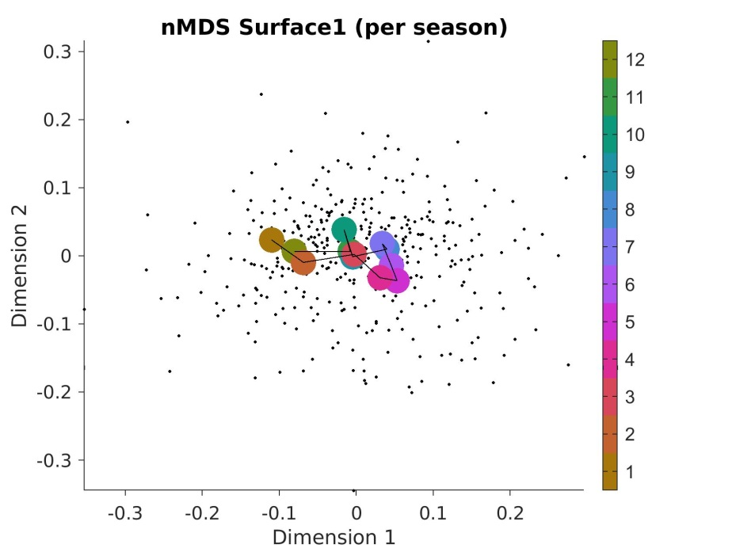
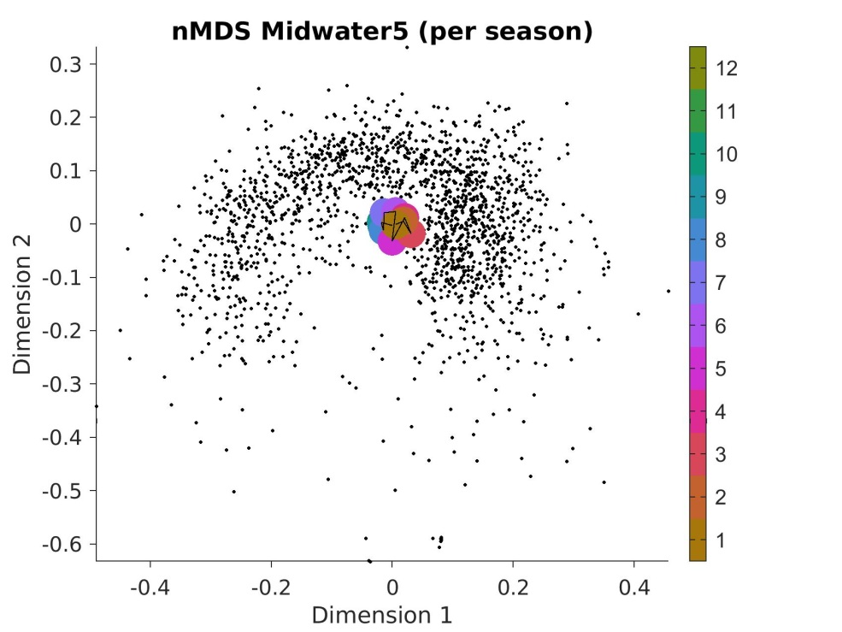
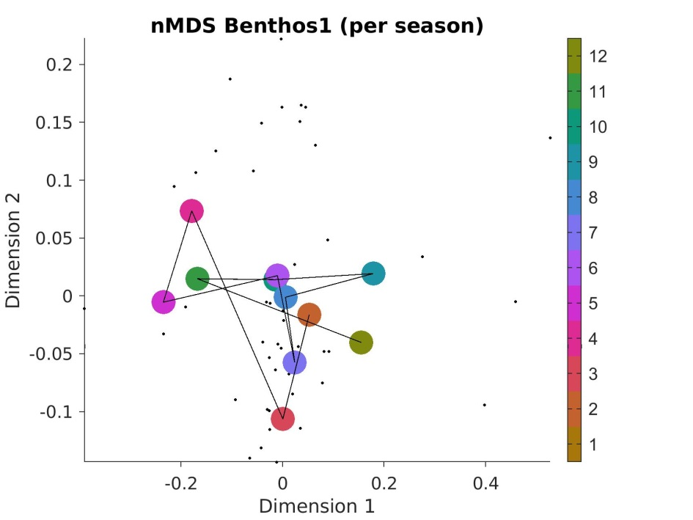
Ecosystem composition: MDS (season)
SURFACE
MIDWATER
BENTHOS

Slide 4
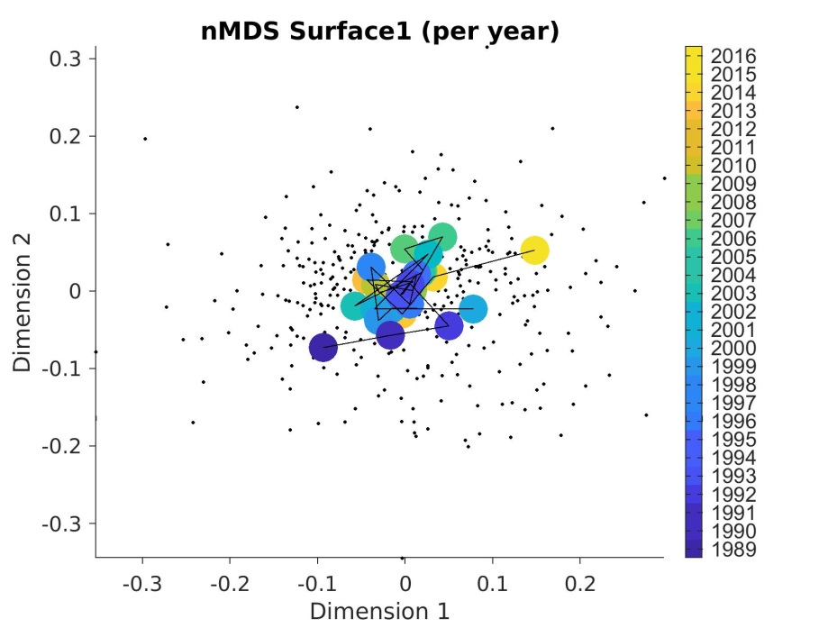
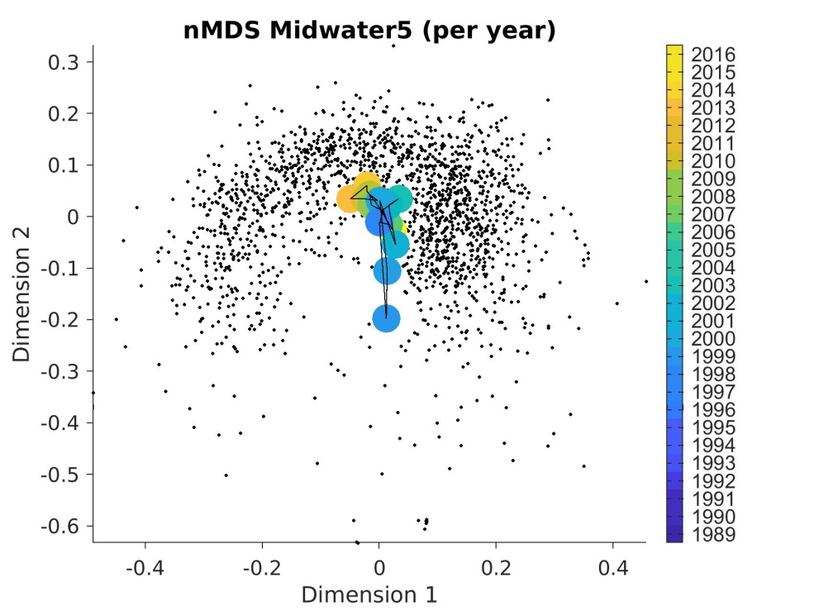
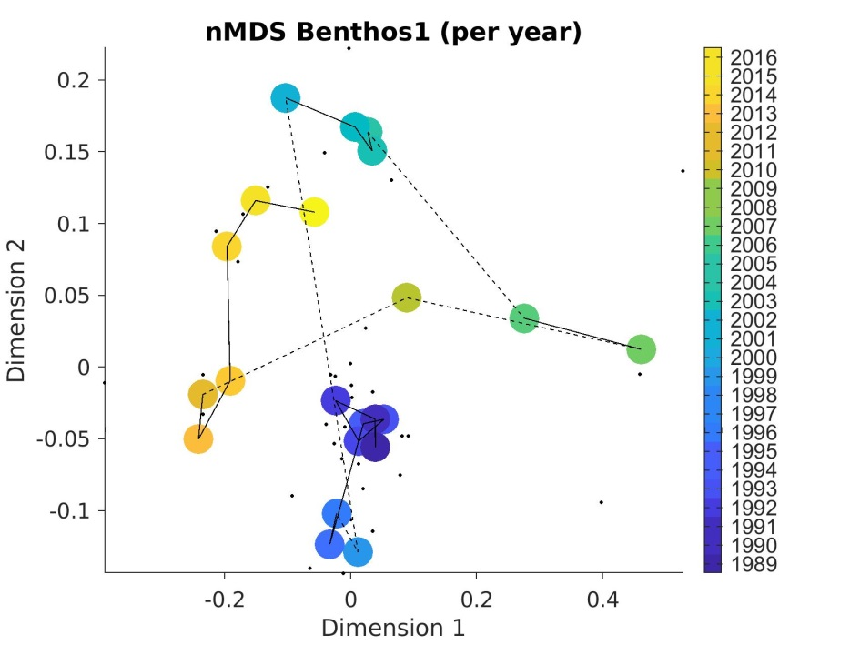
Ecosystem composition: MDS (year)
SURFACE
MIDWATER
BENTHOS

Slide 5
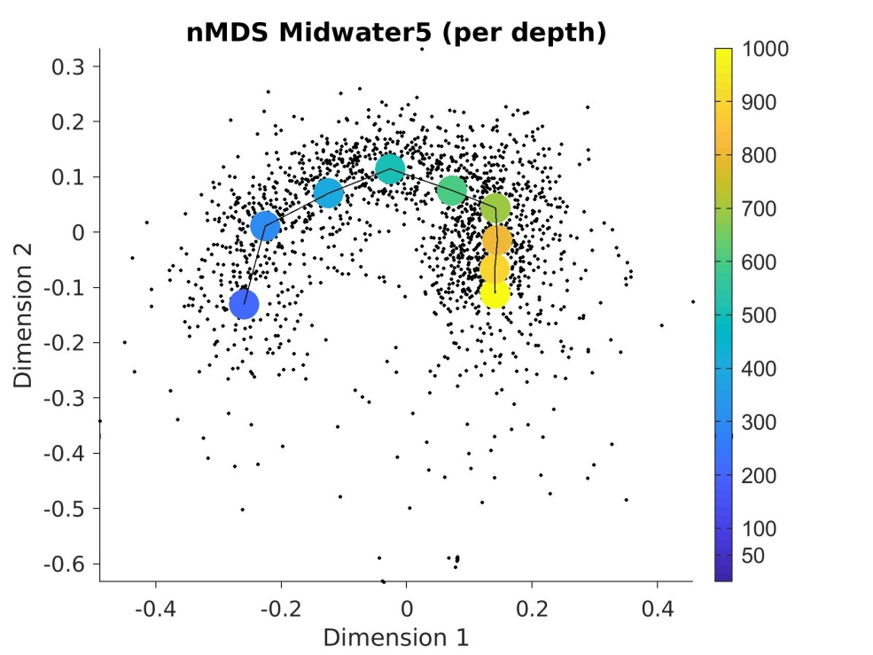
Ecosystem composition: MDS (depth)
MIDWATER

Slide 6
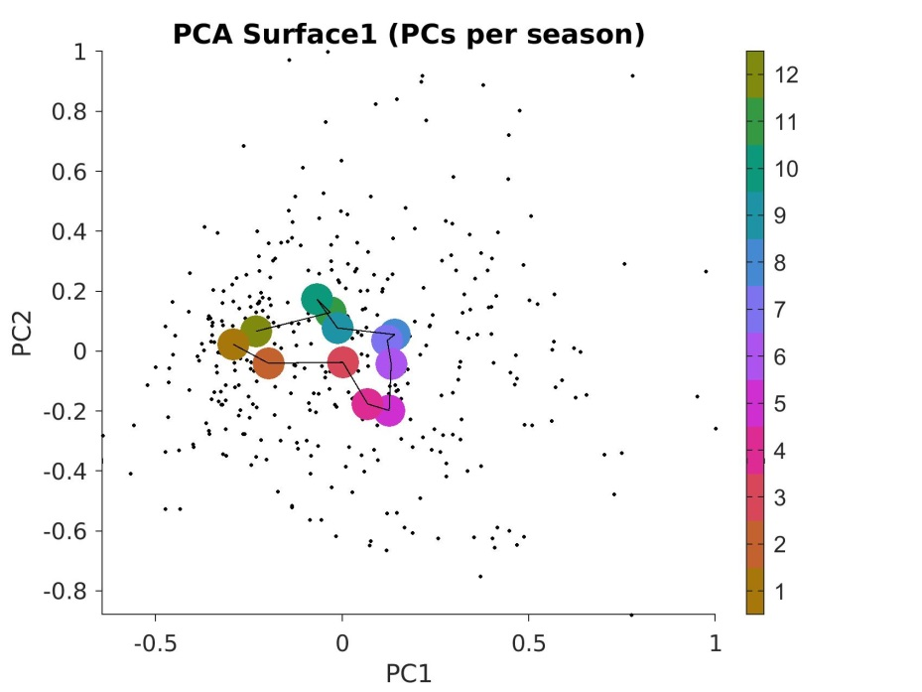
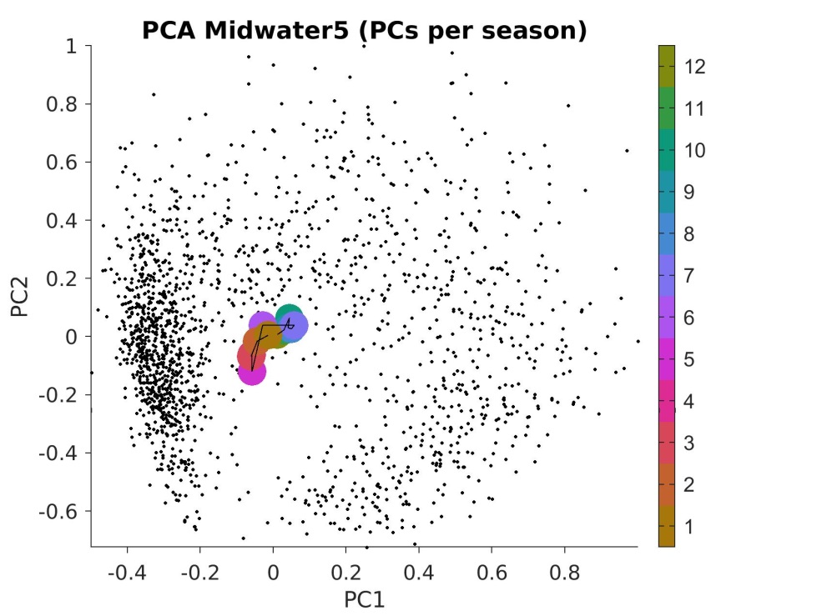
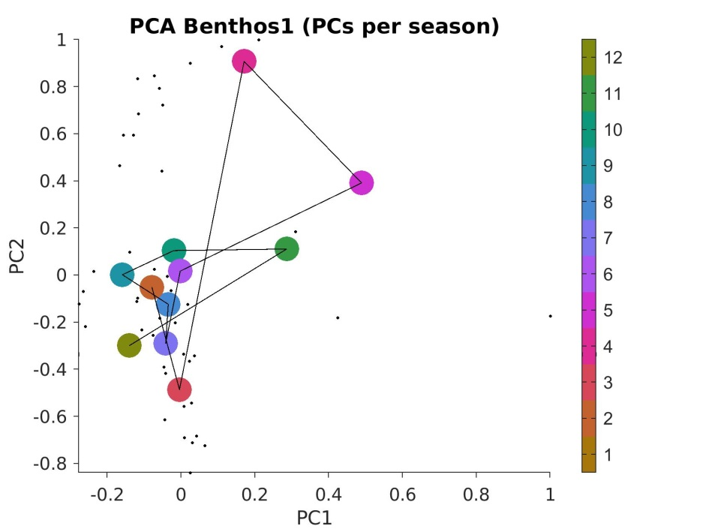
Ecosystem composition: PCA (season)
SURFACE
MIDWATER
BENTHOS

Slide 7
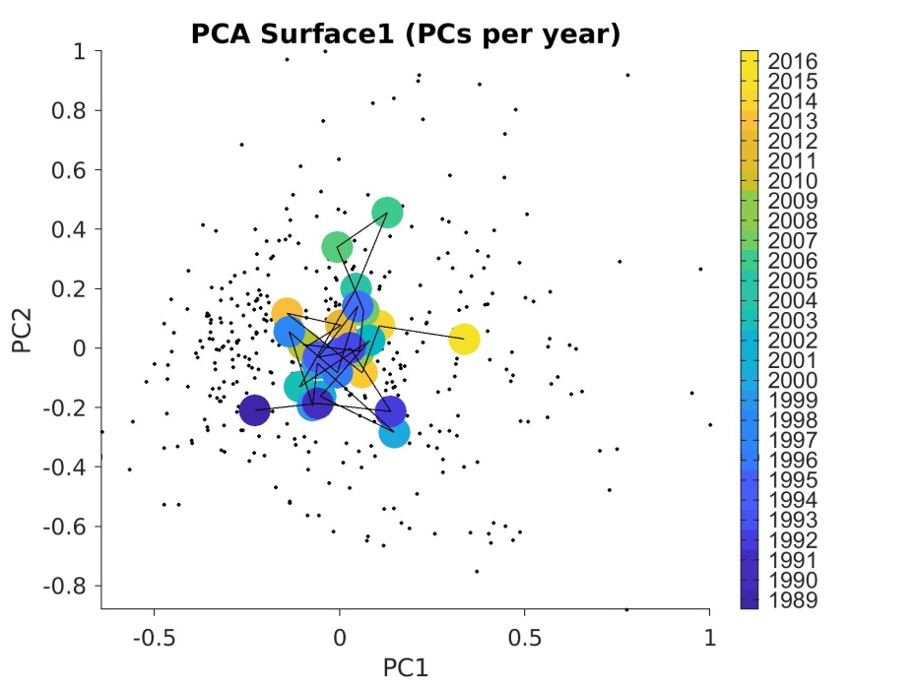
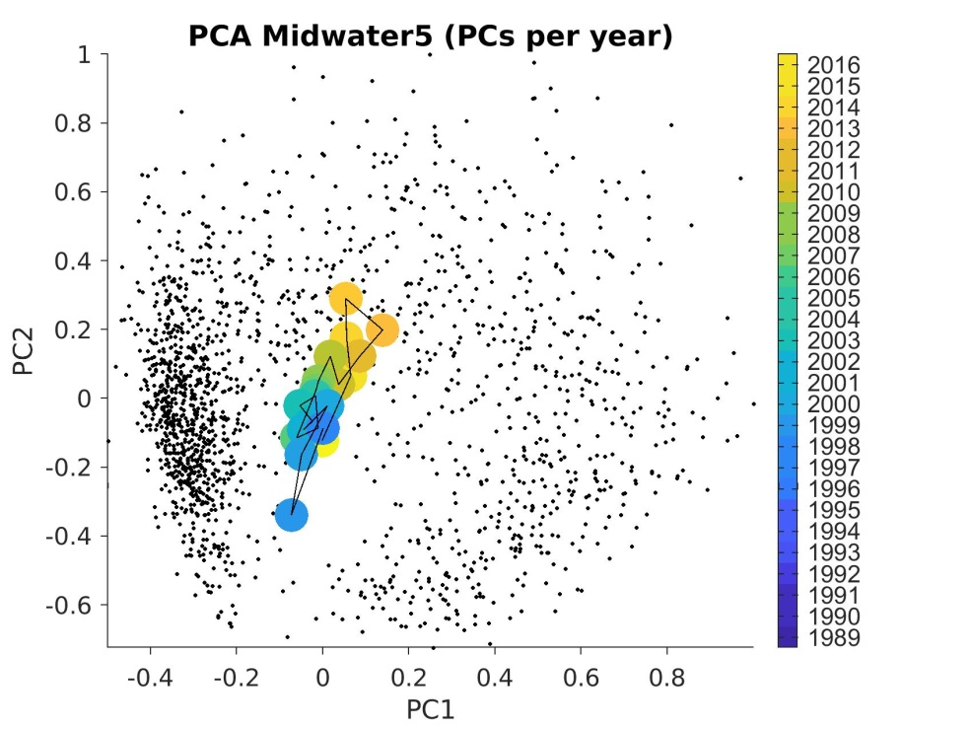
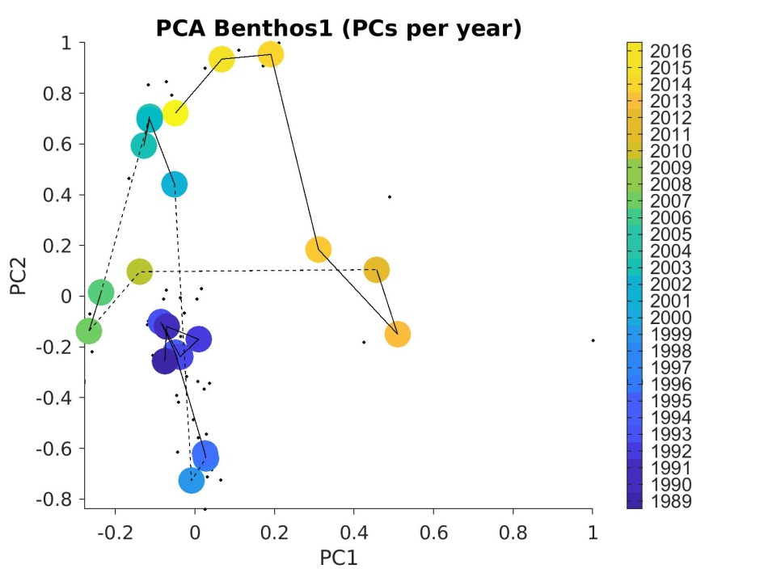
Ecosystem composition: PCA (year)
SURFACE
MIDWATER
BENTHOS

Slide 8
Ecosystem composition: MDS
SURFACE
MIDWATER
BENTHOS
Benthos: sqrt-transformed
Surface & MidW: sqrt4-transformed

Slide 9
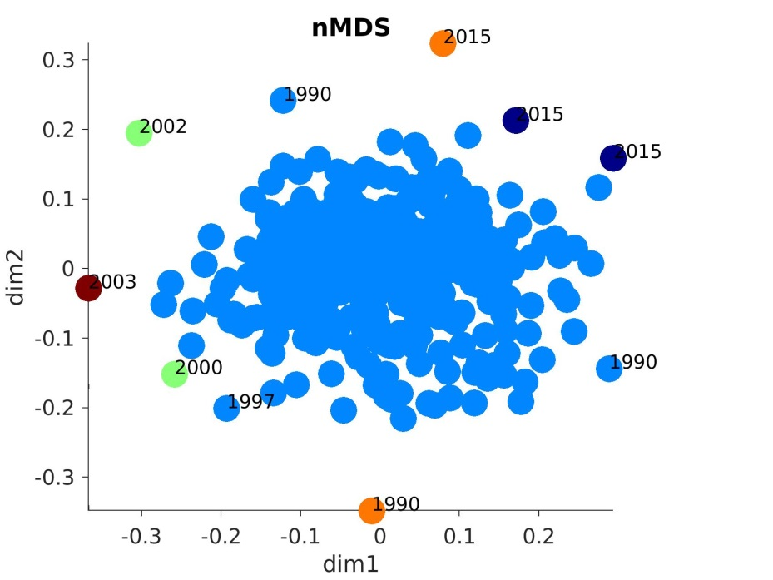
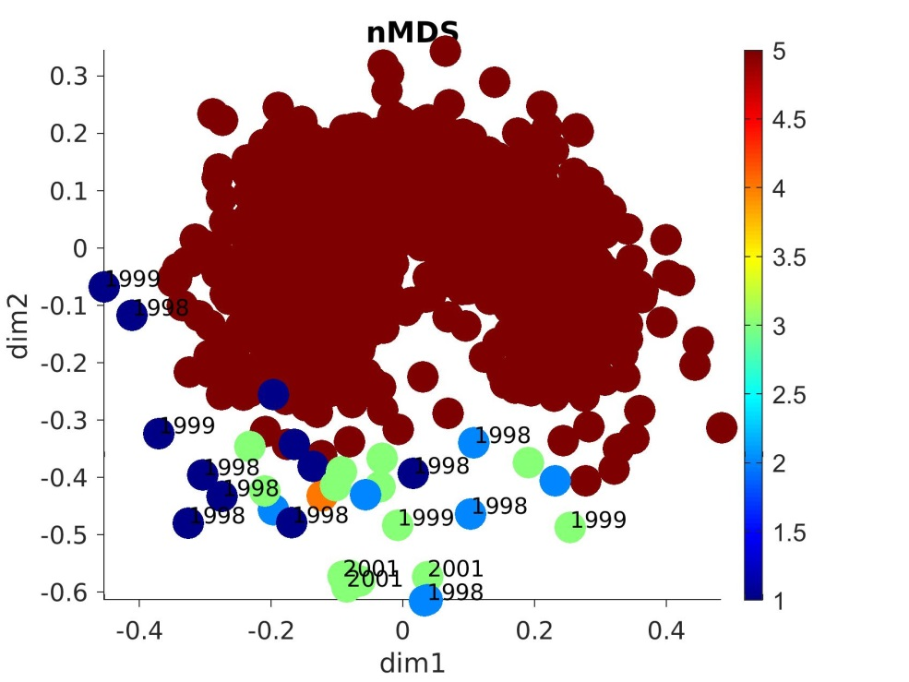
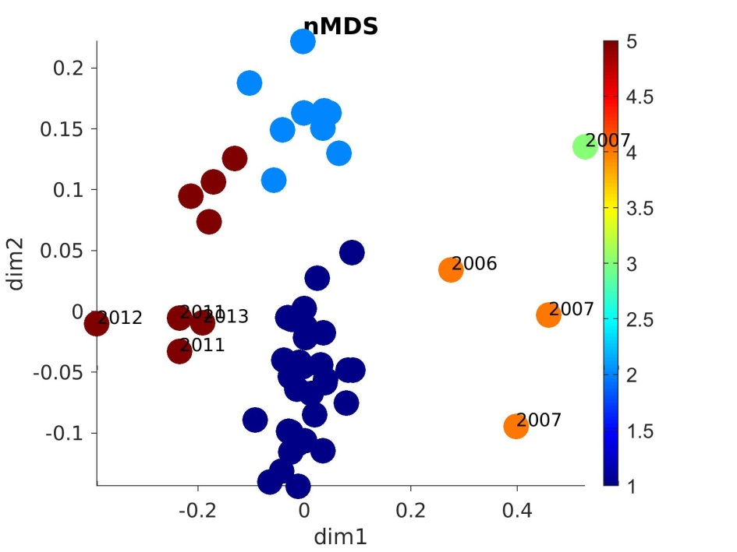
Defining ecosystem states?
SURFACE
MIDWATER
BENTHOS

Slide 10
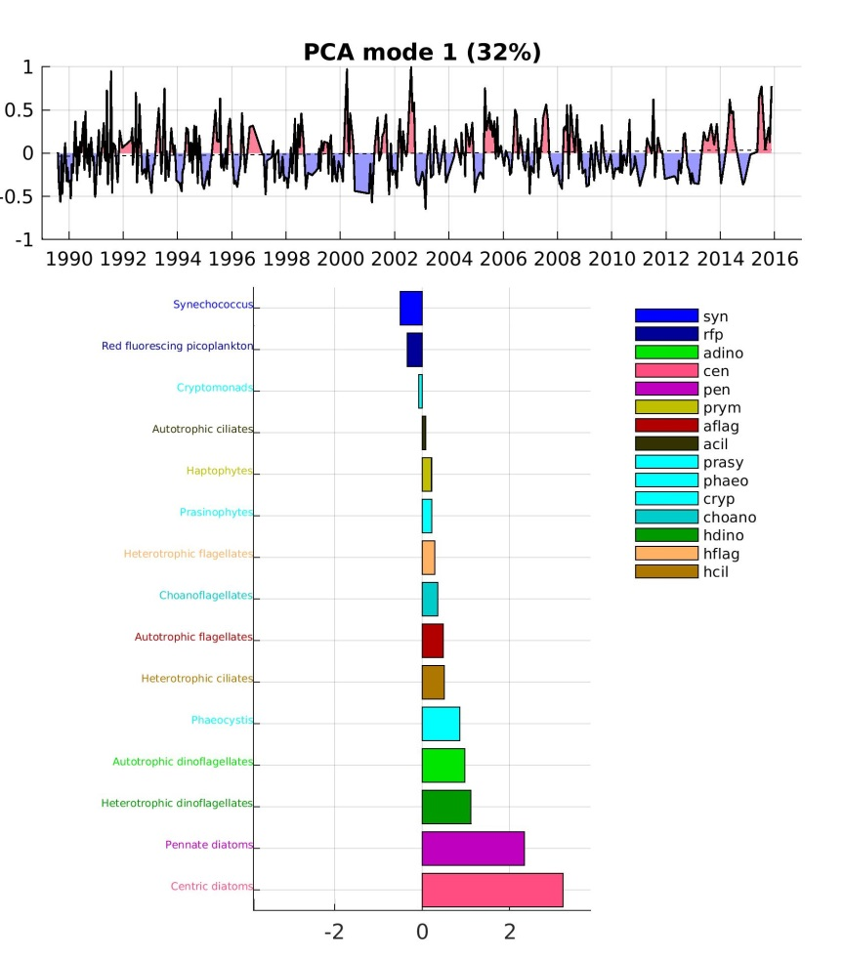
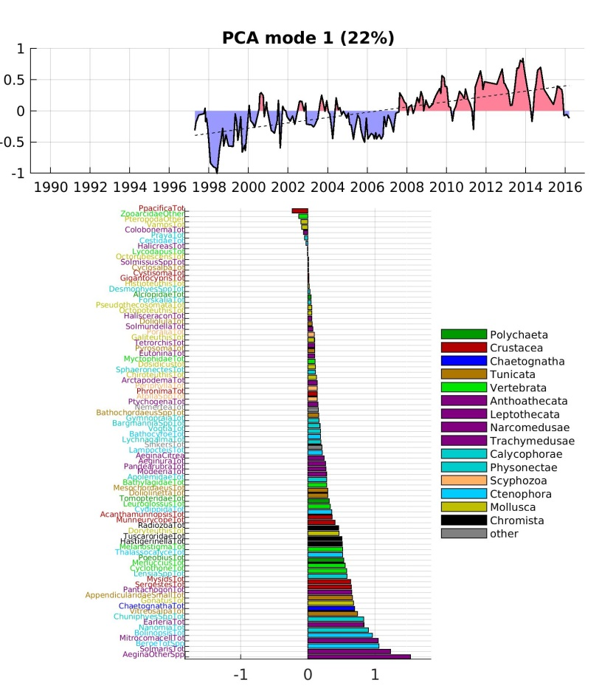
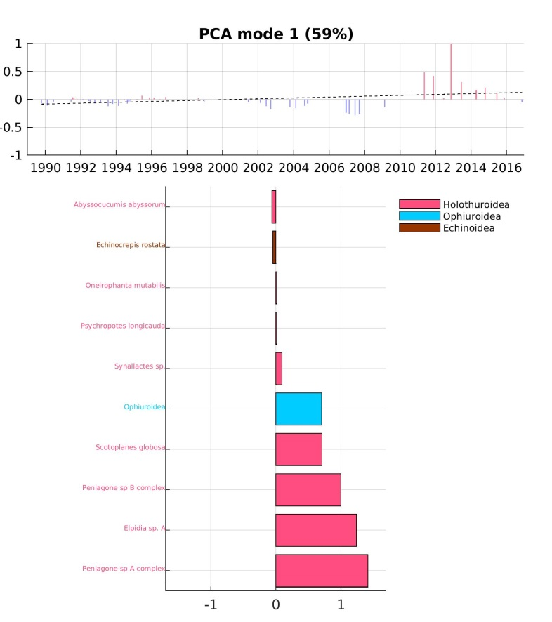
First mode of variability
SURFACE
MIDWATER (int 200-1000m)
BENTHOS
pico
Peniagone sp. B
Elpidia sp. A
diatoms
Peniagone sp. A

Slide 11
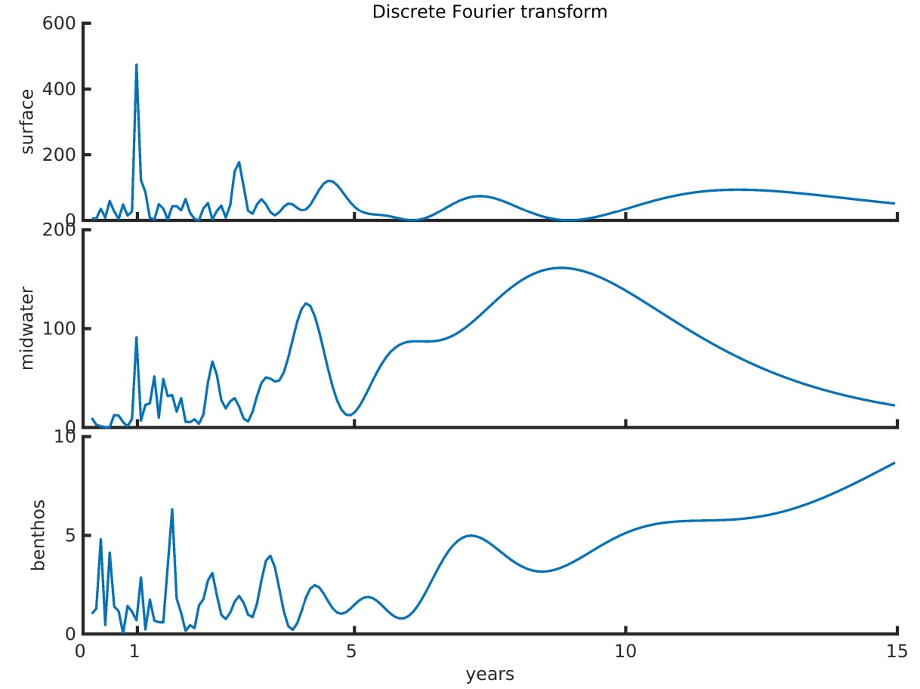
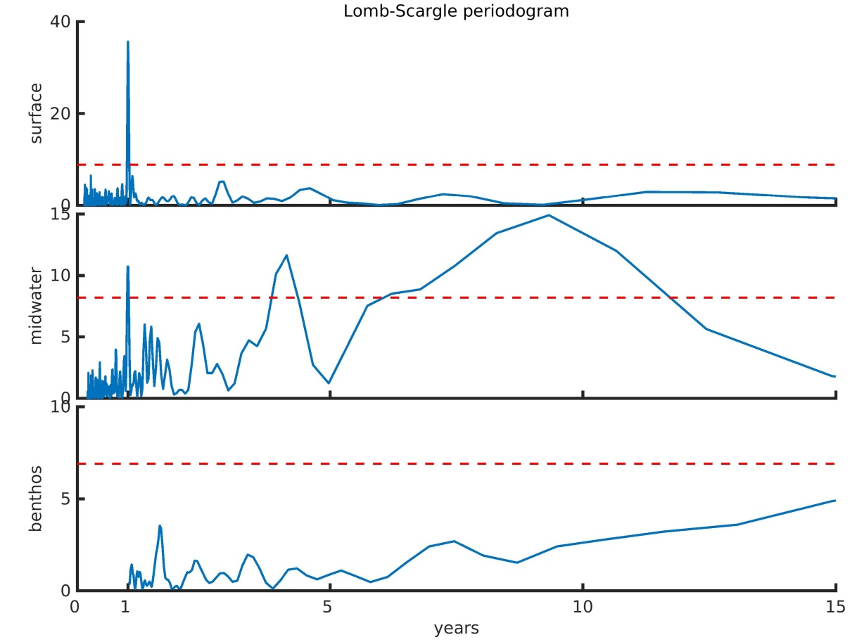
3. Integration through the water column: (a) frequency analysis
(analysis of principal components for mode 1, original sampling temporal resolution)
Discrete Fourier transform
Lomb-Scargle periodogram
SURFACE
SURFACE
MIDWATER
MIDWATER
BENTHOS
BENTHOS

Slide 12
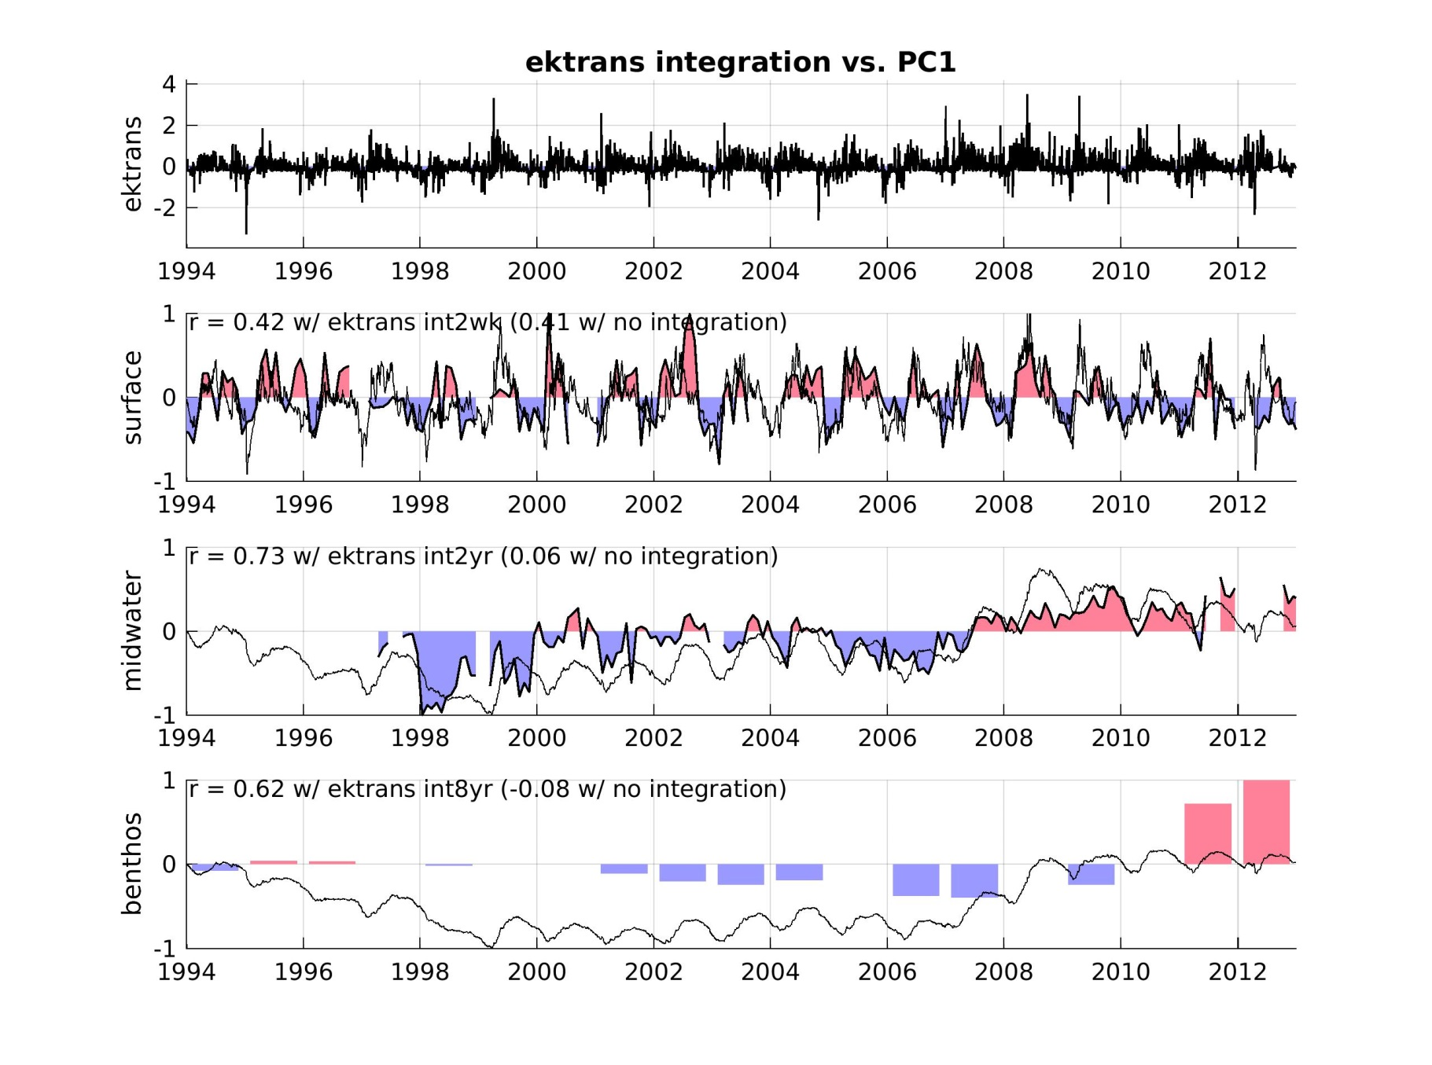
3. Integration through the water column: (b) upwelling forcing
SURFACE
2-week integration
~18%
varex
MIDWATER
~53%
varex
2-year integration
BENTHOS
~38%
varex
8-year integration

Slide 13
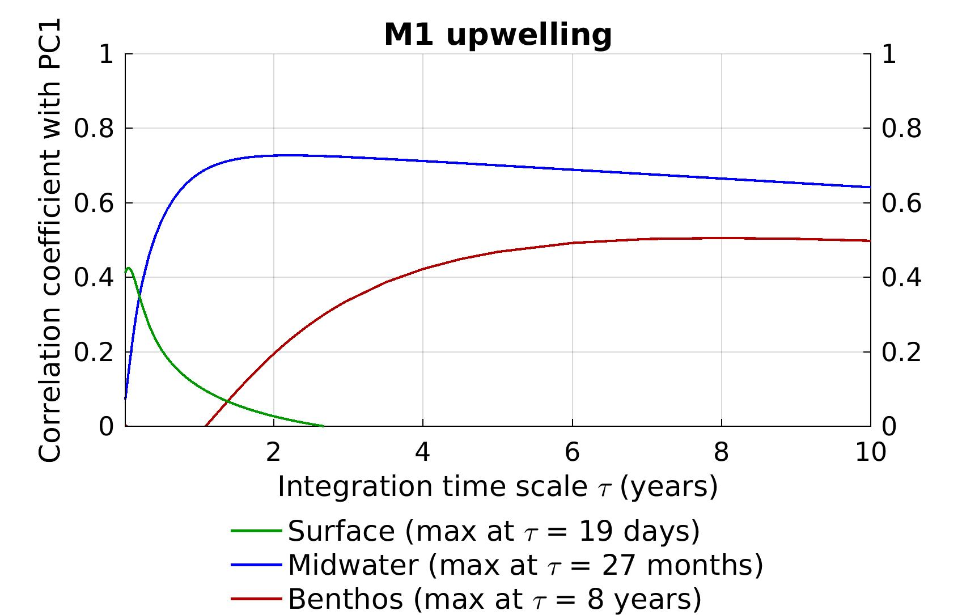
3. Integration through the water column: (b) upwelling forcing
MIDWATER
BENTHOS
SURFACE

