Slide 1
Ocean Sciences abstract
Temporal Variability and Environmental Forcing of Surface, Midwater and Benthic Communities in the California Current System
Long-term marine biological time series are rare, and even more so are time series that monitor ecosystems through the water column, from surface to seafloor. Here, we present an unprecedented dataset integrating three time series (1997-present) spanning the surface, midwater and benthic habitats. Data were obtained from surface microscopic counts, video observations of midwater animals and benthic imaging of the seafloor. Taxon-specific time series of plankton biomass and midwater and benthic animal density were analyzed using principal component analysis (PCA) and non-metric multidimensional scaling (nMDS) to highlight temporal changes in ecosystem structure. The first mode of variability for each time series, as identified from PCA, was compared to environmental forcing including Pacific climate variability indices and local upwelling. We demonstrate how upwelling forcing propagates through the three time-series communities, which provides important understanding of how climate variability impacts ecosystems across the water column.

Slide 2
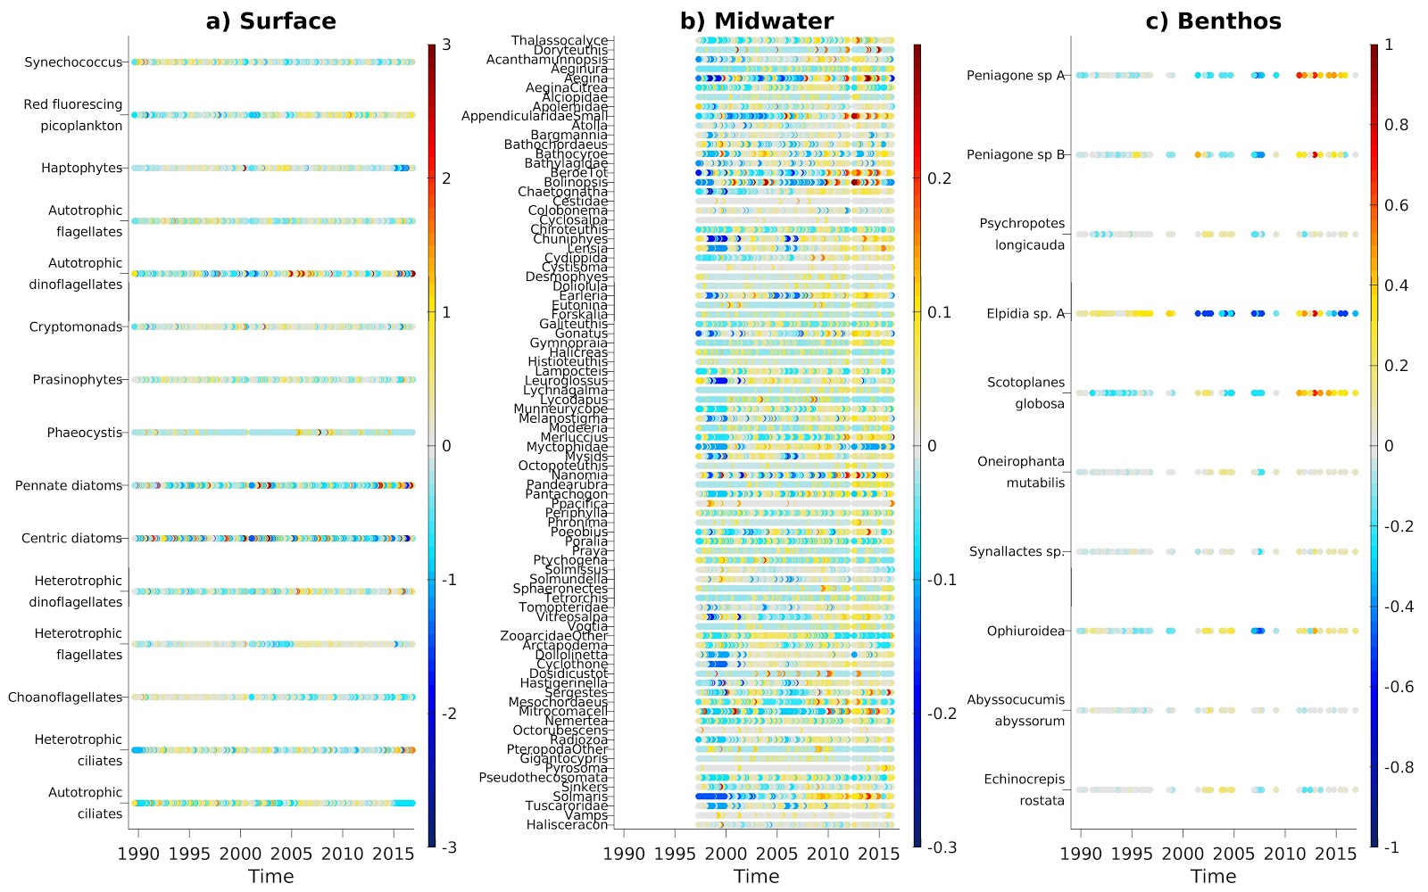
Time series presentation

Slide 3
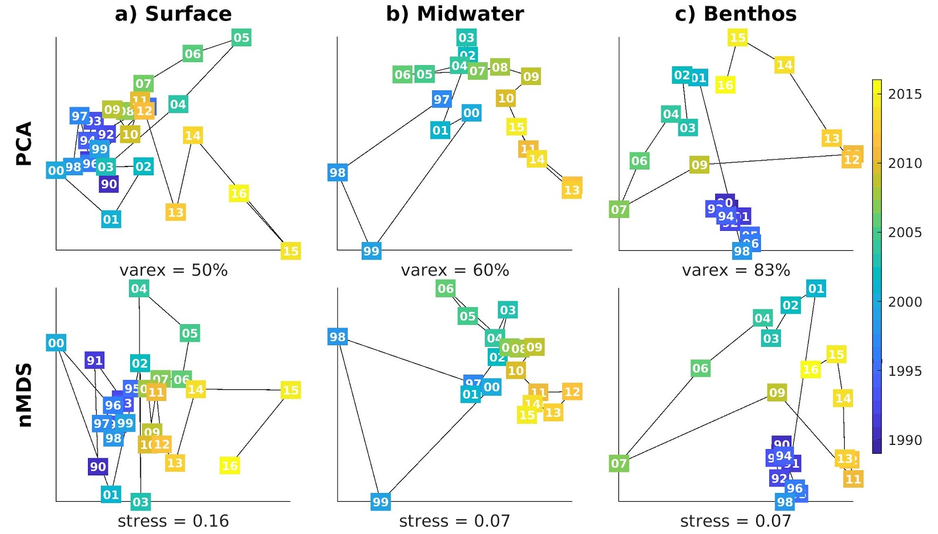
Yearly PCA & MDS

Slide 4
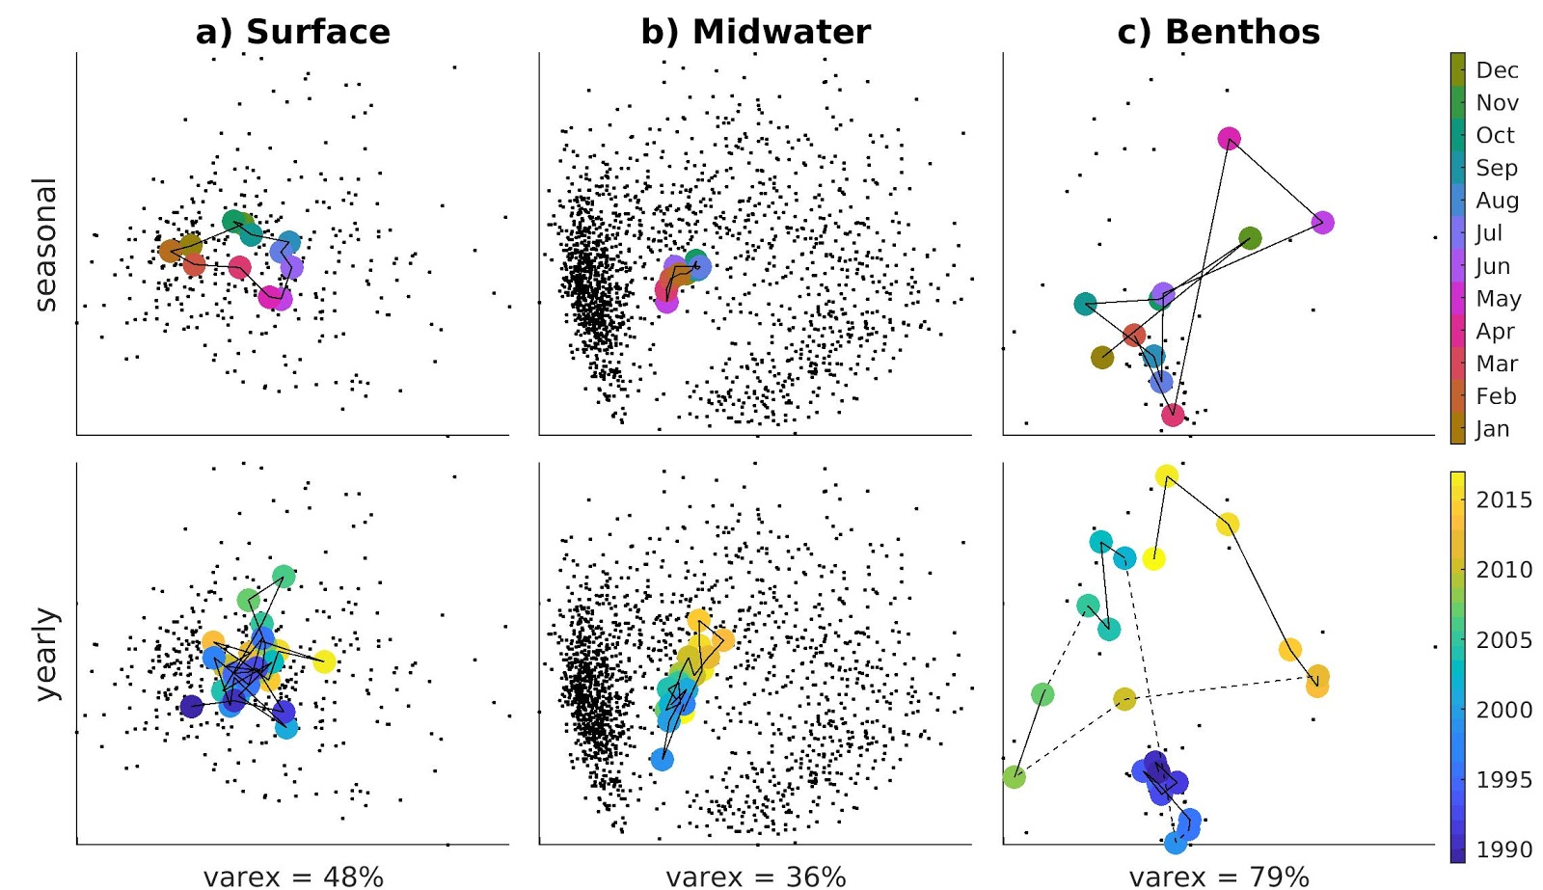
Full resolution PCA

Slide 5
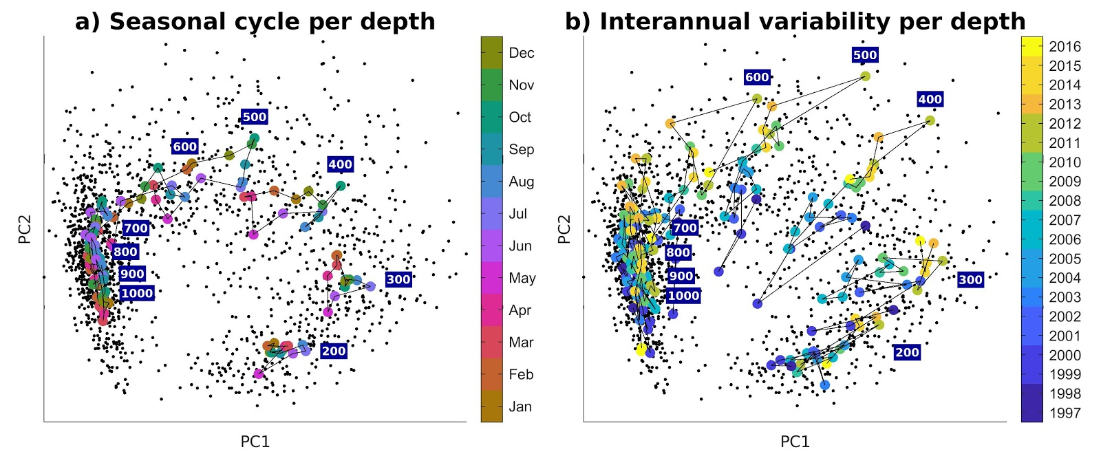
Midwater across depths

Slide 6
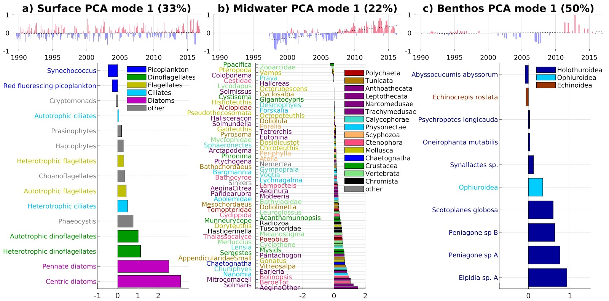
Full resolution PCA mode 1

Slide 7
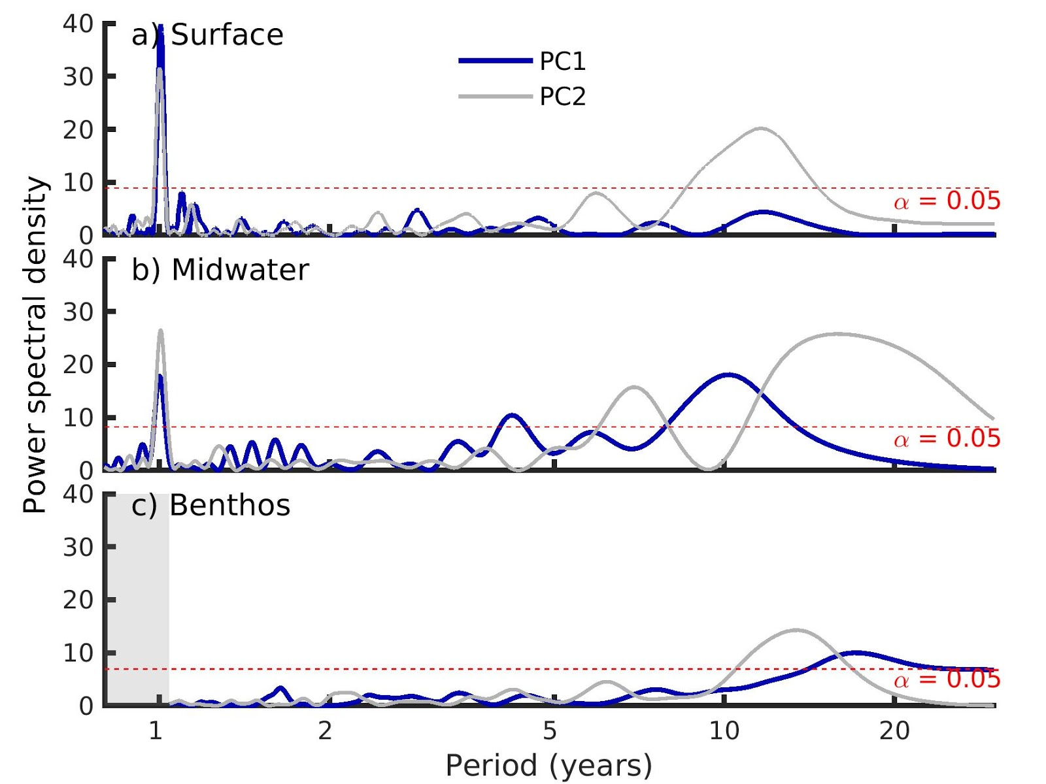
Frequency analysis?

Slide 8
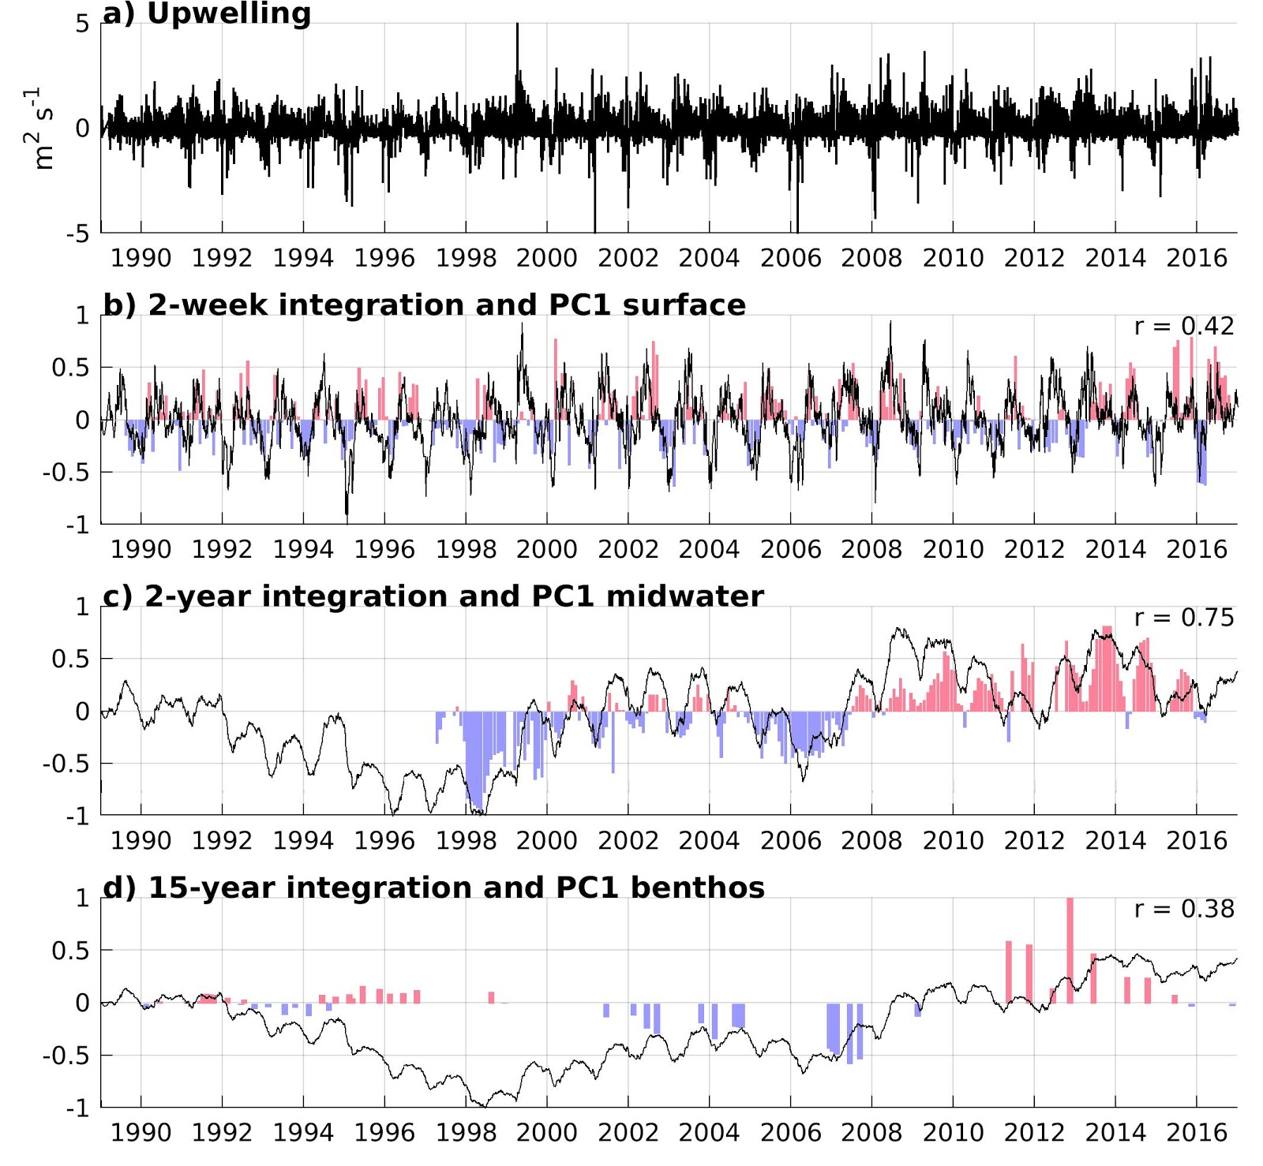
Upwelling integration

Slide 9
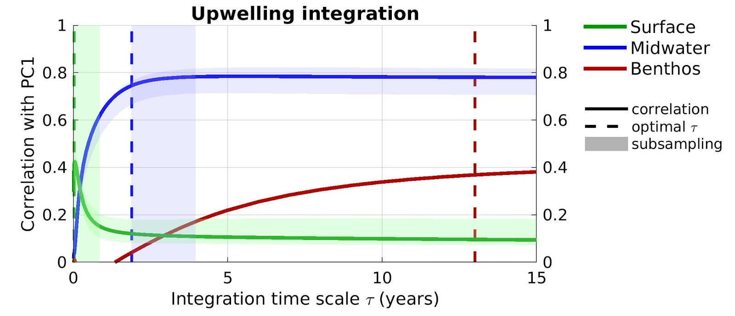
Upwelling integration

Slide 10
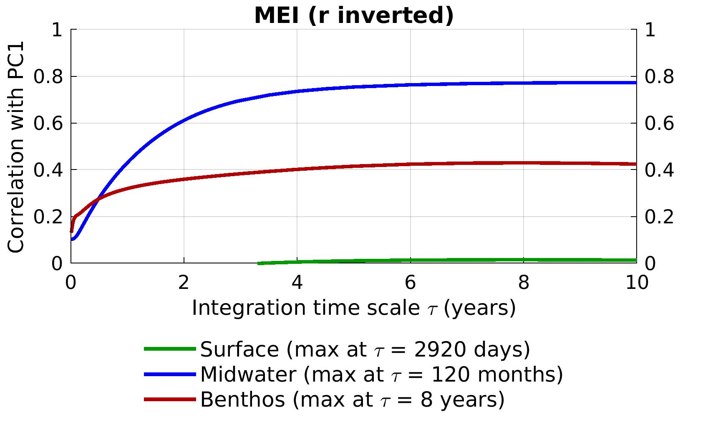
ENSO

Slide 11
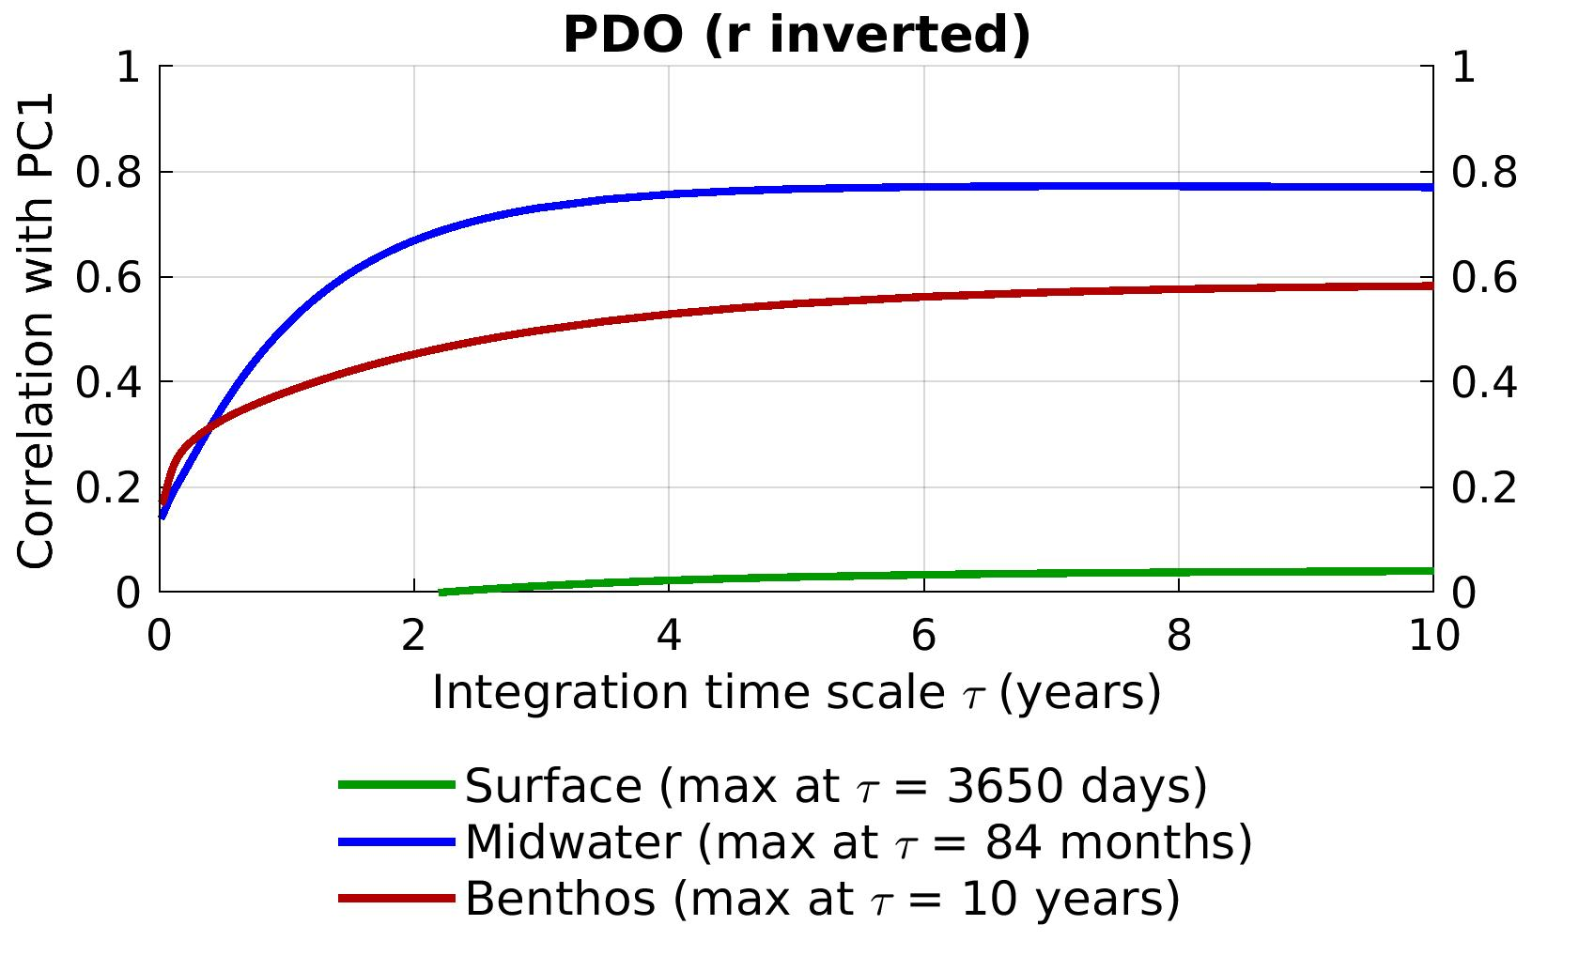
PDO

Slide 12
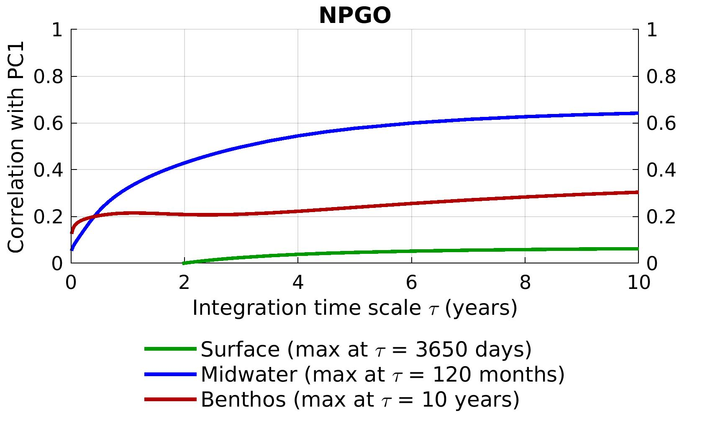
NPGO
Note – very high correlation with benthos PC2

