Slide 1
ITS short paper version
Key hypotheses
Changes in communities are driven by environmental forcing, related to local upwelling and basin-scale modes of variability (eg ENSO, PDO, NPGO).
The surface, midwater, and benthic ecosystems respond to environmental forcing with different lags and integration time scales.
Difference with long paper
No discussion of ecosystem states
No direct link of time series variability (except for the common driver, upwelling)

Slide 2
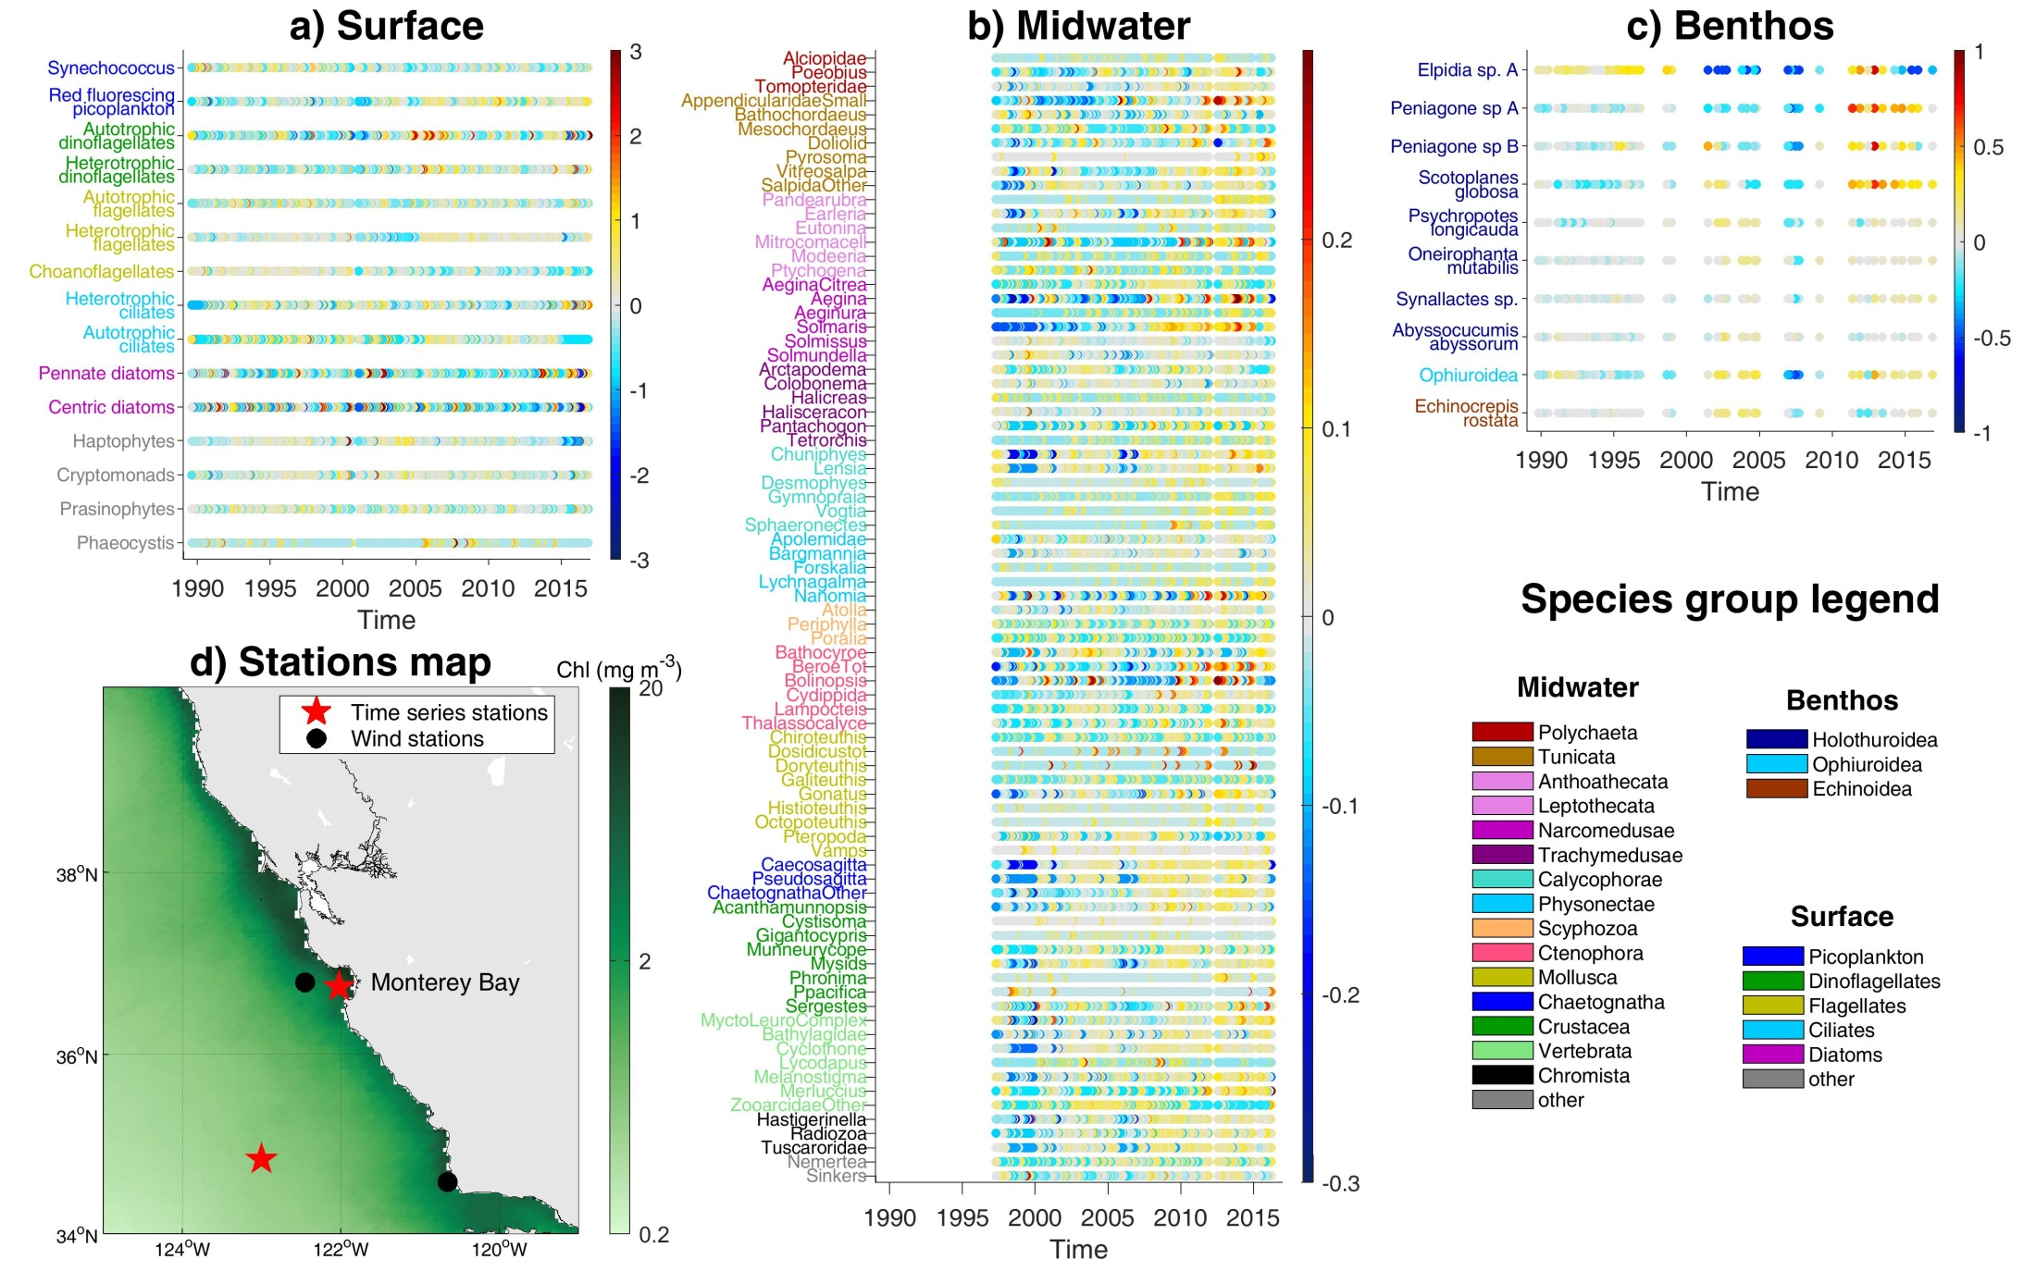

Slide 3
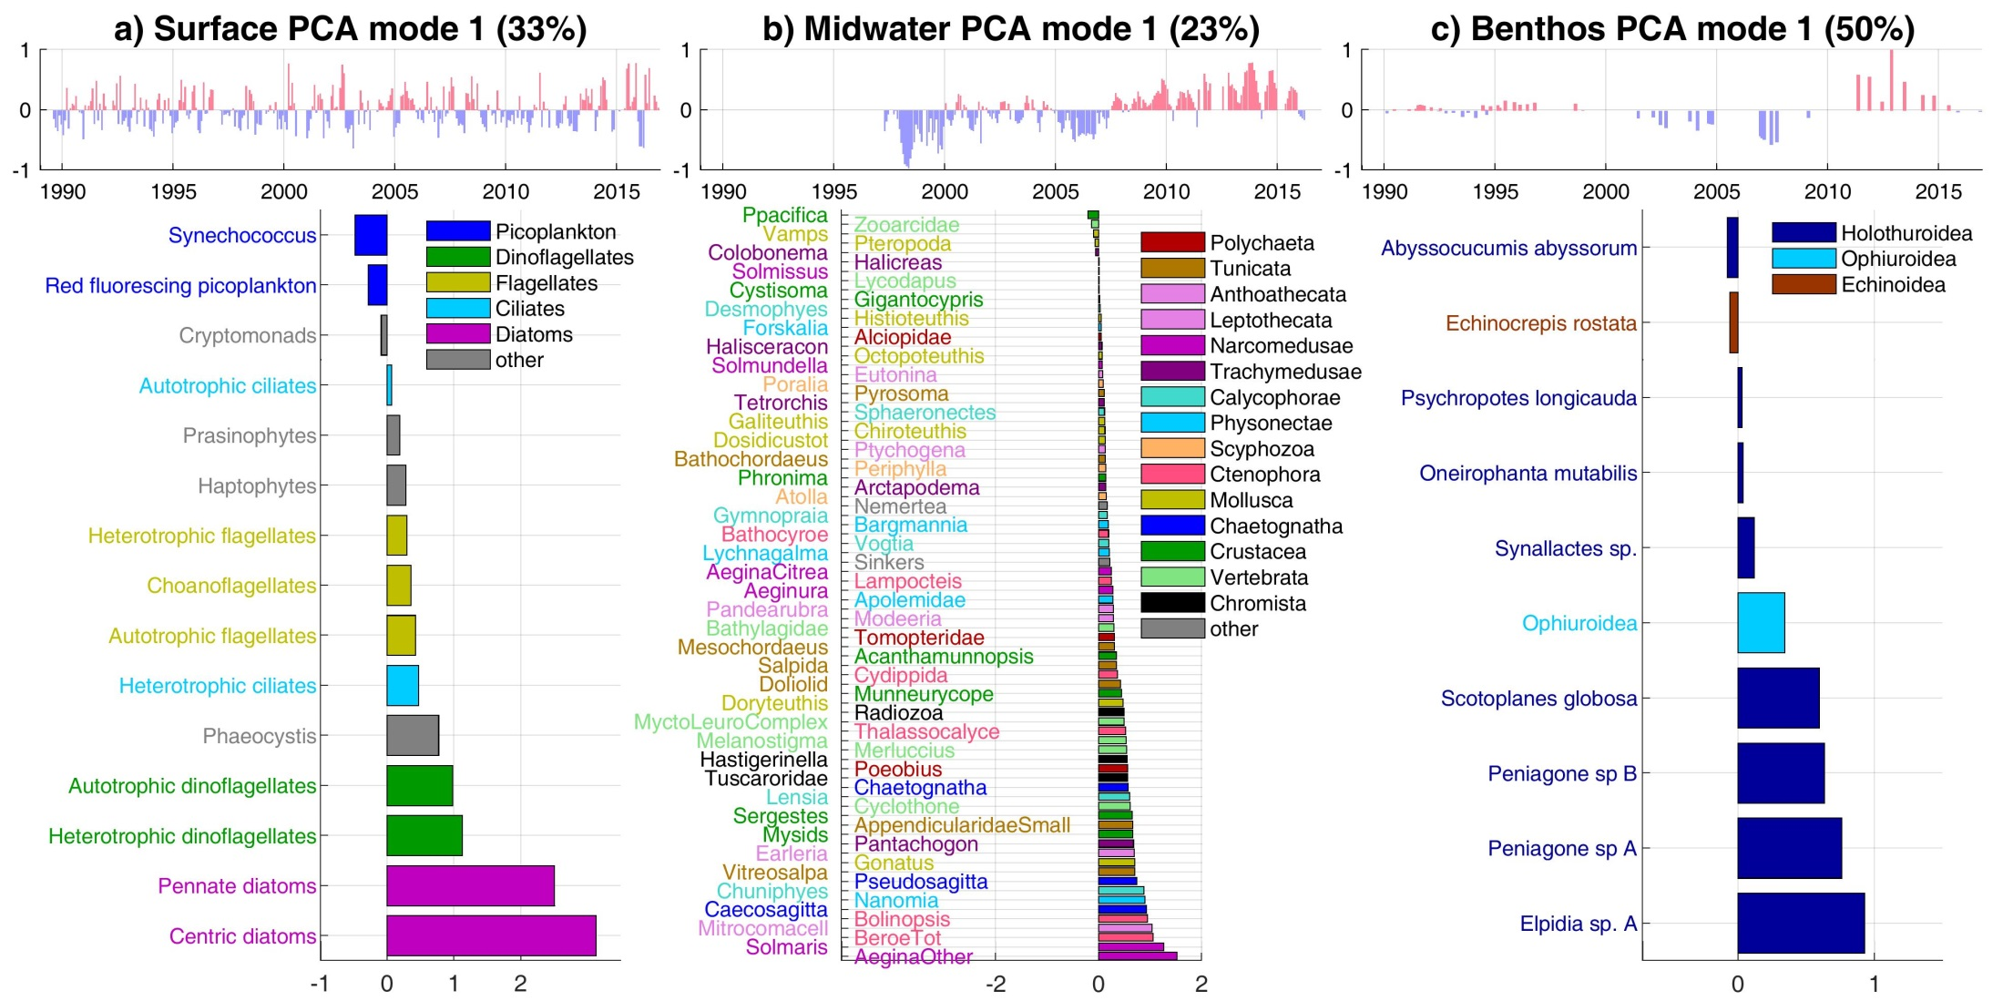
PCA mode 1 = changes in biomass/density

Slide 4
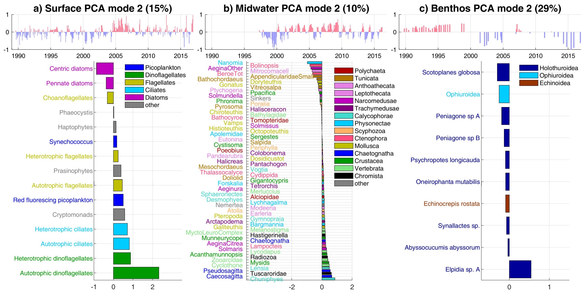
Mode 2 = changes in community composition

Slide 5
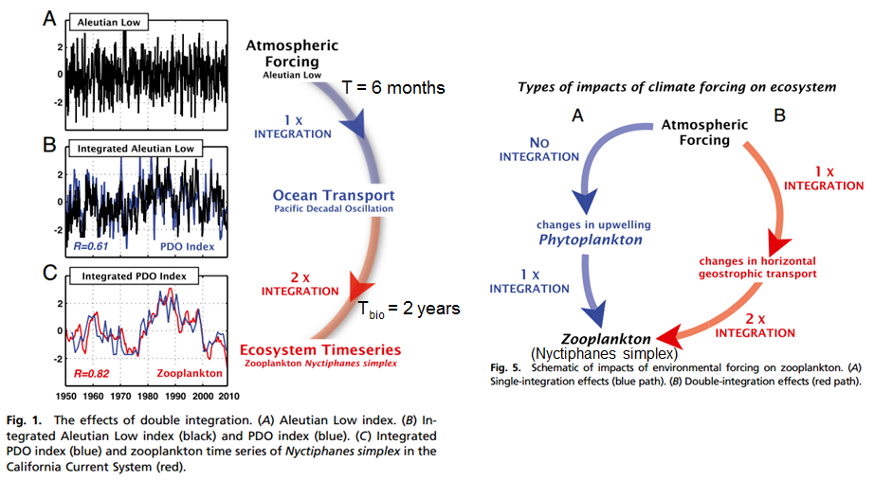
Integration hypothesis:
Di Lorenzo & Ohman, PNAS 2013

Slide 6
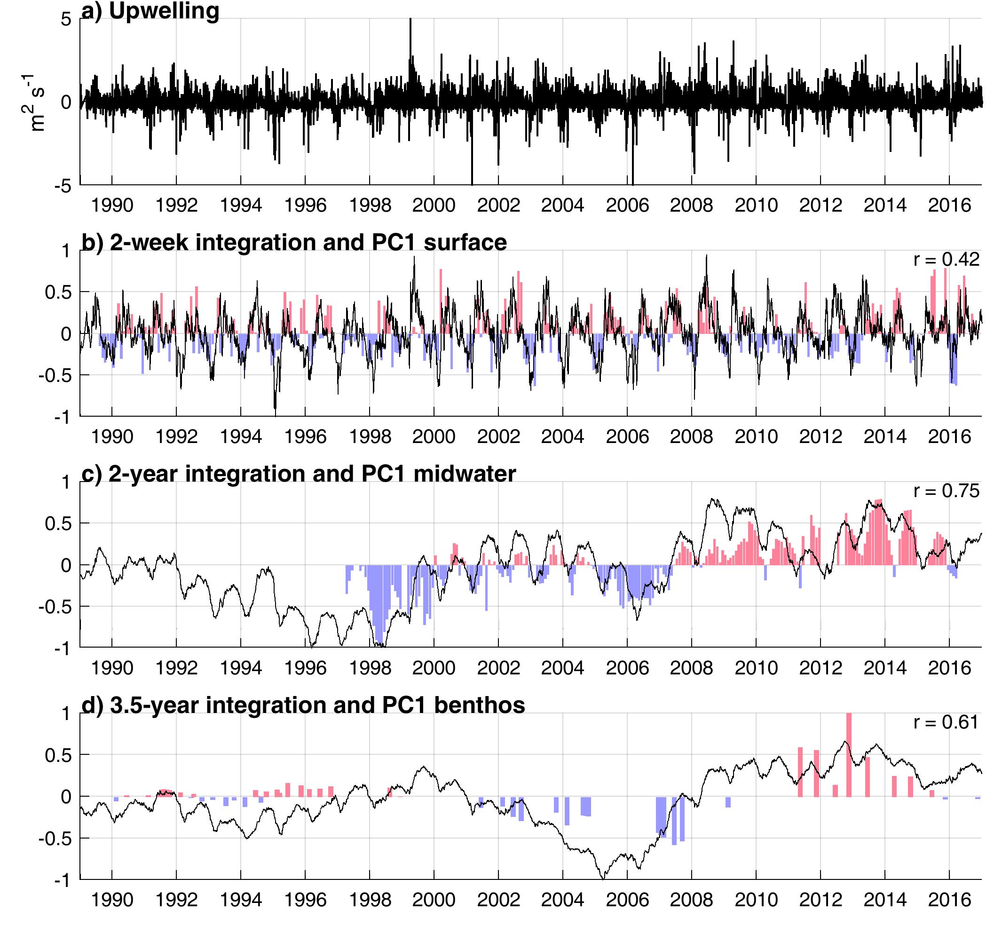
w/o integration:
r=0.24
w/o integration:
r<0
w/o integration:
r<0

Slide 7
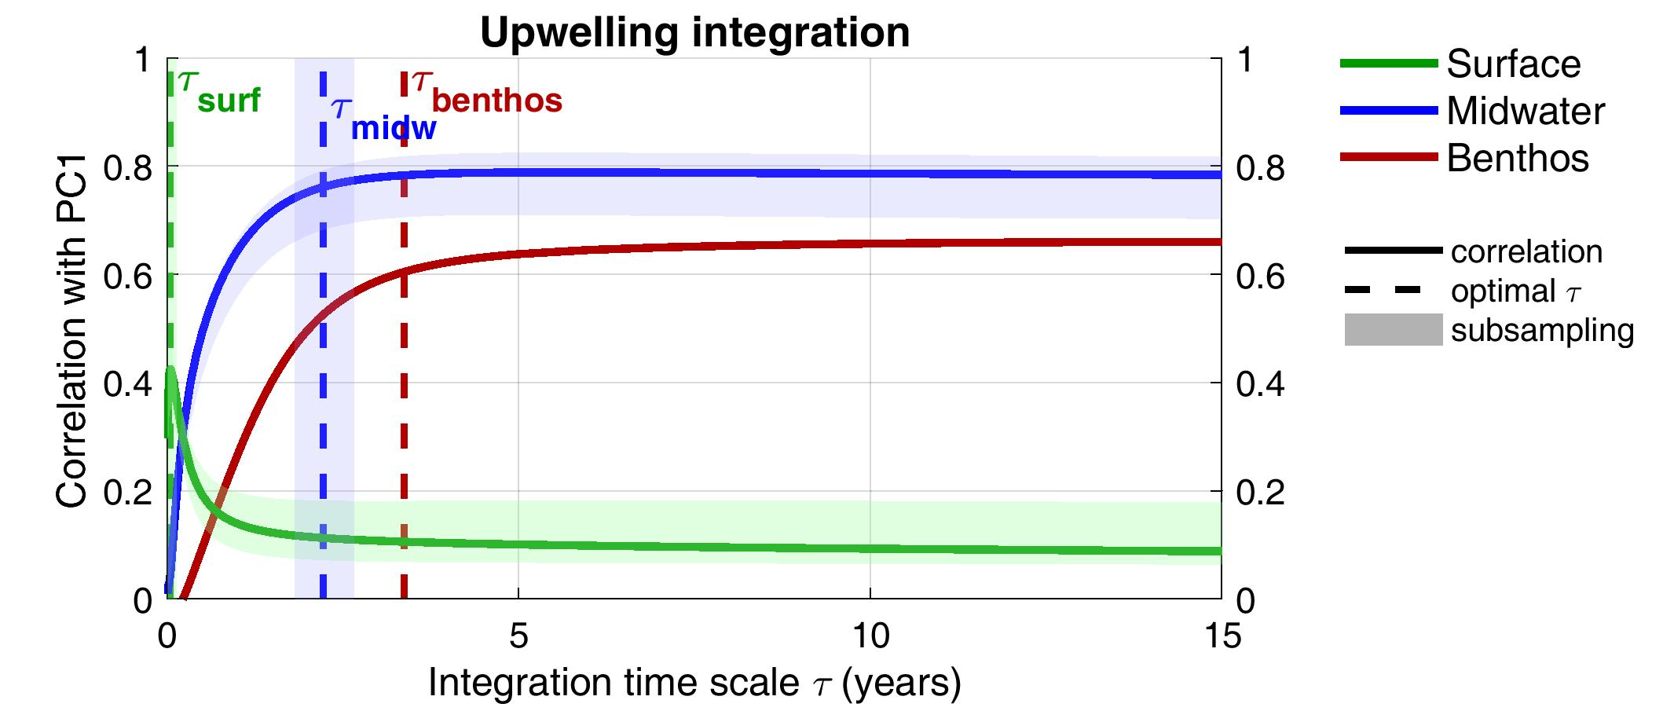
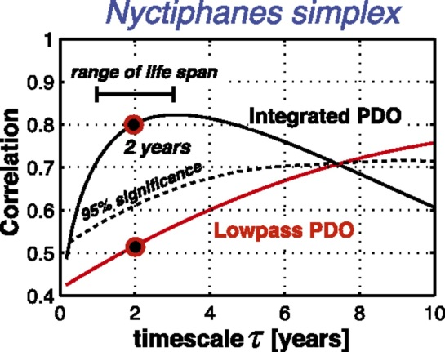
Integration curves (sensitivity)

Slide 8
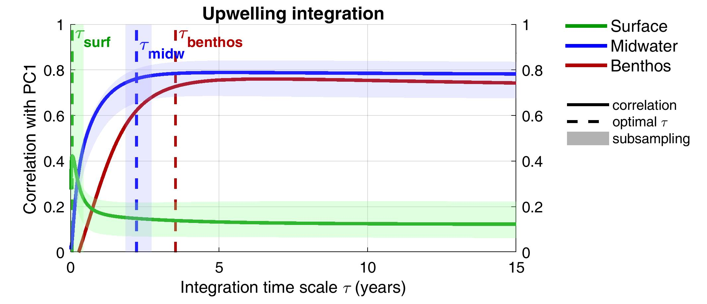
Integration curves (1997-present)

Slide 9
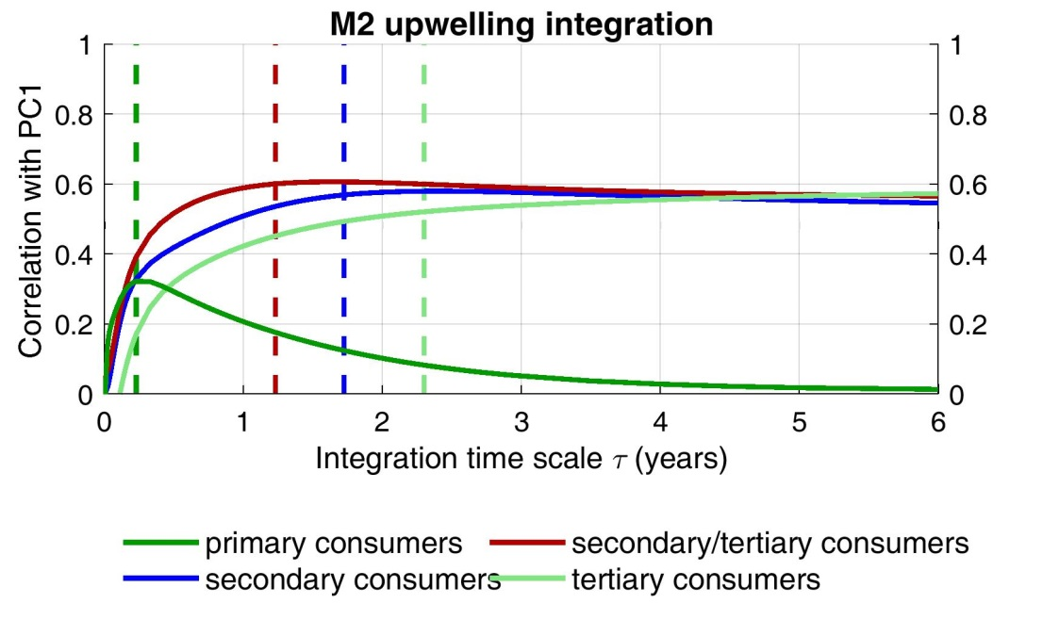
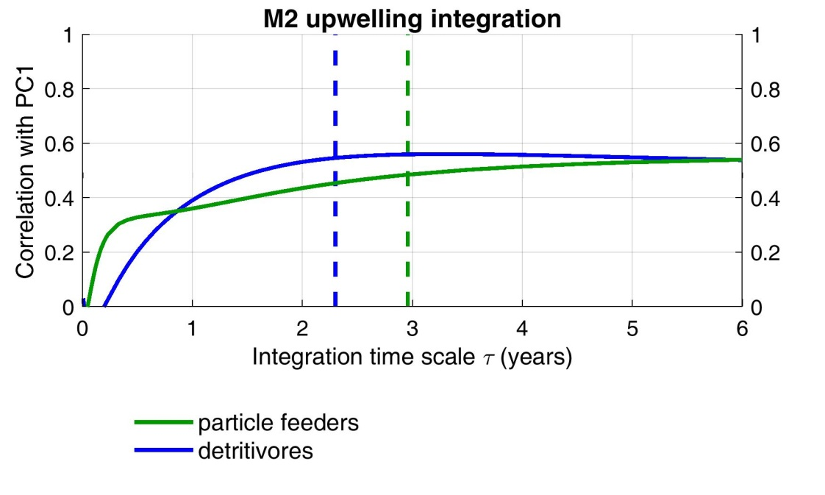
MidW trophic analysis

Slide 10
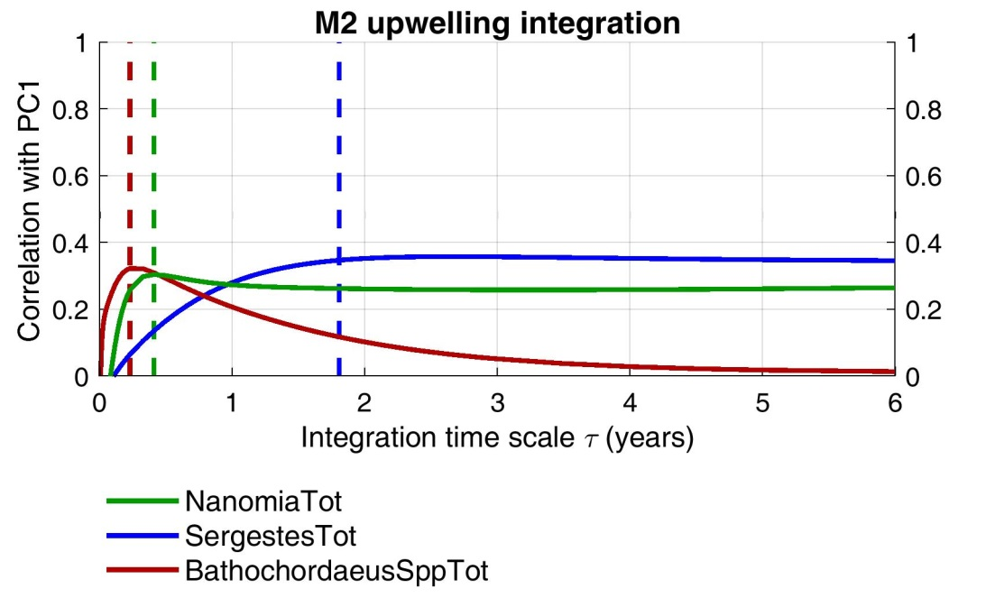
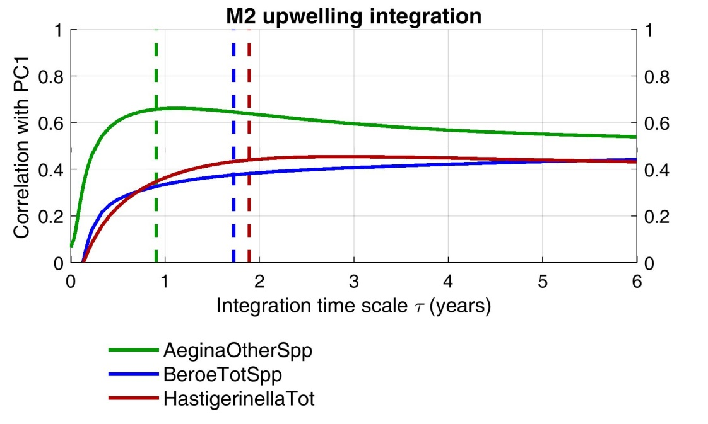
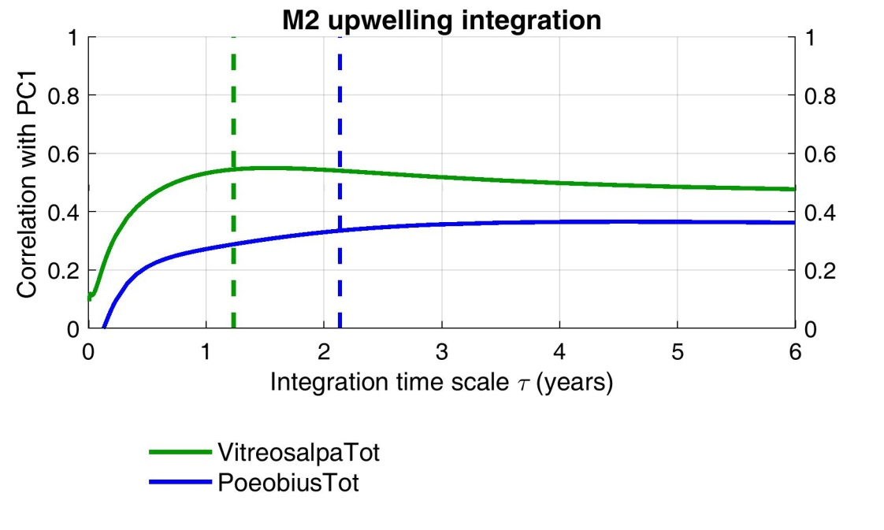

Slide 11
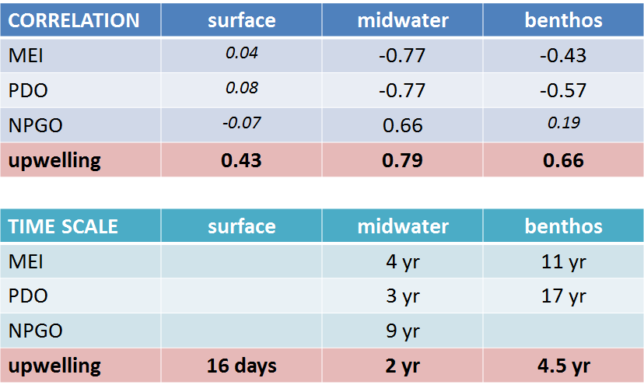
Other environmental forcing

Slide 12
Remaining questions
What controls mode 2 (community composition)? How trustworthy is it? (orthogonality constrain)
What is the role of horizontal advection? (likely impacts surface more)
Direct vs integrated effects: test integrated vs low-pass filtered upwelling time series
Nitrate supply(?)

Slide 13
Title
Upwelling drives surface-to-seafloor biological productivity in the California Current system
Main points:
  Analysis of an entire ecosystem, surface/midwater/benthos, over 20+ years (unprecedented dataset)
  Community variability is: primarily overall changes in productivity (biomass/density), secondarily changes in community composition
  Upwelling drives the overall productivity of the system, with integration time lags depending on trophic level
  Implication: prediction, climate change impacts(?)

Slide 14
Target paper
PNAS (Di Lorenzo & Ohman 2013), Scientific Reports
Plos ONE (“Coastal Upwelling Drives Intertidal Assemblage Structure and Trophic Ecology”), Frontiers in Mar Sci (“Multi-scale processes drive benthic community structure in upwelling-affected coral reefs”)

