Slide 1
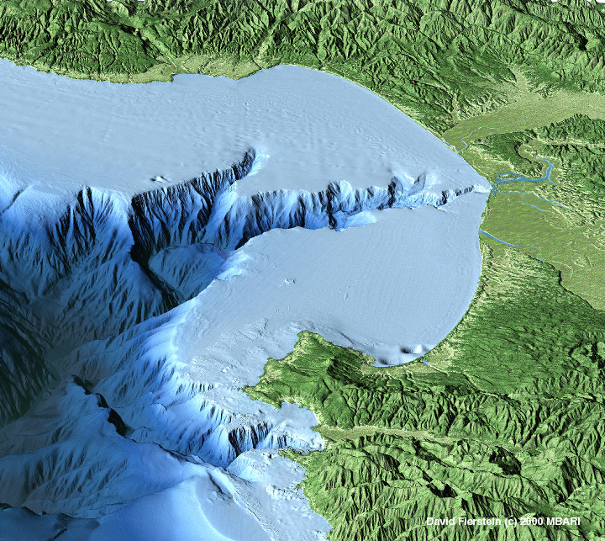
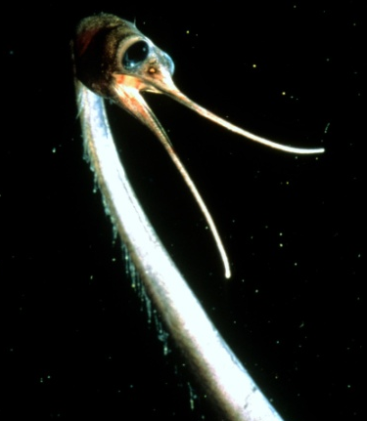
Midwater Time Series
Bigelow’s station 27 (1928)
Skogsberg’s station C (1930s)
Bolin’s single station (1950s)
Barham’s single station (1950s)
Robison’s principal station (1970s)
MBARI’s Midwater #1 (1990s -- now)

Slide 2
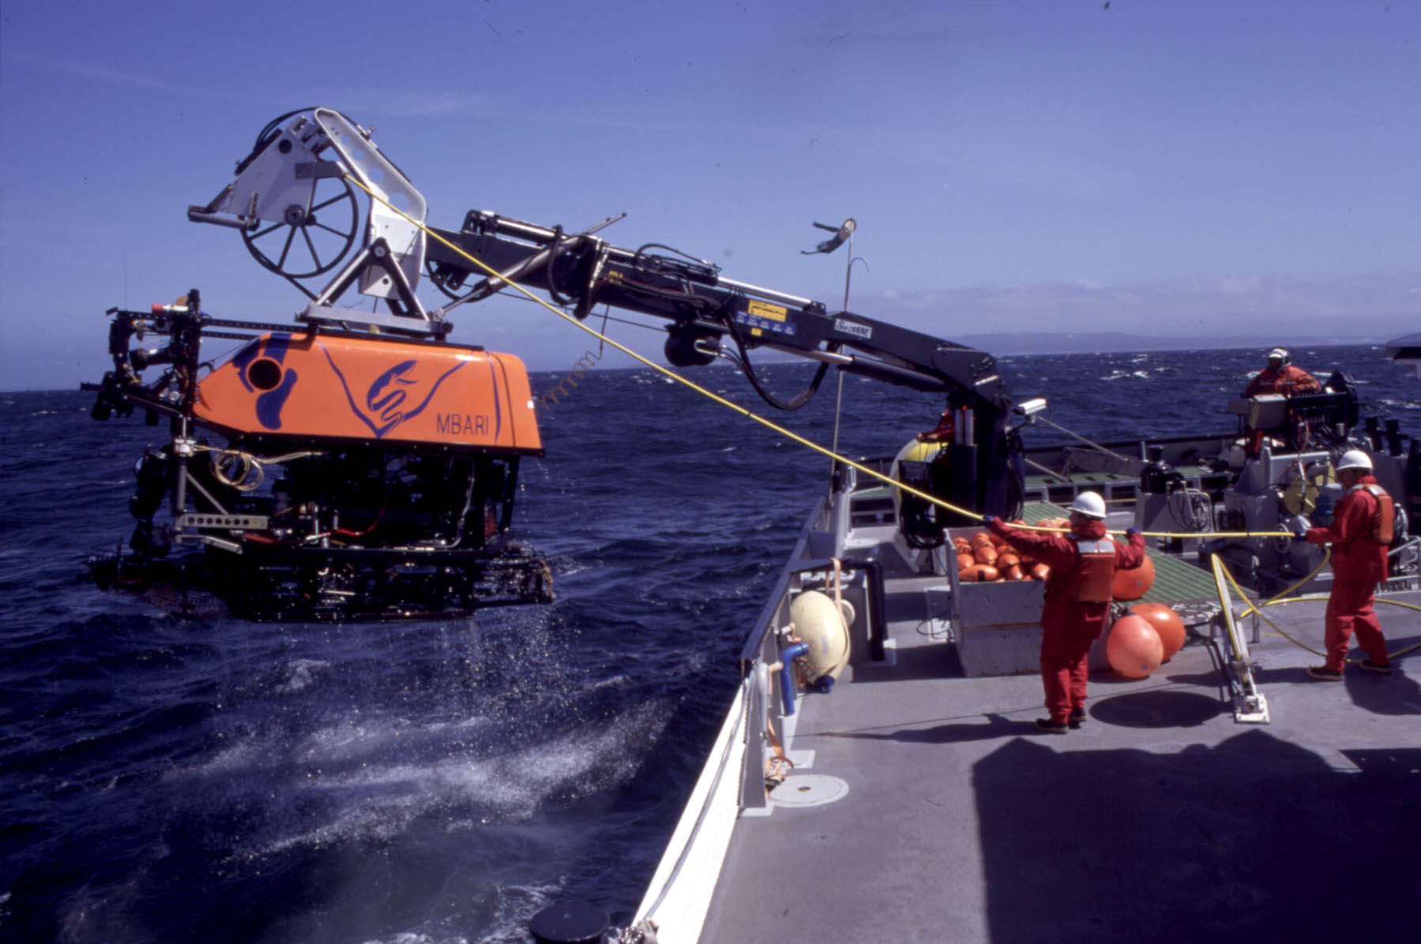
MESOPELAGIC TIME SERIES: QUANTITATIVE VIDEO TRANSECTING -- 1993-2014
Transit:
  ROV time calculated at each depth interval
  Annotated observations made using a Video Annotation System (VICKI & VARS)
  Counts normalized by time spent at depth
Transect:
  10 minute horizontal flights (ca. 0.33 km)with the ROV at regular depth increments from 50 to 1000 m
  speed = 50 cm/s
  1-2 times per month
  Approx. 850 m³ water surveyed per transect
  Annotations made using VICKI & VARS

Slide 3
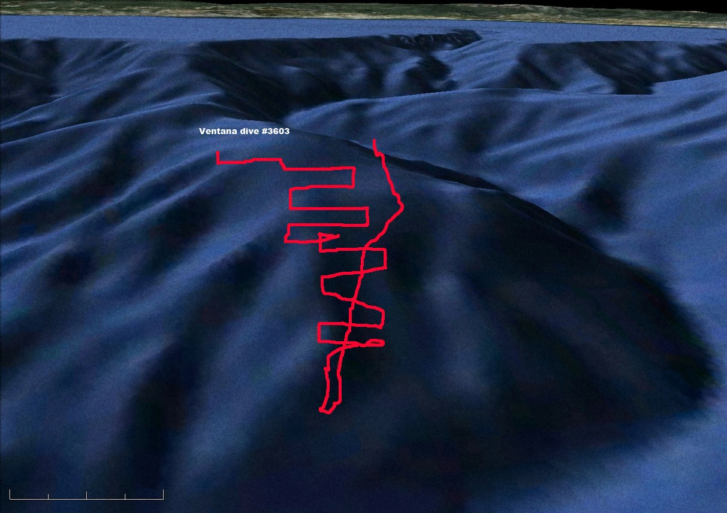
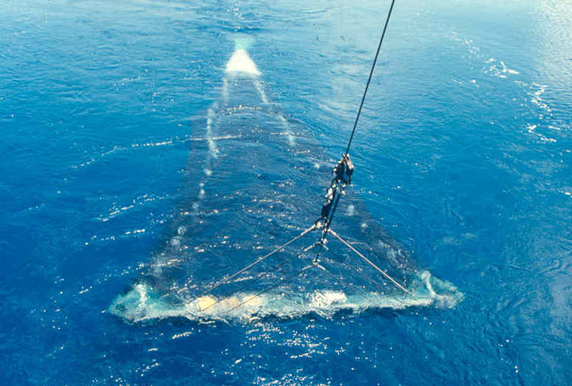
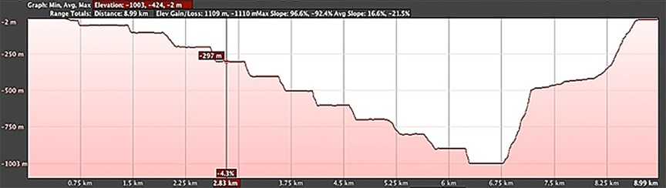

Slide 4
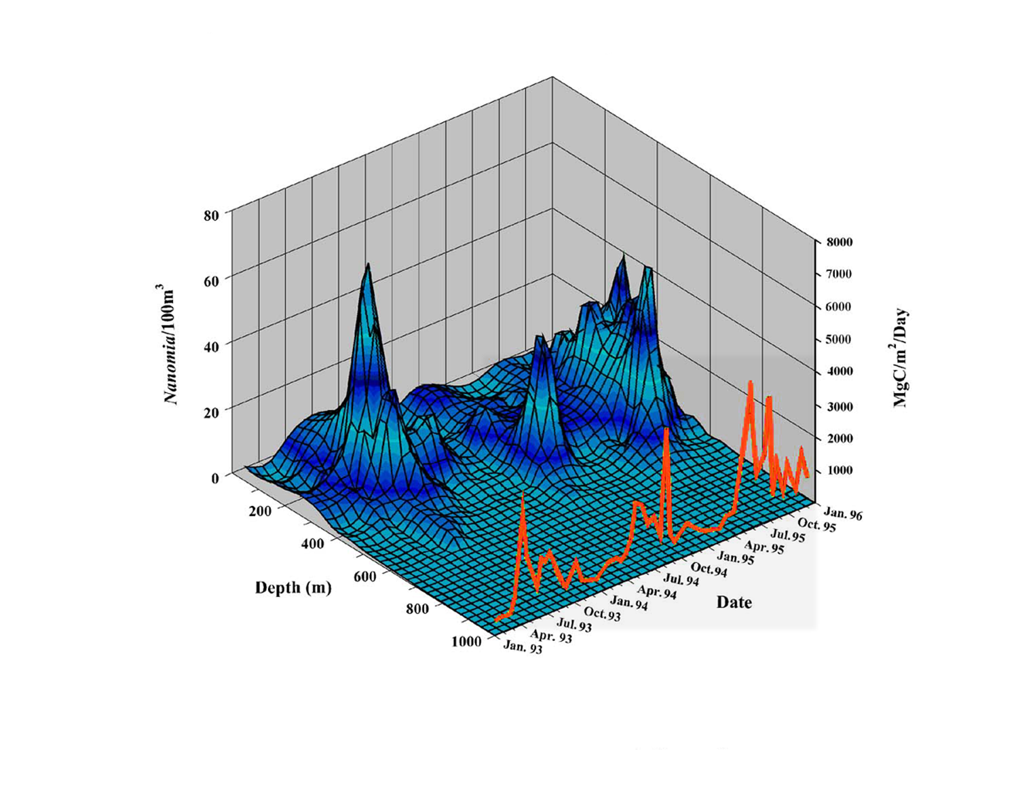
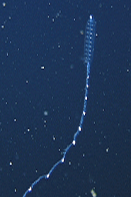
seasonal abundance and vertical distribution
Nanomia bijuga
Robison, Reisenbichler, Sherlock, Silguero & Chavez (1998) Deep-Sea Res. II 45:1741-1751

Slide 5
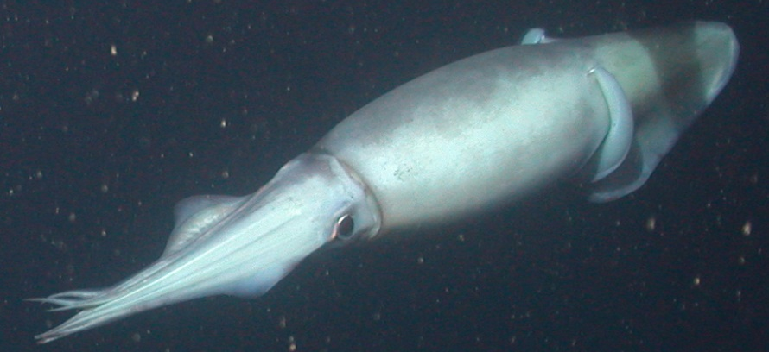
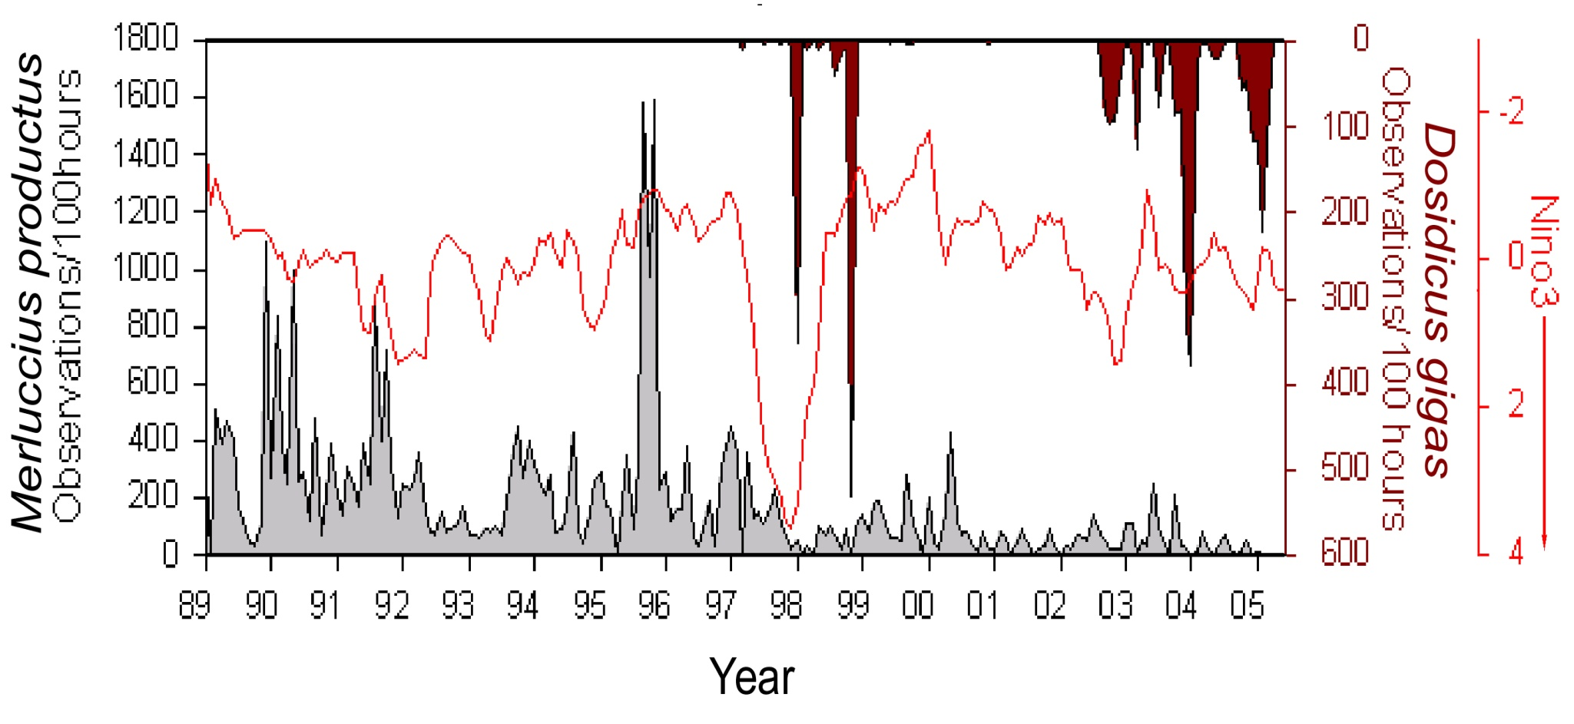
Dosidicus (squid), in red
Merluccius (hake), in gray
Zeidberg & Robison (2007) PNAS 104:12948-12950

Slide 6
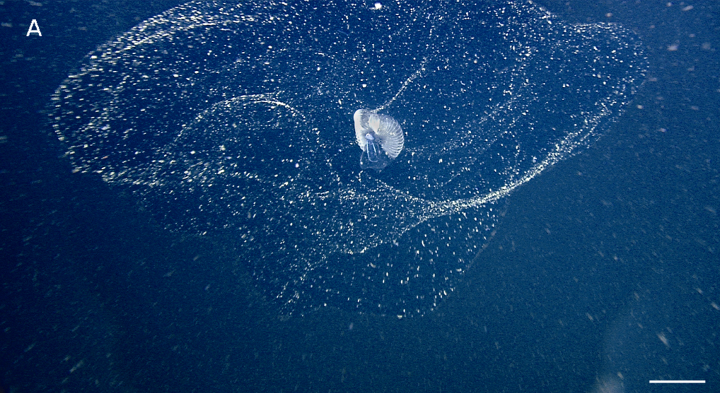
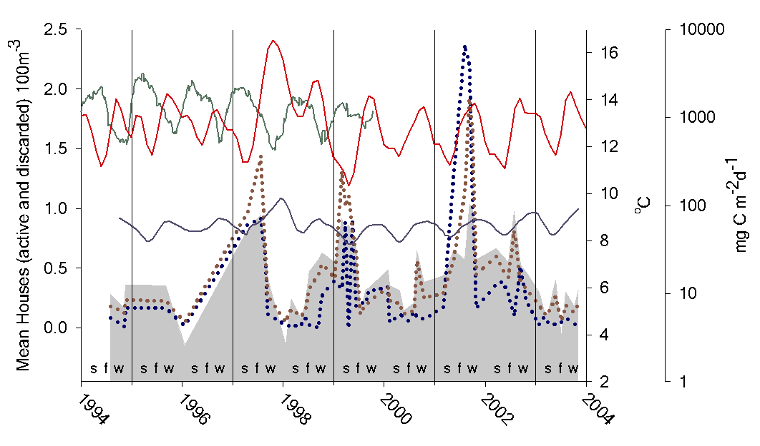

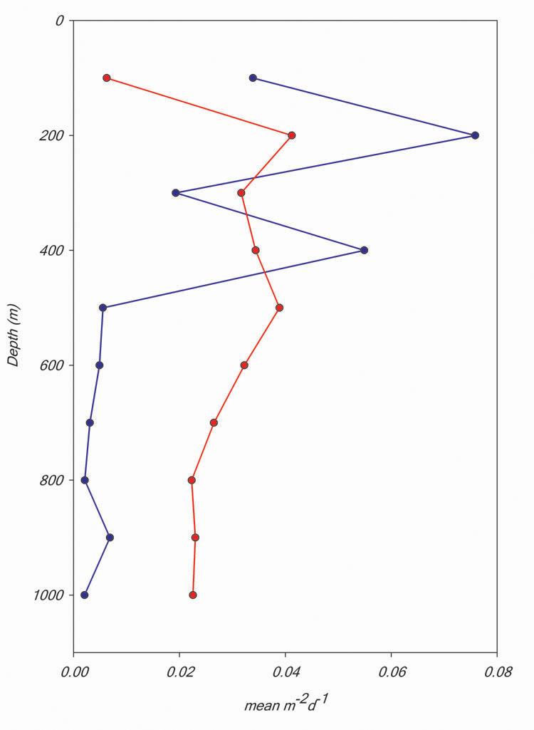
active house
sinker
Robison, Reisenbichler & Sherlock (2005) Science 308:1609-1611

Slide 7
A new class of large, rapidly sinking, nutrient rich particles that contribute substantially to vertical carbon flux in the deep sea
House production rate = 1/day
Sinking rate = 800 m/day
Average organic Carbon content = 5.4 mg (n = 105)
C:N = 6.1
Carbon flux = 26.8 mg/m²/day
The annual total (9.8 g/m²/year) equals one third of the annual Carbon flux to the deep seafloor of Monterey Bay – but it was not previously measured

Slide 8
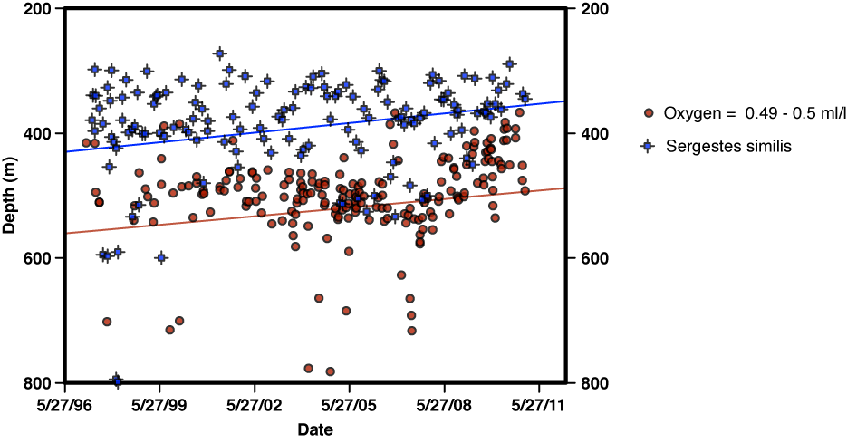
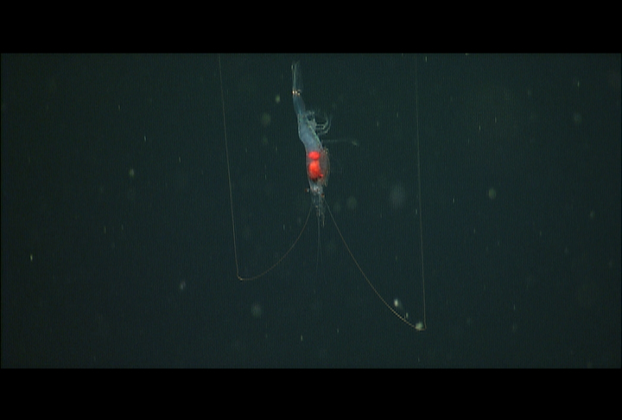
VERTICAL DISTRIBUTION
Top of the OMZ
Center of daytime
vertical range

Slide 9
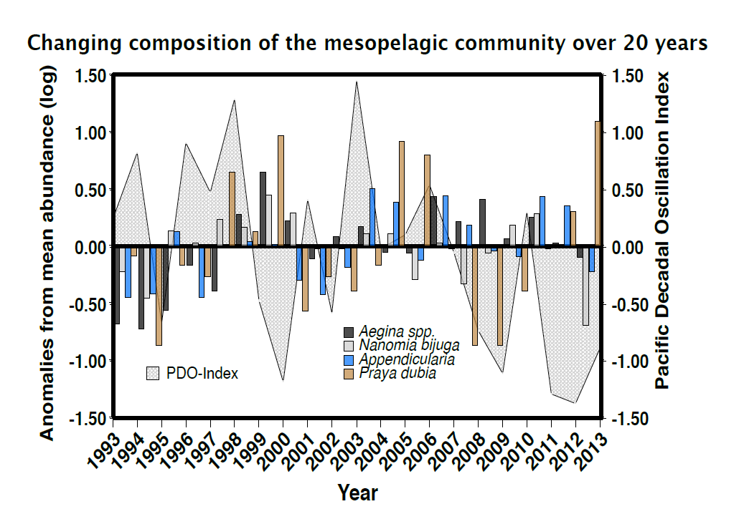

Slide 10
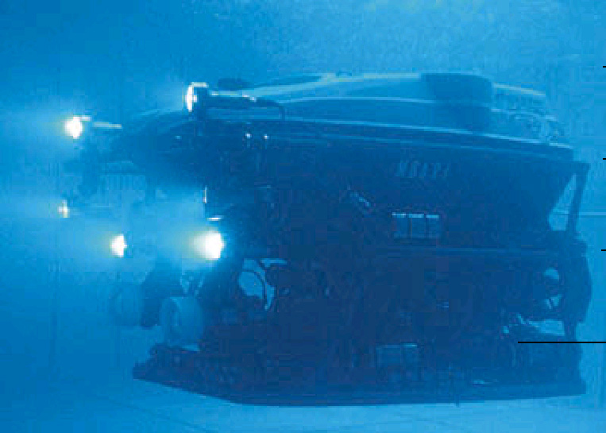
Midwater Time Series
QUANTITATIVE VIDEO TRANSECTING:
Bathypelagic -- 1000 – 3500 m
Oblique descent
Zig-Zag path
Constant rate
Calibrated area
Measured distance
10,000 m³ (Volume equivalent to towing an RMT8 at 2 knots for 25 minutes)
15 transects in 2 yrs
Video lab analysis
BIASES:
Size
Speed
Scale
Avoidance
Attraction
Robison, Sherlock & Reisenbichler (2010) Deep-Sea Res. II , 57:1551

Slide 11
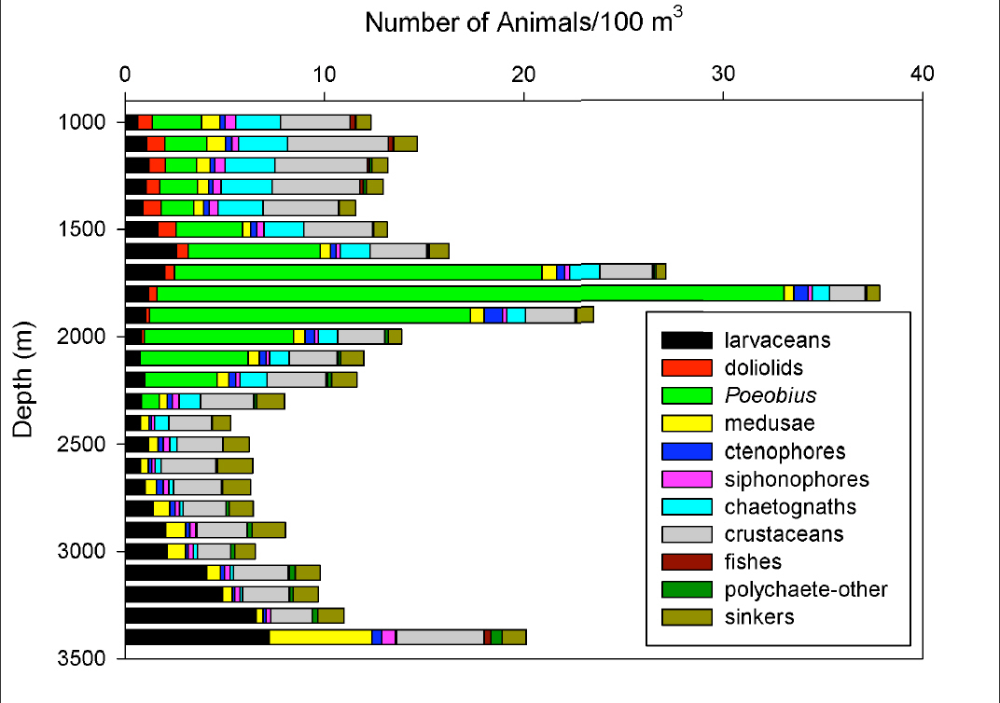
Quantitative abundance of selected taxa
11 taxa
Normalized by the total volume swept within each depth increment

Slide 12
