Slide 1
Pelagic Benthic Coupling

Slide 2
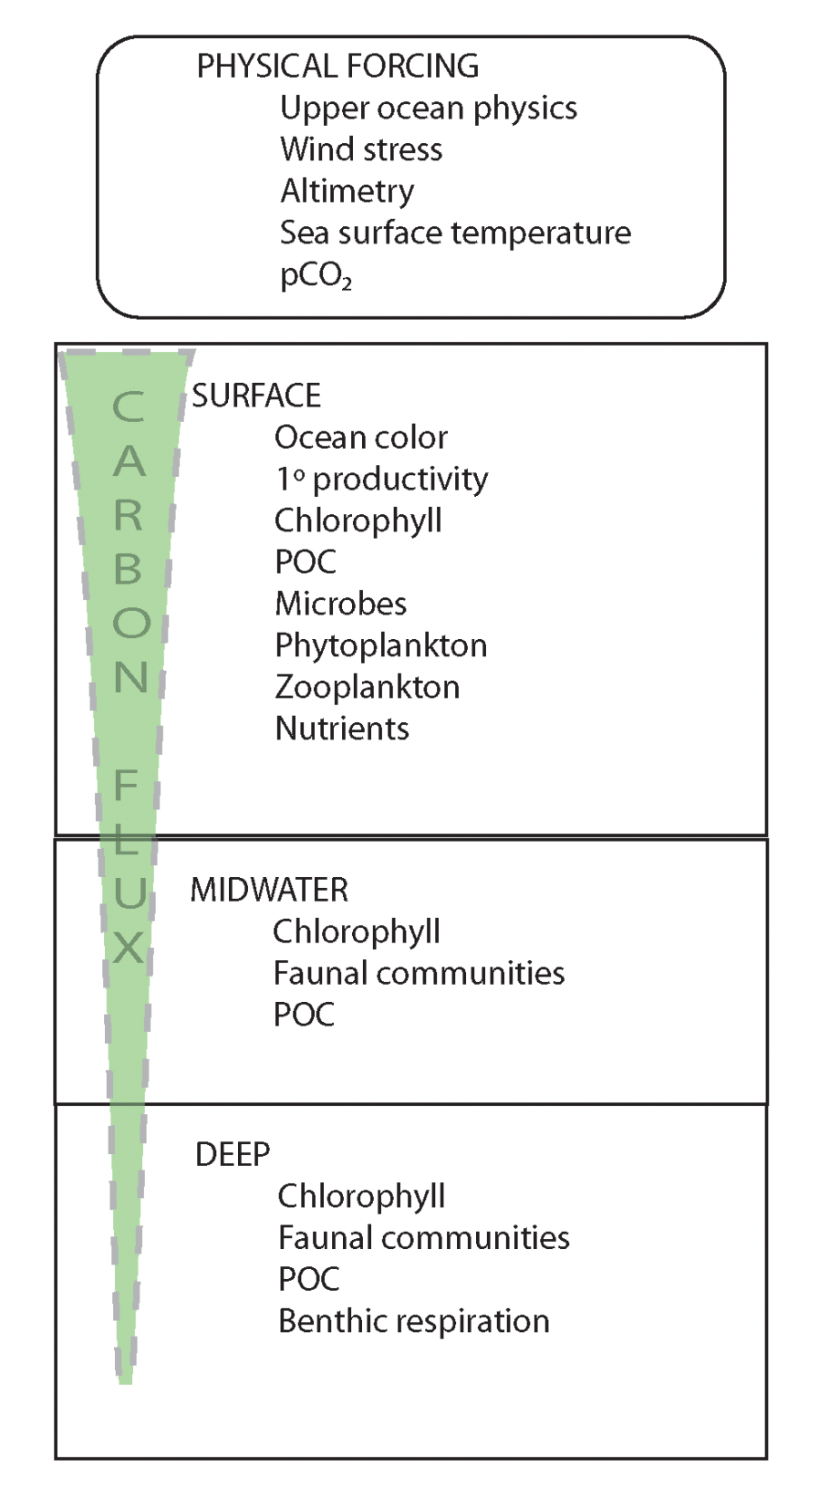
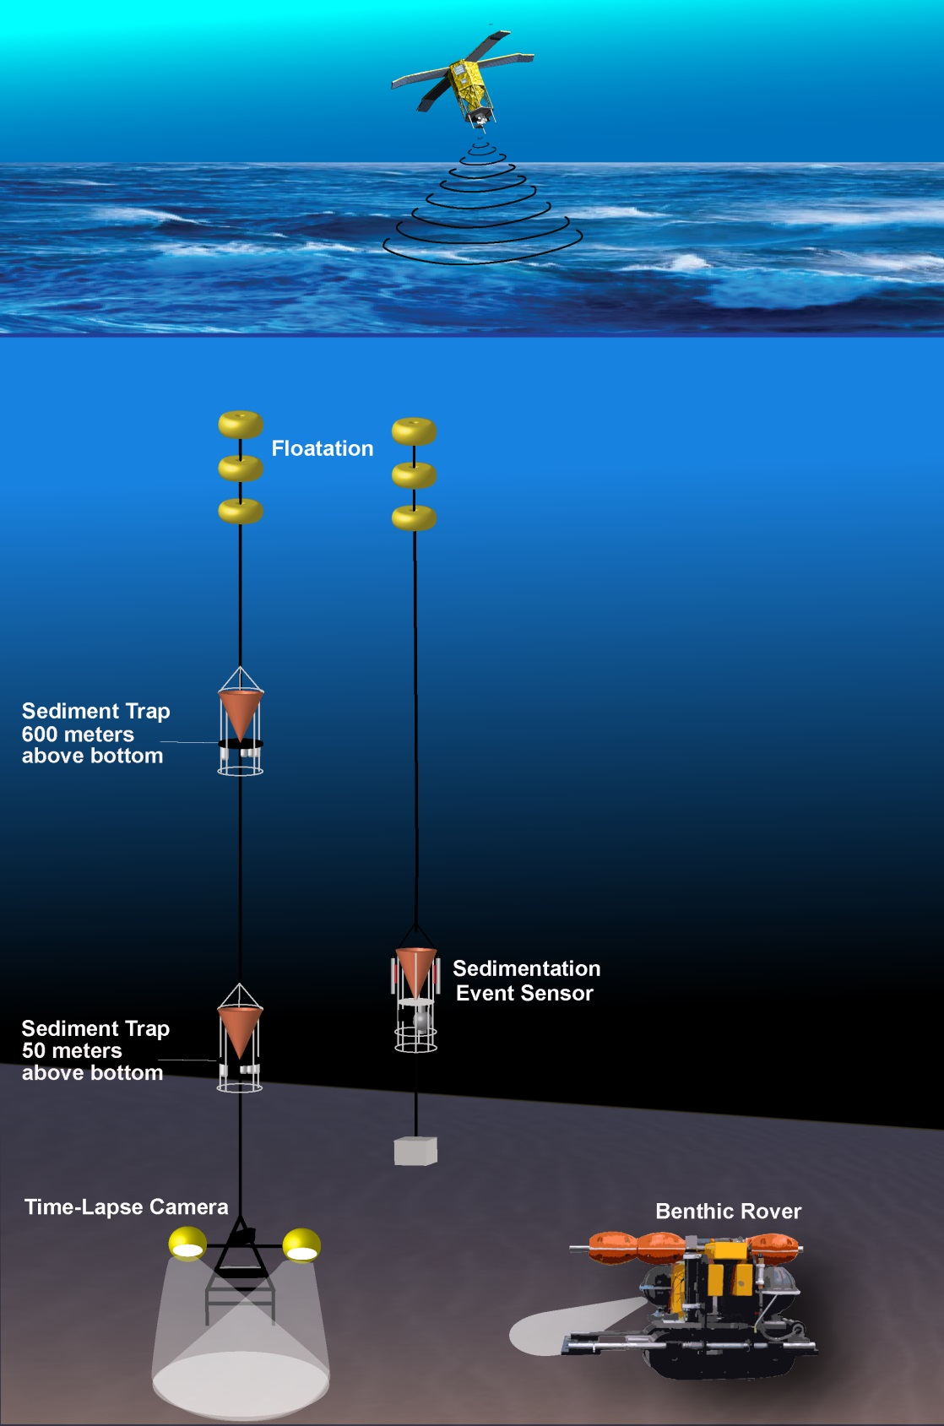

Slide 3
CARBON SUPPLY AND DEMAND AT STATION M

Slide 7
Recent surplus
Periods of organic carbon undersupply dominated the first 20 years of the time series
The carbon surplus from the recent salp bloom in 2012 was estimated to have
exceed demand by 522 – 4900 mg C⁻¹ m²
The surplus from 2012 could fuel future periods of deficit for months to years

Slide 8
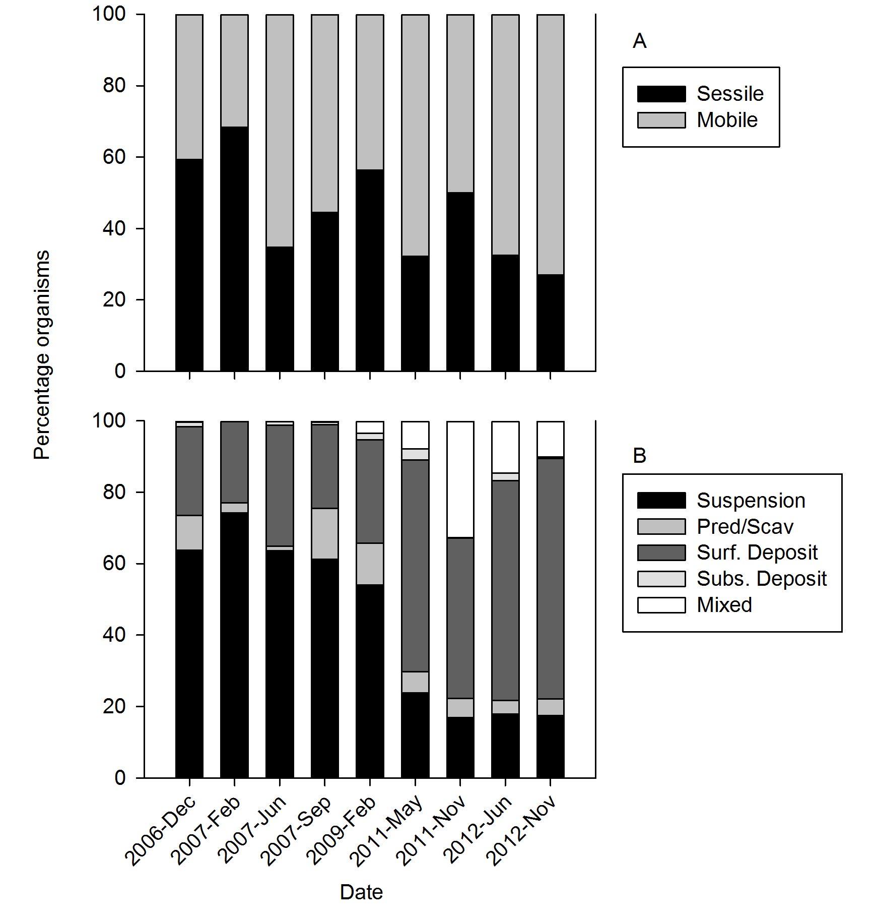
Kuhnz et al., in press

Slide 9
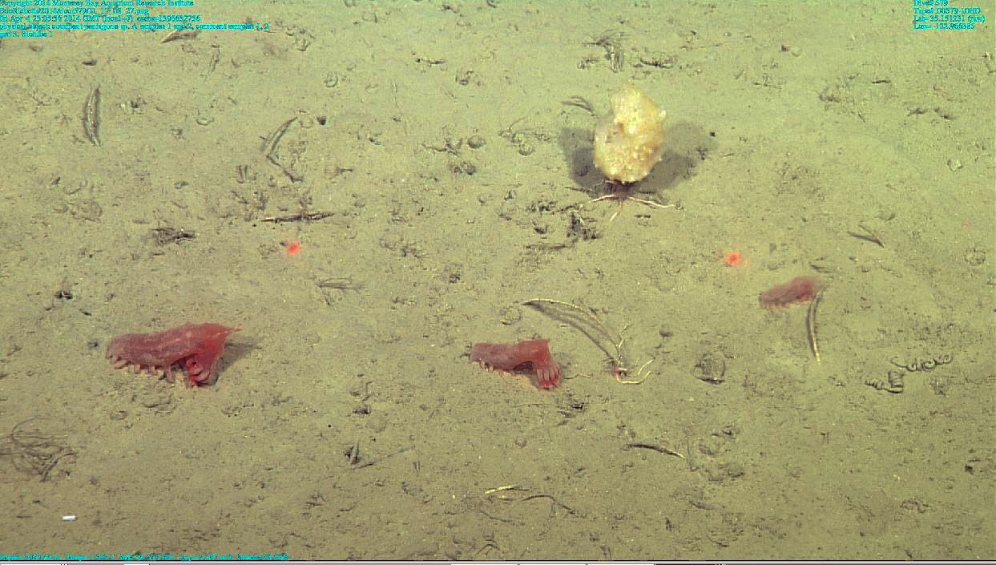

Slide 10
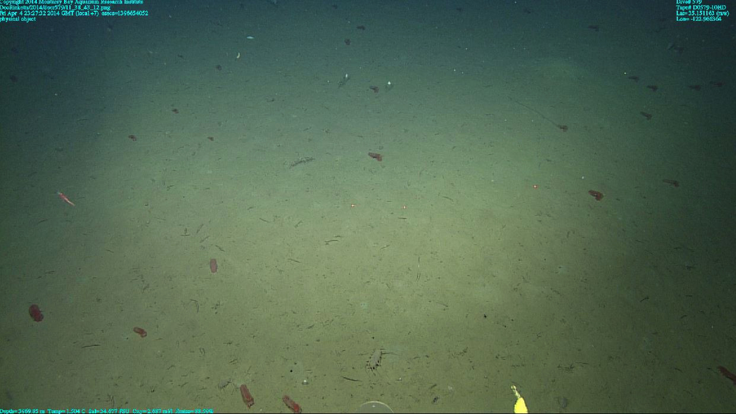

Slide 11


